Slide 1
Task Embeddings and
Occupational Mobility
Spencer Hodge
Bagwell Center for the Study of Markets and Economic Opportunity
Kennesaw State University
Undergraduate Research Fellowship, 2025–26

Slide 2
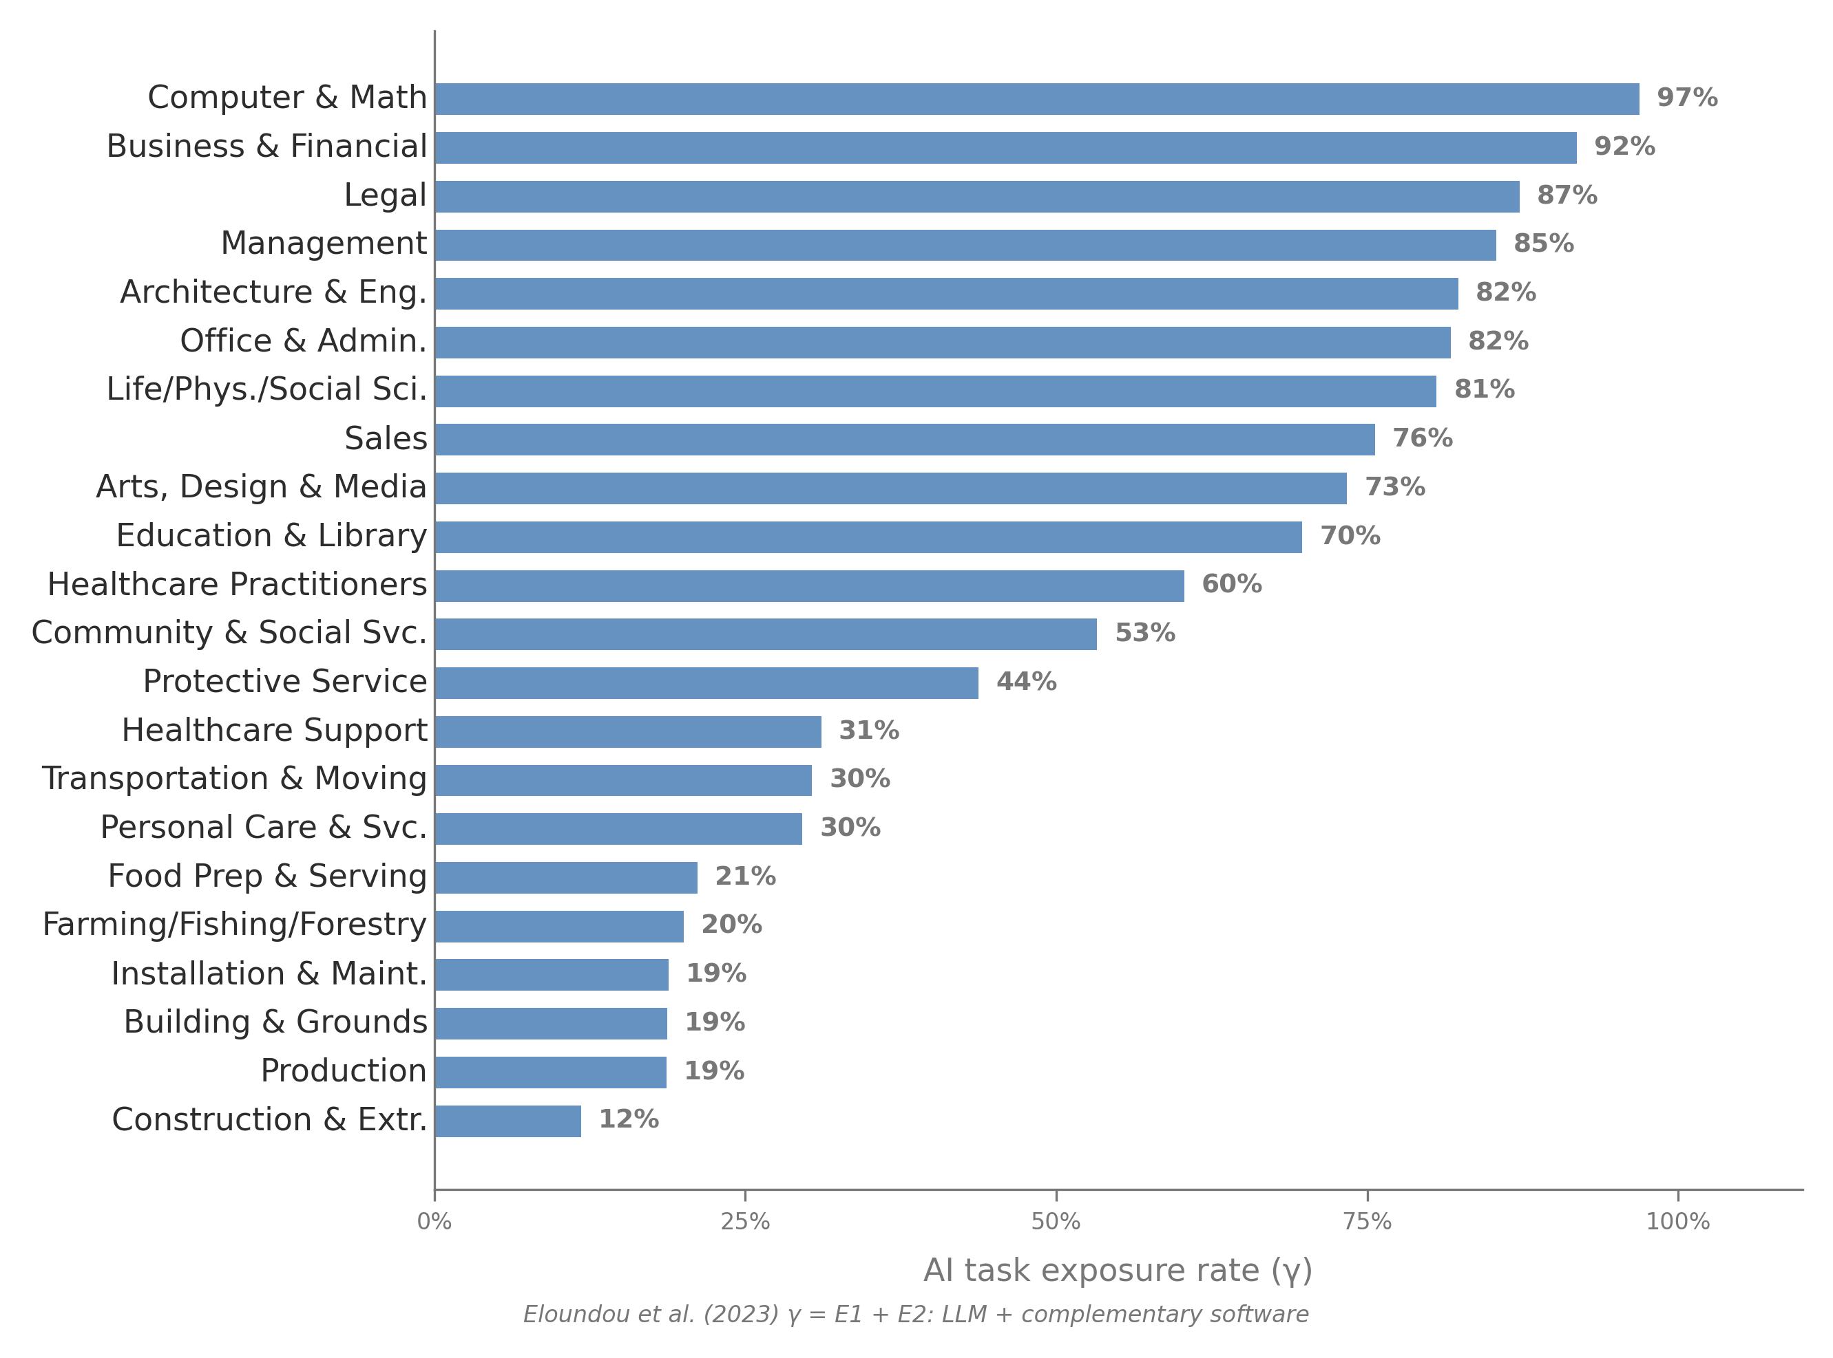
Motivation
New technology is reshaping the labor market.
If your job is disrupted, what can you switch to?
We propose a way to answer that question — and a test for whether it works.
2

Slide 3
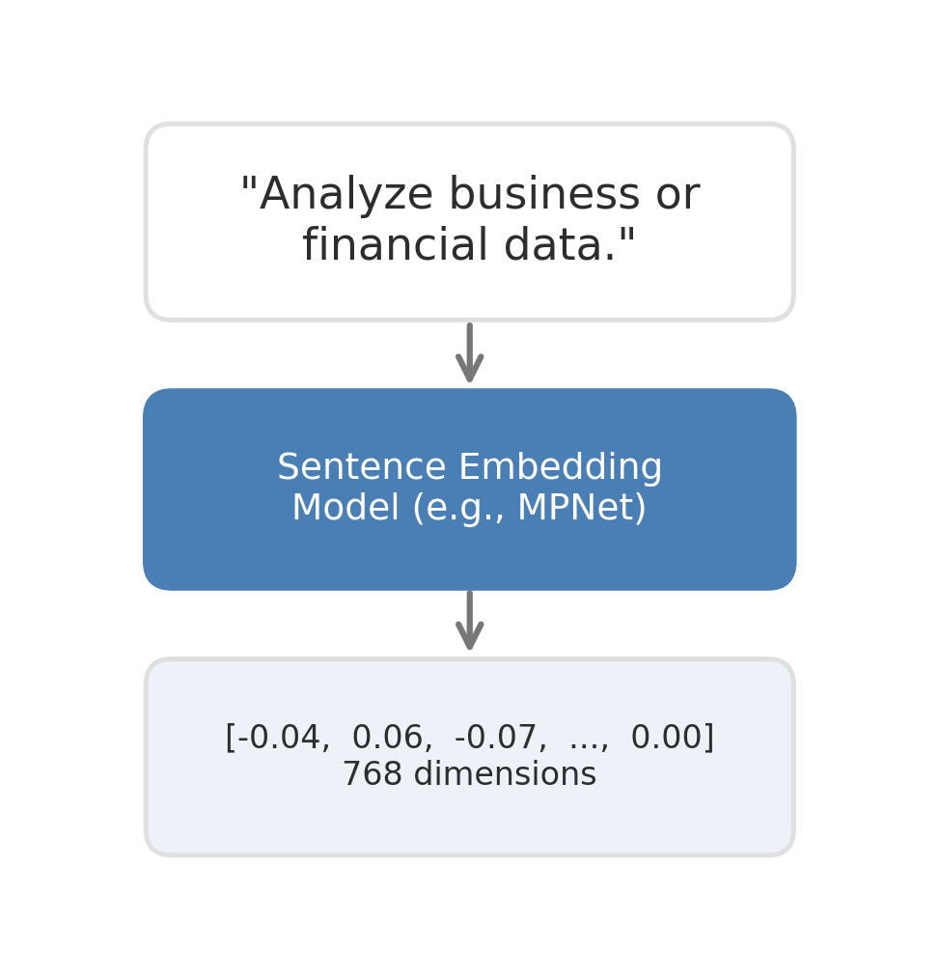
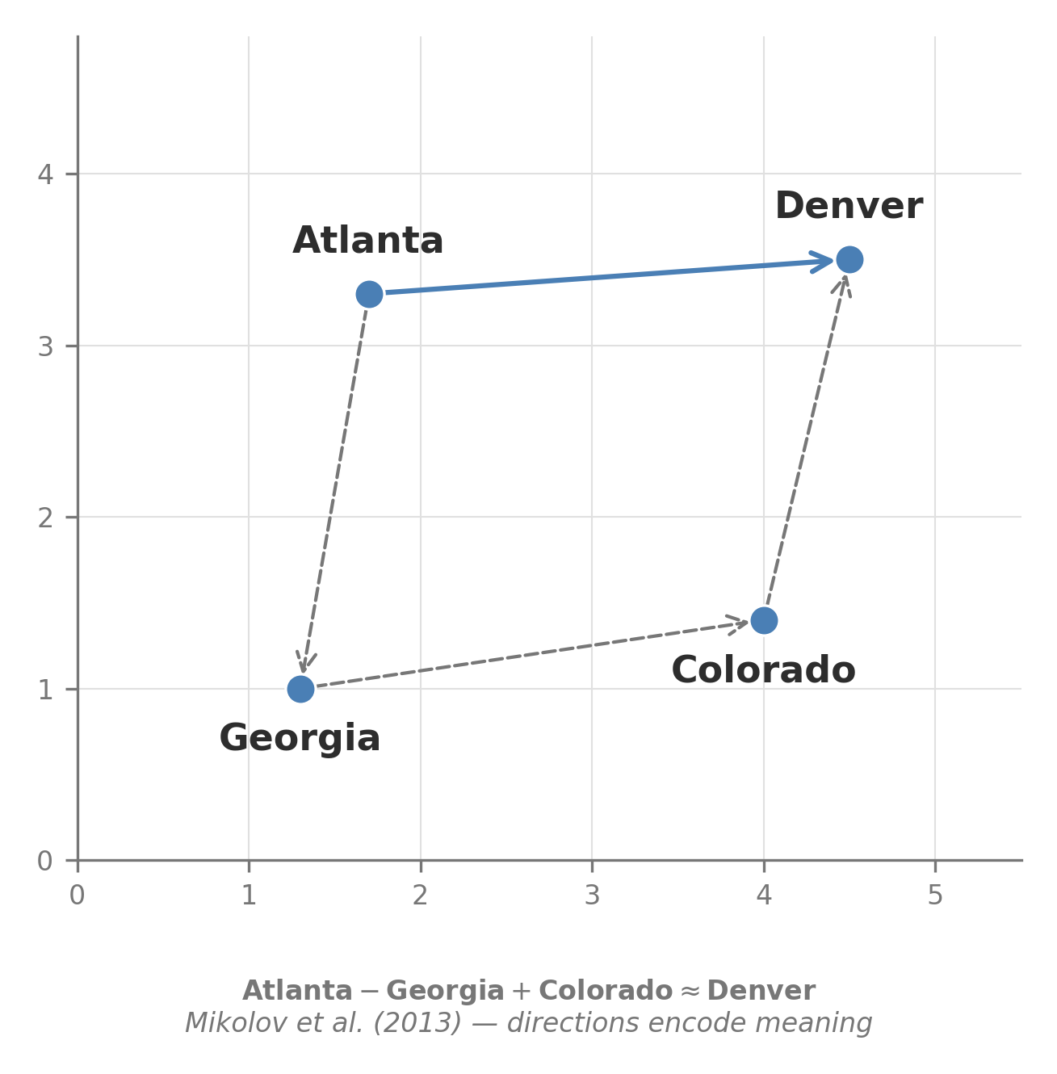
What is a Sentence Embedding?
3

Slide 4
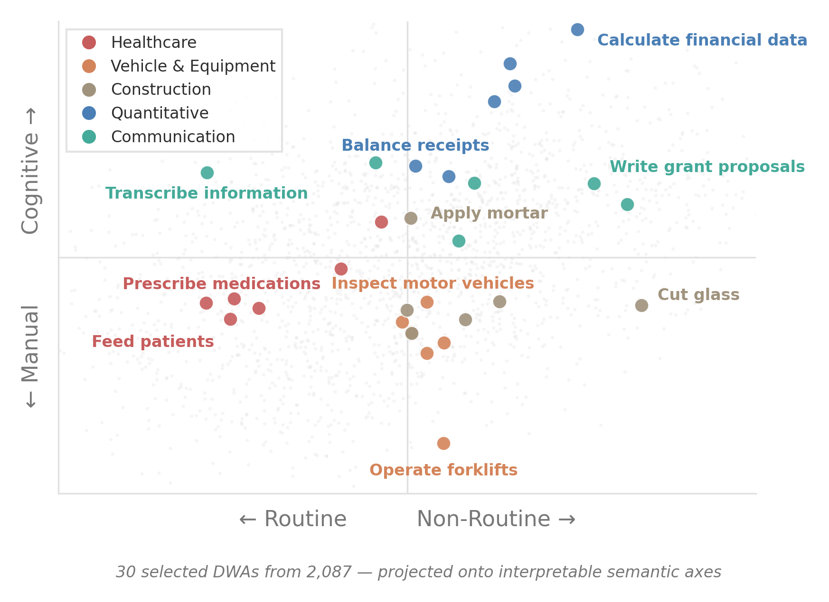
Tasks in Semantic Space
1. Embed 2,087 O*NET task descriptions into a continuous space (MPNet, 768d).
2. Represent each occupation as a distribution over embedded tasks.
3. Test against 89,329 observed job switches (CPS, 2015–2024).
4

Slide 5
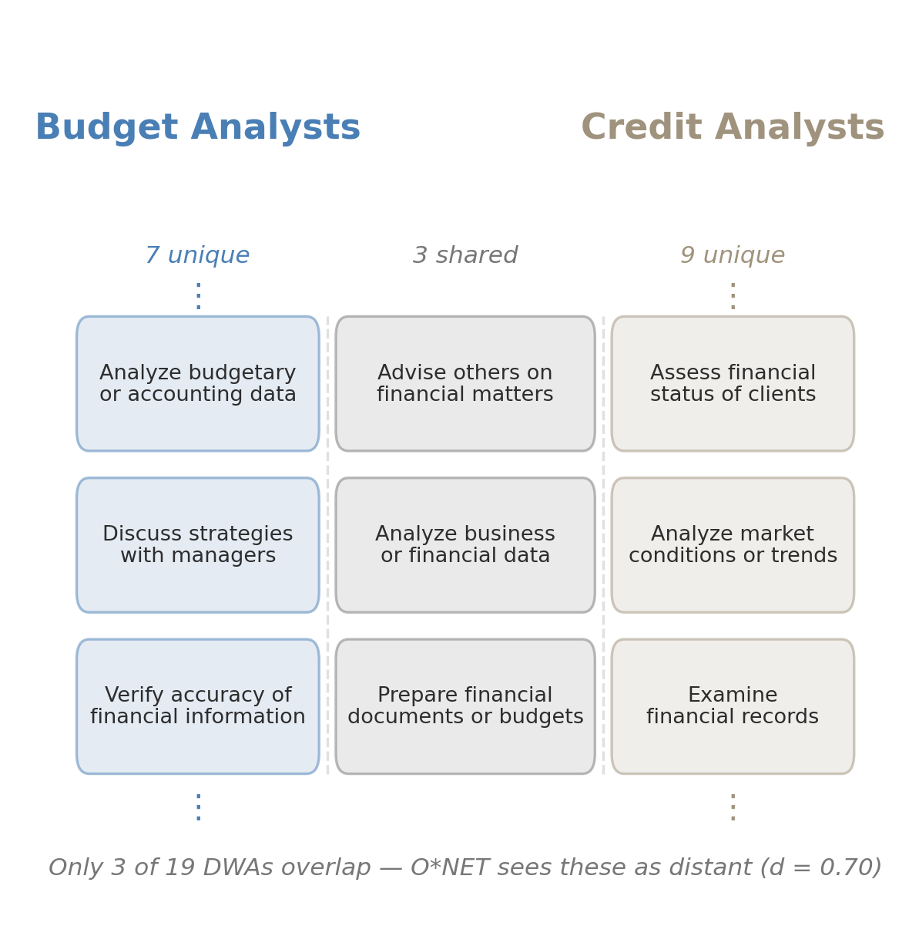
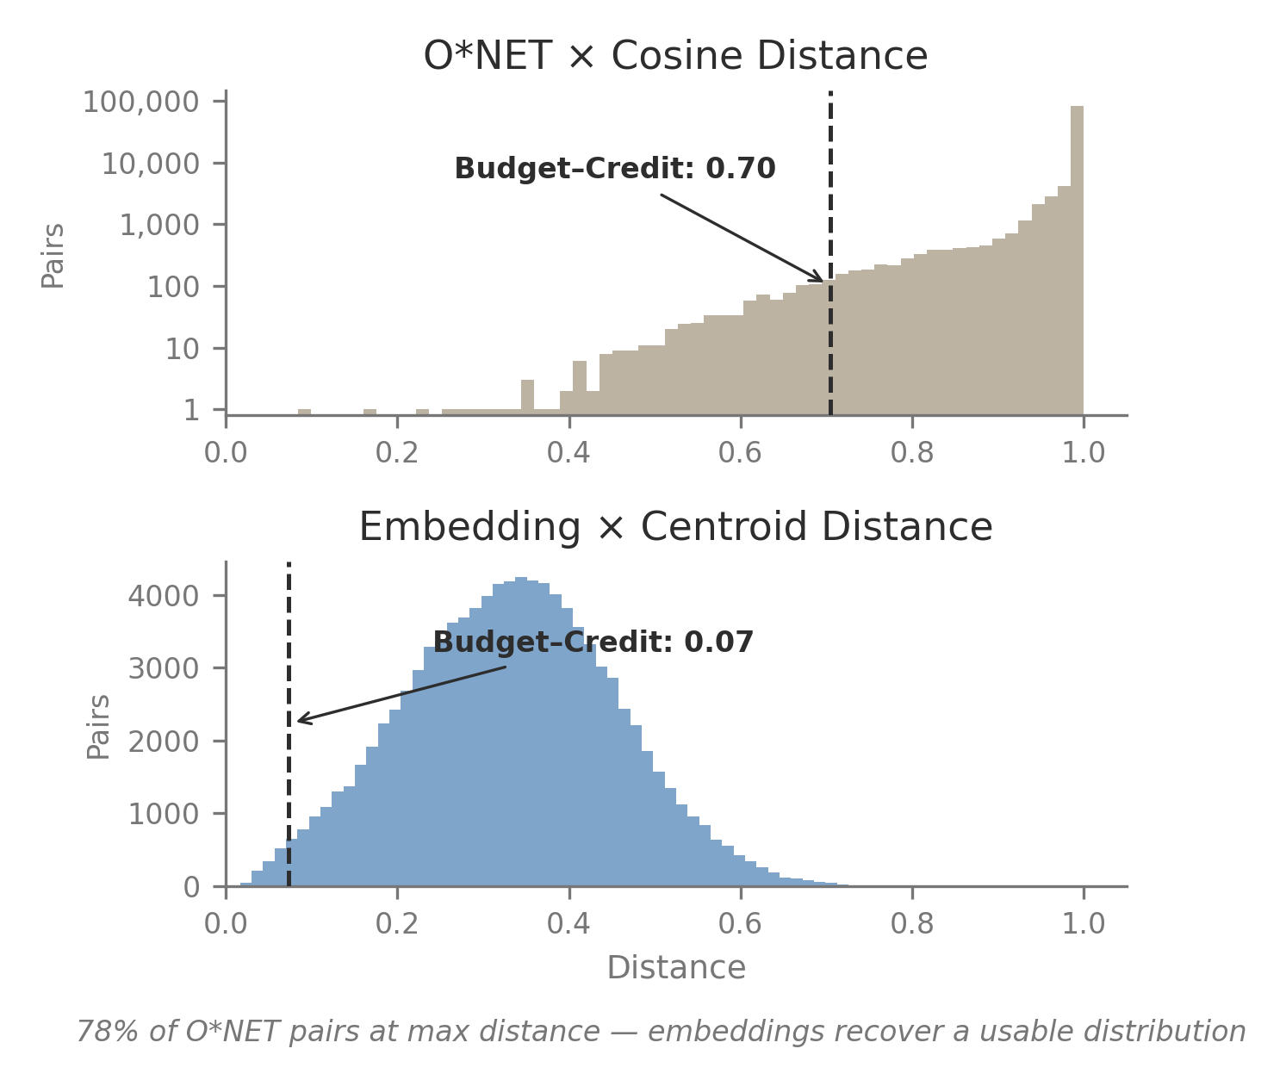
Example: Why Embeddings Matter
5

Slide 6
What Drives the Improvement?
Crossing two choices to isolate what drives predictive gain:
 | Simple average | Optimal transport
O*NET ratings | Baseline | Identity control
Text embeddings | Centroid (primary) | Wasserstein
Validation: 89,329 verified transitions from the CPS. Primary metric: McFadden’s pseudo-R².
6

Slide 7
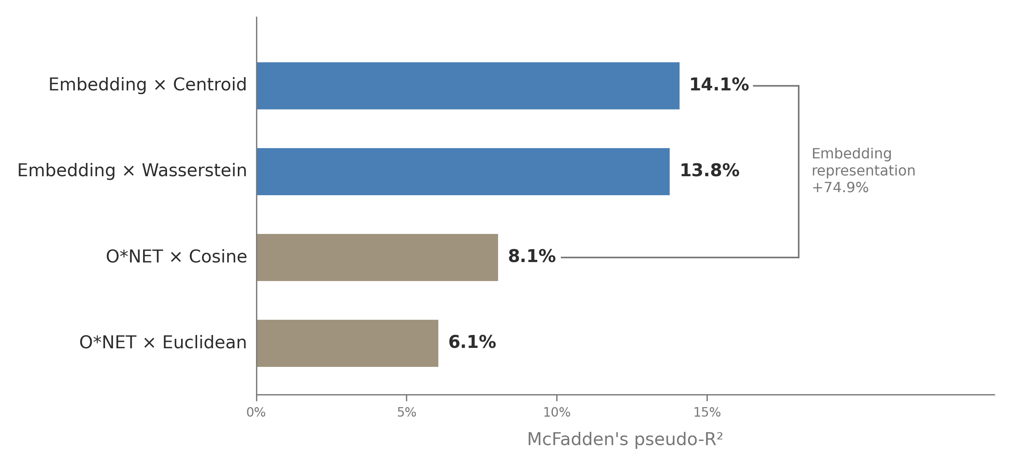
Main Result: Embeddings Dominate
7

Slide 8
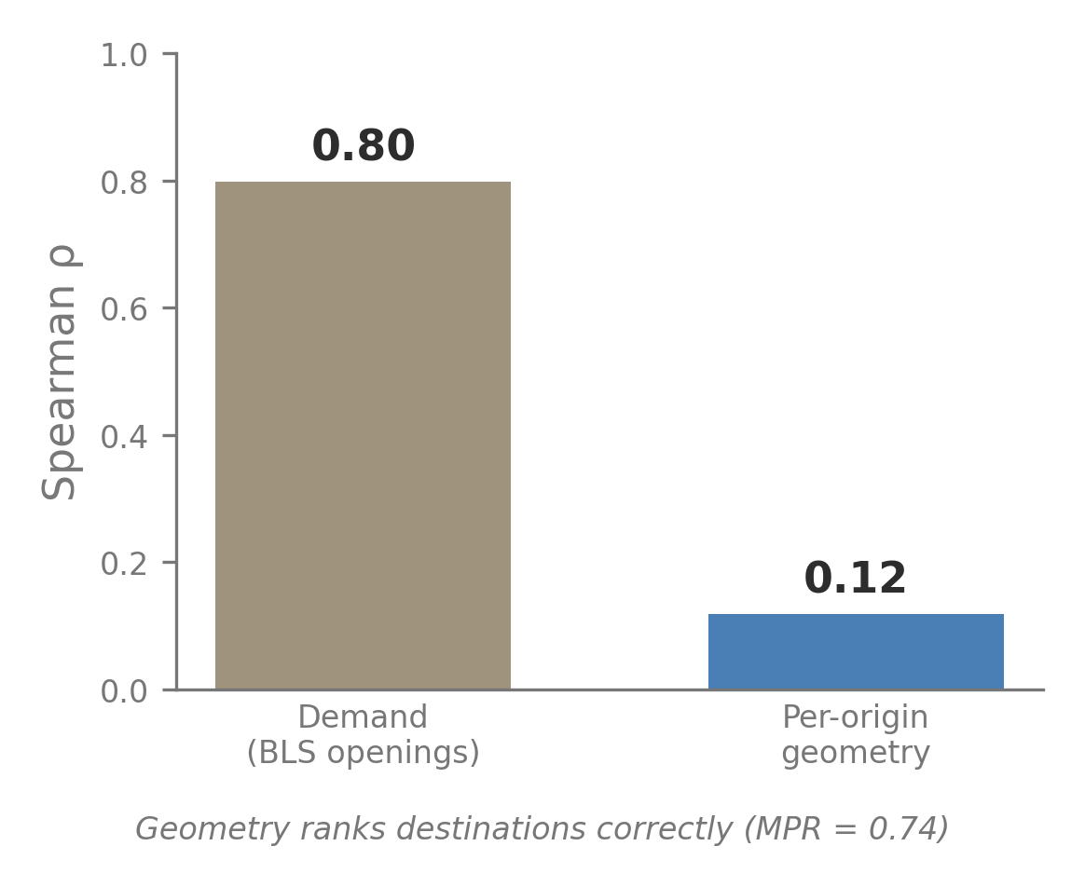
What the Measure Captures
Supply-side feasibility, not demand.
Realized destinations ranked highly (MPR = 0.74).
Aggregate inflows are demand-dominated (ρ = 0.80 with BLS openings).
Orthogonal to AI exposure (r = −0.02) and routine task intensity (r = −0.06). Distinct constructs.
8

Slide 9
Limitations and Scope
Completed transitions only — workers blocked by licensing are absent.
Switching cost identification failed: occupation-mean wages ≠ entry wages.
Single embedding model (MPNet). Domain-specific models could differ.
Cross-sectional — task content treated as static.
Reallocation forecasts need vacancy, wage, geographic, and institutional data.
9

Slide 10
Takeaways
Embeddings improve transition prediction by 74.9% over O*NET baselines (pseudo-R²: 14.1% vs. 6–8%).
The gain is from the embedding representation, not optimal transport.
Captures within-origin pathway feasibility, not aggregate allocation.
Orthogonal to AI exposure (r = −0.02) and routine task intensity (r = −0.06).
Stable pre/post COVID (Δα < 1%, p = 0.72).
10

Slide 11
Thank You
Spencer Hodge
shodge33@students.kennesaw.edu
Code & data: github.com/spencer2718/task-space-model

Slide 12
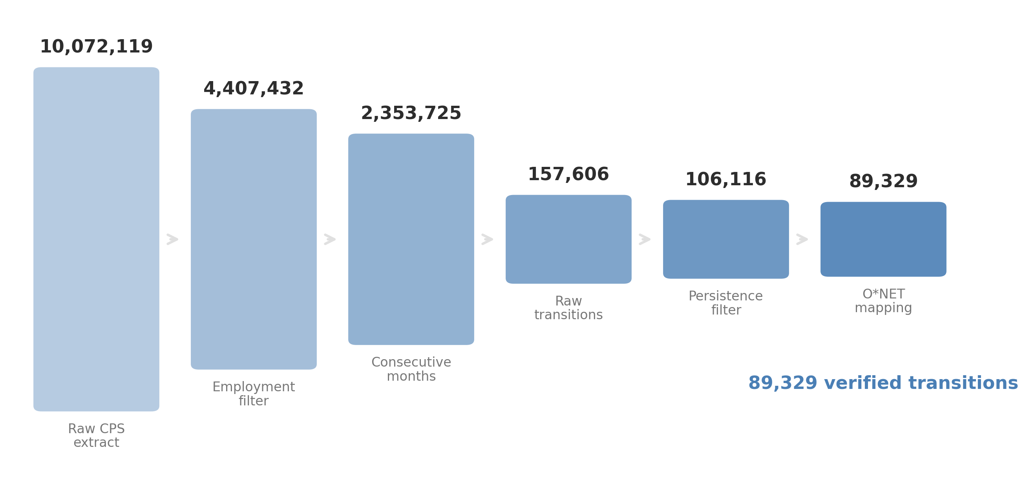
Data Pipeline
B1

