Slide 1
Task Embeddings and
Occupational Mobility
Spencer Hodge
Bagwell Center for the Study of Markets and Economic Opportunity
Kennesaw State University
Undergraduate Research Fellowship, 2025–26

Slide 2
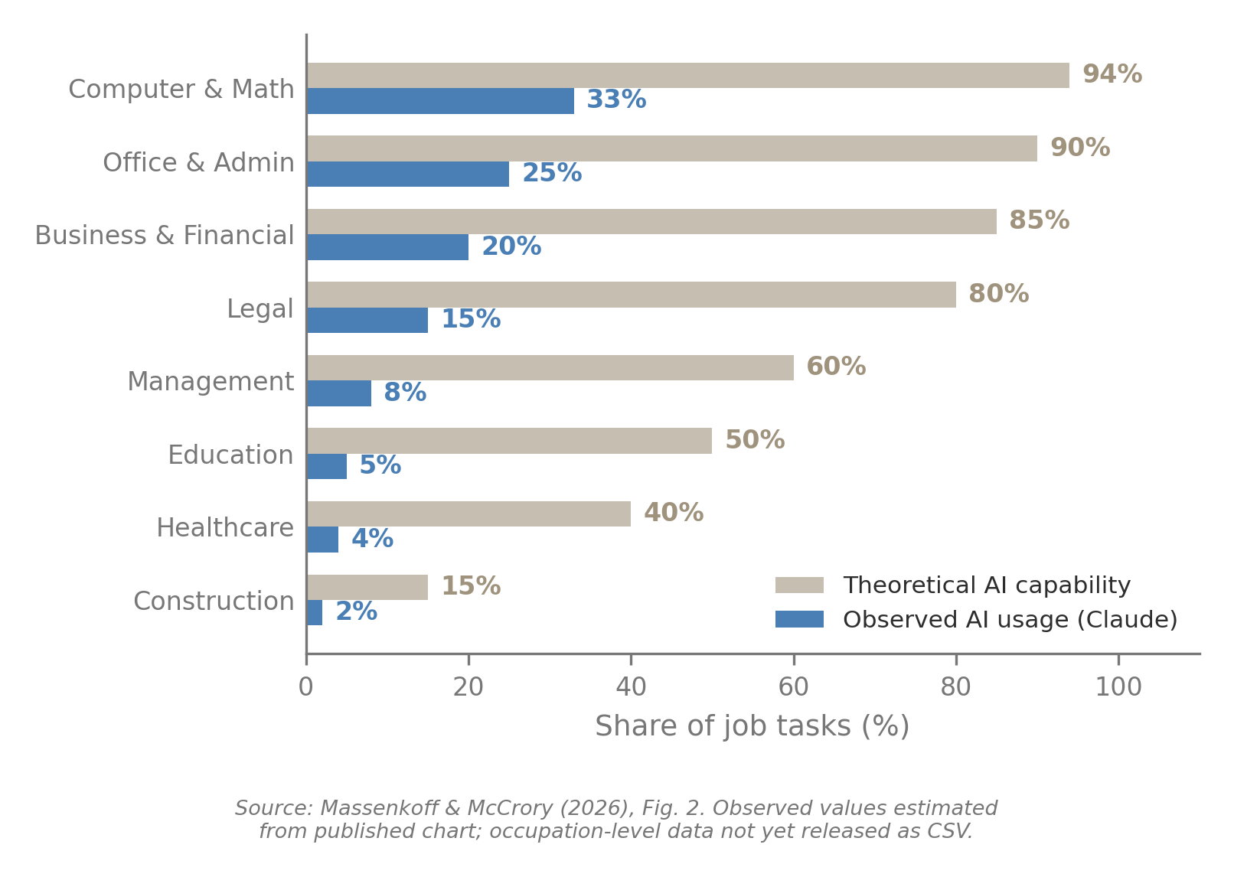
Motivation
New technology is reshaping the labor market.
If your job is disrupted, what can you switch to?
We propose a way to answer that question, and a test for whether it works.
2

Slide 3
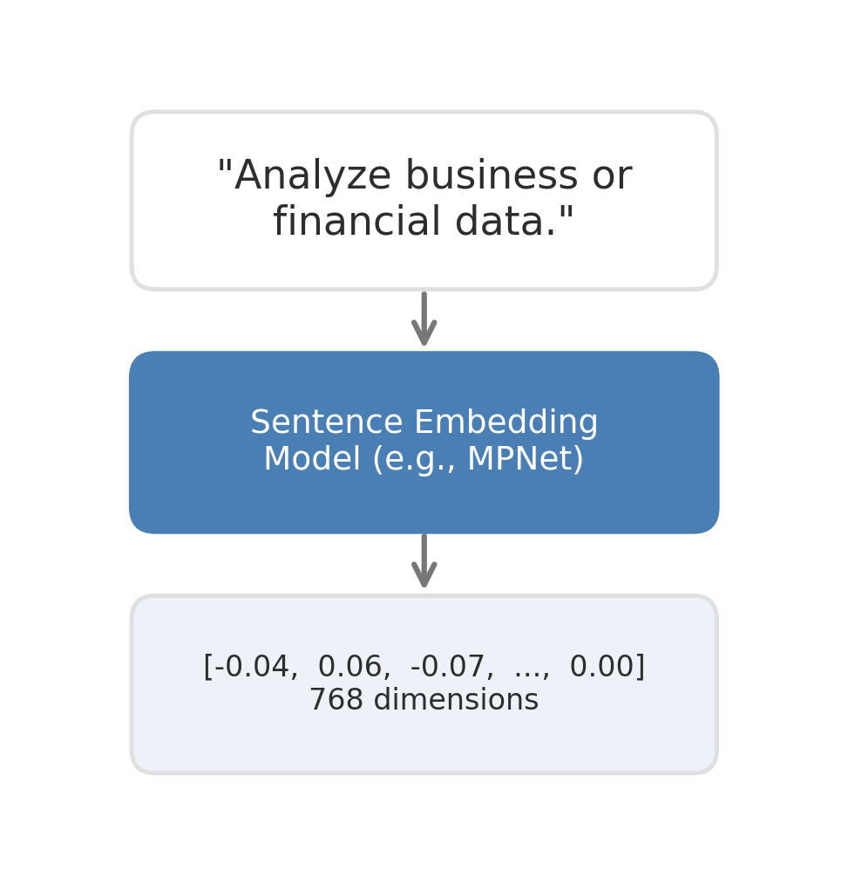
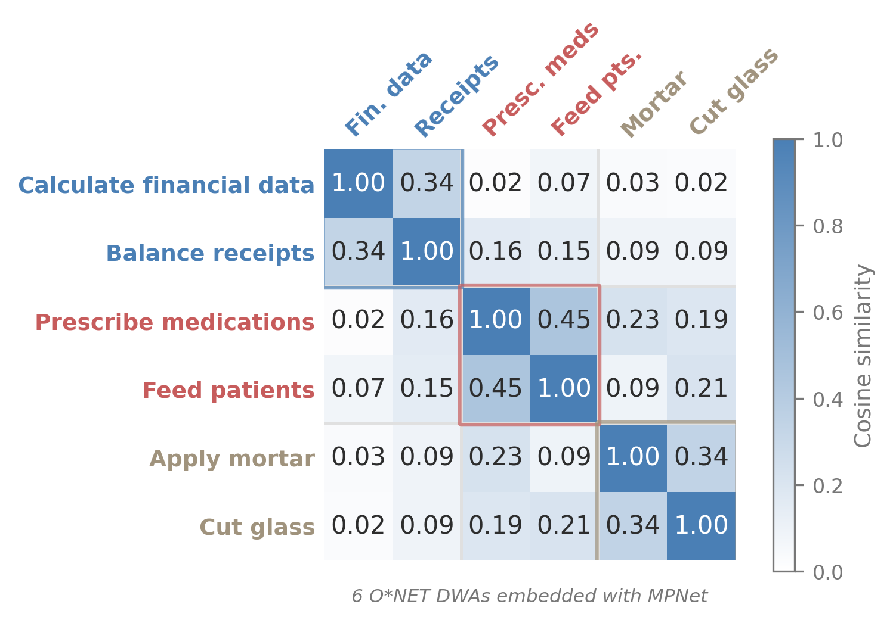
What is a Sentence Embedding?
3

Slide 4
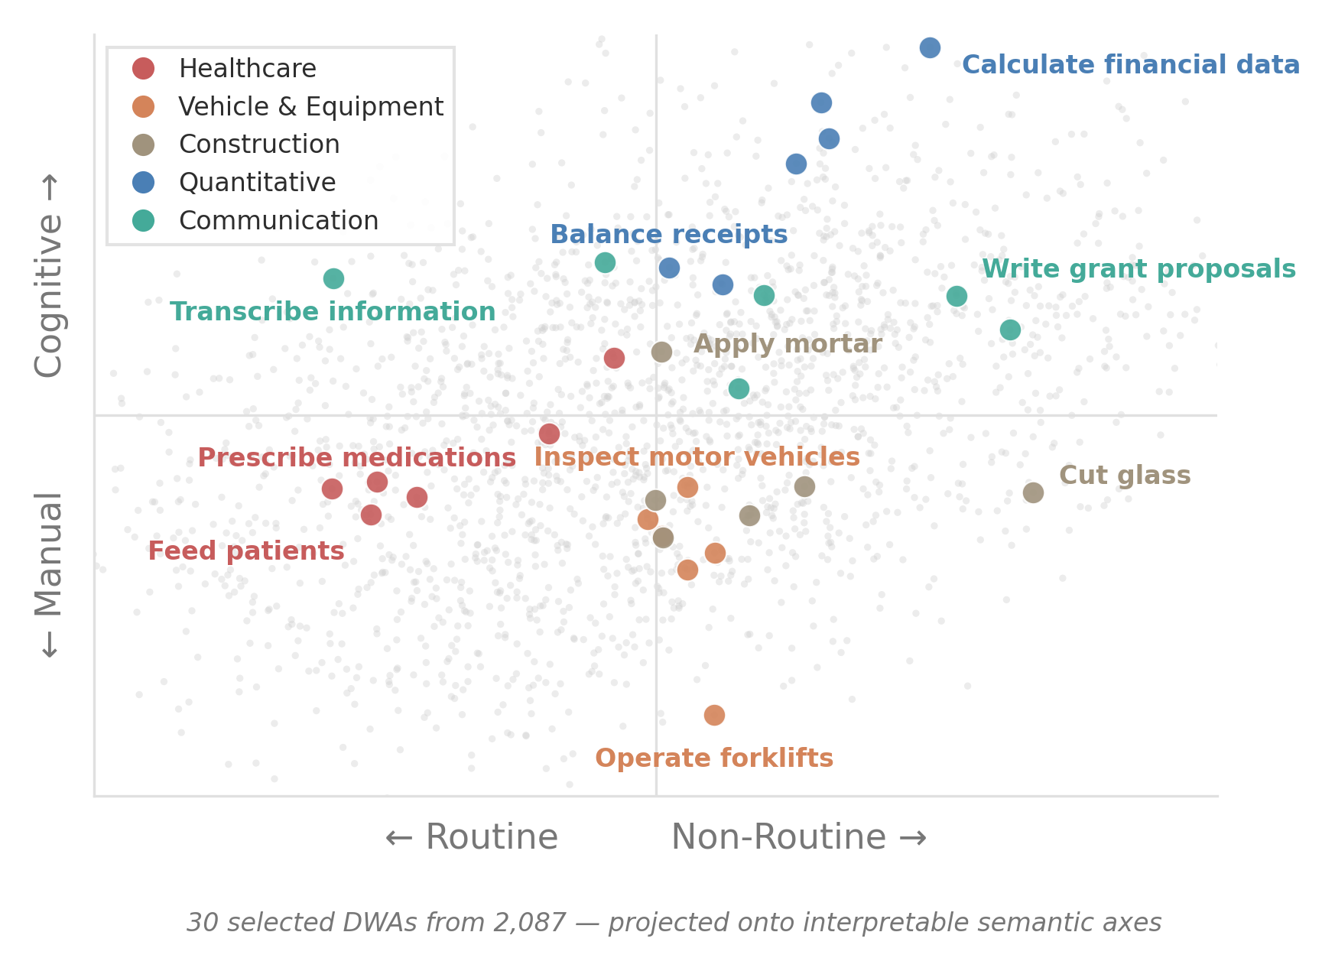
Tasks in Semantic Space
1. Embed 2,087 O*NET task descriptions into a continuous space (MPNet, 768d).
2. Represent each occupation as a distribution over embedded tasks.
3. Test against 89,329 observed job switches (CPS, 2015–2024).
4

Slide 5
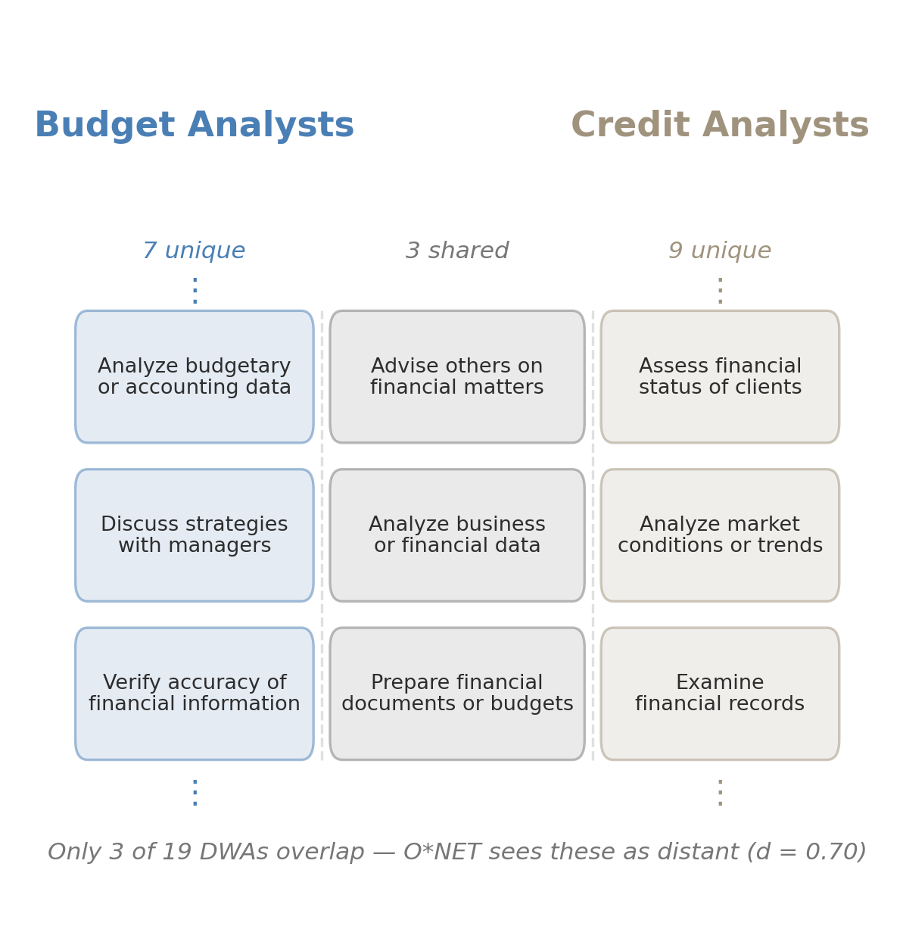
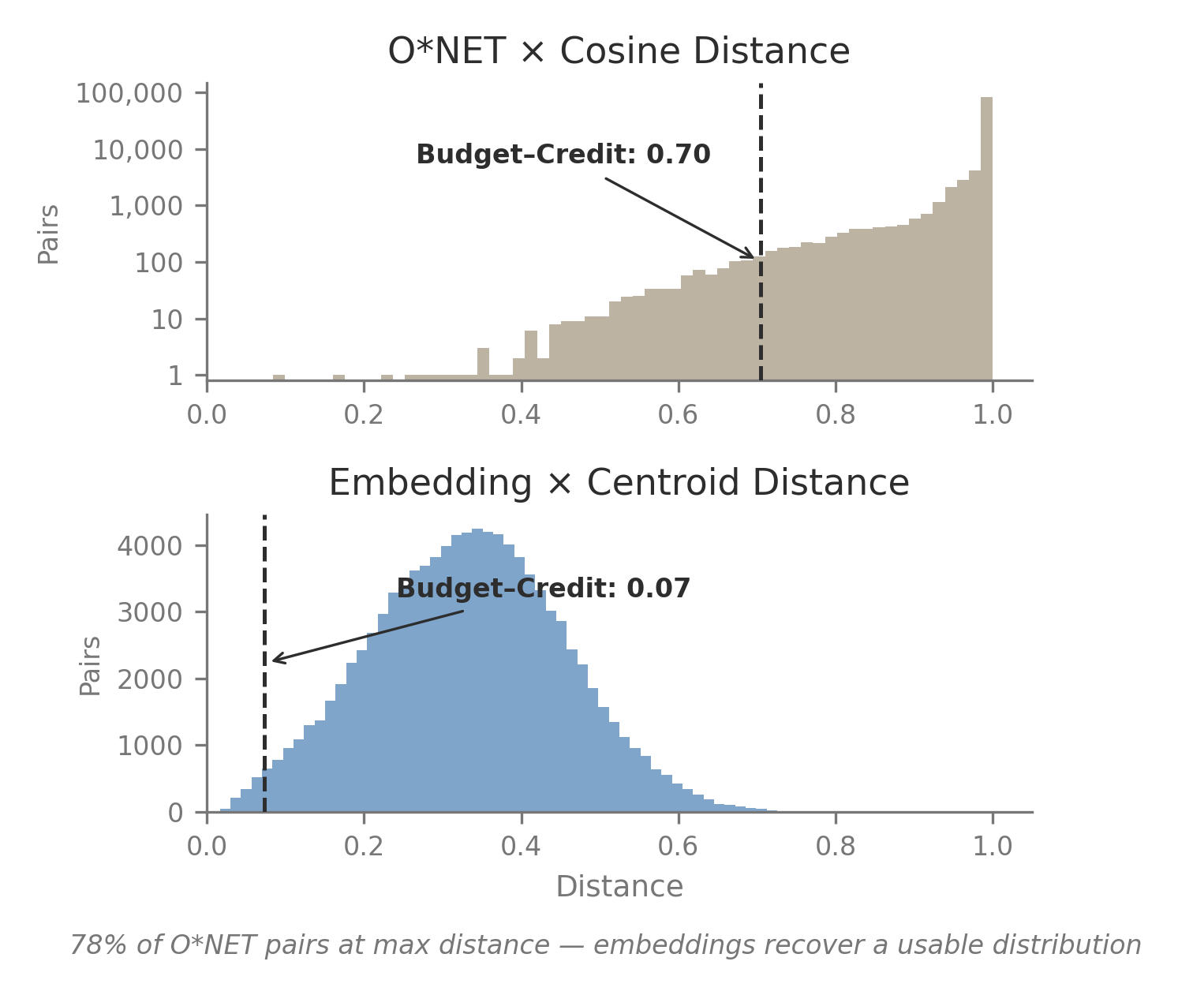
Example: Why Embeddings Matter
5

Slide 6
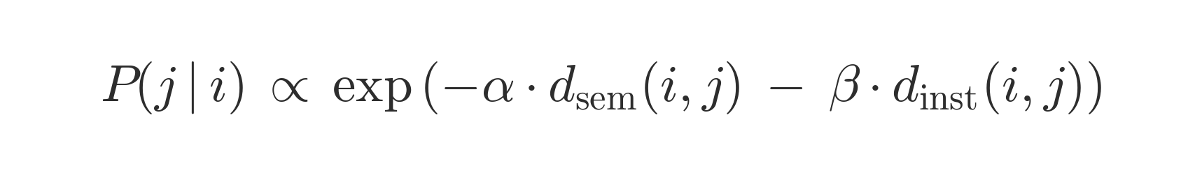
What Drives the Improvement?
Crossing two choices to isolate what drives predictive gain:
Aggregation → Representation ↓ | Centroid | Distributional
O*NET weights | Cosine | Euclidean
Text embeddings | Centroid ★ | Wasserstein
Conditional logit: each worker chooses among destinations weighted by semantic task similarity (α) and institutional proximity (β).
6

Slide 7
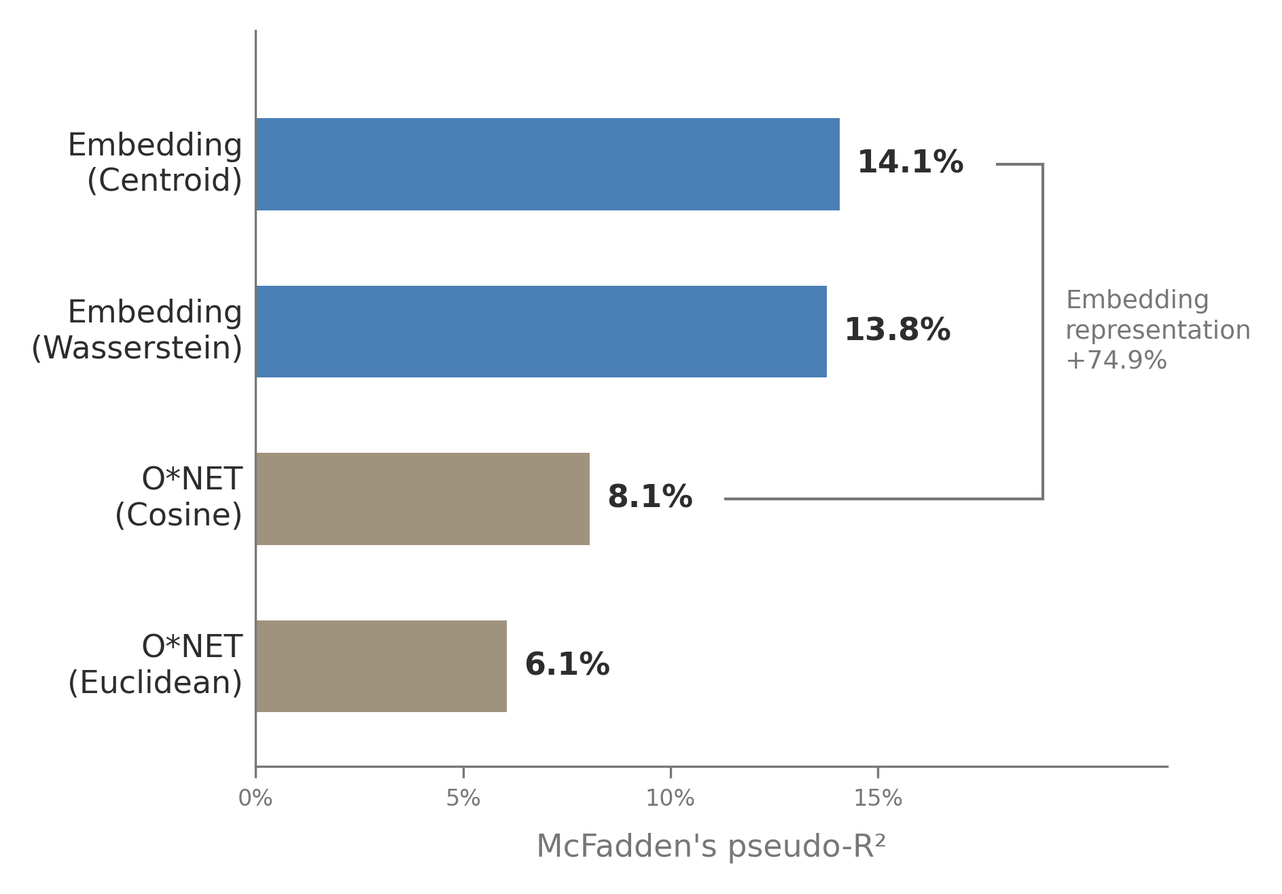
Main Result: Embeddings Dominate
Embedding × Centroid
Parameter | Estimate | t-stat
α (semantic) | 7.404 | 204.0
β (institutional) | 0.139 | 33.7
N = 89,329 transitions
Pseudo-R² = 14.08%
Sampled alternatives (J = 11)
7

Slide 8
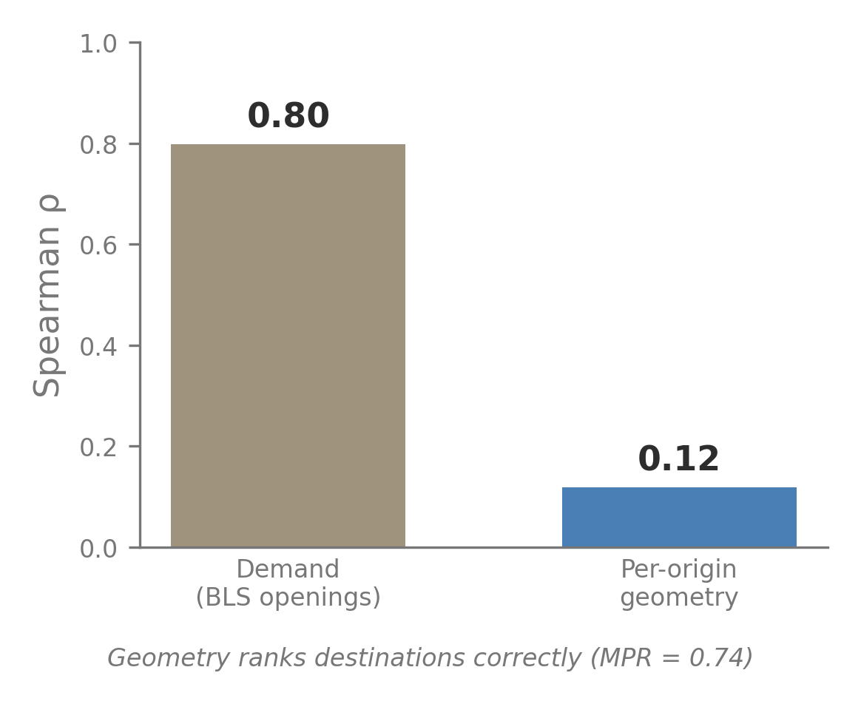
What the Measure Captures
Supply-side feasibility, not demand.
Realized destinations ranked highly (MPR = 0.74).
Aggregate inflows are demand-dominated (ρ = 0.80 with BLS openings).
Orthogonal to AI exposure (r = −0.02) and routine task intensity (r = −0.06).
8

Slide 9
Future Pathways
Results
Extensions
Embedding distance
Demand integration
Combine with vacancy data to predict
realized flows, not just feasibility
pseudo-R² = 14.1%
Individual wage data
Measure actual wage penalties for
switchers with individual-level data
Institutional barriers
t = 33.7
Dynamic task content
Track how occupations’ task profiles
recompose as technology diffuses
Stable across COVID
Technology shock modeling
Model AI exposure as a function of
task embeddings, not static scores
p = 0.72
9

Slide 10
The End
Spencer Hodge
shodge33@students.kennesaw.edu
Code & data: github.com/spencer2718/task-space-model

Slide 11
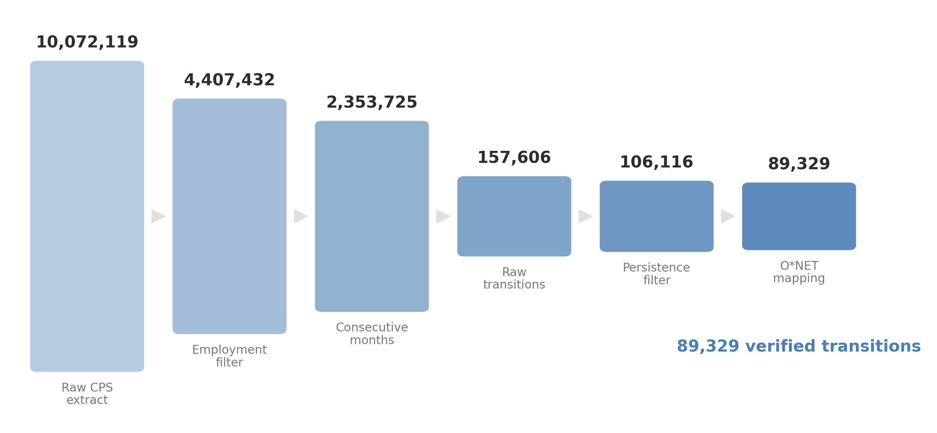
Data Pipeline
B1

