Slide 1
Python basics
Lab 00
CCNY EAS 42000/A4200 Fall 2025
September 3rd, 2025
Prof. Spencer Hill

Slide 2
What we’re covering today:
Motivation: what is Python and why are we using it?
Python basics (syntax, arithmetic, data types)
Python semi-basics (indexing, logic, functions)
Troubleshooting and the programmer’s mindset

Slide 3
What we’re covering today:
Motivation: what is Python and why are we using it?
Python basics (syntax, arithmetic, data types)
Python semi-basics (indexing, logic, functions)
Troubleshooting and the programmer’s mindset

Slide 4
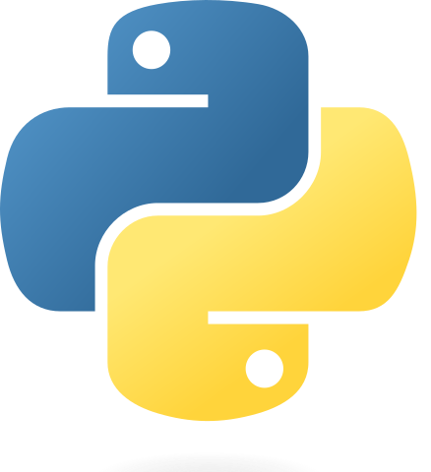
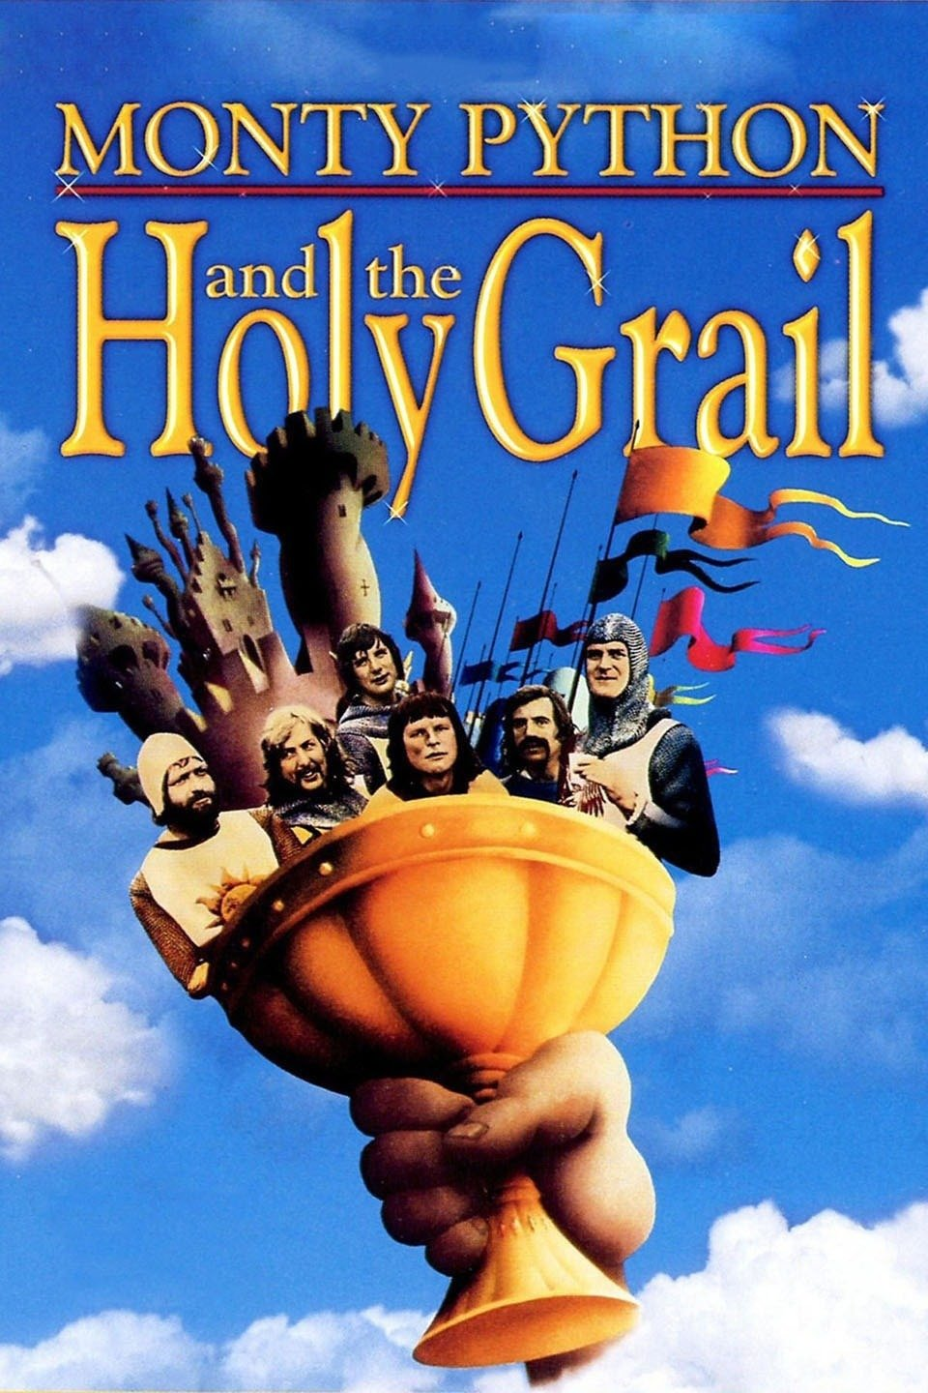
What is Python?
Python official logo
Python is the programming language we will use in this class
Created in 1991 by Guido Van Rossum
Named after the British comedy troupe Monty Python

Slide 5
What is Python?
Arguably the most widely used programming language in scientific research, and among them in other fields
E.g. https://github.blog/2023-03-02-why-python-keeps-growing-explained/
Compared to other languages, easy to learn, huge user base, lots of powerful tools built-in or easily installed

Slide 6
Taking a step back…what is a programming language, and why do we need one?
Computers operate on bits of information:
either 1 or 0, on or off, yes or no; “binary”
Multiple bits can get strung together to generate more complicated forms of information
E.g. the decimal (base-10) number “6” we know and use is equivalent to the binary (base-2) number “110”

Slide 7
Taking a step back…what is a programming language, and why do we need one?
Computers can process millions and billions of these 1s and 0s every millisecond
Enabling them to represent extremely complicated things
But humans can’t read billions of 1s and 0s! Need abstraction
Just like we couldn’t “read” the raw Central Park precip data

Slide 8
Taking a step back…what is a programming language, and why do we need one?
A programming language like Python is a way of representing those 1s and 0s that the computer actually operates on in a way that a human can usefully work with
In fact, there are many levels of abstraction between Python itself and the 1s and 0s… “assembly code”, etc.

Slide 9
What we’re covering today:
Motivation: what is Python and why are we using it? ✅
Python basics (syntax, arithmetic, data types)
Python semi-basics (indexing, logic, functions)
Troubleshooting and the programmer’s mindset

Slide 10
Python concepts we’ll cover in next two weeks
Accessing and opening Python (should be good already!)
Basic syntax: arithmetic; defining variables; comments
Basic data types: integers, decimal numbers (“floats”), text (“strings”), arrays (“lists”, “tuples”), dictionaries
Basic logic: if/else statements; loops
Basics of functions: defining them, calling them
Executing simple Python scripts
“basics”
“semi
basics”

Slide 11
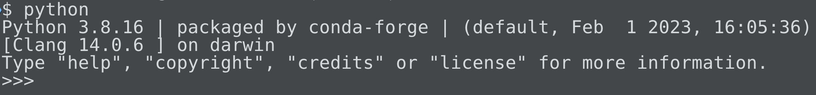
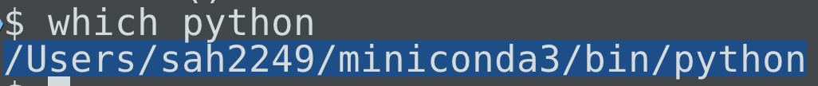
Accessing and opening python: basically, “python” + Enter from a terminal window
On Mac and Linux, can use “which” to see where the Python executable lives:
Windows too?

Slide 12
Accessing and opening python: basically, “python” + Enter from a terminal window
To exit existing Python session: exit() or Control-D

Slide 13
But nicer to use “ipython” rather than plain python (if ipython is installed)
IPython is essentially a nicer version of python: better syntax highlighting, prettier outputs etc.
https://ipython.readthedocs.io/en/stable/
Just try entering ipython from a terminal window; if it works, I recommend using that instead of plain python
For now! We’ll switch to Jupyter notebooks later

Slide 14
But nicer to use “ipython” rather than plain python (if ipython is installed)
$ ipython
Python 3.8.16 | packaged by conda-forge | (default, Feb 1 2023, 16:05:36)
Type 'copyright', 'credits' or 'license' for more information
IPython 8.12.0 -- An enhanced Interactive Python. Type '?' for help.
In [1]:

Slide 15
Basic syntax: to start, play around with using Python as a basic calculator
Addition, subtraction: + and – signs: 2 + 3, 2-3
Multiplication, division: * and /: 2 * 3, 2 / 3
“Integer division”: double slash //: 2 // 3

Slide 16
Basic syntax: to start, play around with using Python as a basic calculator
Remainder (“modulus”): percent sign: 2 % 3
Power: double asterisk: 2 ** 3
Parentheses work basically the same as they do in normal math: (2 + 3) / (2 * 3)

Slide 17
Basic syntax: add comments with the pound/hash; computer doesn’t read these
Can be at the start of a line or the end of a line:
# This whole line is a comment.
myvar = 5 # this is a comment too.

Slide 18
Basic syntax: use a single equals sign to assign values to variables
In Python, a single equals sign = does not mean “this is equal to that” the way it does in math
Instead, that’s how you assign a value to a variable
For example: myvar = 5
Now you can do e.g. myvar + 20

Slide 19
Basic syntax: use a single equals sign to assign values to variables
For example: myvar = 5
If myvar didn’t exist before that, this creates it.
If myvar did exist already, this overwrites whatever it was before

Slide 20
Basic syntax: use a single equals sign to assign values to variables
You can define variables of any of these (or other) types:
num_points = 100
wind_speed = 8.45
is_raining = False
Etc.

Slide 21
Basic syntax: use a single equals sign to assign values to variables
The right-hand-side can be an expression, not just one single thing:
avg_salinity = (3.0 + 4.5 + 2.9) / 3
Etc.

Slide 22
Basic syntax: use a single equals sign to assign values to variables
But the left hand side has to be a single variable.
E.g., you can’t do things like:
3 = myvar
2 / 3 = 0.66
Result: SyntaxError: cannot assign to literal

Slide 23
Basic syntax: Python is case sensitive but (mostly) not space sensitive
All of these are *different* variables:
myvar, MyVar, my_var, MYVAR
But spaces on a single line don’t matter. These are all the same: 2+3, 2 +3, 2+ 3
Exception: power, no space b/w asterisks: **, not * *

Slide 24
Basic comparisons: equal to, less than, greater than, etc. Always return True or False
Less than, greater than: <, >: 2 < 3; 2 > 3
Less/greater than or equal to: 2<=3; 2>=3
Equal to: double equals sign: 2==3
Not equal to: exclamation point equals sign: 2!=3

Slide 25
Basic data types: int, float, bool, string, list, dict
Integer: int (e.g. -5, 932)
Decimal number: float (e.g. -5.4, 932.0)
Text: string (e.g. “Hello World”, ’-5’)
Boolean (True or False): bool (True, False)
Array of items: list. (e.g. [23, -0.3, “abc”])
Array of key-value pairs: dict (e.g. {”dog”: “Dempsey”})

Slide 26
Basic data types: int, float, bool, string, list, dict
To find out what type something is: use ‘type’:
>>> type({"dog": "Dempsey"})
<class 'dict'>

Slide 27
Symbols like + do different things depending on the type! Not always “adding.”
For strings or lists: join (“concatenate”) the two objects together:
>>> "My dog is" + "Dempsey"
'My dog isDempsey’
>>> [123] + [False, True]
[123, False, True]

Slide 28
Symbols like + do different things depending on the type! Not always “adding.”
And not every operator is defined for every type:
>>> {"dog": "Dempsey"} + {"cat": "nope"}
Traceback (most recent call last):
File "<stdin>", line 1, in <module>
TypeError: unsupported operand type(s) for +: 'dict' and 'dict'

Slide 29
What we’re covering today:
Motivation: what is Python and why are we using it? ✅
Python basics (syntax, arithmetic, data types) ✅
Python semi-basics (indexing, logic, functions)
Troubleshooting and the programmer’s mindset

Slide 30
You can use a variable’s existing value when assigning it a new value
myvar = 3 # myvar has been assigned the value 3
myvar = myvar + 8 # myvar is now 3+8 = 11
This is common enough that there are shorthand operators for this: += , -= , *= , and /= . For example:
x *= 1.08 # identical to x = x * 1.08

Slide 31
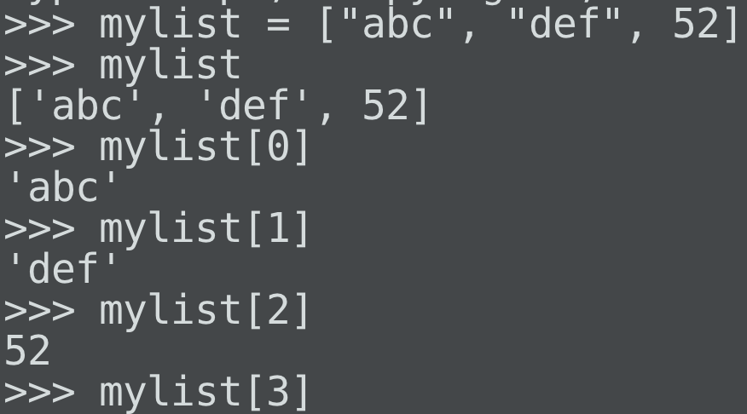
Use square brackets for “indexing” (grabbing individual elements) of lists

Slide 32
Python uses “zero-indexing”: access the 1st value with [0], not [1]
One way of thinking about this:
how far away is it from the start of the array?
The 1st element is the start, so its index is 0
Analogy: my last apartment in NYC was on the ground floor,
and it was number B, not 1B
1B was one flight up from us!

Slide 33
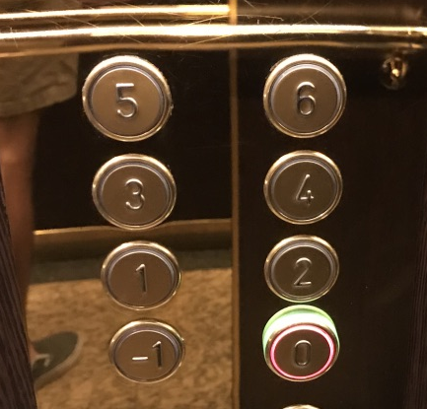
Python uses “zero-indexing”: access the 1st value with [0], not [1]
Analogy 2: these elevator buttons from a hotel in Paris
The ground floor is 0 floors above ground, so it’s the 0th floor.

Slide 34
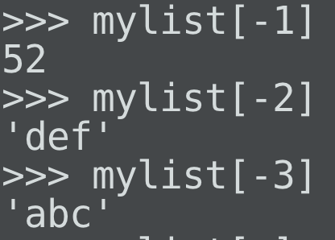
Python uses “zero-indexing”: access the 1st value with [0], not [1]
An upside of this: clean way of accessing values starting from the end of the array using negative numbers:

Slide 35
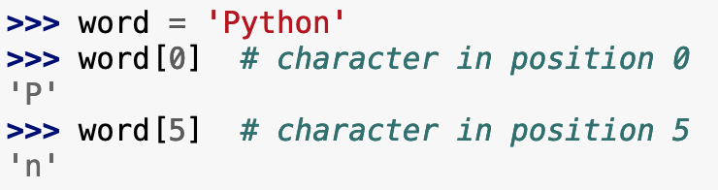
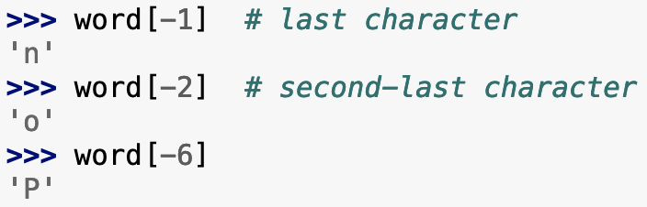
Indexing isn’t just for lists! Same syntax works for strings, tuples, and more.
From Python’s official tutorial (highly recommended):
https://docs.python.org/3/tutorial/introduction.html

Slide 36
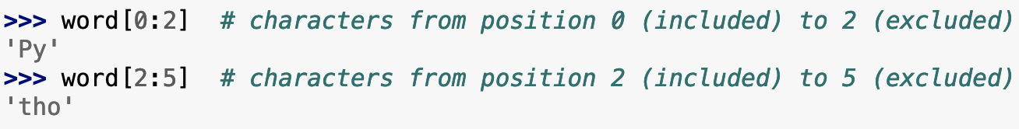
Colons enable you to grab subsets (slices) of a list or string
From Python’s official tutorial (highly recommended):
https://docs.python.org/3/tutorial/introduction.html

Slide 37
Basic logic: if statements. If X is true, do Y. Otherwise, don’t do Y.
if 2 < 3:
print(“EAS FTW”)
More generally:
if <boolean expression>:
line1
line2
…

Slide 38
Basic logic: if statements. If X is true, do Y. Otherwise, don’t do Y.
if 2 < 3: # This evaluates to True
print(“EAS FTW”) # so this gets executed
Key syntax: colon after if statement, indentation of line(s) after
Standard indentation: 4 spaces

Slide 39
Basic logic: if statements. If X is true, do Y. Otherwise, don’t do Y.
if 2 == 3: # This evaluates to False
print(“EAS FTW”) # so this does NOT execute

Slide 40
Basic logic: if/else statements. If X is true, do Y. Otherwise, do Z.
if 2 < 3: # This evaluates to True
print(“EAS FTW”) # so this gets executed
myvar = 999. # and this
else:
print(“are you sure?”) # this does NOT
myvar = 20 # this neither

Slide 41
Basic logic: if/else statements. If X is true, do Y. Otherwise, do Z.
if 2 >= 3: # This evaluates to False
print(“EAS FTW”) # so this does NOT get executed
myvar = 999. # nor this
else:
print(“are you sure?”) # this DOES
myvar = 20 # and this

Slide 42
Basic logic: for loops. Repeat these lines for each item in a given array
for n in [“abc”, True, 84]:
print(“EAS FTW”, n)
Result:
EAS FTW abc
EAS FTW True
EAS FTW 84

Slide 43
Basic logic: while loops. Repeat these lines as long as this condition is True
n = 0
while n < 2:
print(“EAS FTW”, n)
n += 1
Result:
EAS FTW 0
EAS FTW 1

Slide 44
Functions: analogous to functions in math, take some input(s), return some output(s)
Define using the command def:
def my_func(arg1, arg2):
“””Compute product divided by sum”””
return (arg1 * arg2) / (arg1 + arg2)
Syntax: def, then function name, then argument(s) in parentheses, then colon, then indented line(s), and ending with a return statement

Slide 45
Functions: analogous to functions in math, take some input(s), return some output(s)
Now you can call my_func later in your code:
>>> my_func(2, 4)
1.3333333333333333
>>> my_func(1.1, 0.9)
0.49500000000000005
# “Real” answer is 0.495; float operations can be weird! Relevant when doing e.g. ==

Slide 46
Functions: analogous to functions in math, take some input(s), return some output(s)
The return statement is key! That’s what the function spits out. Without it, the function returns nothing (technically, None)
def add(num1, num2):
answer = num1 + num2
>>> add(1, 2)
>>> # blank, because forgot ‘return answer’

Slide 47
Key built-in functions (try these out yourself!)
print
type
help
len
range # what does this do? Try help(range)

Slide 48
Python scripts: can write many lines of code in a plain-text file and run them all together
$ cat my-script.py
"""A simple python script."""
my_dog = "Dempsey"
my_cat = None
my_pets = {"dog": my_dog, "cat": my_cat}
print("These are my pets: ", my_pets)

Slide 49
Python scripts: can write many lines of code in a plain-text file and run them all together
$ python ./my-script.py
These are my pets: {'dog': 'Dempsey', 'cat': None}
Above, the single period “.” means “the current directory”.
And two periods “..” means “this directory’s parent directory”

Slide 50
You write your python scripts in a separate text editor, not within python or using Word
Python code must be saved as plain-text files ending in “.py”
Corollary: You can’t use Word, Pages, or Google Docs!
Every operating system has at least one built-in text editor you can use (MacOS: TextEdit; Windows: Notepad)
Later in this course: more advanced editors; integrated development environments (IDEs), etc.

Slide 51
What we’re covering today:
Motivation: what is Python and why are we using it? ✅
Python basics (syntax, arithmetic, data types) ✅
Python semi-basics (indexing, logic, functions) ✅
Troubleshooting and the programmer’s mindset

Slide 52
If you’re getting an error message, read it! Intimidating at first, but usually very helpful.
>>> my_var = 12345
>>> print(myvar)
Traceback (most recent call last):
File "<stdin>", line 1, in <module>
NameError: name 'myvar' is not defined

Slide 53
If you’re getting an error message, read it! Intimidating at first, but usually very helpful.
>>> my_var = 12345
>>> print(myvar)
Traceback (most recent call last):
File "<stdin>", line 1, in <module>
NameError: name 'myvar' is not defined

Slide 54
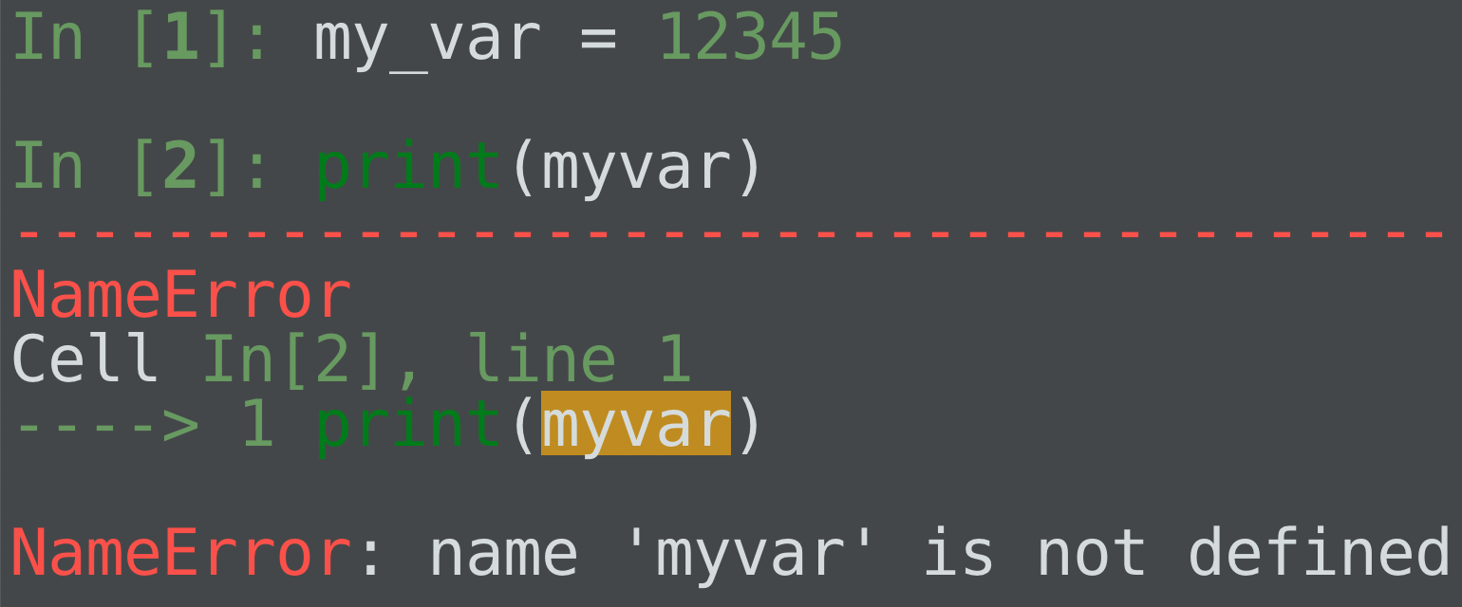
If you’re getting an error message, read it! Intimidating at first, but usually very helpful.
Especially in IPython, which nicely colors the output:

Slide 55
There are tons of free online resources for learning python…just a couple examples:
I found both from quickly Googling e.g. “free python tutorial”
Python’s official tutorial:
https://docs.python.org/3/tutorial/index.html
Code Academy (click on “free” to hide ones that cost $$)
https://www.codecademy.com/catalog/language/python

Slide 56
For all things related to programming, Google and ChatGPT are your friends
In my experience, the vast majority of questions, error messages, etc. that arise can be resolved by simply googling them
Kind of a “One weird trick!” in effective coding

Slide 57
For all things related to programming, Google and ChatGPT are your friends
Don’t overthink it! For an error message you’re stuck on, simply copy and paste it into Google and see what comes up
There’s usually a StackOverflow, YouTube, Reddit, etc. that will come up that solves it

Slide 58
For all things related to programming, Google and ChatGPT are your friends
As such, my 1st response to any coding question will be:
“What did Google/ChatGPT say?”
For both our sakes! To instill in you the habit of solving things yourself, and admittedly to save myself time ☺
Think of it as due diligence (a.k.a. “doing your homework”)

Slide 59
For all things related to programming, Google and ChatGPT are your friends
That said, PLEASE do ask me for help once you have tried Google and/or ChatGPT and are still stuck!
I do NOT mean this to discourage you seeking out help!

Slide 60
At the same time, these tools aren’t a substitute for thinking critically
Before Googling etc., take a beat to think about the problem you’re facing.
What precisely isn’t working you how you want it to?
What have you tried so far to fix it? What’s a possible next step?
If you’re still stumped---meaning you have no idea what to do next---then proceed to the internet or asking a friend

