Slide 1
Data Visualization

Slide 2
What we’re covering today:
Why a whole lecture on data visualization?
Core plot types for 1D data: box-and-whiskers, timeseries, scatterplots, histograms

Slide 3
What we’re covering today:
Why a whole lecture on data visualization?
Core plot types for 1D data: box-and-whiskers, timeseries, scatterplots, histograms

Slide 4
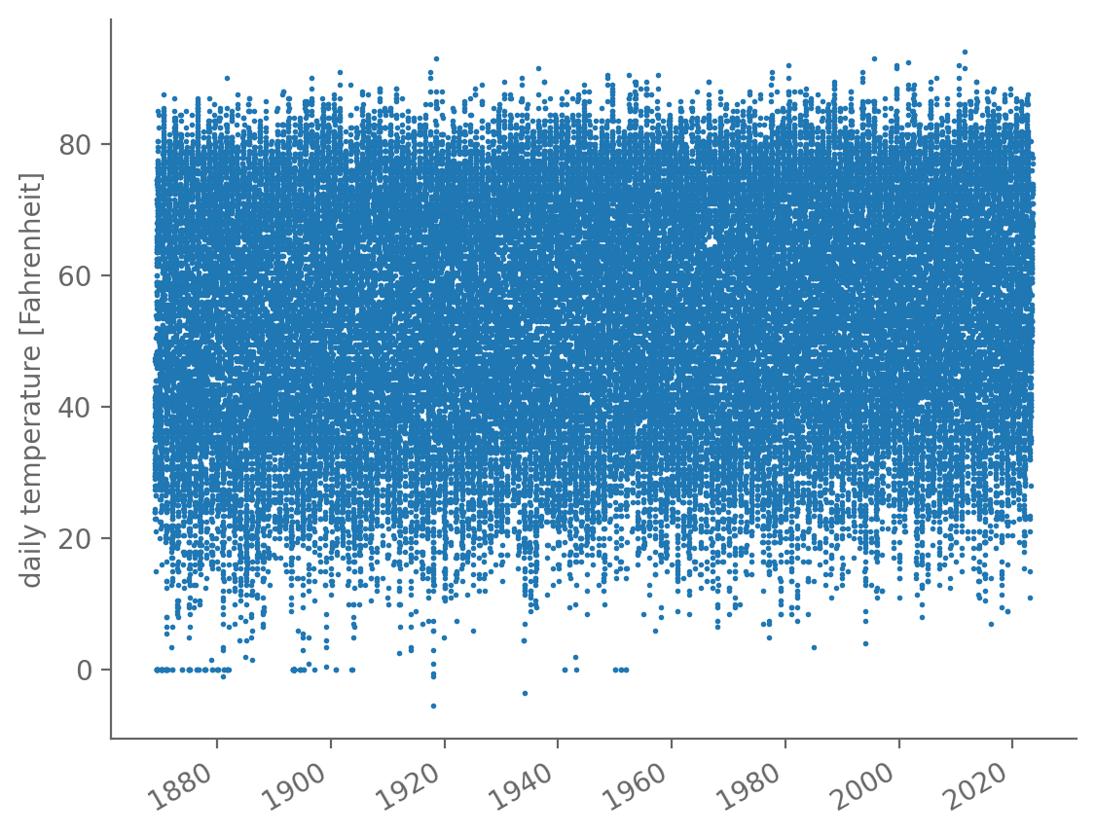
In the introductory lecture, we saw that a single plot can give us a lot of information
Central Park daily average temperature: seasonality, likely warming trend, bad values at 0°F, etc.
Even though we also decided plots alone aren’t sufficient!

Slide 5
Different kinds of plots can provide different key pieces of information
These timeseries plots are great for examining how the dataset varies with time, but that’s not the whole story!
We might want to summarize the overall range of values across all times in a succinct way: box-and-whisker plot

Slide 6
Different kinds of plots can provide different key pieces of information
We might want to see how closely the behavior of one variable is related to another: scatterplot
Or see graphically the ranges of values where the dataset has lots of values vs. few values: histogram

Slide 7
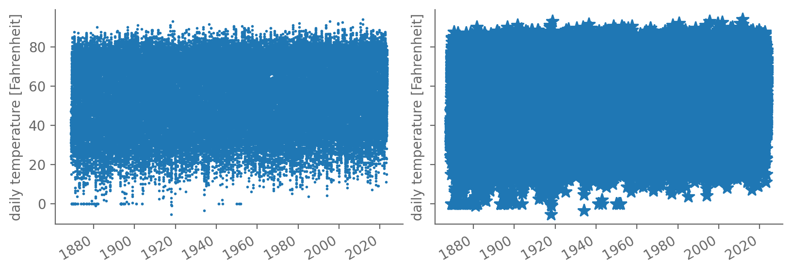
For a given plot, different choices can either clarify or obscure the underlying behaviors
Some of these are obvious (see below), but others aren’t

Slide 8
Plots (histograms especially) provide a conceptual bridge into probability theory
In essence, a histogram is a way of approximating the probability density function (PDF) of a distribution
And PDFs are the beating heart of statistics!
That makes histograms a nice segue into probability theory
Which we’ll cover next time

Slide 9
What we’re covering today:
Why a whole lecture on data visualization? ✅
Core plot types for 1D data: box-and-whiskers, timeseries, scatterplots, histograms

Slide 10
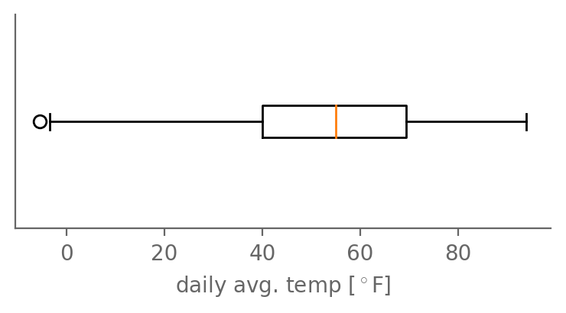
Box-and-whisker plots summarize the median, IQR, and outlier values of a dataset
Precisely what quantity the whiskers end at depends on the plot
Be sure to read the captions or legend carefully!
“flier”
1st quartile
(Q1)
Q3
median
IQR
Q1– 1.5*IQR
max

Slide 11
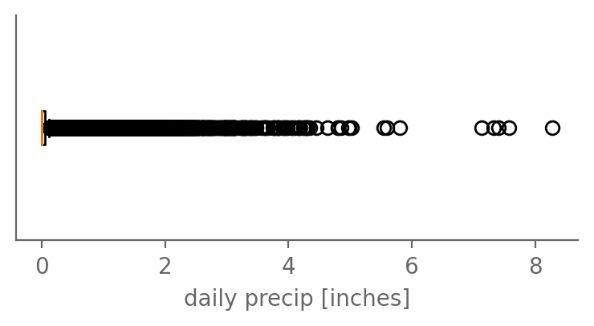
Box-and-whisker plots summarize the median, IQR, and outlier values of a dataset
But for long-tailed data like precip, not as helpful!

Slide 12
We’ve already seen timeseries: time as one axis, the values at each time as the other
Central Park daily average temperature: seasonality, likely warming trend, bad values at 0°F, etc.
Even though we also decided plots alone aren’t sufficient!

Slide 13
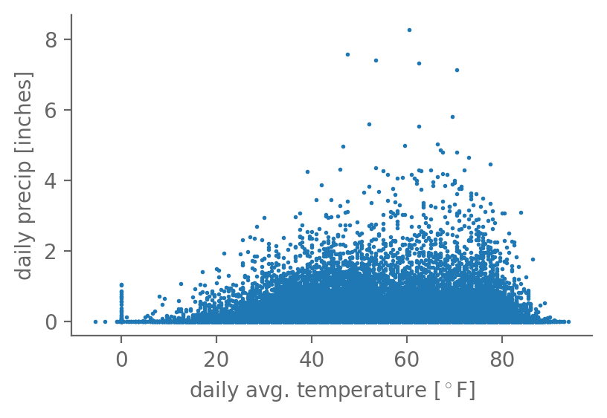
Timeseries are one type of scatterplot: quantity A on one axis; quantity B the other
Here’s the daily average temperature vs. precip:
Scatterplots help reveal relationships between two quantities

Slide 14
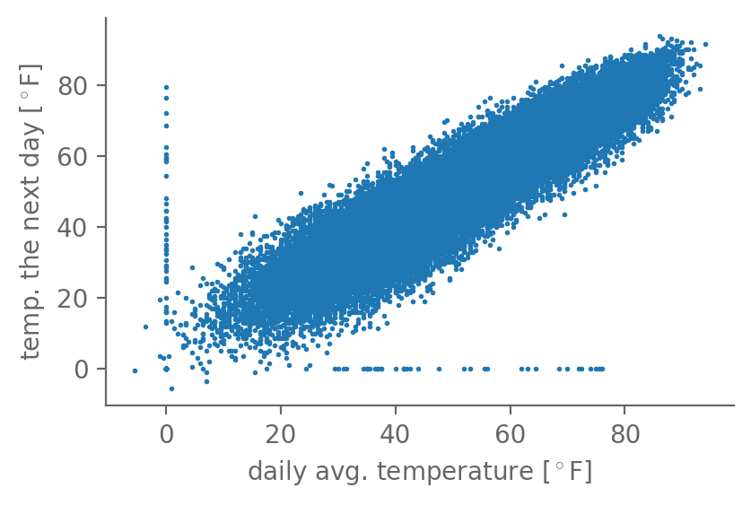
The less scatter, the tighter the relationship between the two quantities
Now, temperature on each day vs. the temperature on the next day
Very strong relationship! Intuitive: weather usually sticks around for a few days

Slide 15
The less scatter, the tighter the relationship between the two quantities
The bad values at 0°F really stick out: can be 80°F one day and go to 0°F the next
And vice versa
Further establishes that these are spurious
So let’s drop them

Slide 16

The less scatter, the tighter the relationship between the two quantities
The bad values at 0°F really stick out: can be 80°F one day and go to 0°F the next
And vice versa
Further establishes that these are spurious
So let’s drop them

Slide 17
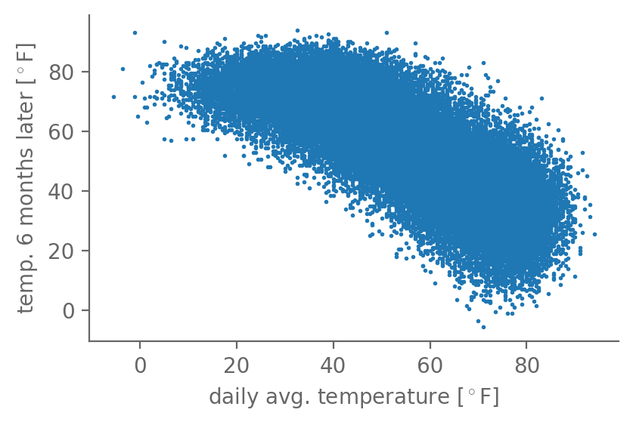
There can be strong positive relationship, or negative, or in between
Now, temperature each day vs. the temperature six months later
Strong (but less strong) negative relationship

Slide 18
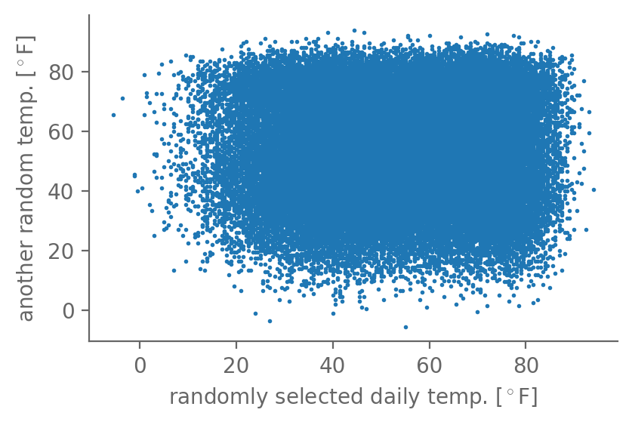
There can be strong positive relationship, or negative, or in between
Now, temperature from one randomly selected day vs. from another random day
No relationship!
We’ll quantify this all soon: correlation, covariance, linear regression

Slide 19
There can be strong positive relationship, or negative, or in between

Slide 20
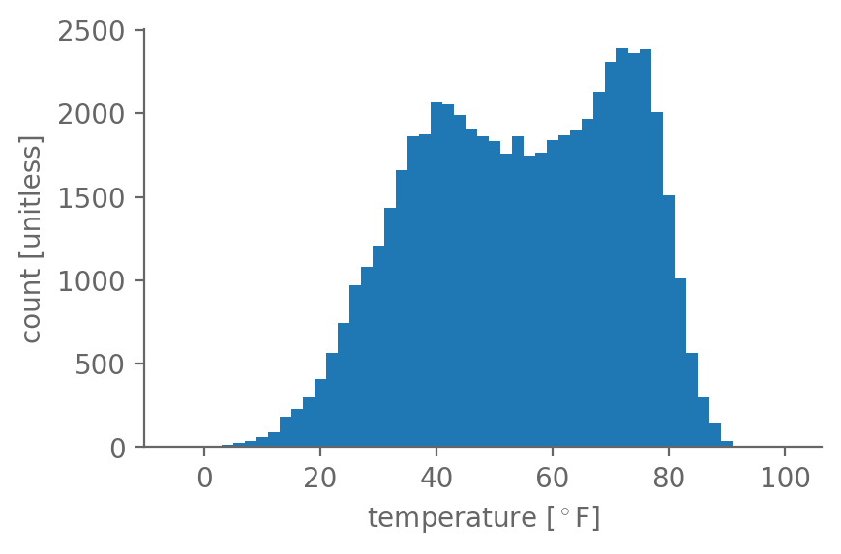
A histogram shows how many values fall into different bins from smallest to largest
In each bin, count how many values fell within its upper and lower bounds
Here: temperature, with bins [-5°F, -3°F), [-3°F, -1°F), …, [97°F, 99°F)
I.e. uniform 2°F bin width

Slide 21
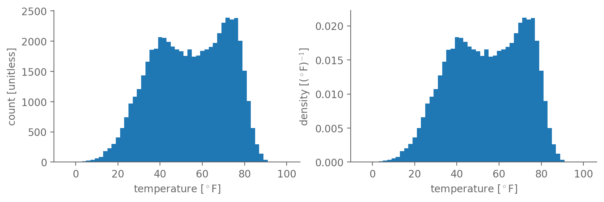
If you normalize by the width of each bin, this becomes a probability density
If all bins are equal size, simply divide the count in each bin by the total count

Slide 22
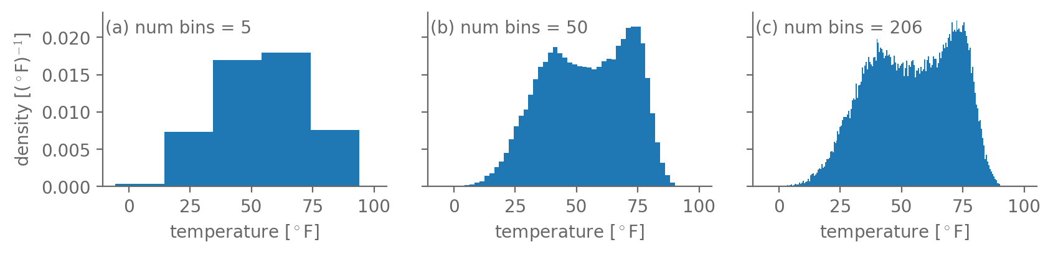
There is no single “right” bin size: balancing act b/w enough resolution vs. too much noise

Slide 23
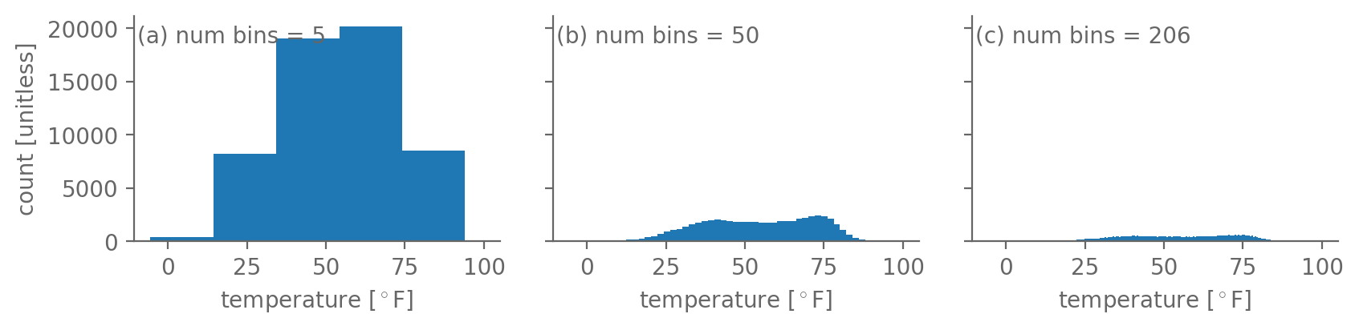
Plotting the density rather than raw count makes the values less sensitive to bin size
But not the shape! All bins just scaled up or down by same factor

Slide 24
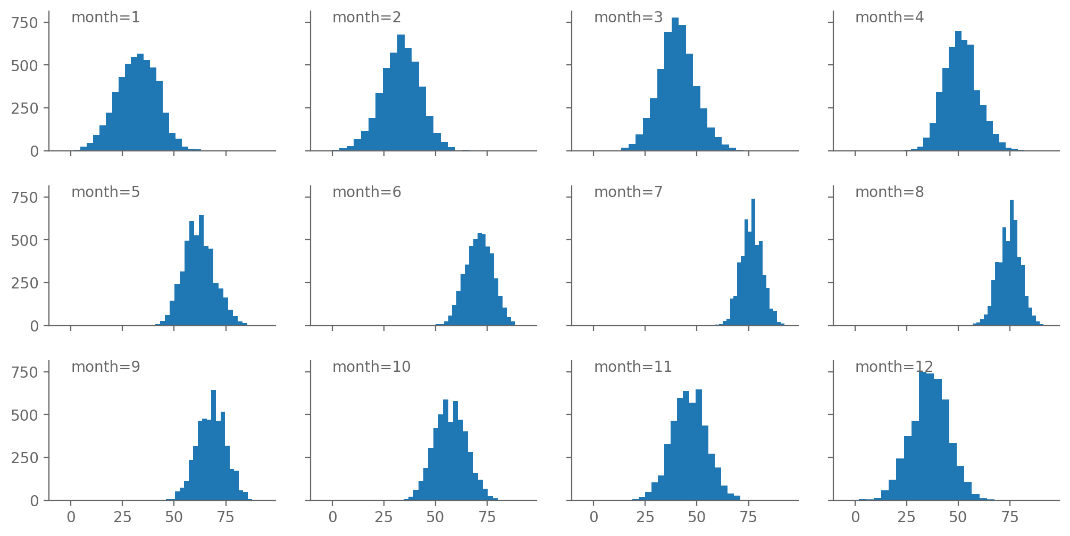
Why is the temperature histogram bimodal (i.e. has two peaks) rather than unimodal?

Slide 25
What we’re covering today:
Why a whole lecture on data visualization? ✅
Core plot types for 1D data: box-and-whiskers, timeseries, scatterplots, histograms ✅
Actually doing these in python: numpy, matplotlib, Jupyter

Slide 26

Jupyter notebooks are a powerful environment for quantitative data analysis
Interactive python session: can’t see plots, hard to do more complicated things, etc.
And python scripts: cumbersome for exploratory analyses to have to save script, run it, edit it, run it again, etc.
Enter Jupyter Notebooks: “computational documents”

Slide 27
Let’s all open a Jupyter notebook session right now
Q: What terminal command should we call to do this?
A: jupyter notebook

Slide 28
Jupyter is not part of the python standard library, so we had to install it with pip
The standard library = everything that’s directly builtin to python.
https://docs.python.org/3/library/index.html
This includes:
Everything we discussed in the Python bootcamp
Everything you can access via import X statements without having separately installed X

Slide 29
Jupyter is not part of the python standard library, so we had to install it with pip
Jupyter is not part of the standard library. It is a 3rd party package.
And any 3rd party package has to be installed separately
Fortunately, python has a very powerful builtin utility for installing these packages called pip
Short for “Pip Installs Packages” (a recursive acronym! 🤓)

Slide 30
Jupyter is not part of the python standard library, so we had to install it with pip
You run pip from the terminal:
pip install <package_name>
Not from an open python/ipython session
Replace <package_name> above with the actual name of the package you want to install
You should already have done this once:
pip install notebook

Slide 31
pip installs the desired package as well as any of its dependencies that are also missing
Almost every package uses things from other packages
To avoid reinventing the wheel; to build off what others do
So for a package to work, all the packages it calls have to be installed too: it depends on them
And all their dependencies have to be installed too, and so on

Slide 32
pip installs the desired package as well as any of its dependencies that are also missing
pip takes care of all of this! It searches the dependency tree, finds what’s missing, and installs all of it
And deals with more complicated things like Windows-specific packages, etc.
For more info: see the official docs: https://pypi.org/project/pip/
And from the terminal: pip --help

Slide 33
Let’s use pip now to install the other packages we need: numpy & matplotlib
But first, let’s see if they’re installed already! Q: what python code could we enter in our Jupyter notebook to check?
A: import numpy and import matplotlib
If nothing seems to happen, they’re installed!
If instead you get an ImportError, they’re not!

Slide 34
Let’s use pip now to install the other packages we need: numpy & matplotlib
Q: What are the commands to install these?
A: pip install numpy and pip install matplotlib,
OR pip install numpy matplotlib (can do multiple at once)

Slide 35

matplotlib is the most widely used plotting package in EAS & what we’ll use
Etymology: it mimics the plotting library from the MATLAB language, hence matplotlib
https://matplotlib.org/

Slide 36
matplotlib is the most widely used plotting package in EAS & what we’ll use
All of its stuff we need is within a submodule: matplotlib.pyplot
By convention, imported as:
from matplotlib import pyplot as plt
In programming, follow conventions unless you have a good reason not to! Makes it easier to share code, etc.

Slide 37
matplotlib supports all of the types of plots we’ll need (and many more)
The ones you’ll use most often:
plt.plot : line plot (good for timeseries)
plt.hist : histogram
plt.boxplot : box-and-whisker plot
plt.scatter : scatter plots

Slide 38
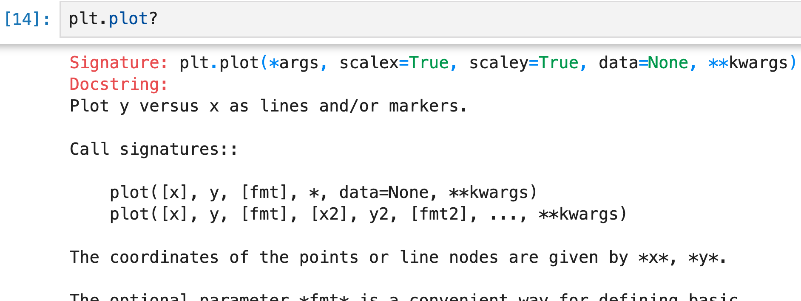
How do we use any of them? Jupyter will tell us if we just ask ☺
Type the name of any object followed by a question mark:

Slide 39
Start your notebook with the Jupyter magic command %matplotlib inline
It makes the plots that you create get automatically generated within the notebook
Might be on by default, but better to include it to be safe
There are many other Jupyter magic commands to explore
E.g. on Macs: %config InlineBackend.figure_format = "retina"

Slide 40

matplotlib works with lists, but for data analysis in general better to use numpy
“Powerful N-Dimensional Arrays”
https://numpy.org/

Slide 41
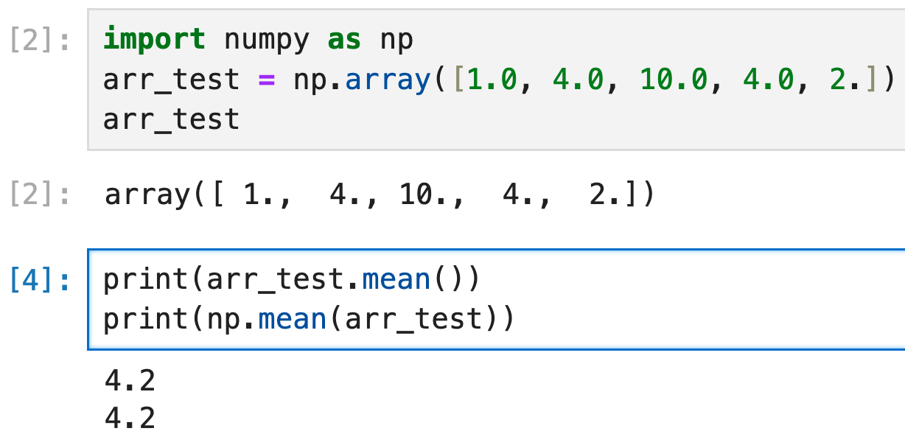
numpy provides an ndarray class that’s perfect for representing scientific datasets

Slide 42
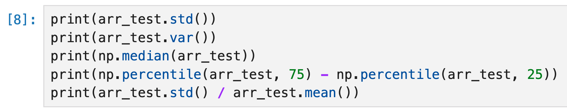
numpy provides an ndarray class that’s perfect for representing scientific datasets

Slide 43
To load a dataset that’s saved on disk into a numpy array, use the netCDF4 package
https://unidata.github.io/netcdf4-python/
Q: What command will install this package?
A: From a terminal session, pip install netCDF4

Slide 44
To load a dataset that’s saved on disk into a numpy array, use the netCDF4 package
”netCDF” is a file format that weather, climate, and other Earth scientists commonly use to store our data
https://www.unidata.ucar.edu/software/netcdf/
”Self-describing”: includes metadata (data about data) describing the data’s dimensions, coordinates, etc.
E.g. if it’s a function of latitude x longitude x time, and what the precise lat, lon, and time values are

Slide 45
To load a dataset that’s saved on disk into a numpy array, use the netCDF4 package
The netCDF4 package enables you to load netCDF files (ending in .nc) into numpy arrays
Such as the Central Park weather station data!
For data stored in Excel spreadsheets or CSV (comma separated values): use the pandas library
We’ll return to pandas later in the course

Slide 46
Specifically, use the Dataset class that the netCDF4 package provides
Q: What Python commands enable us to use Dataset? (Assume we haven’t imported anything yet)
A: from netCDF4 import Dataset then Dataset(…)
or
import netCDF4 then netCDF4.Dataset(…)
or
import netCDF4.Dataset then netCDF4.Dataset(…)

Slide 47
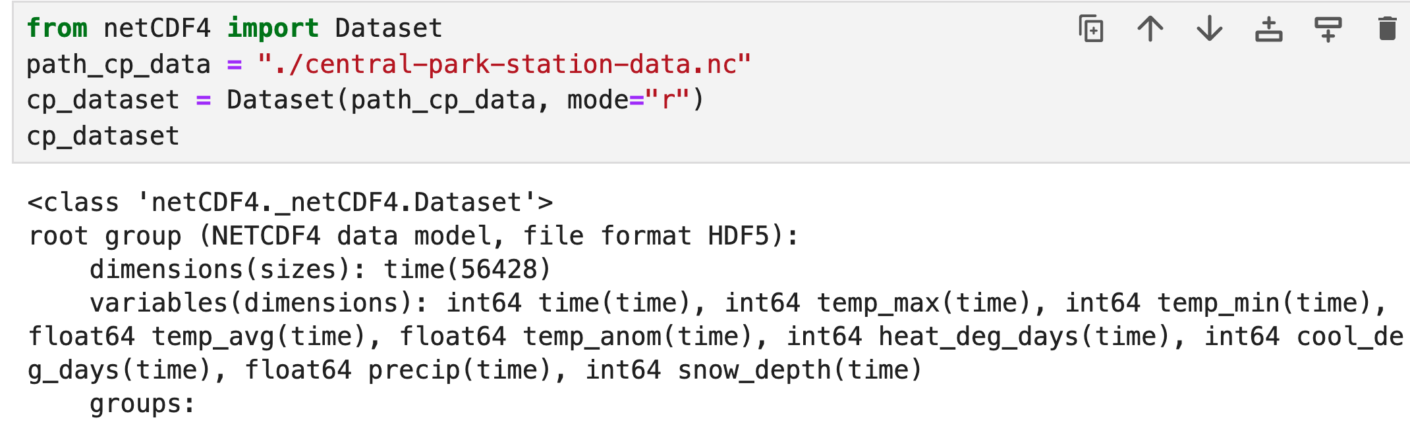
Specifically, use the Dataset class that the netCDF4 package provides
Once you’ve loaded the file into a Dataset, you can access each of its variables like you would the values in a dict:

Slide 48
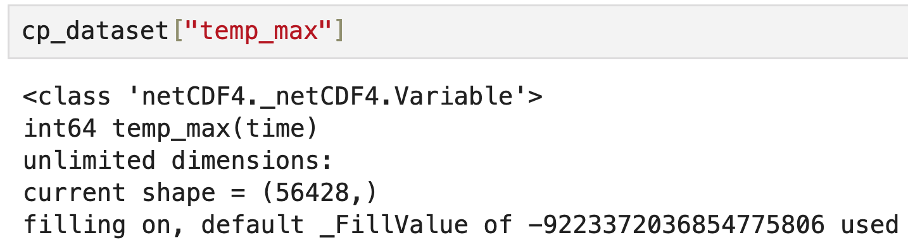
Specifically, use the Dataset class that the netCDF4 package provides
Once you’ve loaded the file into a Dataset, you can access each of its variables like you would the values in a dict:

Slide 49
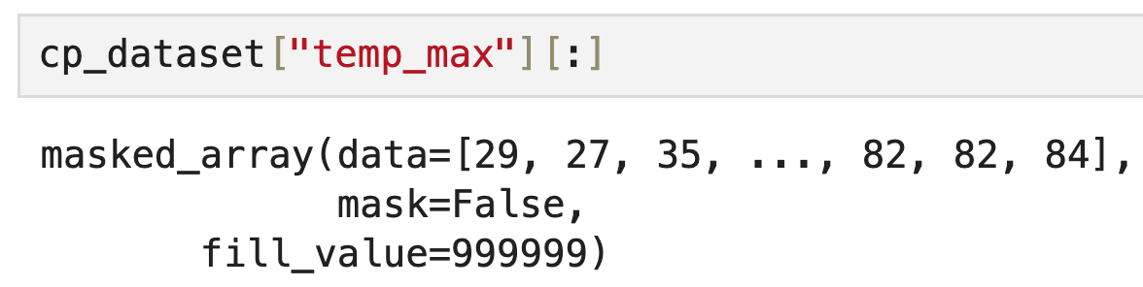
Specifically, use the Dataset class that the netCDF4 package provides
Add [:] at the end to get the underlying numpy array:

Slide 50
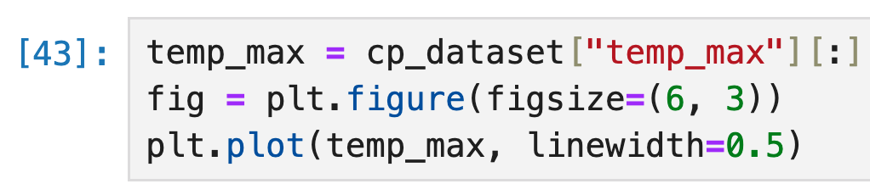
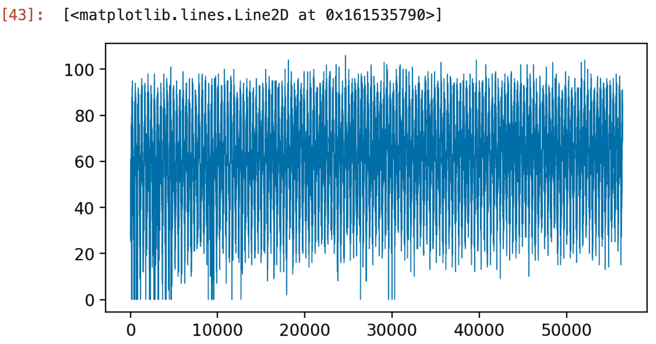
Then you can analyze / plot / etc. it just like you would any numpy array

Slide 51
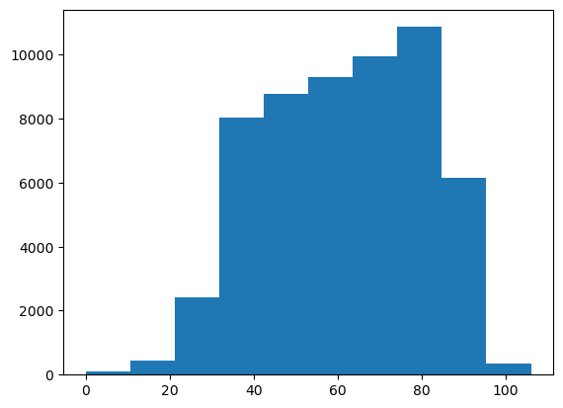
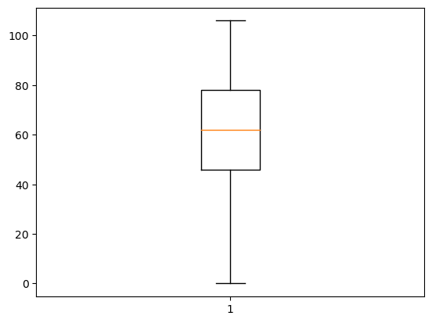
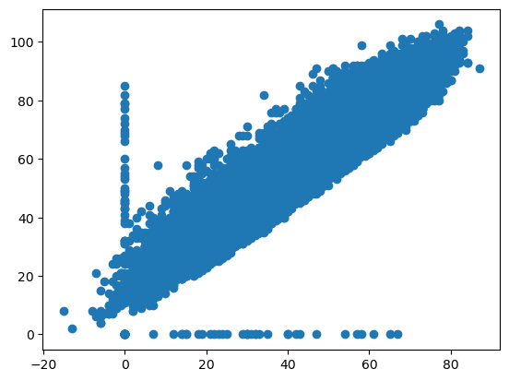
Then you can analyze / plot / etc. it just like you would any numpy array
Min temp vs. max temp

Slide 52
But notice: no nice axis labels, etc. like the plots shown previously: enter xarray
Next time ☺

