Slide 1
Linear regression
EAS 42000 / A4200

Slide 2
How can we use information about one variable to model another variable?
If X and Y are independent, there’s no hope
Recall: independent = knowing one provides no info about other
But otherwise, there is potential to use one to skillfully estimate values of the other
Today: by regressing the values of Y onto those of X
Why might that be useful? At least 2 key reasons.

Slide 3
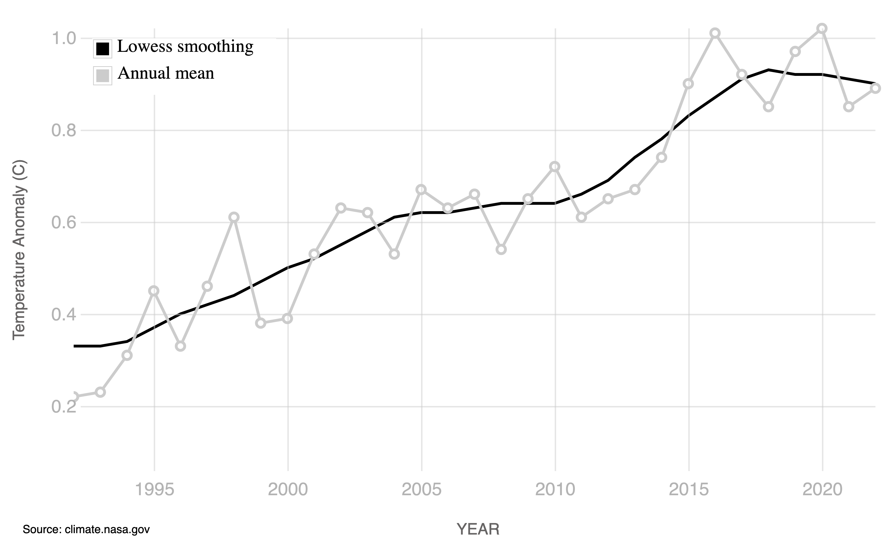
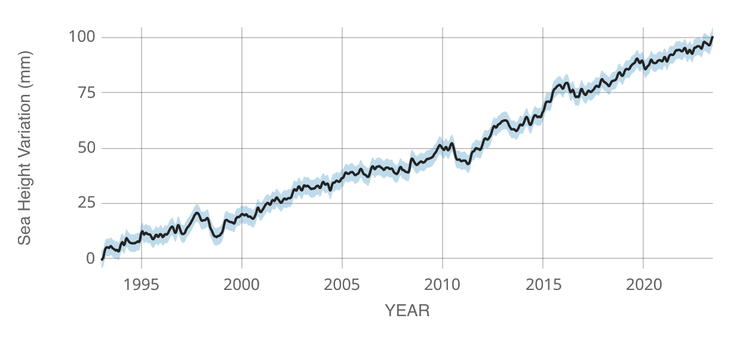
Quantifying the relationship b/w two variables improves our physical understanding
temperature
sea level
https://climate.nasa.gov/vital-signs/global-temperature/
https://sealevel.nasa.gov/understanding-sea-level/key-indicators/global-mean-sea-level/

Slide 4
Quantifying the relationship b/w two variables improves our physical understanding
It looks like global means of surface temperature and sea level have a tight linear relationship over past 30 years
This very likely means there is some physical process (or multiple) that directly links the two
In this case: thermal expansion of water; melting of land ice

Slide 5
A model for Y in terms of X enables us to predict Y out-of-sample
For example, suppose we predict temperatures to follow the red line…
temperature

Slide 6
A model for Y in terms of X enables us to predict Y out-of-sample
…we can then use that to predict sea level
assuming the relationship b/w X and Y stays the same
sea level

Slide 7
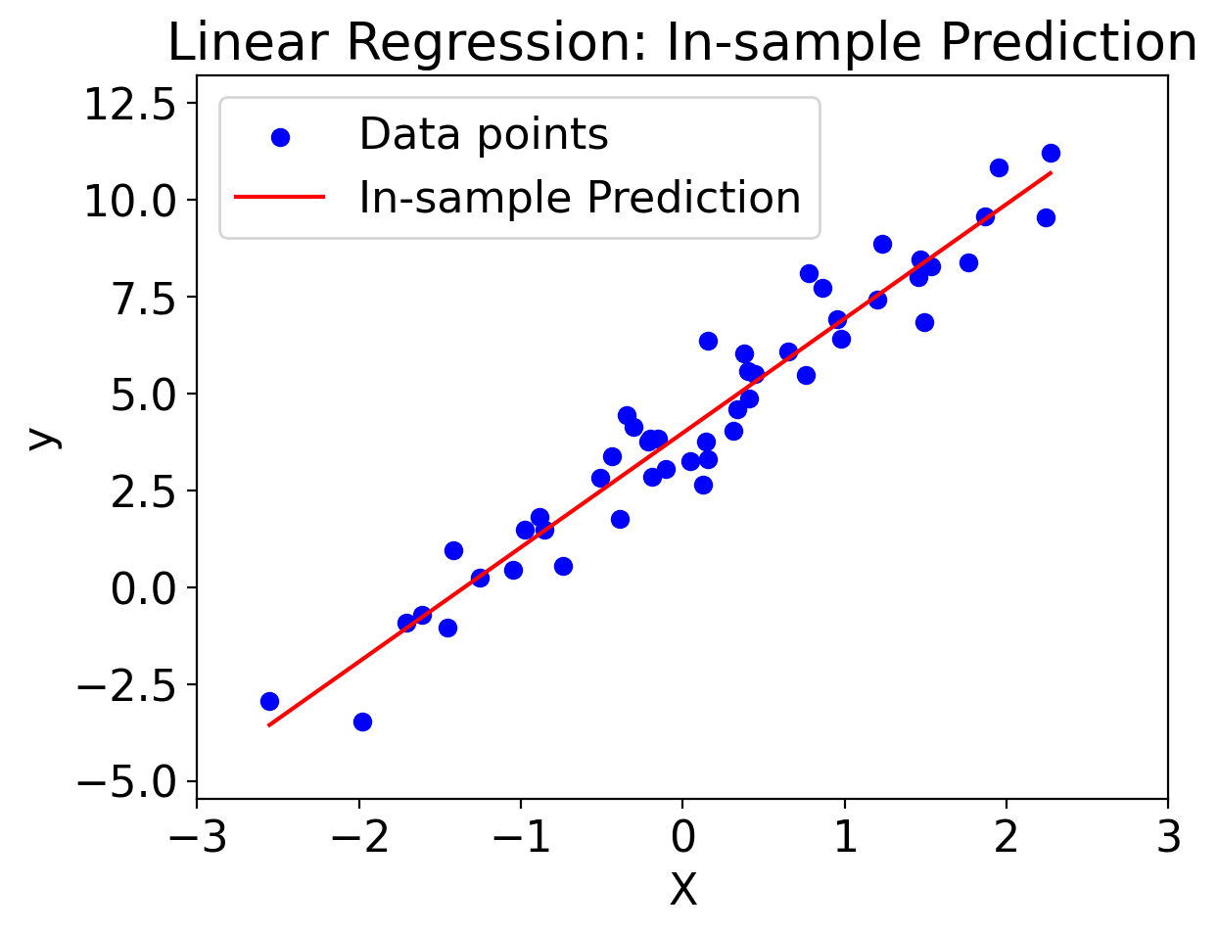
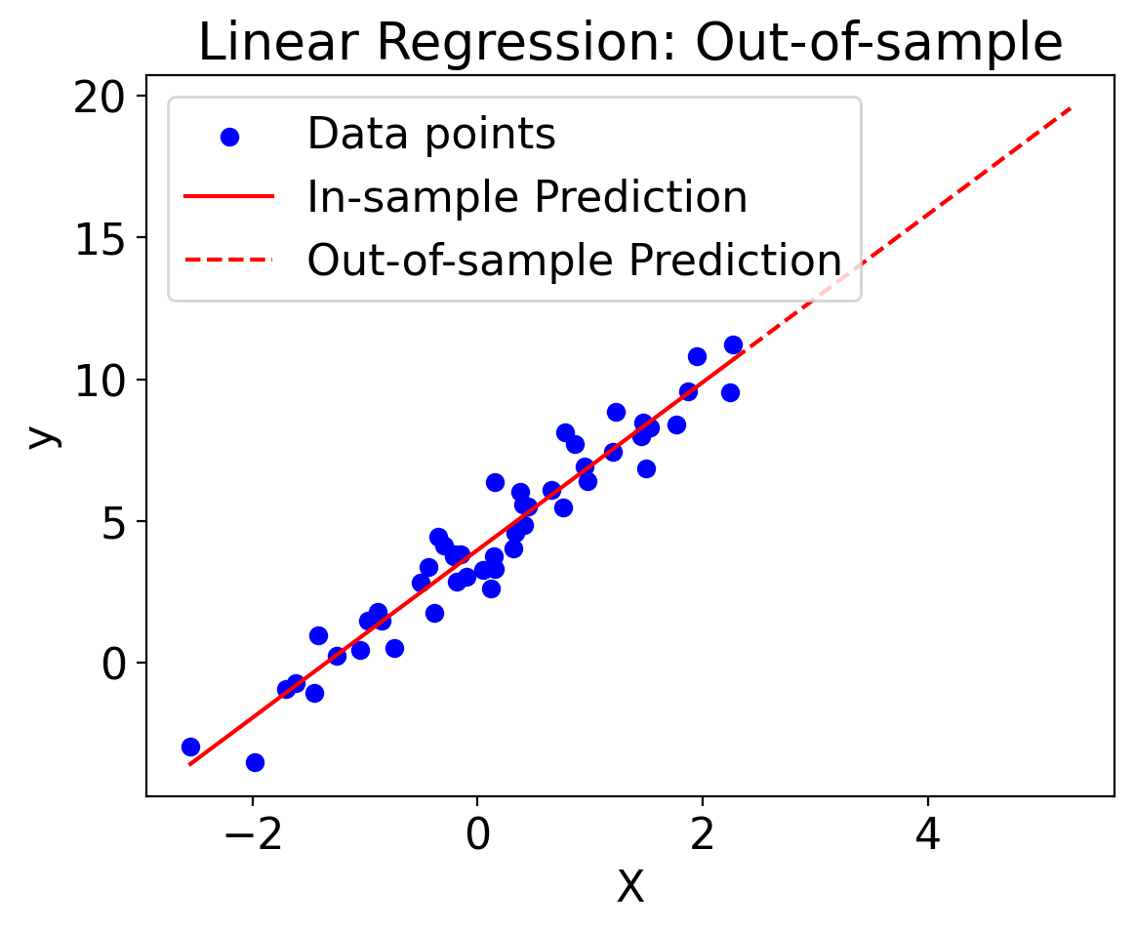
A model for Y in terms of X enables us to predict Y out-of-sample

Slide 8
Perhaps the key way of doing this statistically is via linear regression

Slide 9
Linear regression
Covariance
Correlation
Linear regression

Slide 10
Linear regression
Covariance
Correlation
Linear regression

Slide 11
Covariance measures the joint linear variability between two random variables
Positive covariance: X and Y tend to move in same direction
If X increases, so does Y. If X decreases, so does Y.
Negative covariance: X and Y tend to move in opposite directions
If X increases, Y decreases. If X decreases, Y increases.
Zero covariance: no linear relationship between X and Y
Whether X increases/decreases tells nothing about what Y does

Slide 12
Covariance measures the joint linear variability between two random variables
Formal definition of sample covariance:
Conceptually: sum from first to last value of (the product of (the deviations of that value for each variable from its respective mean))

Slide 13
Question: what is the covariance of a variable with itself?
Set Y=X and simplify. What do you get?

Slide 14
Answer: variance is a special case of covariance: the covariance of a variable with itself

Slide 15
Covariance increases in magnitude as magnitude of variations in either variable increases
If X unchanged and Y variations increase, Cov(X,Y) increases
And vice versa
Q: What are the units of Cov(X, Y)?
A: units of X times units of Y

Slide 16
In python, there are several implementations of covariance to choose from
numpy: numpy.cov
https://numpy.org/doc/stable/reference/generated/numpy.cov.html
scipy: scipy.stats.Covariance
https://docs.scipy.org/doc/scipy/reference/generated/scipy.stats.Covariance.html
xarray: xarray.cov (automatically handles masked (NaN) values)
https://docs.xarray.dev/en/stable/generated/xarray.cov.html
pandas: pandas.DataFrame.cov and pandas.Series.cov
https://pandas.pydata.org/pandas-docs/stable/reference/api/pandas.DataFrame.cov.html
https://pandas.pydata.org/pandas-docs/stable/reference/api/pandas.Series.cov.html

Slide 17
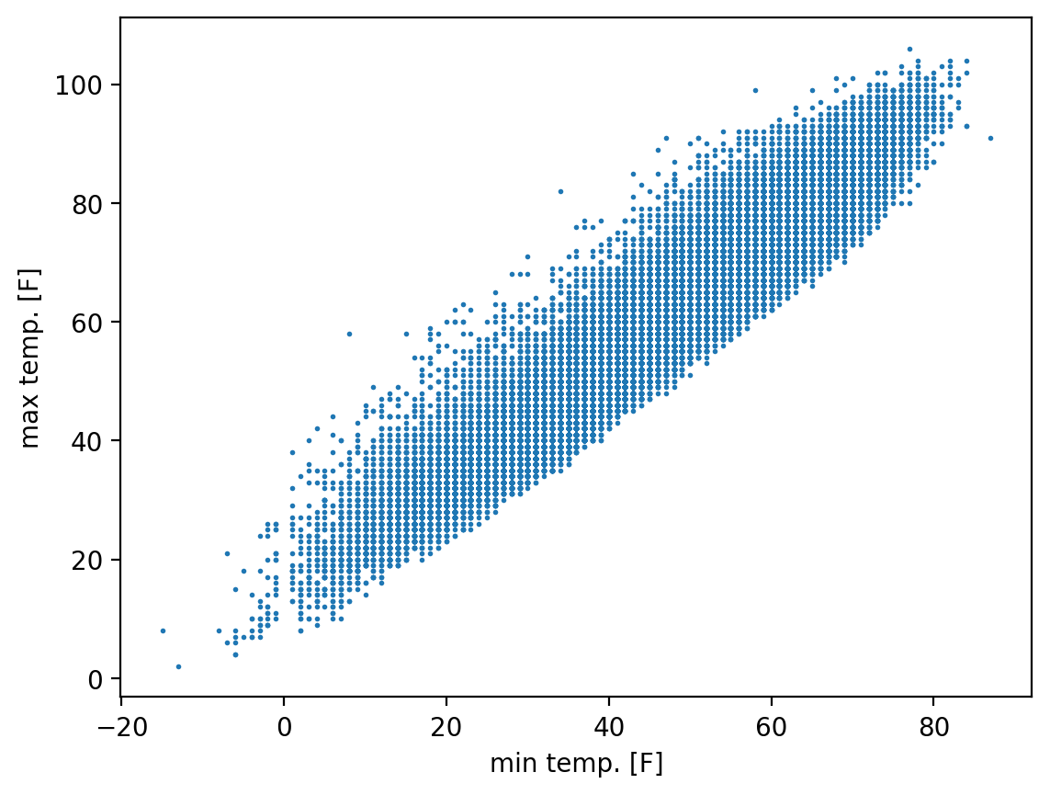
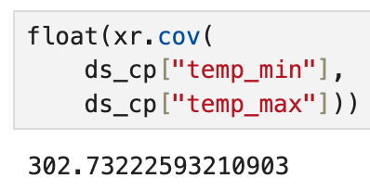
An example covariance computed from our Central Park dataset

Slide 18
Linear Regression
Covariance ✅
Correlation
Linear regression

Slide 19
Correlation provides a nondimensional measure of how two variables co-vary
Tells both the strength and sign of the relationship
Just like covariance
But unlike covariance, doesn’t depend on magnitude of the individual variations in either variable
How much one variable changes as the other changes is normalized by some measure of how each changes individually

Slide 20
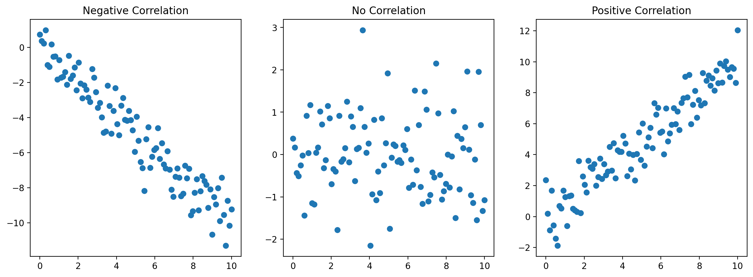
Correlation provides a nondimensional measure of how two variables co-vary

Slide 21
Pearson correlation coefficient quantifies the linear relationship between two variables
Returns a value between -1 and 1:
-1: perfect negative linear relationship,
+1: perfect positive linear relationship
0: no linear relationship
Denoted r(x, y): correlation coefficient of x and y
Symmetric in x and y: r(x, y) = r(y, x)
Dimensionless: can always directly compare r values

Slide 22
Pearson correlation coefficient quantifies the linear relationship between two variables
Looks complicated…let’s walk through it.

Slide 23
Pearson correlation coefficient quantifies the linear relationship between two variables
Multiply top and bottom by 1 / (N-1). What then is numerator?

Slide 24
Pearson correlation coefficient quantifies the linear relationship between two variables
Covariance!

Slide 25
Pearson correlation coefficient quantifies the linear relationship between two variables
Next, bring 1 / (N-1) in denominator under the square root.
What now is the denominator?

Slide 26
Pearson correlation coefficient quantifies the linear relationship between two variables
Hint: split the square root operator…

Slide 27
So r = covariance of x and y divided by product of their standard deviations

Slide 28
In python, there are many implementations of Pearson’s r to choose from
numpy: numpy.corrcoef
https://numpy.org/doc/stable/reference/generated/numpy.corrcoef.html
scipy: scipy.stats.pearsonr
https://docs.scipy.org/doc/scipy/reference/generated/scipy.stats.pearsonr.html
xarray: xarray.corr
https://docs.xarray.dev/en/stable/generated/xarray.corr.html
pandas: pandas.DataFrame.corr and pandas.Series.corr
https://pandas.pydata.org/pandas-docs/stable/reference/api/pandas.DataFrame.corr.html
https://pandas.pydata.org/pandas-docs/stable/reference/api/pandas.Series.corr.html

Slide 29
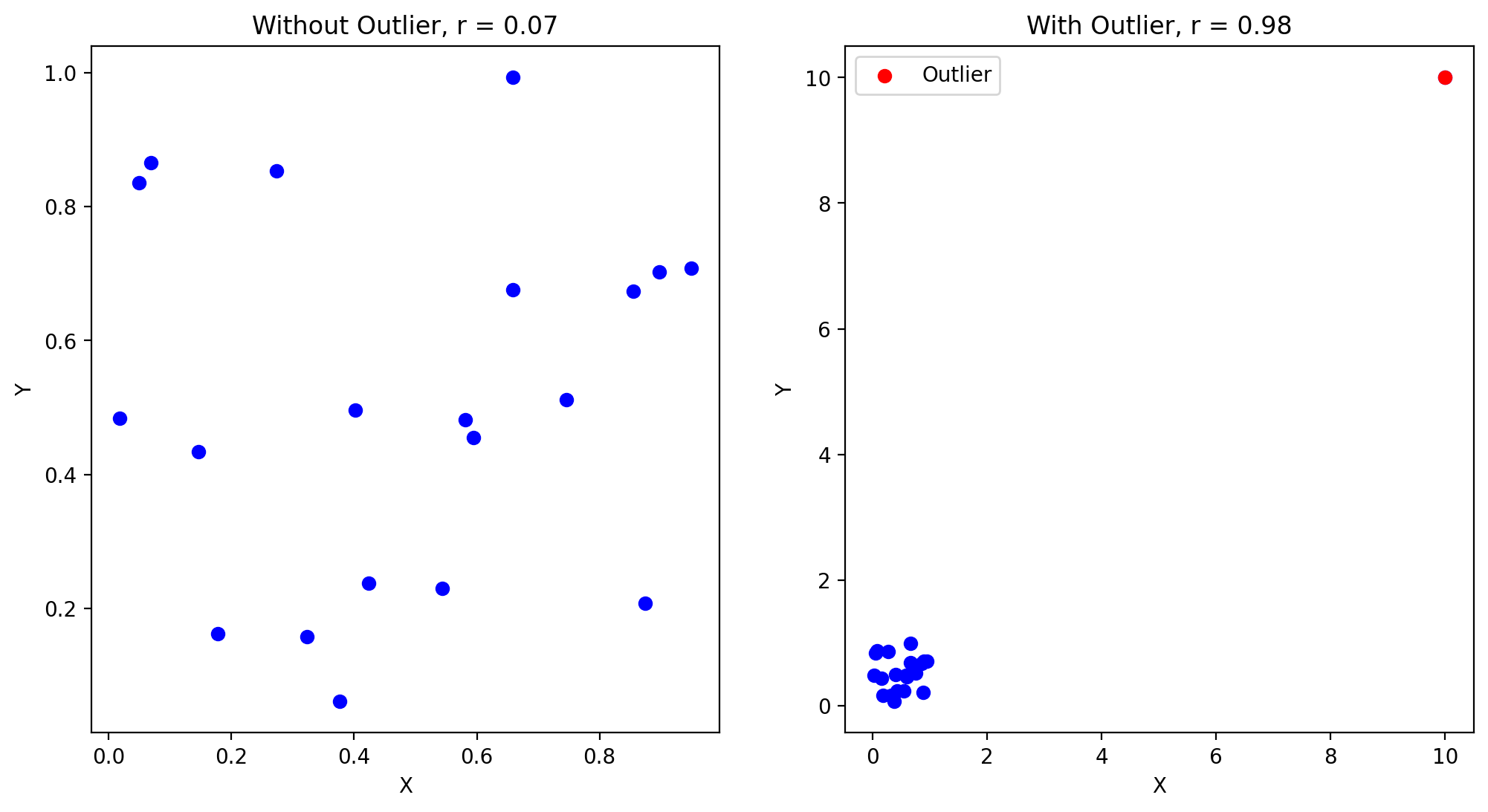
Pearson r is sensitive to outliers

Slide 30
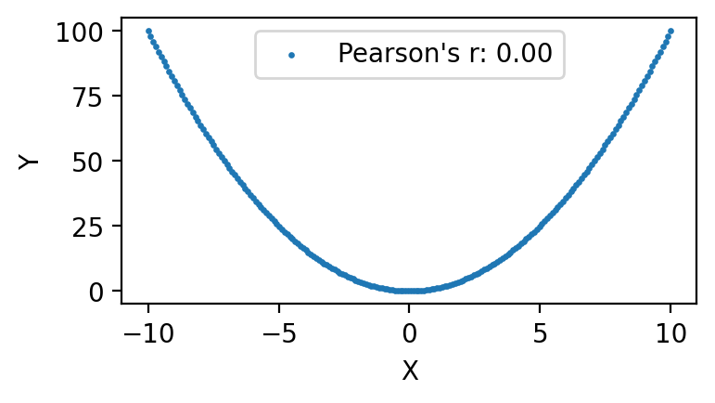
Pearson correlation coefficient will be misleading for nonlinearly related variables
y=x²

Slide 31
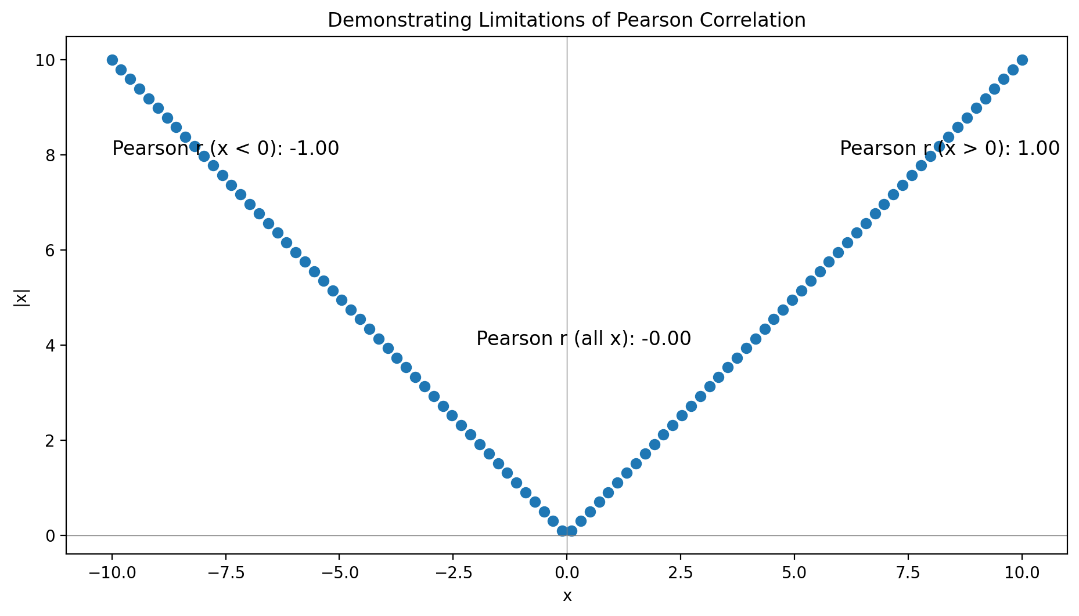
Pearson correlation coefficient will be misleading for nonmonotic relationships
y=|x|

Slide 32
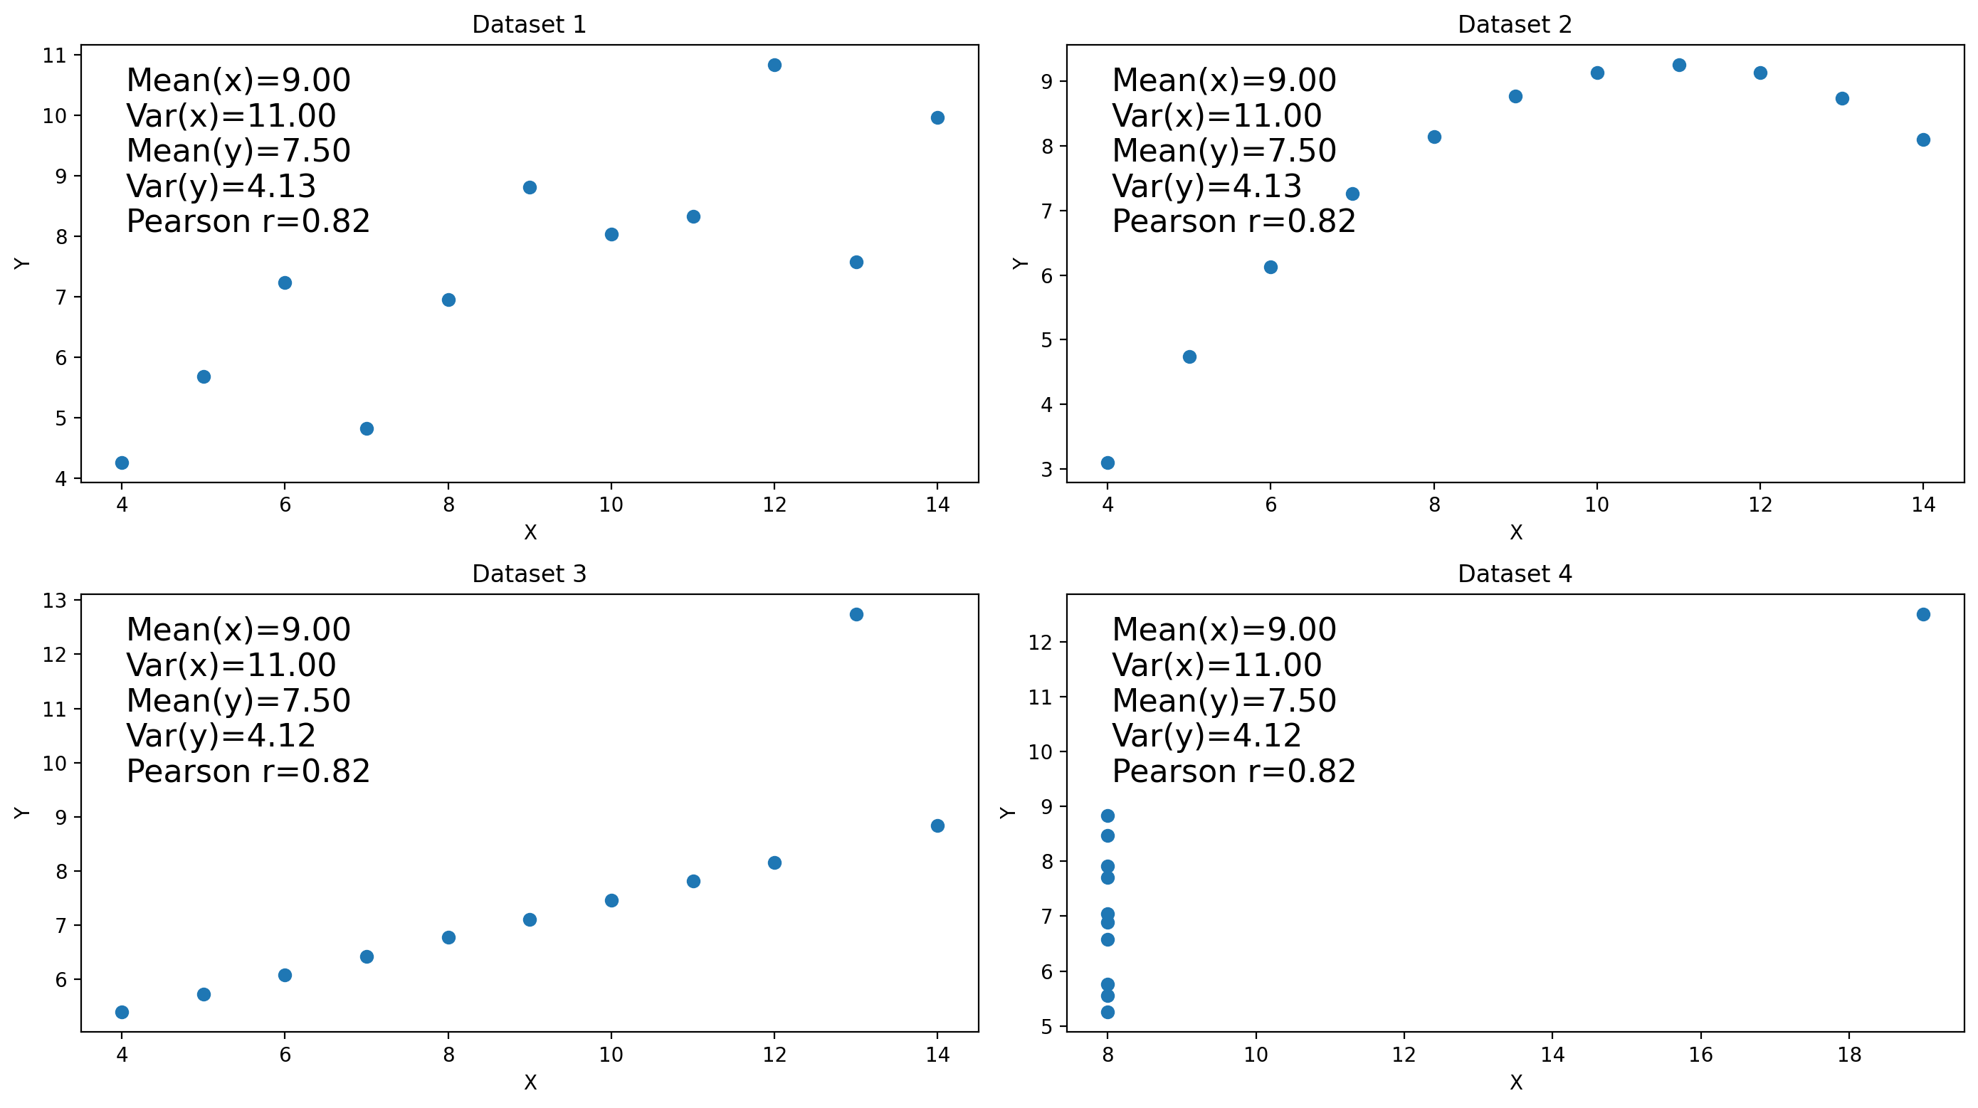
Anscombe’s quartet: identical means, variances, corr. coeffs. And yet…

Slide 34
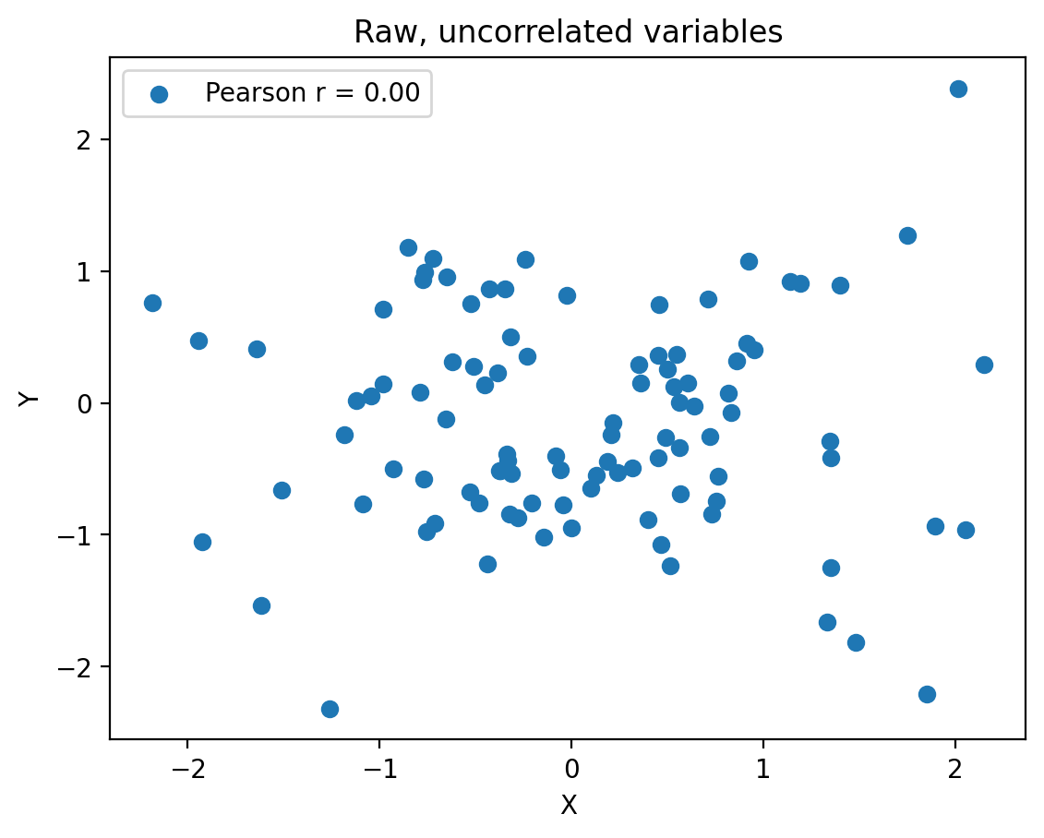
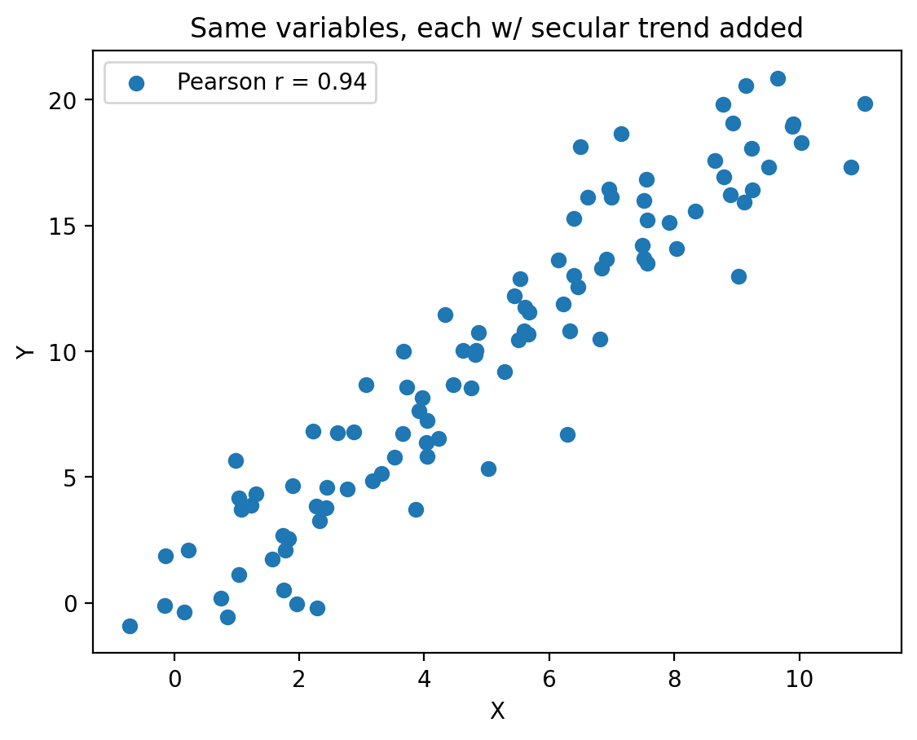
Pearson correlation coefficient interpretation tricky for data w/ secular trends

Slide 35
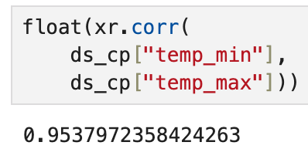
An example Pearson correlation computed from our Central Park dataset

Slide 36
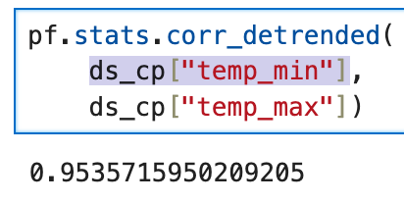
…but isn’t there a secular trend?

Slide 37
…yes, but this is very small compared to seasonal cycle

Slide 38
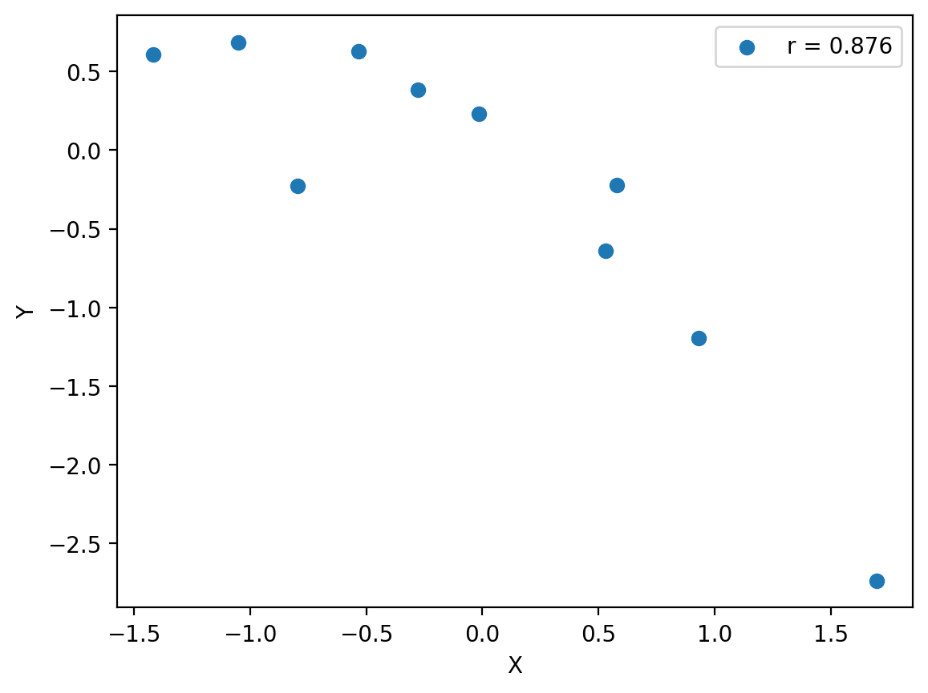
Correlation does not imply causation: it could be due to random chance
Plot: two independent samples w/ N=10, from a Gaussian, compute their correlation, repeat 100x, pick largest magnitude one
Becomes less likely as sample size increases

Slide 39
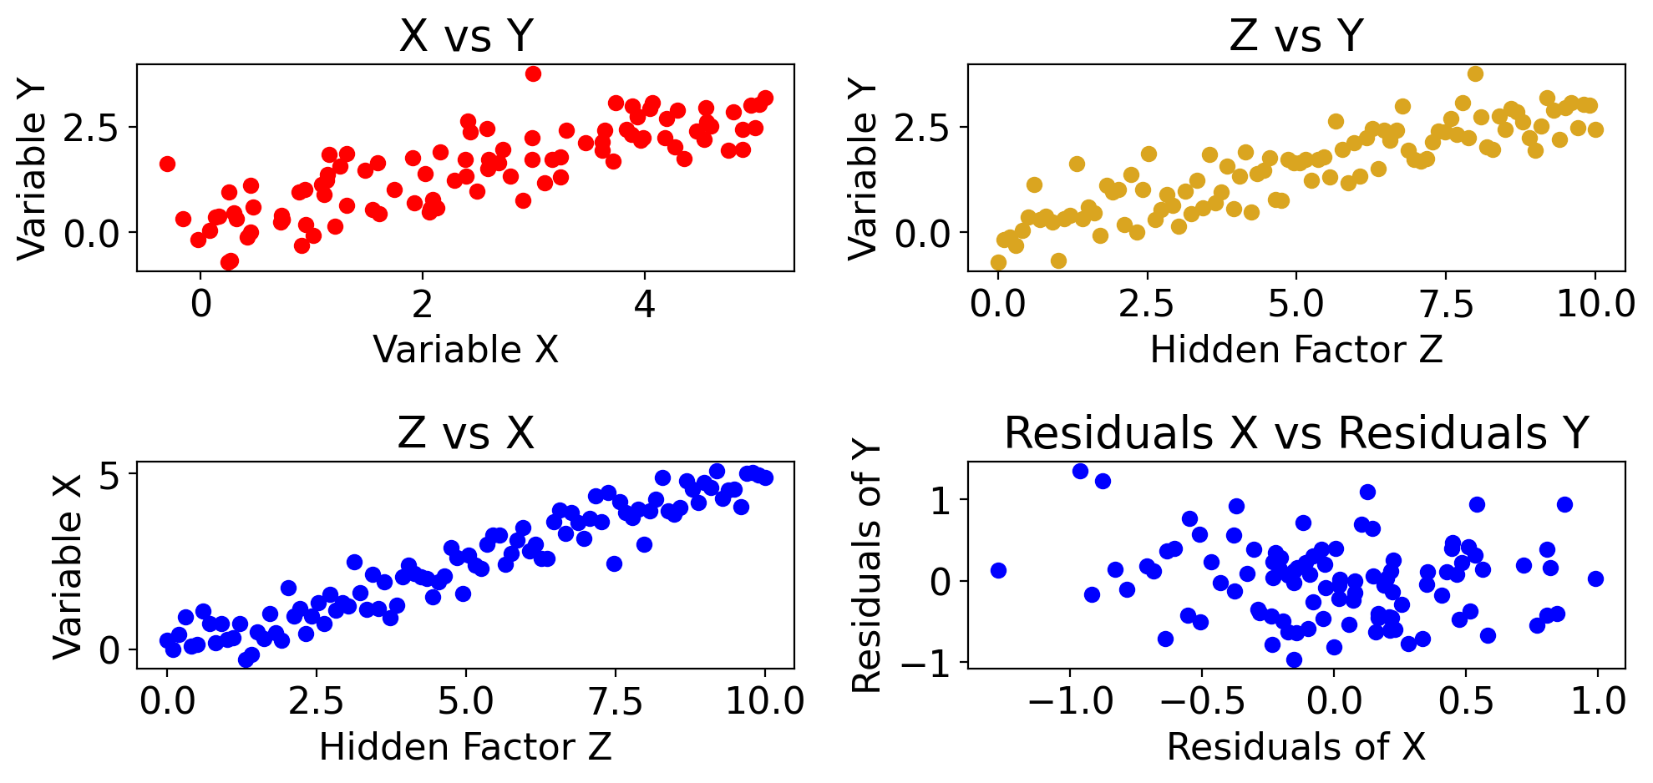
Correlation does not imply causation:

Slide 40
Correlation does not imply causation: a 3rd variable could be the cause

Slide 41
Other correlation coefficients exist, but we won’t go into them in any detail
For example, Spearman’s rank correlation, Kendall’s tau
You should know what Pearson’s correlation is conceptually and in its formal definition

Slide 42
Spearman’s rank coefficient is a nonlinear measure of relationship b/w two variables
Like Pearson, returns values from -1 to 1
With same meanings: -1 = perfect negative, etc.
Based on the rank of the values in each variable
Rank:
Sort the whole array from lowest to highest
Lowest value gets rank=1, 2nd lowest gets 2, etc.

Slide 43
Linear Regression
Covariance ✅
Correlation ✅
Linear regression

Slide 44
Linear regression uses the covariance of X and Y to model Y given the values of X
Y is the dependent variable
I.e. the one we’re trying to predict/model (“predictand”)
X is the independent variable
I.e. the one we are using to model Y (“predictor”)
For now: single linear regression, meaning only one X
Later: multiple linear regression: X1, X2, etc.

Slide 45
Linear regression uses the covariance of X and Y to model Y given the values of X
Using the word “model” to mean that, from knowledge of X, we generate estimates of the corresponding values of Y
Often “predict” is used in this context: predict Y given X, but be aware that linear regression doesn’t just refer to timeseries
E.g. you could have regression model of time-mean precipitation vs. column water vapor in space

Slide 46
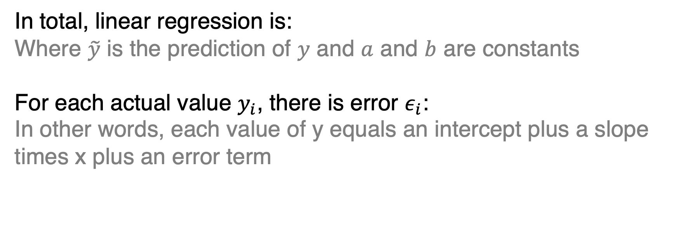
Linear regression uses the covariance of X and Y to model Y given the values of X
In total, linear regression is:
Where $\tilde{y}$ is the prediction of $y$ and $a$ and $b$ are constants
For each actual value $y_{i}$, there is error $ε_{i}$:
In other words, each value of y equals an intercept plus a slope times x plus an error term

Slide 47
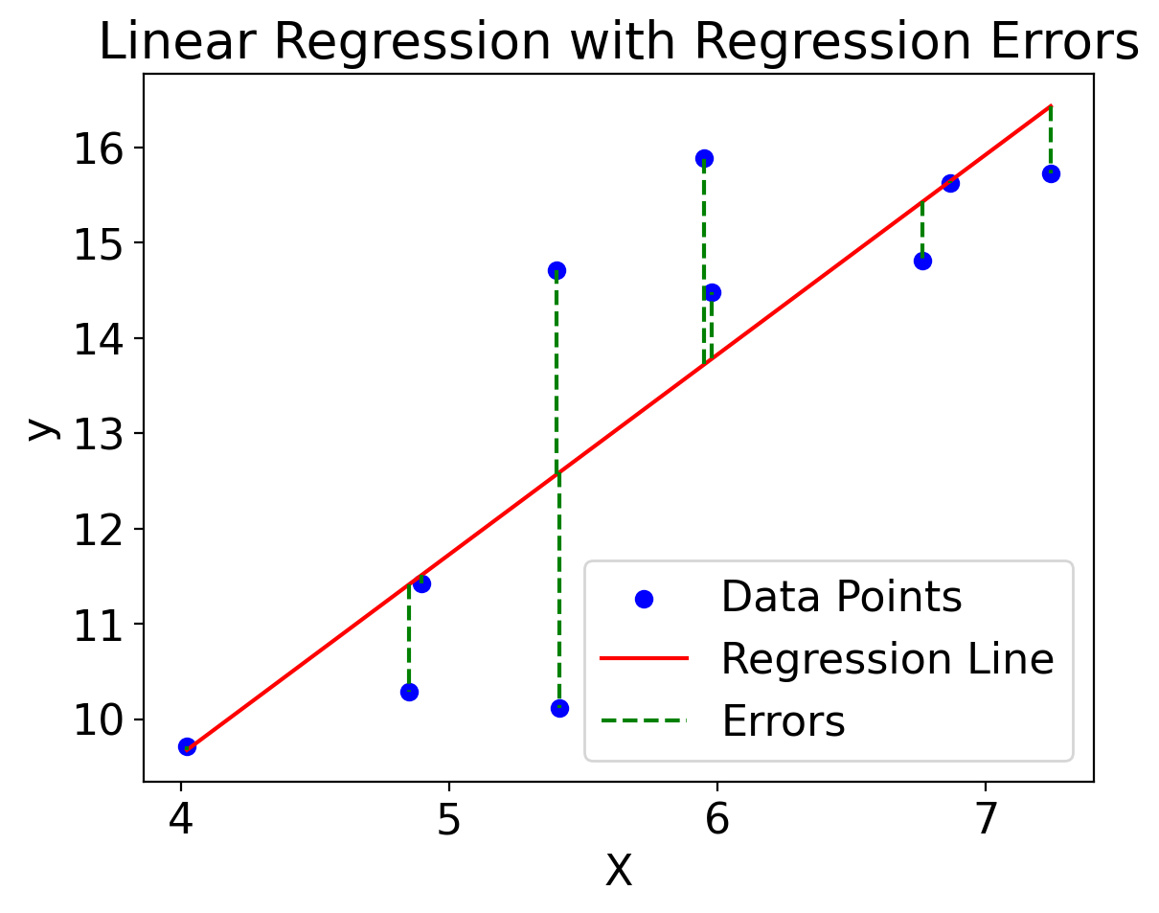
Each true value of y equals an intercept plus a slope times x plus an error term

Slide 48
Linear regression minimizes mean squared error between the predicted and actual Y
Mean squared error (MSE) definition:
As such, known as least squares regression
Short for “least possible value of mean squared error”

Slide 49
Linear regression minimizes mean squared error between the predicted and actual Y
Conceptually: square the length of each dashed line, and sum them
The least squares solution is the solid line such that this sum is the smallest it can possibly be

Slide 50
How to minimize the mean squared error? First, algebra (2 equations for 2 unknowns)
For a given sample (i.e. given values of all x_{i} and corresponding values y_{i} ), we have two unknowns: a and b
So we need two independent equations in terms of a and b, which we can then solve for a and b

Slide 51
How to minimize the mean squared error? Second, calculus!
For a given sample (X, Y), the MSE of a linear regression is a function of the regression slope a and intercept b:
Recall from calculus: at an extremum (=min or max) of a function, what is the value of all its partial derivatives?
Zero!

Slide 52
How to minimize the mean squared error? Second, calculus!
So we need and
Recalling that

Slide 53
How to minimize the mean squared error? Second, calculus!
These partial derivatives are

Slide 54
How to minimize the mean squared error? Third, more algebra!
Set them equal to 0:
Proceed similarly for a, then combine the two and solve

Slide 55
How to minimize the mean squared error? Third, more algebra!
Ultimately, arrive at following simple expressions in terms of quantities we’re already familiar with:
I.e. the least squares solution slope = sample covariance of X and Y divided by sample variance of X

Slide 56
How to minimize the mean squared error? Third, more algebra!
Ultimately, arrive at following simple expressions in terms of quantities we’re already familiar with:
I.e. the least squares solution y intercept = sample mean of Y minus a times sample mean of X

Slide 57
<interactive plot of mean squared error>
We can create “alternative” regression lines with arbitrary a and b values
No matter what those values, the MSE will be higher than that of the true least squares solution!
The preceding derivation ensures that’s always true; but it can be useful to try (and fail) to “break” it

Slide 58
In python, there are several implementations of linear regression to choose from
numpy.polyfit https://numpy.org/doc/stable/reference/generated/numpy.polyfit.html
scipy.stats.linregress
https://docs.scipy.org/doc/scipy/reference/generated/scipy.stats.linregress.html
scikit-learn: https://scikit-learn.org/sable/modules/generated/sklearn.linear_model.LinearRegression.html

Slide 59
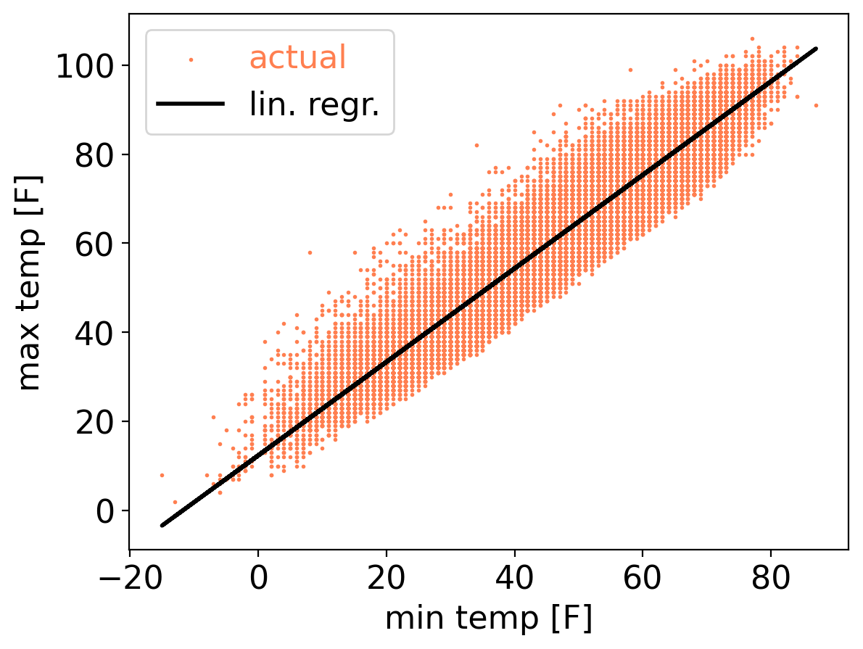
Using any of these, for Central Park daily max temp regressed on min temp:

