Slide 1
Data Visualization
EAS 42000/A4200
9/29/2025
Lab 02
Prof. Spencer Hill

Slide 2
What we’re covering today:
Why a whole class on data visualization?
Core plot types for 1D data: box-and-whiskers, timeseries, scatterplots, histograms

Slide 3
What we’re covering today:
Why a whole class on data visualization?
Core plot types for 1D data: box-and-whiskers, timeseries, scatterplots, histograms

Slide 4
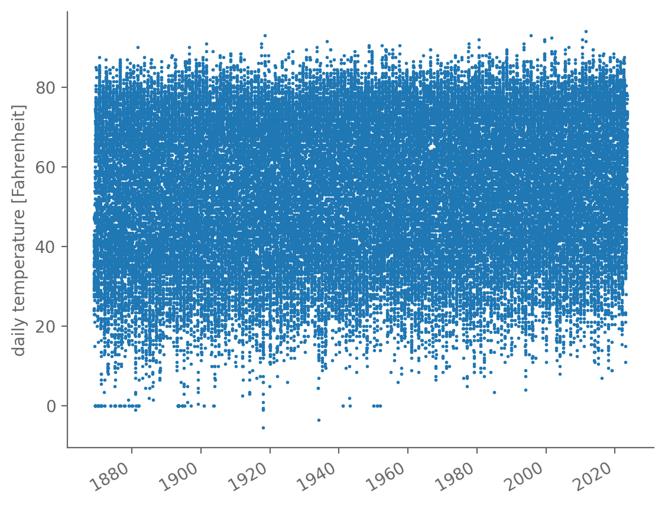
Already, we saw that a single plot can give us a lot of information
Central Park daily average temperature: seasonality, likely warming trend, bad values at 0°F, etc.
Even though we also decided plots alone aren’t sufficient!

Slide 5
Different kinds of plots can provide different key pieces of information
These timeseries plots are great for examining how the dataset varies with time, but that’s not the whole story!
We might want to summarize the overall range of values across all times in a succinct way: box-and-whisker plot

Slide 6
Different kinds of plots can provide different key pieces of information
We might want to see how closely the behavior of one variable is related to another: scatterplot
Or see graphically the ranges of values where the dataset has lots of values vs. few values: histogram

Slide 7
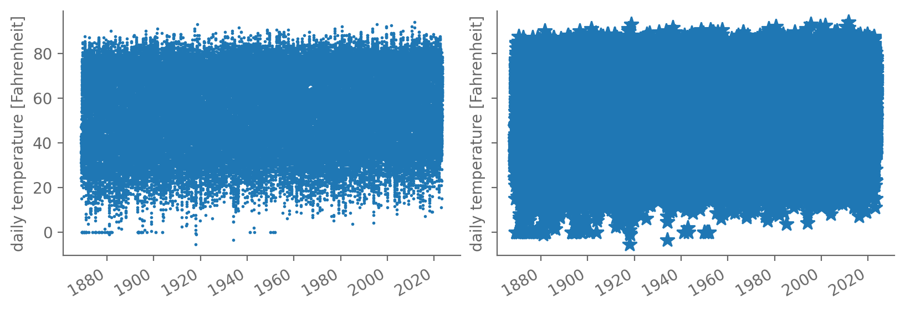
For a given plot, different choices can either clarify or obscure the underlying behaviors
Some of these are obvious (see below), but others aren’t

Slide 8
Plots (histograms especially) provide a conceptual bridge into probability theory
In essence, a histogram is a way of approximating the probability density function (PDF) of a distribution
And PDFs are the beating heart of statistics!
That makes histograms a nice segue into probability theory
Which we’ll cover next time

Slide 9
What we’re covering today:
Why a whole class on data visualization? ✅
Core plot types for 1D data: box-and-whiskers, timeseries, scatterplots, histograms

Slide 10
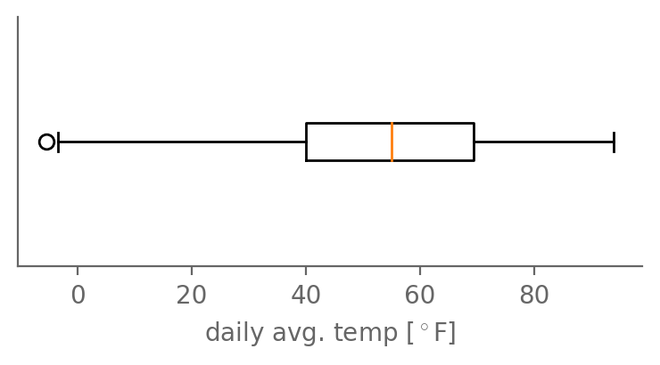
Box-and-whisker plots summarize the median, IQR, and outlier values of a dataset
Precisely what quantity the whiskers end at depends on the plot
Be sure to read the captions or legend carefully!
“flier”
1st quartile
(Q1)
Q3
median
IQR
Q1– 1.5*IQR
max

Slide 11
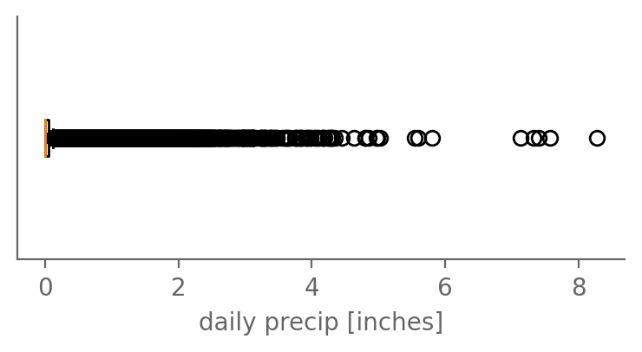
Box-and-whisker plots summarize the median, IQR, and outlier values of a dataset
But for long-tailed data like precip, not as helpful!

Slide 12
We’ve already seen timeseries: time as one axis, the values at each time as the other
Central Park daily average temperature: seasonality, likely warming trend, bad values at 0°F, etc.
Even though we also decided plots alone aren’t sufficient!

Slide 13
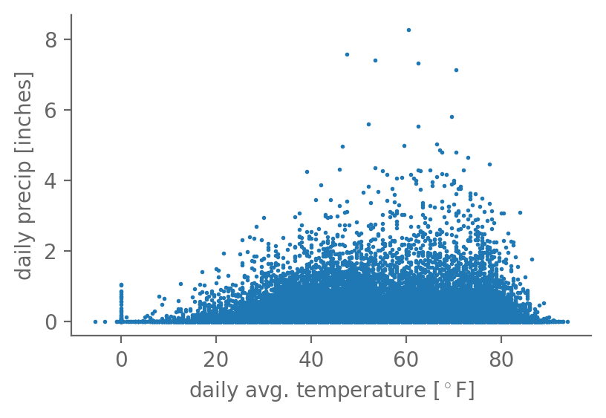
Timeseries are one type of scatterplot: quantity A on one axis; quantity B the other
Here’s the daily average temperature vs. precip:
Scatterplots help reveal relationships between two quantities

Slide 14
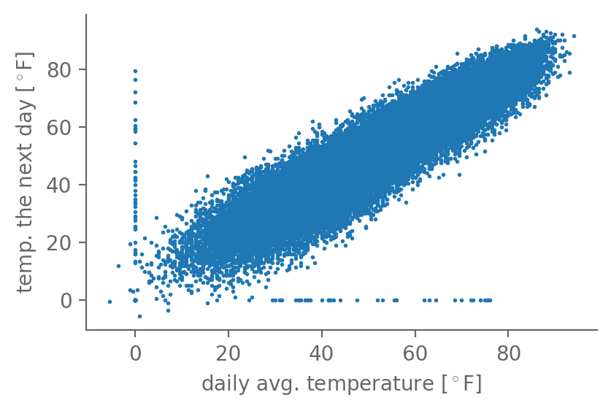
The less scatter, the tighter the relationship between the two quantities
Now, temperature on each day vs. the temperature on the next day
Very strong relationship! Intuitive: weather usually sticks around for a few days

Slide 15
The less scatter, the tighter the relationship between the two quantities
The bad values at 0°F really stick out: can be 80°F one day and go to 0°F the next
And vice versa
Further establishes that these are spurious
So let’s drop them

Slide 16

The less scatter, the tighter the relationship between the two quantities
The bad values at 0°F really stick out: can be 80°F one day and go to 0°F the next
And vice versa
Further establishes that these are spurious
So let’s drop them

Slide 17
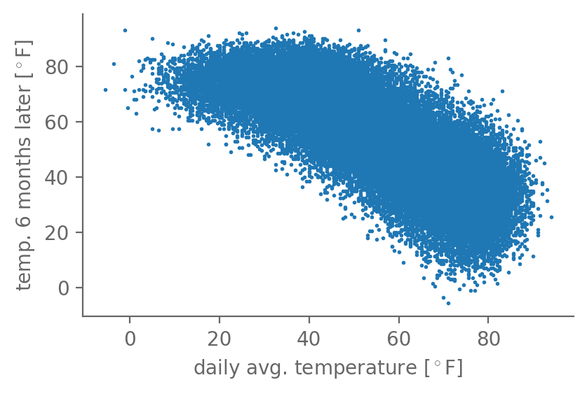
There can be strong positive relationship, or negative, or in between
Now, temperature each day vs. the temperature six months later
Strong (but less strong) negative relationship

Slide 18
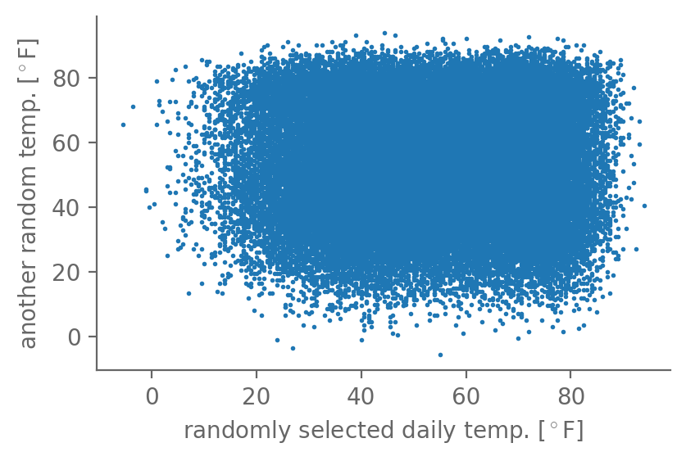
There can be strong positive relationship, or negative, or in between
Now, temperature from one randomly selected day vs. from another random day
No relationship!
We’ll quantify this all soon: correlation, covariance, linear regression

Slide 19
There can be strong positive relationship, or negative, or in between

Slide 20
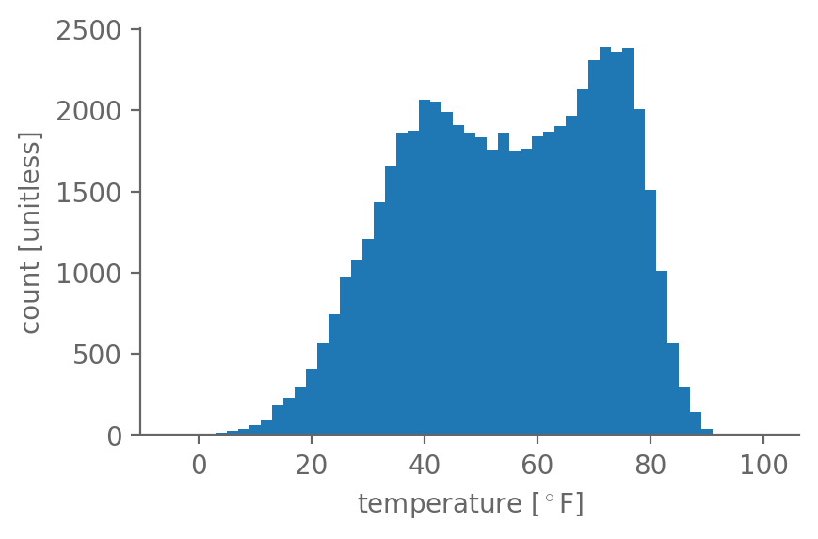
A histogram shows how many values fall into different bins from smallest to largest
In each bin, count how many values fell within its upper and lower bounds
Here: temperature, with bins [-5°F, -3°F), [-3°F, -1°F), …, [97°F, 99°F)
I.e. uniform 2°F bin width

Slide 21
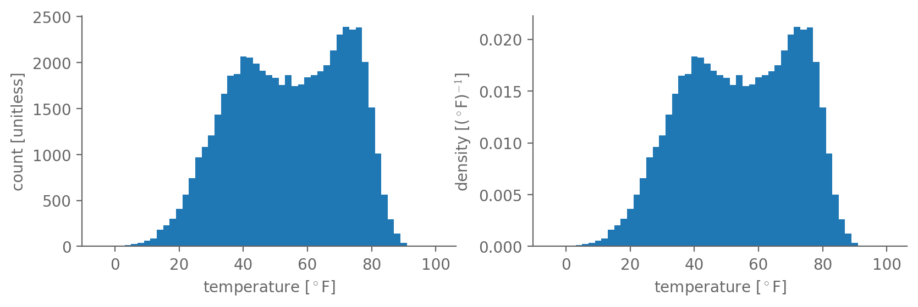
If you normalize by the width of each bin, this becomes a probability density
In matplotlib, use the density kwarg for plt.hist to change this.
Left panel: density=False. Right: density=True.

Slide 22
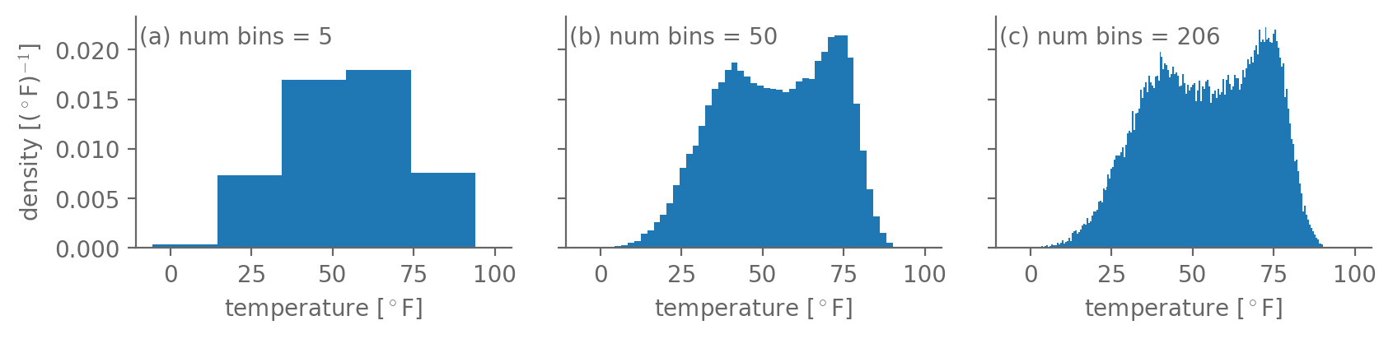
There is no single “right” bin size: balancing act b/w enough resolution vs. too much noise
5 bins: lose the bimodal structure…too coarse!
200+ bins: lots of “noise”, a.k.a. jumps up and down from one bin to a next…too fine!
In this case, around 50 seems to be a good compromise

Slide 23
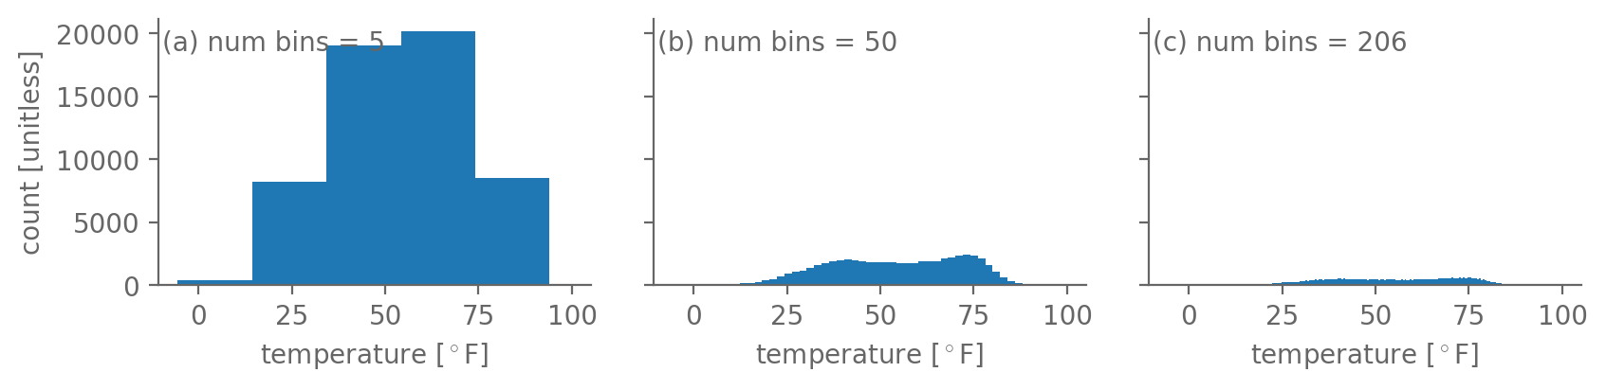
Plotting the density rather than raw count makes the values less sensitive to bin size
Previous slide: density=True. These: same but density=False.
But not the shape! All bins just scaled up or down by same factor

Slide 24
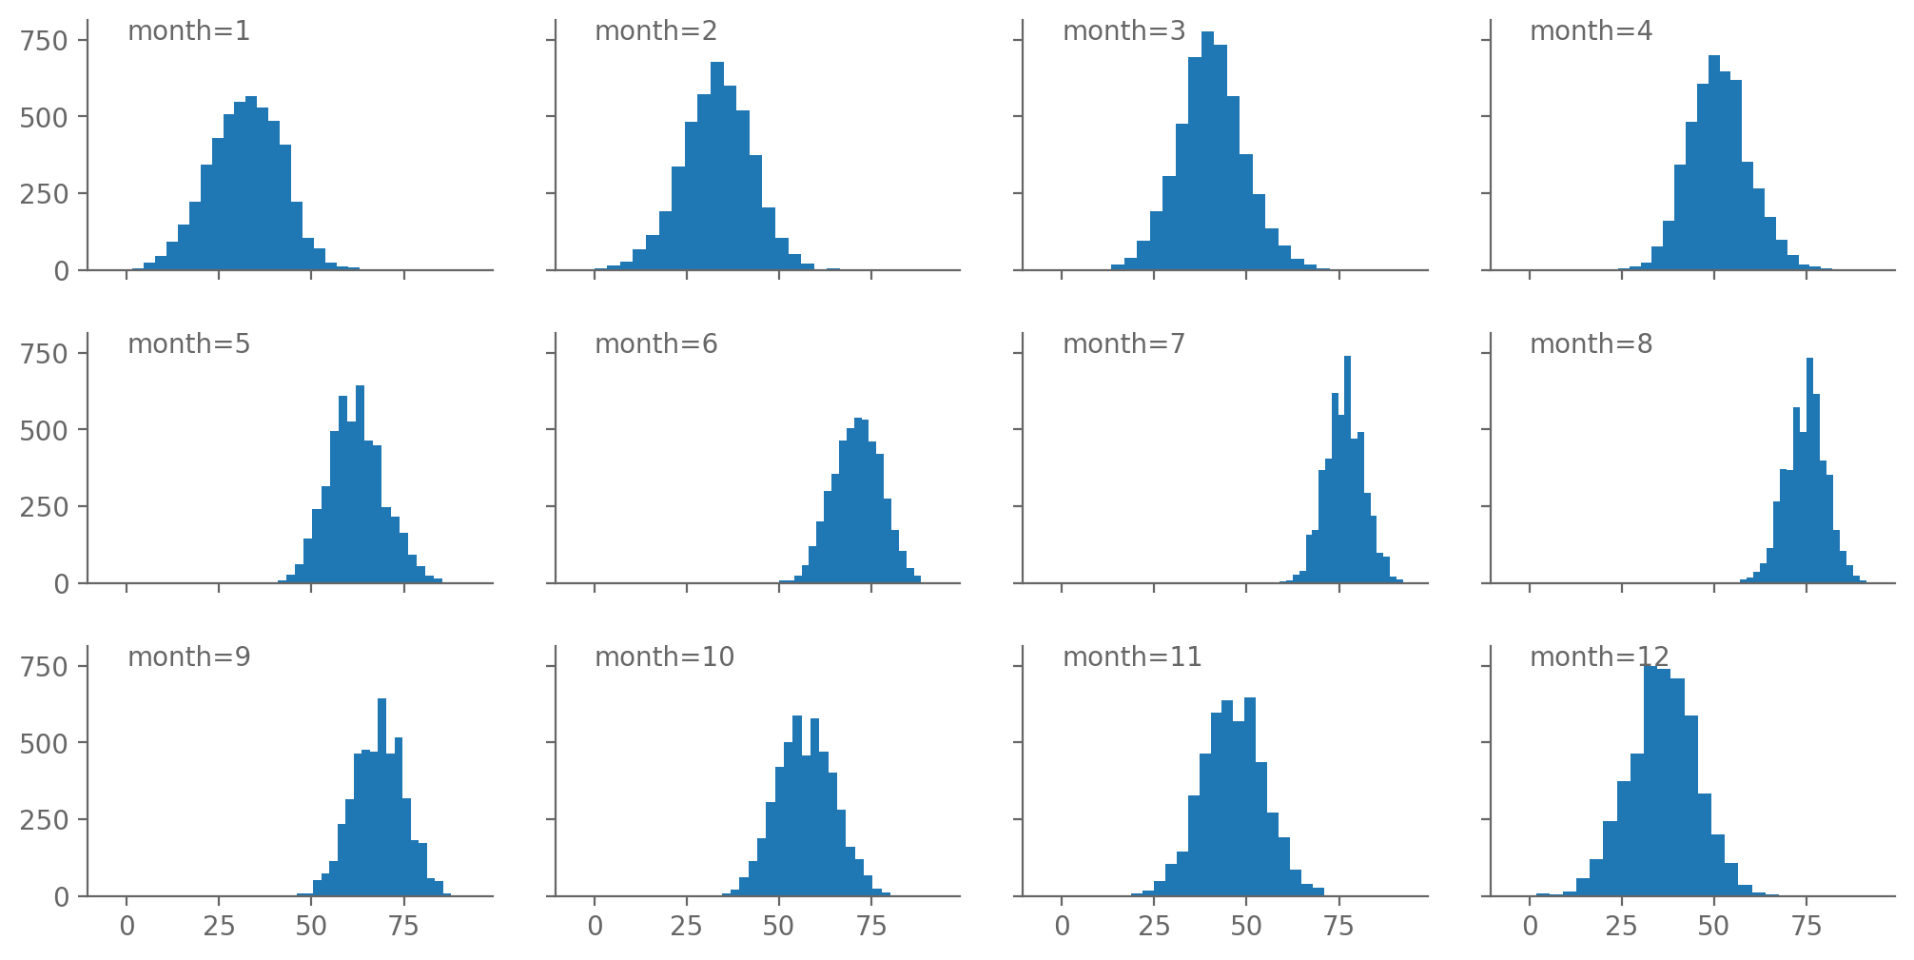
Why is the temperature histogram bimodal (i.e. has two peaks) rather than unimodal?

Slide 25
What we’re covering today:
Why a whole lecture on data visualization? ✅
Core plot types for 1D data: box-and-whiskers, timeseries, scatterplots, histograms ✅
Actually doing these in python: numpy, matplotlib, Jupyter

Slide 26

matplotlib is the most widely used plotting package in EAS & what we’ll use
Etymology: it mimics the plotting library from the MATLAB language, hence matplotlib
https://matplotlib.org/

Slide 27
matplotlib is the most widely used plotting package in EAS & what we’ll use
All of its stuff we need is within a submodule: matplotlib.pyplot
By convention, imported as:
from matplotlib import pyplot as plt
In programming, follow conventions unless you have a good reason not to! Makes it easier to share code, etc.

Slide 28
matplotlib supports all of the types of plots we’ll need (and many more)
The ones you’ll use most often:
plt.plot : line plot (good for timeseries)
plt.hist : histogram
plt.boxplot : box-and-whisker plot
plt.scatter : scatter plots

Slide 29
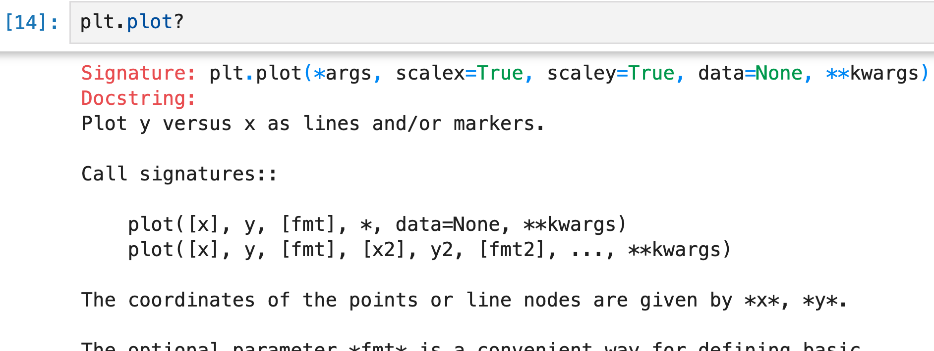
How do we use any of them? Jupyter will tell us if we just ask ☺
Type the name of any object followed by a question mark:

Slide 30
xarray also provides some of these directly
If you have an xr.DataArray named arr:
arr.plot : line plot if arr is 1D
arr.plot : contour plot if arr is 2D
arr.plot : histogram if arr is >=3D

Slide 31
Start your notebook with the Jupyter magic command %matplotlib inline
It makes the plots that you create get automatically generated within the notebook
Might be on by default, but better to include it to be safe
There are many other Jupyter magic commands to explore
E.g. on Macs: %config InlineBackend.figure_format = "retina"

Slide 32

matplotlib works with lists, but for data analysis in general better to use numpy
“Powerful N-Dimensional Arrays”
https://numpy.org/

Slide 33
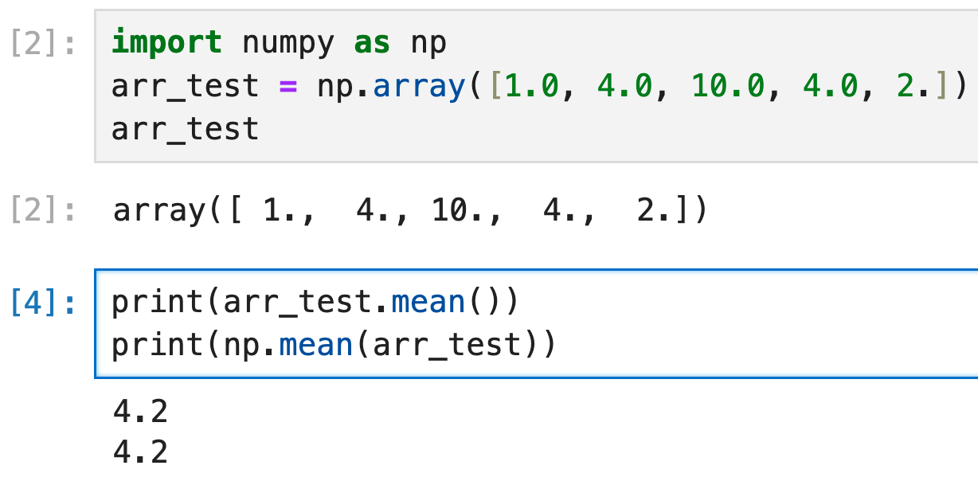
numpy provides an ndarray class that’s perfect for representing scientific datasets

Slide 34
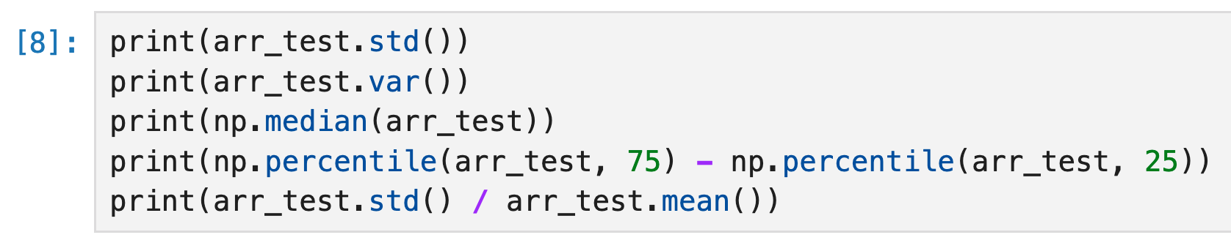
numpy provides an ndarray class that’s perfect for representing scientific datasets

Slide 35
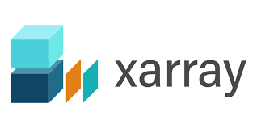
Even better: xarray. Adds labels and lots of other helpful stuff.
Convention: import xarray as xr

Slide 36
xarray.DataArray objects store their values numpy.ndarray: access it via the values attribute:
If you have an xr.DataArray named arr:
arr.values
(But for plotting and most things, just use arr itself!)

