Slide 1
Data Visualization in python

Slide 2

Jupyter notebooks are a powerful environment for quantitative data analysis
Interactive python session: can’t see plots, hard to do more complicated things, etc.
And python scripts: cumbersome for exploratory analyses to have to save script, run it, edit it, run it again, etc.
Enter Jupyter Notebooks: “computational documents”

Slide 3
Let’s all open a Jupyter notebook session right now
Q: What terminal command should we call to do this?
A: jupyter notebook

Slide 4
Jupyter is not part of the python standard library, so we had to install it with pip
The standard library = everything that’s directly builtin to python.
https://docs.python.org/3/library/index.html
This includes:
Everything we discussed in the Python bootcamp
Everything you can access via import X statements without having separately installed X

Slide 5
Jupyter is not part of the python standard library, so we had to install it with pip
Jupyter is not part of the standard library. It is a 3rd party package.
And any 3rd party package has to be installed separately
Fortunately, python has a very powerful builtin utility for installing these packages called pip
Short for “Pip Installs Packages” (a recursive acronym! 🤓)

Slide 6
Jupyter is not part of the python standard library, so we had to install it with pip
You run pip from the terminal:
pip install <package_name>
Not from an open python/ipython session
Replace <package_name> above with the actual name of the package you want to install
You should already have done this once:
pip install notebook

Slide 7
pip installs the desired package as well as any of its dependencies that are also missing
Almost every package uses things from other packages
To avoid reinventing the wheel; to build off what others do
So for a package to work, all the packages it calls have to be installed too: it depends on them
And all their dependencies have to be installed too, and so on

Slide 8
pip installs the desired package as well as any of its dependencies that are also missing
pip takes care of all of this! It searches the dependency tree, finds what’s missing, and installs all of it
And deals with more complicated things like Windows-specific packages, etc.
For more info: see the official docs: https://pypi.org/project/pip/
And from the terminal: pip --help

Slide 9
Let’s use pip now to install the other packages we need: numpy & matplotlib
But first, let’s see if they’re installed already! Q: what python code could we enter in our Jupyter notebook to check?
A: import numpy and import matplotlib
If nothing seems to happen, they’re installed!
If instead you get an ImportError, they’re not!

Slide 10
Let’s use pip now to install the other packages we need: numpy & matplotlib
Q: What are the commands to install these?
A: pip install numpy and pip install matplotlib,
OR pip install numpy matplotlib (can do multiple at once)

Slide 11

matplotlib is the most widely used plotting package in EAS & what we’ll use
Etymology: it mimics the plotting library from the MATLAB language, hence matplotlib
https://matplotlib.org/

Slide 12
matplotlib is the most widely used plotting package in EAS & what we’ll use
All of its stuff we need is within a submodule: matplotlib.pyplot
By convention, imported as:
from matplotlib import pyplot as plt
In programming, follow conventions unless you have a good reason not to! Makes it easier to share code, etc.

Slide 13
matplotlib supports all of the types of plots we’ll need (and many more)
The ones you’ll use most often:
plt.plot : line plot (good for timeseries)
plt.hist : histogram
plt.boxplot : box-and-whisker plot
plt.scatter : scatter plots

Slide 14
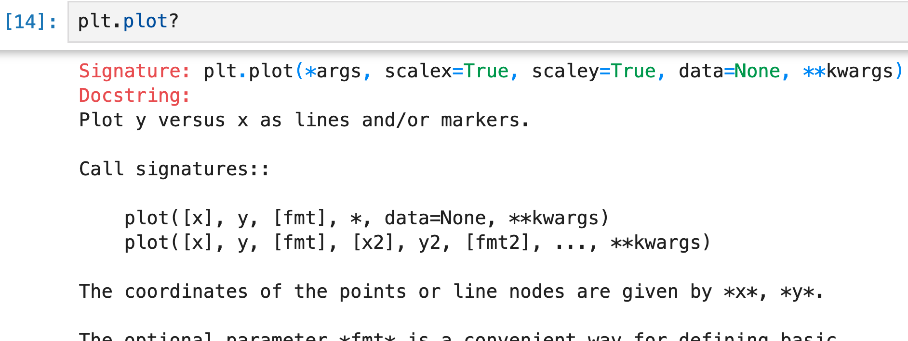
How do we use any of them? Jupyter will tell us if we just ask ☺
Type the name of any object followed by a question mark:

Slide 15
Start your notebook with the Jupyter magic command %matplotlib inline
It makes the plots that you create get automatically generated within the notebook
Might be on by default, but better to include it to be safe
There are many other Jupyter magic commands to explore
E.g. on Macs: %config InlineBackend.figure_format = "retina"

Slide 16

matplotlib works with lists, but for data analysis in general better to use numpy
“Powerful N-Dimensional Arrays”
https://numpy.org/

Slide 17
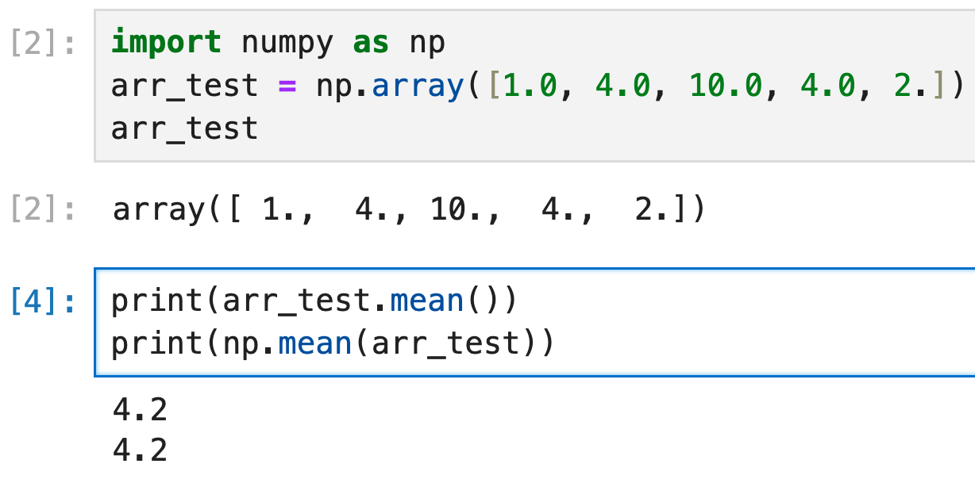
numpy provides an ndarray class that’s perfect for representing scientific datasets

Slide 18
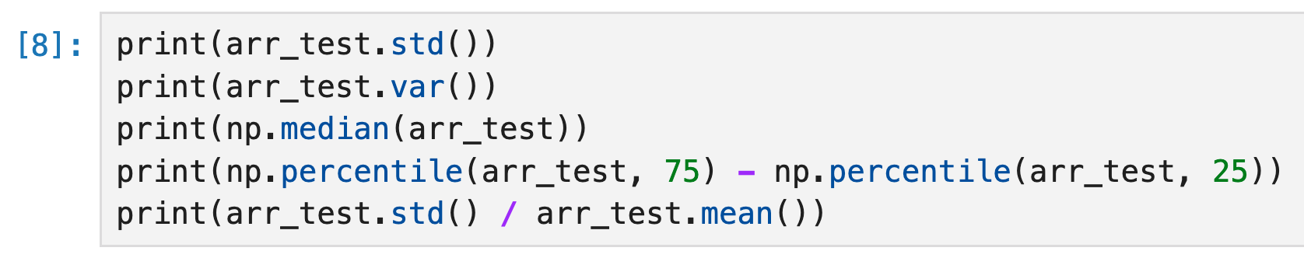
numpy provides an ndarray class that’s perfect for representing scientific datasets

Slide 19
To load a dataset that’s saved on disk into a numpy array, use the netCDF4 package
https://unidata.github.io/netcdf4-python/
Q: What command will install this package?
A: From a terminal session, pip install netCDF4

Slide 20
To load a dataset that’s saved on disk into a numpy array, use the netCDF4 package
”netCDF” is a file format that weather, climate, and other Earth scientists commonly use to store our data
https://www.unidata.ucar.edu/software/netcdf/
”Self-describing”: includes metadata (data about data) describing the data’s dimensions, coordinates, etc.
E.g. if it’s a function of latitude x longitude x time, and what the precise lat, lon, and time values are

Slide 21
To load a dataset that’s saved on disk into a numpy array, use the netCDF4 package
The netCDF4 package enables you to load netCDF files (ending in .nc) into numpy arrays
Such as the Central Park weather station data!
For data stored in Excel spreadsheets or CSV (comma separated values): use the pandas library
We’ll return to pandas later in the course

Slide 22
Specifically, use the Dataset class that the netCDF4 package provides
Q: What Python commands enable us to use Dataset? (Assume we haven’t imported anything yet)
A: from netCDF4 import Dataset then Dataset(…)
or
import netCDF4 then netCDF4.Dataset(…)
or
import netCDF4.Dataset then netCDF4.Dataset(…)

Slide 23
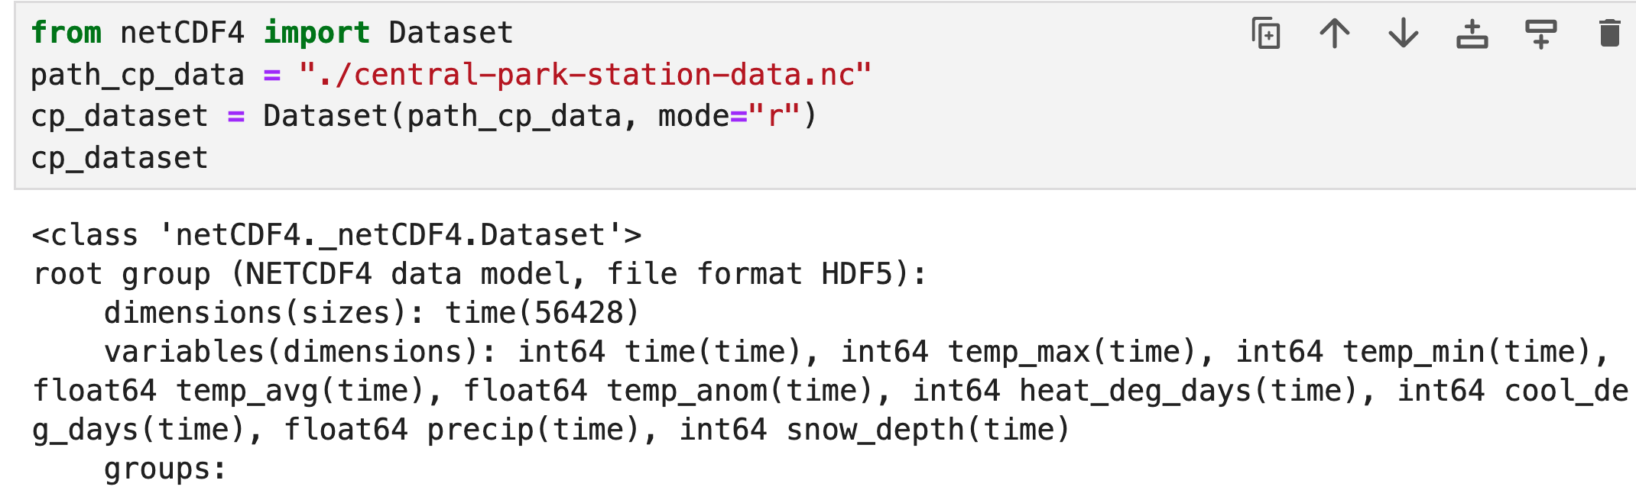
Specifically, use the Dataset class that the netCDF4 package provides
Once you’ve loaded the file into a Dataset, you can access each of its variables like you would the values in a dict:

Slide 24
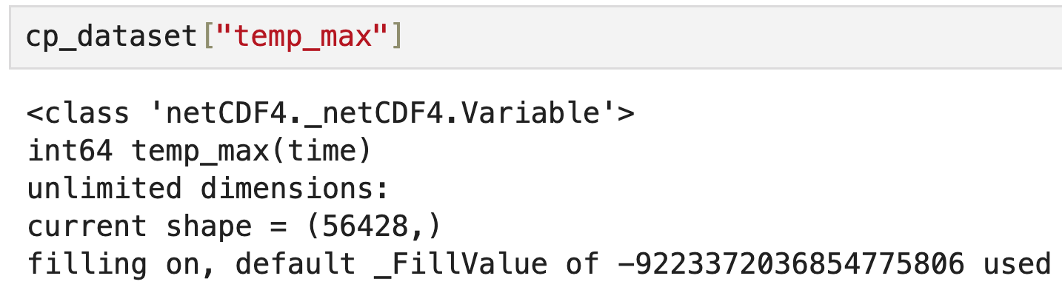
Specifically, use the Dataset class that the netCDF4 package provides
Once you’ve loaded the file into a Dataset, you can access each of its variables like you would the values in a dict:

Slide 25
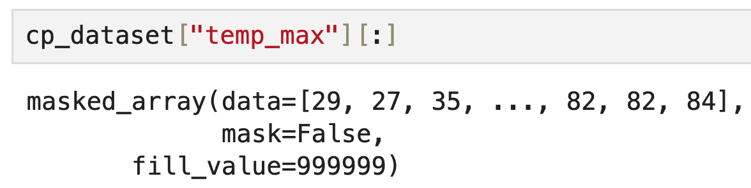
Specifically, use the Dataset class that the netCDF4 package provides
Add [:] at the end to get the underlying numpy array:

Slide 26
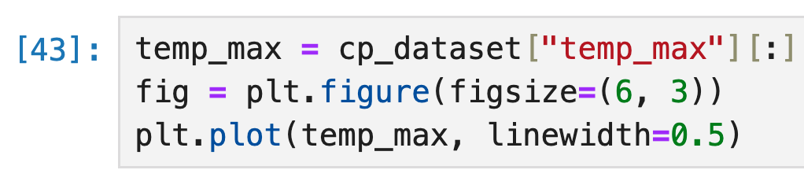
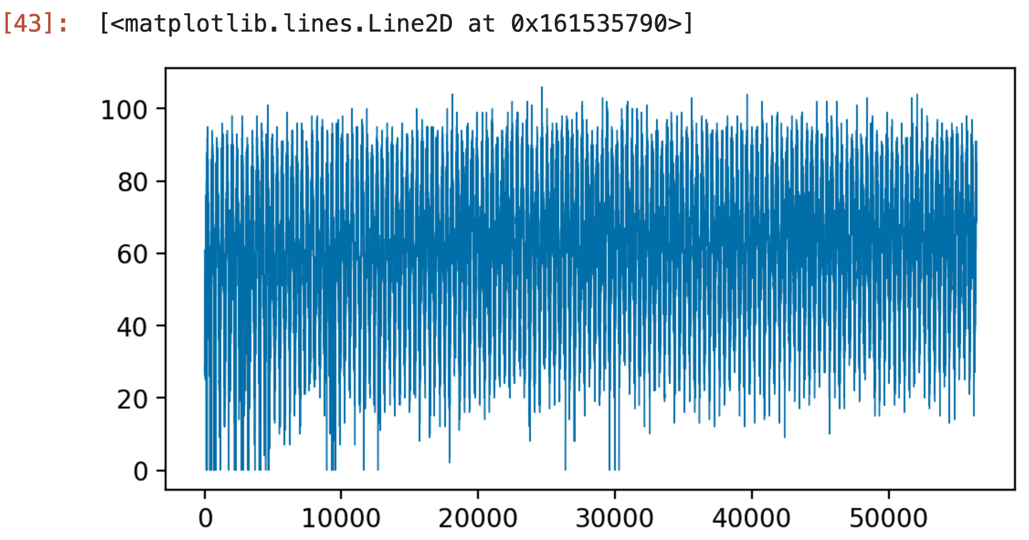
Then you can analyze / plot / etc. it just like you would any numpy array

Slide 27
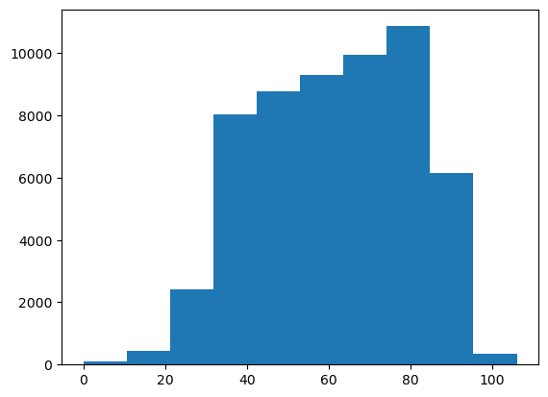
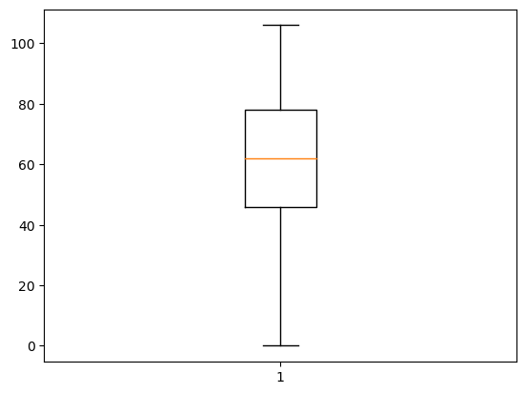
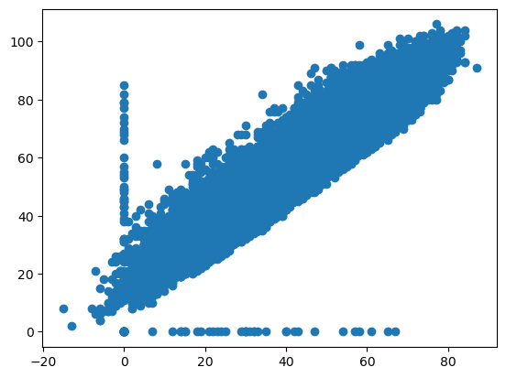
Then you can analyze / plot / etc. it just like you would any numpy array
Min temp vs. max temp

Slide 28
But notice: no nice axis labels, etc. like the plots shown previously: enter xarray
Next time ☺

