Slide 1
Probability II
Distributions, samples, populations
CCNY EAS 42000 / A4200
Lecture 04
October 14, 2025
Prof. Spencer Hill

Slide 2
Probability II
Probability distributions: mass, density, cumulative
Theoretical probability distributions
Populations vs. samples

Slide 3
Probability II
Probability distributions: mass, density, cumulative nice 15 min video: https://youtu.be/YXLVjCKVP7U
Theoretical probability distributions
Populations vs. samples

Slide 4
Let’s first distinguish between discrete and continuous variables
Discrete: there’s a finite number of possible values
E.g. 1,2,3,4,5,6 for a dice roll; # of days in a year w/ earthquakes
Continuous: infinitely many possible values
E.g. wind speed, daily precipitation

Slide 5
Let’s first distinguish between discrete and continuous variables
Instrument/computer finite precision technically turn continuous variables into discrete ones
E.g. cooling degree days reported in whole °F
But almost always the precision is high enough that we can still usefully treat them as continuous
So for now, don’t worry about this technicality

Slide 6
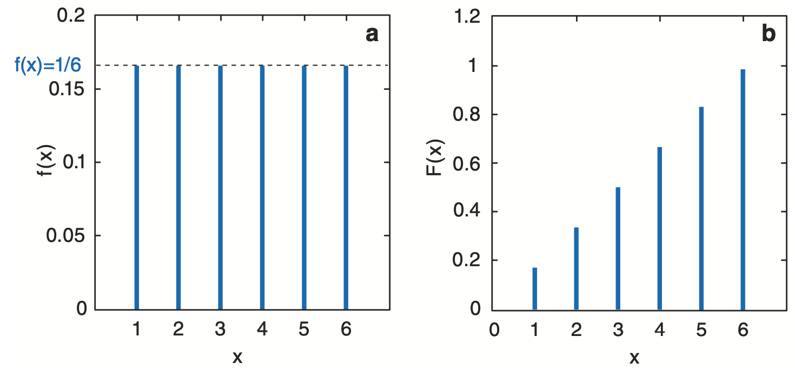
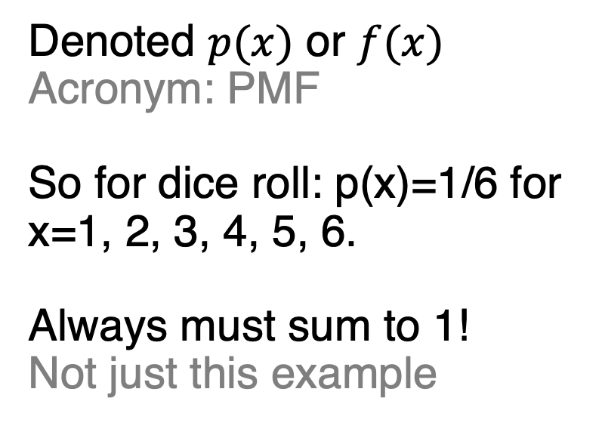
Discrete variables: probability mass function gives the probability of each value
Denoted $p(x)$ or $f(x)$
Acronym: PMF
So for dice roll: p(x)=1/6 for x=1, 2, 3, 4, 5, 6.
Always must sum to 1!
Not just this example

Slide 7
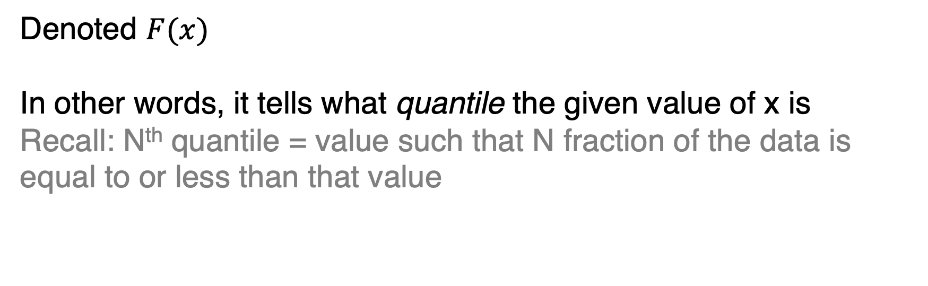
The cumulative distribution function (CDF) of X gives P(X≤x) for every possible x
Denoted $F(x)$
In other words, it tells what quantile the given value of x is
Recall: N^{th} quantile = value such that N fraction of the data is equal to or less than that value

Slide 8
Discrete: cumulative distribution function = sum of PMF at each x over all smaller values
Dice roll PMF
Dice roll CDF

Slide 9
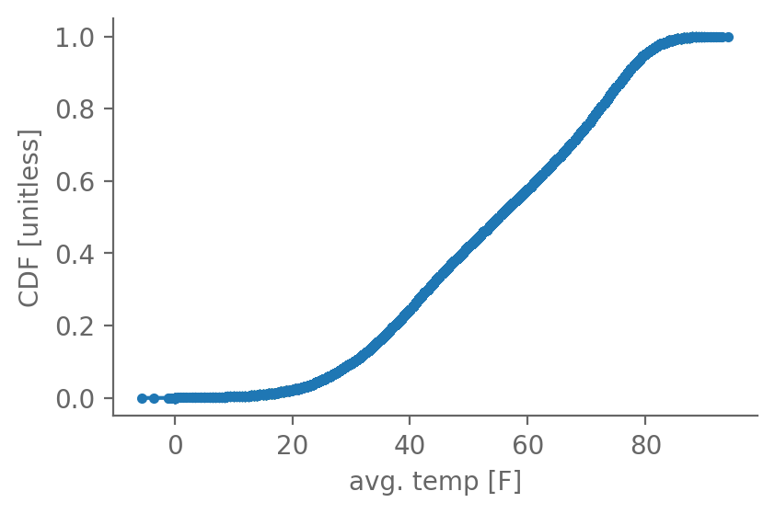
Continuous: CDF meaning and name both identical to the discrete case
Central Park daily average temperature:
Notice: monotonic
I.e. as temp goes up, CDF always gets larger

Slide 10
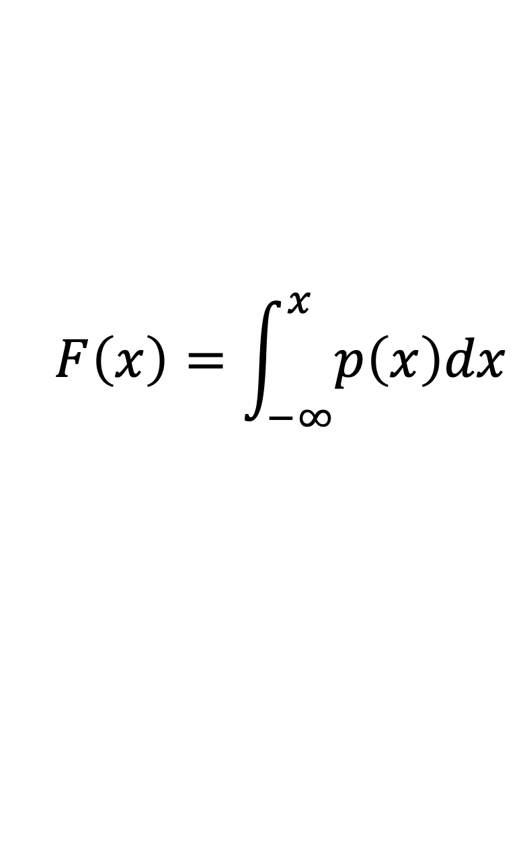
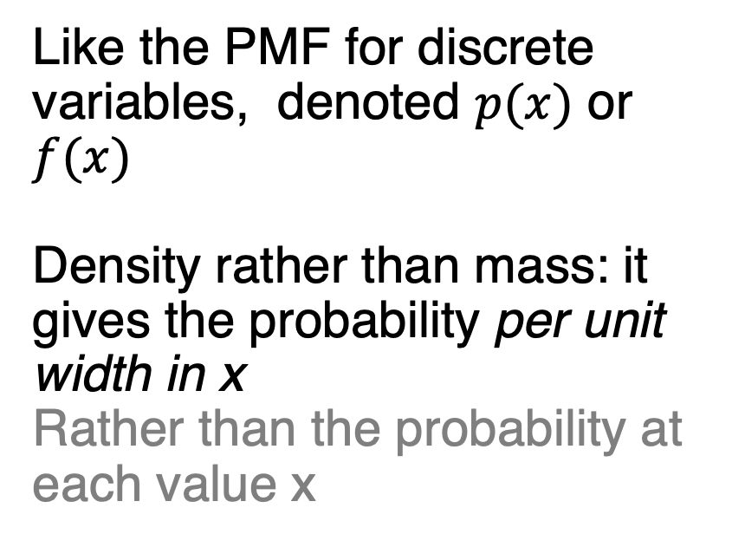
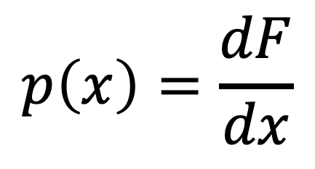
Continuous variables: probability density function is the derivative of the CDF
Like the PMF for discrete variables, denoted $p(x)$ or $f(x)$
Density rather than mass: it gives the probability per unit width in x
Rather than the probability at each value x
$$p\left(x\right)=\frac{dF}{dx}$$
$$F\left(x\right)=\int_{−∞}^{x}{p\left(x\right)dx}$$

Slide 11
Continuous variables: probability density function is the derivative of the CDF
<go to interactive holoviews plot>

Slide 12
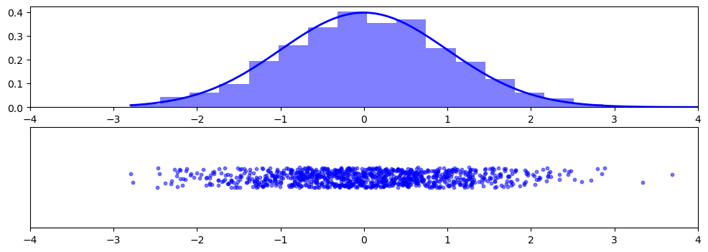
The probability density function tells how densely packed randomly drawn points will be
1000 values randomly drawn from a standard Normal. Dots = each value. Bars = histogram of this sample. Blue curve=true std. normal PDF

Slide 13
Probability II
Probability distributions: mass, density, cumulative
Theoretical probability distributions
Populations vs. samples

Slide 14
Recall: empirical probabilities and distribution are the ones that come directly from the data
Empirical: “based on, concerned with, or verifiable by observation or experience rather than theory or pure logic”
How likely is Central Park rainfall ≥5.48”? The empirical answer is: well, there have been 9 such days out of 56,620 total days, so 9/56,620 = 0.000159

Slide 15
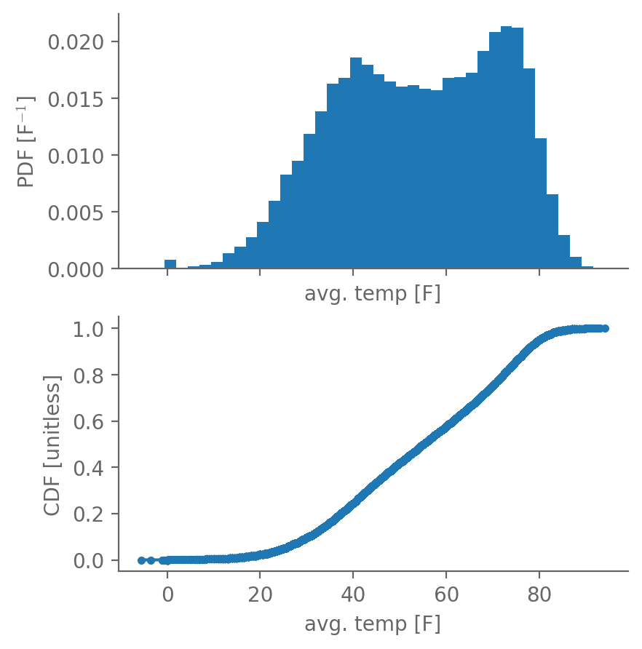
Recall: empirical probabilities and distribution are the ones that come directly from the data
Empirical approximation to the PDF: histogram of the values
Empirical CDF: sort the values, lowest becomes 0th percentile, highest becomes 100th percentile

Slide 16
A theoretical probability distribution is one that’s defined using an equation
Empirical distributions, because they are finite, suffer from noise and are limited in their span (their range)
They are also very difficult to investigate cleanly in a mathematical way

Slide 17
A theoretical distribution is one that’s defined using an equation
Also known as parametric distributions
Ones we’ll cover today: uniform, binomial, and Gaussian
Often we have good reason to believe that the empirical data we have is drawn from a particular theoretical distribution
Examples: Gaussian for many things, gamma distributions for precipitation

Slide 18
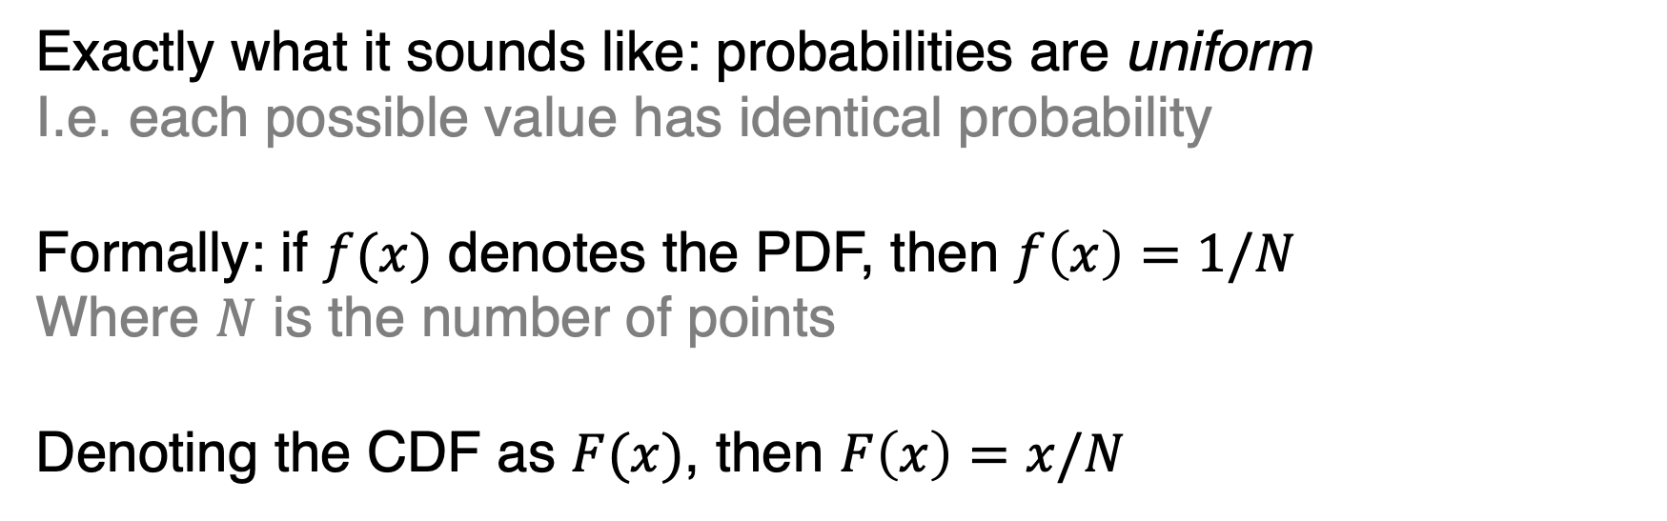
Perhaps the simplest theoretical distribution is the uniform distribution
Exactly what it sounds like: probabilities are uniform
I.e. each possible value has identical probability
Formally: if $f(x)$ denotes the PDF, then $f\left(x\right)=1/N$
Where $N$ is the number of points
Denoting the CDF as $F(x)$, then $F\left(x\right)=x/N$

Slide 19
The PDF and CDF of the uniform distribution as applied to a dice roll:
Fig. 3.4, Python Recipes for Earth Sciences

Slide 20
The binomial distribution gives the probability of x “successes” in N “trials”
For example, the probability of getting 4 heads in 5 flips
Like the uniform distribution, the binomial distribution is discrete
As opposed to continuous
It depends on the number of trial N and the probability of success in each trial, denoted p

Slide 21
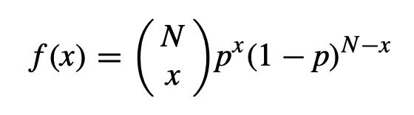
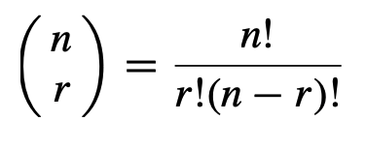
The binomial distribution gives the probability of x “successes” in N “trials”
The PDF is:
where “n choose r”
The ! symbol means factorial: for example, 5! = 5*4*3*2*1.

Slide 22
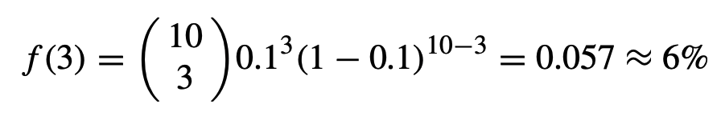
For example, if N=10, p=0.1, and x=3, then:
E.g. you know the probability of an Earthquake in any given year at a given location is 10%, and you want to know the likelihood that in a 10 year span there are exactly 3 earthquakes

Slide 23
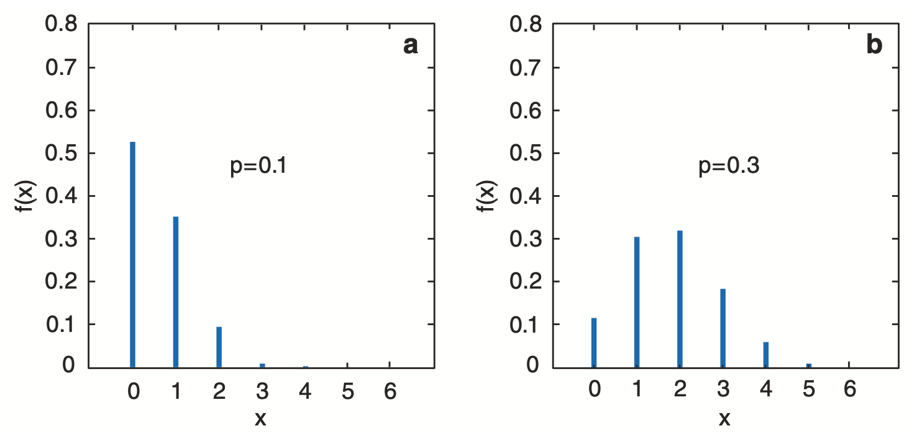
The PDF and of two binomial distributions with N=6 and (left) p=0.1 or (right) p=0.3

Slide 24
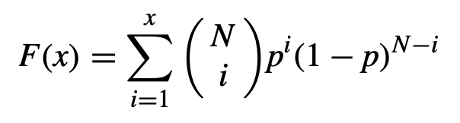
The CDF of the binomial distribution is:
CDF:
Notice: this is just the sum of the PDF over all values less than (and including) the given value x
Earthquake example: F(3) gives probability that 1, 2, or 3 earthquakes occur in that 10 year span

Slide 25
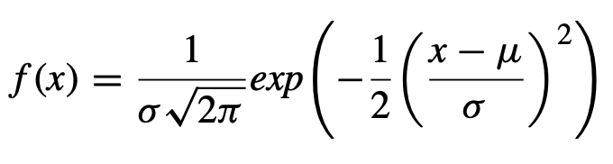
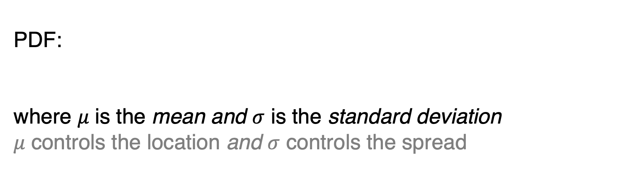
The normal distribution (or Gaussian) gives the classic “bell curve” shape
PDF:
where 𝜇 is the mean and $σ$ is the standard deviation
𝜇 controls the location and $σ$ controls the spread

Slide 26
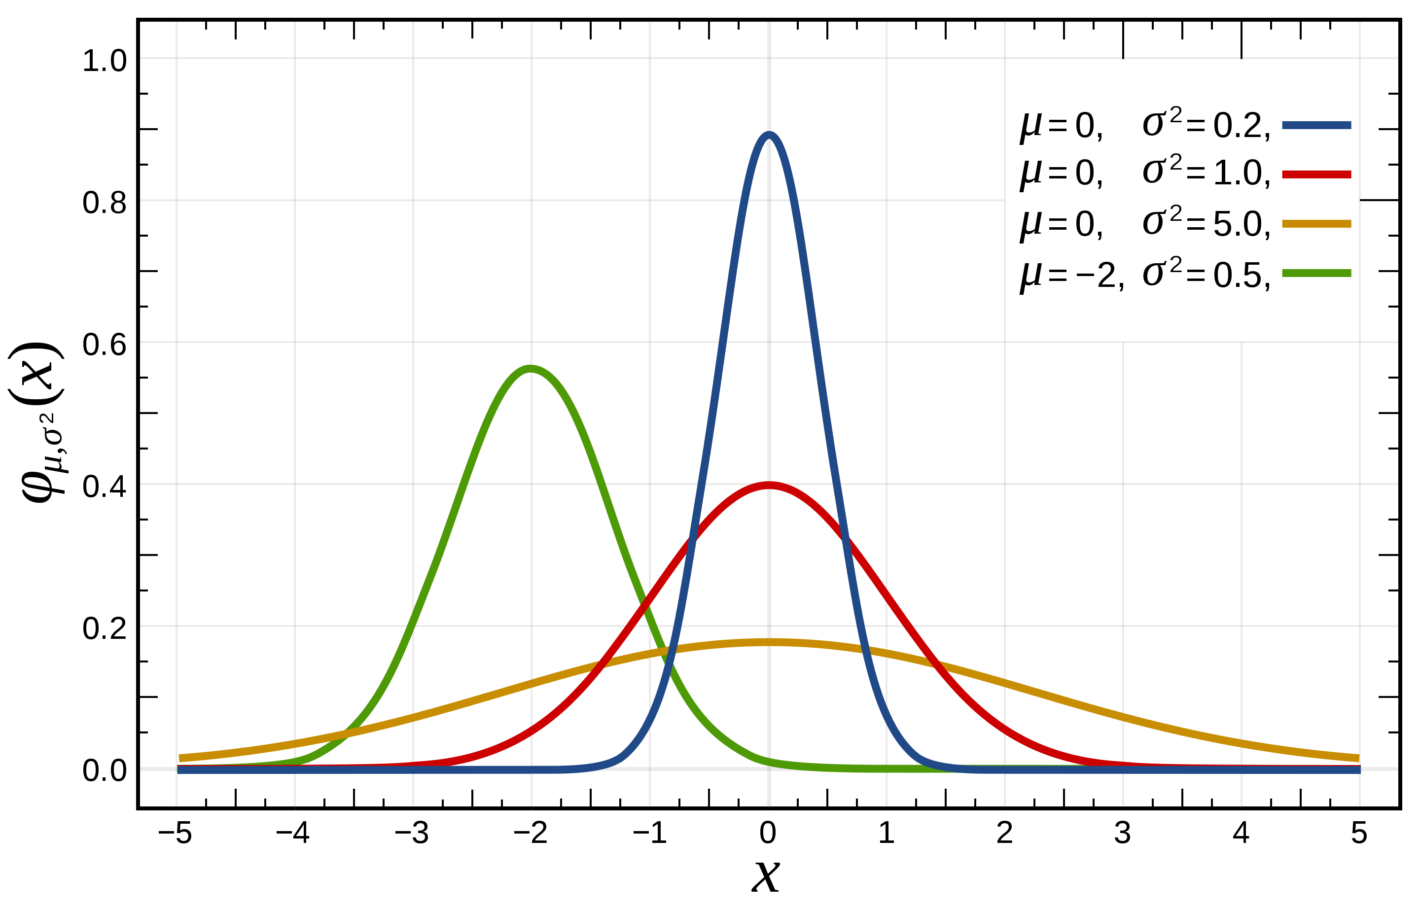
The normal distribution (or Gaussian) gives the classic “bell curve” shape
PDFs of 4 different Gaussians
The mean controls where the bell peaks
Standard deviation controls how tall/narrow vs. short/wide it is

Slide 27
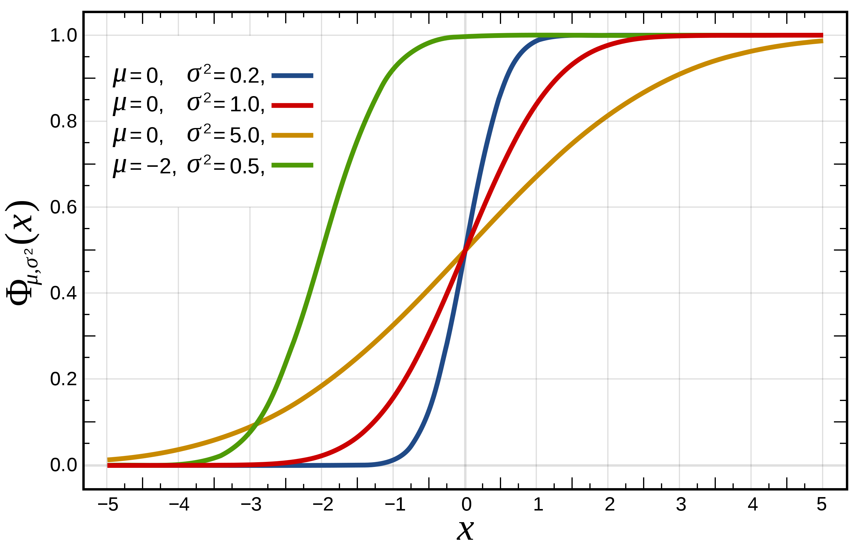
The normal distribution (or Gaussian) gives the classic “bell curve” shape
PDFs of 4 different Gaussians
Corresponding CDFs
https://en.wikipedia.org/wiki/Normal_distribution

Slide 28
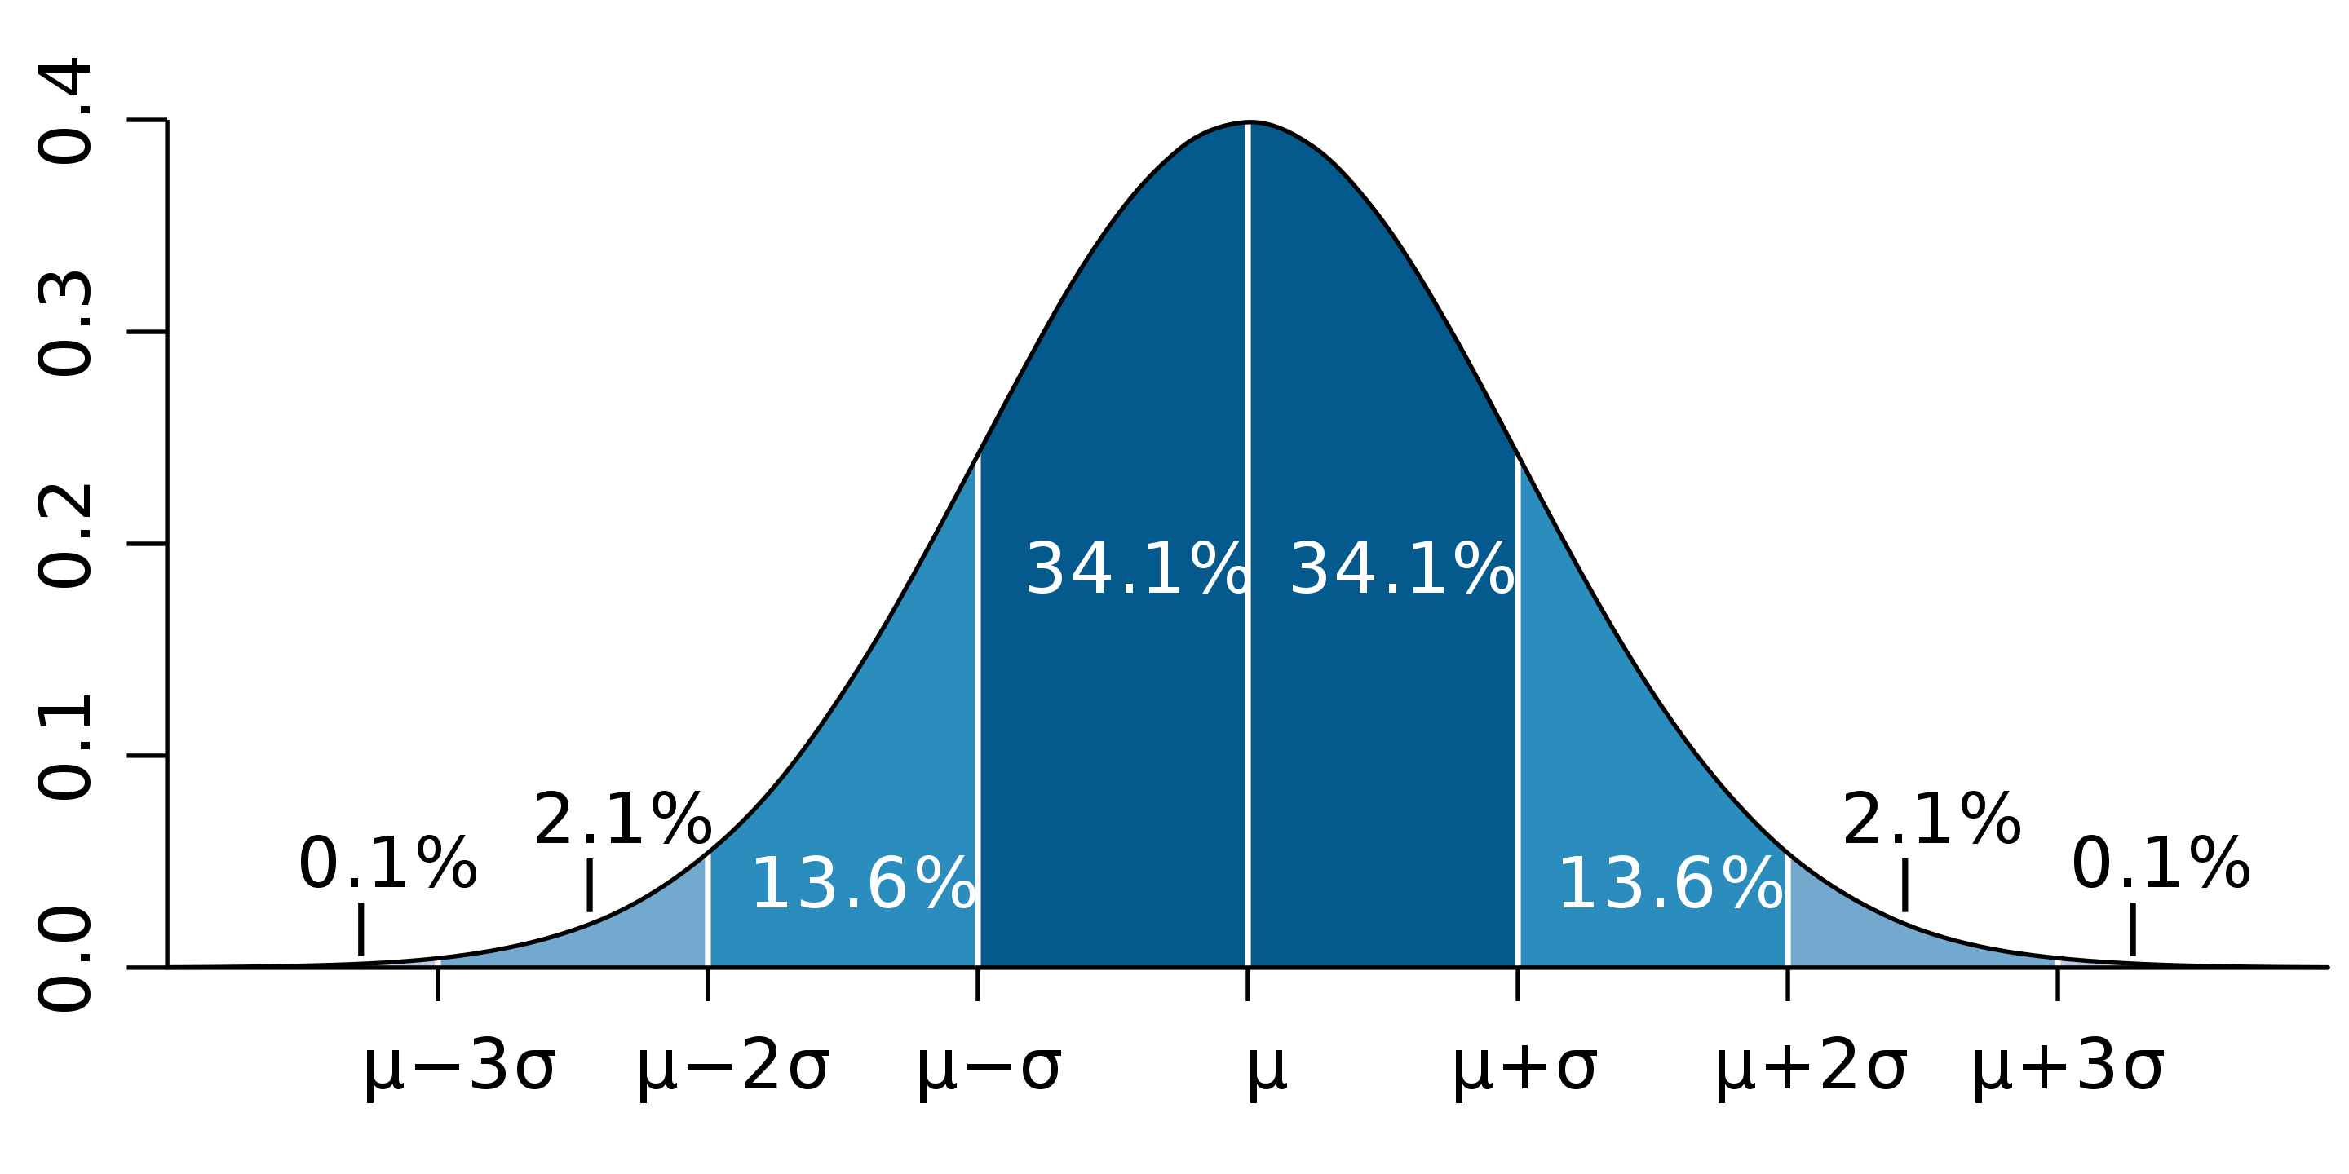
The normal distribution (or Gaussian) gives the classic “bell curve” shape
68.2% falls between +/-1 stdev.
95.5% falls between +/-2 stdev.

Slide 29
The standard normal distribution is the normal distribution with 𝜇=0 and 𝜎=1
PDFs of 4 different Gaussians
Corresponding CDFs

Slide 30
A few Gaussian PDFs along w/ 1000 random draws and the resulting histograms

Slide 31
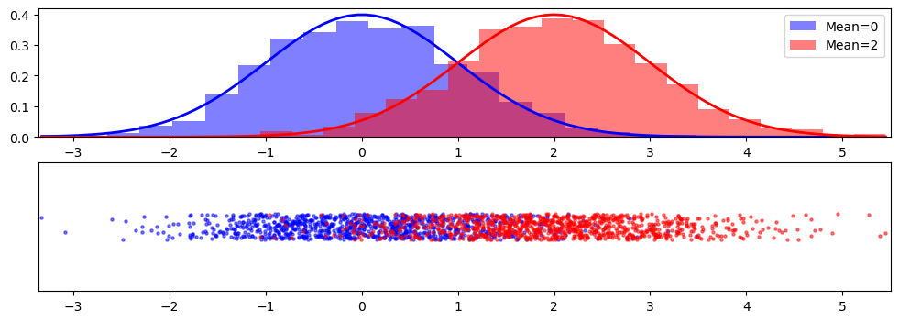
A few Gaussian PDFs along w/ 1000 random draws and the resulting histograms

Slide 32
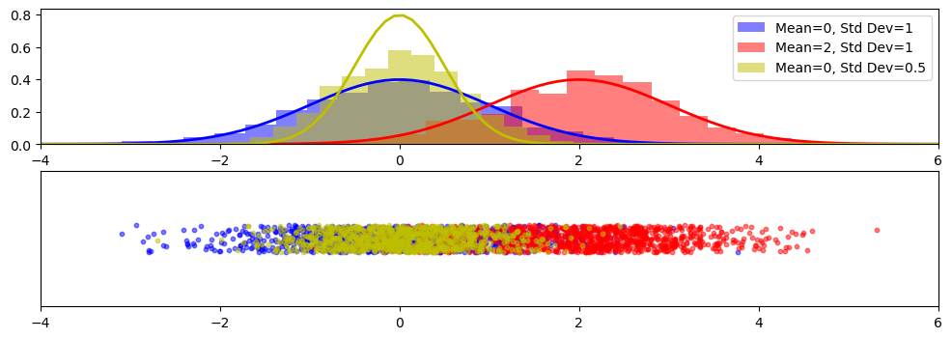
A few Gaussian PDFs along w/ 1000 random draws and the resulting histograms

Slide 33
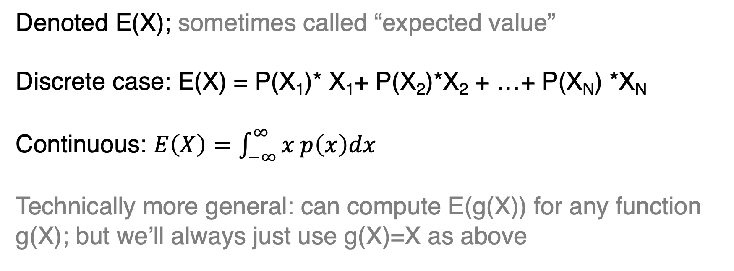
Expectation is the probability-weighted average over a PMF or PDF
Denoted E(X); sometimes called “expected value”
Discrete case: E(X) = P(X₁)* X₁+ P(X₂)*X₂ + …+ P(X_{N}) *X_{N}
Continuous: $E\left(X\right)=\int_{−∞}^{∞}{x p\left(x\right)dx}$
Technically more general: can compute E(g(X)) for any function g(X); but we’ll always just use g(X)=X as above

Slide 34
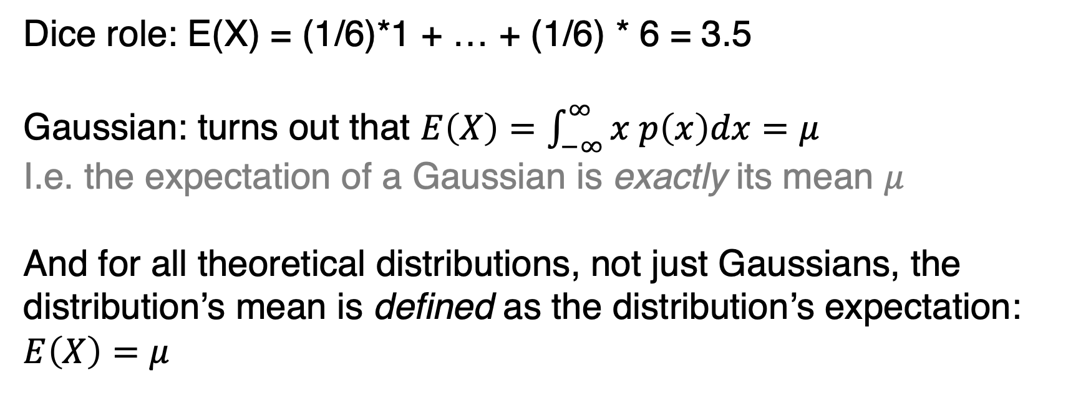
Expectation is the probability-weighted average over a PMF or PDF
Dice role: E(X) = (1/6)*1 + … + (1/6) * 6 = 3.5
Gaussian: turns out that $E\left(X\right)=\int_{−∞}^{∞}{x p\left(x\right)dx}=μ$
I.e. the expectation of a Gaussian is exactly its mean $μ$
And for all theoretical distributions, not just Gaussians, the distribution’s mean is defined as the distribution’s expectation: $E\left(X\right)=μ$

Slide 35
Probability II
Probability distributions: mass, density, cumulative
Theoretical probability distributions
Populations vs. samples

Slide 36
Consider polling for an election: want to know how whole population will vote
Here, population has its normal, every-day meaning: all of the people living in a place
Pollsters want to predict if candidate X will win the election. In other words, they want to know how every person in the (voting) population intends to vote

Slide 37
Consider polling for an election: impossible to ask everyone, can only ask a sample
So they ask a random sample of people how they will vote
If they survey 100 people, their sample size is 100
Each person is a single observation
The whole group of 100 is a single sample

Slide 38
Consider polling for an election: impossible to ask everyone, can only ask a sample
As the sample size grows, it will more closely approximate the whole population
But it’s always possible that, for any sample size less than the whole population, they get unlucky, and happen to get a much higher percentage of respondents who would vote for Candidate X than the actual percentage of the whole population

Slide 39
Consider polling for an election: summarizing population vs. sample
Voting summary: because it’s practically impossible to determine how the whole population intends to vote, pollsters ask a random sample of people that hopefully approximates the full population
From voting to Earth and Atmospheric Sciences: because it’s impossible to determine the exact causes of any given phenomena, we collect samples of observations (of e.g. snow fall) that hopefully approximate the overarching population

Slide 40
In statistics, we treat all datasets analogously: samples drawn randomly from a population
So, for annual snow fall during 1900-1919, the collection of all 20 observations (one for 1900, one for 1901, …, one for 1919) is our sample
And the sample mean is the average over those 20 years
These, we assume, are drawn randomly from an overarching population of possible values of annual snowfall, each value with a corresponding probability of being drawn

Slide 41
In statistics, we treat all datasets analogously: samples drawn randomly from a population
<interactive holoviews plot of random draws from normal>

Slide 42
The population is determined by whatever physical processes generate the observations
For example, the laws of physics cause daily rainfall to have approximately gamma distributions
(don’t worry what a gamma is)
Because of the Central Limit Theorem (defined next slide), for any quantity that’s the sum or average of a (decently) large number of smaller things, a good bet is that this population follows a Gaussian distribution

Slide 43
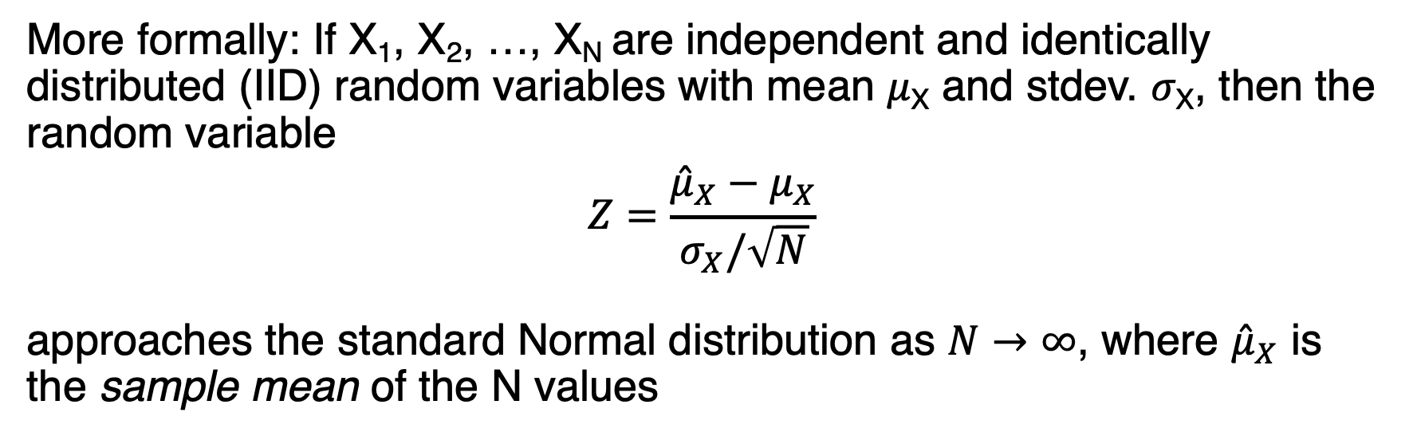
Central Limit Theorem: roughly speaking, sums of large samples are ~Gaussian
More formally: If X₁, X₂, …, X_{N} are independent and identically distributed (IID) random variables with mean 𝜇_{X} and stdev. 𝜎_{X}, then the random variable
$$Z=\frac{{\hat{μ}}_{X}−μ_{X}}{σ_{X}/\sqrt{N}}$$
approaches the standard Normal distribution as $N→∞$, where ${\hat{μ}}_{X}$ is the sample mean of the N values
https://www.youtube.com/watch?v=zeJD6dqJ5lo

Slide 44
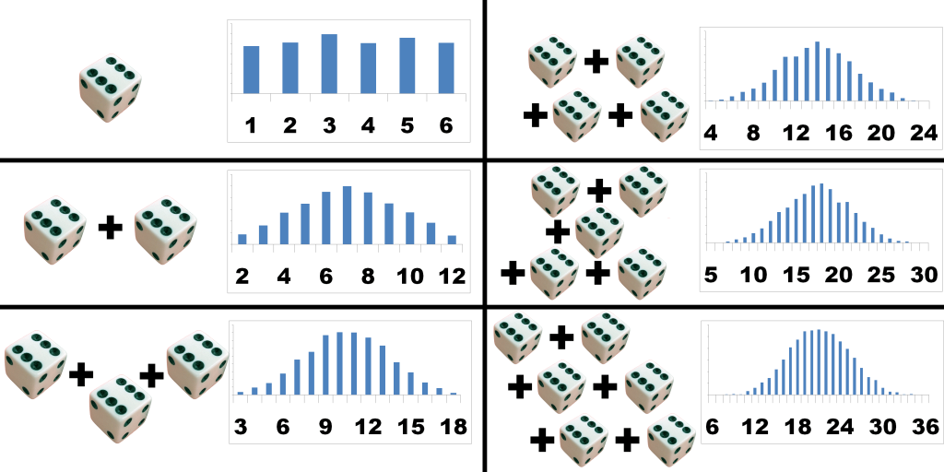
Central Limit Theorem holds even if the variables themselves are not Gaussian
This schematic: dice roll distribution is uniform, but the distribution of the sum of multiple dice rolls will become increasingly Gaussian as the number of rolls increases!
https://prwatech.in/blog/data-science/data-science-modules/central-limit-theorem-tutorial/

Slide 45
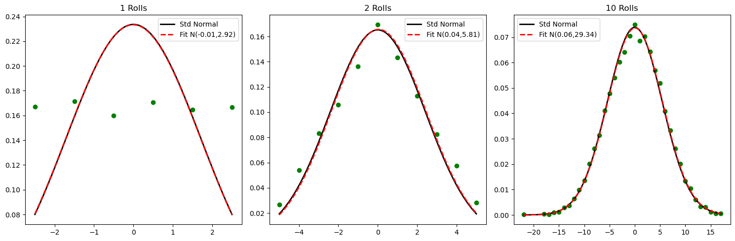
Central Limit Theorem holds even if the variables themselves are not Gaussian

Slide 46
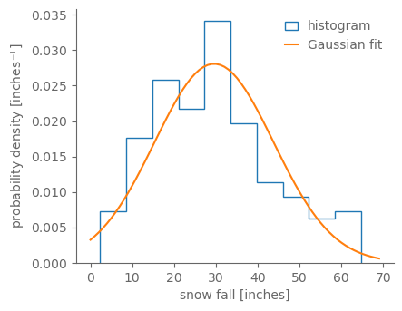
The histogram of annual snow fall over all years 1869-2022 looks reasonably Gaussian
Annual snow fall: sum the snow fall over all 365 or 366 days,
So Central Limit Theorem should approximately work
Even though this isn’t perfect! For example, snow fall can never be negative, but a Gaussian can

Slide 47

Notation: use hats to denote sample quantities
So, for example, we use “mu” 𝜇 to denote the population mean and $\hat{\text{μ}}$ to denote the sample mean

Slide 48
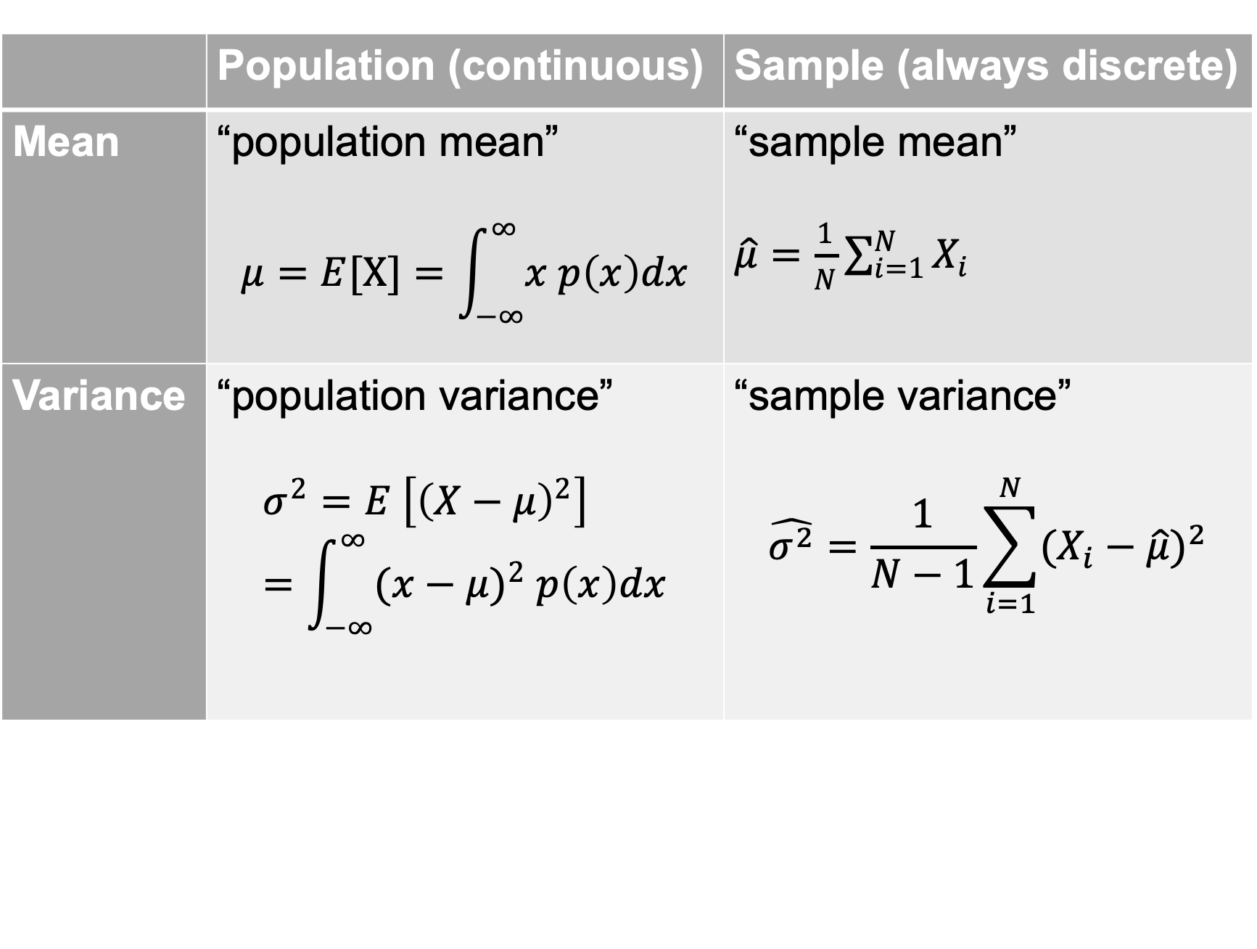
 | Population (continuous) | Sample (always discrete)
Mean | “population mean” $$μ=E[X]=\int_{−∞}^{∞}{x p\left(x\right)dx}$$ | “sample mean” $\hat{\text{μ}}=\frac{1}{N}\sum_{i=1}^{N}{X_{i}}$
Variance | “population variance” $$σ^{2}=E \left[{\left(X−μ\right)}^{2}\right] =\int_{−∞}^{∞}{{(x−μ)}^{2} p\left(x\right)dx}$$ | “sample variance” $$\hat{σ^{2}}=\frac{1}{N−1}\sum_{i=1}^{N}{{(X_{i}−\hat{μ})}^{2}}$$

Slide 49
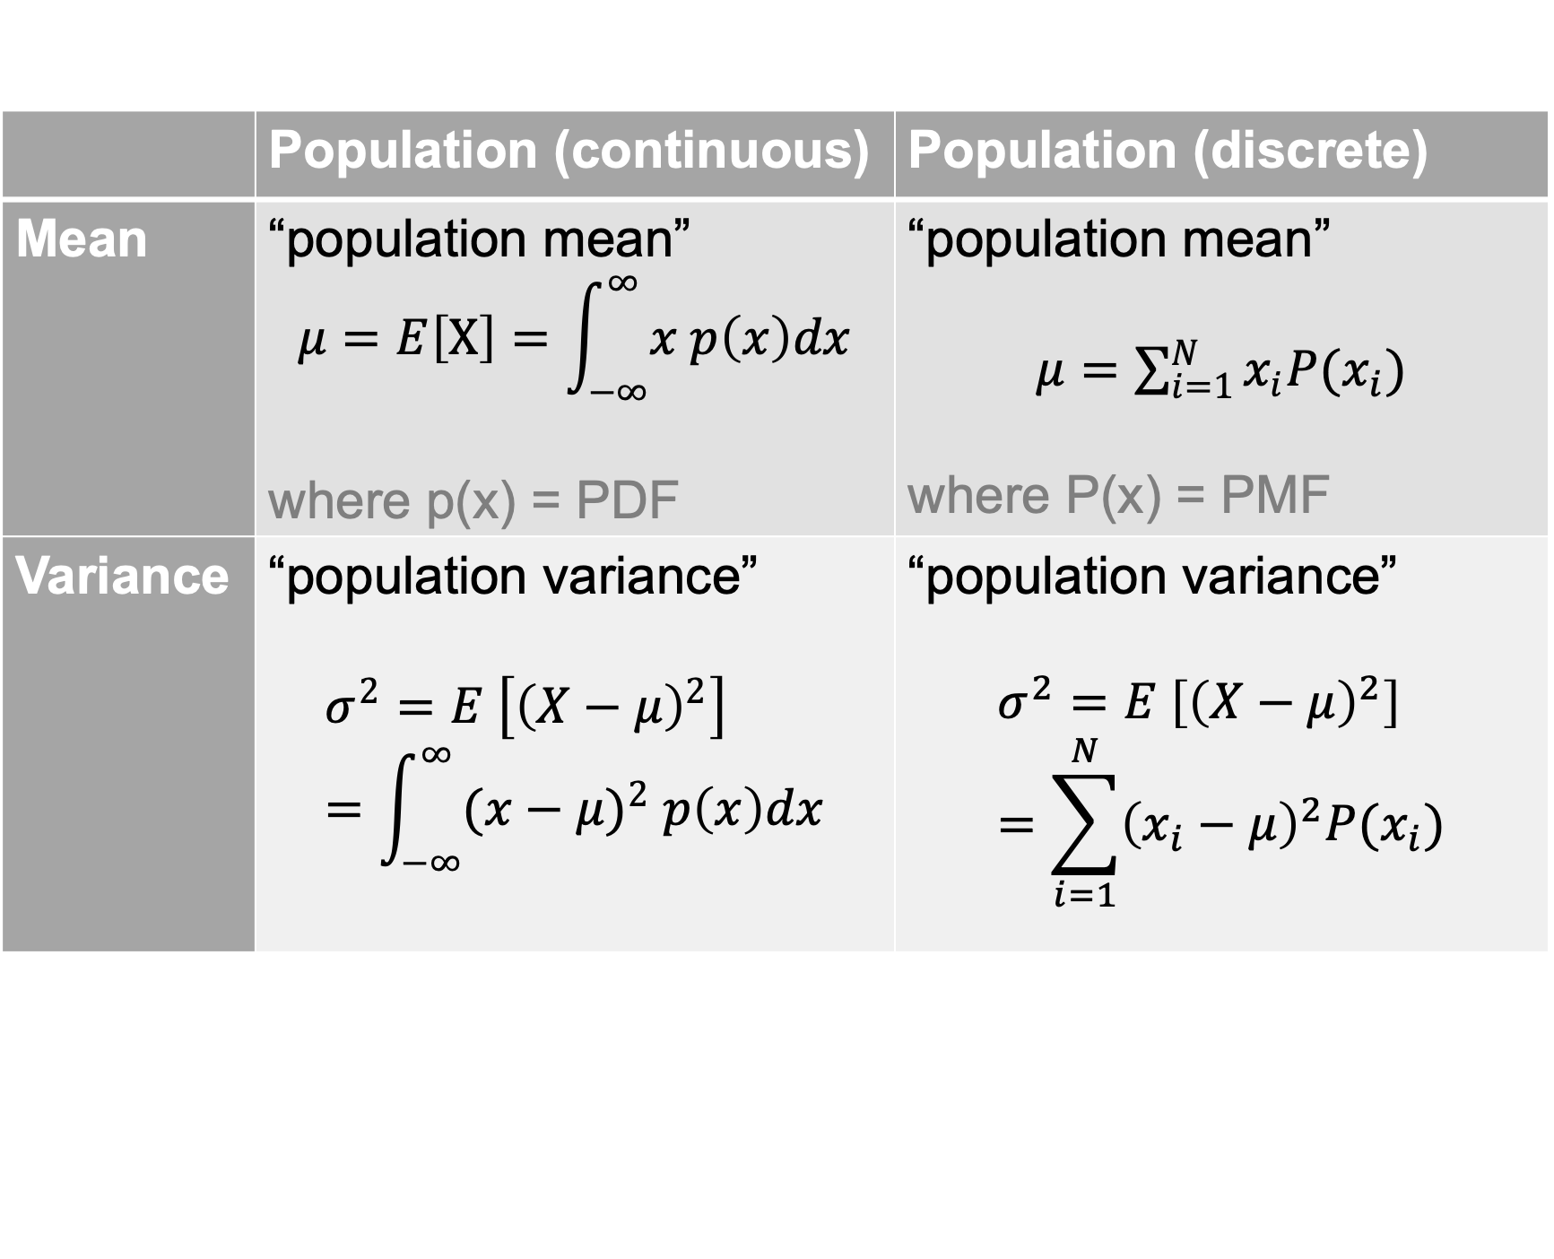
 | Population (continuous) | Population (discrete)
Mean | “population mean” $$μ=E\left[X\right]=\int_{−∞}^{∞}{x p\left(x\right)dx}$$ where p(x) = PDF | “population mean” $μ=\sum_{i=1}^{N}{x_{i}P(x_{i})}$ where P(x) = PMF
Variance | “population variance” $$σ^{2}=E \left[{\left(X−μ\right)}^{2}\right] =\int_{−∞}^{∞}{{(x−μ)}^{2} p\left(x\right)dx}$$ | “population variance” $$σ^{2}=E \left[{\left(X−μ\right)}^{2}\right]=\sum_{i=1}^{N}{{\left(x_{i}−μ\right)}^{2}P(x_{i})}$$

Slide 50
Why N-1 in denominator for sample variance vs. just N for sample mean?
Hopefully N for sample mean is intuitive
Average = sum up the N values, and then divide by N
For variance, the denominator indicates the number of degrees of freedom. Is every data point free in a sample?
No, because any given sample has a sample mean.
Consider: if you know the mean and the values of any N-1 points, then you can solve for the Nth value

Slide 51
Why N-1 in denominator for sample variance vs. just N for sample mean?
In other words, the sample mean constrains the Nth value, making it not “free”
So the unbiased estimator of the population variance is the sample variance with N-1 as the denominator, not N
Python note: by default, most stdev and variance functions don’t include this! np.var, np.std: use ddof optional arg.

Slide 52
Why N-1 in denominator for sample variance vs. just N for sample mean?
<go to interactive notebook example>

