Slide 1
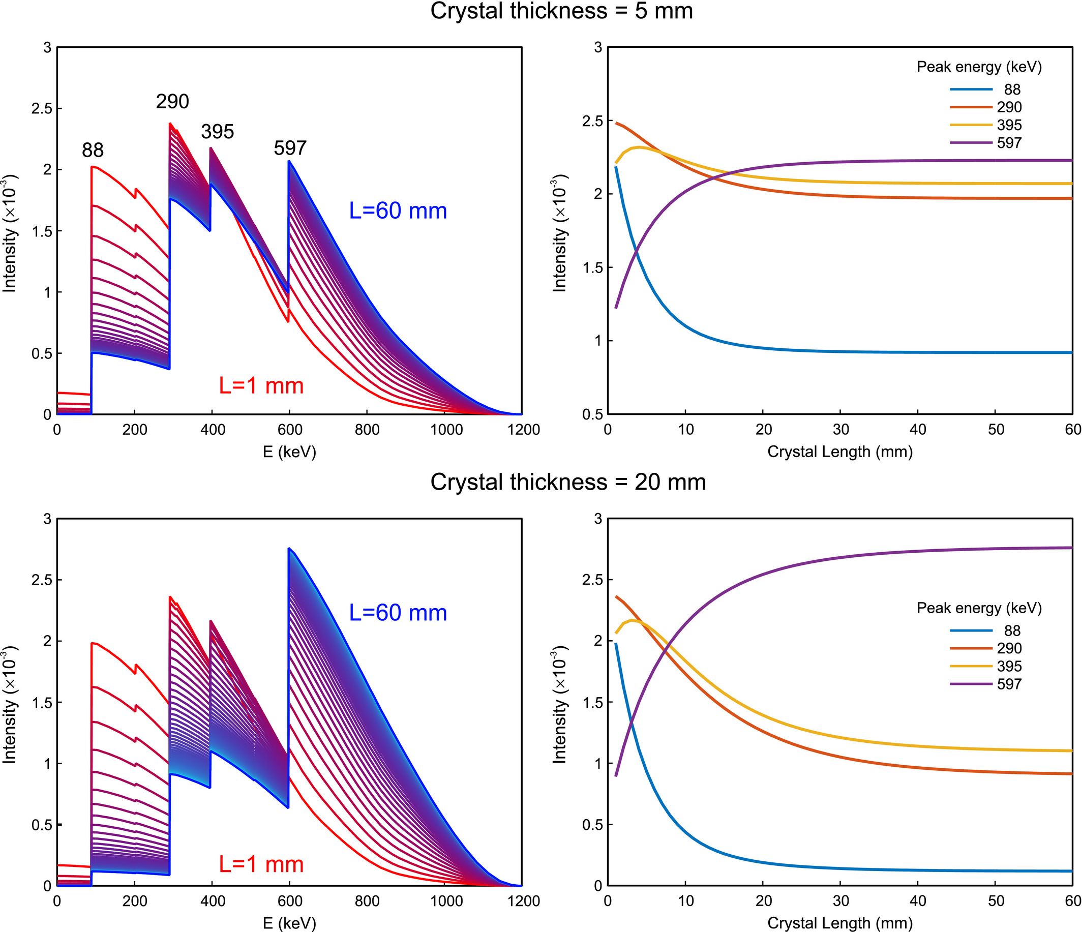
Energy spectra due to the intrinsic radiation of LYSO/LSO scintillators for a wide range of crystal sizes
Medical Physics, Volume: 48, Issue: 4, Pages: 1596-1607, First published: 21 January 2021, DOI: (10.1002/mp.14729)
Notes:
On the left the energy spectra due to the intrinsic radioactivity of LYSO square base cuboids of lengths L = 1 to 60 mm for two different thicknesses, T = 5 mm (top) and T = 20 mm (bottom). To the right, the intensities of the most prominent peaks are shown as a function of crystal length.
IF THIS IMAGE HAS BEEN PROVIDED BY OR IS OWNED BY A THIRD PARTY, AS INDICATED IN THE CAPTION LINE, THEN FURTHER PERMISSION MAY BE NEEDED BEFORE ANY FURTHER USE. PLEASE CONTACT WILEY'S PERMISSIONS DEPARTMENT ON PERMISSIONS@WILEY.COM OR USE THE RIGHTSLINK SERVICE BY CLICKING ON THE 'REQUEST PERMISSIONS' LINK ACCOMPANYING THIS ARTICLE. WILEY OR AUTHOR OWNED IMAGES MAY BE USED FOR NON-COMMERCIAL PURPOSES, SUBJECT TO PROPER CITATION OF THE ARTICLE, AUTHOR, AND PUBLISHER.

