Slide 1
Programming 2
Unit Testing

Slide 2
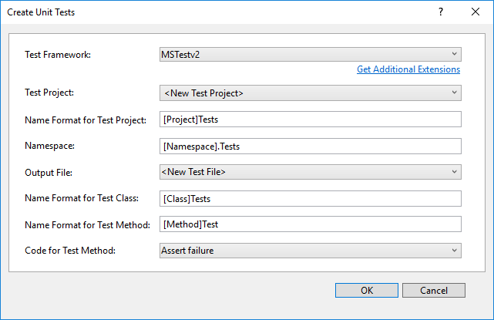
5. Unit Tests
To Create a unit test, right-click the method you want to test and select Create Unit Tests.
In the dialog
select the unit test you added earlier
Add to the existing cs file for the output file

Slide 3
5. Unit Tests
To test your method in the Unit Test…
Call the method
Assert on the expected outcome.
Example, if I want to test that the Sum method correctly adds 2 numbers, I would do this…
int n1 = 4, n2 = 5;
Assert.AreEqual<int>(9, Sum(n1, n2));
To run your test, right-click the test method or the test class and select Run Test(s).

Slide 4
Unit Tests
UNIT TEST BASICS
UNIT TEST WALKTHROUGH

