Slide 1
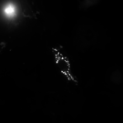
Cell 1

Slide 2
Cell 1

