Slide 1
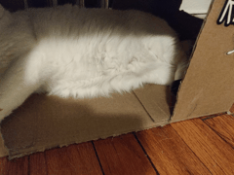







Cell 1

Slide 2

Cell 1

Slide 3
Cell 2

