Slide 1
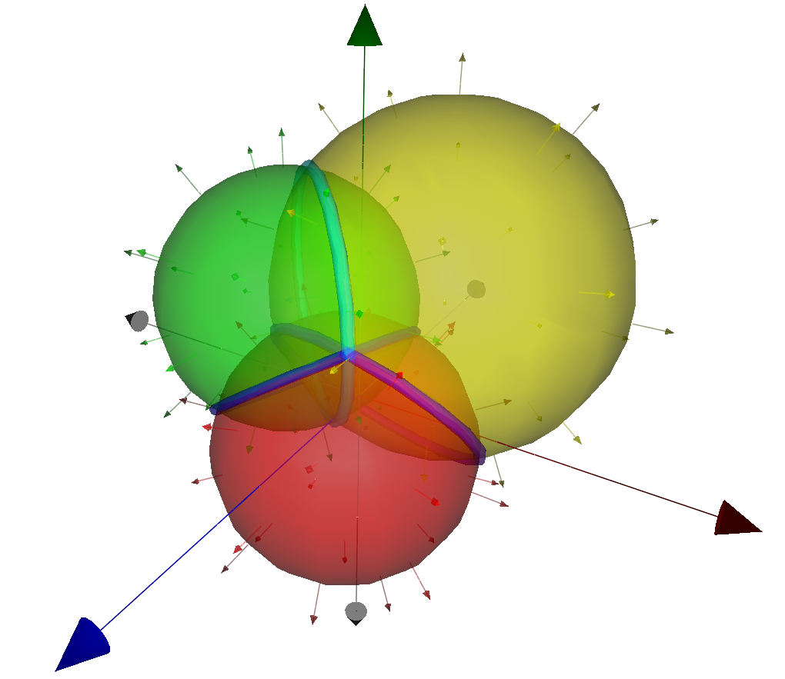
Models of Geometry using Geometric Algebra

Slide 2


The Outer Product
Notes:
The outer product glues a bunch of vectors together into something new called a blade.
The blade is non-zero if and only if the m vectors form a linearly independent set.
Therefore, m <= n. m is the grade of the blade.
The outer product is anti-commutative.
The term blade suggests something flat. If V^n is Euclidean, we can visualize that.
0-blades are scalars. n-blades are psuedo-scalars.
Blades may represent sub-spaces of V^n and a little bit more. Sub-spaces of V^n become elements of computation.
The outer product is left and right distributive over addition. Blade addition, factorization, meet and join are interesting topics. The wedge product is associative.

Slide 3



The Inner Product

Slide 4

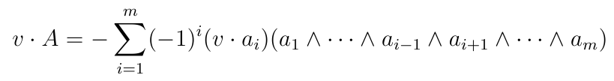

The Inner Product Continued…

Slide 5

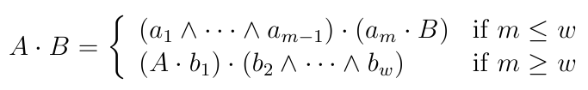
The Inner Product Continued…
Notes:
This is a recursive definition.
The outer product is left and right distributive over addition. It is not associative.

Slide 6

The Geometric Product
Notes:
This is not a blade. It is a sum of blades of different grades, a multivector.
Multivectors are sums of blades or sums k-vectors of various grade. All k-blades are k-vectors, but not all k-vectors are k-blades.
Some elements have multiplicative inverses with respect to the geometric product.

Slide 7


The Geometric Product Continued…

Slide 8

The Geometric Product Continued…
Notes:
This is called a versor if each and every vector has a multiplicative inverse with respect to the geometric product.
I call general products of vectors, (invertible or not), psuedo-versors.
Versors are even or odd, but the term grade does not apply. This versor is not of grade m, for example. It expands as a multivector.

Slide 9
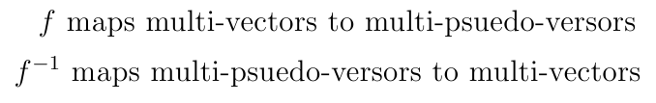

The Geometric Product Continued…

Slide 10


Representing Geometries as Point Sets
Notes:
Note that if v^B = 0, then v must be a linear combination of any vector factorization of B.
It doesn’t matter right now how p is defined.
So the set of all Euclidean points in our geometry is the set of all corresponding vectors in the blade representing that geometry.
In CGA, the Euclidean points are embedded in the geometric algebra. (i.e., they are a sub-algebra of the algebra.) But for models of geometry in general, this may not be necessary.
B* is a dual of B. It is everything in the super-space that is not in the sub-space represented by B. B* is the complement of B with respect to the parent space.
B directly represents G’(B).
B dually represents G(B).
If B directly represents a geometry, then B^* dually represents the same geometry and vice-versa.

Slide 11
The Intersection of Geometries
Notes:
Suppose A and B both directly represent their respective geometries.
This is actually un-interesting to me. What will be interesting is a proof of closure, or the re-interpretation theorem.
A^B is the direct representation of the geometry that is the intersection of the geometries represented by A and B.

Slide 12

The Union of Geometries?
So what is the geometry represented by A^B in this case?!?!
We will get to the bottom of this!
Notes:
Suppose A and B are dual representatives of their respective geometries.
A^B dually represents a geometry that is more than their union!
The converse of the statement is not true. If v^A^B=0, v may be in a sub-space of A^B that non-trivially overlaps both A and B.

Slide 13
The Conformal Geometries
Vectors of certain forms can be found that directly represent spheres, points and planes.
We can then intersect these to create circles, lines, point-pairs, tangent points (degenerate circles and point-pairs), and flat points (2 or 3-blades representative of points).
Notes:
For the moment, the specific vector forms of spheres, points and planes doesn’t matter, because it would just cloud the issues at hand.

Slide 14
Conformal Points
For any Euclidean point x, the vector p(x) is the direct form representative of the point x.
But wait! That means p(x).p(x)=0.
Yes, p(x) is called a null vector.
The GA for the conformal model is therefore non-Euclidean.
Notes:
The point-sets of geometries can also be thought of as the set of all conformal points such that yadda-yadda.

Slide 15
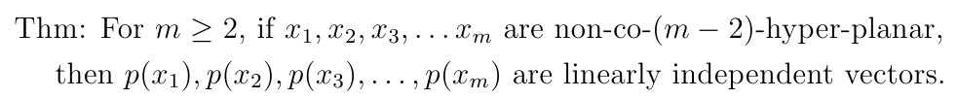
An Important Theorem
If m=2, unique
If m=3, non-co-linear,
If m=4, non-co-planar,
If m=5, non-co-hyper-planar,
etc.

Slide 16
Conformal Point-Pairs, Circles and Spheres
Let B be a blade dually representative of a point-pair, circle or sphere (an m-dimensional round in general with m>0.)
Then we can find m+1 Euclidean points in G(B) such that they are all non-co-(m-1)-hyper-planar.
If x1, x2, x3, … x(m+1) are such points, it follows that B = s*p(x1)^p(x2)^p(x3)^…^p(x(m+1)).
Notes:
Here s is a scalar.

Slide 17
Conformal Lines and Planes
Let B be a blade dually representative of a line or plane (an m-dimensional flat in general.)
Then we can find m+2 Euclidean points in G(B) such that they are all non-co-(m-1)-hyper-planar and non-co-m-hyper-spherical.
If x1, x2, x3, … x(m+2) are such points, it follows that B = s*p(x1)^p(x2)^p(x3)^…^p(x(m+2)).
Notes:
If m+2 points were co-m-hyper-spherical, then their outer product would be zero. This is easy to prove. We can find an m+1 subset of the m+2 points that forms the m-hyper-sphere, and therefore their outer product is non-zero. Then wedging with the remaining point on the m-hyper-sphere gives zero, because it’s on the sphere!
Since all m+2 points are in G(B), their outer product with B is zero. And since the outer product of the m+2 points is non-zero, they form a linearly independent set. It follows that B is a scalar multiple of their outer product!

Slide 18
What have we learned?
Any dual round or flat can be factored into the outer product of conformal points.
The outer product of dual rounds (or flat) can create higher dimensional dual rounds (or flats) that are more than simple unions.
By contrast, the outer product of direct rounds (or flats) can create lower dimensional direct rounds (or flats) that are simply intersections.
Notes:
Give example of problem solving in the model: Fit a direct sphere to a direct point and direct circle. (It’s the inner product of the two blades.) Fit a direct sphere to two direct point-pairs.

Slide 19
Geometric Analysis
Let A and B be direct or dual form representatives of the same geometry.
It then follows that, up to scale, A = B.
Proof: We can find a common basis for A and B (or their duals) in terms of conformal points.
Any blade B can be interpreted in a canonical form.
Notes:
For example, the intersection of two spheres can be interpreted as the intersection between a plane and a sphere centered on that plane, which is the canonical form of a circle.
Canonical forms can be used to decompose geometries.

Slide 20
We didn’t use the geometric product!
We haven’t used it yet!
We can find unit-versors V that represent affine transformations that have no shear or non-uniform scale.
Then for any blade B, the blade VBV~ represents the transformed geometry!
Notes:
Transformation versors can also be used to compose geometries from simpler things, such as a normal Euclidean vector.

Slide 21
The End
Any questions?

