Slide 1

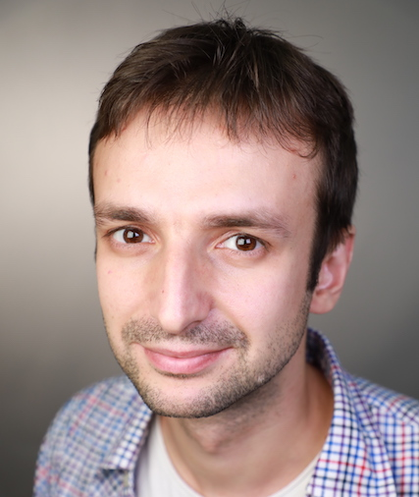
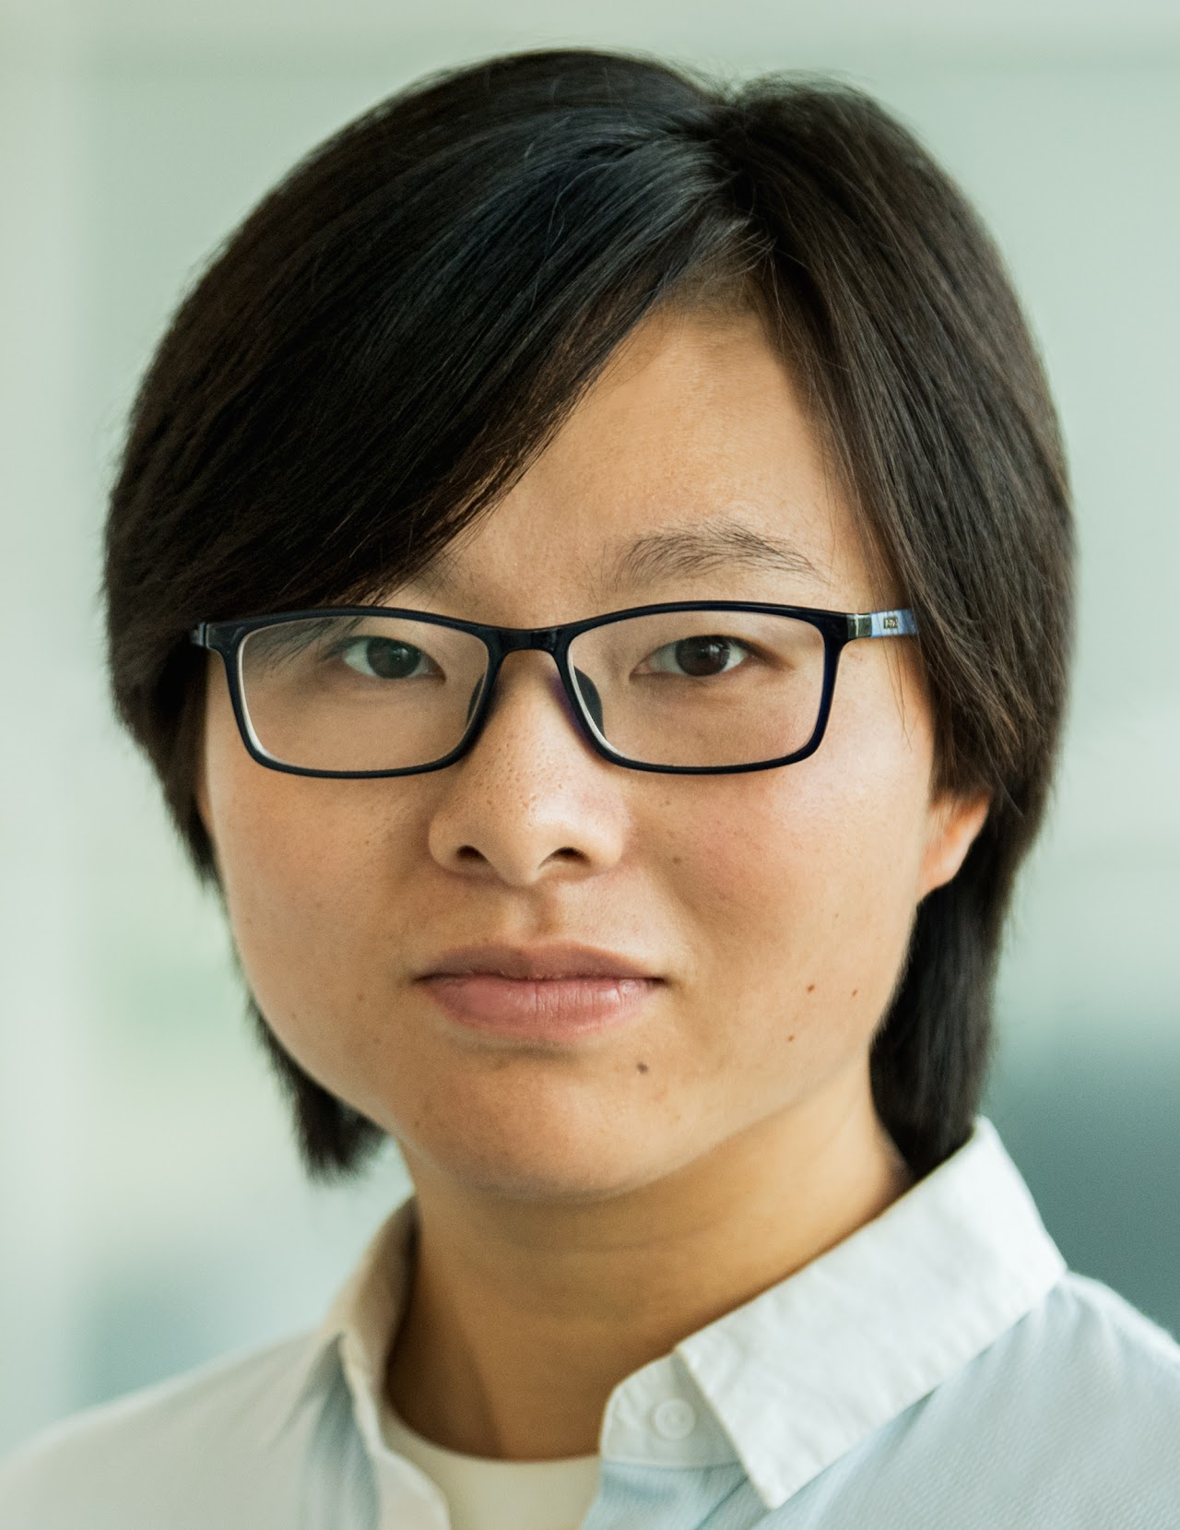
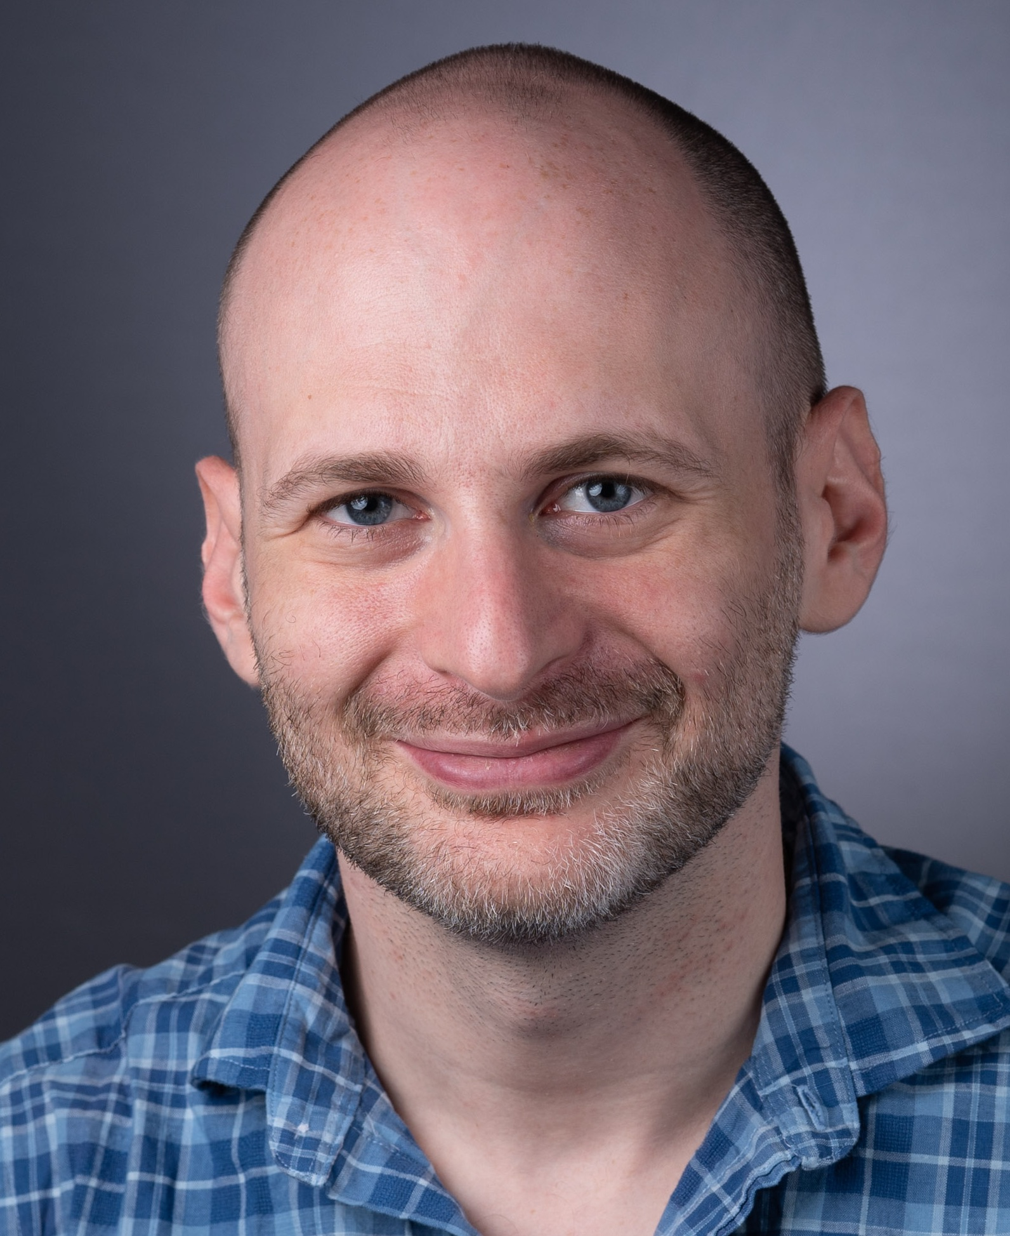
The (im)possibility of simple search-to-decision reductions for approximation problems
APPROX’23
Spencer Peters, and

Slide 2
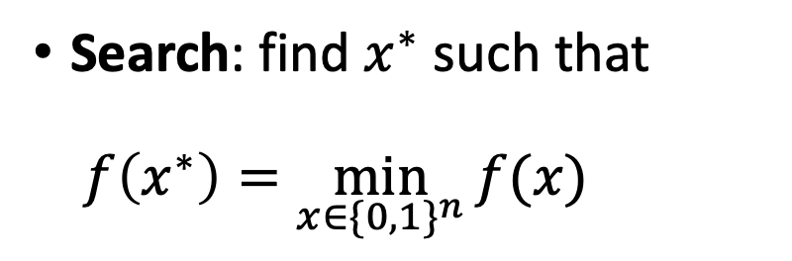
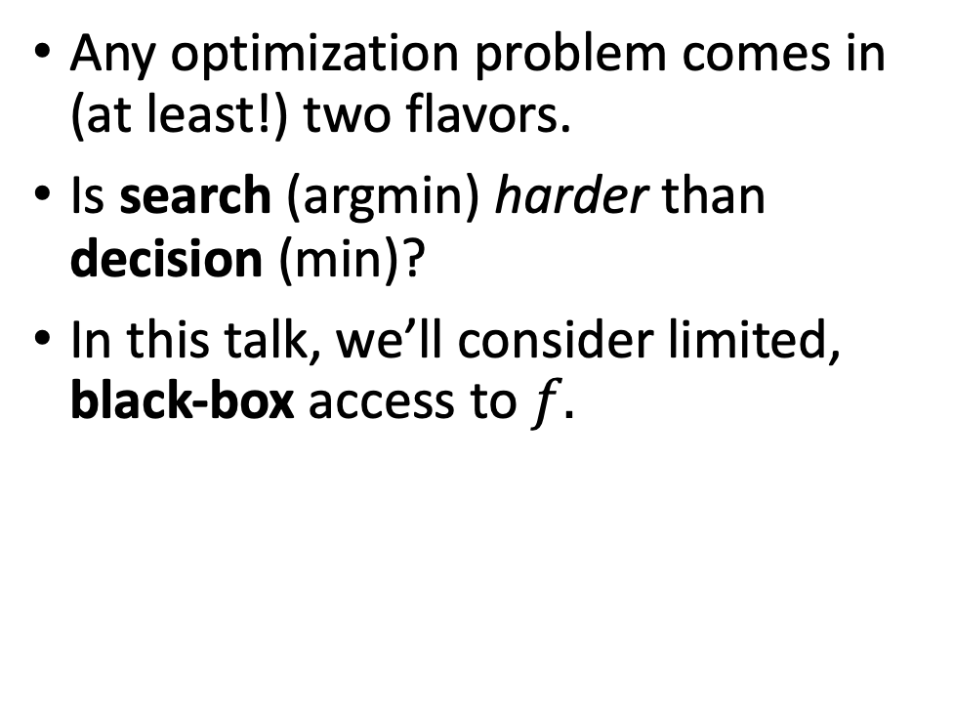
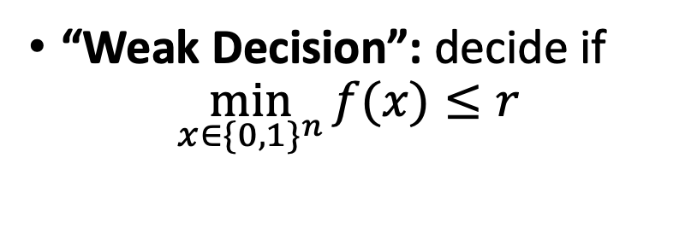
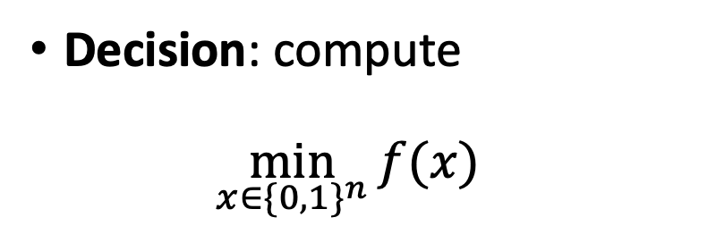
Optimization Problems
Any optimization problem comes in (at least!) two flavors.
Is search (argmin) harder than decision (min)?
In this talk, we’ll consider limited, black-box access to $f.$
Search: find $x^{∗}$ such that $f\left(x^{∗}\right)=\min_{x∈\{0, 1\}^{n}}{f(x)}$
Decision: compute $\min_{x∈\{0, 1\}^{n}}{f(x)}$
“Weak Decision”: decide if
$$\min_{x∈\{0, 1\}^{n}}{f(x)}≤r$$

Slide 3

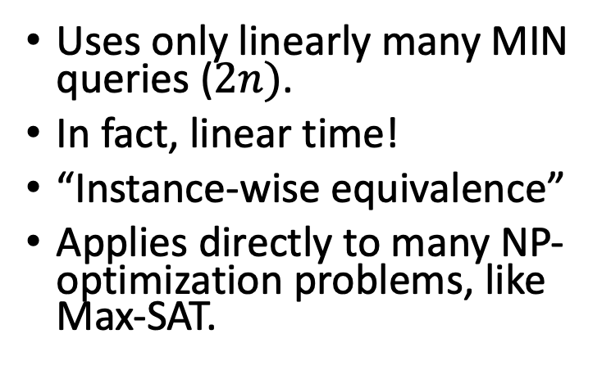
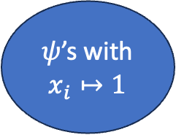
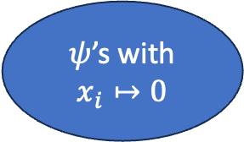
A search-to-decision reduction
Uses only linearly many MIN queries ($2n)$.
In fact, linear time!
“Instance-wise equivalence”
Applies directly to many NP-optimization problems, like Max-SAT.
*
MIN = 3
0…
1…
MIN = 5
MIN = 3
10…
11...
MIN = 3
…
Boolean constraints $ψ$
10…1
$ψ$’s with
$x_{i}↦0$
$ψ$’s with
$$x_{i}↦1$$
MIN = 3

Slide 4
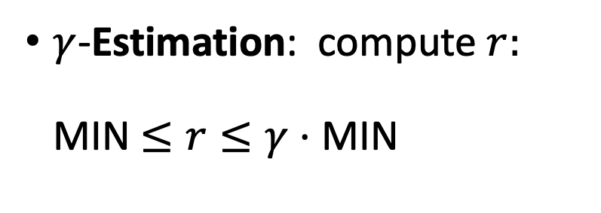
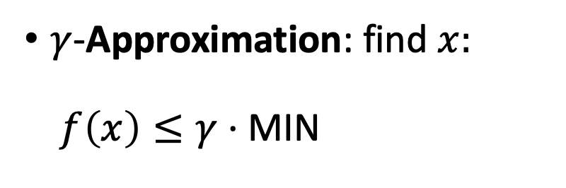
What about approximate Optimization?
$γ$-Approximation: find $x:$ $f\left(x\right)≤γ⋅$ MIN
$γ$-Estimation: compute $r:$ MIN $≤r≤γ⋅$ MIN
Is Approximation harder than Estimation?

Slide 5
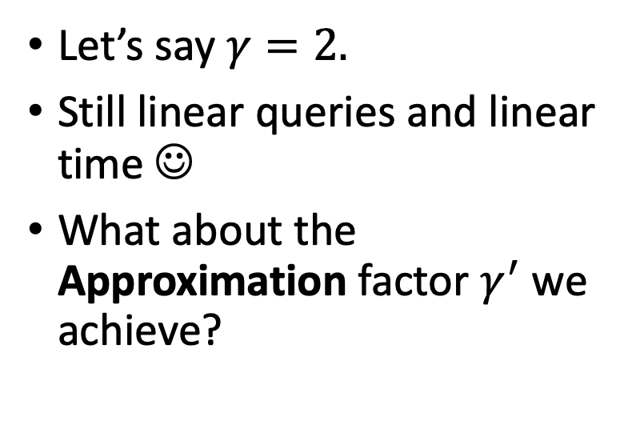
The “greedy” reduction
*
Let’s say $γ=2.$
Still linear queries and linear time ☺
What about the Approximation factor $γ^{′}$ we achieve?
EST = 3
0…
1…
EST = 5
EST = 4
10…
11...
EST = 8
EST = 20
…
10…1
EST = ?

Slide 6
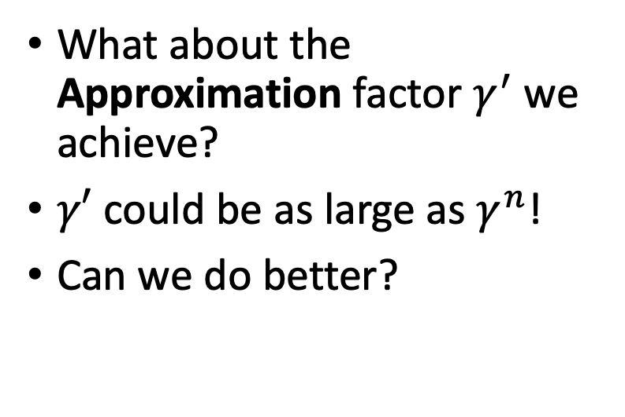

The “greedy” reduction
*
What about the Approximation factor $γ^{′}$ we achieve?
$γ′$ could be as large as $γ^{n}$!
Can we do better?
EST = 1
0…
1…
EST = 2
EST = 2
10…
11...
EST = 4
EST = 4
…
10…1
EST = $2^{n}$

Slide 7
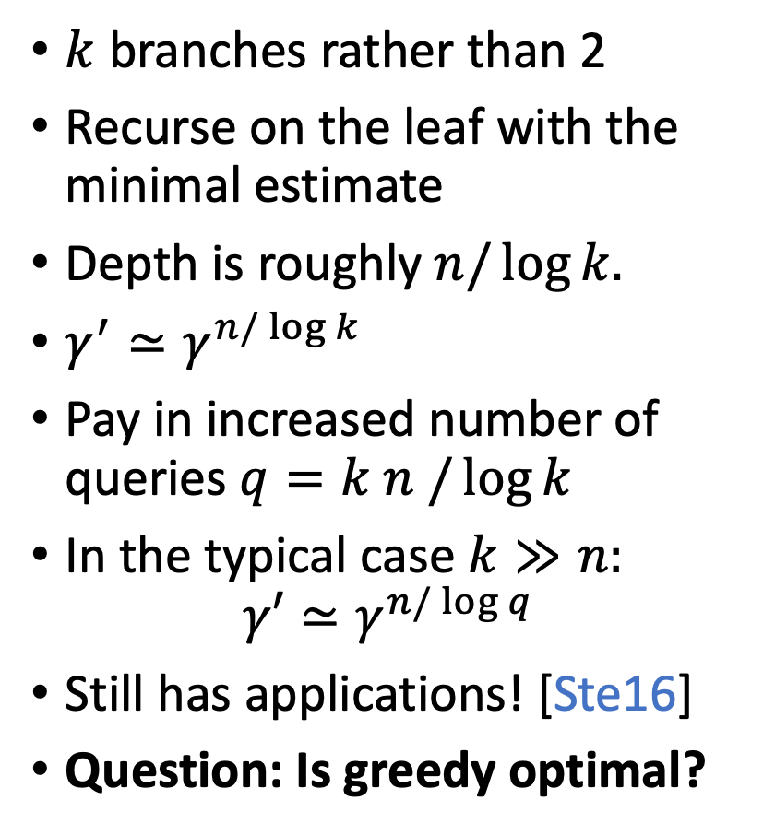
The “greedy” reduction
$k$ branches rather than 2
Recurse on the leaf with the minimal estimate
Depth is roughly $n{/\log{k. }}$
$γ^{′}≃γ^{n/\log{k}}$
Pay in increased number of queries $q=k n /\log{k}$
In the typical case $k≫n:$ $γ′≃γ^{n/\log{q}}$
Still has applications! [Ste16]
Question: Is greedy optimal?
…
…
…

Slide 8
Branch-and-bound algorithms
At a high level, a generalization of the “greedy” reduction!
Practical. (e.g., [MJSE16]).Used for combinatorial optimization problems like TSP, MaxCSPs [BMHW21, Cook16]
Question: how powerful are “black-box” branch-and-bound algorithms?
…
…

Slide 9
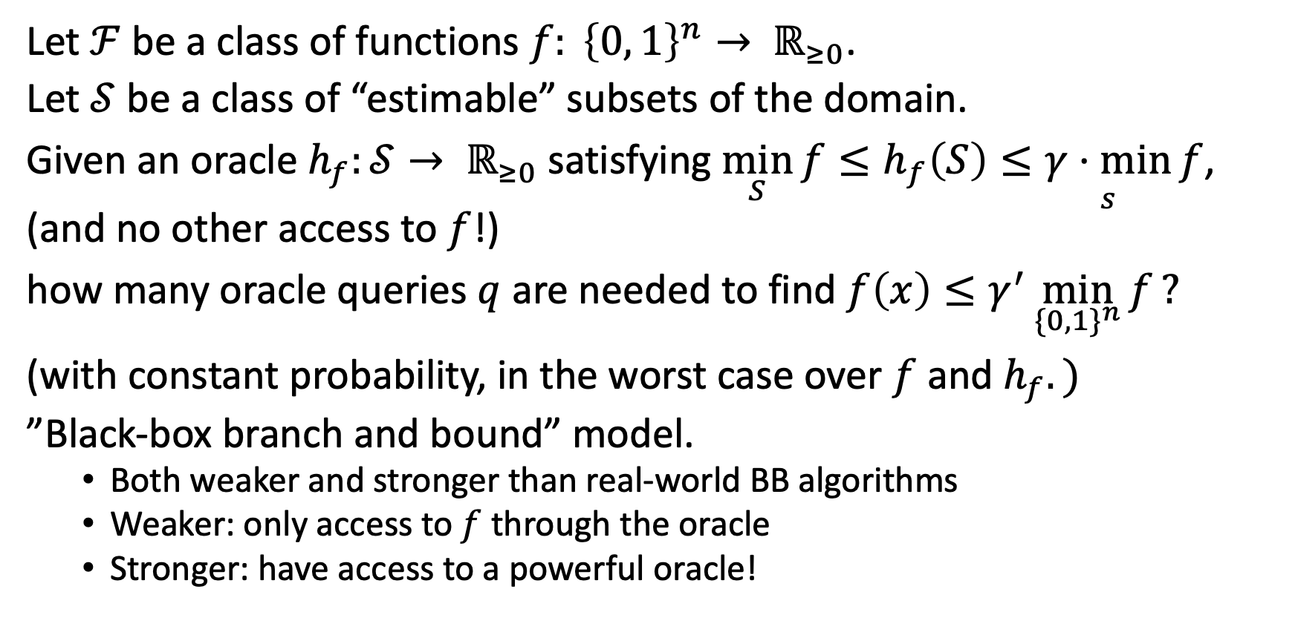
Our Model
Let $ℱ$ be a class of functions $f: {\left\{0, 1\right\}}^{n}→ ℝ_{≥0}$.
Let $𝒮$ be a class of “estimable” subsets of the domain.
Given an oracle $h_{f}:𝒮→ ℝ_{≥0}$satisfying ${\min_{S}{f}≤h}_{f}\left(S\right)≤\underset{s}{γ⋅min}{f}$, (and no other access to $f$!)
how many oracle queries $q$ are needed to find $f\left(x\right)≤γ^{′}\min_{\{0, 1\}^{n}}{f}?$
(with constant probability, in the worst case over $f$ and $h_{f}.)$
”Black-box branch and bound” model.
Both weaker and stronger than real-world BB algorithms
Weaker: only access to $f$ through the oracle
Stronger: have access to a powerful oracle!

Slide 10

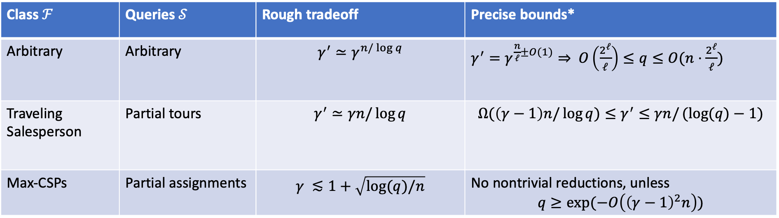
Our Results
For arbitrary $f,$greedy is optimal!
A tight lower bound for the Traveling Salesperson Problem (TSP).
A strong lower bound for Max-Constraint Satisfaction Problems.
Class $ℱ$ | Queries $𝒮$ | Rough tradeoff | Precise bounds*
Arbitrary | Arbitrary | $$γ^{′}≃γ^{n/\log{q}}$$ | $γ^{′}=γ^{\frac{n}{ℓ}±O(1)}⇒$ $O\left(\frac{2^{ℓ}}{ℓ}\right)≤q≤O(n⋅\frac{2^{ℓ}}{ℓ})$
Traveling Salesperson | Partial tours | $$γ^{′}≃γn/\log{q}$$ | $${Ω(\left(γ−1\right)n/\log{q)}≤γ}^{′}≤γn/(log{(q)−1)}$$
Max-CSPs | Partial assignments | $$γ ≲1+\sqrt{\log{(q)/n}}$$ | No nontrivial reductions, unless $$q≥\exp{(−O\left({\left(γ−1\right)}^{2}n\right))}$$

Slide 11

Useless Oracles
Idea: Find $𝒟∈Δ(ℱ)$ such that for every $S$, the min of $f←𝒟$ over $S$ is overwhelmingly likely to fall in a fixed interval of width $γ$.
Then, for $f←𝒟$, a $γ$-estimation oracle $h_{f}$ is useless! You know in advance what it’s going to tell you.
How do we make this intuition formal?

Slide 12
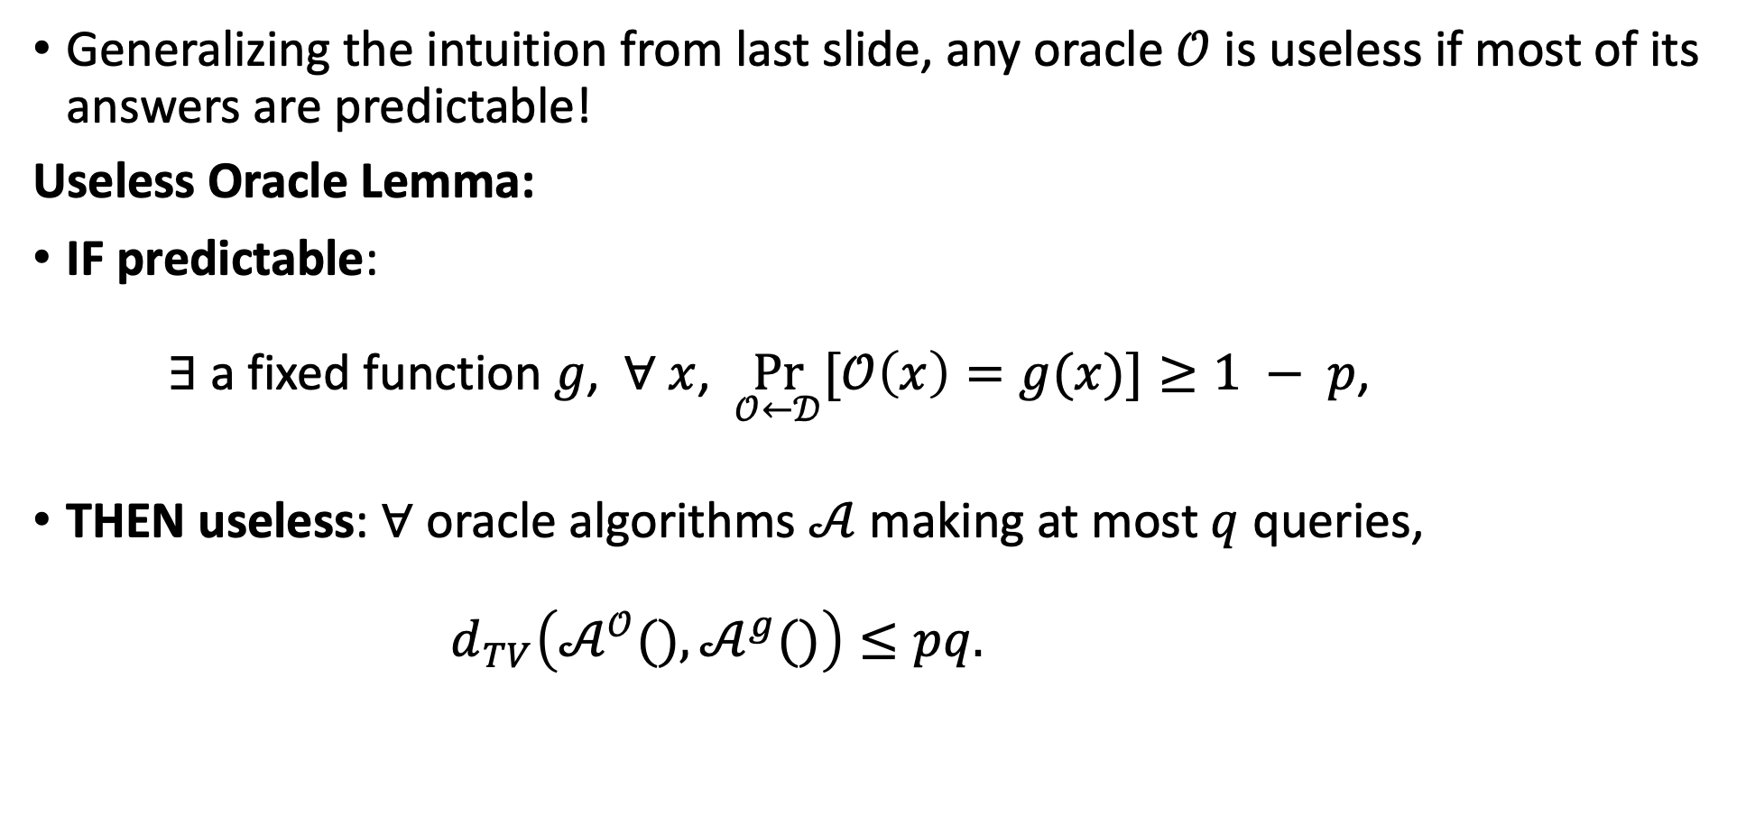
Useless Oracles
Generalizing the intuition from last slide, any oracle $𝒪$ is useless if most of its answers are predictable!
Useless Oracle Lemma:
IF predictable: $∃$ a fixed function $g$, $∀ x$, $\underset{𝒪←𝒟}{Pr}{[𝒪\left(x\right)=g(x)]}≥1 − p$,
THEN useless: $∀$ oracle algorithms $𝒜$ making at most $q$ queries, $d_{TV}\left(𝒜^{𝒪}(), 𝒜^{g}()\right)≤pq.$

Slide 13
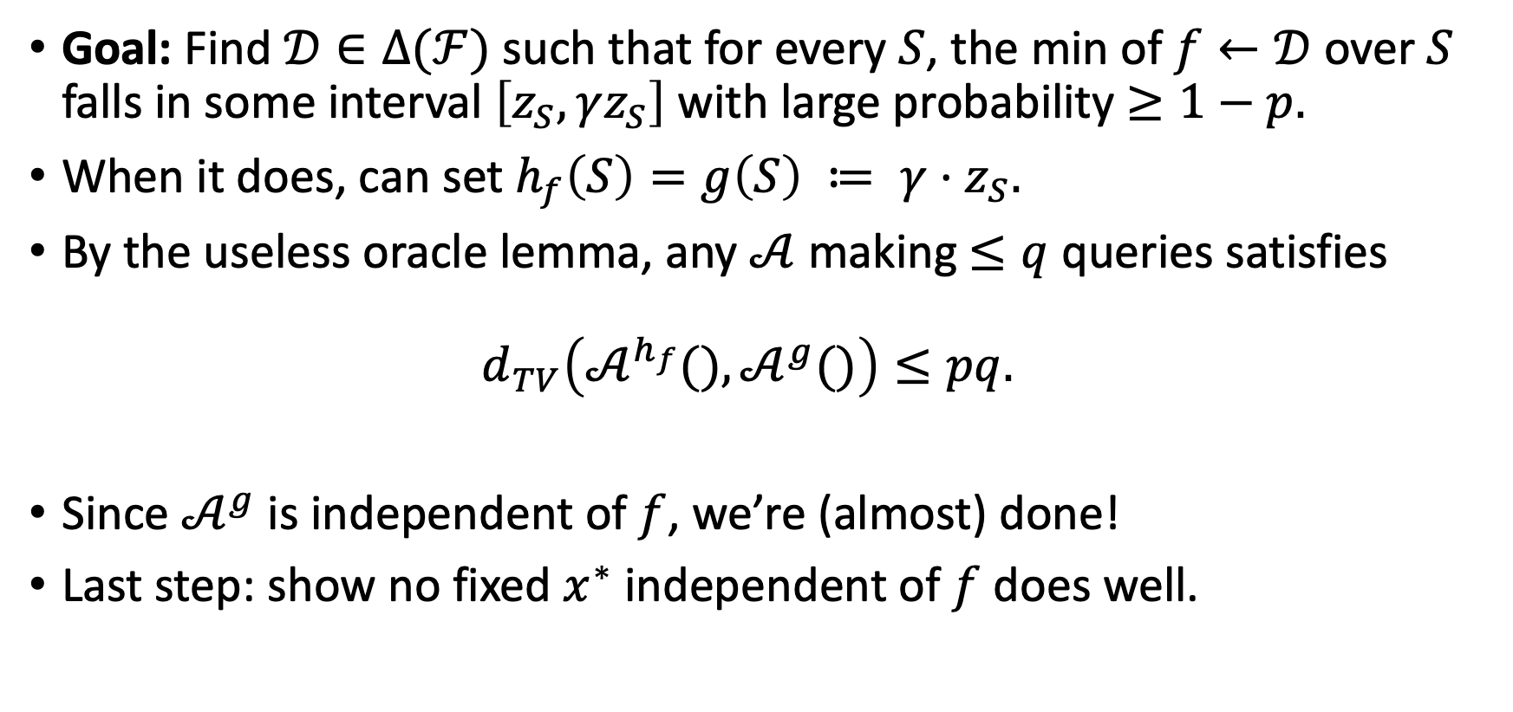
Useless Estimators
Goal: Find $𝒟∈Δ(ℱ)$ such that for every $S$, the min of $f←𝒟$ over $S$ falls in some interval $\left[z_{S}, γz_{S}\right]$ with large probability $≥1−p.$
When it does, can set $h_{f}\left(S\right)=g\left(S\right) ≔ {γ⋅z}_{S}.$
By the useless oracle lemma, any $𝒜$ making $≤q$ queries satisfies $d_{TV}\left(𝒜^{h_{f}}(), 𝒜^{g}()\right)≤pq.$
Since $𝒜^{g}$ is independent of $f$, we’re (almost) done!
Last step: show no fixed $x^{∗}$ independent of $f$ does well.

Slide 14
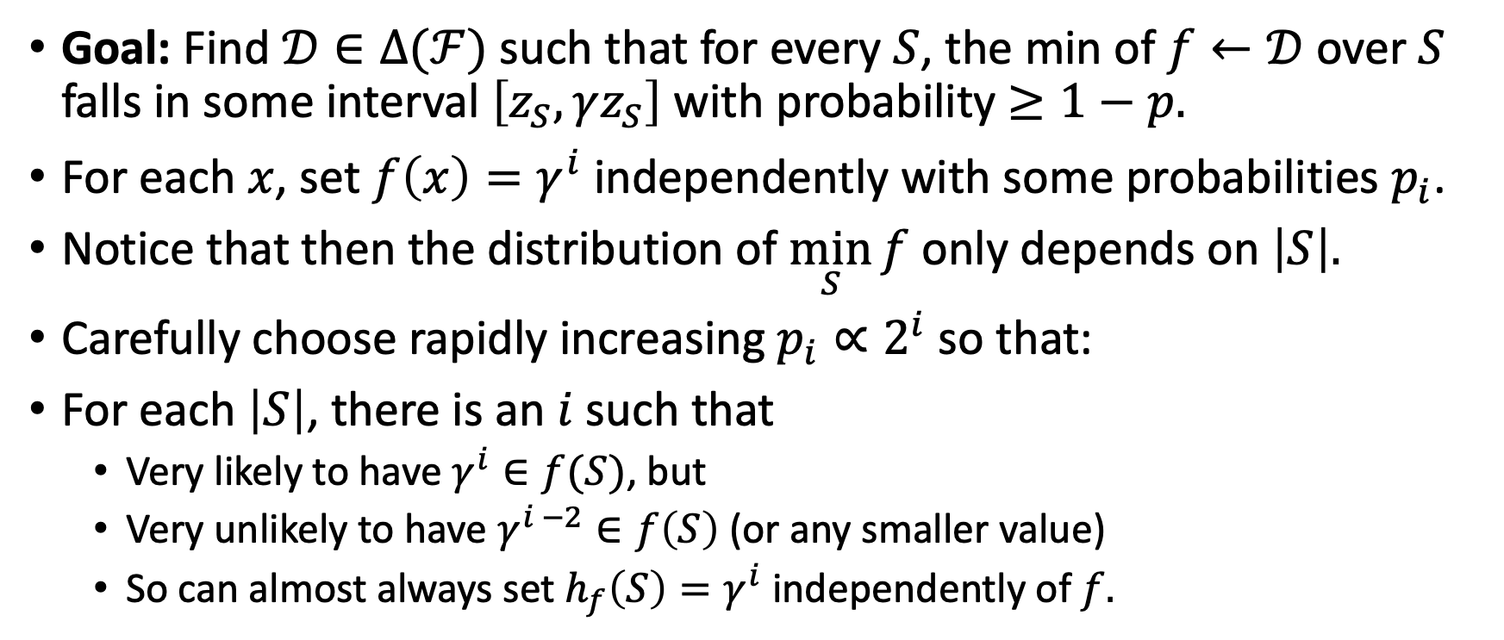
“Greedy” is optimal
Goal: Find $𝒟∈Δ(ℱ)$ such that for every $S$, the min of $f←𝒟$ over $S$ falls in some interval $\left[z_{S}, γz_{S}\right]$ with probability $≥1−p.$
For each $x$, set $f\left(x\right)=γ^{i}$ independently with some probabilities $p_{i}$.
Notice that then the distribution of $\min_{S}{f}$ only depends on $\left|S\right|.$
Carefully choose rapidly increasing $p_{i}∝2^{i}$ so that:
For each $\left|S\right|$, there is an $i$ such that
Very likely to have $γ^{i}∈f(S)$, but
Very unlikely to have $γ^{i −2}∈f\left(S\right)$ (or any smaller value)
So can almost always set $h_{f}\left(S\right)=γ^{i}$ independently of $f.$

Slide 15
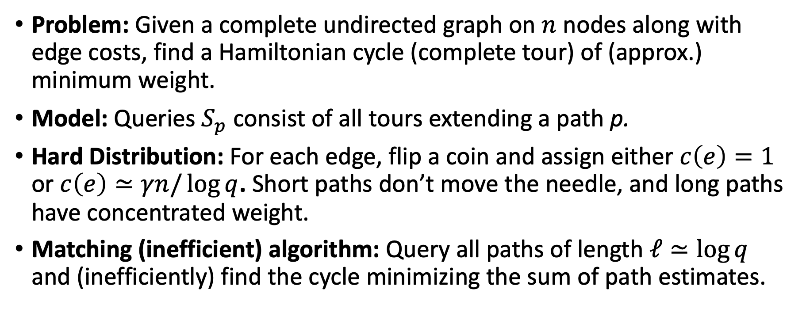
Traveling Salesperson
Problem: Given a complete undirected graph on $n$ nodes along with edge costs, find a Hamiltonian cycle (complete tour) of (approx.) minimum weight.
Model: Queries $S_{p}$ consist of all tours extending a path p.
Hard Distribution: For each edge, flip a coin and assign either $c\left(e\right)=1$ or $c\left(e\right)≃γn/\log{q}$. Short paths don’t move the needle, and long paths have concentrated weight.
Matching (inefficient) algorithm: Query all paths of length $ℓ≃\log{q}$ and (inefficiently) find the cycle minimizing the sum of path estimates.

Slide 16
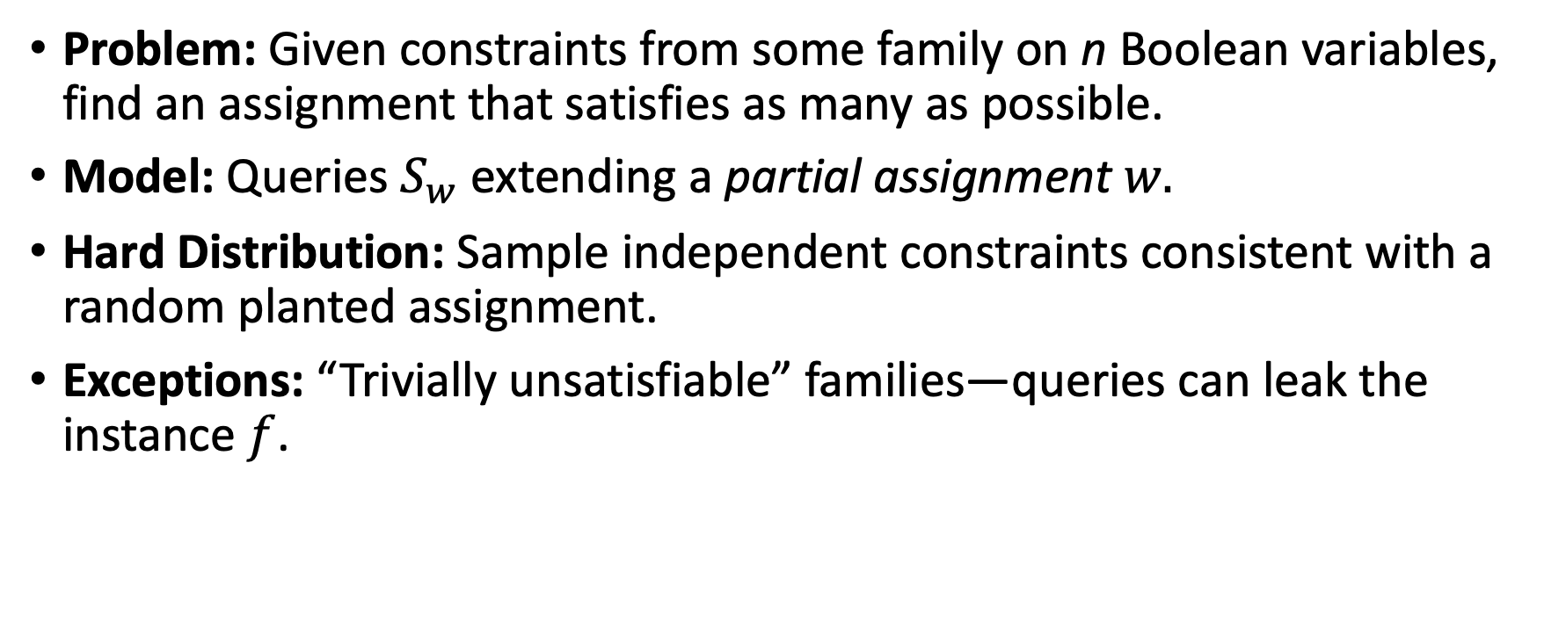
Max-Constraint Satisfaction Problems
Problem: Given constraints from some family on n Boolean variables, find an assignment that satisfies as many as possible.
Model: Queries $S_{w}$ extending a partial assignment $w.$
Hard Distribution: Sample independent constraints consistent with a random planted assignment.
Exceptions: “Trivially unsatisfiable” families—queries can leak the instance $f$.

Slide 17

Open Questions
The most obvious direction is to study more function classes $ℱ$.
Average-case results?
More interestingly, could we make richer models of branch-and-bound algorithms that still have provable lower bounds?

Slide 18
Thank you!
Feel free to follow up with me at speters@cs.cornell.edu

Slide 19
References
[BHMW21]: Armin Biere, Marijn Heule, Hans van Maaren, and Toby Walsh. Handbook of satisfiability, volume 336. IOS press, 2021.
[Cook11]: William J. Cook. In pursuit of the traveling salesman. Princeton University Press, 2011.
[MJSE16]: David R. Morrison, Sheldon H. Jacobson, Jason J. Sauppe, and Edward C. Sewell. Branch-and-bound algorithms: A survey of recent advances in searching, branching, and pruning. Discrete Optimization, 19:79–102, February 2016. doi:10.1016/j.disopt.2016.01.005.
[Ste16]: Noah Stephens-Davidowitz. Search-to-decision reductions for lattice problems with approximation factors (slightly) greater than one. In APPROX, 2016

