Slide 1
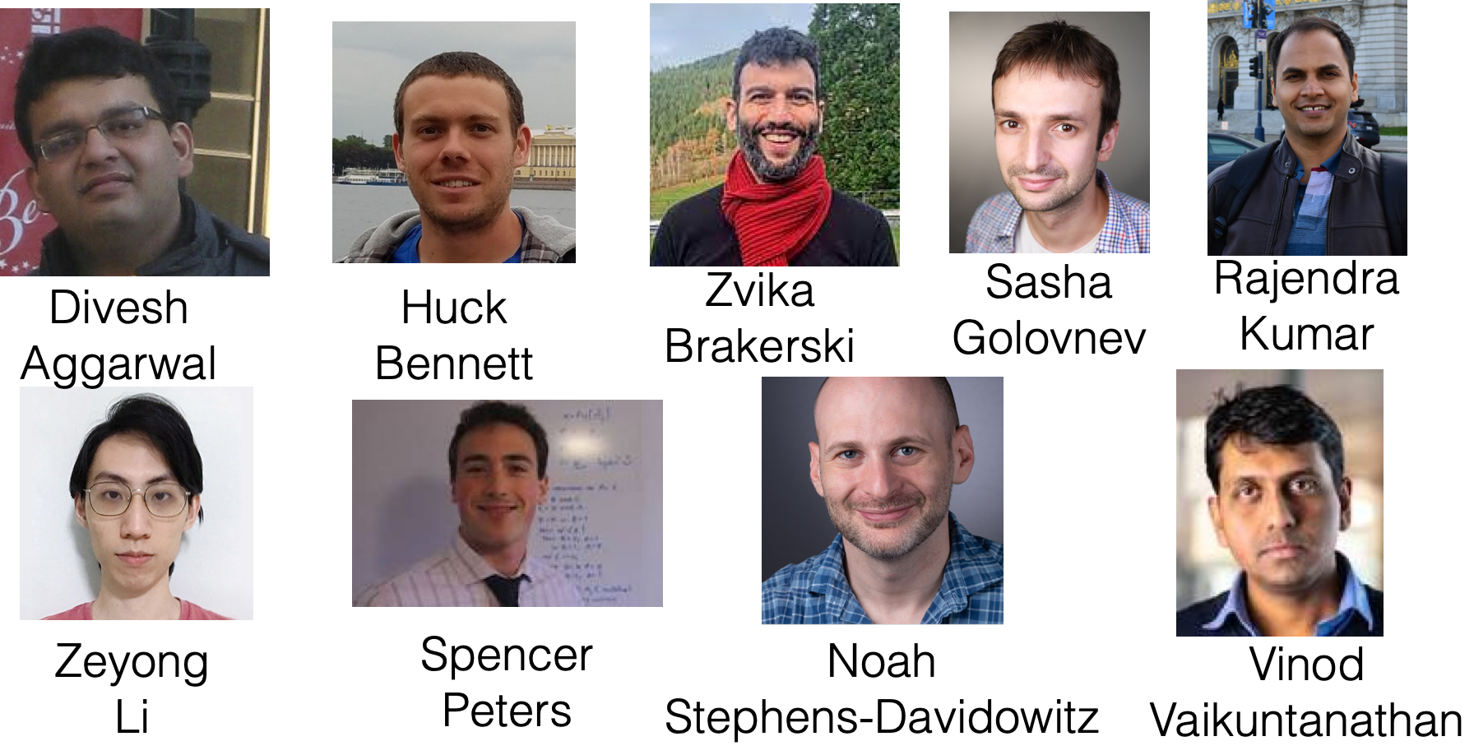
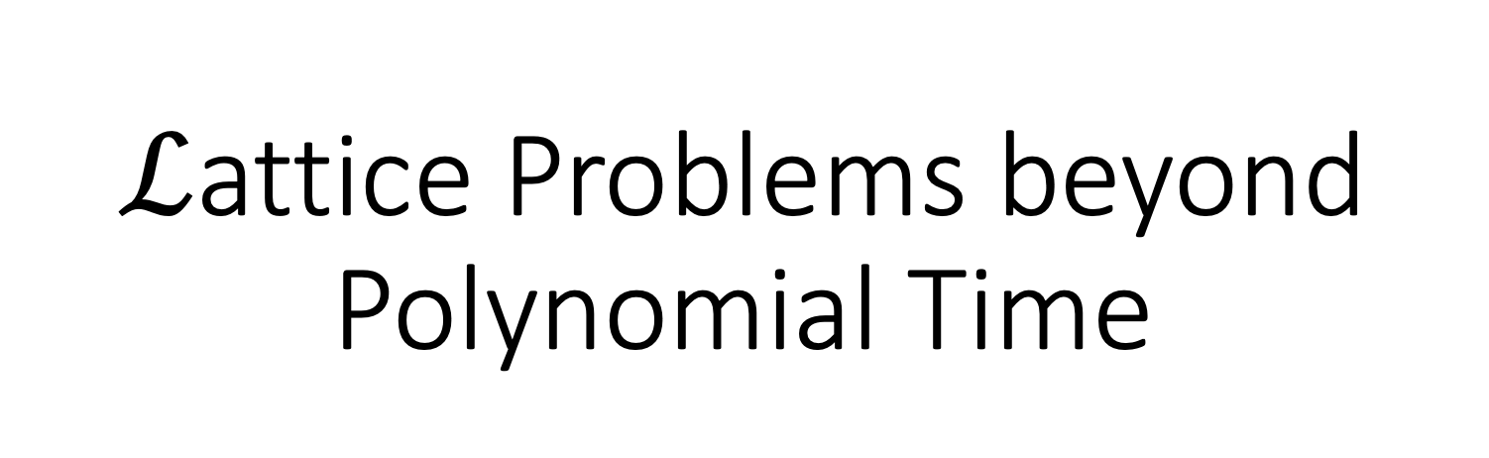
$ℒ$attice Problems beyond Polynomial Time

Slide 2
Organization
Flipping the usual order!
FIRST, an overview of results, so you have the big picture in mind
THEN background, motivation, and implications

Slide 3
Overview

Slide 4
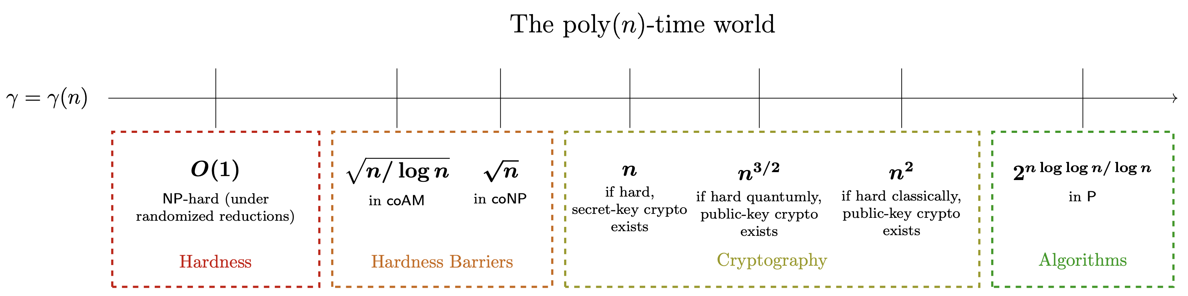
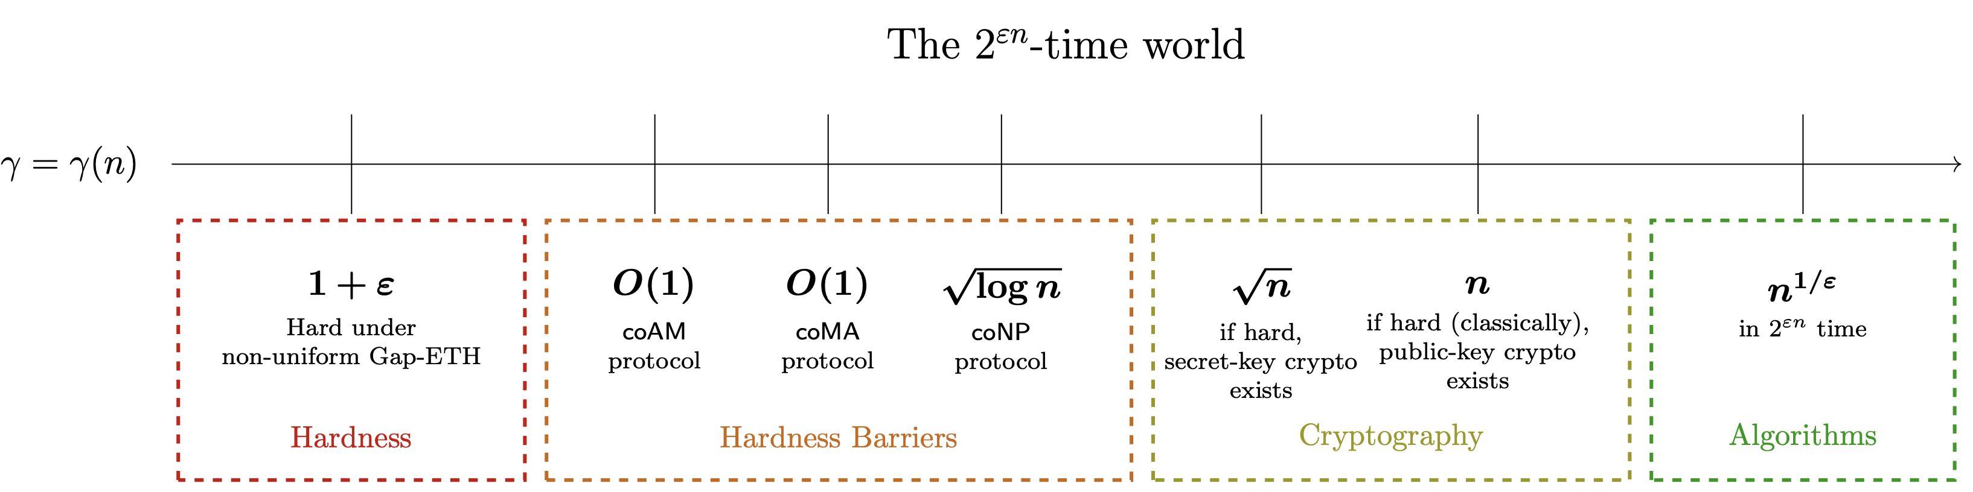
Approximating a certain important problem…
Barriers to proving exponential hardness from, for example, the Exponential Time Hypothesis ☹
Our work!
Better security guarantees! (Assuming exponential hardness, widely believed.)

Slide 5
Background
(What approximation problem are we talking about?!)

Slide 6
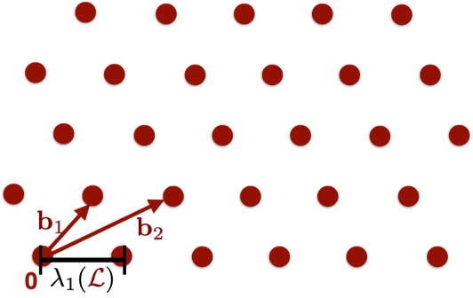
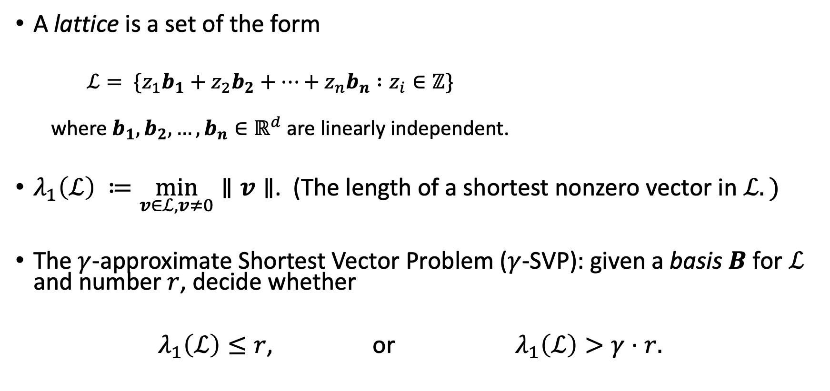
Lattices
A lattice is a set of the form
$ℒ= \{z_{1}b_{1}+z_{2}b_{2}+…+z_{n}b_{n} :z_{i}∈ℤ\}$
where $b_{1},b_{2},…, b_{n}∈ℝ^{d}$ are linearly independent.
$λ_{1}\left(ℒ\right) ≔\min_{v∈ℒ, v≠0}∥v∥$. (The length of a shortest nonzero vector in $ℒ.)$
The $γ$-approximate Shortest Vector Problem ($γ$-SVP): given a basis $B$ for $ℒ$ and number $r$, decide whether
$λ_{1}\left(ℒ\right)≤r$, or $λ_{1}\left(ℒ\right)>γ⋅r.$

Slide 7
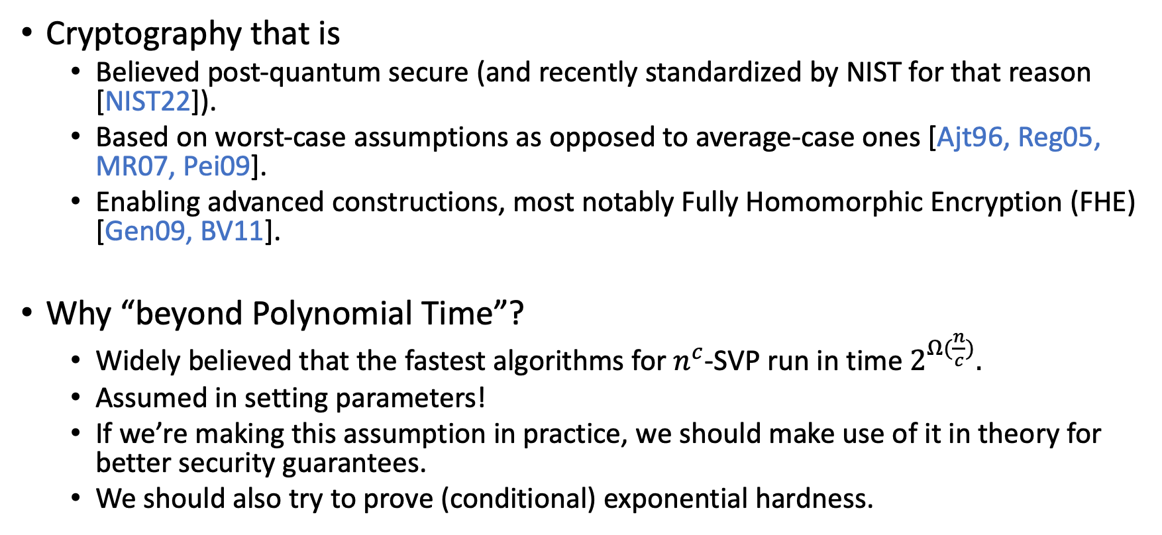
Lattice Cryptography
(or, why is SVP so important?)
Cryptography that is
Believed post-quantum secure (and recently standardized by NIST for that reason [NIST22]).
Based on worst-case assumptions as opposed to average-case ones [Ajt96, Reg05, MR07, Pei09].
Enabling advanced constructions, most notably Fully Homomorphic Encryption (FHE) [Gen09, BV11].
Why “beyond Polynomial Time”?
Widely believed that the fastest algorithms for $n^{c}$-SVP run in time $2^{Ω(\frac{n}{c})}.$
Assumed in setting parameters!
If we’re making this assumption in practice, we should make use of it in theory for better security guarantees.
We should also try to prove (conditional) exponential hardness.

Slide 8
Results and Implications

Slide 9
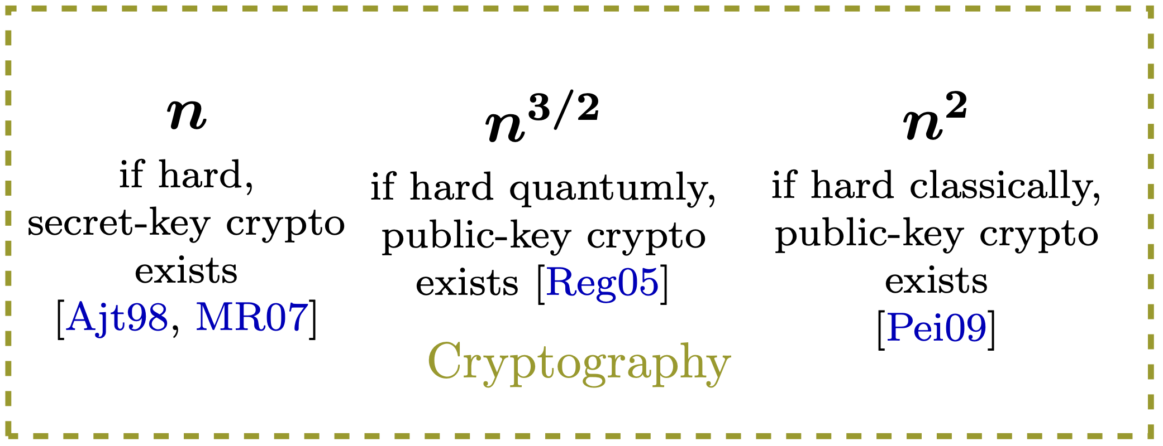
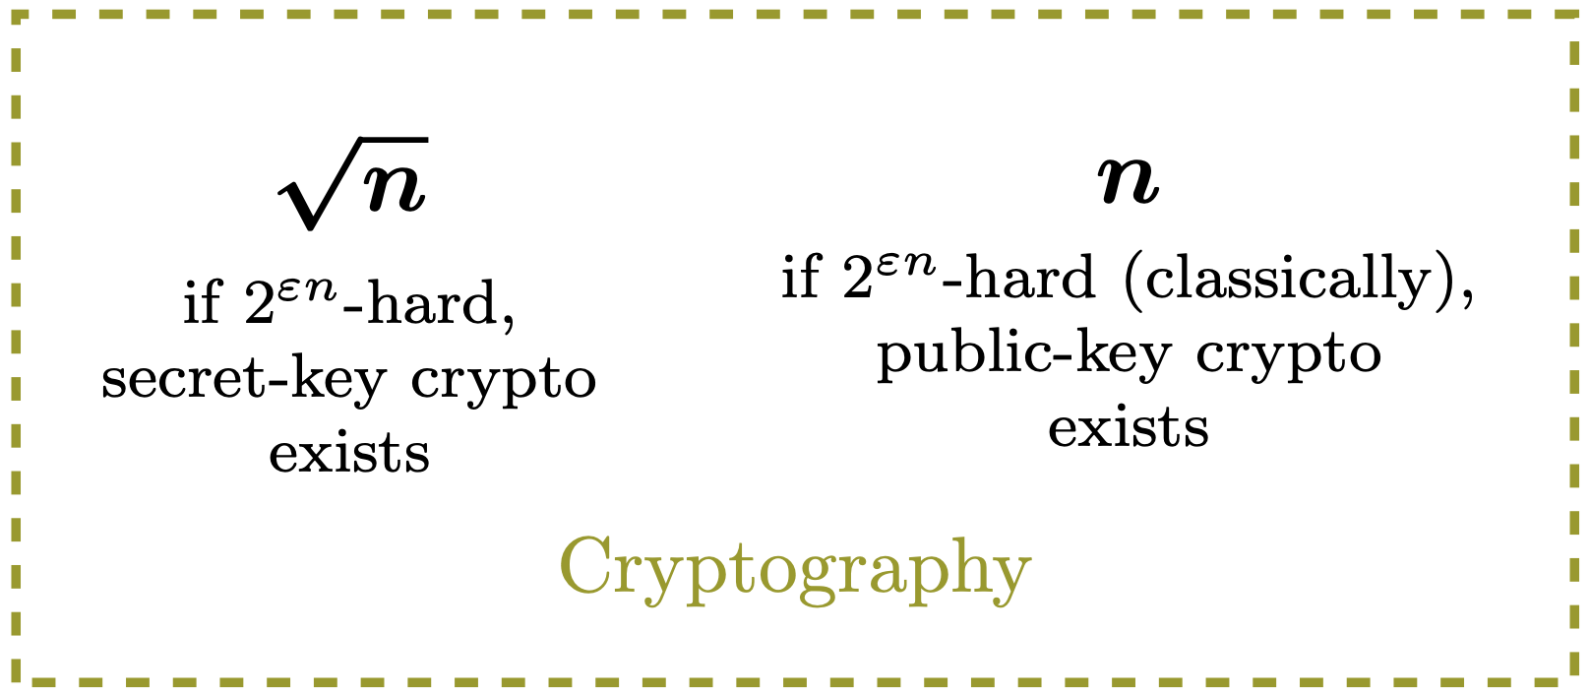


Security Guarantees
The poly($n$)-time world
The $2^{εn}$-time world

Slide 10
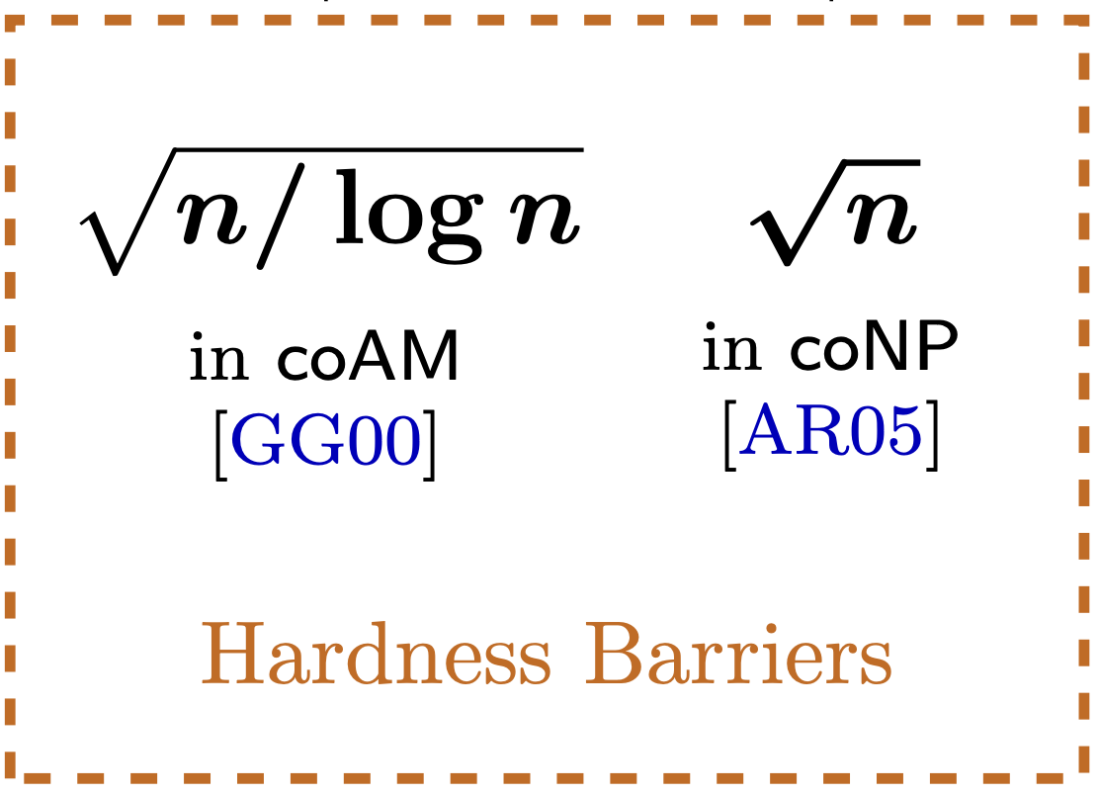
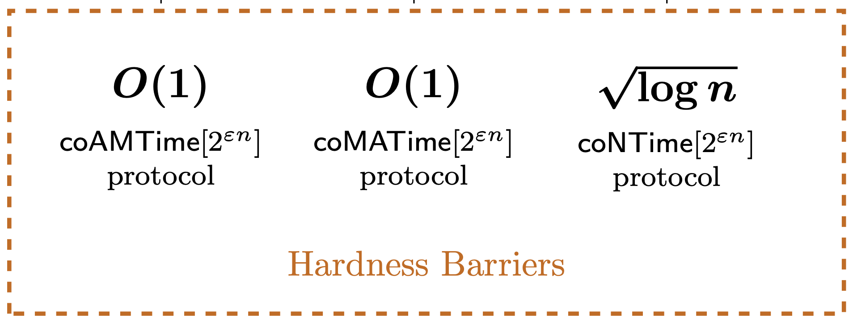


Hardness Barriers
The poly($n$)-time world
The $2^{εn}$-time world

Slide 11


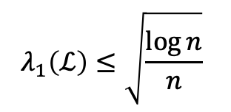



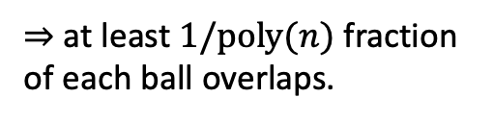

Example: coAM
Claim: $\sqrt{n/\log{n}}$-SVP $∈$ coAM
1$/2$
1$/2$
$$λ_{1}\left(ℒ\right)≤\sqrt{\frac{\log{n}}{n}}$$
$$λ_{1}\left(ℒ\right)>1$$
$⇒$ balls are disjoint.
$⇒$ at least $1/poly(n)$ fraction of each ball overlaps.
Private-coin protocol. Can be made public-coin (true coAM) with standard tricks.

Slide 12
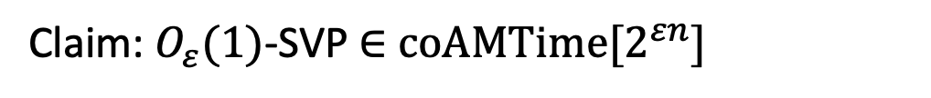


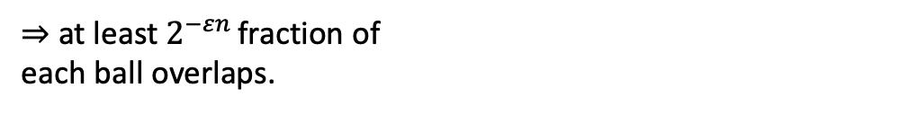
Example: coAM
Claim: $O_{ε}(1)$-SVP $∈$ coAMTime[$2^{εn}]$
1/2
1$/2$
$$λ_{1}\left(L\right)≤O_{ε}\left(1\right)$$
$⇒$ at least $2^{−εn }$fraction of
each ball overlaps.
$λ_{1}\left(L\right)>1⇒$ balls are disjoint.

Slide 13
Thanks for listening (from all of us)!
I’m happy to take further questions at sjpeters@cs.cornell.edu.

Slide 14
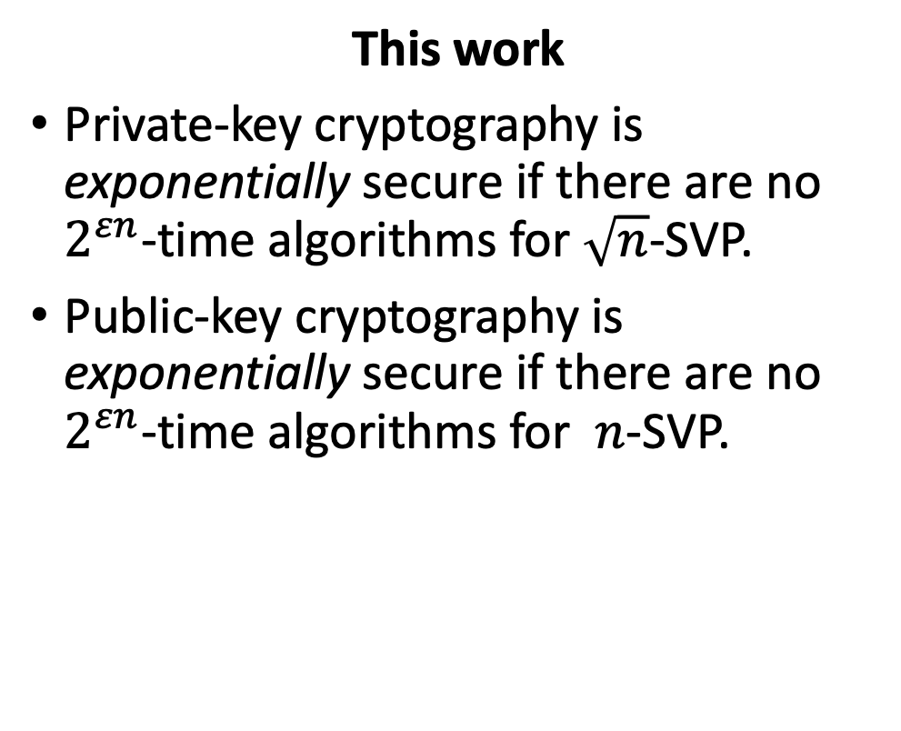
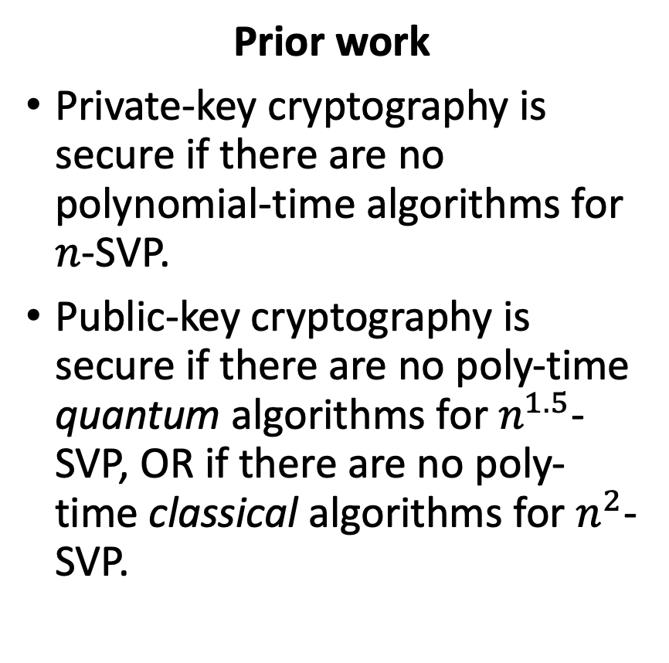
Improved security guarantees
Prior work
Private-key cryptography is secure if there are no polynomial-time algorithms for $n$-SVP.
Public-key cryptography is secure if there are no poly-time quantum algorithms for $n^{1.5}$-SVP, OR if there are no poly-time classical algorithms for $n^{2}$-SVP.
This work
Private-key cryptography is exponentially secure if there are no $2^{εn}$-time algorithms for $\sqrt{n}$-SVP.
Public-key cryptography is exponentially secure if there are no $2^{εn}$-time algorithms for $n$-SVP.

Slide 15
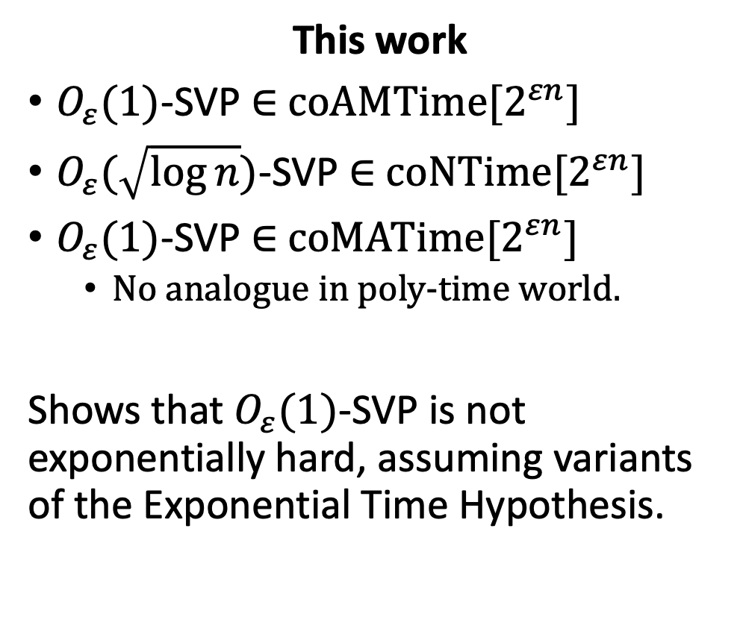
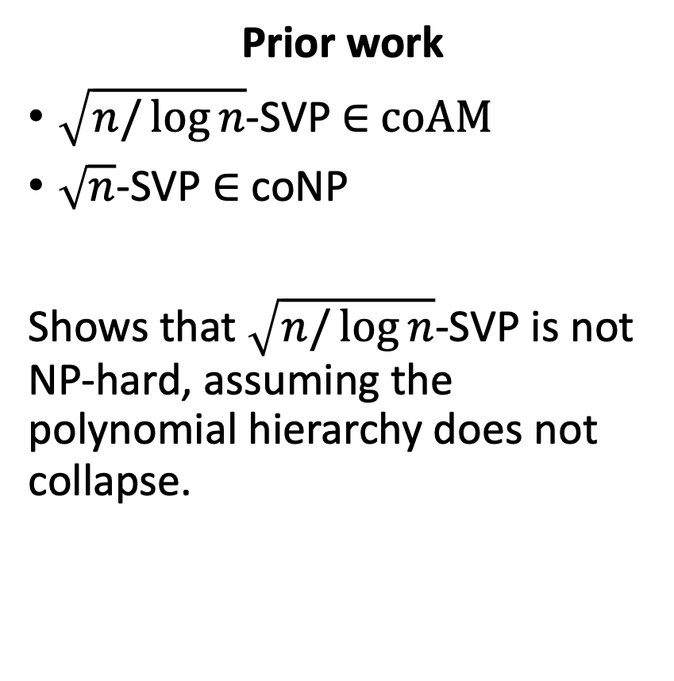
Hardness Barriers
Prior work
$\sqrt{n/\log{n}}$-SVP $∈$ coAM
$\sqrt{n}$-SVP $∈$ coNP
Shows that $\sqrt{n/\log{n}}$-SVP is not NP-hard, assuming the polynomial hierarchy does not collapse.
This work
$O_{ε}(1)$-SVP $∈$ coAMTime[$2^{εn}]$
$O_{ε}(\sqrt{\log{n}})$-SVP $∈$ coNTime[$2^{εn}]$
$O_{ε}(1)$-SVP $∈$ coMATime[$2^{εn}]$
No analogue in poly-time world.
Shows that $O_{ε}(1)$-SVP is not exponentially hard, assuming variants of the Exponential Time Hypothesis.

