Slide 1
Chicago Airbnb Listings

Slide 2
library(tidyr) airbnb = read.csv("airbnb.csv") str(airbnb)
## 'data.frame': 500 obs. of 63 variables: ## $ id : int 14843458 722570 8153968 18327990 12673204 10344726 5737004 16826474 5414283 8610501 ... ## $ listing_url : Factor w/ 500 levels "https://www.airbnb.com/rooms/10043106",..: 131 431 453 316 56 4 391 243 381 464 ... ## $ name : Factor w/ 500 levels "#61 King Arthurs Court",..: 177 302 191 410 119 124 151 193 179 17 ... ## $ summary : Factor w/ 492 levels "","- Townhome 150 yds (2 min walk) from McCormick Place - Free Parking - Huge Room with queen bed (and futon) - Pr"| __truncated__,..: 124 1 283 421 463 126 280 292 323 175 ... ## $ space : Factor w/ 366 levels "","- This is a great, two bedroom, one bathroom home on the 1st floor of a four unit building. The first bedroom h"| __truncated__,..: 250 78 349 1 176 107 170 6 365 51 ... ## $ description : Factor w/ 499 levels "- Townhome 150 yds (2 min walk) from McCormick Place - Free Parking - Huge Room with queen bed (and futon) - Pr"| __truncated__,..: 127 117 286 427 470 129 283 295 326 178 ... ## $ neighborhood_overview : Factor w/ 331 levels "","------------------------------------------------------------------------------ SUPER CONVENIENT LOCATION!!! ---"| __truncated__,..: 102 1 119 1 86 186 187 3 82 220 ... ## $ notes : Factor w/ 225 levels "","- Any short-term stays of 3 or lesser nights (over a weekend) may be assessed a surcharge",..: 100 1 211 1 143 92 1 3 73 1 ... ## $ transit : Factor w/ 346 levels "","- 1 min walk to the Lawrence Red Line station - 1 mile from Metra station (commuter rail) - Divvy Bike station "| __truncated__,..: 227 1 269 1 59 100 300 9 131 252 ... ## $ access : Factor w/ 315 levels "","#94 is the door code. How to receive keys will be arranged ahead of time.",..: 194 1 312 1 163 297 1 52 172 22 ... ## $ interaction : Factor w/ 313 levels "","24/7 access to the host via phone, text, or email.",..: 301 1 300 1 121 178 1 223 103 198 ... ## $ house_rules : Factor w/ 318 levels "","-- Not handicap accessible (there are 59 stairs - no elevator!)",..: 107 151 41 225 98 176 267 236 55 143 ... ## $ host_id : int 20653807 3731751 16500117 6903096 34473759 45766549 29751294 111964625 2768284 37417772 ... ## $ host_url : Factor w/ 461 levels "https://www.airbnb.com/users/show/100027760",..: 106 205 82 369 185 264 156 33 143 206 ... ## $ host_name : Factor w/ 365 levels "Aama","Aamir",..: 170 211 314 117 206 327 111 208 68 218 ... ## $ host_since : Factor w/ 413 levels "01/02/2016","01/02/2017",..: 281 319 170 181 161 323 80 15 199 205 ... ## $ host_location : Factor w/ 31 levels "Barrington, Illinois, United States",..: 16 7 7 26 7 7 7 7 7 7 ... ## $ host_about : Factor w/ 319 levels "","\"Depth and breadth are crucial to creativity.\" -Adam M Grant \n\nChicago native. Buckeye nation.",..: 314 295 122 192 173 309 1 292 34 12 ... ## $ host_response_rate : Factor w/ 32 levels "0%","100%","33%",..: 2 2 2 2 2 2 32 2 2 10 ... ## $ host_is_superhost : Factor w/ 2 levels "f","t": 1 1 2 1 2 1 1 1 2 1 ... ## $ host_neighbourhood : Factor w/ 61 levels "","Albany Park",..: 1 28 1 1 28 28 28 28 1 21 ... ## $ host_verifications : Factor w/ 82 levels "['email', 'phone', 'amex', 'reviews', 'kba', 'work_email']",..: 23 71 24 76 71 71 71 26 70 76 ... ## $ host_has_profile_pic : Factor w/ 2 levels "f","t": 2 2 2 2 2 2 2 2 2 2 ... ## $ host_identity_verified : Factor w/ 2 levels "f","t": 2 2 2 1 2 2 2 1 2 1 ... ## $ street : Factor w/ 126 levels "Albany Park, Chicago, IL 60625, United States",..: 31 66 31 31 66 67 67 66 26 56 ... ## $ neighbourhood : Factor w/ 45 levels "Albany Park",..: 20 20 20 20 20 20 20 20 14 14 ... ## $ latitude : num 42 42 42 42 42 ... ## $ longitude : num -87.7 -87.7 -87.7 -87.7 -87.7 ... ## $ is_location_exact : Factor w/ 2 levels "f","t": 1 2 1 1 2 2 2 2 1 2 ... ## $ room_type : Factor w/ 3 levels "Entire home/apt",..: 1 1 2 1 1 1 1 1 2 1 ... ## $ accommodates : int 3 4 4 2 3 3 2 6 2 4 ... ## $ bathrooms : num 1 2 1 1 1 1 1 2 1 1 ... ## $ bedrooms : int 1 2 1 1 2 0 1 3 1 1 ... ## $ beds : int 1 2 2 1 2 2 1 4 1 2 ... ## $ bed_type : Factor w/ 5 levels "Airbed","Couch",..: 5 5 5 5 5 5 5 5 5 1 ... ## $ amenities : Factor w/ 495 levels "{\"Air conditioning\",Kitchen,\"Pets allowed\",Heating,\"Family/kid friendly\",\"Smoke detector\",\"Carbon mono"| __truncated__,..: 428 151 189 12 375 92 68 155 187 436 ... ## $ price : int 69 139 65 80 150 83 85 85 59 120 ... ## $ monthly_price : int NA NA 1600 NA NA 695 NA NA 1470 NA ... ## $ security_deposit : int NA 300 NA NA NA NA NA 150 NA NA ... ## $ cleaning_fee : int 20 80 15 NA 35 NA NA 59 20 NA ... ## $ guests_included : int 1 3 2 1 1 2 1 2 2 4 ... ## $ price_extra_people : int 48 20 10 0 0 10 0 15 0 25 ... ## $ maximum_nights : int 14 21 1125 1125 1125 1125 1125 1125 31 1125 ... ## $ calendar_updated : Factor w/ 22 levels "1 week ago","12 months ago",..: 19 5 5 5 5 19 16 21 15 8 ... ## $ availability_30 : int 6 1 16 0 0 0 0 9 8 11 ... ## $ availability_60 : int 7 1 43 0 8 3 0 15 36 23 ... ## $ availability_90 : int 13 5 73 0 19 16 0 15 61 30 ... ## $ availability_365 : int 13 280 73 129 19 73 0 46 332 305 ... ## $ review_scores_cleanliness : int 9 10 10 NA 10 10 10 8 10 9 ... ## $ review_scores_communication: int 10 10 10 NA 10 10 10 10 10 10 ... ## $ review_scores_value : int 10 10 10 NA 10 10 10 10 10 9 ... ## $ instant_bookable : Factor w/ 2 levels "f","t": 1 1 1 2 1 1 1 1 1 1 ... ## $ cancellation_policy : Factor w/ 3 levels "flexible","moderate",..: 1 2 2 1 2 2 2 3 2 1 ... ## $ reviews_per_month : num 0.96 0.29 2.61 NA 0.43 2.28 0.16 6.32 3.47 1.58 ... ## $ cable_tv : Factor w/ 2 levels "No","Yes": 1 2 2 1 1 1 1 2 2 1 ... ## $ wireless_internet : Factor w/ 2 levels "No","Yes": 2 2 2 1 2 2 2 2 2 2 ... ## $ kitchen : Factor w/ 2 levels "No","Yes": 2 2 2 1 2 2 2 2 2 2 ... ## $ pets_allowed : Factor w/ 2 levels "No","Yes": 1 1 1 1 1 1 1 1 1 2 ... ## $ breakfast : Factor w/ 2 levels "No","Yes": 1 1 1 1 1 2 1 1 2 1 ... ## $ heating : Factor w/ 2 levels "No","Yes": 2 2 2 1 2 2 1 2 2 2 ... ## $ X24.hour_checkin : Factor w/ 2 levels "No","Yes": 1 1 1 1 2 1 1 2 2 2 ... ## $ smoking_allowed : Factor w/ 2 levels "No","Yes": 1 1 1 1 1 1 2 1 1 1 ... ## $ smoking_allowed.2 : int 0 0 0 0 0 0 1 0 0 0 ...
# Setting descriptions, URLS, to character types

Slide 3
airbnb_char = airbnb %>% mutate_at(c(2:12, 14, 18, 25), as.character) # Set numerics where they're needed library(stringr) airbnb_char$host_response_rate = as.numeric(str_remove(airbnb_char$host_response_rate, "%"))
## Warning: NAs introduced by coercion
# all others should be properly formatted

Slide 4
# Set boolean columns airbnb_char = airbnb_char %>% mutate_at(c(20, 23, 24, 29, 52, 55:62), as.character) # R won't reassign unless column is of character type airbnb_char[airbnb_char=="f"] = "false" # true and false are parseable by as.logical airbnb_char[airbnb_char=="No"] = "false" airbnb_char[airbnb_char=="t"] = "true" airbnb_char[airbnb_char=="Yes"] = "true" airbnb_clean = airbnb_char %>% mutate_at(c(20, 23, 24, 29, 52, 55:62), as.logical) # boolean values are set to be TRUE and FALSE

Slide 5
# Set missing values to NA airbnb_clean[airbnb_clean==""] = NA # Note: this should work for both character and factor variables # Setting dates to date types airbnb_clean$host_since = as.Date(airbnb_clean$host_since, format="%m/%d/%Y") # this is done last because it breaks slicing

Slide 6
# While there are many libraries for this, we can easily whip up a quick summary statistics function summary_stats = function(variable) { cat("Total Count: ", length(variable), "\n") cat("N: ", sum(!is.na(variable)), "\n") cat("Minimum: ", min(variable, na.rm = TRUE), "\n") cat("Maximum: ", max(variable, na.rm = TRUE), "\n") cat("Mean: ", mean(variable, na.rm = TRUE), "\n") cat("Standard Deviation: ", sd(variable, na.rm = TRUE), "\n") cat("Median: ", median(variable, na.rm = TRUE), "\n") cat("Quantiles:", "\n") print(quantile(as.numeric(variable), c(0, 0.25, 0.5, 0.75, 1), na.rm = TRUE)) cat("IQR: ", IQR(variable, na.rm = TRUE), "\n") }

Slide 7
Number of guests accommodated:
summary_stats(airbnb_clean$accommodates)
## Total Count: 500 ## N: 500 ## Minimum: 1 ## Maximum: 16 ## Mean: 3.872 ## Standard Deviation: 2.600219 ## Median: 3 ## Quantiles: ## 0% 25% 50% 75% 100% ## 1 2 3 5 16 ## IQR: 3

Slide 8
low = quantile(airbnb_clean$price)[2] medium = quantile(airbnb_clean$price)[3] high = quantile(airbnb_clean$price)[4] price_category = vector(length = length(airbnb_clean$price)) lowcheck = sum(airbnb_clean$price <= low) price_category[airbnb_clean$price <= low] = "low" print(lowcheck == sum(price_category == "low"))
## [1] TRUE
medcheck = sum(airbnb_clean$price > low & airbnb_clean$price <= medium) price_category[airbnb_clean$price > low & airbnb_clean$price <= medium] = "medium" print(medcheck == sum(price_category == "medium"))
## [1] TRUE
hicheck = sum(airbnb_clean$price > medium & airbnb_clean$price <= high) price_category[airbnb_clean$price > medium & airbnb_clean$price <= high] = "high" print(hicheck == sum(price_category == "high"))
## [1] TRUE
vcheck = sum(airbnb_clean$price > high) price_category[airbnb_clean$price > high] = "very high" print(vcheck == sum(price_category == "very high"))
## [1] TRUE
# All checks seem right, let's see if our distribution checks out: airbnb_clean$price_category = factor(price_category, levels = c("low", "medium", "high", "very high")) ggplot(airbnb_clean, aes(price_category)) + geom_bar() + labs(x = "Price Category", y = "Count", title = "Price Category Distributions")

Slide 9
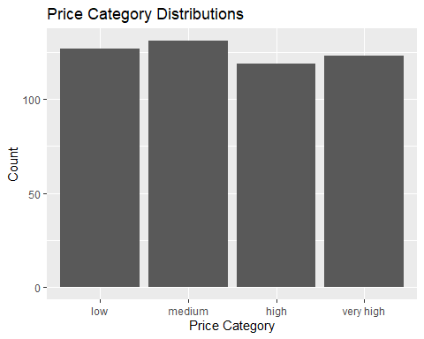

Slide 10
# Looks reasonably even.
Reviews per month:
summary_stats(airbnb_clean$reviews_per_month)
## Total Count: 500 ## N: 426 ## Minimum: 0.05 ## Maximum: 9.75 ## Mean: 2.135563 ## Standard Deviation: 1.960553 ## Median: 1.485 ## Quantiles: ## 0% 25% 50% 75% 100% ## 0.050 0.620 1.485 3.245 9.750 ## IQR: 2.625
Notes:
This gives an interesting variety, let’s look at a histogram.

Slide 11
ggplot(airbnb_clean, aes(reviews_per_month)) + geom_histogram() + labs(x = "Reviews Per Month", y = "Count", title = "Reviews Per Month Distribution")
## `stat_bin()` using `bins = 30`. Pick better value with `binwidth`.
## Warning: Removed 74 rows containing non-finite values (stat_bin).

Slide 12
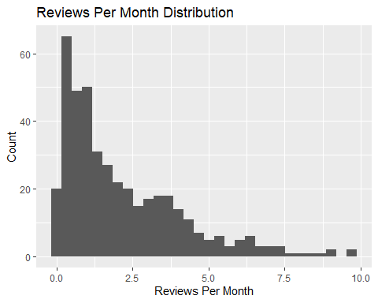

Slide 13
ggmap(m) + geom_point(data = airbnb_clean2, aes(x = longitude, y = latitude, color=price_category), size=.9, alpha=.75) + coord_sf(xlim = c(-87.8, -87.5), ylim = c(41.73, 42.05), expand = FALSE)+ labs(title="Price Categories Mapped", y = "Latitude",x = "Longitude", color="Price Category")+ scale_color_brewer(palette="Dark2")
## Coordinate system already present. Adding new coordinate system, which will replace the existing one.
## Warning: Removed 2 rows containing missing values (geom_point).
Notes:
We can see a right skew with a floor at 0, so we know most locations aren’t reviewed many times per month.

Slide 14
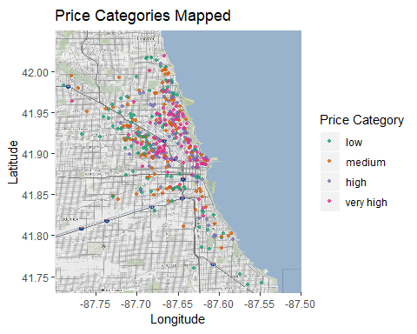

Slide 15
ggplot(data=airbnb_clean2, aes(x=reorder(neighbourhood,-price), y=price)) + geom_bar(position = "dodge", stat = "summary", fun.y = "mean", fill='Light Blue', color = 'Red')+ theme(axis.text.x = element_text(angle=90,hjust=0.95,vjust=0.2))+ scale_y_continuous(breaks = seq(0, max(airbnb_clean$price), by = 20))+ labs(title="Neighbourhoods By Mean Price", y = "Mean Price ($)",x = "Neighbourhood")+ stat_summary(aes(label=round(..y..,2)), fun.y=mean, geom="text", size=3, hjust=-0.1, angle=90)

Slide 16
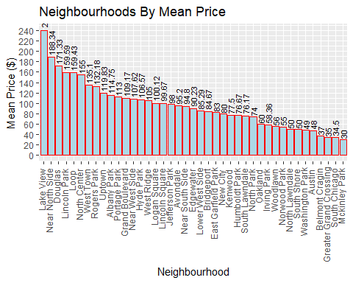

Slide 17
#the labels on each bar were made using code similar to the one from user agstudy on stack over flow here: #https://stackoverflow.com/questions/20139978/ggplot2-label-values-of-barplot-that-uses-fun-y-mean-of-stat-summary

Slide 18
ggmap(m) + geom_point(data = airbnb_clean2, aes(x = longitude, y = latitude, color=room_type), size = .9, alpha=.75) + coord_sf(xlim = c(-87.8, -87.5), ylim = c(41.73, 42.05), expand = FALSE)+ labs(title="Room Types Mapped", y = "Latitude",x = "Longitude", color="Room Type")+ scale_color_brewer(palette="Dark2")
## Coordinate system already present. Adding new coordinate system, which will replace the existing one.
## Warning: Removed 2 rows containing missing values (geom_point).

Slide 19
ggplot(airbnb_clean2, aes(x=reorder(neighbourhood,-price), fill=room_type))+geom_bar(position="fill")+ theme(axis.text.x = element_text(angle=90,hjust=0.95,vjust=0.2))+ labs(title="Neighbourhood Room Types Ordered by Mean Price Descending", y = "Room Type %",x = "Neighbourhood", fill="Room Type")+ scale_fill_brewer(palette="Set2")

Slide 20
ggmap(m) + geom_point(data = airbnb_clean2, aes(x = longitude, y = latitude, color=factor(bedrooms)), size=.9, alpha=.75) + coord_sf(xlim = c(-87.8, -87.5), ylim = c(41.73, 42.05), expand = FALSE)+ labs(title="# of Bedrooms Mapped", y = "Latitude",x = "Longitude", color="Bedrooms")+ scale_color_brewer(palette="Set1")
## Coordinate system already present. Adding new coordinate system, which will replace the existing one.
## Warning: Removed 3 rows containing missing values (geom_point).

Slide 21
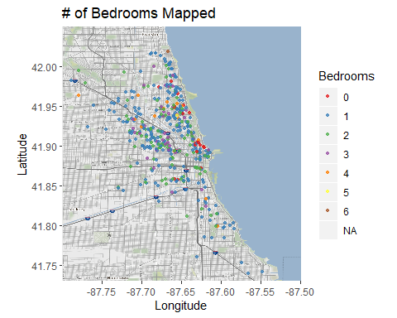

Slide 22
ggplot(data=airbnb_clean2, aes(x=reorder(neighbourhood,-price), y=bedrooms)) + geom_bar(position = "dodge", stat = "summary", fun.y = "mean", fill='Light Blue', color = 'Red')+ theme(axis.text.x = element_text(angle=90,hjust=0.95,vjust=0.2))+ labs(title="Mean Bedrooms per Neighbourhood Sorted by Mean Price Descending", y = "Mean Bedrooms",x = "Neighbourhood")+ stat_summary(aes(label=round(..y..,2)), fun.y=mean, geom="text", size=2, vjust = -0.5)
## Warning: Removed 1 rows containing non-finite values (stat_summary). ## Warning: Removed 1 rows containing non-finite values (stat_summary).

Slide 23
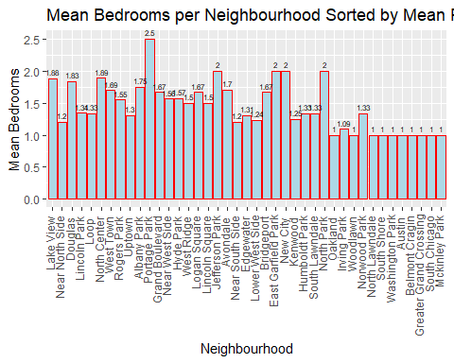

Slide 24
ggmap(m) + geom_point(data = airbnb_clean2, aes(x = longitude, y = latitude, color=factor(accommodates)), size=.9, alpha=.75) + coord_sf(xlim = c(-87.8, -87.5), ylim = c(41.73, 42.05), expand = FALSE)+ labs(title="Accomodations for # of People", y = "Latitude",x = "Longitude", color="# of People")
## Coordinate system already present. Adding new coordinate system, which will replace the existing one.
## Warning: Removed 2 rows containing missing values (geom_point).

Slide 25
ggplot(data=airbnb_clean2, aes(x=reorder(neighbourhood,-price), y=accommodates)) + geom_bar(position = "dodge", stat = "summary", fun.y = "mean", fill='Light Blue', color = 'Red')+ theme(axis.text.x = element_text(angle=90,hjust=0.95,vjust=0.2))+ scale_y_continuous(breaks = seq(0, max(airbnb_clean$accommodates), by = 1))+ labs(title="Mean # of Guest Accommodations per Neighbourhood Ordered by Mean Price", y = "Mean Accommodations",x = "Neighbourhood")+ stat_summary(aes(label=round(..y..,2)), fun.y=mean, geom="text", size=3, angle=90, hjust=-.11)

Slide 26
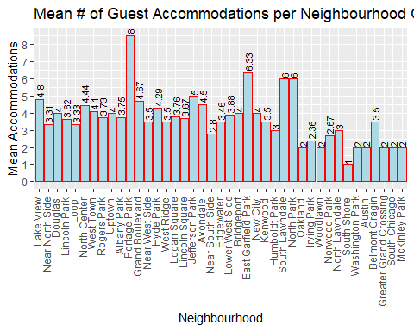

Slide 27
Text Data
Several of the variables here come in the form of long text descriptions from which useful information can be pulled with some effort. [Kaleb]

