Slide 1

Reddit vs. Wall St (ETL)
By: Spencer Johnson

Slide 2
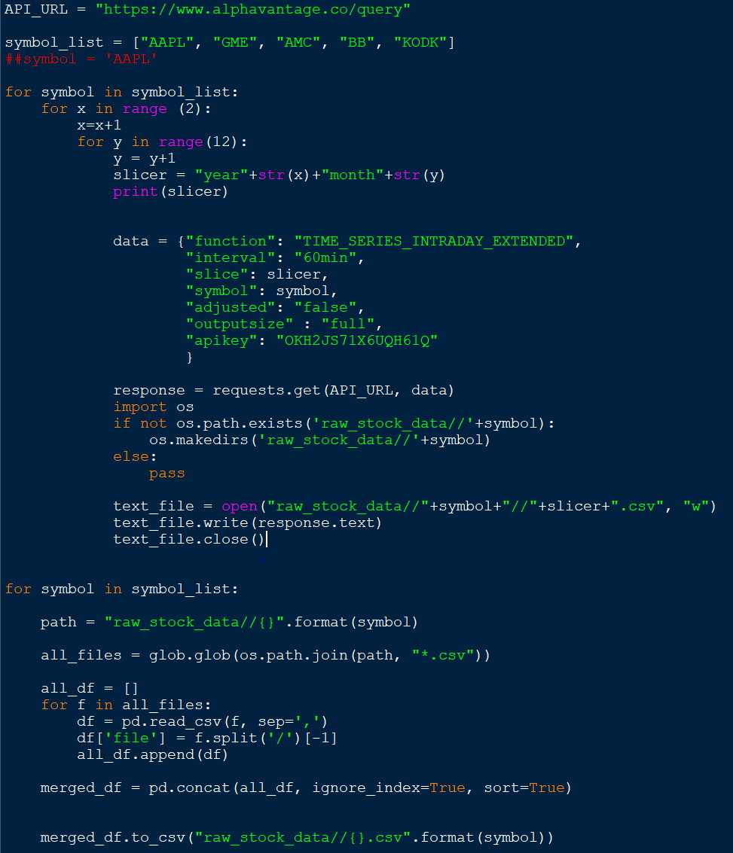


Extract
STOCK DATA
Previously Yahoo Finance was used.
Due to limitations a new stock API (Alpha Vantage) was used to gather hourly stock data
REDDIT COMMENTS
Discussions with the most comments are now being scraped
NEWS ARTICLES
News Headline + Date Scraped for each stock from Bloomberg

Slide 3
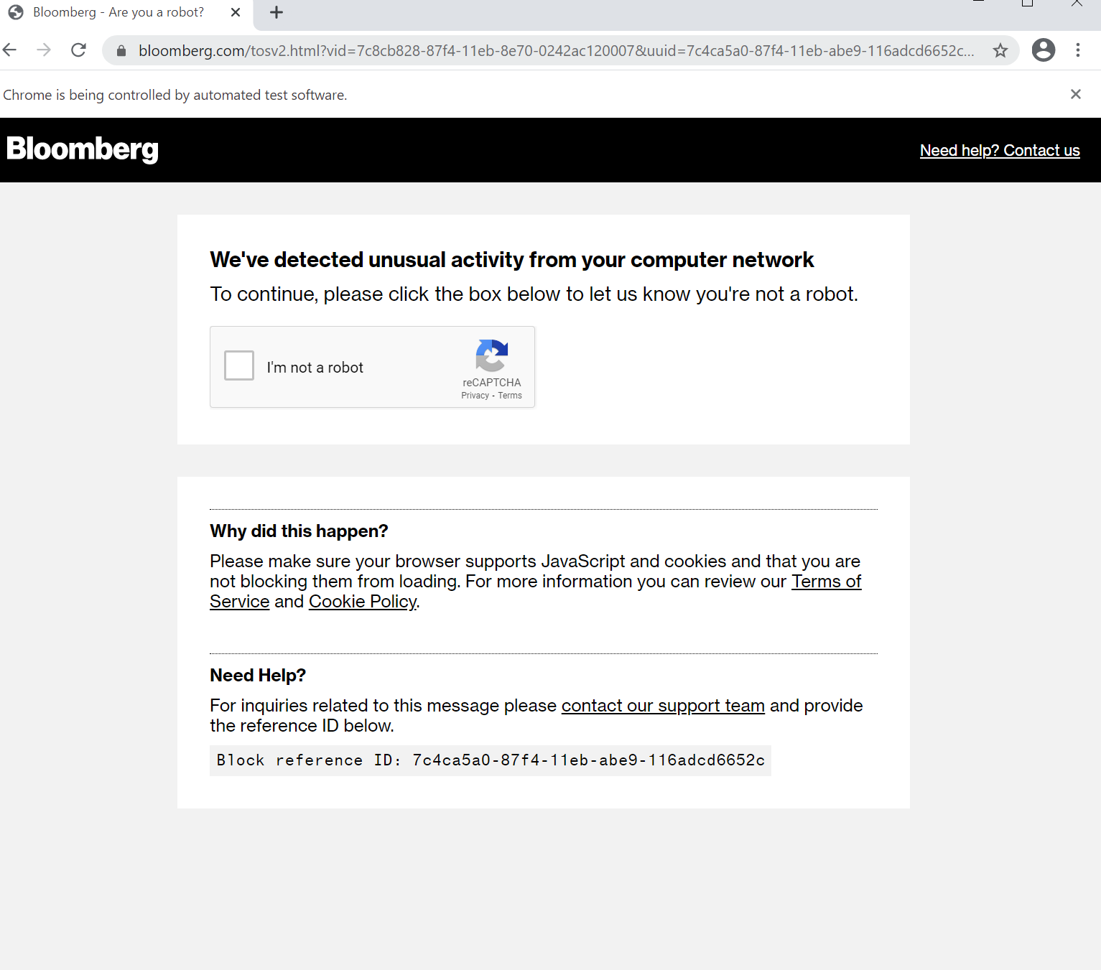
Extract - ISSUES
Ran into captchas on Bloomberg. It was not bad when scraping headlines however when looking to scrape article content and get exact time (which requires opening each article) I ran into a captcha every few minutes

Slide 4
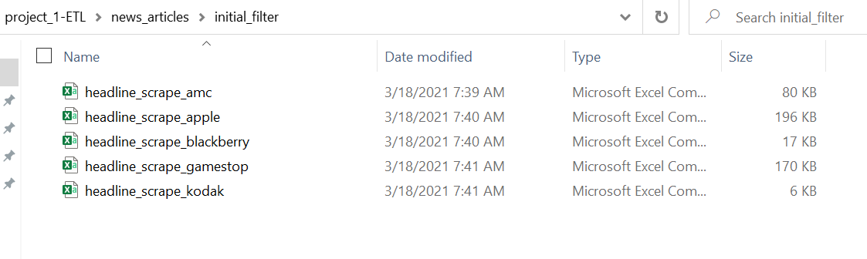
transform
For all of the data I had it was in folders in individual CSV files.
With these files
-Added the stock ticker to its own column within the dataset so that when merged they would be able to be sorted and filtered still
- Then merged all together into one
This was done for – News articles, Stock Prices, Redditt Comments

Slide 5
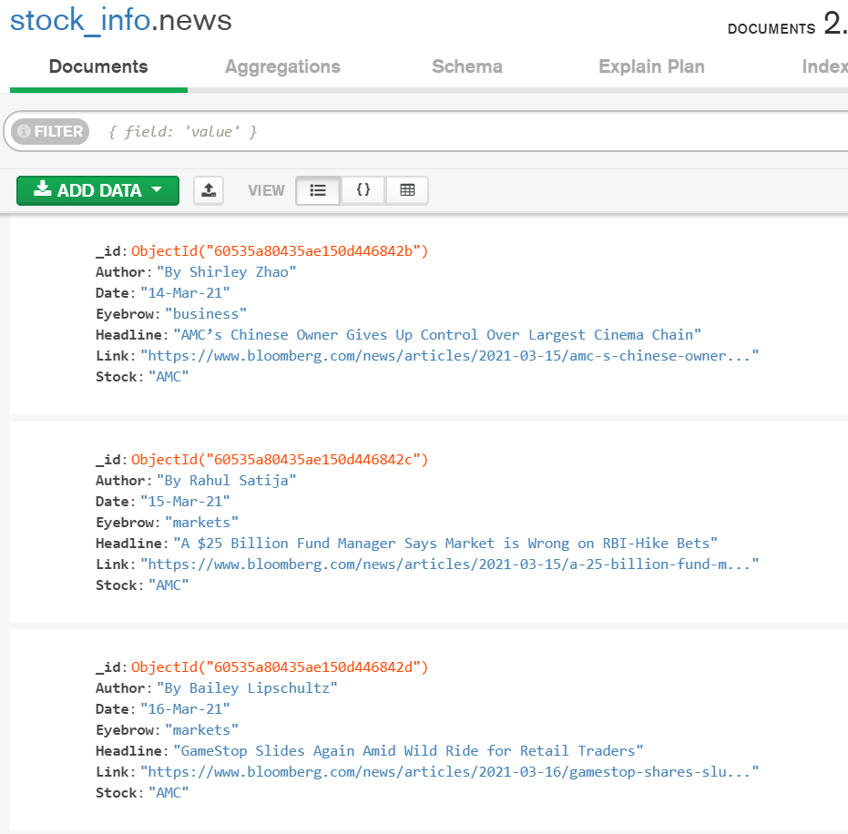
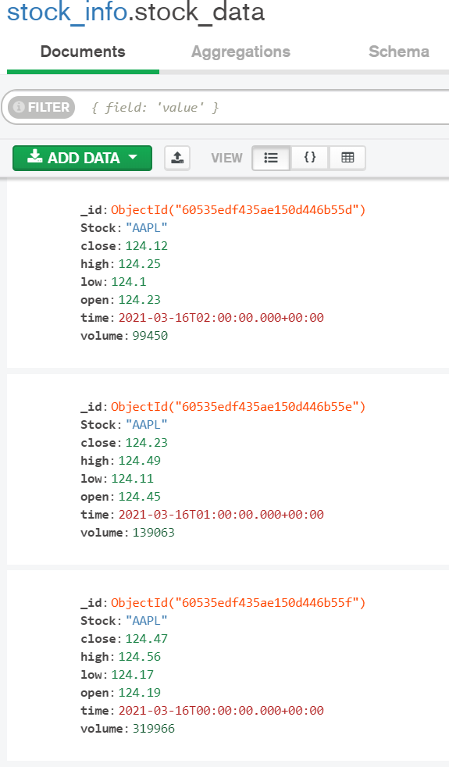
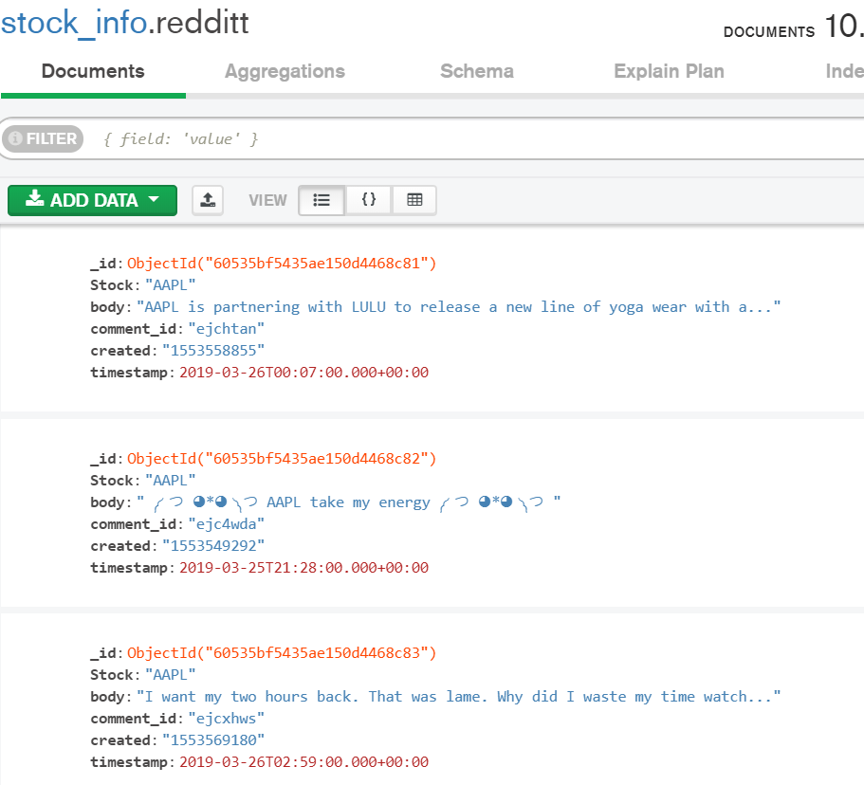
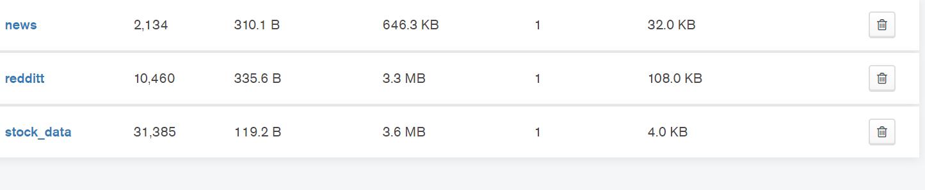
Load
MongoDB was used to store the data
All documents were combined from csv files and loaded into the database.
End Result – 1 Database with 3 collections.
-Redditt
-Stock_data
-News

Slide 6
Conclusions
Further Research:
Sentiment of news articles and comments
Get hourly time of news posting (need to add proxies and or captcha solving API)
Using NLP for identifying common phrases
Comparison of news coverage vs reddit comments
Bring in other sources
Google Trends
Google News
Stock Twits

