Slide 1

Reddit vs. Wall St
By: Spencer Johnson and Keeta Vaccaro

Slide 2
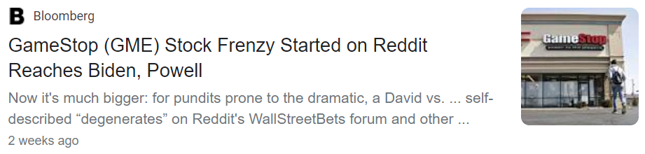
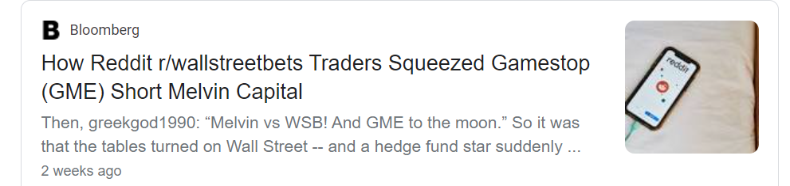
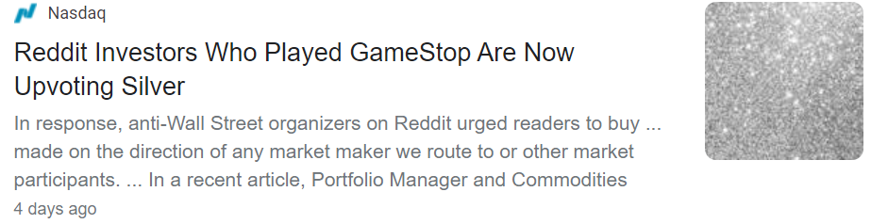
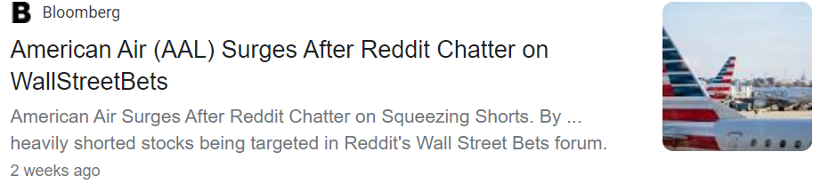

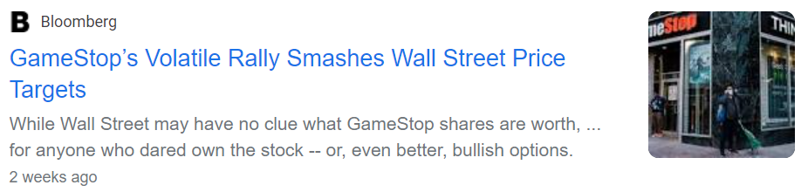
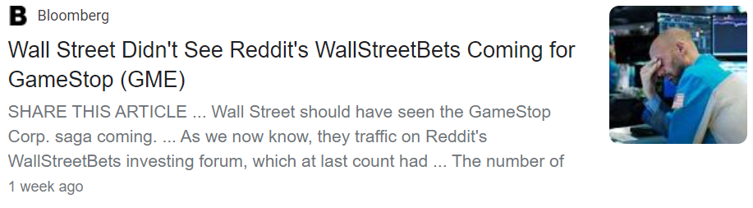
The “issue”
Groups on Reddit have been manipulating stock prices, creating the momentum to short squeeze hedge funds.

Slide 3

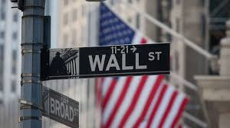
Concept
Collect Reddit comment data and Stock ticker data
Determine most liked commentors
Determine most frequent commentors
Compare # of comments in a day to the stock price movement
Compare # of comments in a day to the stock price movement
Main Hypothesis: Determine if the Reddit threads really caused the stock price increase or if there are other variables to consider.
VS.

Slide 4


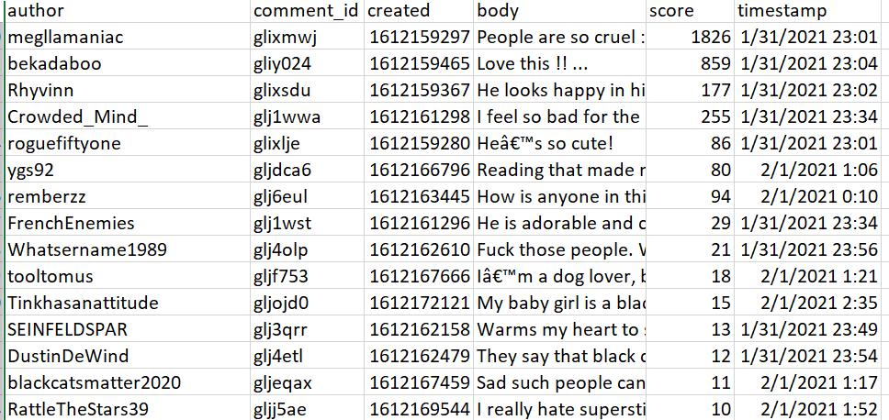
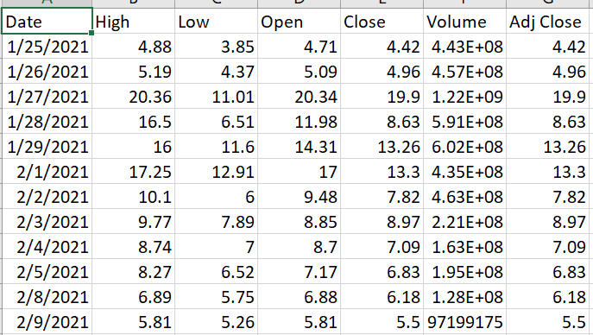
Data Sources
Two sets of data were gathered for this:
1. Reddit Comment Data using PRAW (Python Reddit API Wrapper)
2. Daily Stock Data using Yahoo Finance API

Slide 5
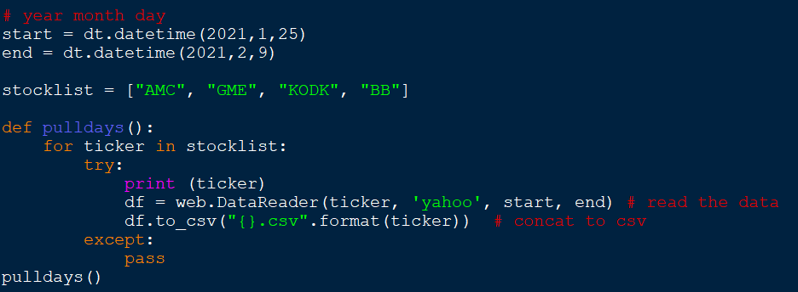
Data Gathering (Yahoo)
Using the API the data was gathered easily:
Timeframe defined and Stock tickers were put into a list
Yahoo Finance API call for each ticker and timeframe in list

Slide 6
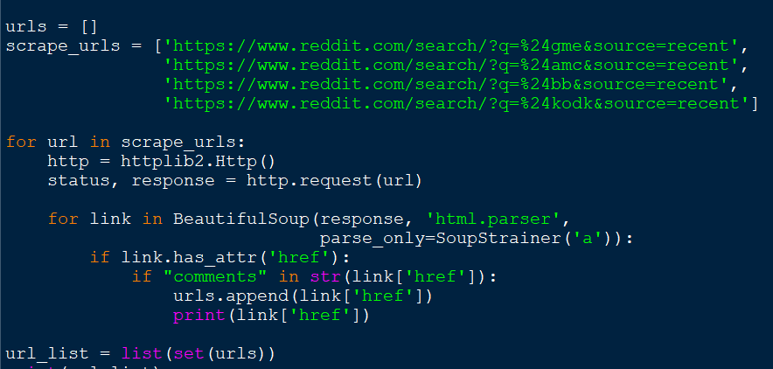
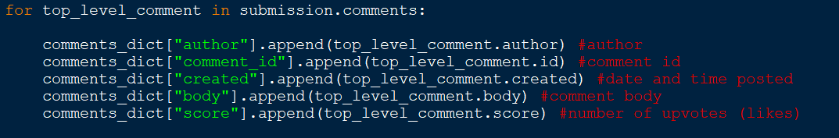
Data Gathering (Reddit)
Reddit data was gathered/cleaned in multiple ways:
URLs for discussions on each stock were gathered manually
For each of those URLs the list of discussion board URLs was scraped
For each of those discussion boards the relevant data for each comment was gathered (author, id, date/time, body, score).
Duplicate comments were dropped (based on comment id)

Slide 7
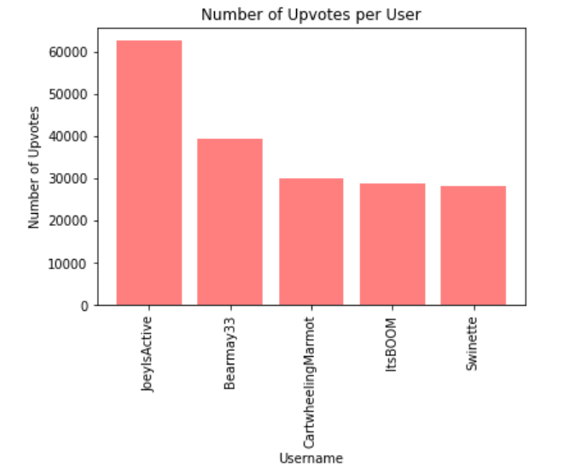
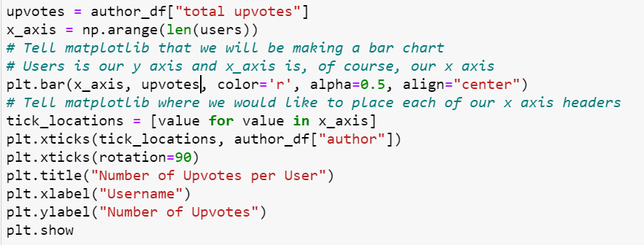
Most Upvotes
Bar Graph:
Most upvoted people

Slide 8
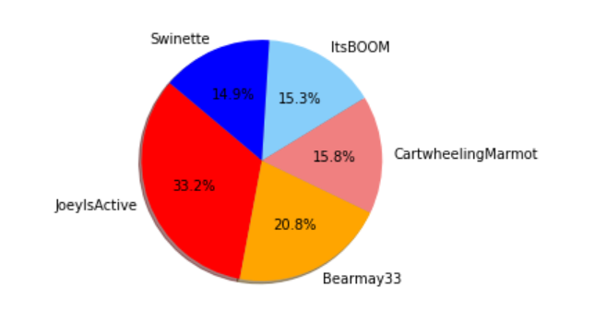
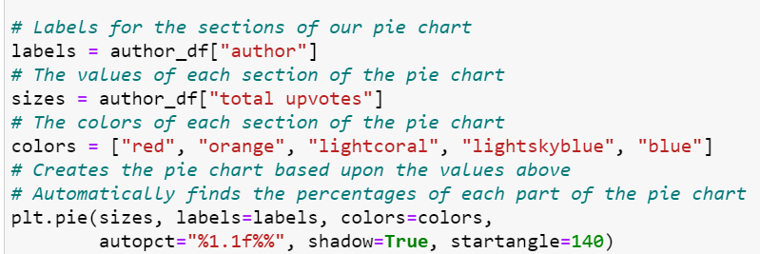
Most Upvotes (%)
Pie chart:
the % of their upvotes in the top 5 most upvoted people

Slide 9
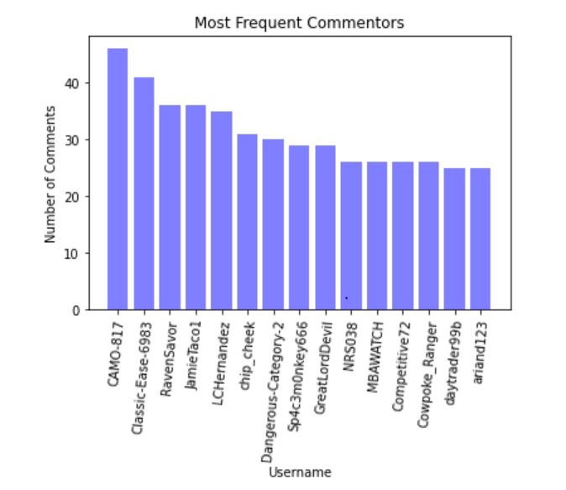
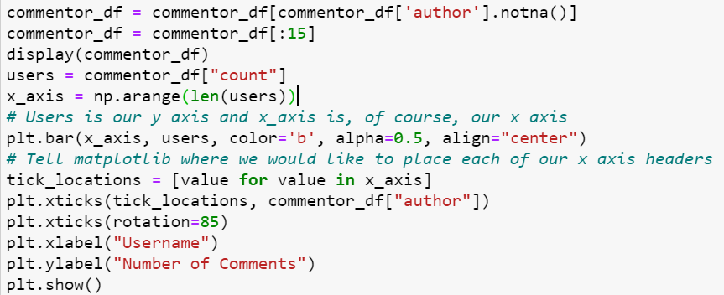
Frequent commentors
Bar Chart:
Number of comments made by most frequent commentors

Slide 10
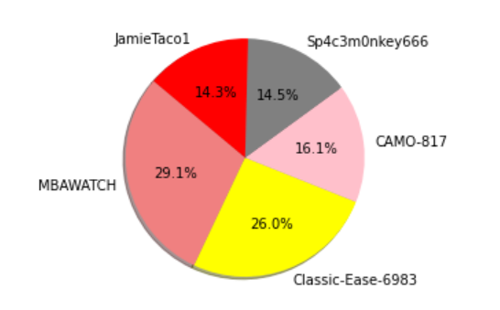
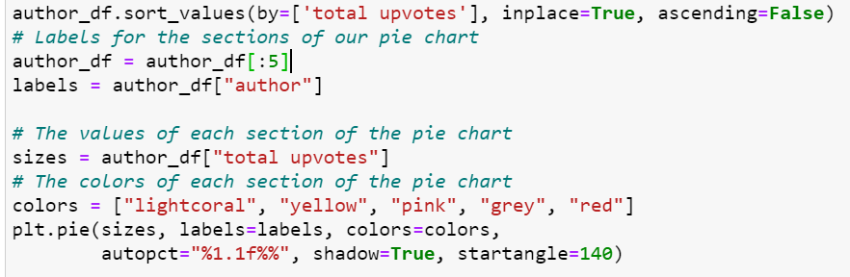
Frequent commentors (% upvotes)
Pie Graph:
Top 5 Most upvoted of the most frequent commentors

Slide 11
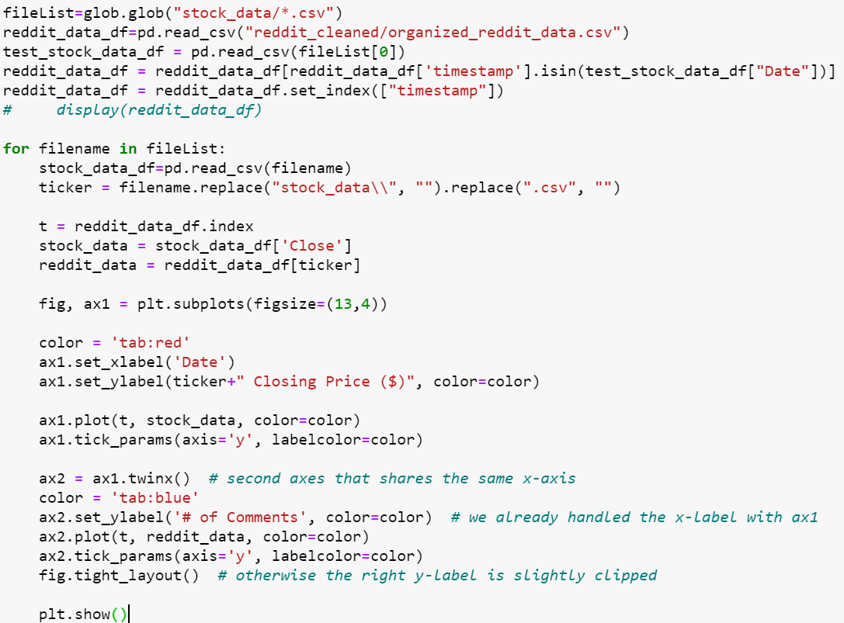
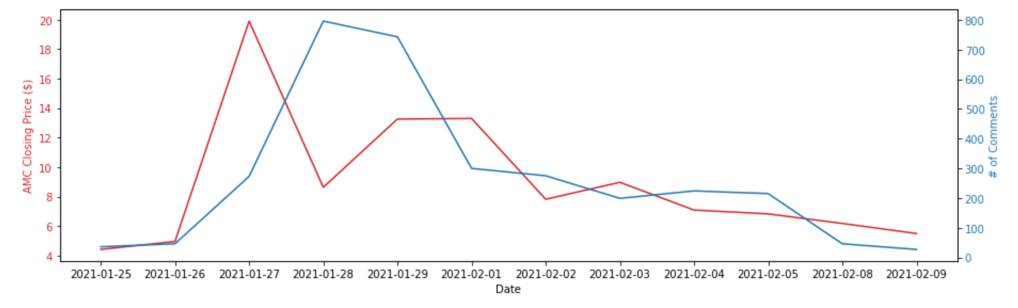
Comments vs. Stock Change

Slide 12
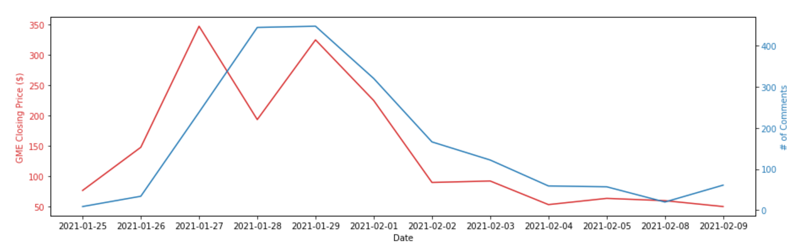
Comments vs. Stock Change
Blue Line: # Of Comments
Red Line: Stock Price

Slide 13
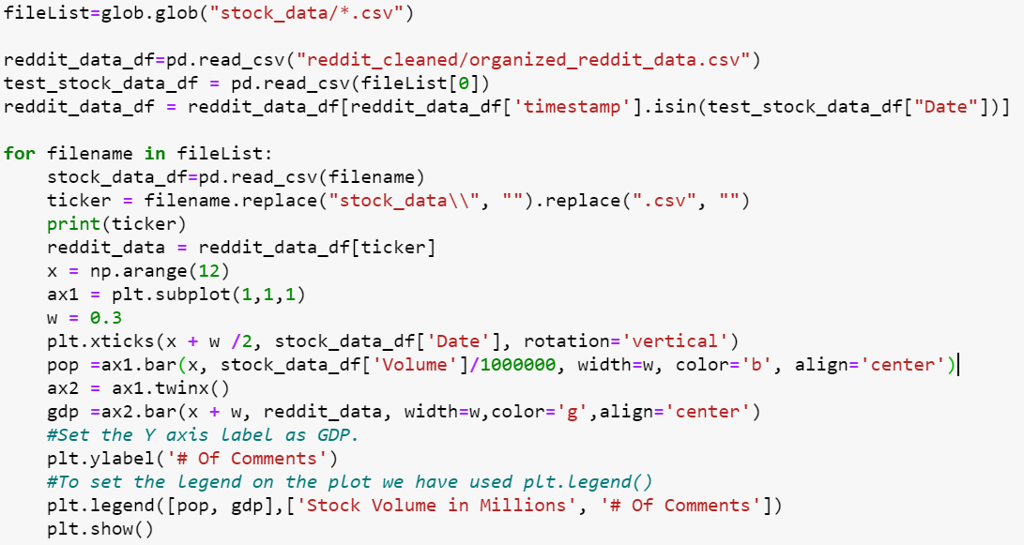
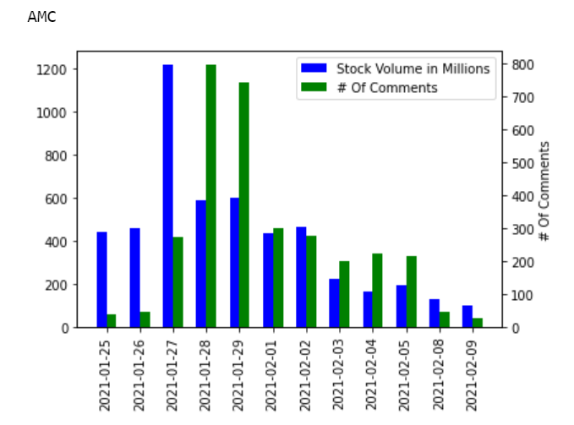
Comments vs. Stock Volume

Slide 14
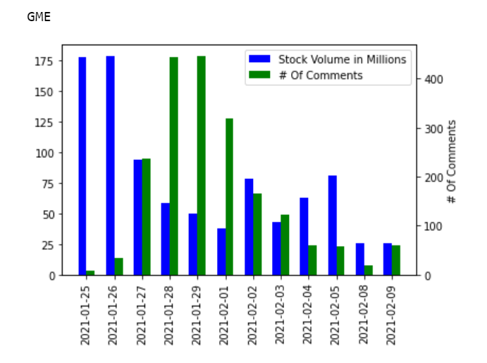
Comments vs. Stock Volume

Slide 15

Conclusions
While some things were gleamed it seems to be more the start of an endless search for answers.
Further Research:
Narrow down time frame to see if there is a different relationship between comments and stock movement
Analyze Insider data on transactions/funds holding to see how much of their transactions moved the stock
Statistical analysis on correlations between comments and volume as well as comments and price movement on multiple timeframes
More stocks and more data scraped
Side-thoughts
Most threads scraped were created just before or during the movement of the stock happened so no previous history can be gathered to compare
More in depth stock data would be needed to do further analysis

