Slide 1
Predicting a Hike’s Rating
Spencer Tollefson
October 12, 2018
Notes:
Curiosity what makes a hike popular
Use case: hiking planners

Slide 2


Database
Voting system
Notes:
Non-profit advocacy group
Database: hiking descriptions, characteristics
Hiker interaction: voting and trip reports

Slide 3
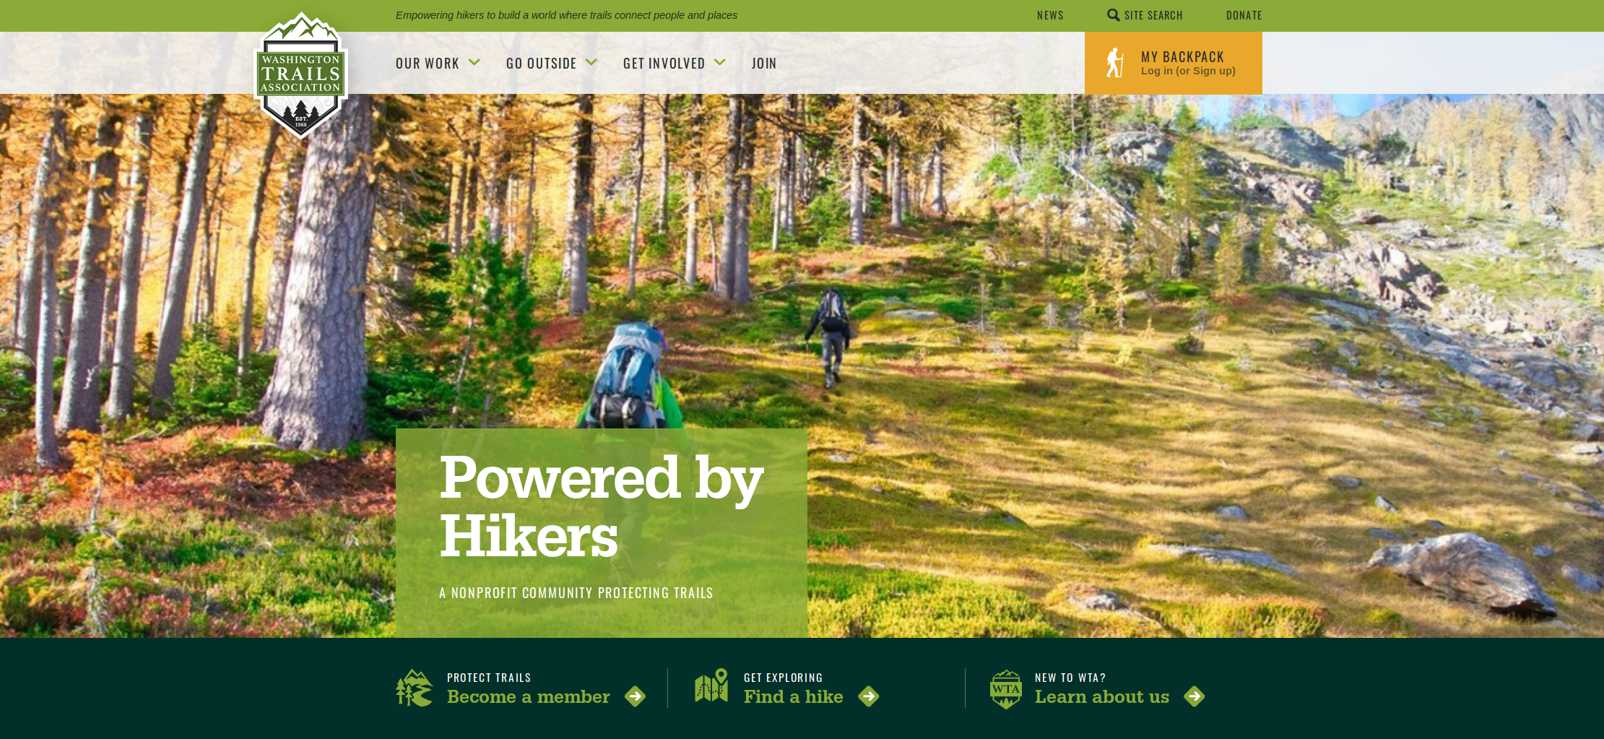
Notes:
Main page of website
Looks good

Slide 4
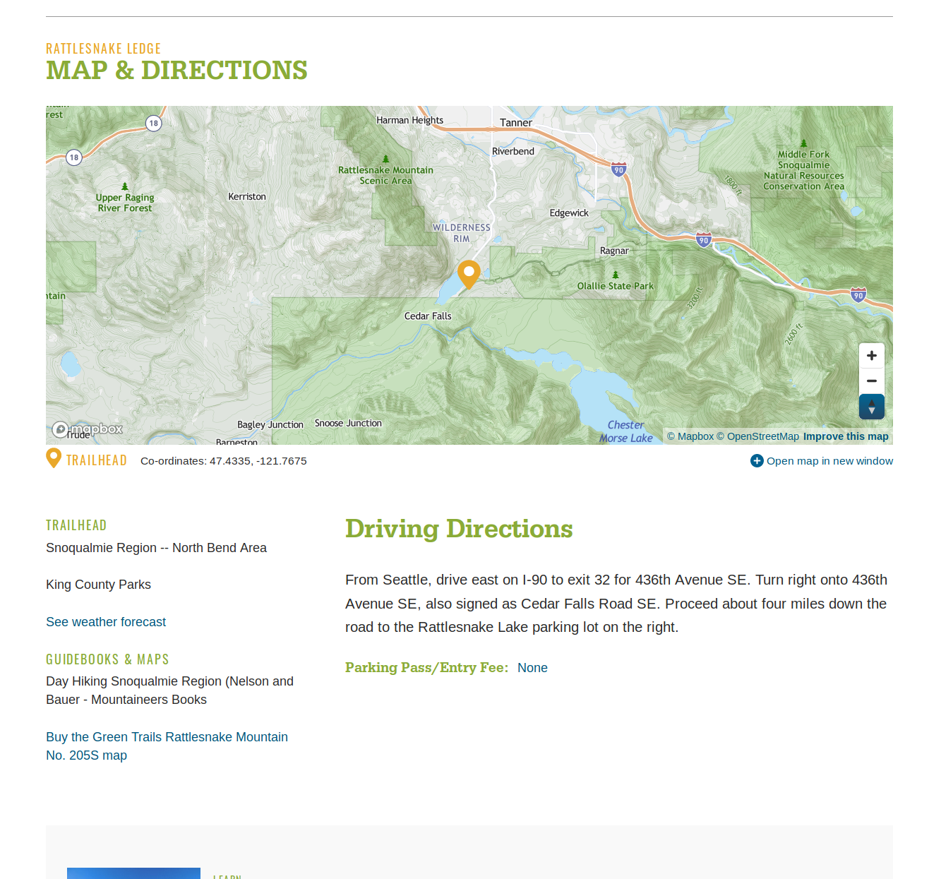
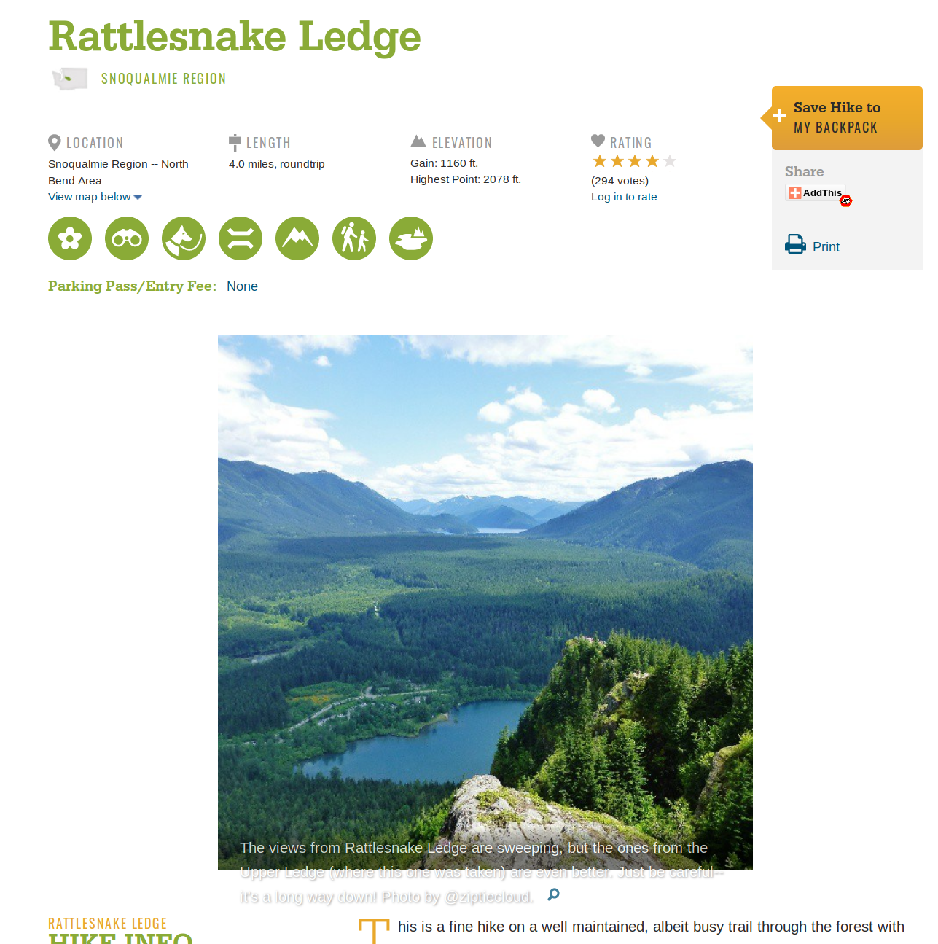

Slide 5
Process
Collect Data
Train Model
Evaluate Results

Slide 6
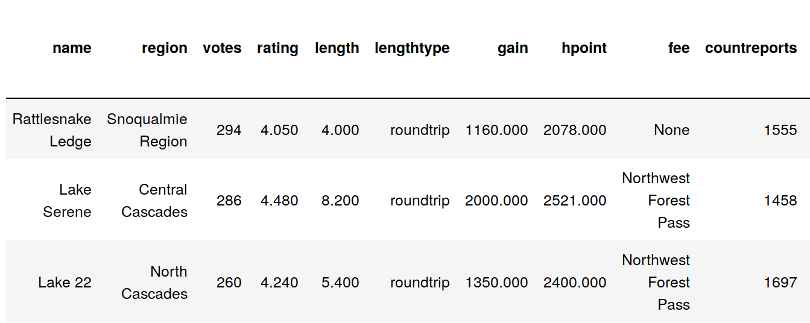
Data
3,555 total hikes
1,015 suitable for model
24 features
Notes:
Scraped into workable table
Cut some variables
Cleaning
Missing values
Incorrectly populated
Duplicates flowing other fields
One way vs round trip
Final set down to < 30% of total hikes

Slide 7
Continuous Features
Feature | Unit
Trip Report | Count
Length | Miles
Starting Elevation | Feet
Elevation Gain | Feet
Standardize
Notes:
Different Scales → Standardization (mean of 0 and std dev of 1)

Slide 8
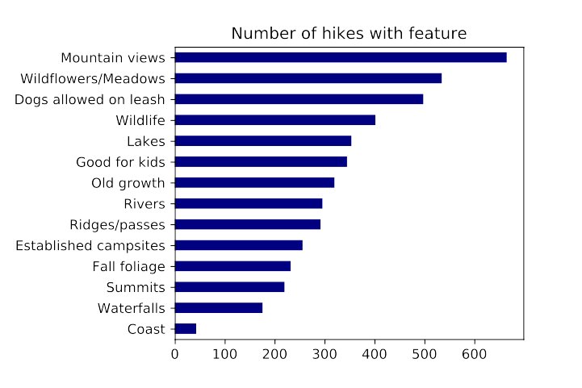
Categorical Features
11 Regions
7 Fee / Pass types
14 “Present” Features
Dummy Variables
Notes:
One-Hot Encoding

Slide 9
Process
Collect Data
Train Model
Evaluate Results

Slide 10
Modeling
Linear Regression
2nd degree polynomial
Fairly well fit
R² Score | Test/Train R² Difference | MSE
.18 | .06 | .36
Notes:
Best fit line
2nd degree polynomial allows interactions between gains/summits, coasts/forests, etc.
Further techniques used to amplify more predictive features and dampen weaker ones
R2: “Indicator of Goodness of Fit”
“Proportion of Variance of dependent variable explained by the model”

Slide 11
Process
Collect Data
Train Model
Evaluate Results

Slide 12
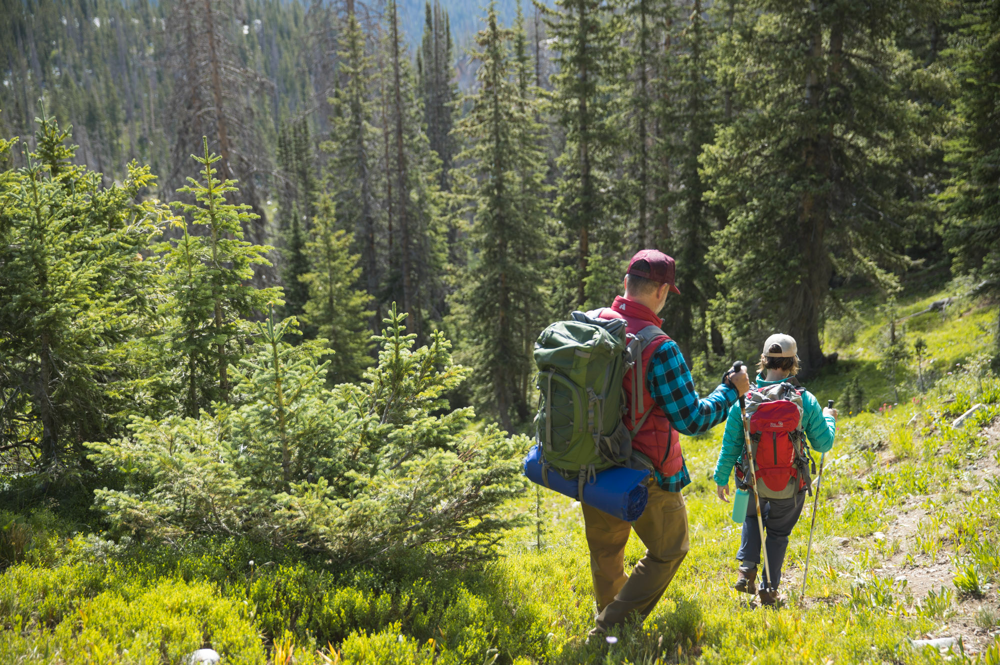
Conclusion
Model is not great at predicting hikes
Better than chance
More data + More features = Better model
Notes:
Not great
Gap between train and test R²
Missing features
Rating only represents people who take the time to go online afterward, know of the website, then vote. Pro or novice hiker?

Slide 13
Future work
More features
Predict something other than rating
Predict popularity of hike on a given day
Notes:
More features:
- Trail maintenance, reputation, weather on day of vote, NLP of trip reports
- Type of hiker voting (amateur/experienced/posts online often
-Other data sources
Pop on given day:
Weather
Day of week / holiday
Time of year

Slide 14
Questions?

Slide 15
Appendix

Slide 16
Model Results
Regularization Model | Test R² Score | Test/Train R² Difference | MSE
Lasso | .18 | .08 | .34
Ridge Regression | .16 | .19 | .36
Elastic Net (L1 = 0.1) | .18 | .06 | .35
Notes:
Slight R^2
L1 Elastic = Mostly Ridge Regression, a little bit of lasso

Slide 17
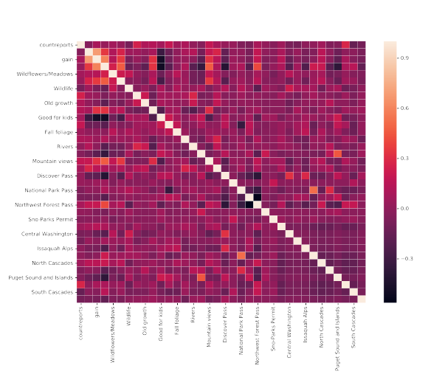
Correlation Heatmap

Slide 18
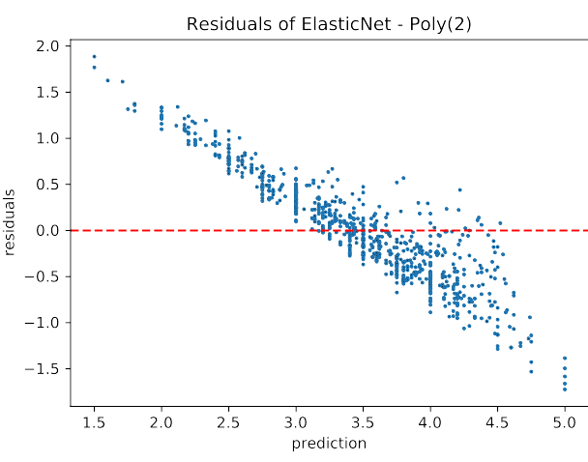
Residual Chart

Slide 19
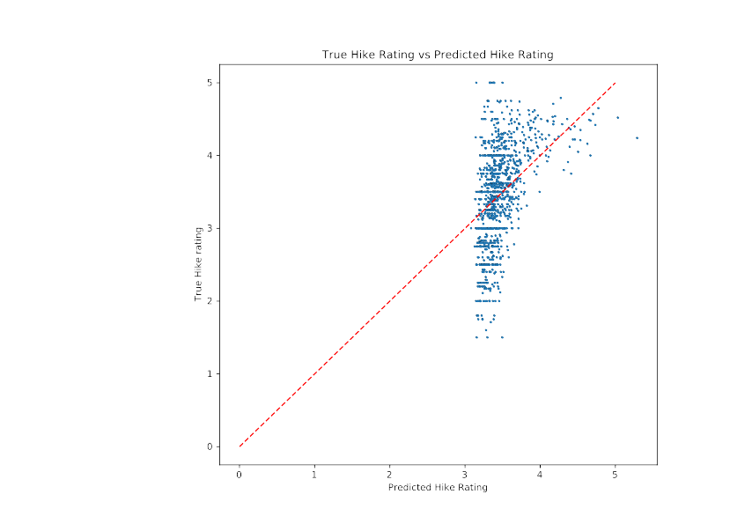
Predicted vs Actual Rating

Slide 20
Continuous
Encode
Training
Modeling
Split!
Combined
Evaluate
Categorical
Standardize
Testing
Notes:
Consider cooler shapes (split could be a lightning bolt?) Modeling could be recycling arrows.
Evaluate could be a paper

