Slide 1
Predicting County Presidential Winners
Honpan Spencer Tse • 03.21.2022

Slide 2
Overview
Problem - Predicting county winner with limited data
Expected Performance - Mitt Romney continue to lead
Model Selection - Support Vector Classification
Model Evaluation - Precision/Recall, F1

Slide 3
Overview (cont.)
Model Tuning - Resampling & Dimension Reduction
Conclusion - Despite predicted victory of Romney, overall election result is more dependent on States level instead of Counties
Next Step - Fine Tuning Contribution Factors, Model Logics, and Productionize code
Appendix - Dependencies

Slide 4
Problem - Predicting county winner with limited data and time
We are experiencing a challenge of racing through time, the model needs to be trained quickly with limited amount of data
If there is more data coming, it will imply less value generated on the model
If more time is consumed, there will be no reason the model is needed
Limited amount of data will pose issue with accuracy of the model

Slide 5
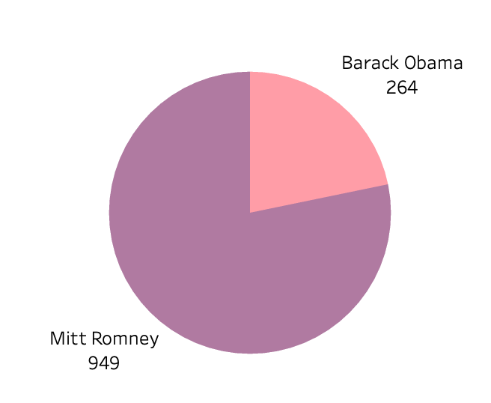
Expected Performance - Mitt Romney continue to lead
Within the ~40% known results, Mitt Romney is winning in over 78% counties.
The model will be biased towards Mitt Romney due to the imbalance current view
Limited amount of data would also reduce accuracy

Slide 6
Model Selection - Support Vector Classification
Supervised Learning with a specific goal, a classification model that has a target outcome
Features appears to be continuous variables instead of categorical
Limited data and time of data prevent us from other options

Slide 7
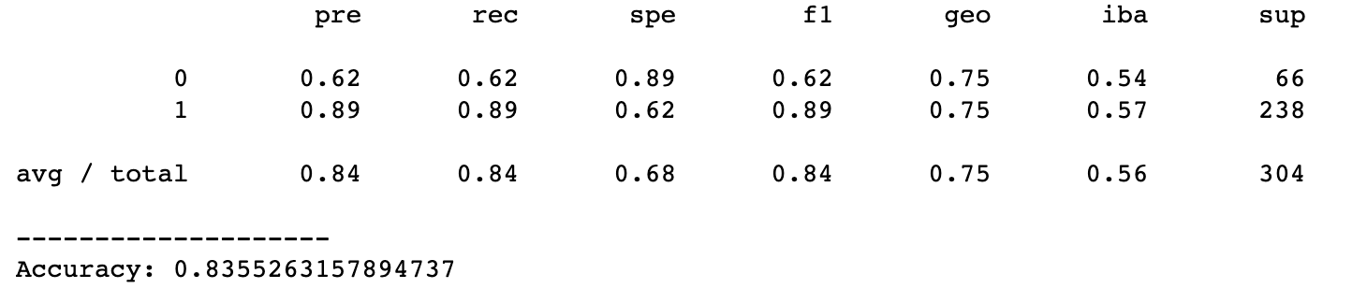
Model Evaluation - Precision/Recall, F1
Since there is significant imbalance in the training data, we will observe F1 score to keep track of both precision and recall

Slide 8
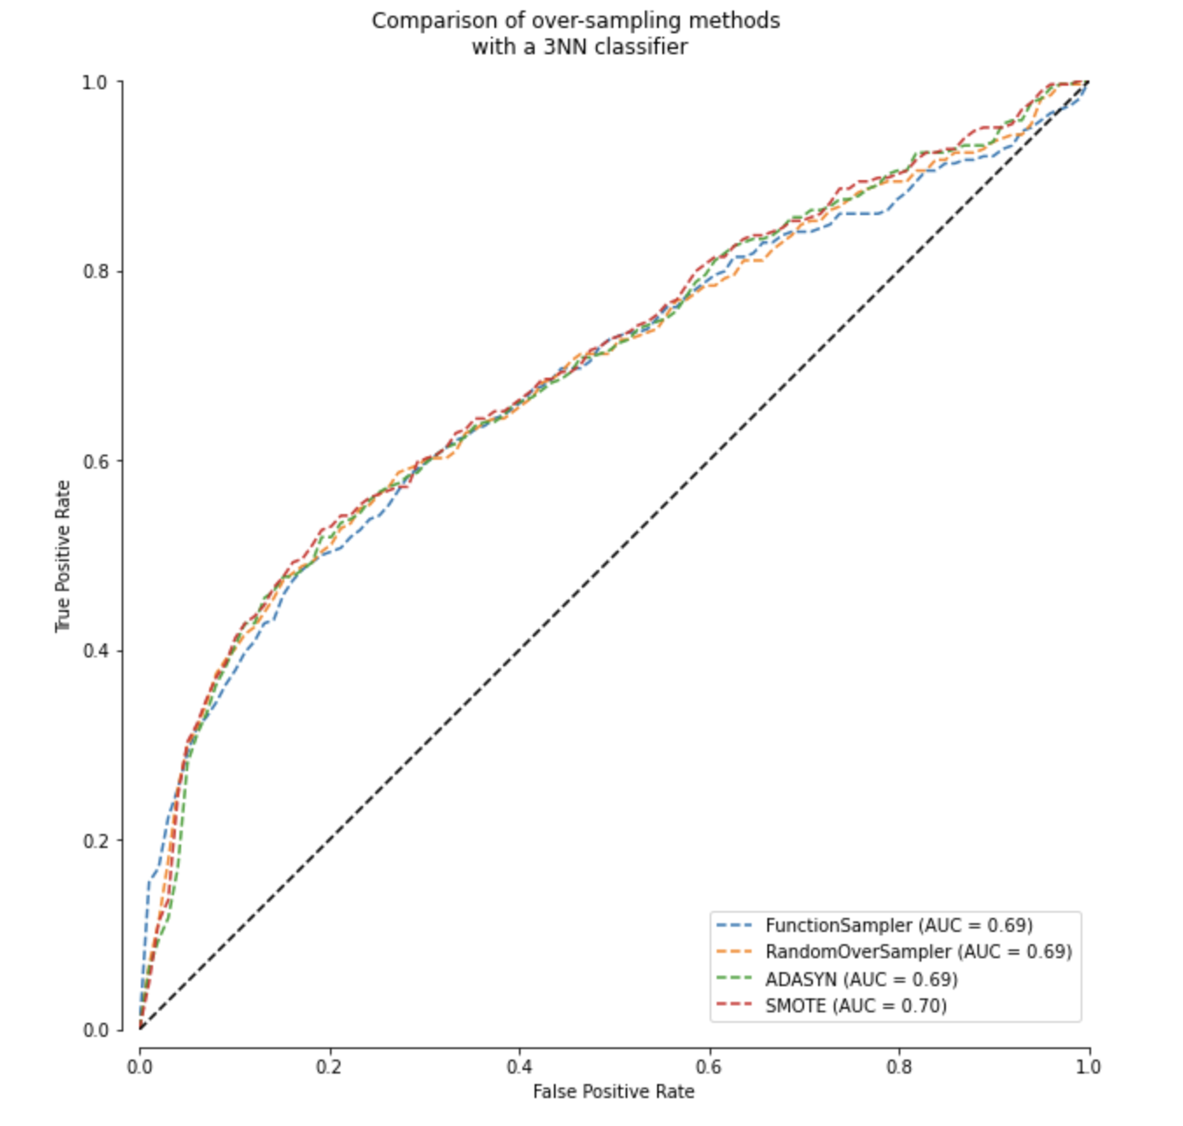
Model Tuning - Resampling
We chose Random Oversampler. Based on ROC Curve, most methods have similar performance.
Due to lack of data, we will not apply any undersampling methods

Slide 9
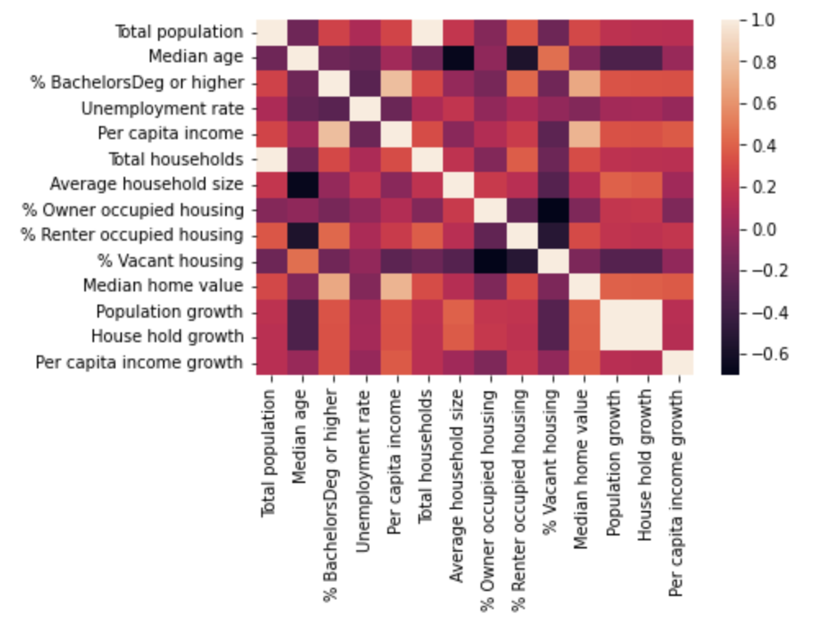
Model Tuning - Dimension Reduction
Approximately 4-5 variables are highly correlated
Household size vs population size
Income vs education

Slide 10
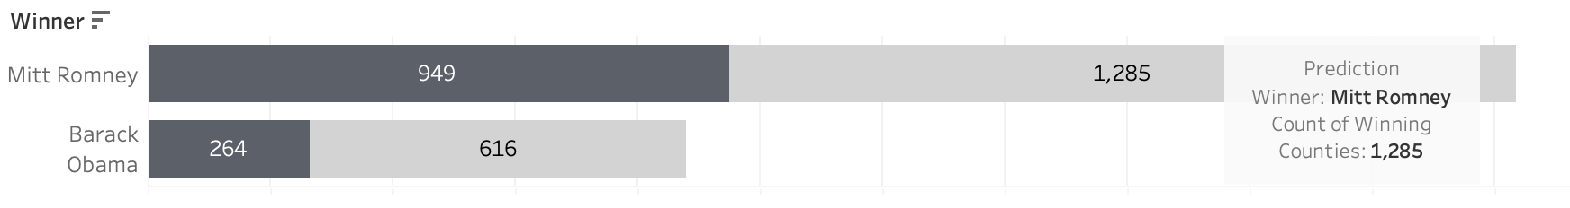
Conclusion - Despite predicted victory of Romney, overall election result is more dependent on States level instead of Counties
Predicted result matches expectation with Romney winning 67% of the counties, and the model overcome imbalances to successfully predicted more Barack Obama winning cases

Slide 11
Next Step - Fine Tuning Contribution Factors, Model Logics, and Productionize code
Fine Tuning the dimensional reduction logics
Perform a deeper correlation studies, and output a better number of principal component computationally instead of reading a heatmap.
Experiment with decision trees and random forest, approaching the problem as categorical features
Certain features in the training data such as education and income appears to be some conditional factors, and a tree style modeling will provide a realistic explanation and action plan towards affecting the unknown result counties
Experiment with more cross validation methods, building ensemble SVC models
After an experiment with decision trees, we will attempt to combine models for potential better result
Collect more historical election data
Getting a better holistic view instead of a time crunch model (the current project model is a race through time)
Package the data processing pipelines and model applications into objects
Will facilitate team work, and scalability

Slide 12
Appendix
Model Dependencies
Anaconda
scikit-learn
Imbalanced-learn
**Please refer to dependencies.txt

