Slide 1
Visualization of Non-deterministic Pushdown and Finite Automata Derived From Context-Free Grammars
Nicolas Hempe Ardila
Spencer Turkel

Slide 2
Introduction
In this project we are using a web application to visualize a context-free grammar into NFA and NPDA.
The application will take a context-free grammar in a form on the webpage and dynamically update the graphs as you enter the grammar.
Each graph will be dynamically created and displayed in the webpage as the user types.

Slide 3
Implementation
Created using TypeScript and Angular
Grammar is first parsed from form, then transformed into the applicable automata data structures, which are then transformed into Graphviz DOT language, which is then parsed by the Graphviz library to create visualizations.

Slide 4
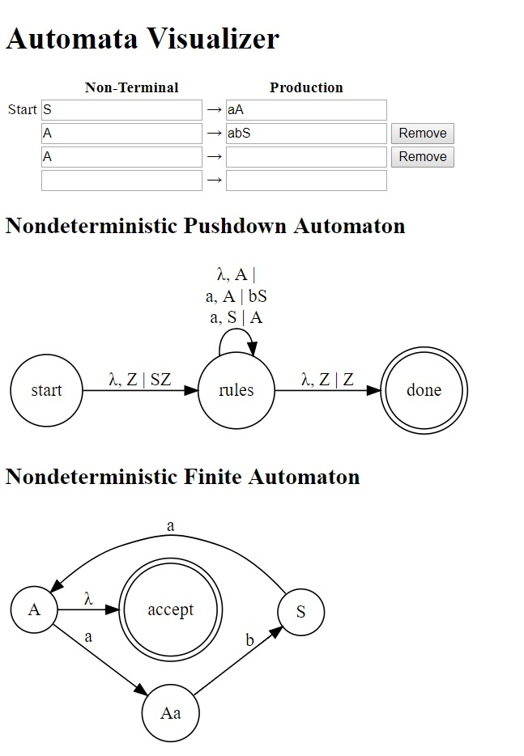
Results
The following example shows the Nondeterministic pushdown automaton and Nondeterministic finite automaton with the context-free grammar:
S⟶aA
A⟶abS | λ

Slide 5
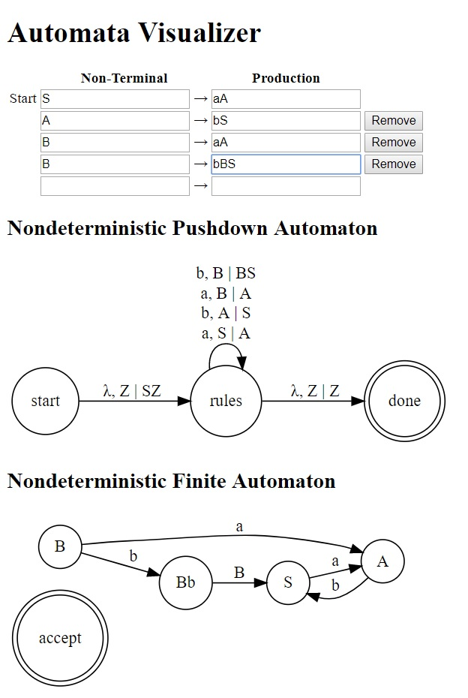
Results
This example shows the Nondeterministic pushdown automaton and Nondeterministic finite automaton with the following grammar:
S⟶aA
A⟶bS
B⟶aA | bBS
This example shows that the NFA does not accept this grammar since there is no state that leads to the final state.

Slide 6
Conclusion
“Power” difference between NPDA and NFA intuitive
Widely known theorems for grammar to automata conversions are not as helpful as they could be
Application could be extended to provide more informative error messages, or to simulate automata operation

