Slide 1
Measuring Performance of Page Replacement Algorithms
Nicolas Hempe Ardila
Spencer Turkel

Slide 2
Introduction
In this project we will simulate the performance of page replacement algorithms in C++.
These include First-In, First-Out (FIFO), Least Recently Used (LRU), Least Frequently Used (LFU), Most Frequently Used (MFU) and Optimal.
Our program allowed us to compare these page replacement algorithms and attempt to determine which algorithms perform better or worse in multiple cases.

Slide 3
First-in, First-out (FIFO)
Replace the page that has been in physical memory the longest period of time.
Our implementation works by pushing and popping page references from a std::deque used as a FIFO Queue.

Slide 4
Least Recently Used (LRU)
Replace the page that has not been used in the longest amount of time.
Our implementation maintains page references in a std::set. To erase the least recently used page, we replace the maximum element out of all the loaded pages ordered by their minimum distance from the current input.

Slide 5
Least Frequently Used (LFU)
Replace the page with the least references made to them.
Our implementation used a std::vector to maintain a list of pages and their amounts of references. When there is a hit, we increment the reference count of that page, then reorder the list so that it forms a min heap based on the reference counts. When there is a miss, we pop the top of the min heap, push the new value, and reorder the list so that it again forms a min heap.

Slide 6
Most Frequently Used (MFU)
Replace the page with the most references made to them.
Our implementation used a std::vector to maintain a list of pages and their amounts of references. When there is a hit, we increment the reference count of that page, then reorder the list so that it forms a max heap based on the reference counts. When there is a miss, we pop the top of the max heap, push the new value, and reorder the list so that it again forms a max heap.

Slide 7
Optimal
Replace the page that will not be used for the longest period of time.
Our implementation uses a map from page reference numbers to positions of the input where their next use is. On a miss, we replace the maximum element of the table ordered by next uses.

Slide 8
Results
Our results tended towards First-in, First-out (FIFO) and Least Frequently Used (LFU) performing the worst.
The Optimal algorithm always performed the best.

Slide 9
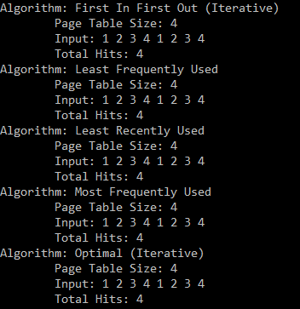
An input with cycles in size equal to the size of the page table causes all algorithms perform equally.

Slide 10
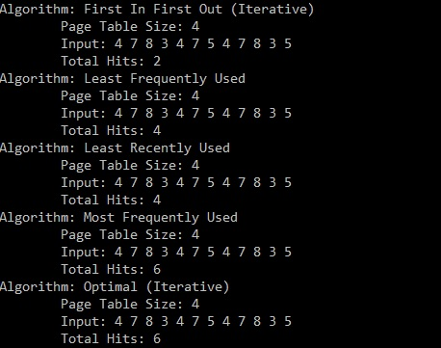
This performs worst with the FIFO algorithm, followed by the LFU and LRU algorithms.

Slide 11
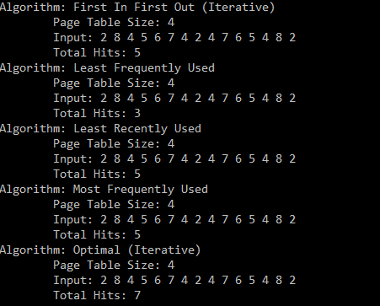
We tried
When we use palindrome traces such as the following 2 8 4 5 6 7 4 2 4 7 6 5 4 8 2 the Least Frequently Used algorithm always performs the worst.

Slide 12
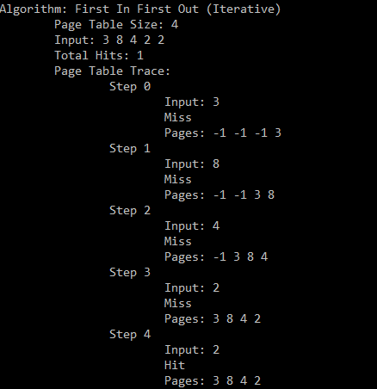
Sample output using the First-in, First-out (FIFO) algorithms showing the number of frames, input, total hits, and step-by-step solution to the trace.

Slide 13
Conclusion
After a great deal of experimentation, we found that the worst performing algorithms were FIFO and LFU, while the best performing algorithm was Optimal.
Optimal was expected to be best, but it is impractical.
Did FIFO and LFU seem to be the worst because we tended towards certain input patterns?
It’s hard to characterize algorithms outside of their best and worst cases.

