Slide 1
Terminal Chess
by Mini-Max Search & Parallelized Alpha-Beta Pruning
0310006
0310015
0310030
0312236

Slide 2
Content
What is Minmax Search and Alpha-Beta Pruning
Chess implementation
  Bit board
  Evaluation
  Search
Paralleling Mini-Max Search
Result and Conclusion

Slide 3
Content
What is Minmax Search and Alpha-Beta Pruning
Chess implementation
  Bit board
  Evaluation
  Search
Paralleling Mini-Max Search
Result and Conclusion

Slide 4
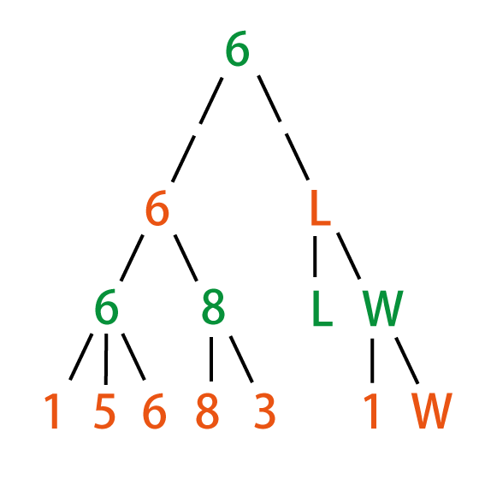
Mini-Max Search
(* the minimax value of n, searched to depth d *)
fun minimax(n: node, d: int): int =
if leaf(n) or depth=0
return evaluate(n)
if n is a max node
v := L
for each child of n
v' := minimax (child,d-1)
if v' > v, v:= v'
return v
if n is a min node
v := W
for each child of n
v' := minimax (child,d-1)
if v' < v, v:= v'
return v

Slide 5
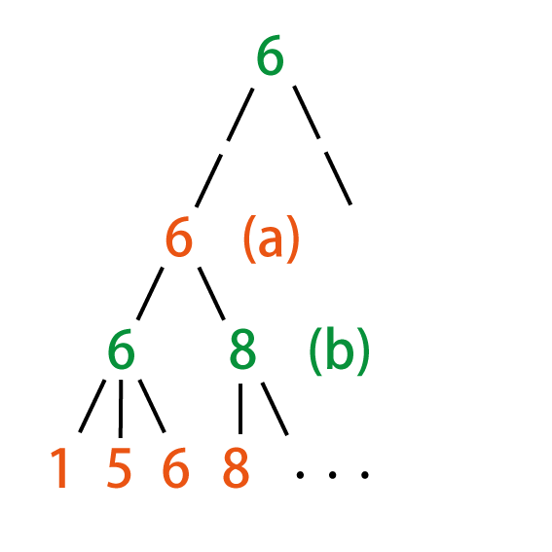
Alpha-Beta Pruning
(* the minimax value of n, searched to depth d.
* If the value is less than min, returns min.
* If greater than max, returns max. *)
fun minimax(n: node, d: int, min: int, max: int): int =
if leaf(n) or depth=0
return evaluate(n)
if n is a max node
v := min
for each child of n
v' := minimax (child,d-1,v,max)
if v' > v, v:= v'
if v > max return max
return v
if n is a min node
v := max
for each child of n
v' := minimax (child,d-1,min,v)
if v' < v, v:= v'
if v < min return min
return v
Alpha-Beta pruning

Slide 6
Content
What is Minmax Search and Alpha-Beta Pruning
Chess implementation
  Bit board
  Evaluation
  Search
Paralleling Mini-Max Search
Result and Conclusion

Slide 7
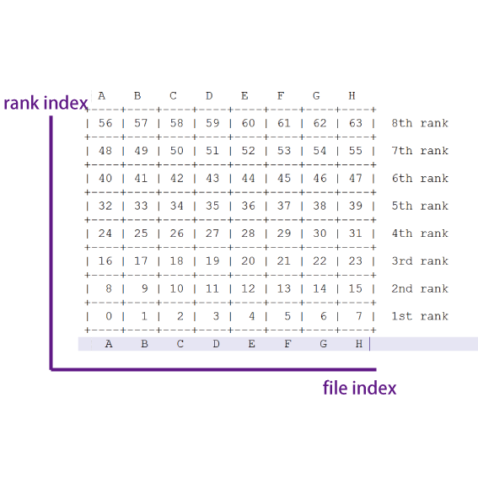
Bit Board
int boardMap[64] ;
map<int,Piece*> pieceMap;
squareIndex = 8 * rankIndex + fileIndex
rankIndex = squareIndex div 8
fileIndex = squareIndex mod 8

Slide 8
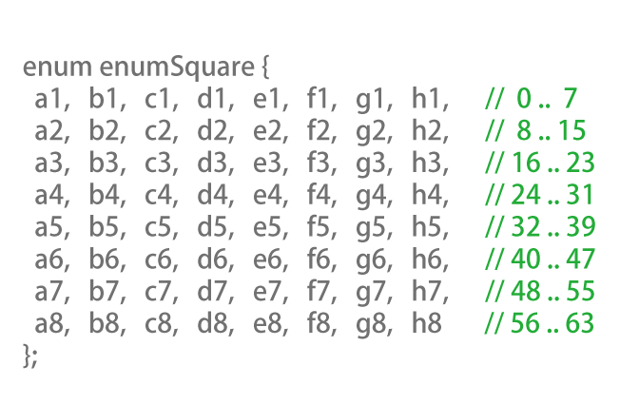
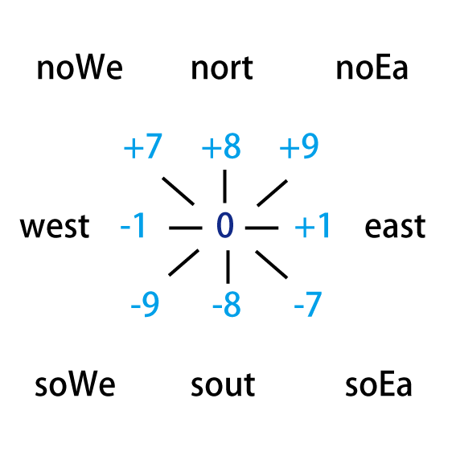
Bit Board

Slide 9
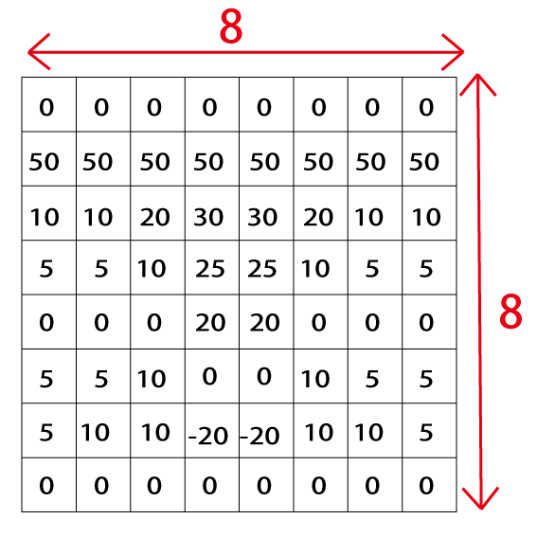
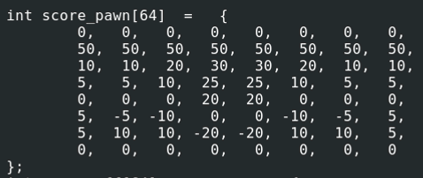
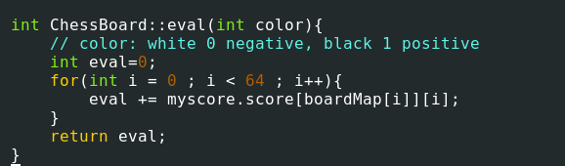
Evaluation
Score is based on the position on the chessboard

Slide 10
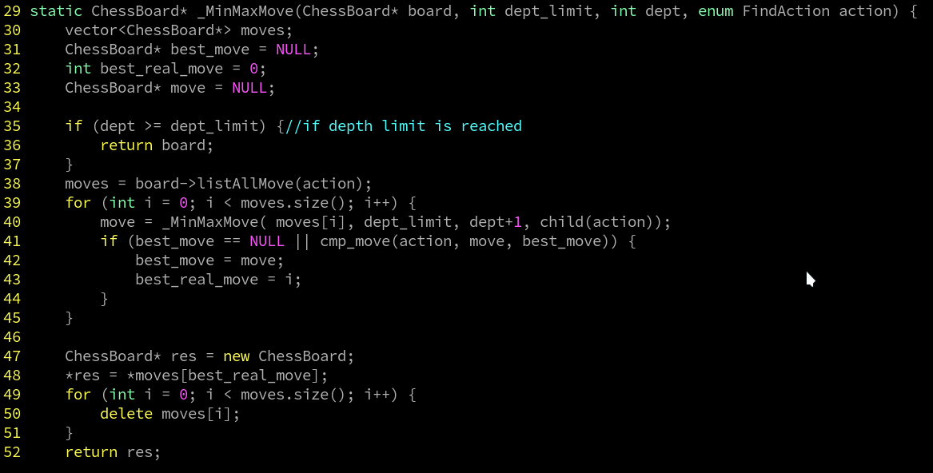
Mini-Max Search

Slide 11
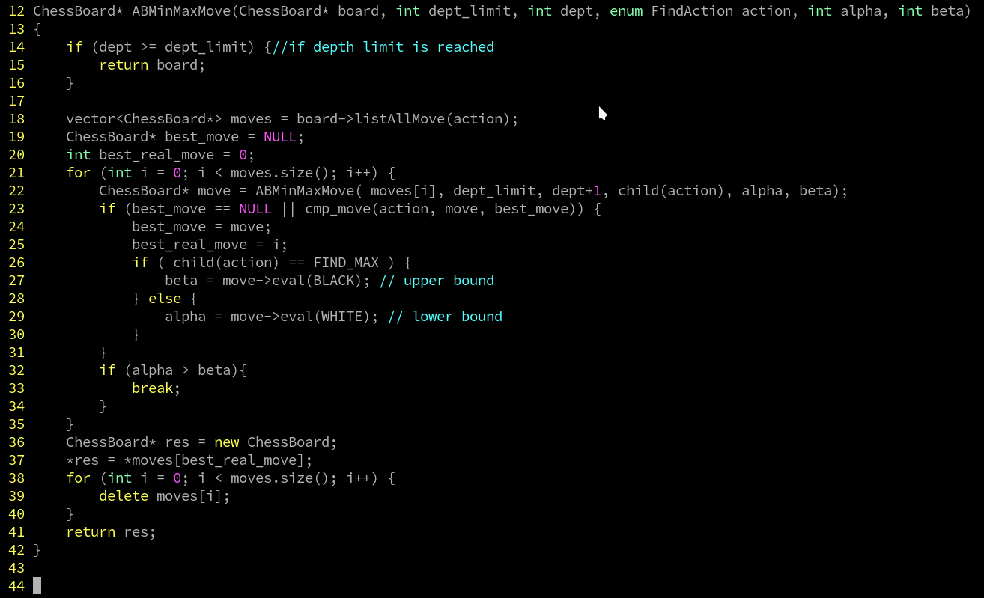
Alpha-Beta Search

Slide 12
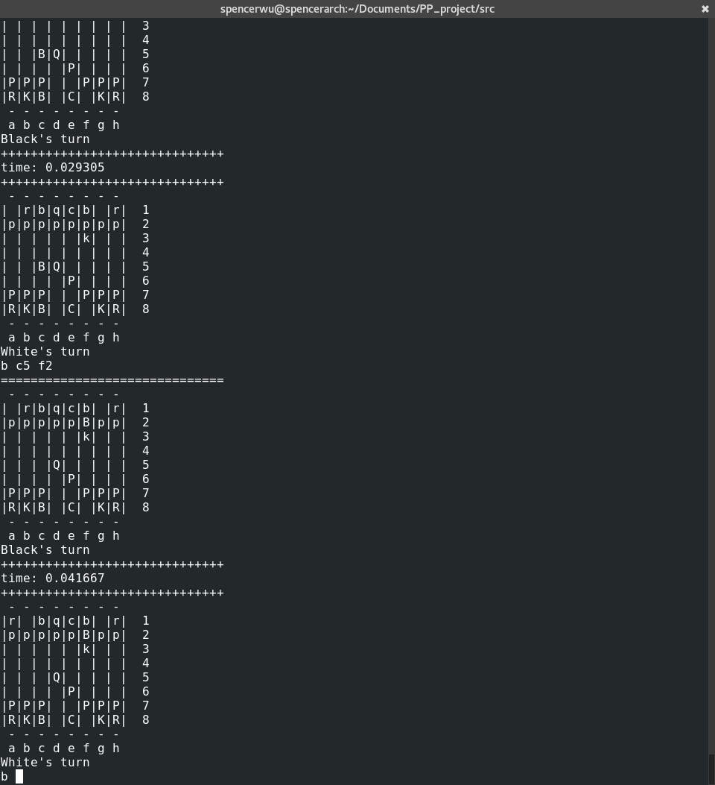

Slide 13
Content
What is Minmax Search and Alpha-Beta Pruning
Chess implementation
  Bit board
  Evaluation
  Search
Paralleling Mini-Max Search
Result and Conclusion

Slide 14
Parallelizing Alpha-beta
PVSplit:
  easier to implement, less scalability, poor load balancing
YBWC:
  little bit better scalability
Dynamic Tree Splitting (DTS)
  good scalability, good load balancing
  most of chess engines use this
  hard to implement

Slide 15
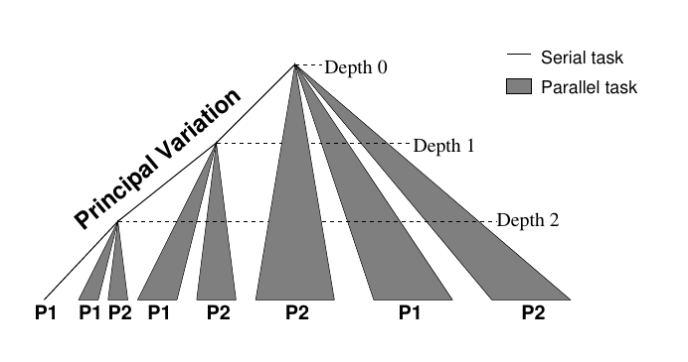
PVSplit
Principal Variation (http://iacoma.cs.uiuc.edu/~greskamp/pdfs/412.pdf)

Slide 16
Implementation
pthread → glib thread pool
use g_thread_mutex to protect saved best solution and alpha-beta values.

Slide 17
Why worse than normal A-B?
too many threads
  in the beginning, we try to invoke N threads at once to avoid this.
bad load balance
  wait other threads to complete
solution make this a little bit better: thread pool

Slide 18
Why worse than normal A-B?
too many threads
  in the beginning, we try to invoke N threads at once to avoid this.
bad load balance
  wait other threads to complete
solution make this a little bit better: thread pool

Slide 19
Bad Scalability
idle cores
possible solution: enhanced PVSplit (EPVS).
  idle cores can help other cores to handle some subtrees.
  we haven't implemented this.
in 16 cores, speedup is at most 6x with EPVS.
  from the original research

Slide 20
Content
What is Minmax Search and Alpha-Beta Pruning
Chess implementation
  Bit board
  Evaluation
  Search
Paralleling Mini-Max Search
Result and Conclusion

Slide 22
Result

Slide 23
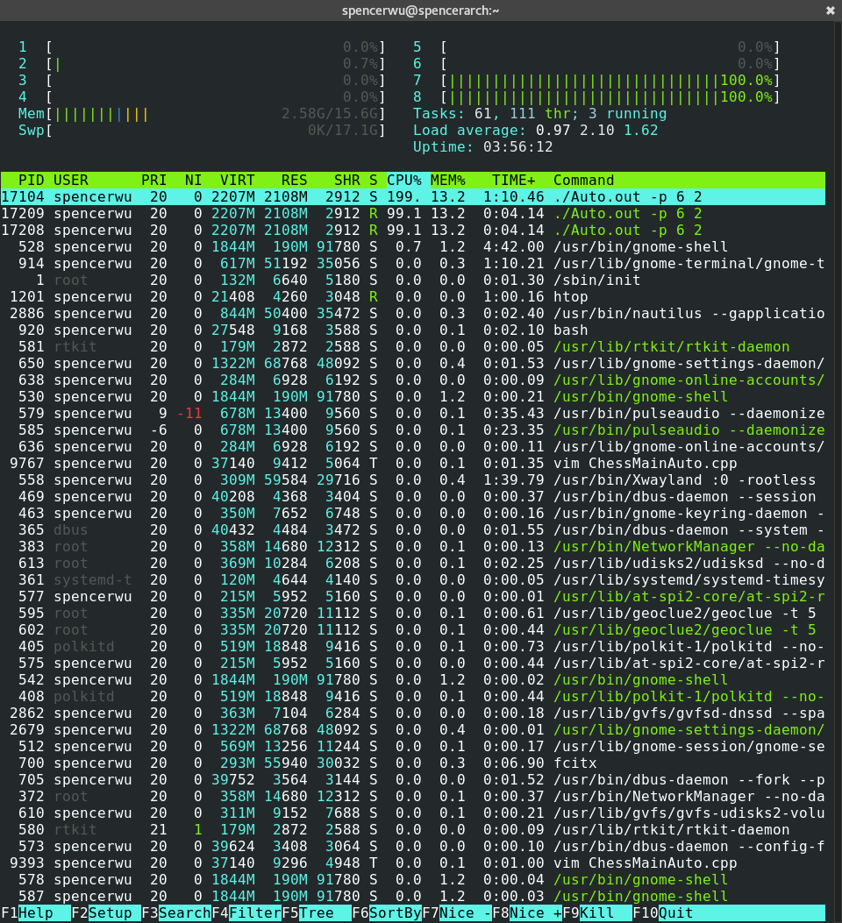
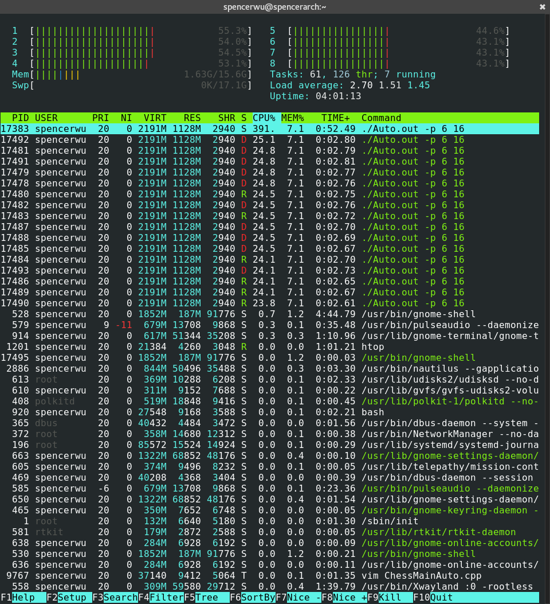

Slide 24
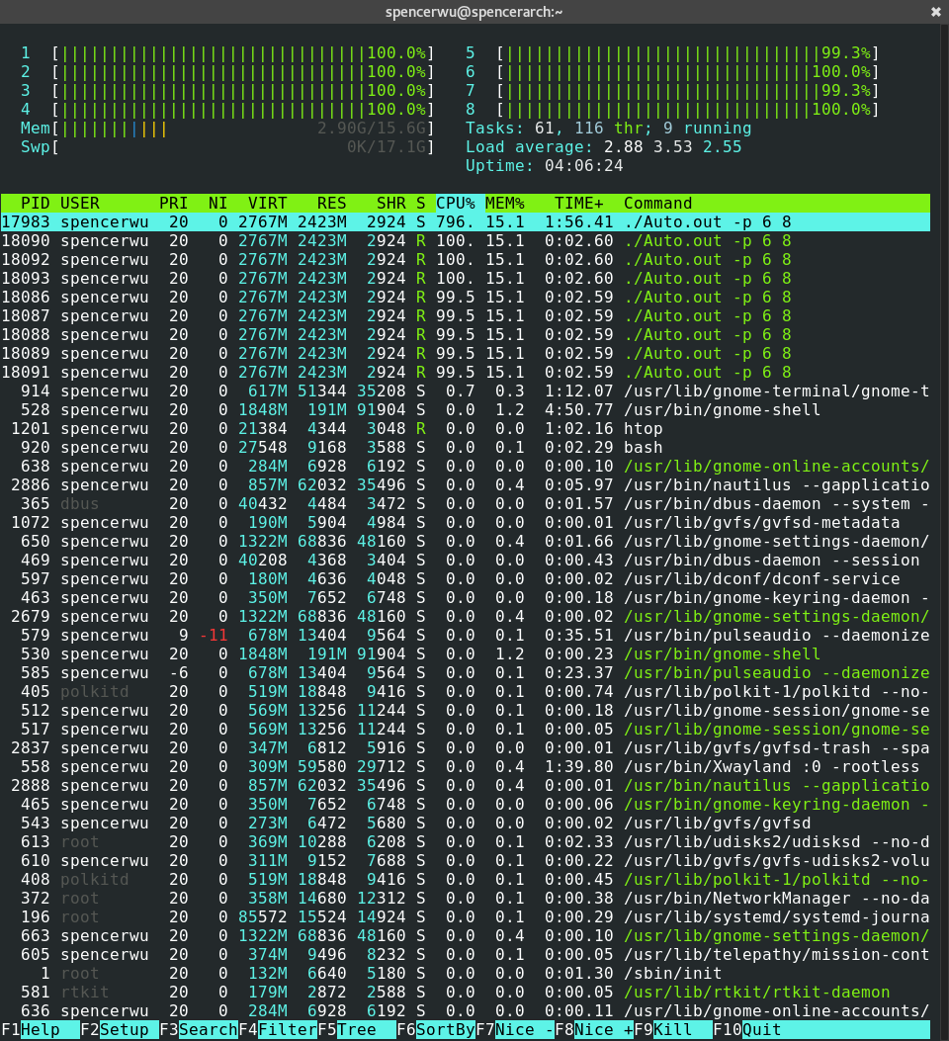

Slide 25
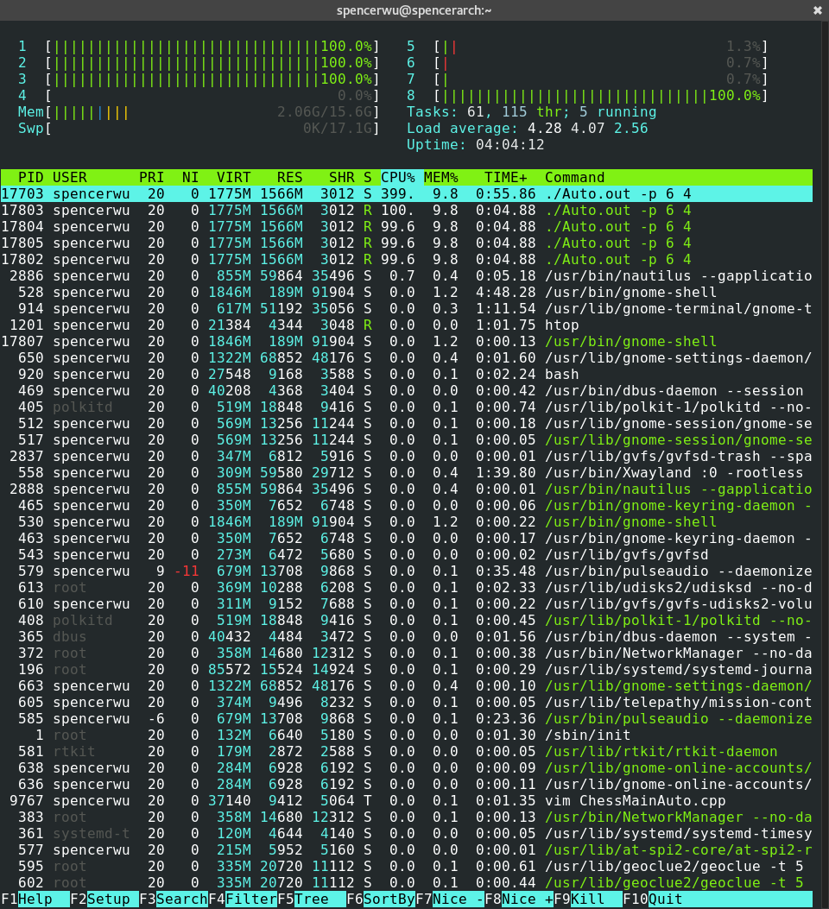
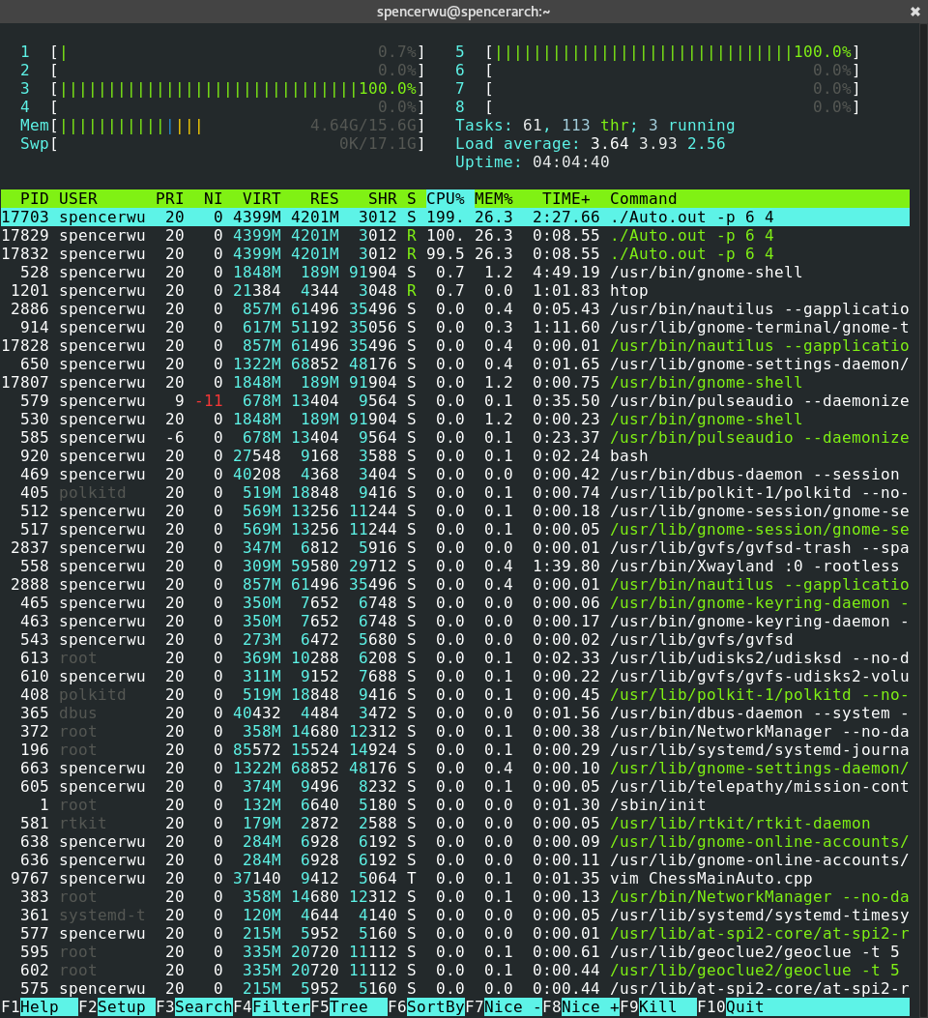

Slide 26
Scalability
 | 2 | 4 | 8 | 16
Depth 5 | 0.764 | 0.572 | 0.357 | 1.103
Depth 6 | 21.784 | 12.240 | 10.207 | 18.643

Slide 27
Conclusion
In our Chess Evaluation, we may have a different result by paralleling alpha-beta Search.
If the search cut off too early, we may not have speed up when paralleling

Slide 28
Future Works
Implementing the Dynamic Tree Splitting.
Using GPU algorithm.
Better evaluation.

Slide 29
Reference
Chess Programming Wiki
  https://chessprogramming.wikispaces.com/
Parallel Alpha-Beta Search on Shared Memory Multiprocessors
  http://www.top-5000.nl/ps/Parallel%20Alpha-Beta%20Search%20on%20Shared%20Memory%20Multiprocessors.pdf

Slide 30
Reference
Parallelizing a Simple Chess Program
  http://iacoma.cs.uiuc.edu/~greskamp/pdfs/412.pdf
Parallel Game Tree Search
  http://www.iis.sinica.edu.tw/~tshsu/tcg/2013/slides/slide11.pdf

Slide 31
Q & A

