Slide 1
Elevator Project Submission
Spencer Zelin
7/6/2026

Slide 2
About Me
Quant Developer at Blackrock supporting FI (Credit, Munis)
Grew up in NJ → Moved to NYC in highschool
IOE @ Michigan; MS Analytics @ GaTech
Interests: playing guitar, reading, running/weights, foodie, NY sports
Fun fact: only red head in my family

Slide 3
Background & Problem
Design a simplified simulation of an intelligent elevator system
Multi-elevator building
Configure elevator count, floor count, per-car capacity
Timed requests
Every passenger specifies an origin, destination, and exact time (tick) they appear
Destination dispatch
Each request is assigned straight to a specific car, not a shared hallway button
No lookahead
The scheduler only sees requests that have been released

Slide 4




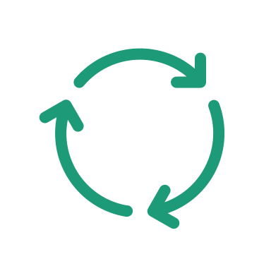
Project Structure
main.py
main CLI point:
parses args, wires up the scheduler and simulation, writes results.
io_utils.py
CSV parsing, position-log output, and summary statistics.
models.py
Domain state: Passenger, Elevator, Direction, and stop bookkeeping.
scheduler.py
Pluggable strategy:
Nearest-Car by default, Round-Robin baseline.
simulation.py
Owns the tick loop: release, assign, board, move, log.

Slide 5
Simulation Loop Flow
1: Release requests
2:Assign elevator
3:Drop off
4: Pick up
5: Move
6: Log Position
Loop ends when:
All requests released
All passengers delivered
All elevators idle

Slide 6
Scheduling Options
Nearest-Car
(default)
Cost = distance to pickup + direction penalty + load penalty
Round Robin
(used for comparison)
Cycles through elevators in a fixed order
Free pickup when the passenger is already on the car's path
Detour cost added when a car must finish its sweep and reverse
Skips any car already at committed capacity
Greedy — decides from current state only, no lookahead
Ignores position, direction, and current path entirely
Still skips any car at committed capacity

Slide 7
Scheduling Results: Nearest Wins Every Time
Same 10-request workload · 4 elevators · 60 floors · capacity 8
Ticks to Clear Queue:
100 vs 182
(for Round-Robin)

Slide 8
Elevator Log Results:
Floor Positions for Each Elevator – Nearest Car

Slide 9
Future Improvements
Addl strategy testing… zone-based
Idle repositioning – move idle elevator cars to more ideal positions
Cap max wait time
Live visualizations
Model cost weights based on load

Slide 10
APPENDIX

Slide 11
Input & Time Model
One tick, one floor, no looking ahead…
Discrete time units — one tick = one floor of travel, up or down
No syncing to a real clock; ticks are just an integer counter
Simulation advances 1 unit at a time, even when requests skip ahead
The scheduler never sees a request before its own timestamp arrives
T = 0 → 1 → 2 → 3 …
Input Format:
time,id,source,dest
0,passenger1,1,51
0,passenger2,1,37
10,passenger3,20,1

