Slide 1
Logistic Regression using Spark Machine Learning
Srini Penchikala
10.04.17

Slide 2


About Me
Software Architect
Big Data Processing with Apache Spark book (Q4 2017)
Co-author of “Spring Roo in Action” book (2012)
Current Focus:
Reactive Microservices
Containers
ML/Deep Learning

Slide 3
Introductions
Role
Developers / Architects
Data Scientists
Data Analysts
DBAs, OPS Team
Other role?
Experience in:
Machine Learning
Apache Spark
Spark MLlib
Scala

Slide 4
Agenda
Machine Learning
Classification & Regression
Spark MLlib
Sample Application
Demo
Conclusions
Q&A

Slide 5
Machine Learning Data Pipeline
*Source: https://www.infoq.com/articles/apache-sparkml-data-pipelines

Slide 6
Machine Learning Categories
Supervised Learning
Make predictions based on a set of examples
Task driven
Unsupervised Learning
Data points have no labels associated with them
Data driven
Reinforcement Learning
Learns by interacting with its environment and observing the results of these interactions
Look for patterns in the value labels
Examples: Classification, Regression, Anomaly Detection
Goal is to organize data in some way or to describe its structure (e.g. group data into clusters)
Examples: Clustering, Dimensionality Reduction, Recommender Systems, Deep Learning
Find balance between “exploration” (of uncharted territory) and “exploitation” (of current knowledge)
Use cases: Game Theory, Robotics, Computer Networking, Vehicle Navigation, AlphaGo
Is a form of unsupervised learning

Slide 7
Machine Learning Algorithms
Classification & Regression
Logistic Regression
Decision Tree
Random Forest
Gradient Boosted Tree
Collaborative Filtering
Alternating Least Squares (ALS)
Frequent Pattern Mining
Clustering
K-Means
LDA
FP-growth

Slide 8
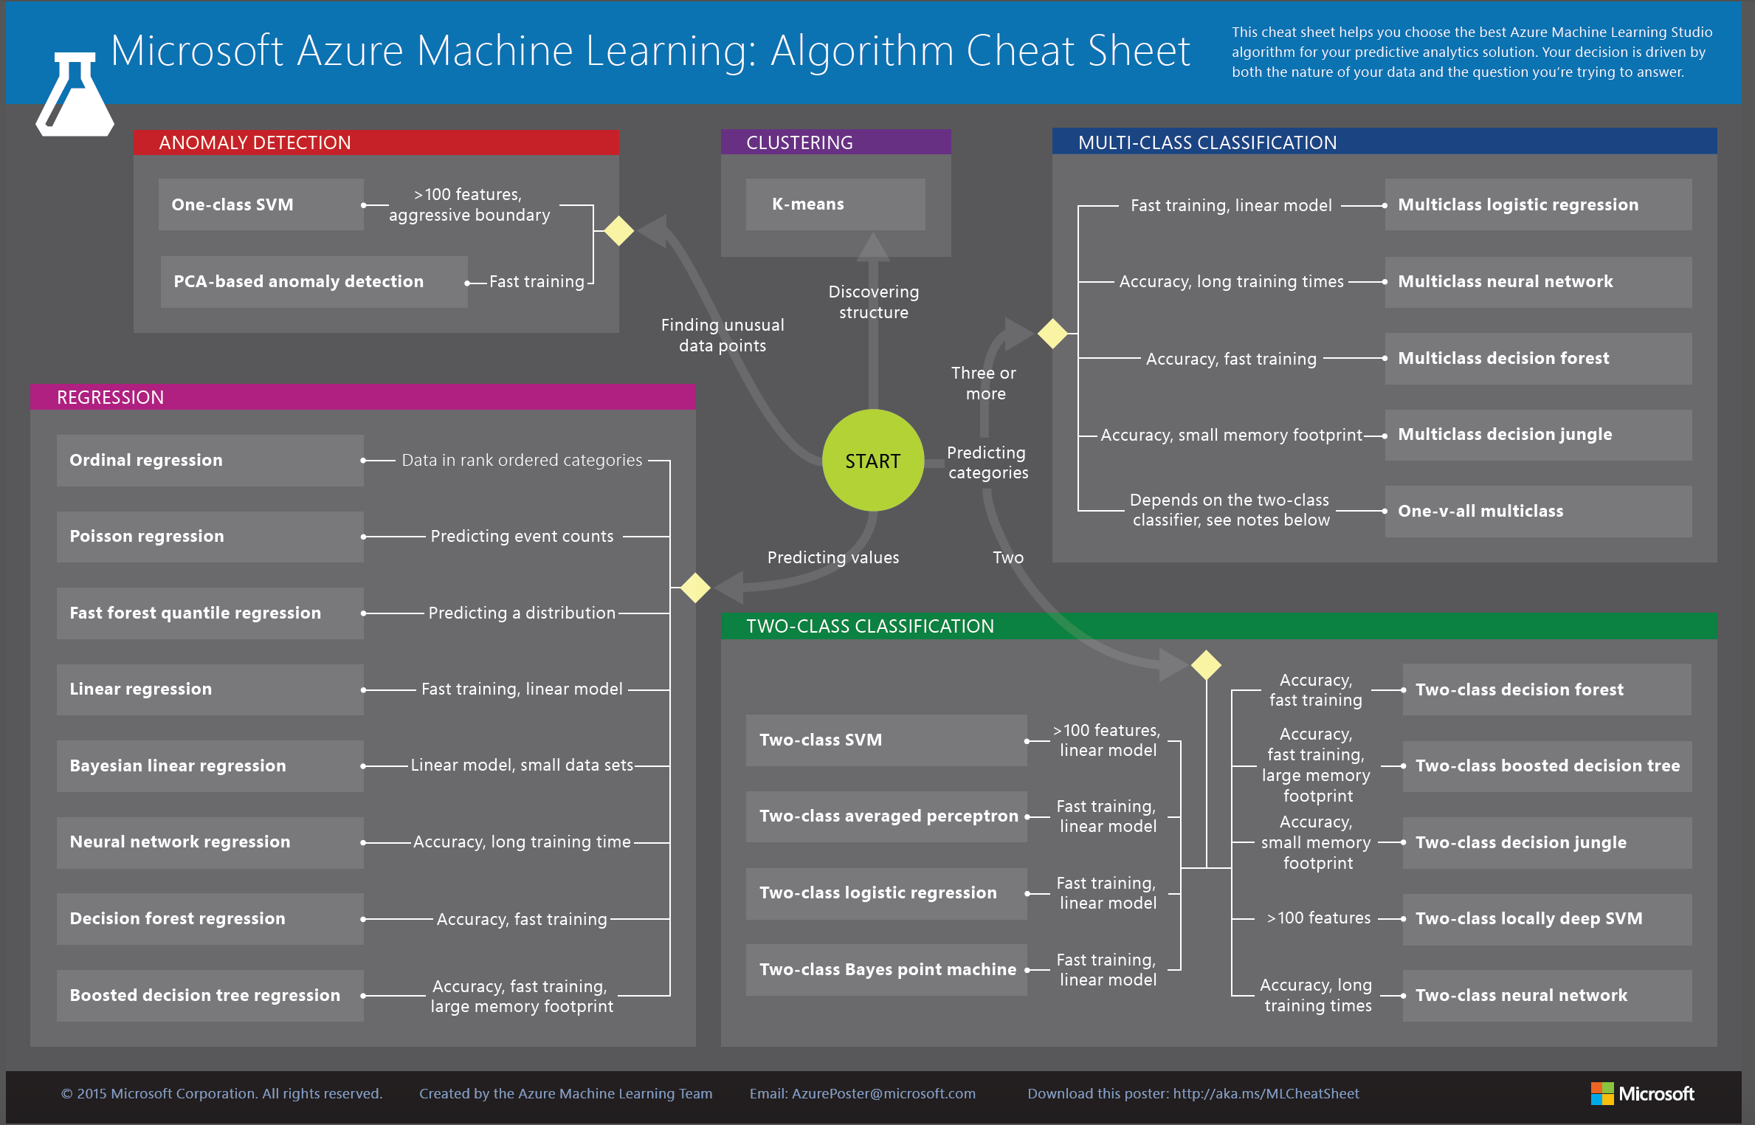
ML Algorithm Cheat Sheet
Source:
http://download.microsoft.com/download/A/6/1/A613E11E-8F9C-424A-B99D-65344785C288/microsoft-machine-learning-algorithm-cheat-sheet-v6.pdf

Slide 9
Classification Use Cases
Spam detection
Fraud detection
Weather prediction
Google news classification
Cancer cell classification (Benign, Malignant)
Credit scoring
Ad targeting
Image classification

Slide 10
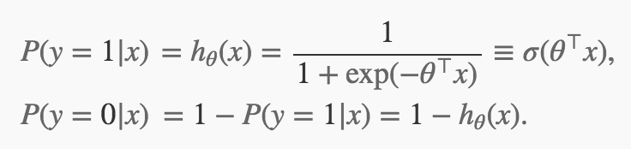
Logistic Regression
Measures the relationship between categorical dependent variable & one or more independent variables
Developed by statistician David Cox in 1958
Outcome is usually coded as 0 or 1 (success=1, failure=0)
Function:

Slide 11
Logistic Regression Types
Logistic regression can be binomial, multinomial or ordinal
Binomial: observed outcome for a dependent variable can have only two possible types: 0 & 1
Multinomial: outcome can have three or more possible types that are not ordered
Ordinal: deals with dependent variables that are ordered

Slide 12
Use Cases
Probability of failure of a given process, system or product
Trauma & Injury Severity Score (TRISS), which is used to predict mortality in injured patients
Predict:
whether a patient has a given disease based on observed characteristics of the patient (age, gender, body mass index, results of blood tests)
whether an American voter will vote for one party or another, based on age, income, gender, race, state of residence, votes in previous elections
if a customer would purchase a product or halt a subscription
the likelihood of a homeowner defaulting on a mortgage
Source: https://en.m.wikipedia.org/wiki/Logistic_regression

Slide 13
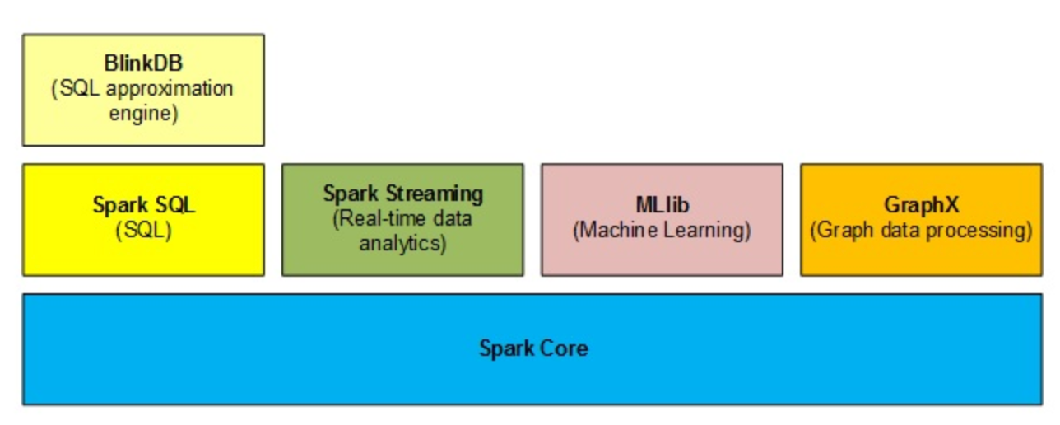
Spark Ecosystem with Spark MLlib

Slide 14
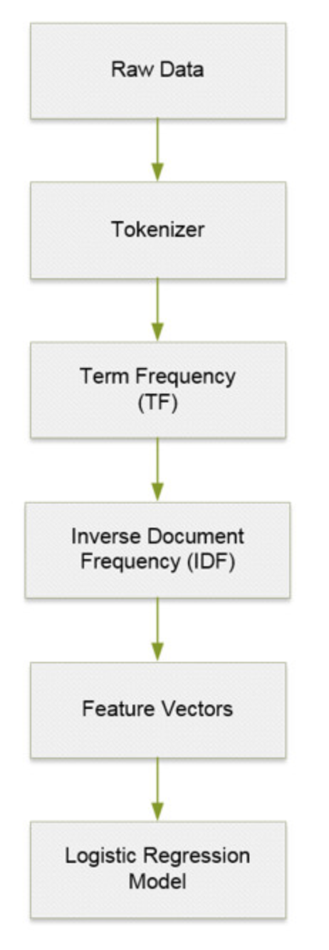
Text Classification

Slide 15
TF-IDF
Term Frequency - Inverse Document Frequency (TF-IDF)
Statistical measure to evaluate how important a word is to a document in a given corpus
Used to rank how important a word is to a collection of documents
TF: If a word appears frequently in a doc, it’s important. This is calculated as:
TF = (# of times word X appears in a document) / (Total # of words in the document)
IDF: used to diminish the weight of terms that occur very frequently in the document set and increases the weight of terms that occur rarely (e.g "the")

Slide 16
Sample Application
Use Case:
Technologies
Spam Detection
Spark MLlib (v 2.2.0)
Scala
Spark Shell (CLI)

Slide 17
Spam Detection Process

Slide 18
Spark MLlib Classification API
Tokenizer
HashingTF
IDF
LogisticRegression
Pipeline
BinaryClassificationEvaluator
*Package: org.apache.spark.ml

Slide 19
Demo
Logistic Regression
Reference: Building machine-learning apps with Spark
Github Project
Scala Example
Datasets*
Not spam (3,600 files)
Spam (1,500 files)
Training Dataset
Iteration #1: Small (~10 files)
Iteration #2: Large (~3k files)
* Caution about the spam file content

Slide 20
Next Steps/Enhancements
Streaming data analytics
Kafka & Spark Streaming
Deep Learning & NLP (Tensorflow)

Slide 21
Conclusions
Classification
Logistic Regression
Spark MLlib framework

Slide 22
References
Apache Spark main website
Spark Machine Learning Programming Guide
Logistic Regression
Apache Spark Data Pipelines article on InfoQ
Apache Spark article series on InfoQ

Slide 23
Thank You
Contact Information
http://www.infoq.com/author/Srini-Penchikala
srinipenchikala@gmail.com
@srinip
Big Data Processing using Apache Spark
Spring Roo in Action Book

Slide 24
Questions?

