Slide 1
Pinellas House Price Prediction
By Spenser Johnson

Slide 2
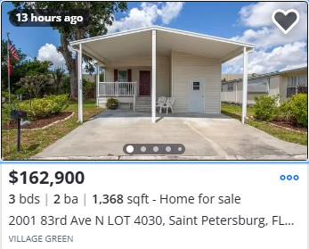
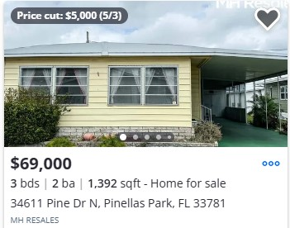
Problem: What’s the house worth?
Same number of bedrooms, bathrooms, and nearly the same area. Physically 1.5 miles apart. Why are the prices so different?
Notes:
What’s the house worth?
Differences in housing prices can seem both objective and arbitrary. These two houses are the same number of bedrooms, bathrooms, and nearly the same square footage. Why is the difference in price so great?

Slide 3
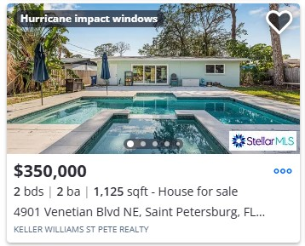
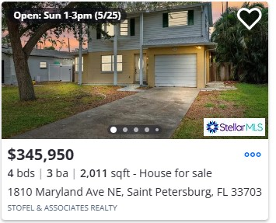
Problem: What’s the house worth?
One house has two extra bedrooms, and extra bathroom, and 900 more square feet. They are 1000 ft apart. Why are the prices so similar?
Notes:
One house has twice the number of bedrooms and an extra bathroom, for an extra 900 square feet compared to the other. One house clearly has a pool. Both are in the same neighborhood. Why are the prices so similar? Why does the larger one have a lower asking price???

Slide 4
Problem: What’s the house worth?
What factors drive the differences in house prices?
Can those factors be used to predict house prices?
Notes:
I wanted to see what factors of a house seem to most affect the price and see if those factors can then be used to predict the prices.

Slide 5
Problem: What’s the house worth?
Who should care about this?
Homeowners
Homebuyers
Realtors
Property Appraisers
Notes:
Almost everyone should care how houses are valued.
Homeowners looking to sell their house will want to know what factors affect the price of their home so that they can make an asking price.
Homebuyers would want to know what factors affect the price of a house to help determine what kinds of houses could fit their budget.
Realtors would want to know the same as both the homeowners and homebuyers to be able to assist them professionally.
Property Appraisers will want to know how to value a house from year to year based on comparable houses.

Slide 6
Data and Wrangling:
Factors that could have an effect
Amount of supply
Size of the house/lot
Style of the house
Location
# of beds/baths
Age of the house
Additional work
Notes:
Housing prices have lots of factors. Size of housing supply. Size of the house and lot. Style of construction. Location, location, location. Most people looking to buy a house start with the budget they think they can handle, then look for a house that meets their needs, hoping the house of their dreams is in their price range.
The number of bedrooms and bathrooms can be a concern for a new couple looking to start a family or a couple of empty-nesters looking to downsize.
Some people might prefer new construction while others will want a house that might needs some d-i-y fixing up.

Slide 7

Data and Wrangling:
Factors that could have an effect
Amount of supply
Size of the house/lot
Style of the house
Location
# of beds/baths
Age of the house
Additional work
Data collected from Pinellas County Property Appraiser’s Office(PCPAO)
Notes:
I looked for data from a handful of locations. Dolthub, a version controlled database was the first spot I checked. It was mostly null values and not a lot of info about the house. The Pinellas County Property Appraiser’s Office was the main source for the dolthub data and much more data-rich, so I went to the source and used the Advanced Search to collect the data on all single family home sales in Pinellas county.
I looked at trying to collect recent house sales data from Zillow but the amount of collectable data was smaller than what I could get from the PCPAO. The only benefit that the Zillow data would of had is the # of bedrooms and bathrooms.

Slide 8
Data and Wrangling
Advanced Search Parameters on the PCPAO website:
Property Type: 0110-Single Family Homes
Transactions: All sales
Advanced Search Output Fields:
Notes:
The PCPAO has tons of information available through its advanced search. I focused on getting all transactions for single family homes.

Slide 9
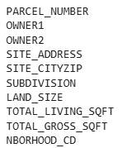
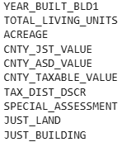
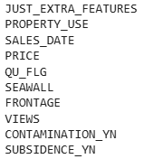
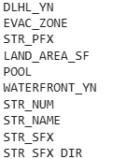
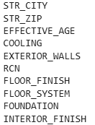

Data and Wrangling
Advanced Search Parameters on the PCPAO website:
Property Type: 0110-Single Family Homes
Transactions: All sales
Advanced Search Output Fields: 54 total fields, 1.2 million rows.
Notes:
For the output fields, I had 54 total fields that I though might be interesting and relevant.

Slide 10
Data and Wrangling
Notes:
I ended up deleting a significant portion of the fields once I fully understood what they were. Some rows got renamed with values cleaned up and condensed. At the end, prior to any preprocessing or dummy variable creation, I reduced all the data to this…

Slide 11
Data and Wrangling:
CITY
ZIP
Evac_Zone_A
Central_Cooling
Notes:
These remaining columns are the one that I cared most about in EDA and brought to preprocessing.

Slide 12
Explorations
What features affected price the most?
Possible features:
Size
Location related(City/Zip code)
Construction
Seawall, Waterfront, Evac_Zone A
Notes:
How each feature affects the price is complex. Many of the features earlier have an effect dependent on each other. Whether a house has a seawall depends heavily on its location being on the water and the size of the lot that the house is on. Whether a house has a pool can depend on the size of the lot. The construction of the house can depend on the age of the house. Older houses would not be built to the same code as newer houses, especially when near the coast. I mainly looked at how each feature affected the median price compared to the rest of the houses. The features that I take a look at are size, location, construction, and lot features.

Slide 13
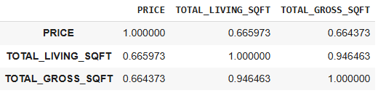
Explorations: Size
 | Total Living Space in Sq. Ft. | Total Gross Space in Sq. Ft.
Price per Sq. Ft. from a linear regression | $263 per Sq. Ft. | $177 per Sq. Ft.
Median Area | 1512 Sq. Ft. | 2108 Sq. Ft.
Median Area x $/Sq.Ft. | $397656 | $373116
Intercept Price | $29758 | $63
Predicted Price | $367898 | $373053
 | Total Living Space in Sq. Ft. | Total Gross Space in Sq. Ft.
Median Price per Sq. Ft. | $217 | $157
Median Area | 1512 Sq. Ft. | 2108 Sq. Ft.
Median Area x $/Sq.Ft. | $328104 | $330956
Notes:
Exploring how house size affects price is pretty straight forward. Running a linear regression on price versus total living space and total gross space gave slopes of $263 dollars per square foot of living space and $177 dollars per square foot of gross space. Using the medians of total living space and total gross space and the linear regression intercepts, the basic linear regression gave predicted prices for the median area houses of $368 thousand and $373 thousand dollars. The median price in the dataset was $335 thousand dollars, indicating that the linear regression based on just living space or gross space over estimated the price by 30-40 thousand dollars.
I also found the median prices per square foot of total living space and total gross space to be $217 dollars and $157 dollars. Using the median areas for each, I found prices that were within $7 thousand dollars of the median price.
A correlation of price to living sqft and gross sqft found both had a positive correlation of .66. The accuracy of the prices based on just using the mean or median price per square foot suggests that these values affect price the most.

Slide 14
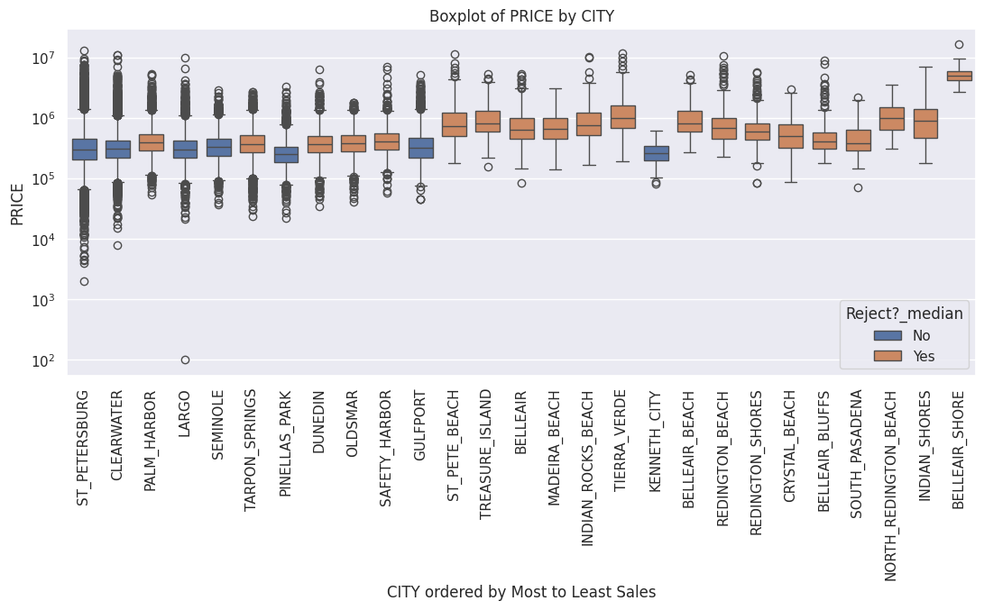
Explorations: City Location
Median beach town house prices were at least 50 thousand dollars more than the county as a whole.
Notes:
Median House Price: 335 thousand dollars.
What stood out in exploring the median price of houses based on city, ordered by the number of sales is that the lower number of sales mostly occurred in beach towns and those towns had some of the most statistically significant differences in median house price. The lowest median price in any beach town was 389 thousand. The highest median price was 5.1 million. Just being in a beach town meant a minimum difference in median price of 50 thousand dollars.
These 15 beach towns also accounted for under 5000 total sales over 8 years or under 42 sales per city per year as compared to larger cities which had at minimum 200 sales per city per year.
To get this set of box plots, I found whether the median house price for a city was statistically significantly greater than the rest of the county using bootstrap replicates of the median house price based on the number of houses in each city.

Slide 15
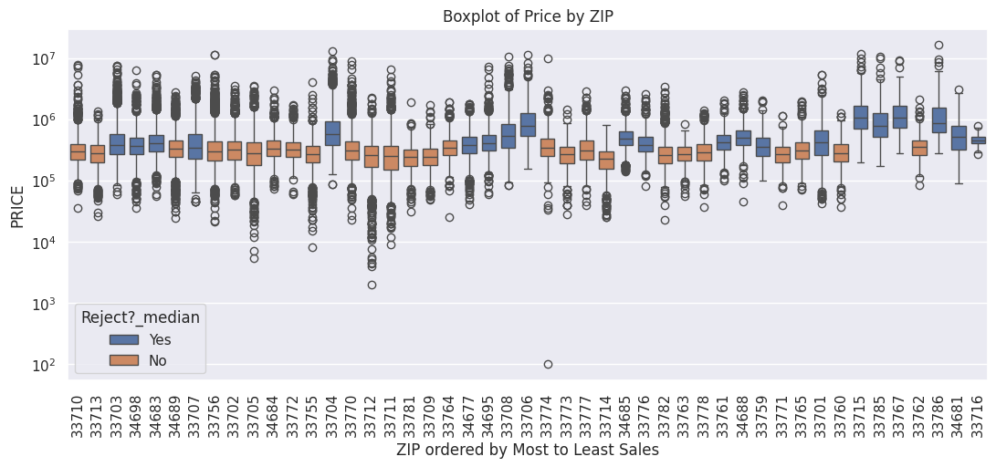
Explorations
Less sales: Median price is statistically significantly different.
Notes:
Median House Price: 335 thousand dollars.
Many zip codes had statistically significant medians. Unlike the city feature where the beach towns were the majority of the statistically significant features, the zip codes don’t have a clear pattern. It could be that they follow a similar pattern to the towns where zip codes that are on the water are the interesting zip codes, but without coloring a map, it is hard to say.
To get this set of box plots, I found whether the median house price for a zip code was statistically significantly greater than the rest of the county using bootstrap replicates of the median house price based on the number of houses in each zip code.

Slide 16
Explorations: Construction
 | Foundation | Floor System | Floor Finish | Exterior Walls
Comparison | ‘Continuous Poured Footing’ vs ‘Other’ | ‘Slab on Grade’ vs ‘Wood’ vs ‘Low_Slab_Above_Grade’ vs ‘High_Slab_above_Grade’ | ‘Carpet/Hard Tile/Hardwood’ vs Carpet/Vinyl/ Asphalt’ vs ‘Hard Tile/Wood/ Marble’ vs ‘Concrete’ | ‘Concrete Block/Masonry’ vs ‘Stucco/Reclad’ vs ‘Frame’
Affect on Median $335000 Price | -$5,000 vs +$134,000 | -$1,500 vs -$25,000 vs +285,000 vs +1,465,000 | +$5,000 vs -$93,500 vs +$800,000 vs +$125,850 | -$70,100 vs +$39,900 vs -30,000
Notes:
Median House Price: 335 thousand dollars.
Construction of a house had 8 features to consider. Some features I reduced down from multiple values to two or three based on percentages. For example in the Foundation feature, the ‘Continuous Poured Footing’ value represented 94% of houses, while ‘Other’ was originally 5 separate values. If two or three values described similar things, they were condensed into one value instead.
The most common types of construction had the smallest positive or even negative effects on the median home price while rarer construction types typically had large positive effects on the median home price.
For example we can see that a house with a High slab above grade, meaning the house living space was raised high above the ground, generally had a price 1.4 million dollars more than the median house price of 335 thousand. The house having a hard tile/marble/wood floor finish was generally worth 800 thousand more than the median priced house.

Slide 17
Explorations: Construction
 | Interior Finish | Roof Frame | Roof Cover | Central Cooling
Comparison | ‘Drywall/Plaster’ Vs ‘Upgrade’ | ‘Gable/Hip’ Vs ‘Flat Shed’ Vs ‘Mansard/Gambrel’ | ‘Shingle’ Vs ‘Concrete tile/metal’ Vs ‘Other’ | ‘Yes’ Vs ‘No’
Effect on Median $335000 Price | -$35,000 Vs +$206,000 | +$0 Vs -$15,000 Vs +$155,000 | -$12,000 Vs +$204,000 Vs -$47,000 | +$2,000 Vs -$160,000
Notes:
Median House Price: 335 thousand dollars.
Similar patterns played out for interior finish, roof frame, and roof cover. A house that has an ‘upgrade’ wall interior finish is valued higher than the more common plaster/drywall interior finish house.
Central cooling had an interesting if expected result. While the median value of a house with central cooling was 2000 more than the median price of all houses, if the house did NOT have central cooling, the median price was 160 thousand dollars less than the median of all houses.

Slide 18
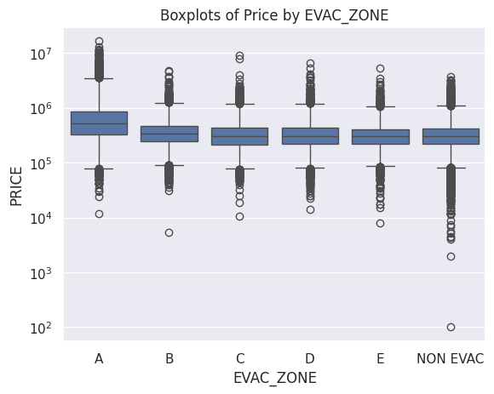
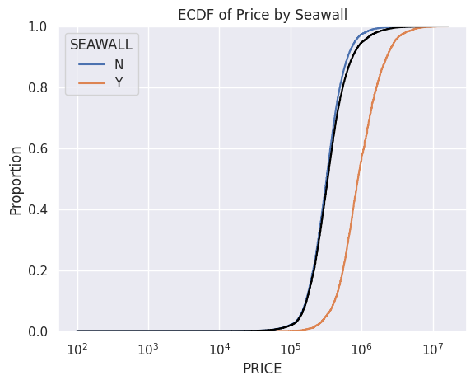
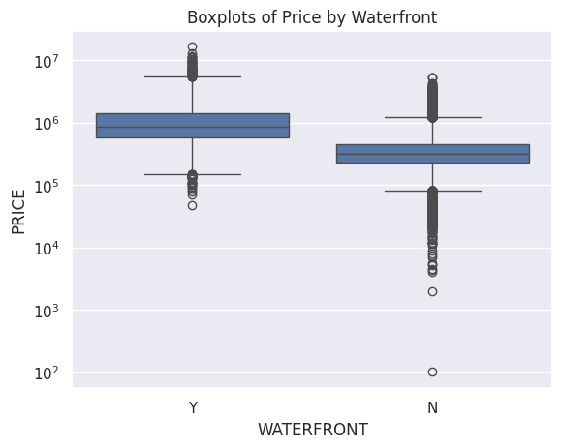
Explorations: Lot Features
Median House Price
EVAC_ZONE A | $515,000
Other | $310,000
Median House Price
With Seawall | $890,000
Without Seawall | $320,000
Median House Price
Waterfront | $875,000
No Waterfront | $320,000
Notes:
Median House Price: 335 thousand dollars.
If a house was in EVAC_ZONE A, the median price difference was 205 thousand.
If a house was on the waterfront, the median price difference was 555 thousand.
If a house had a seawall, the median price difference was 570 thousand

Slide 19
Explorations
What features affected median price the most?
Size: Hard to say how it affects price, but is effective at predicting price.
City/ZIP: Beach towns has a +$50k effect on the median price. Hard to determine ZIP’s effect on the median.
Construction: Hard tile, wood, and marble floors increase price by $800k. An elevated house raises price by at least $285k. A concrete tile/metal roof is worth an extra $200k. Having no central cooling costs $160k.
Seawall: +$500k Waterfront: +$500k Evac_Zone A: +$200k
Notes:
Plenty of the feature values have a statistically significant affect on the median home price.

Slide 20
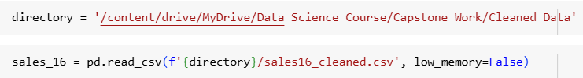
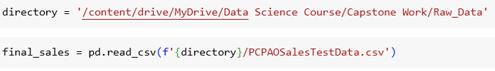

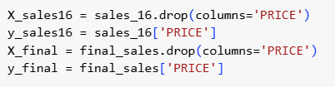
Preprocessing: Importing old and new data
Imported Original Cleaned Dataset and New Test set
Cleaned new test set to match previous wrangling
Splitting datasets into Xs and Ys
Notes:
To start preprocessing I imported the originally cleaned data and a new set of data. I had to complete come data wrangling to make sure that column names and column values matched, and that there were no values in the new set that were not in the original set. Then I split the datasets into the respective Xs and ys.

Slide 21
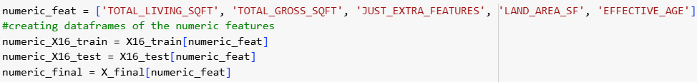

Preprocessing: Train/Test Split
I split the original sales data into a test train split. Y values were left untouched for the rest of the preprocessing.
Creating a set of numeric X datasets.
Creating a set of categorical X datasets.
Notes:
To start preprocessing I imported the originally cleaned data and a new set of data. I had to complete come data wrangling to make sure that column names and column values matched, and that there were no values in the new set that were not in the original set. Then I split the datasets into the respective Xs and ys.

Slide 22
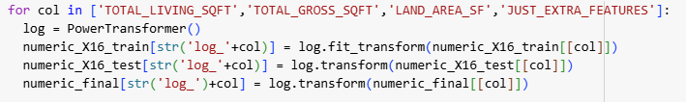
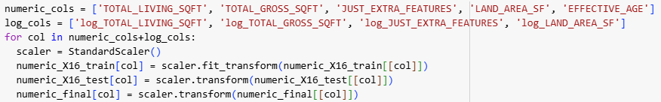
Preprocessing: Numeric values
Numeric datasets had columns added with log transformations
Numeric datasets were scaled with StandardScaler
Notes:
For the numeric columns, except for effective age, I created power transformed values to deal with log scaling the values. Then the original numeric columns and the log-scaled columns were scaled with sci-kit learn’s standard scaler.

Slide 23

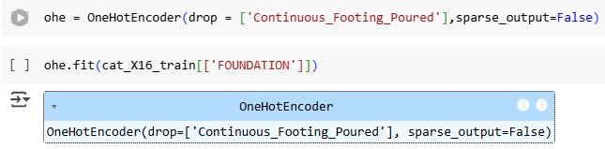

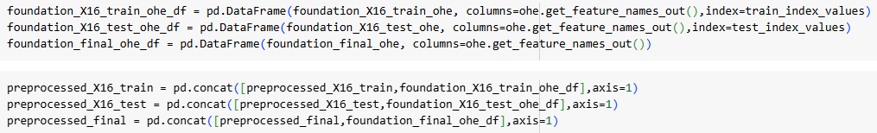
Preprocessing: Categorical features
Condensing features to fewer values
Creating and fitting a One-hot Encoder
Transforming a column which gets turned into a new DataFrame and concatenated with the numeric DataFrames
Notes:
For most of the categorical features, I reduced the number of values in each feature and one-hot encoded the remaining values. I generally opted to drop the most frequent value of each feature. After creating a one-hot encoder and transforming a column, I would create a new DataFrame that ohe data and column names and concatenate it with the earlier numerical features. This was referred to as the preprocessed DataFrames
For binary columns like Pool, Waterfront, Seawall, and Central Cooling, I checked to be sure that the resulting columns were properly named.
The only categorical features that were did not have a value dropped during encoding were city and zip.

Slide 24
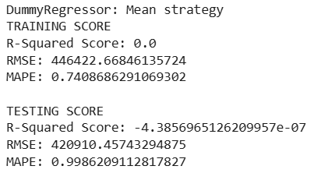
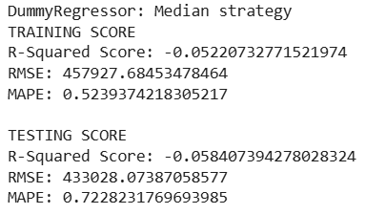
Model Selection:
Best Training MAPE: .52
Best Testing MAPE: .72
Imported training and testing data
Evaluated a pair of Dummy Regressors
One used predicting the mean, the other the median
Notes:
For model selection, I started with creating a baseline using two Dummy Regressors. I decided to evaluate the model performance based on the Mean Absolute Percentage Error as the value could give me a sense of how far off an prediction is on average. A Mean Absolute Error would give a numerical dollar value for how far off the model is on average, which would stand out if a predicted value was near the same magnitude of the error.

Slide 25
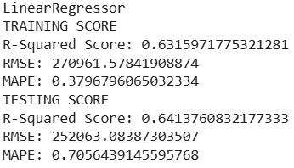
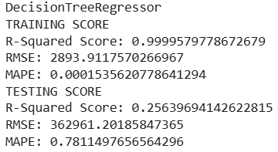
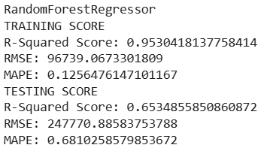
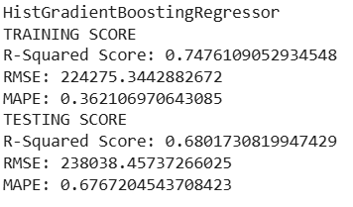
Model Selection: Trying Basic Models
Training MAPE: .52
Testing MAPE: .72
Best Model: DummyReg
Notes:
I tried a couple more models: A Linear Regressor, a decision tree, a random forest, and a Histogram-Gradient Boosting Regressor.
All the models when tested on the training data beat the dummy regressor with a median strategy.
The Decision Tree and Random Forest regressors did over fit to the training data in the process, so their testing score was not as good as the HGB Regressor

Slide 26
Model Selection: Trying Basic Models
Training MAPE: .36
Testing MAPE: .67
Best Model: HGB_Reg
Notes:
I tried a couple more models: A Linear Regressor, a decision tree, a random forest, and a Histogram-Gradient Boosting Regressor.
All the models when tested on the training data beat the dummy regressor with a median strategy.
The Decision Tree and Random Forest regressors did over fit to the training data in the process, so their testing score was not as good as the HGB Regressor

Slide 27
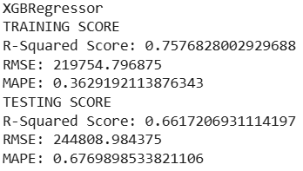
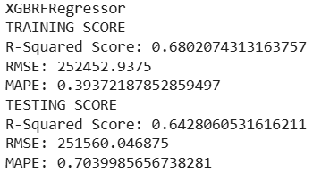
Model Selection: XGBoost Models
Training MAPE: .36
Testing MAPE: .67
Best Model: HGB_Reg
Notes:
I did check a pair of XGBoost models. The basic XGBoost Regressor performed as well as the HGB Regressor.
A XGBoost Random Forest Regressor did well, but not as well as HGB Regressor. I opted to just work with tuning the HGB_Regressor instead.

Slide 28
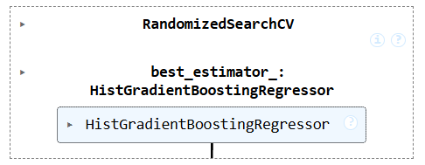



Model Selection: Tuning the HGB_Regressor
Training MAPE: .33
Testing MAPE: .65
Best Model: HGB_Reg1
Classifier 1
Classifier 2
Classifier 3
Notes:
I ran 3 different cross validated randomized searches to find a good choice of parameters for the HGB_Regressor. I noticed that no model was performing on the testing set as well as it did on the training set. I decided to inspect why.

Slide 29
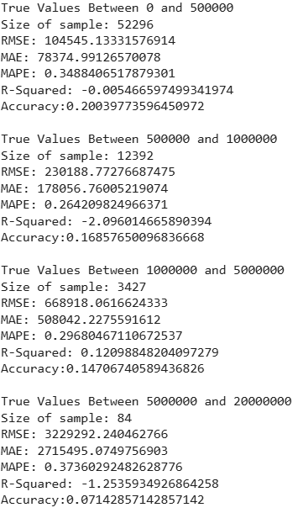
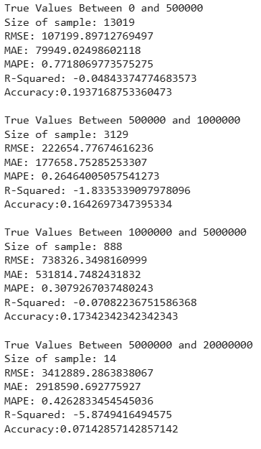
Model Selection: MAPE in Ranges
Training MAPE: .33
Testing MAPE: .65
Best Model: HGB_Reg1
Model performance predicting testing values in ranges
Model performance predicting training values in ranges
Notes:
I feed the regressor different training and testing data based on what the true value was. I found that if the true value was between 0 and 500 thousand, the model’s MAPE spike on the test data but not on the training data. The other ranges had MAPE’s that were similar between training and testing data.

Slide 30
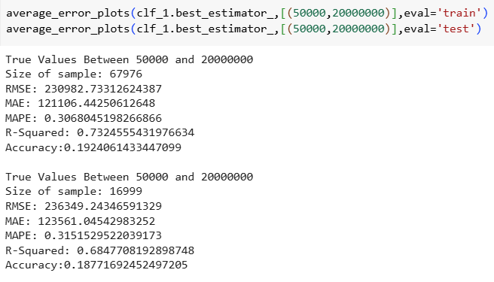
Model Selection: MAPE in Ranges
Training MAPE: .33
Testing MAPE: .65
Best Model: HGB_Reg1
Notes:
A similar test found that the HGB_Reg1 had similar MAPE’s for the true range of values from 50 thousand to 20 million. This led me to consider that I might have an outlier in the test set.

Slide 31
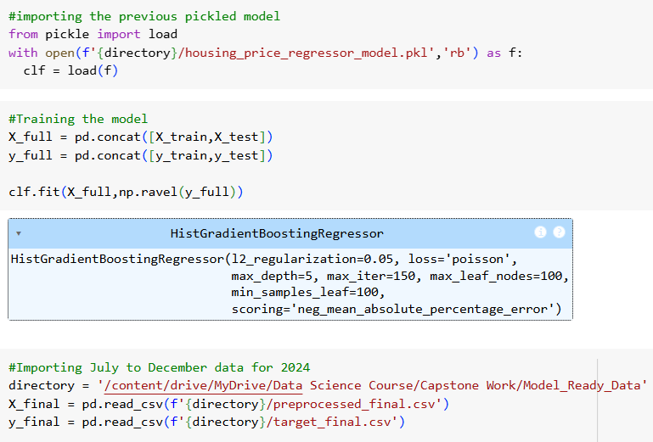
Model Selection: Training on Full Data
Training MAPE: .33
Testing MAPE: .65
Best Model: HGB_Reg1
Notes:
I pickled my model from earlier so that it was easier to reload. I concatenated the training and testing data, trained the model on the full dataset and imported an extra dataset that when through the same preprocessing as the train and test data. Now when I scored the model on the full data and the extra data, I found

Slide 32
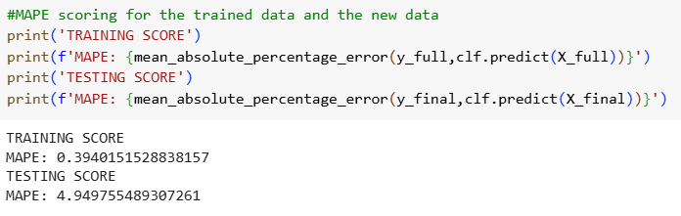
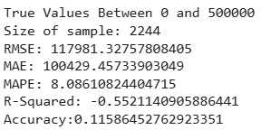
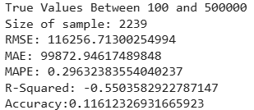
Model Selection: Training on Full Data
Training MAPE: .33
Testing MAPE: .65
Best Model: HGB_Reg1
MAPE when predicting $100
MAPE when not predicting $100
Lower bound is exclusive. Upper bound is inclusive.
Notes:
…the worst testing score I had seen and a training score worse than earlier. I suspected that the error was due to some $100 house prices in the datasets. When I scored the model based on the range of true values I found these results. The entire change in MAPE is trying to predict the $100 house.

Slide 33
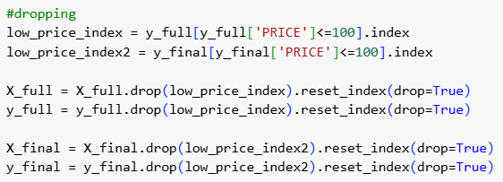

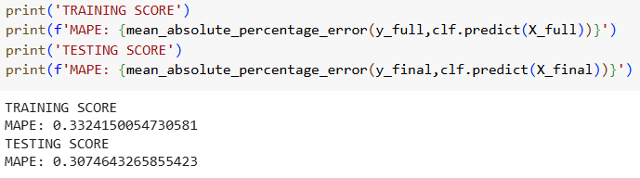
Model Selection: Performance on All Data
Training MAPE: .33
Testing MAPE: .30
Best Model: HGB_Reg1
Notes:
I dropped the $100 prices and corresponding inputs-from the full dataset and the extra dataset. Upon doing so, the MAPEs for the model predicting both dataset improved.

Slide 34
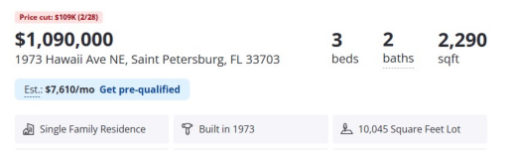
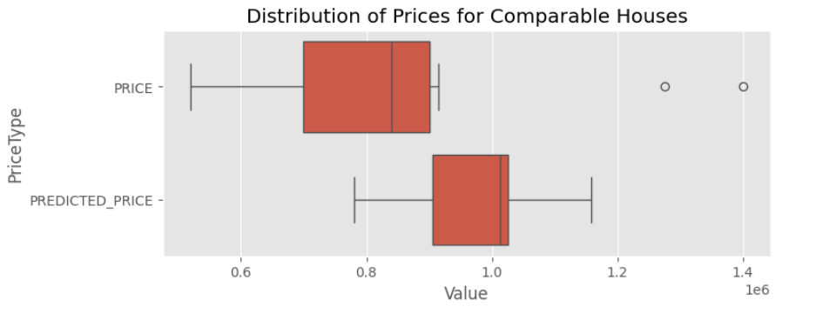
Model Selection: Predicting prices for a house
Training MAPE: .33
Testing MAPE: .30
Best Model: HGB_Reg1
Query dataset for houses similar to a current house on the market.
11 similar houses were found. I made a boxplot of their true prices and their predicted prices.
Notes:
Finally, we want to know “Can the model use our selected factors to predict a house’s price?” I queried the full dataset for houses similar to this house currently on the market. The dataset had 11 houses with similar lot area, living space, and location and lot features. Using the model to predict prices for those houses gave a higher median house price than the dataset’s true prices, but also gave a range which the current house’s asking price is within. The model was able to predict range of reasonable asking prices for the house.

Slide 35
Thank You
Questions?

