Slide 1
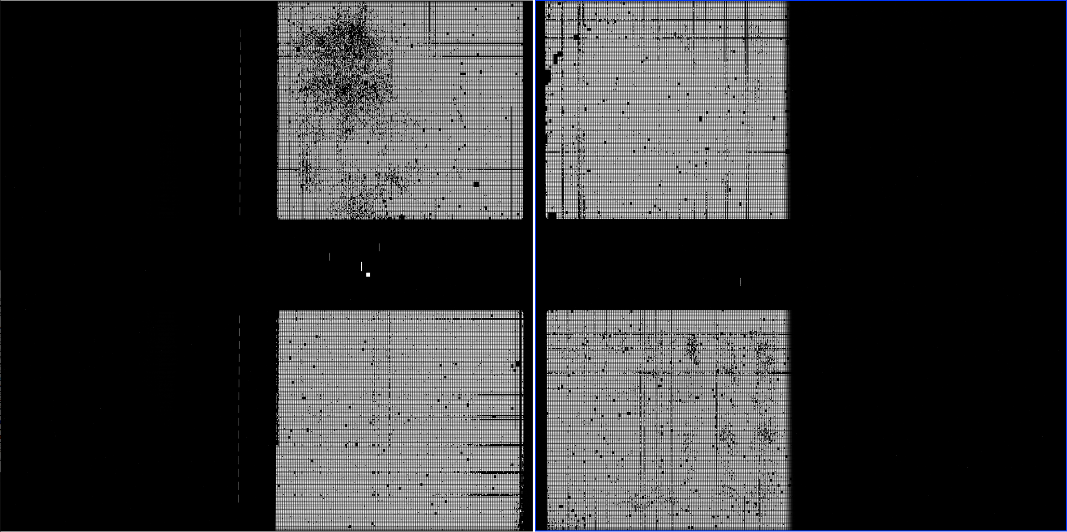
SKY
POSITION ON SKY of
3 TA stars
DMS view of the sky
i
DMS SCI_X
Out #4
Q3
Q1
Out #1
Out #3
491
492
Out #2
DMS SCI_Y
j
j
Out #2
Out #3
Q4
Q2
Out #1
Out #4
i

Slide 2
SKY
POSITION ON SKY of
3 TA stars
FPA Orientation
Photon point of view
i
Out #4
Q3
Q1
Out #1
Out #3
491
492
Out #2
j
j
Out #2
Out #3
Q4
Q2
Out #1
Out #4
i

Slide 3
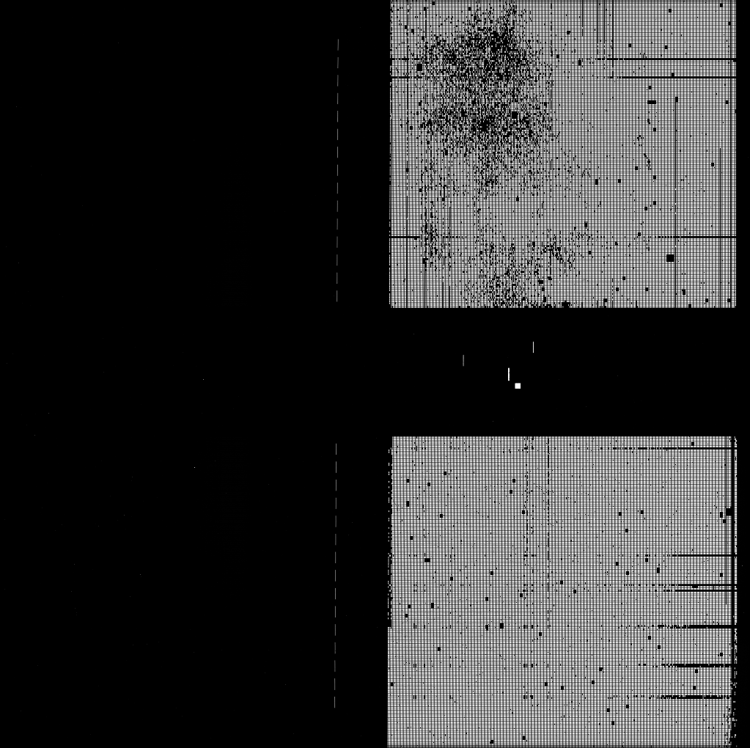
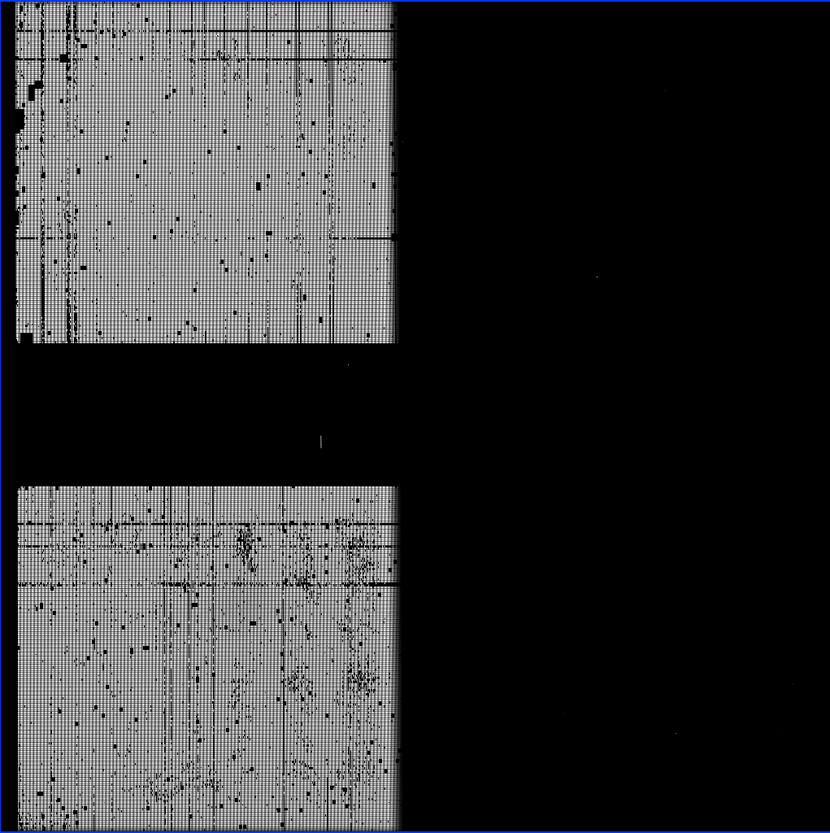
Detector Orientation of RAW files in FPAP and as seen on DS9
i
Out #4
Q3
Q1
Out #1
Out #3
j
Out #2
491
492
j
Out #2
Q4
Out #3
Q2
Out #1
Out #4
i
i
Given the successful BOTA verification in the certlab with simulated exposure and at CV3
I am 99.999 certain that OSS works in the this exact configuration (J,i) where J are the columns
and I are the rows. The red dot is the first pixel written , the one on its right is the second….
The BOTA OSS test found the centroid of the star at:
(colCentroid = j , rowCentroid =i) = (1000.69622896450073313, 1430.374155
which is the correct center of the A1600 slit ( the small white dot in the upper half of 491)

