Slide 1
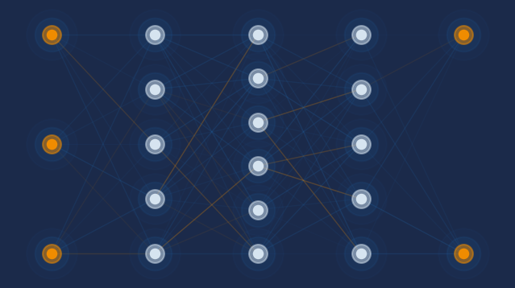
FRAML AI Assistant
Smart Segmentation · Threshold Tuning · AML P&P Q&A
Princeton Strategy Group
March 2026 | Confidential

Slide 2
System Architecture
Component overview and data flow
User / Browser
↓
Dash Web Application (Flask · Chat UI · Side-panel quick prompts)
↓
Orchestrator Agent (intent routing · agent dispatch)
Threshold Agent
Segmentation Agent
Policy Agent
threshold_tuning sar_backtest segment_stats
ss_cluster_analysis alerts_distribution
ChromaDB RAG 11 AML docs · 241 chunks
↓
↓
↓
Alerts CSV (5,035 rows · customer transaction aggregates · FP / FN labels)
ChromaDB (vector store all-MiniLM-L6-v2 embeddings)
↓
↓
Fine-Tuned Language Model — qwen-framl-v5 (Q4_K_M GGUF · LM Studio · localhost:1234/v1)
Qwen 2.5 7B Instruct · LoRA fine-tuned on 189 FRAML examples · 8,192 token context · Serves all agents
Princeton Strategy Group | Confidential
1

Slide 3
System Overview
End-to-end architecture: from user query to analytical insight
User Interface
Orchestrator
Agents + Tools
Dash web app Chat interface Side-panel quick prompts
Intent routing Query classification Multi-agent coordination
Threshold Agent → threshold_tuning / sar_backtest Segmentation Agent → ss_cluster_analysis / alerts_distribution Policy Agent → ChromaDB RAG retrieval
→
→
↓ API calls
Fine-Tuned Language Model (qwen-framl-v5 · Q4_K_M GGUF · LM Studio API)
Qwen 2.5 7B Instruct base · LoRA fine-tuned on 189 FRAML examples · 8,192 token context · localhost:1234/v1
Princeton Strategy Group | Confidential
2

Slide 4
The Three Agents
Specialised AI agents, each with their own tools and system prompt
Threshold Agent
Segmentation Agent
Policy Agent
• Analyses FP/FN trade-offs as alert thresholds change
• K-Means clustering of customer behavioural profiles
• Retrieval-Augmented Generation over AML policy documents
• Tools: threshold_tuning, sar_backtest, segment_stats
• Tools: ss_cluster_analysis, alerts_distribution
• ChromaDB knowledge base: 11 docs, 241 chunks
• Returns PRE-COMPUTED sweep tables — model copies verbatim
• Identifies high-risk clusters by transaction frequency and volume
• Sources: FFIEC Manual, Wolfsberg Guidance, 31 CFR Parts 1010/1020, FinCEN advisories
• Covers Business and Individual segments across 3 threshold columns
• Renders treemap and scatter visualisations
• Cites source documents; disclaims when KB has no relevant content
Princeton Strategy Group | Confidential
3

Slide 5
Tool Interaction Flow
How the model calls tools and generates accurate, grounded responses
1 User Query
2 Agent selects tool
3 Tool executes
4 Model responds
"What threshold gives a 90% SAR catch rate for Individual monthly transaction amount?"
Threshold Agent identifies: sar_backtest( segment=Individual, threshold_column= TRXN_AMT_MONTHLY )
Python computes sweep against real customer data. Returns PRE-COMPUTED block with exact numbers.
Copies PRE-COMPUTED block verbatim. Adds ONE sentence of AML insight. Stops. No hallucinated numbers.
→
→
→
Key design principle: the model never computes numbers — Python does. The PRE-COMPUTED block is generated by application.py and passed to the model as the tool result. The model's only job is to copy it verbatim and add one insight sentence.
Princeton Strategy Group | Confidential
4

Slide 6
AML Policy Knowledge Base
Retrieval-Augmented Generation over regulatory and compliance documents
Source Documents
How RAG Works
• FFIEC BSA/AML Examination Manual
Ingest
• Wolfsberg Risk-Based Approach Guidance (2006, 2015, 2025)
PDFs and DOCX chunked and embedded using all-MiniLM-L6-v2 into ChromaDB (241 chunks total)
• 31 CFR Part 1010 — General BSA Provisions
• 31 CFR Part 1020 — Rules for Banks
Retrieve
• FinCEN Advisory FIN-2014-A008
User query embedded → top-8 semantically similar chunks retrieved from ChromaDB
• FinCEN Guidance FIN-2010-G004
• BSA/AML Risk Assessment Framework
Generate
• FFIEC Compliance Program Assessment
Retrieved chunks injected into model prompt. Model cites source document by name. If no relevant content found → disclaims and provides general guidance only.
• BsaAmlExamProcsPackage (4 volumes)
Princeton Strategy Group | Confidential
5

Slide 7
Training Data Pipeline
How real customer data becomes fine-tuning examples
Step 1 Customer Aggregation
Step 2 SAR Simulation
Step 3 FN Injection
Step 4 Alerts CSV
1,090,815 account rows ↓ 280,621 unique customers Transaction metrics summed across all accounts per customer
4,835 alerted customers 10% SAR filing rate = 484 SARs SAR score: logistic model on alert amount, count, volume
200 non-alerted customers added as false negatives (flew under current threshold) Source: 20th–80th percentile of alerted population
5,035 rows FP=4,351 | FN=684 Individual=4,668 | Business=367 Used by all threshold and segmentation tools
→
→
→
From Data to Training Examples
Each training example is a complete conversation: system prompt → user query → tool call → tool result (PRE-COMPUTED) → correct assistant response. Examples cover threshold tuning, SAR backtest, clustering, segment stats, and policy Q&A — with specific gap-fixing examples written after each round of production testing.
Princeton Strategy Group | Confidential
6
Notes:
1. docs/ss_segmentation_data.csv — transaction features for all customers (the big 298MB file)
2. docs/sar_simulation.csv — which customers were alerted and their is_sar label
build_alerts_csv.py joins them on customer_id, keeping only alerted customers, then stamps ALERT=Yes, FP=Yes where is_sar=0, and FN=Yes where is_sar=1. The output is docs/custs_accts_txns_alerts.csv.
The pipeline:
1. Start with all alerted customers from real alert data
2. Compute a sar_score using a weighted formula (alert amount, alert count, transaction volume, frequency + noise)
3. Set is_sar=1 for the top 10% by sar_score (the SAR_RATE = 0.10 threshold) — so the sar_score threshold is the 90th percentile, not a fixed dollar amount
4. is_sar=0 → FP (alerted but not truly suspicious)
5. is_sar=1 → TP at the lowest threshold
On FNs — this is the key point:
All customers in this dataset were alerted. There are no true FNs in the raw data because un-alerted customers aren't in the file at all.
FNs are simulated — as you raise the sweep threshold (e.g. AVG_TRXN_AMT > $500k), some is_sar=1 customers fall below it and would stop being alerted. Those become FNs. It's asking: "if we had set a higher threshold originally,
which real SARs would we have missed?“

Slide 8
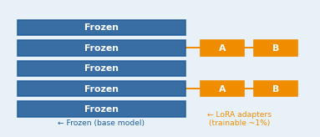
The Fine-Tuning Process
From general-purpose LLM to FRAML-specialised analytics assistant
Base Model
LoRA Training
GGUF Conversion
Deployment
Qwen 2.5 7B Instruct (Unsloth 4-bit hub mirror) General-purpose LLM no FRAML knowledge
Low-Rank Adaptation R=16, Alpha=32 LR=2e-4, 100 steps Vast.ai RTX 3090 Ti ~10 min per run
Merge LoRA → base Convert to GGUF F16 Quantize to Q4_K_M 4.7 GB final size
LM Studio localhost:1234/v1 OpenAI-compatible API 8,192 token context
→
→
→
Why LoRA?
LoRA fine-tunes only ~1% of model parameters (small adapter matrices) rather than the full 7B weights. Training is fast (~10 min on a single GPU) and reversible. Base model knowledge is preserved; adapters inject FRAML-specific behaviour.
Princeton Strategy Group | Confidential
7

Slide 9
Iterative Improvement: V1 → V4
Production testing drives continuous gap identification and training data expansion
V1
V2
V3
V4
60 base examples Initial FRAML behaviour Basic tool calling English-only output
+20 gap examples 80 total Fixed: language, FP/FN labels, threshold direction, citations
+36 gap examples 116 total Fixed: V2 gaps + SAR backtest tool coverage
+47 gap examples 163 total Fixed: commentary control, cluster stats, no fabricated thresholds, policy citations
10 gaps identified
6 gaps identified
11 gaps identified
Testing in progress
Gap Identification Process
After each training run: deploy model → run standard test prompts across all tools → document failures (wrong numbers, fabricated thresholds, unsolicited commentary) → write correct gold-standard examples → retrain. Each example shows the RIGHT answer only — the model learns by imitation, not by seeing its own mistakes.
Princeton Strategy Group | Confidential
8

Slide 10
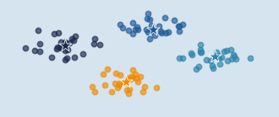
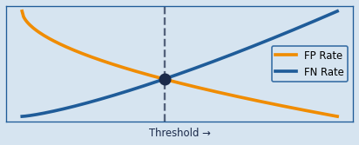
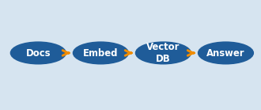
Live Demo
Smart Segmentation
Threshold Tuning
Policy Q&A
Cluster Business customers into 4 groups Identify highest-risk segment Treemap visualisation
FP/FN sweep for Individual AVG_TRXN_AMT Crossover point analysis SAR backtest at 90% catch rate
Query structuring detection policy Citation from FFIEC Manual KB disclaimer behaviour
App running at http://127.0.0.1:5000
Model: qwen-framl-v5 · LM Studio localhost:1234/v1 · Context: 8,192 tokens
Princeton Strategy Group | Confidential
9

