Slide 1
Improvement of Data Coverage for Ingesting
Real-Time Streaming Tweets
ICDATA 2021
Presenter: Minseon Kim
sperospera1225@seoultech.ac.kr

Slide 2
TABLE OF CONTENTS
01
02
03
04
Proposed Framework
Introduction
Scenario-Based Validation
Conclusion
Introduction
Motivations
Contributions
Overall Architecture
Real-Time Architecture
Conclusion
Future work
Experiments

Slide 3
「
」
Introduction

Slide 4
Introduction
Part 1
Coverage Limitation for collecting real-time streaming tweets
Parallel architecture working with Apache Kafka and Apache Spark Streaming
Notes:
Improving data coverage while streaming real-time data is an important issue.
In this study, We analyze the coverage limitation for collecting real-time streaming tweets.
To resolve this limitation, we present a parallel architecture working with Apache Kafka and Apache Spark Streaming to maximize the coverage of ingesting real-time data streams

Slide 5
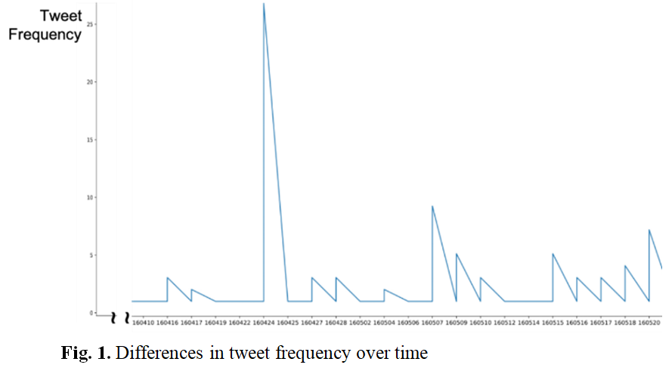
Motivation
Part 1
Frequency of tweets associated with cyber-attacks dramatically varied over time[1].
Notes:
There have been several research efforts for building real-time data processing architecture.
However, all of these existing studies do not propose a complete pipeline for the real-time data stream to improve the data coverage, which is our main focus.
Fig. 1 shows that the frequency of tweets associated with cyber-attacks dramatically varied over time.
In this respect, ingesting streaming data without loss is necessary for a complete tweet analysis.

Slide 6
Contributions
Part 1
Investigate the necessity of a queueing framework for complete processing of real-time data streams
Propose a framework to improve the data ingestion coverage of real-time twitter streaming
Validate the proposed framework based on the actual scenario
Notes:
In this study, we make the following contributions.
First, we investigate the necessity of a queuing framework for complete processing of real-time data streams by showing that there is a limitation to a rate of collected tweets for a target example keywords.
Next, we propose a framework working with Apache Kafka to improve the data ingestion coverage of real-time twitter streaming. In this framework, we can improve data ingestion coverage by assigning streaming data into multiple queues in Apache Kafka, instead of sequentially processing them.
Finally, we validate the proposed framework based on the actual scenario compared to the sequential processing and show it through the actual experiments.

Slide 7
「
」
Proposed Framework

Slide 8
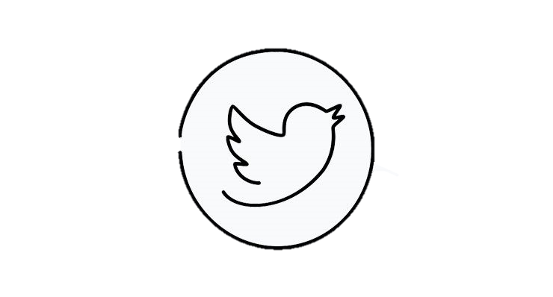


Overall Architecture
Part 2
JSON
Queueing
Structure
Spark Platforms
:filtering and enrichment
Data Warehouses
INGEST
BATCH
PROCESS
JSON
JSON
Spark Platforms
Notes:
The overall architecture is as follows:
The first step is data collection. In this study, we target the real-time data obtained through the Twitter Streaming API by filtereing based on the predefined keywords.
Next step is data ingestion. One of the main benefits of using Apache Kafka with twitter steam is fault tolerance.
To take advantage of this, the producer receives data from the Twitter stream for each topic and stores it into a queue as a log without processing it
Processing data is a following step. In here, we process the real time data streams, which are received from the Kafka consumer, and extract target fields of tweets in batch. Further data analysis can be done, which will further highlight the advantages of our model.
After the data extraction using Apache Spark Streaming, we directly passes extracted result into datawarehouses by using connector.

Slide 9
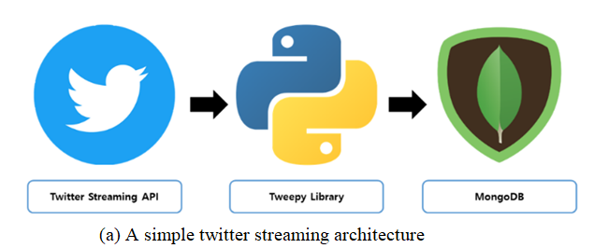
Real-Time Architecture
Part 2
< A simple twitter streaming architecture>
Ingestion speed can not cover the generating speed of streaming tweets (Every second, on average, around 6,000 tweets are tweeted on Twitter)
Notes:
Now we compare the two different real time architectures. In a simple twitter steraming architecture, ingestion speed can not cover the generating speed of streaming tweets as tweets are generated endlessly at a rapid pace.
In this figure, the streaming tweets are sequentially collected and stored in the database, and consequently, much portion of them will be lost because the ingestion speed cannot cover the generating speed of steaming tweets.

Slide 10
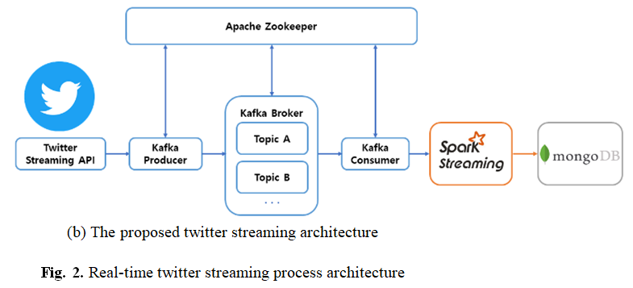
Problem Definition
Part 2
< The proposed twitter streaming architecture>
Message queues in Apache Kafka act as a buffer for the distributed data steram working in parallel
Spark Streaming to consume the loaded entries in the messaging queus for each RDD
Notes:
On contray, in the proposed architecture, the message queues act as a buffer for the distributed data stream working in parallel, thereby improving the data coverage. To consume the loaded entries in the messaging queues at a fast speed, we also adopt Apache Spark Streaming to process the data produced by Apache Kafka

Slide 11
「
」
Scenario-Based Validation

Slide 12
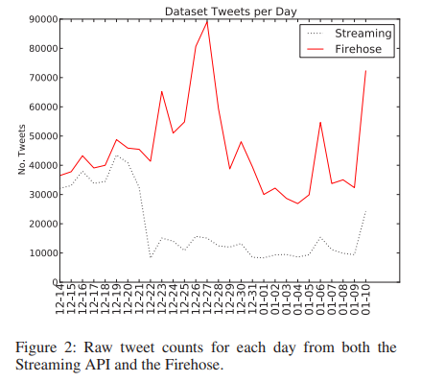
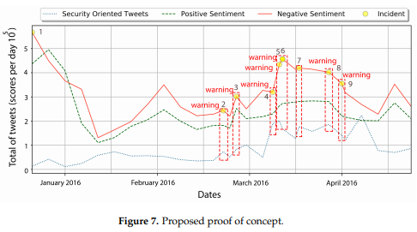
Related Research
Part 3
Morstatter et al. [2] showed that a small sample of data does not adequately represent the overall activity on Twitter. As the streaming API does not consistently ook for top hashtags, and tweets extracted using them have lower coverage than tweets using firehose, the accuracy of anlysis can be reduced.
Hernandez-Suarez et al. [3] showed that there is a link between the content of the tweet and cyber-attacks, and cyber-attacks can be predicted through tweet analysis
Notes:
The following researches can support the validity of our scenario. Morstatter has showed that a small sample of data does not adequately represent the overall activity on Twitter. As the streaming API does not consistently ook for top hashtags, and tweets extracted using them have lower coverage than tweets using firehose, the accuracy of anlysis can be reduced.
In addition, Hernandez-suarez has represented the strong correlation between the content of tweets and actual cyber attack.

Slide 13
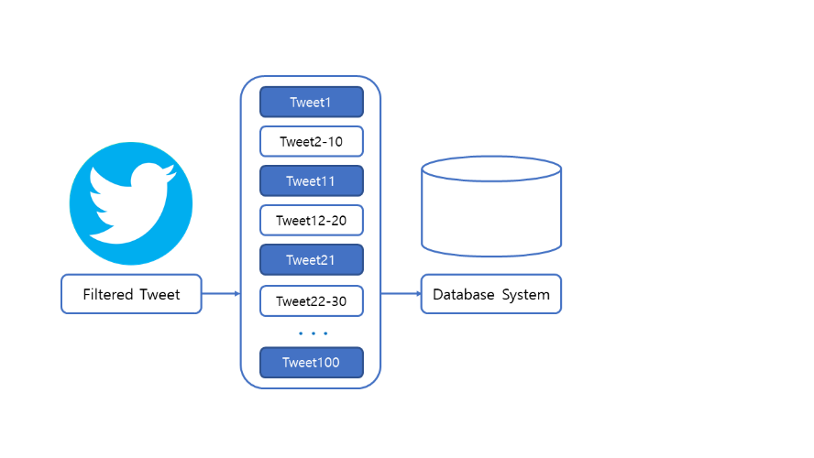
Scenario-Based Validation
Part 3
Comparison of data coverage for streaming tweets
Sequential ingestion of streaming tweets leading low data coverage
Notes:
Simple architecture in this figure ingests the tweets sequentially in the order in which they are received, resulting in a low coverage

Slide 14
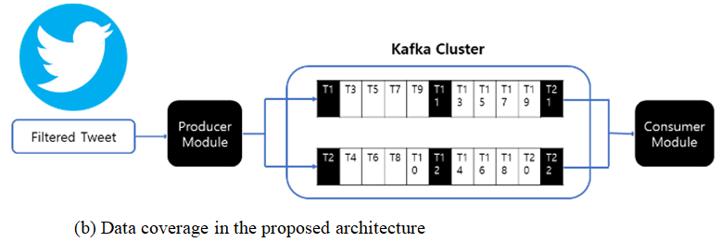
Scenario-Based Validation
Part 3
Comparison of data coverage for streaming tweets
Increased data coverage of streaming data to be ingested by multiple queues
Proportional to the number of partitioned queues and number of consumers
Notes:
However, in the proposed architecture in Figure b, assuming two messaging queues, the received tweets are ingested in parallel, allowing a much more portion of the streaming data to be ingested.
Here, the improvement of coverage will increase as the number of partitioned queues increased.

Slide 15
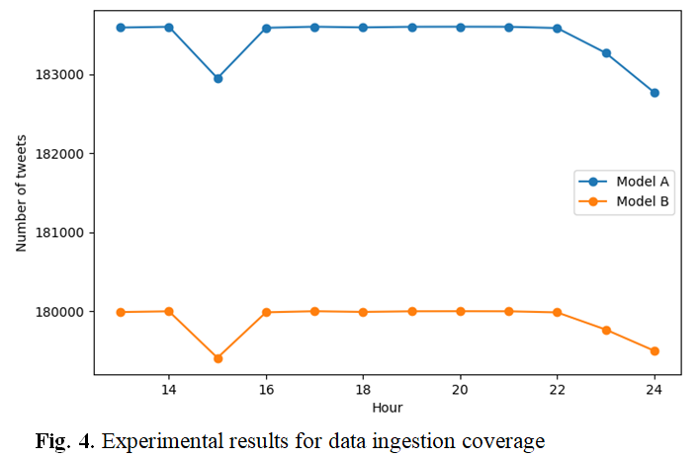
Scenario-Based Validation
Part 3
Experiments for Data Ingestion Coverage
Actual experiment with pre-defined cyber-attack keywords for 12 hours on April 30, 2021
Model A showed 1.98% better data ingestion coverage than Model B
Notes:
In this study, we actually ingested tweets associated with pre-defined cyber-attack keywords for 12 hours on April 30, 2021.
Figure 4 shows the distribution of ingested tweets. Here, we define two models: 1) Model A, which constructs a simple messaging queue model using 3 node message brokers in Apache Kafka, and 2) Model B, which directly connects to streaming APIs without a messaging queue. According to the result, Model A showed 1.98% better data ingestion coverage than Model B. The graph also indicates that there is a fluctuation in the proportion of tweets ingested, at the same time, it shows that the effectiveness of a messaging queue to manage streaming data. Therefore, we need to design an effective streaming framework to maximize the data ingestion coverage.

Slide 16
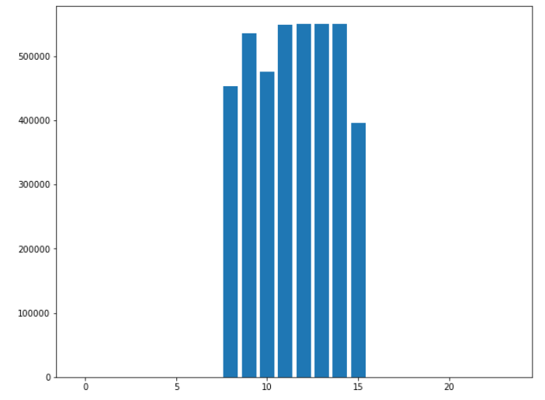
Scenario-Based Validation
Part 3
Additional Experiments after Submission
By using 3 producers with 3 node brokers (1 replication factor), we can now collect up to 600000 cyber-related tweets per hour
Notes:
Additional experiments to improve the data coverage and ingesting speed has been done after submission of the paper. By using 3 producers with 3 node brokers with 1 replication factor, we can now collect up to 600000 cyber-related tweets per hour. The direction of further research will be described in the conclusion section.

Slide 17
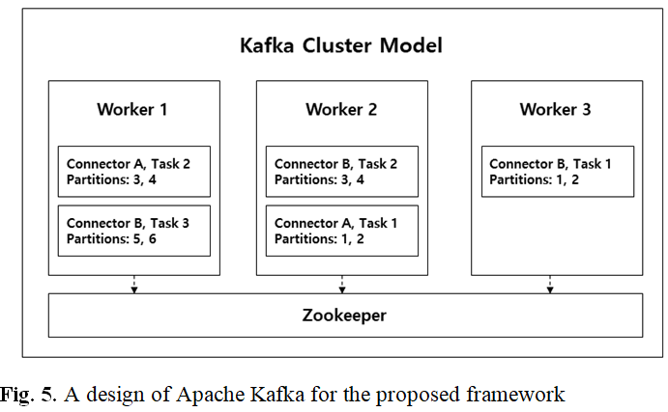
Scenario-Based Validation
Part 3
Necessity of determining appropriate number of brokers in terms of the end-to-end latencies and throughput at the same time
Notes:
Obviously, we know that many partitions could lead to high throughput because producers and consumers ingest multiple partitions simultaneously to process data in Apache Kafka. However, we need to determine an appropriate number of brokers to optimize the performance of each broker in terms of the end-to-end latencies and throughput at the same time

Slide 18
「
」
Conclusion

Slide 19
Conclusion
Part 4
Low latency and High coverage
Dramatic changes in real time tweets affect the data ingestion coverage, finally affecting the accuracy of event prediction
Effectiveness of adopting queueing framework for data streams
Contributions:
Investigate the necessity of a queueing framework
Propose a framework to improve the data ingestion coverage of real time tweet streams
Validate the proposed framework based on the actual scenario
Notes:
In this study, we noted that dramatic changes in generated tweets in real time affect the data ingestion coverage, finally affecting the accuracy of event prediction
By validating the effectiveness of adopting of a queuing system for steaming data processing, we compare the data coverage between a simple data streaming architecture without a messaging queue and the proposed architecture incorporating messaging queues with improved processing with Apache Spark.
According to the experiment based on the actual scenario, proposed model presented increased data coverage by roughly 1.98%.

Slide 20
Future Work
Part 4
Architectural improvement
Correlation between the number of partitions, the number of threads in the producer and consumers, and the throughput will be discovered
Real time model training with high performance
Correlation between the number of partitions, the number of threads in the producer and consumers, and the throughput will be discovered
Notes:
The future research is proposed as follows:
The maximum coverage will be found assuming that throughput will increase linearly with the maximum available producer.
Furthermore, a correlation between the number of partitions, the number of threads in the producer and consumers, and the throughput will be discovered.
We will also demonstrate that continuous model learning with the proposed improved framework leads to improved accuracy of cyber-attack prediction performance.

Slide 21
References
Junha Lee, Boyoung Han, and Hyuk-Yoon Kwon. (2019). Predicting of Cyber Attacks based on Graphs and Time-Series Using Tweets. Vol. 35 No. 03 PP. 0003 ~ 0017.
Morstatter, Fred, et al. “Is the sample good enough? comparing data from twitter’s streaming api with twitter’s firehose.” Proceedings of the International AAAI Conference on Web and Social Media. Vol. 7. No. 1. 2013.
Hernandez-Suarez, A., Sanchez-Perez, G., Toscano-Medina, K., Martinez-Hernandez, V., Perez-Meana, H., Olivares-Mercado, J., & Sanchez, V. (2018). Social sentiment sensor in twitter for predicting cyber-attacks using ℓ1 regularization. Sensors, 18(5), 1380.
Notes:
The Referenced papers in the presentation are as follows.
적은 표본의 데이터는 트위터에서의 전반적인 활동을 제대로 표현하지 못한다는 점을 주장하였다. Streaming Api는 consistently 하게 top hashtags를 찾지 않으며 이를 이용해서 추출한 트윗들은 firehose를 이용한 트윗에 비해 coverage가 낮으며, 낮은 커버리지는 곧 분석 정확도의 감소로 이어질수 있다고 한다.

Slide 22
「
」
Thank You
Notes:
Thank you for listening.

