Slide 1
Attack of the Triangles AOT²
Seth Perry, Tyler Cook, Anthony Ryden, Nick Rohn

Slide 2
Tools
Github
Trello
MySQL
phpMyAdmin
Automated Unit Tests – Unity Test Tools
Doxygen
MonoDevelop

Slide 3


Purpose: Git repository hosting service provides a version control system allowing the team remote access to the files, while keeping the codebase consistent and updated.
Our rating:

Slide 4

Purpose: project management tool. Project board contains lists enabling us to keep track of active tasks. Individual tasks (cards) were moved from list to list as project and individual tasks progressed.
Our rating:

Slide 5
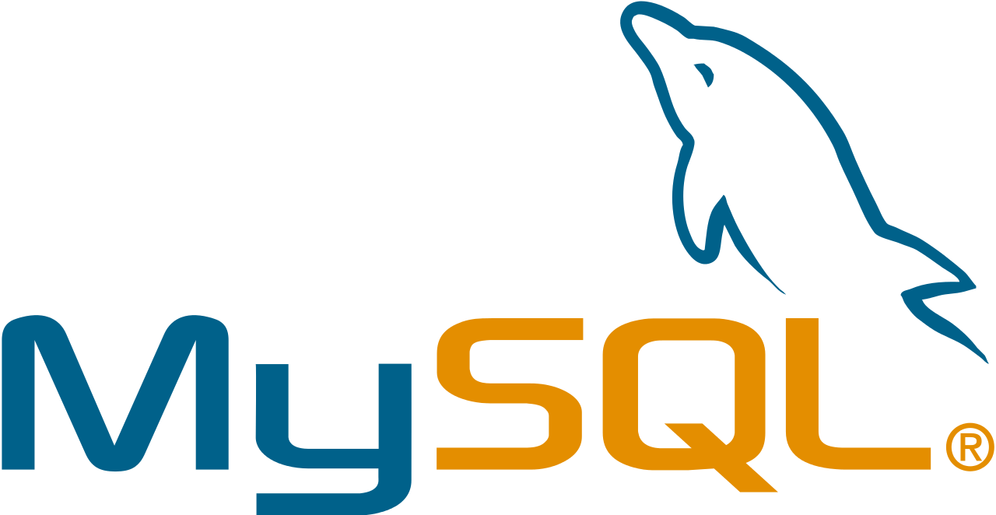
MySQL enabled us to manage our database in order to organize and maintain individual player data (e.g., high scores) so that they could be displayed publicly.
Our rating:

Slide 6
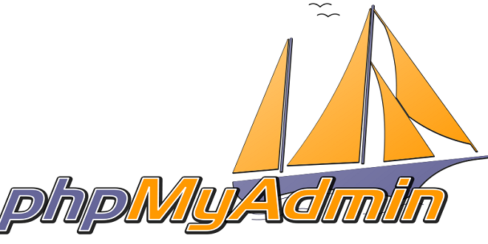
This free tool allowed us to effectively perform tasks such as modifying, creating, and organizing tables, rows, etc. in our database.
Enabled us to manage MySQL with a web browser.
Our rating:

Slide 7
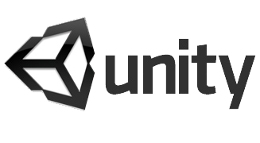

Automated Unit Tests – Unity Test Tools
Unity Test Tools enabled us to test individual methods within our codebase to ensure that they were fit for use.
Our rating:

Slide 8

We used Doxygen to generate documentation for our C# code to provide meaningful explanations of the various scripts in our codebase.
Our rating:

Slide 9
Deployment Environment
Laptop – Windows/OSX/UNIX
Standalone Game

Slide 10

Additional Tools
IDE: we used MonoDevelop, which is the integrated development environment supplied with Unity.
Provides debugging.
Our rating:

Slide 11
Methodologies
We used the waterfall development model to fit our sequential design process.
We used pair programming as a technique during particular points during development, especially when facing challenging, new problems.

Slide 12
Demo

Slide 13
Challenges

