Slide 1



What Now?
Week 11 Report
Ethan Janovich, Sam Persinger, Lavender Wilson

Slide 2
This Week:
Generate commands is finished
Pop-ups to confirm commands on the Voice screen
Android recipe development continued
Edit and Search UI implemented
Notifications

Slide 3
Challenges and solutions
Challenges:
Getting command confirmation pop-up for edit commands.
Allowing more relaxed language for commands.
Incorrect library used in recipe setup script
Figuring out implementing async/await for the notifs.
Solutions:
Extract updated event from tuple, only include edited fields in pop-ups for edit, no old values.
Made AI model prompt shorter and more concise and instruct to specifically convert words like “move” or “create” to the correct command.
Changed all referenced instances of that library to the correct one
Not difficult, just never done it in python before.

Slide 4
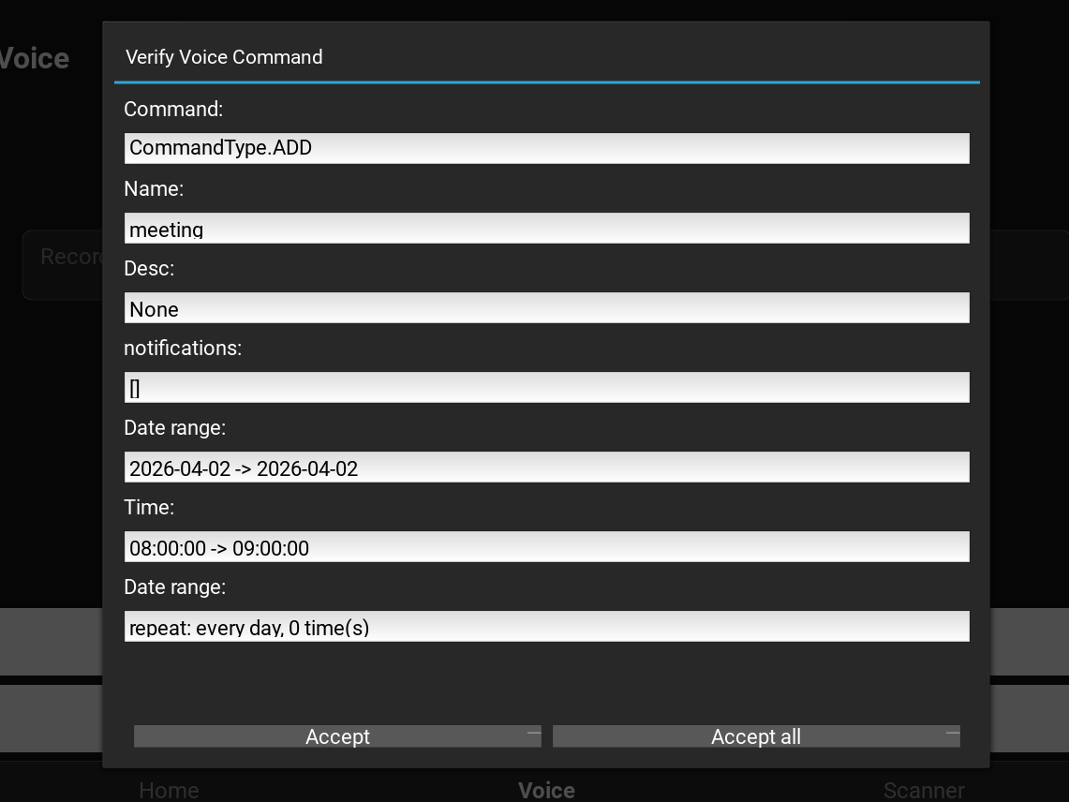
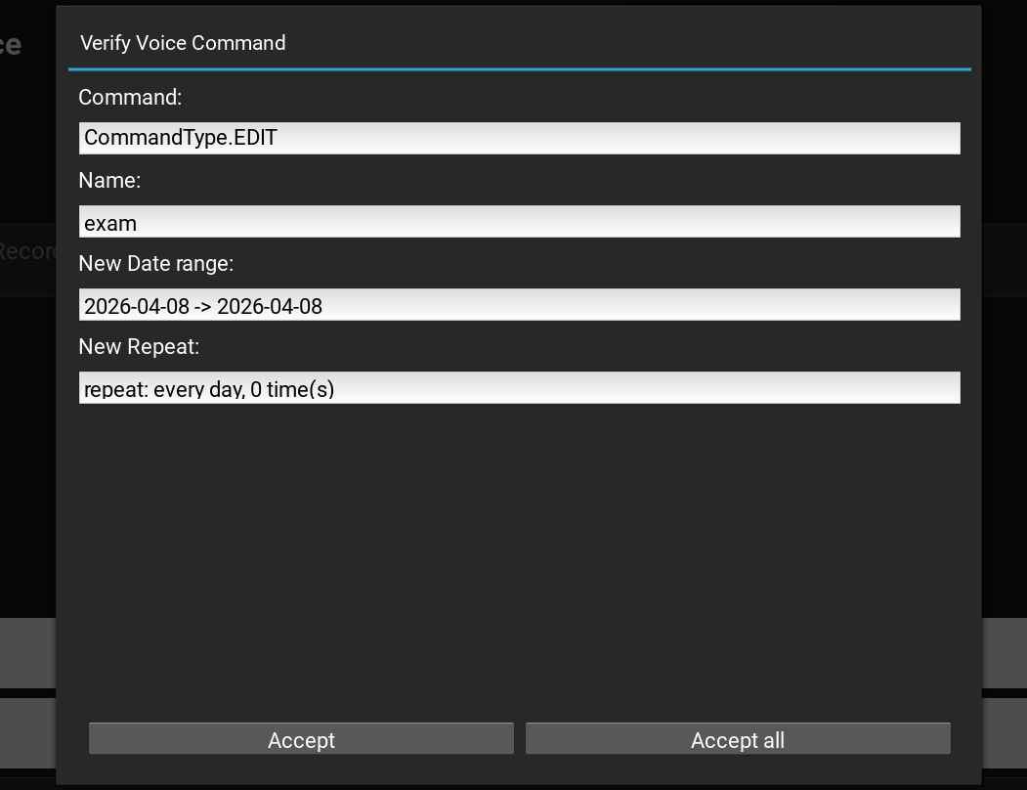
Command Pop-ups
Input: “schedule meeting for April 2 at 8 am” and “move exam to April 8”

Slide 5
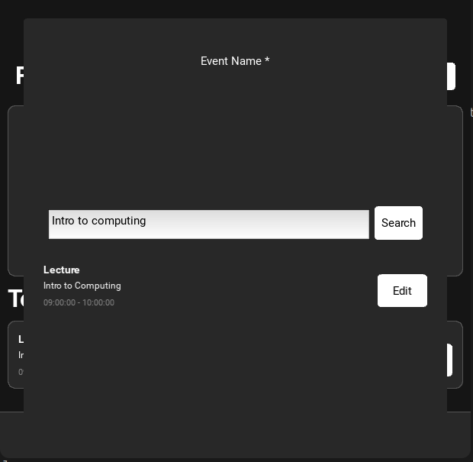
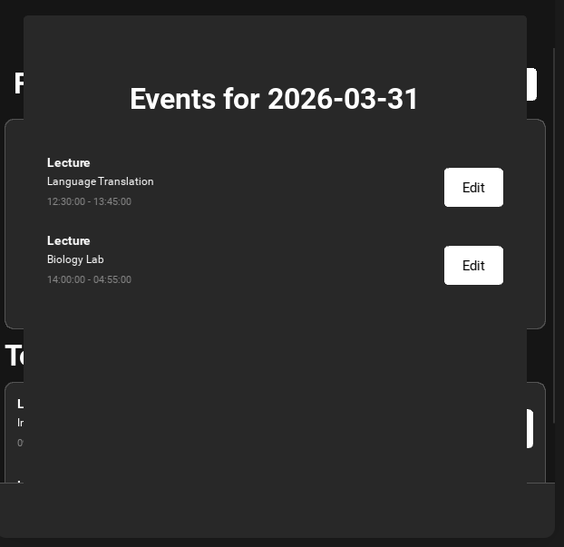
Event views
Search view Day View

Slide 6
Gantt Chart
We must use our wiggle room at the end of the Gantt chart to finish the project in time.

Slide 7
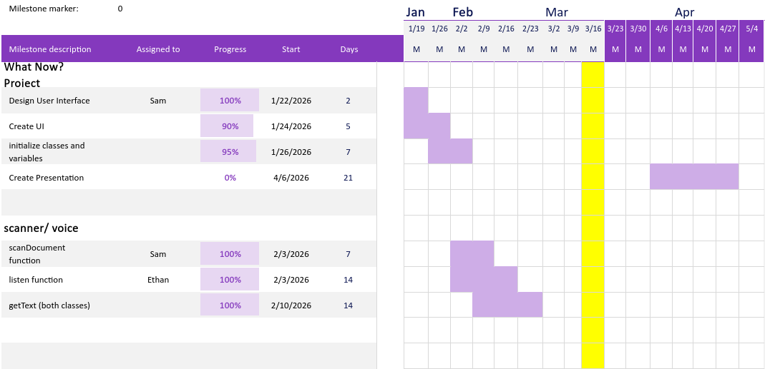
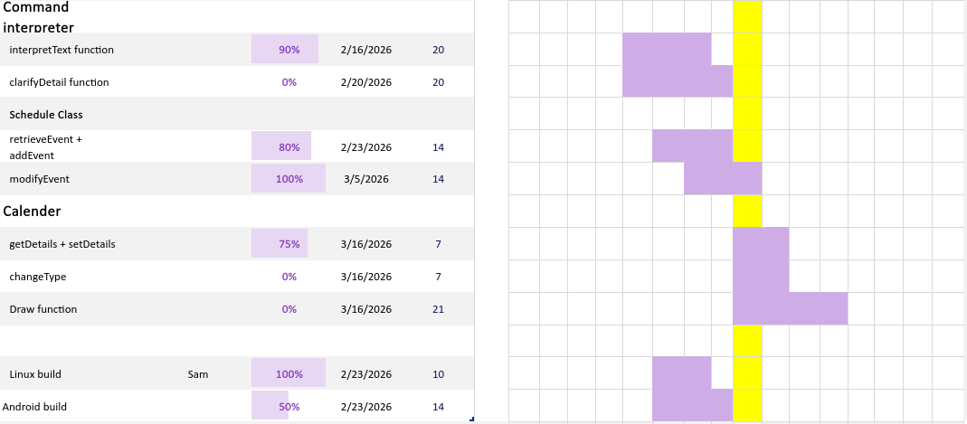
Gantt Chart

Slide 8
Next Steps
Touch up Command parsing
Read in Calendar/ Save Calendar using icalendar library
Finish with notifications. Almost complete
Continue recipe development

Slide 9
Website
We will be storing all our documents, including reports, on this website: https://spersinger.github.io/what-now-website/

