Slide 1



What Now?
Week 14 Report
Ethan Janovich, Sam Persinger, Lavender Wilson

Slide 2
This Week:
Android build
Bug fixes + error handling
User manual

Slide 3
Challenges and solutions
Challenges:
Android (many)
Bug fixes across the application
Solutions:
(many)
Update ordering of events, fix some buggy document scanner stuff.

Slide 4
Live Demo

Slide 5
Gantt Chart
We are in good shape to finish everything that is needed this week.

Slide 6
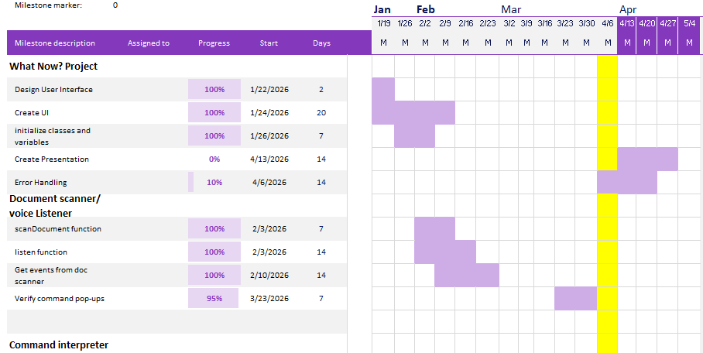
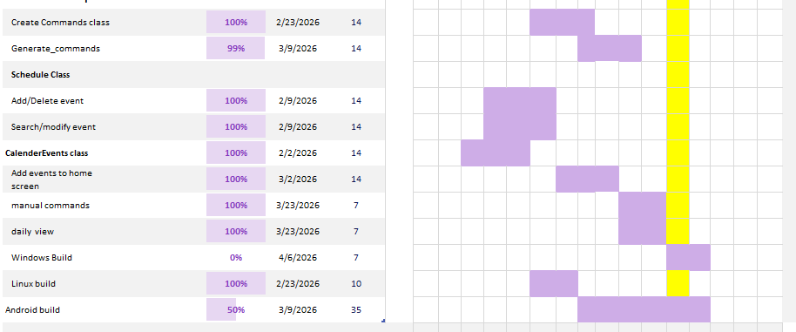
Gantt Chart

Slide 7
Next Steps
In depth testing and reviewing of all code
Presentation
User Manual

Slide 8
Website
We will be storing all our documents, including reports, on this website: https://spersinger.github.io/what-now-website/

