Slide 1



What Now?
Week 9 Report
Ethan Janovich, Sam Persinger, Lavender Wilson

Slide 2
This Week:
Built apk files that are fully 16KB memory page compatible
Debugging apk, got successful build
UI is merged into main now
Modify event function finished, Schedule debugged and merged

Slide 3
Challenges and solutions
Challenges:
Building an apk with all 16 KB compatible libraries
buildozer unable to find .kv file.
audioop-lts library not pure python(used in SpeechRecognition)
Some minor bug fixes on the UI while waiting to plug it in
Solutions:
Trial and error changing dependencies in the spec file
Put .kv file in the same directory as source files and adjust main to accept it.
Use Plyer to access Android's speech to text API (Plyer.stt)

Slide 4

App installed on android
WIP app icon.

Slide 5
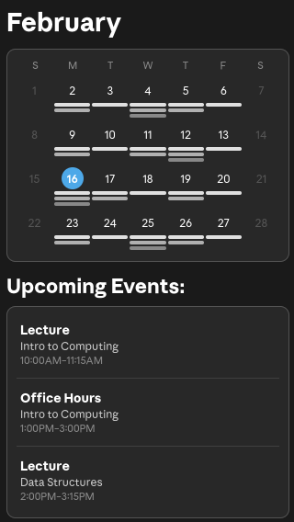
UI implementation

Slide 6
Gantt Chart
We are behind our Gantt chart projections with the android build.
We are still on pace to finish this project in time
The margin for error is decreasing, but it still exists

Slide 7
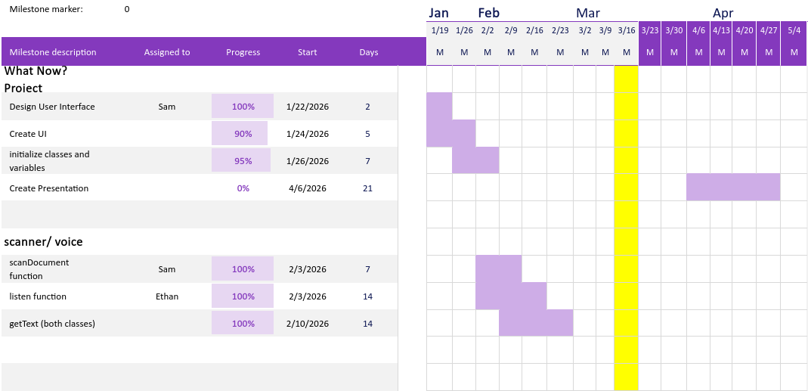
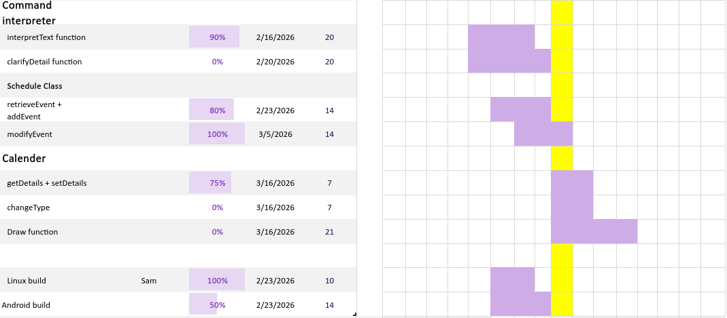
Gantt Chart

Slide 8
Next Steps
Continue debugging the android build
Hook up all pieces we have built seperately together.

Slide 9
Website
We will be storing all our documents, including reports, on this website: https://spersinger.github.io/what-now-website/

