Slide 1



What Now?
Week 7 Report
Ethan Janovich, Sam Persinger, Lavender Wilson

Slide 2
This Week:
Finished building pipelines for Android, Linux, and Windows
CalendarEvent and Schedule work is on schedule.
UI designs are fully implemented
Integration testing

Slide 3
Challenges and solutions
Challenges:
More UI issues.
Issue with Android building an APK for older versions of Android
AppImage not bundling ui assets / building .desktop properly
Solutions:
Simple fixes that took some diving into the documentation.
Still being worked on
Moved assets into a singular folder and updated imports across the application.

Slide 4
UI Demo
Showcases adding a one off event, or a recurring event and how the calendar reacts to it

Slide 5
CommandInterpreter and Schedule Communication Progress

Slide 6
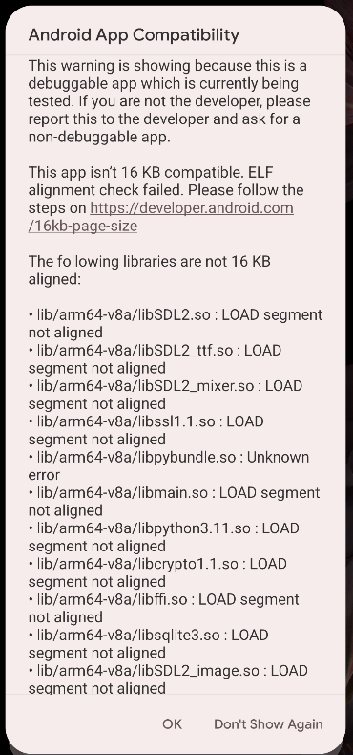
APK Issues

Slide 7
Gantt chart
Made adjustments to better represent our progress and future plans.
Progress was a bit slow this week but we're on pace to finish the “What Now?” Project on time.

Slide 8
Website
We will be storing all our documents, including reports, on this website: https://spersinger.github.io/what-now-website/

Slide 9
Next Steps
Begin integrating the new classes with the previous ones.
Continue CommandHandler implementation
Merge in UI and ensure all new elements are styled with the components written.
Begin looking into GitHub actions for automated building.

