Slide 1



What Now?
Week 13 Report
Ethan Janovich, Sam Persinger, Lavender Wilson

Slide 2
This Week:
Compatible repeats and notifications when loading / saving icalendar file
Windows build
Android build
Responsive UI
Bug fixes + error handling

Slide 3
Challenges and solutions
Challenges:
Windows and Linux build file paths (.kv files, model files, pytesseract files)
Module SpeechRecognition not found
Pyaudio android issues
Notification bug on Windows
UI being rendered in the wrong order
Solutions:
Check if system has attribute that is created by pyinstaller and use the temporary folder path that pyinstaller creates
Patch setup.py
No solution; use alternatives or Plyer/Pyjnius on separate android branch
Move notification event loop out of its own thread to the main event loop thread.
Add the elements declaratively in code depending on which needed to be rendered first.

Slide 4
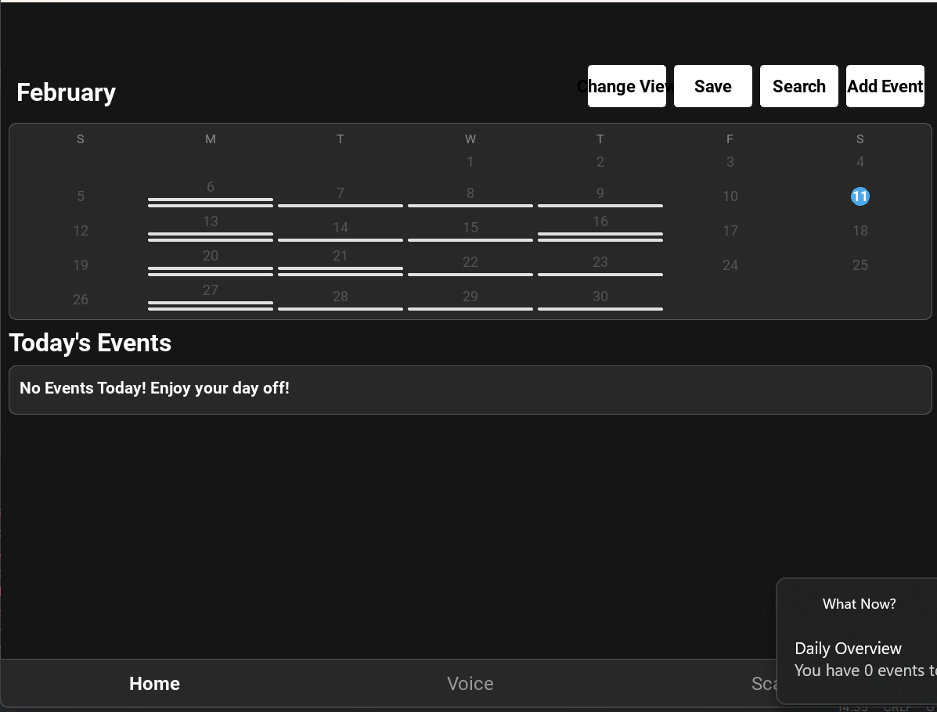
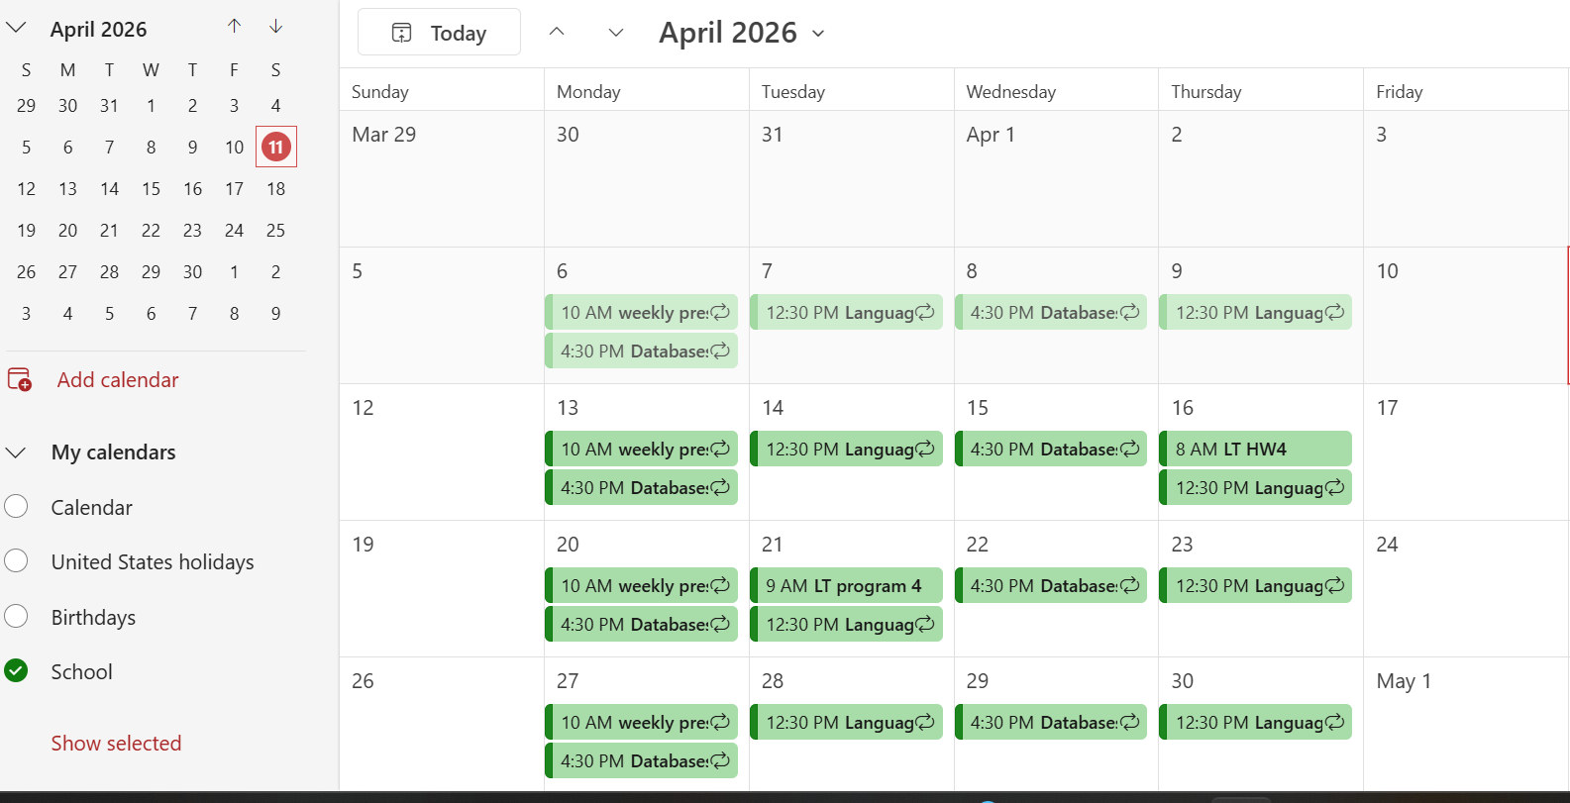
.ICS compatibility

Slide 5
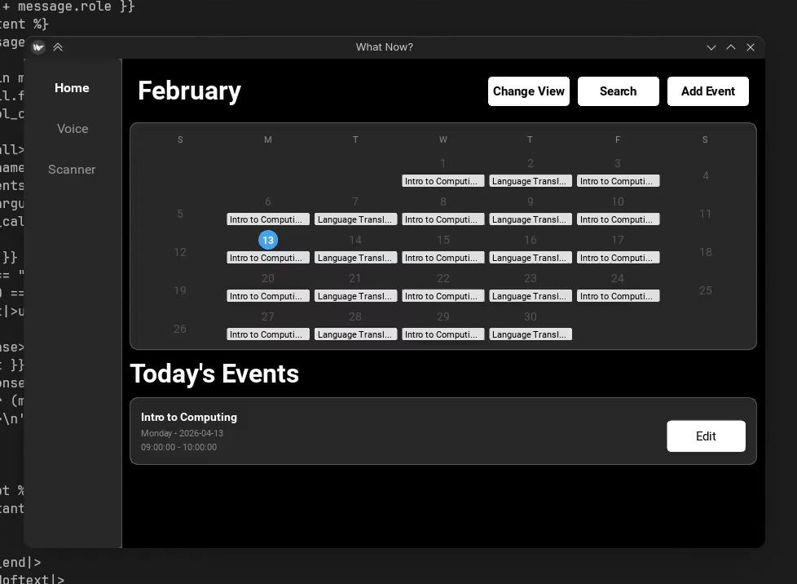
Responsive UI

Slide 6
Gantt Chart
If we are efficient in testing, reviewing, and adding error handling, we are sitting pretty.

Slide 7
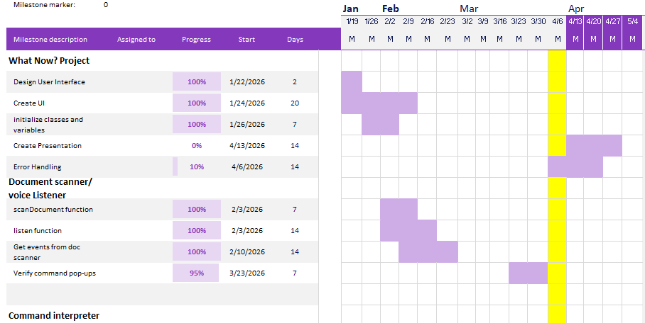
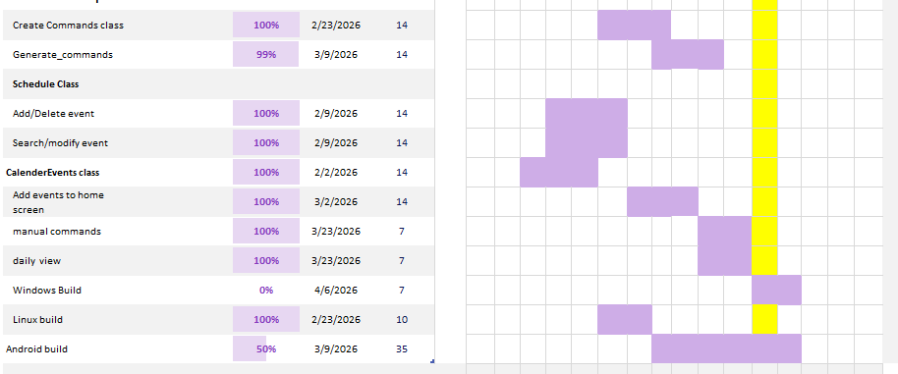
Gantt Chart

Slide 8
Next Steps
Find and handle as many errors as possible
In depth testing and reviewing of all code
Continue recipe development for android build
Presentation
User Manual

Slide 9
Website
We will be storing all our documents, including reports, on this website: https://spersinger.github.io/what-now-website/

