Slide 1

Interview questions 1. round
Data Analytics & Modeling team
2021

Slide 2
Welcome to our recruitment process
We are excited to welcome you on our recruitment process and wishing you all the best to become a successful team member of ours.
In this section, you are facing with 6 coding challenges, which are made for measuring your programming knowledge in Python.
Here are a few requirements:
Please use Python 3.7 – 3.9 versions.
Solutions needs to be uploaded to your github/gitlab, and share with us the link.
There is no restriction, which environment you would like to use. (Pycharm, Jupyter notebook, Google collab).
Codes need to be clearly readable, without overly nested solutions, and well commented.
Please use your own solutions and restrain from googling direct ones, as we are interested in your own knowledge and how you think and break down each problem.
The following slides contain exercises. The order of the task does not reflect the exercise’s difficult level. Try to solve as much of them as you can!
Best of luck!
Data Analytics & Modeling team

Slide 3
1. exercise
In this problem, your input is a list of integers, which represents the layout of a 3D structure, cubes arranged into towers in a row. The first number is the height of the first tower, the second is the height of the second and so on. The function has to calculate the surface area of the structure (we suppose the surface area of a single cube is 6 unit). If the input starts as [2, 1], then the first tower connects with the second one in 1 level, which means the surface area is 14 units.

Slide 4
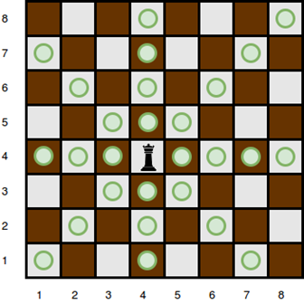
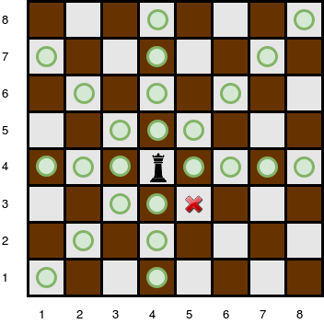
2. exercise
You will be given a square chess board with one queen and a number of obstacles placed on it. Determine how many squares the queen can attack. A queen is standing on an 𝑛 by 𝑛 chessboard. The chess board's rows are numbered from 1 to 𝑛 , going from bottom to top. Its columns are numbered from 1 to 𝑛 , going from left to right. Each square is referenced by a tuple, (𝑟,𝑐 , describing the row, 𝑟 , and column, 𝑐 , where the square is located. The queen is standing at position (𝑟𝑞,𝑐𝑞) . In a single move, she can attack any square in any of the eight directions (left, right, up, down, and the four diagonals). In the diagram below, the green circles denote all the cells the queen can attack from (4,4) :
Given the queen's position and the locations of all the obstacles, find and print the number of squares the queen can attack from her position at (𝑟𝑞,𝑐𝑞) . In the board above, there are 24 such squares.
There are obstacles on the chessboard, each preventing the queen from attacking any square beyond it on that path. For example, an obstacle at location (3,5) in the diagram above prevents the queen from attacking cells (3,5) , (2,6) , and (1,7) .
The function has the following parameters:
— int n: the number of rows and columns in the board
— int r_q: the row number of the queen's position
— int c_q: the column number of the queen's position
— int obstacles[k][2]: each element is an array of 2 integers, the row and column of an obstacle
Returns
— int: the number of squares the queen can attack

Slide 5
3. exercise
For this exercise, you can only use numpy library.
Create a function which produces an 𝑛×𝑛 array which contains ±1 numbers like a chessboard. (𝑀𝑖,𝑗=(−1)^{i+j}).

Slide 6
4. exercise
For this exercise, you can only use numpy library.
Create a function which computes the Euclidean norm of each line for a 2D array.
Use numpy operations and vectorization, avoid for cycles.
Here is the wrong solution.
def rowwise_norm(X):
def my_dot(x, y):
result = 0.0
for i in range(len(x)):
result += x[i] * y[i]
return result
return np.array([np.sqrt(my_dot(x, x)) for x in X])
X = np.arange(5)[:, None]*np.ones((5, 3));
print(rowwise_norm(X))
print(rowwise_norm([[1], [-1], [1], [-1]]))

Slide 7
5. exercise
Create a function which expects any number of square matrices and outputs a block-matrix which contains the input matrices in its main diagonal, and contains 0 in every other place.
Input is a list, containing the matrices.

Slide 8
6. exercise
Solve this task with recursive programming.
In this exercise you have to find how much cookies can be consumed with the given amount of money.
money: Starting money, to spend for cookies
price: Price of the cookie
wrap: Number of wrappers to be returned for getting one extra cookie.
It may be assumed that all given values are positive integers and greater than 1.
Example:
Input: money = 16, price = 2, wrap = 2
Output: 15
Price of a cookie is 2. You can buy 8 cookies from
amount 16. You can return 8 wrappers back and get 4 more
cookies. Then you can return 4 wrappers and get 2 more
cookies. Finally you can return 2 wrappers to get 1
more cookie.

