Slide 1
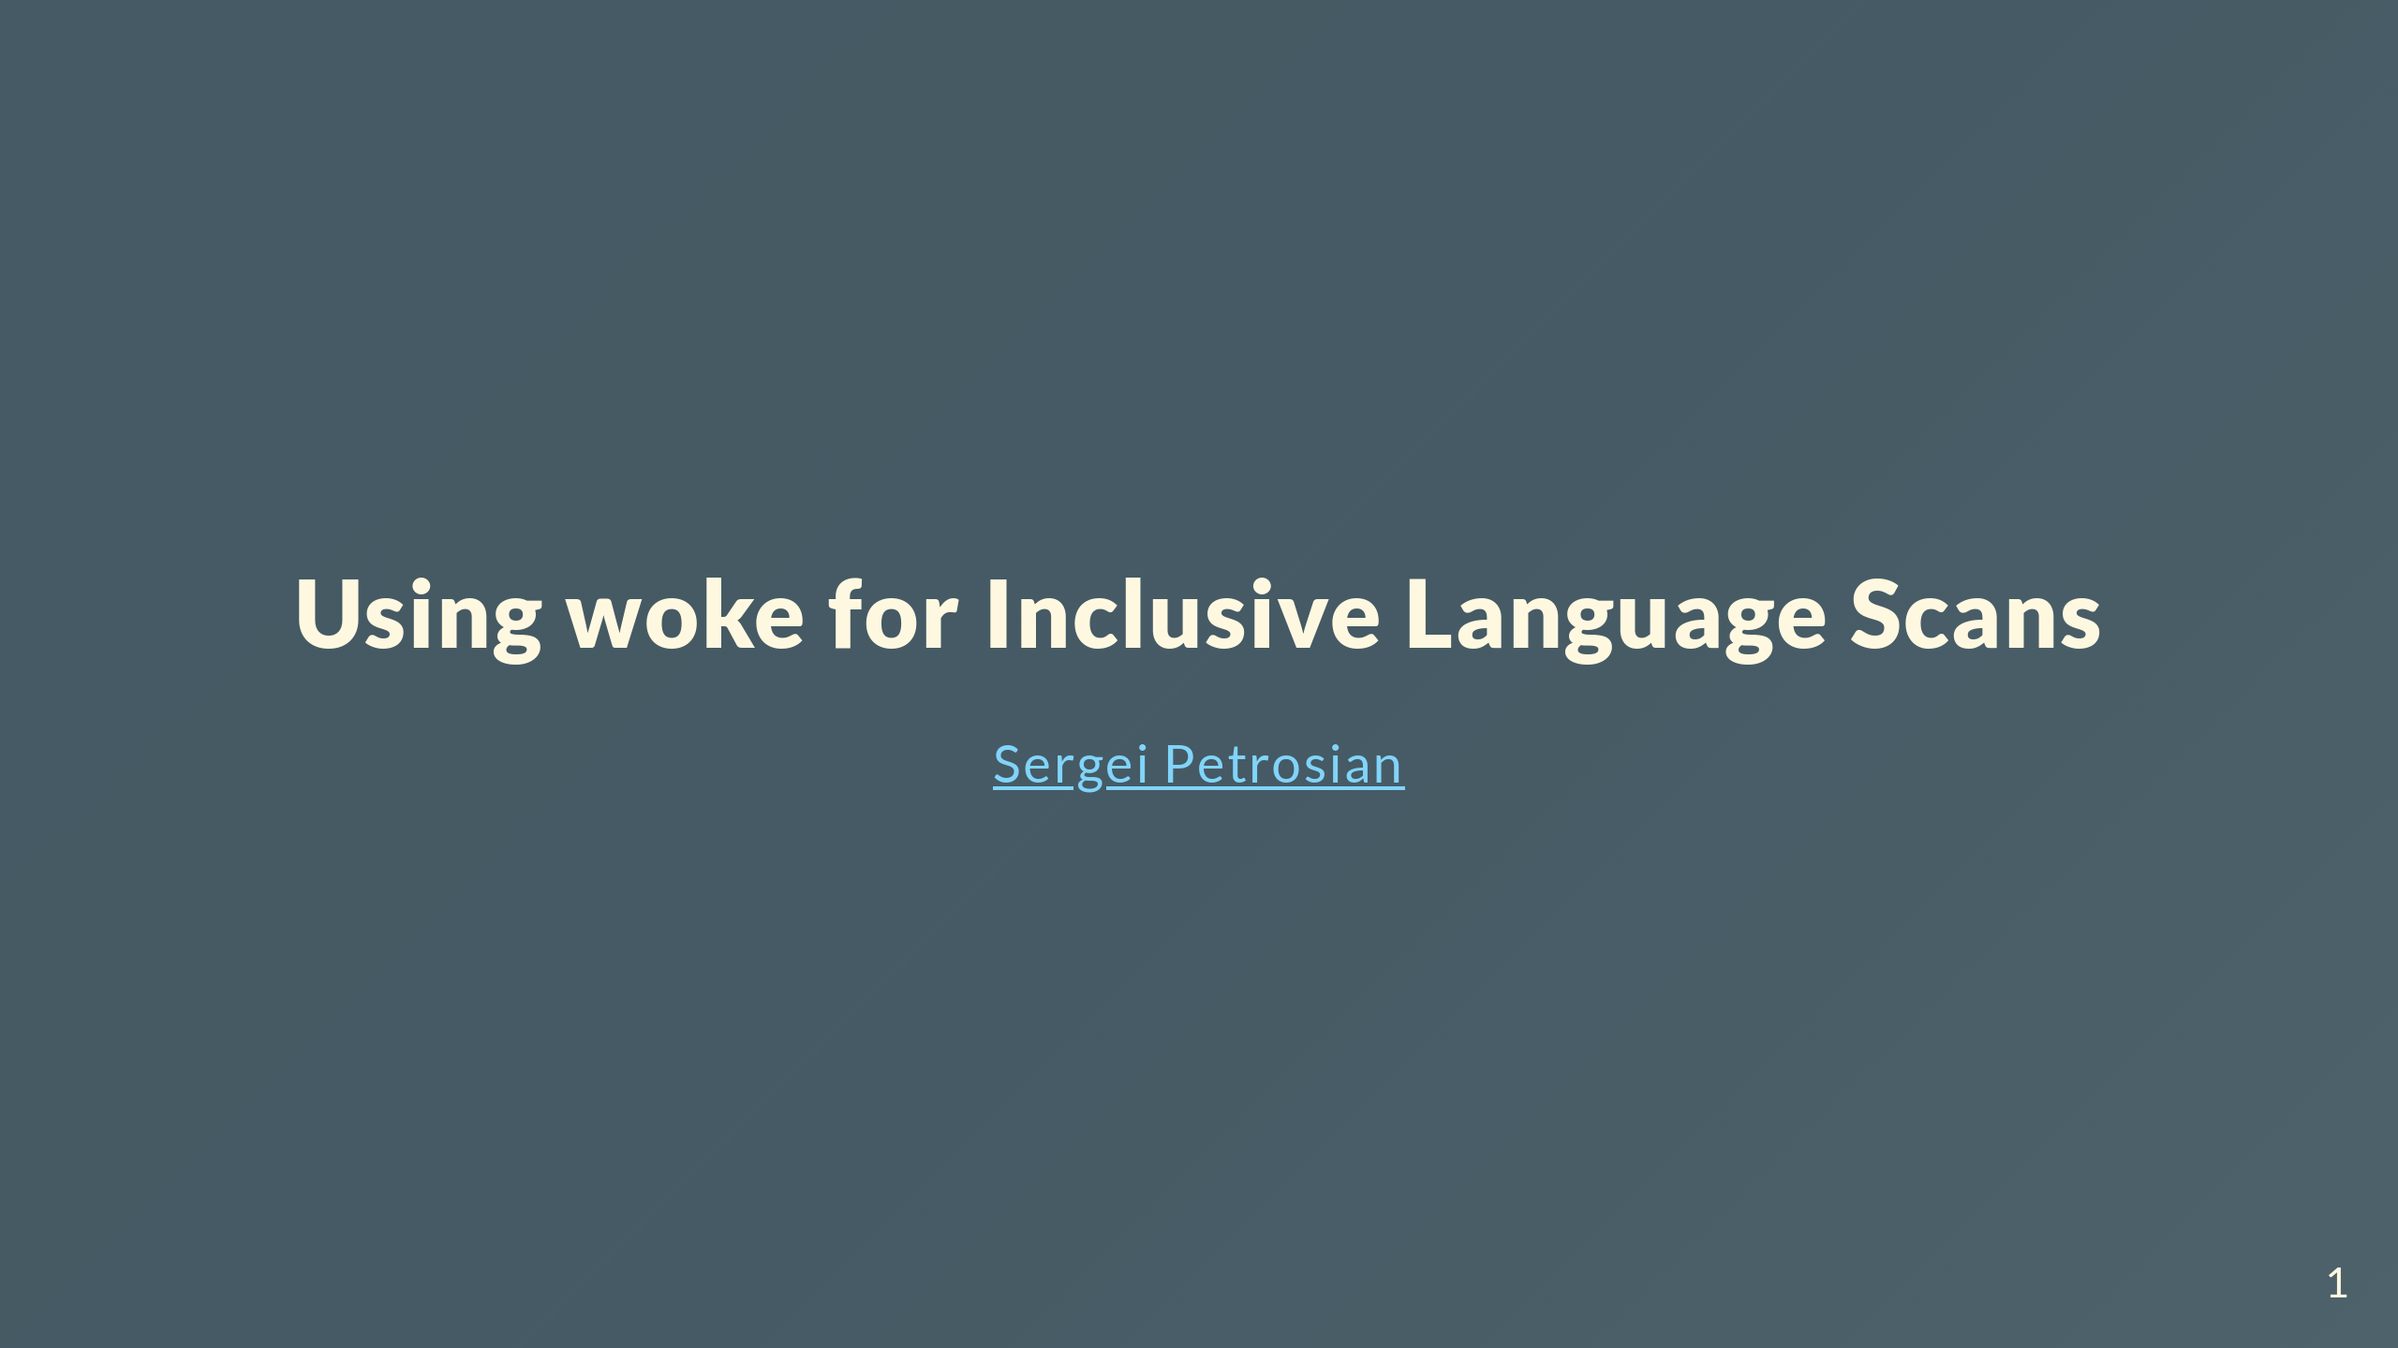
Notes:
https://spetrosi.github.io/use_woke_devconf2023 Diversity, Equity, and Inclusion (DEI) is a focus of many organizations today. It is important for all users and developers to feel comfortable using and contributing to open source projects. Part of this is Inclusive Language, using words and expressions that are inclusive rather than exclusive.

Slide 2
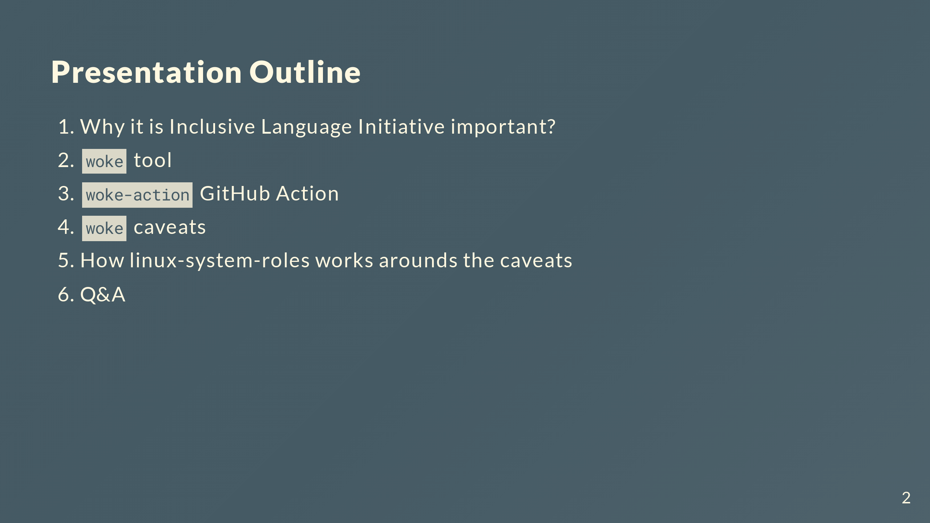
Notes:
The Linux System Roles project has recently begun using a tool called "woke" as part of our github code checking. During this presentation you will learn about the "woke" tool, how we are using it in Linux System roles github action checking, the hurdles we faced converting Linux System Roles to have more inclusive language, and ways you can help the "woke" project.

Slide 3
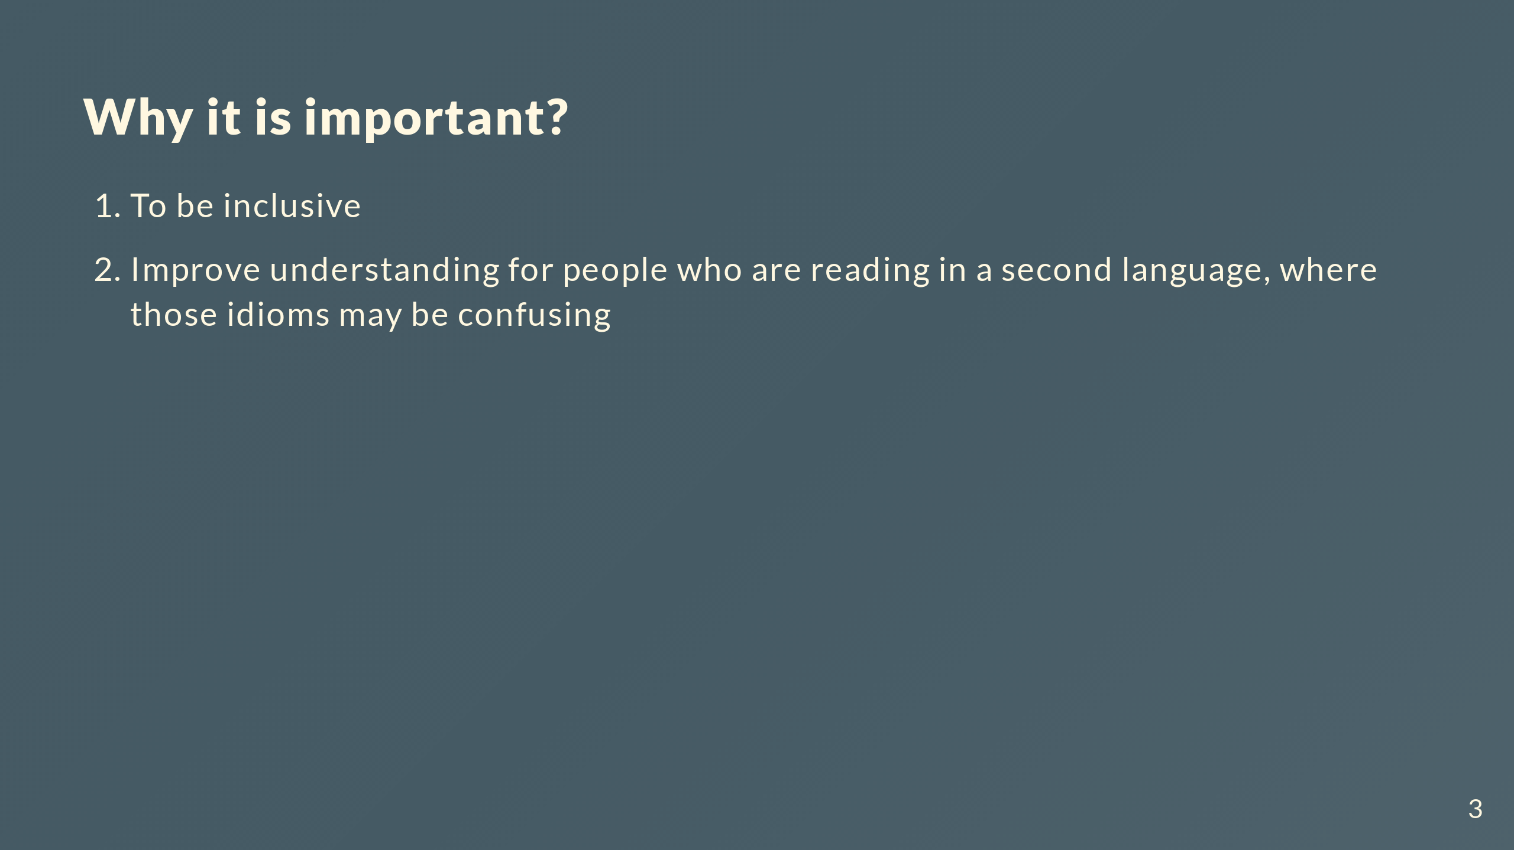
Notes:
The software industry sometimes uses certain words that may carry a great deal of emotional and historical baggage. If software is truly meant to be inclusive and a place where anyone can participate, it must be welcoming to all. If words or phrases convey secondary unintended meanings to our audience, we are potentially limiting participation in our projects. To avoid unintended connotations that some common words and phrases have, we can use more precise words. Not only does this eliminate the hurt caused by those connotations, it also improves understanding, particularly for people who are reading in a second language, where those idioms may be confusing.

Slide 4
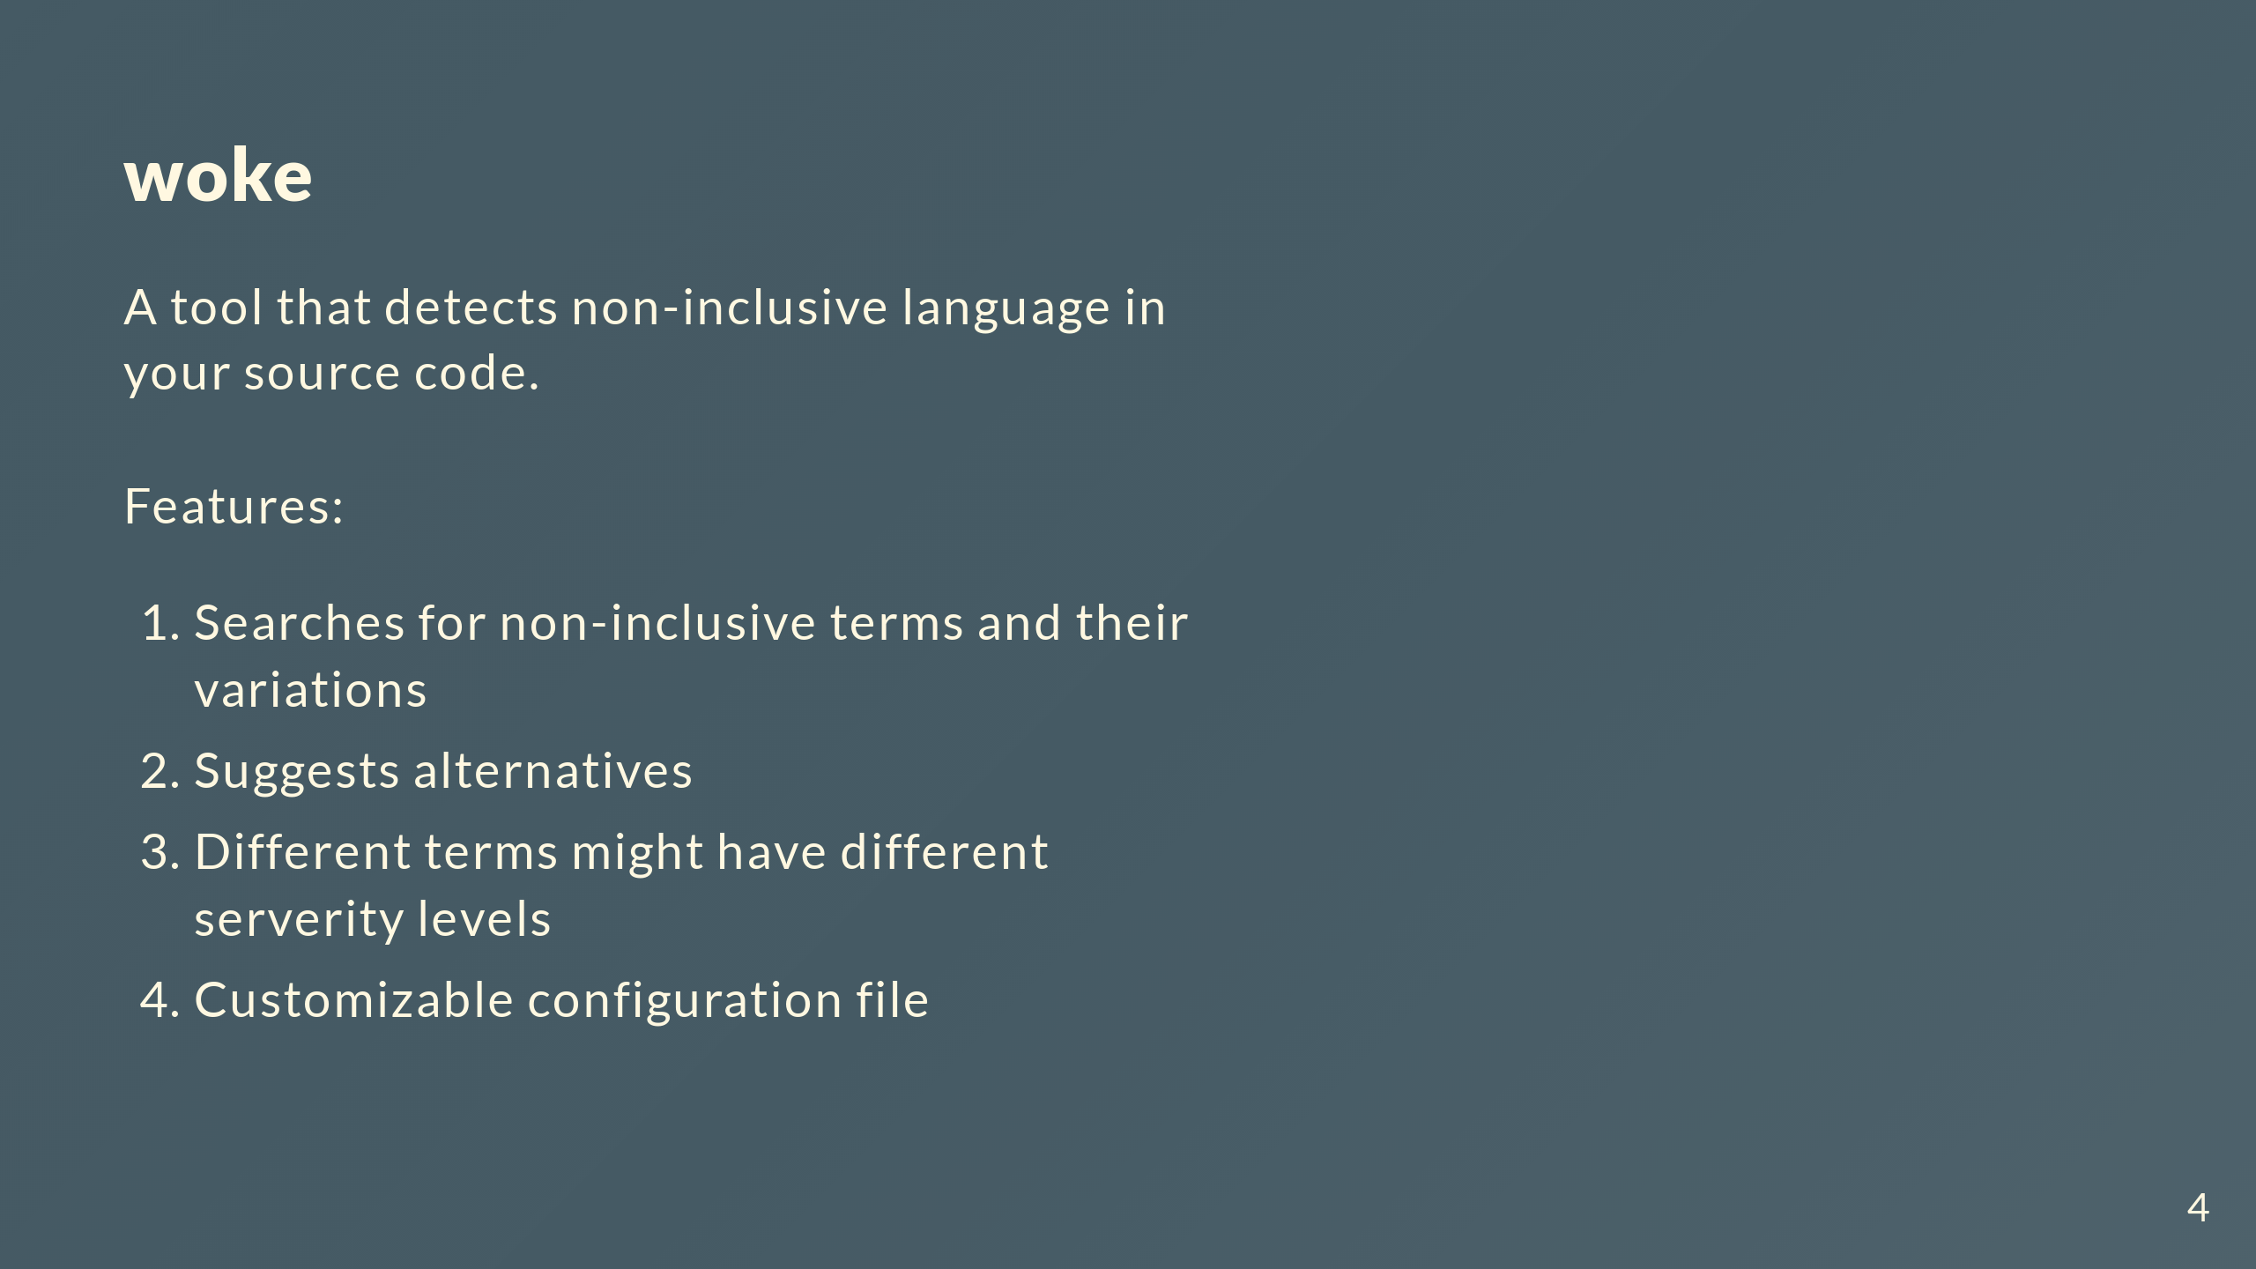

Slide 5
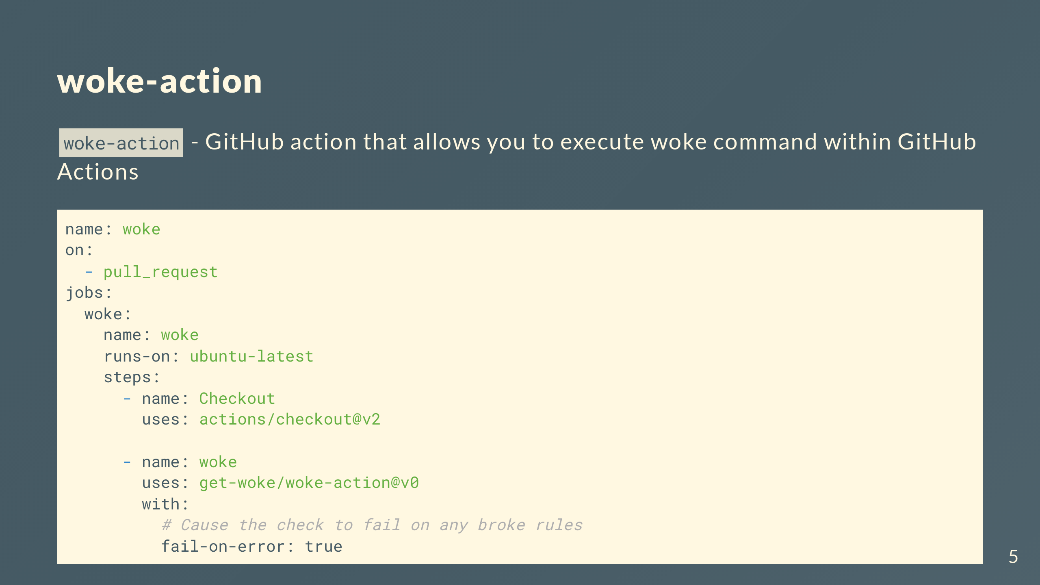

Slide 6
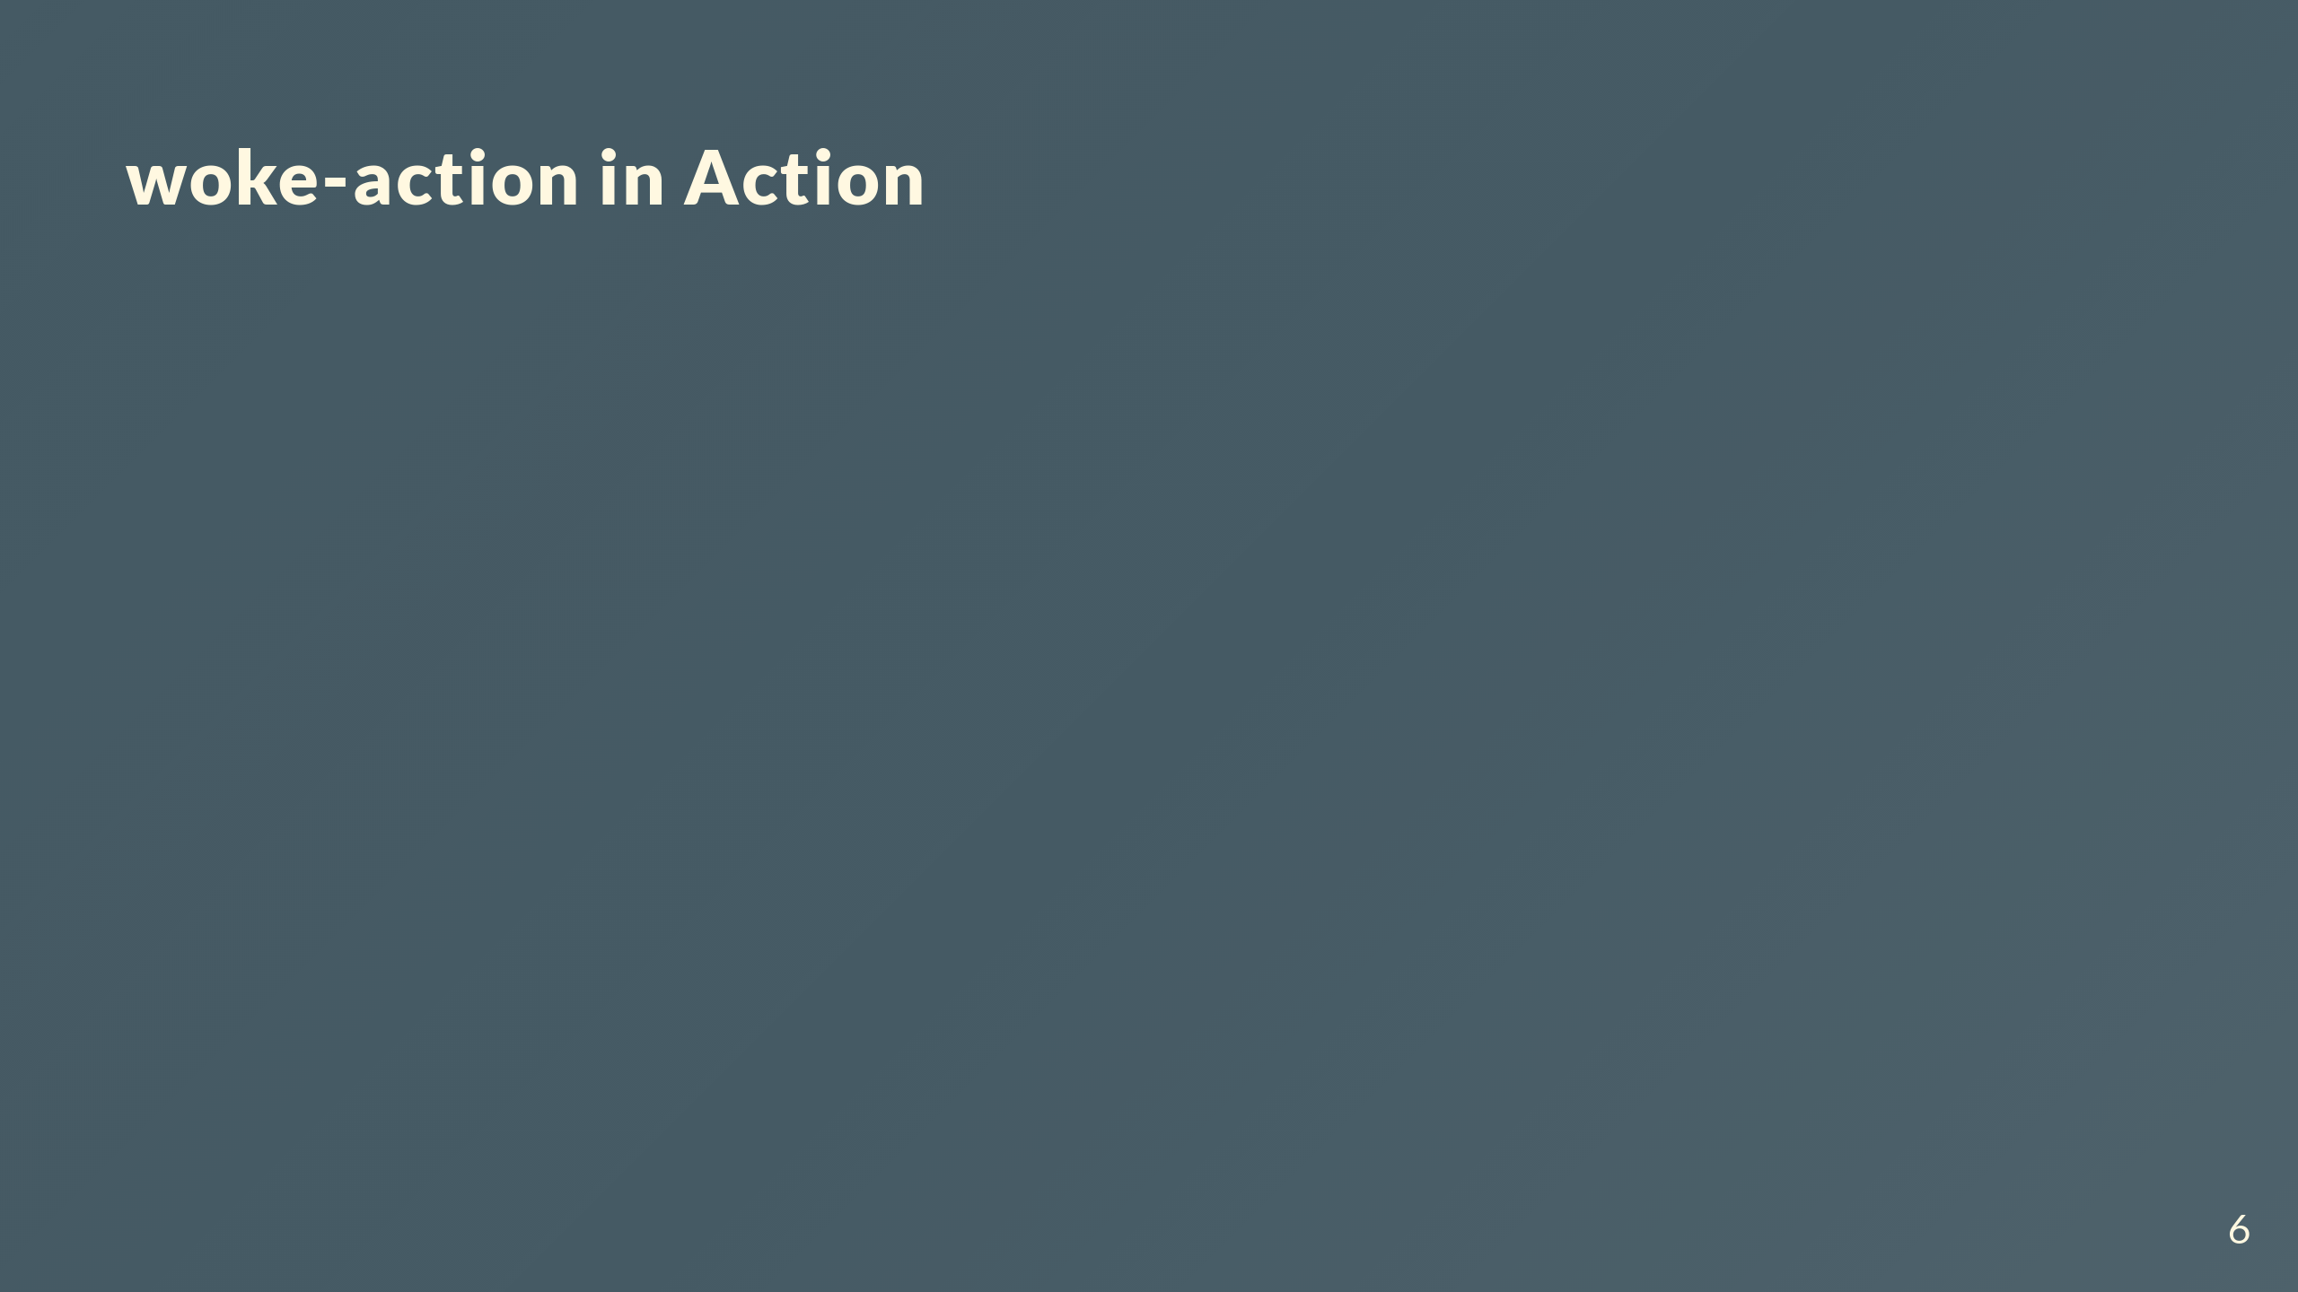

Slide 7
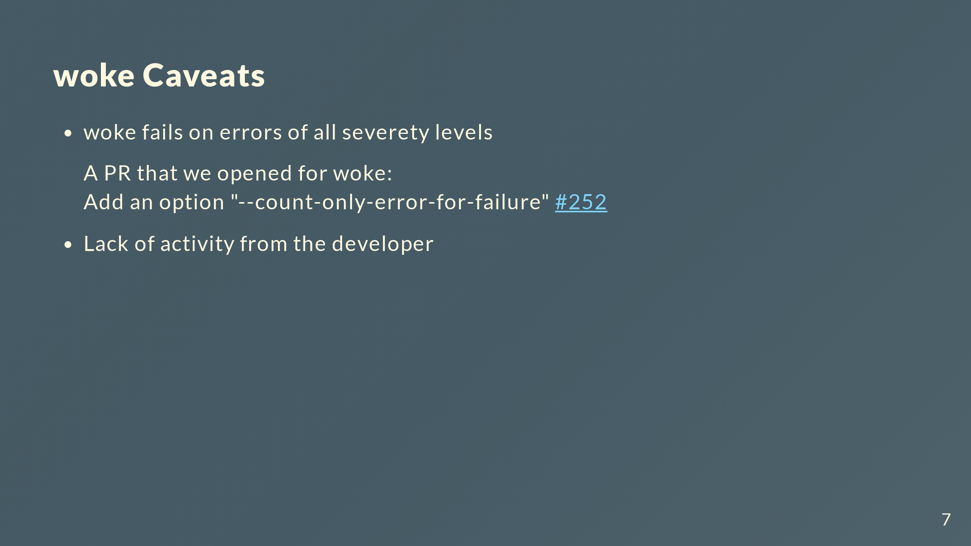

Slide 8
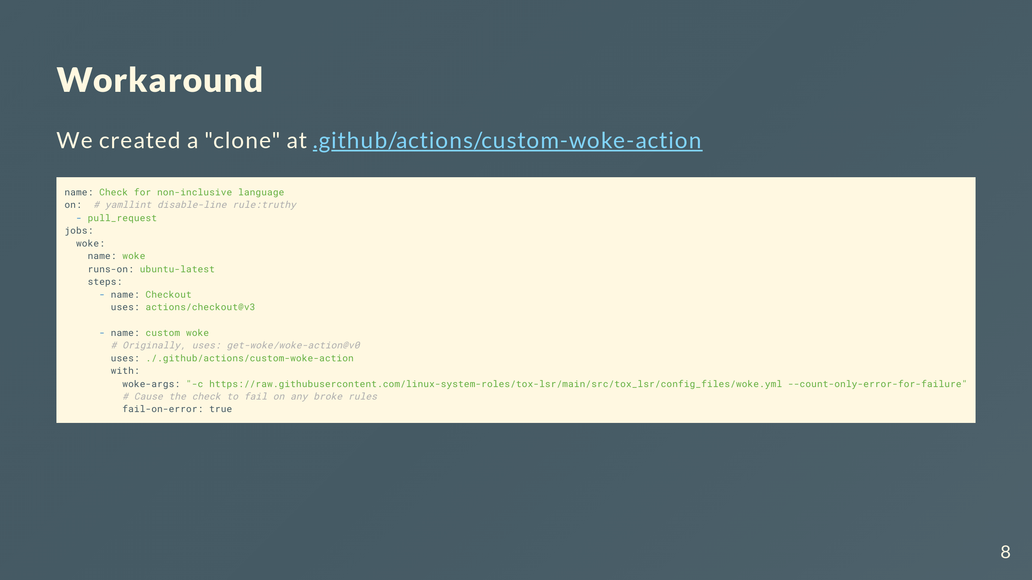

Slide 9
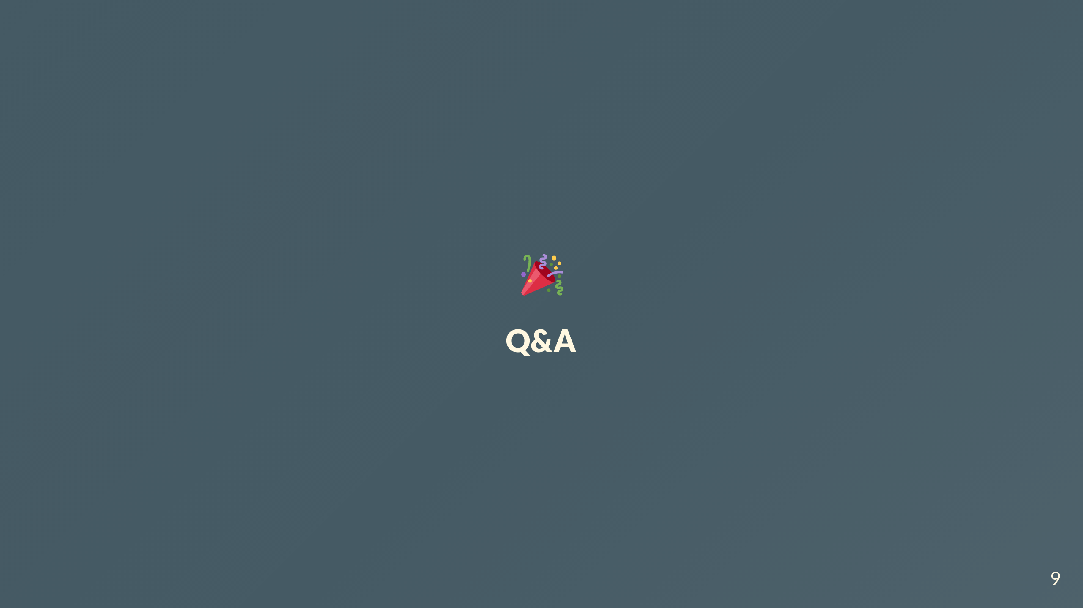

Slide 10
