Slide 1
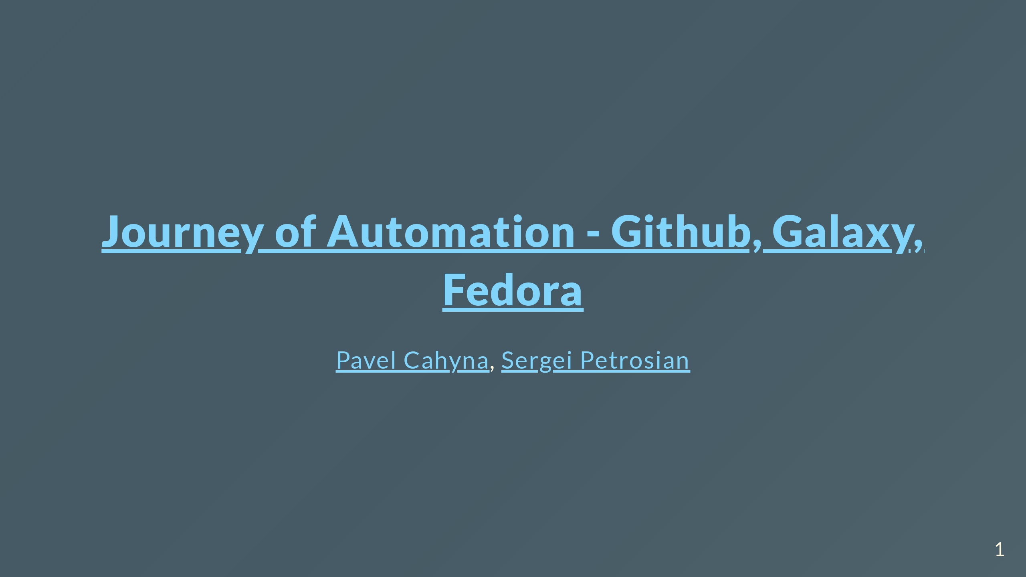

Slide 2
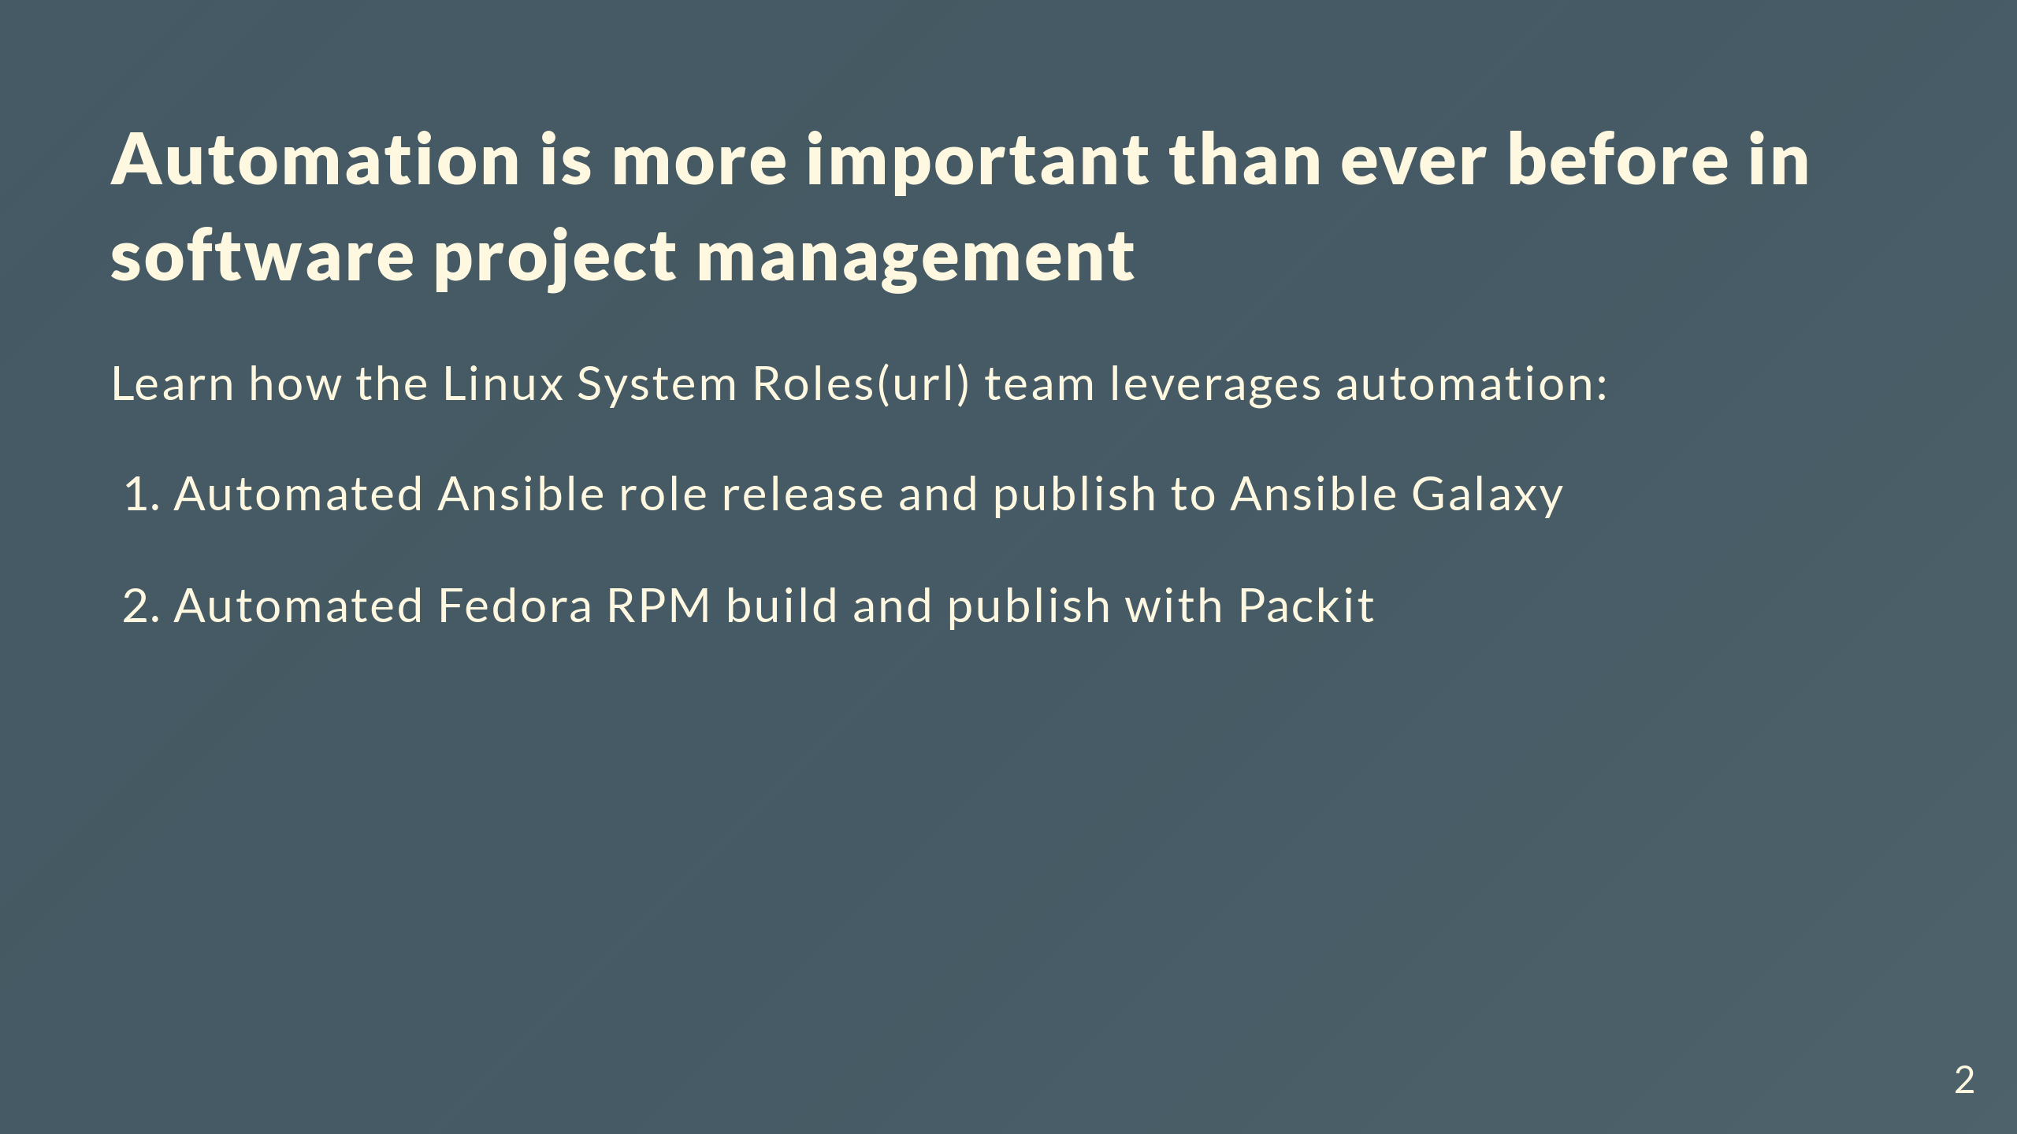
Notes:
Being able to automate the low level, labor intensive parts of project management is critical. There are many tools in the Fedora and Github ecosystems that facilitate project management, such as GitHub workflows, Packit, and more. 2. Automated Ansible collection build, publish and release to Galaxy Comments for the slide for the presenters For slies syntax examples use https://github.com/ralexander-phi/marp-to-pages/blob/main/README.md and https://github.com/spetrosi/jak_psat_moderni_ucebnice/blob/dev/README.md

Slide 3
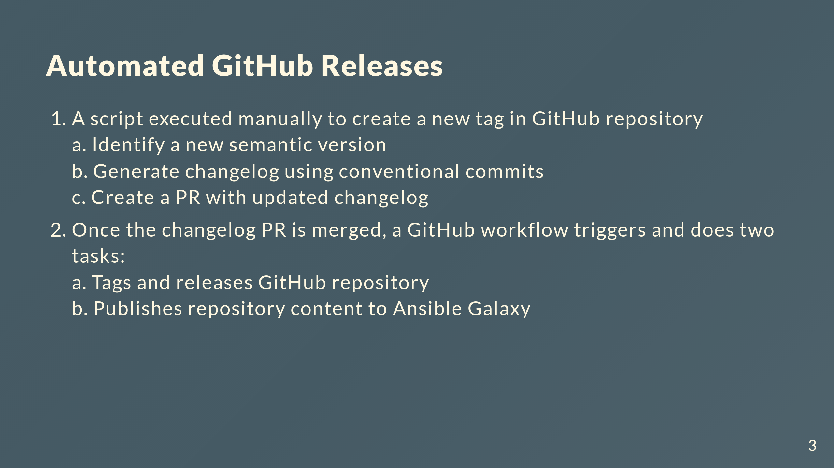
Notes:
3. Cron-like daily GitHub workflow that collects and publishes content from multiple repositories if any repository has an update

Slide 4
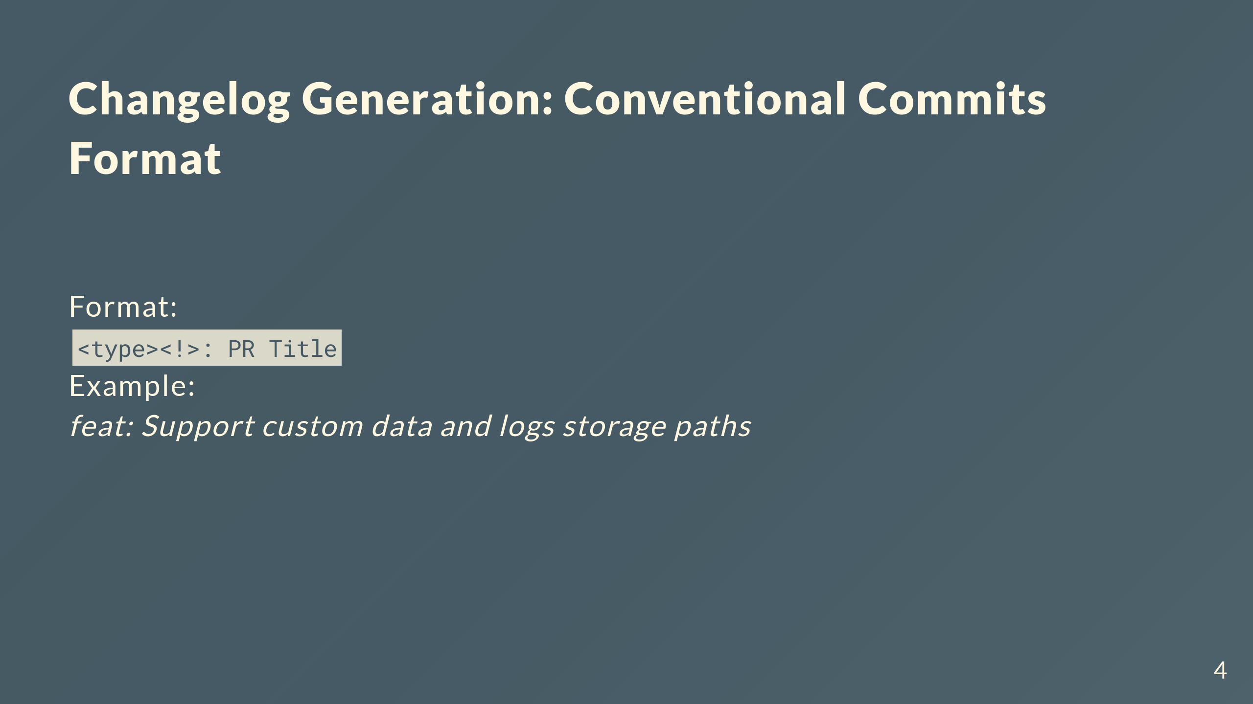

Slide 5
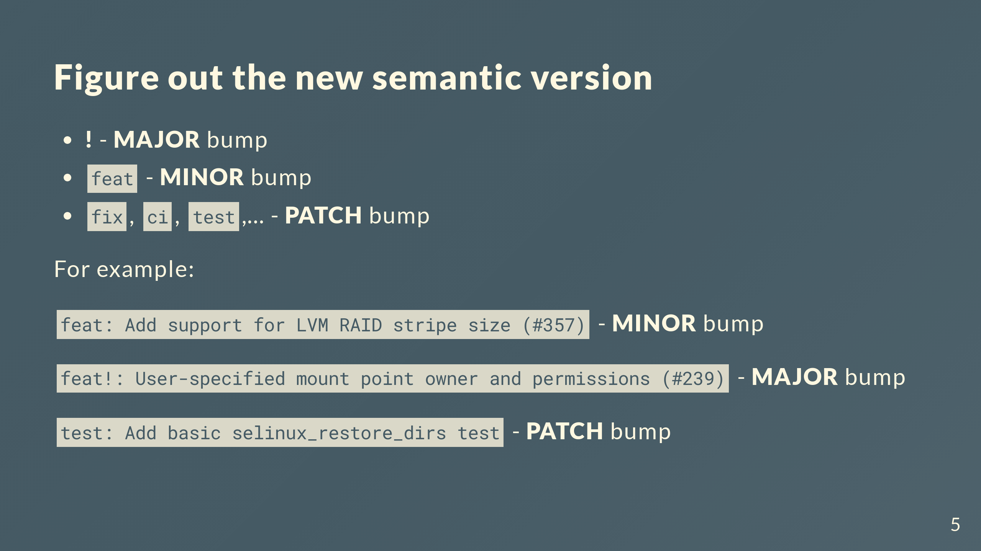

Slide 6
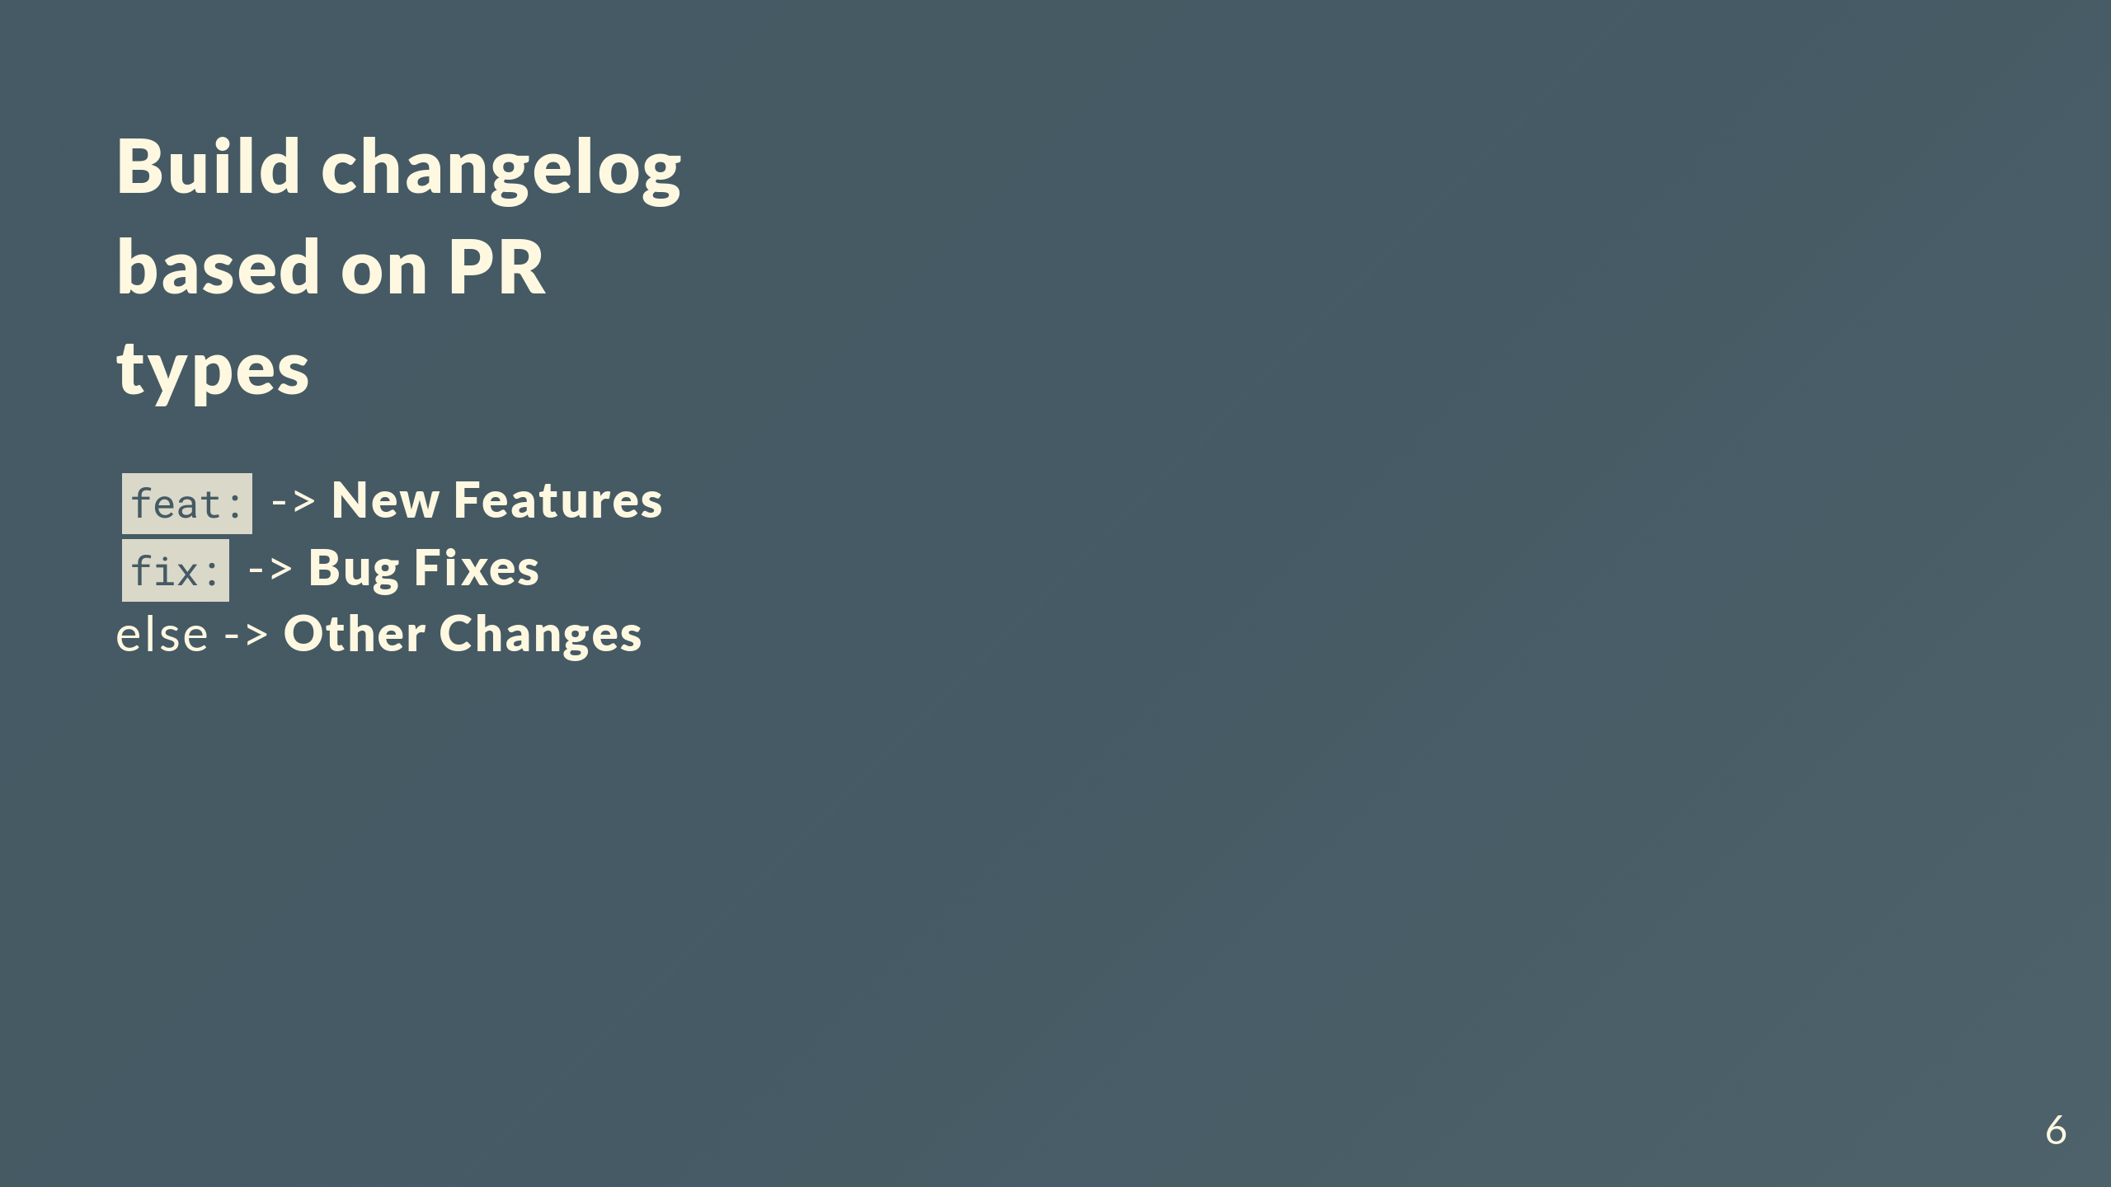
Notes:
![w:600 h:400](img/new_changelog.png)

Slide 7
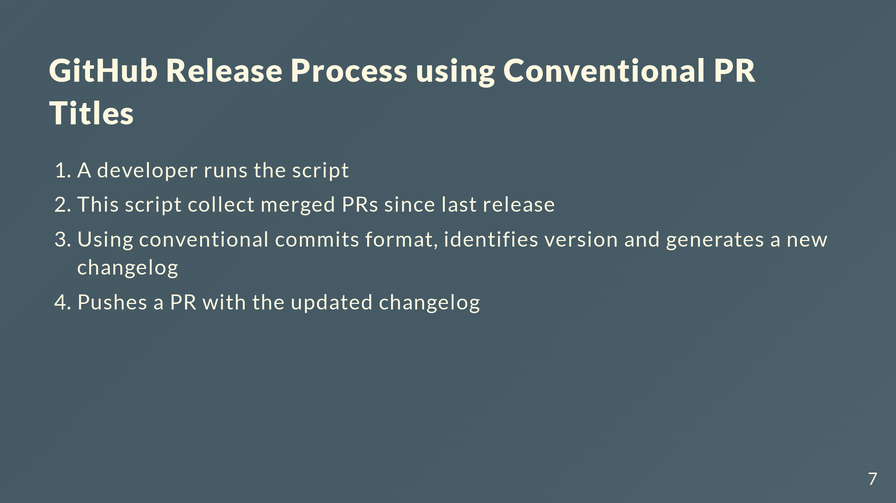

Slide 8
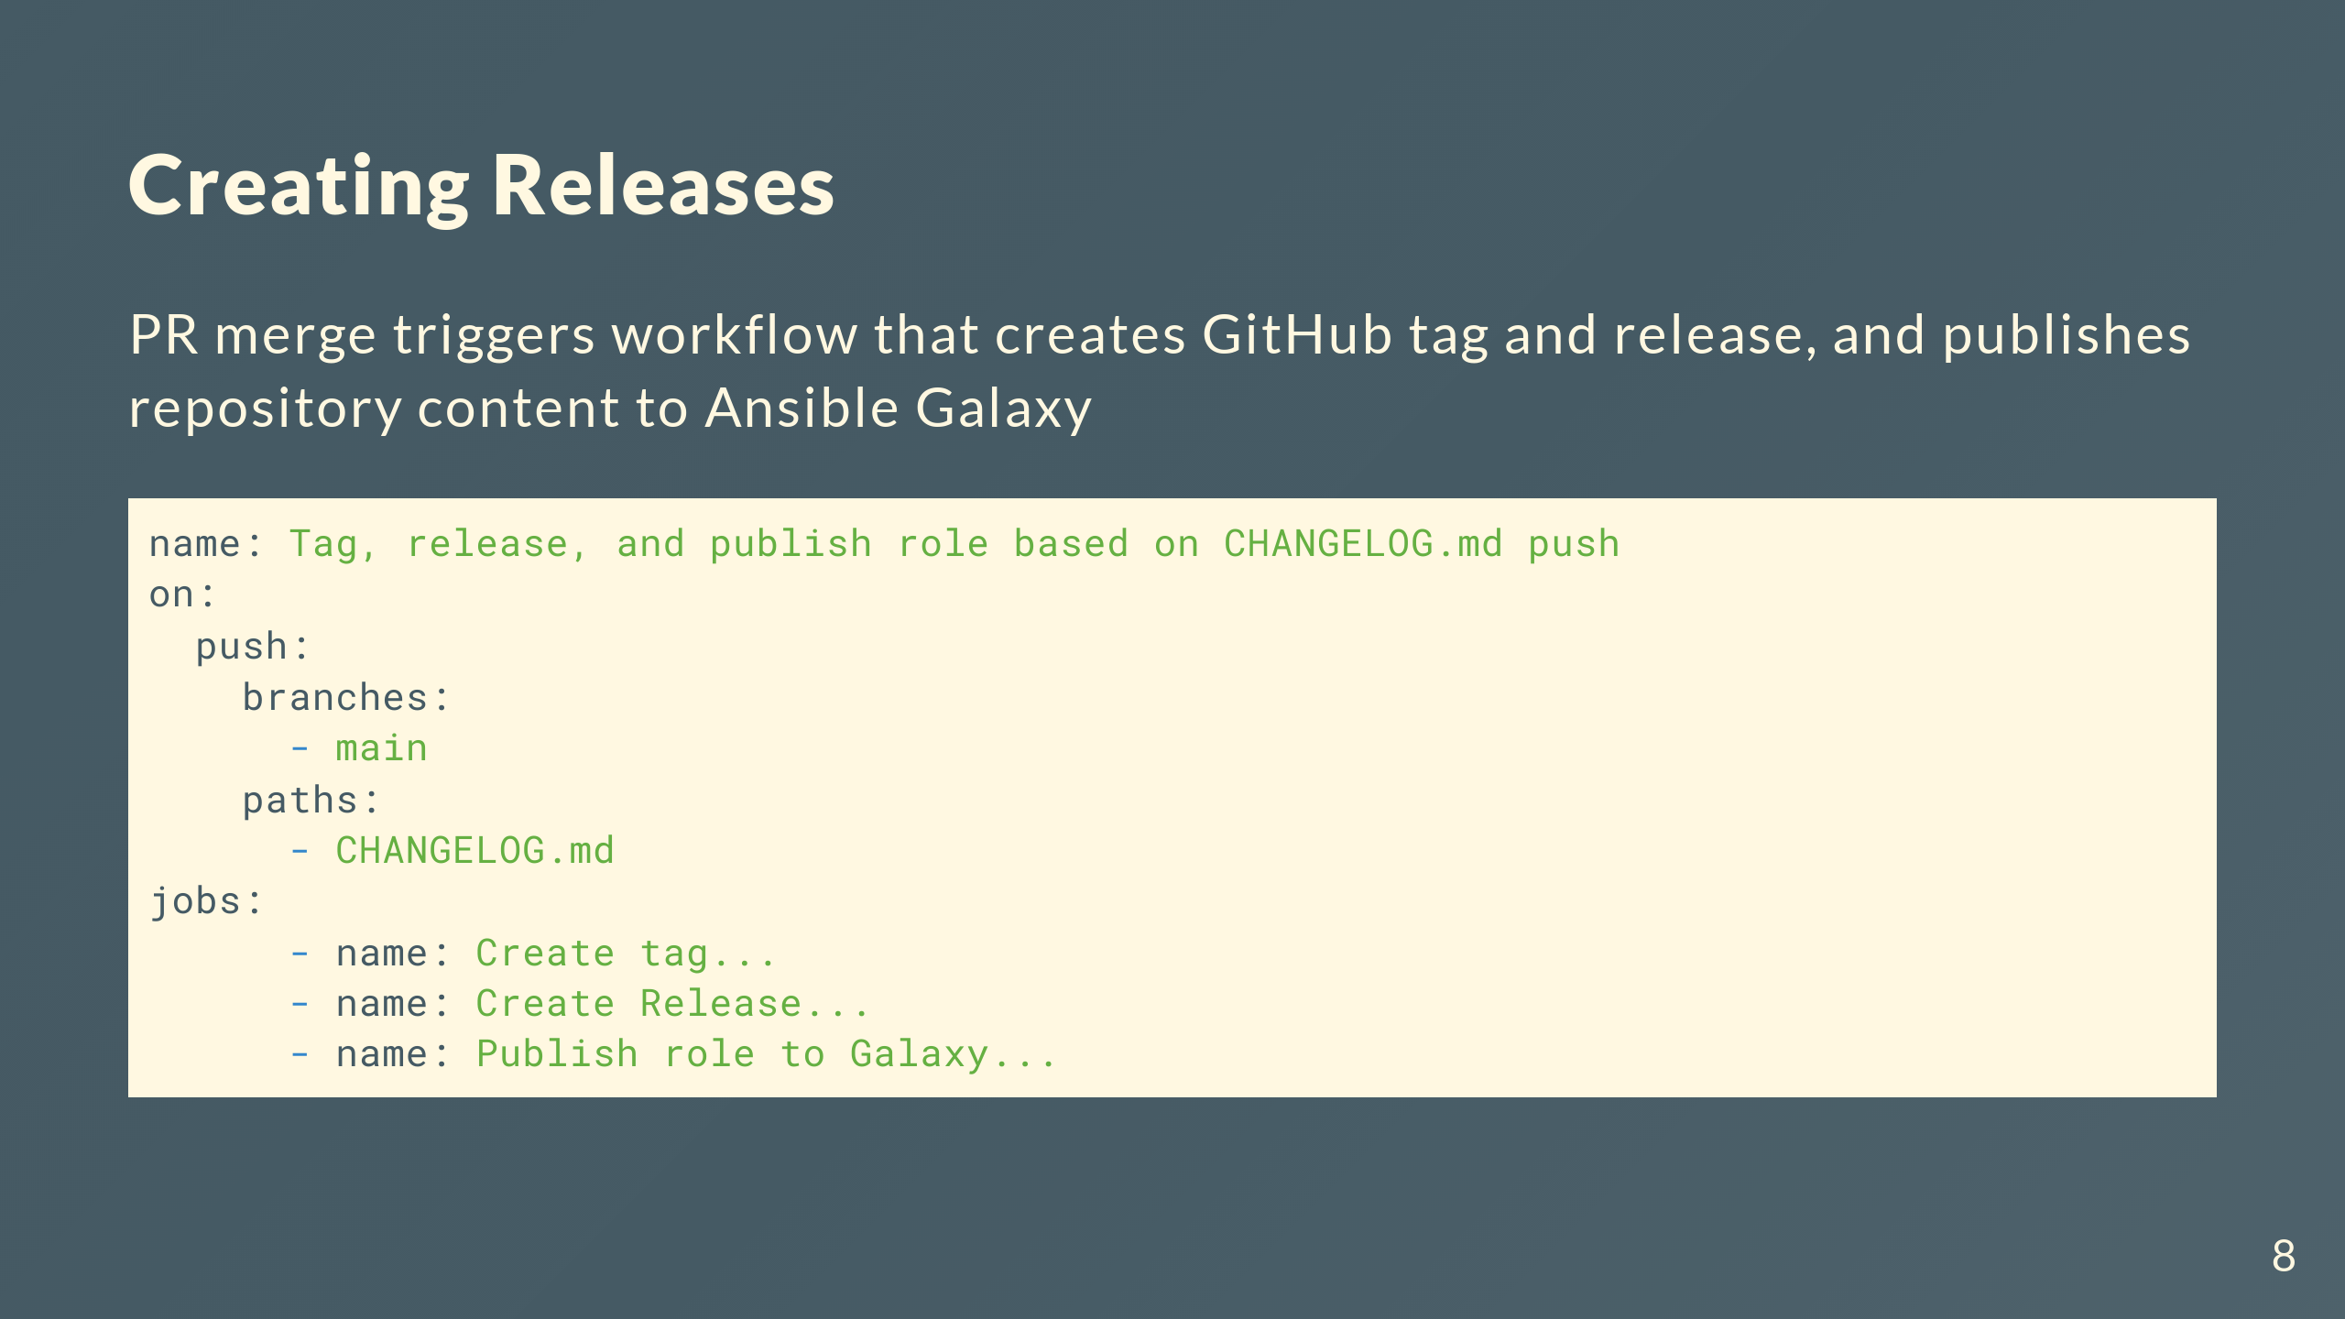

Slide 9
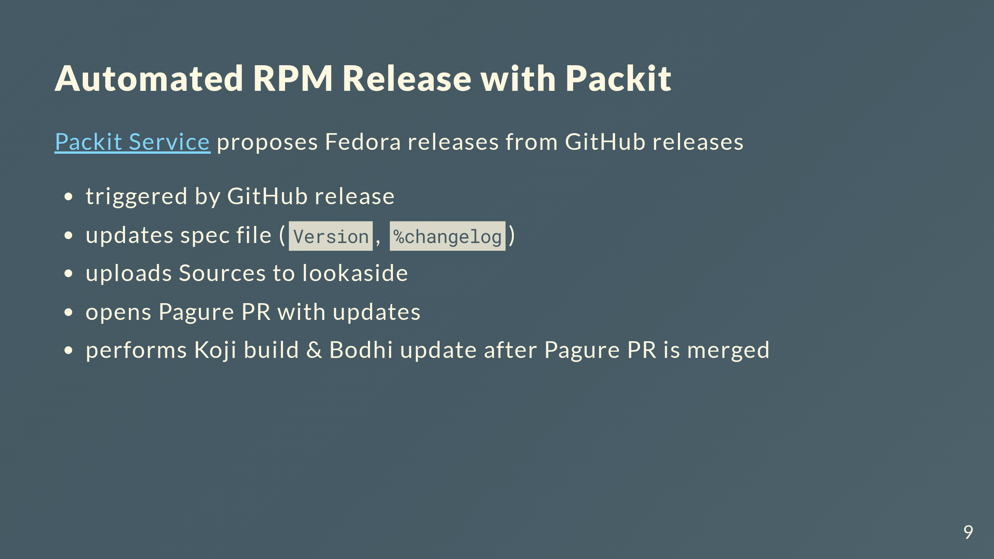

Slide 10
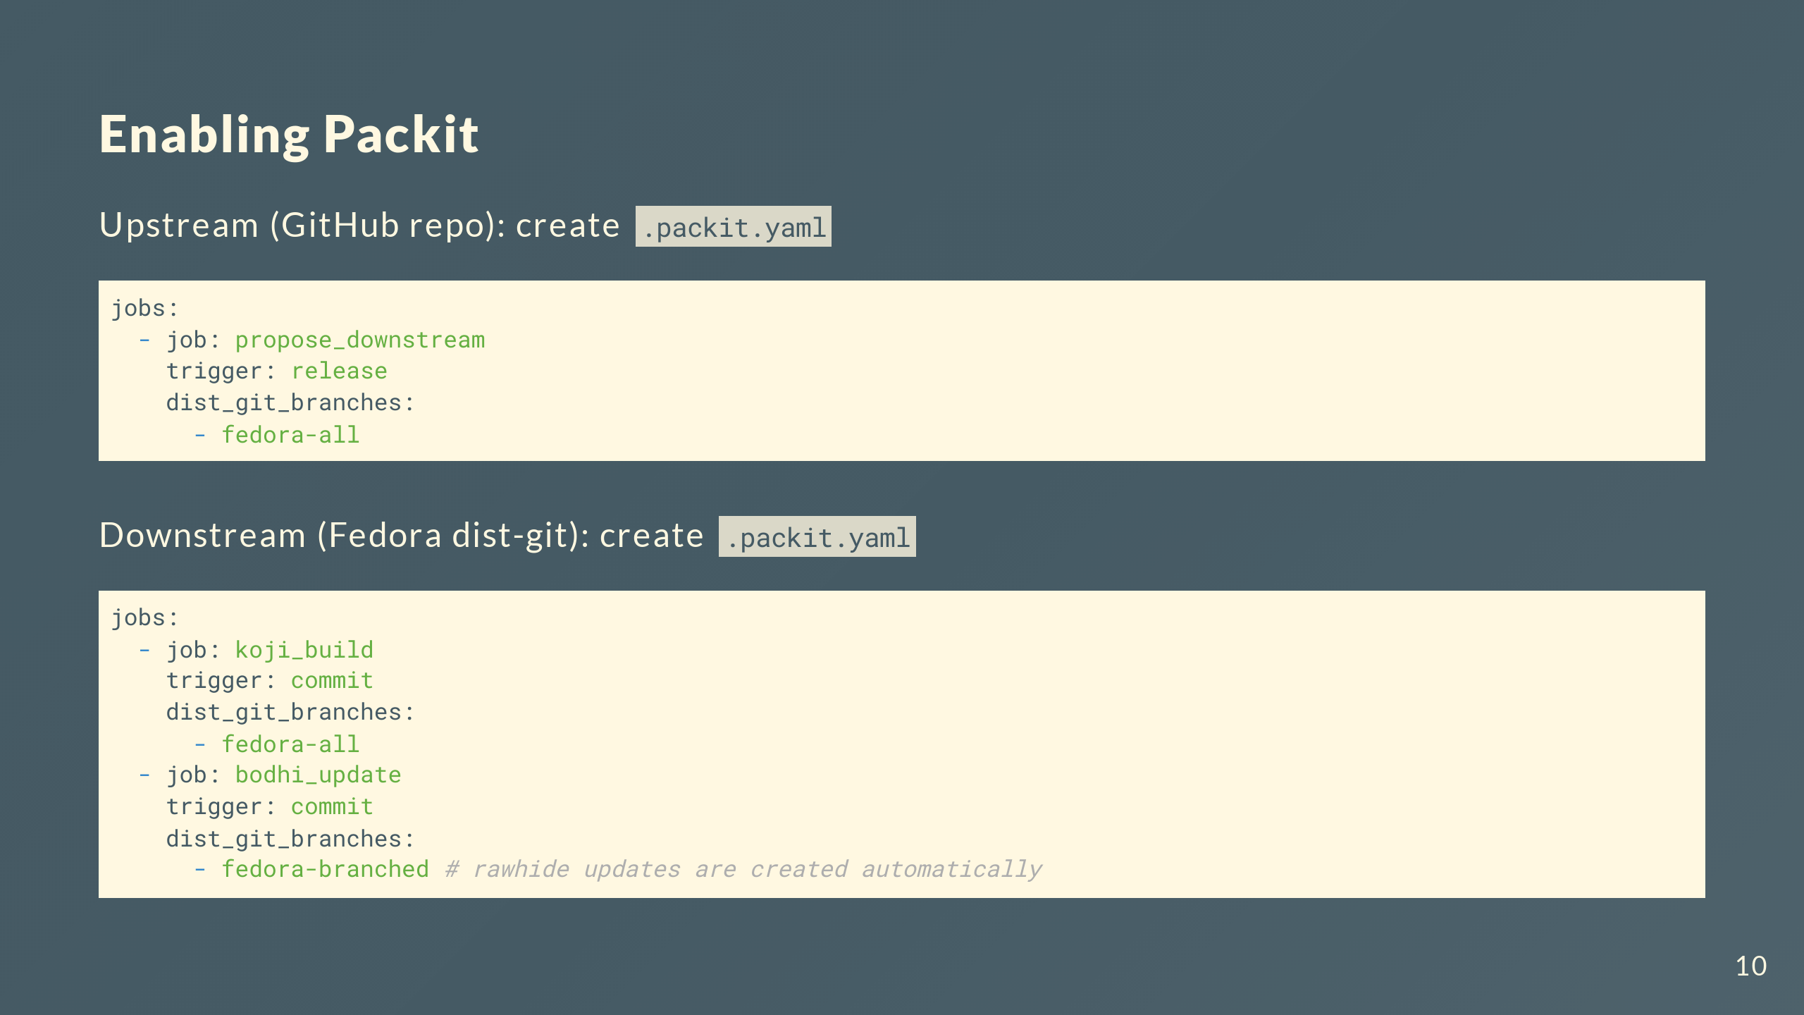

Slide 11
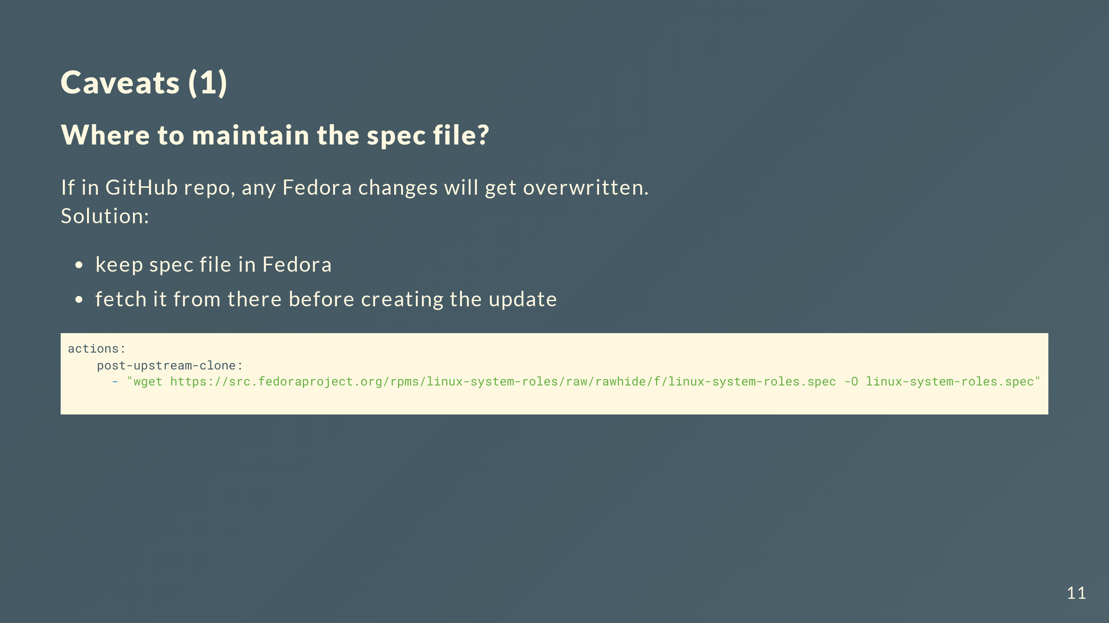

Slide 12
