Slide 1
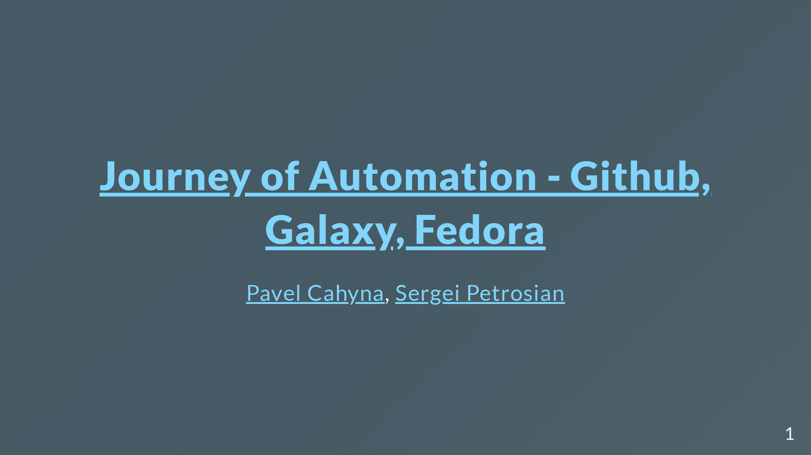

Slide 2
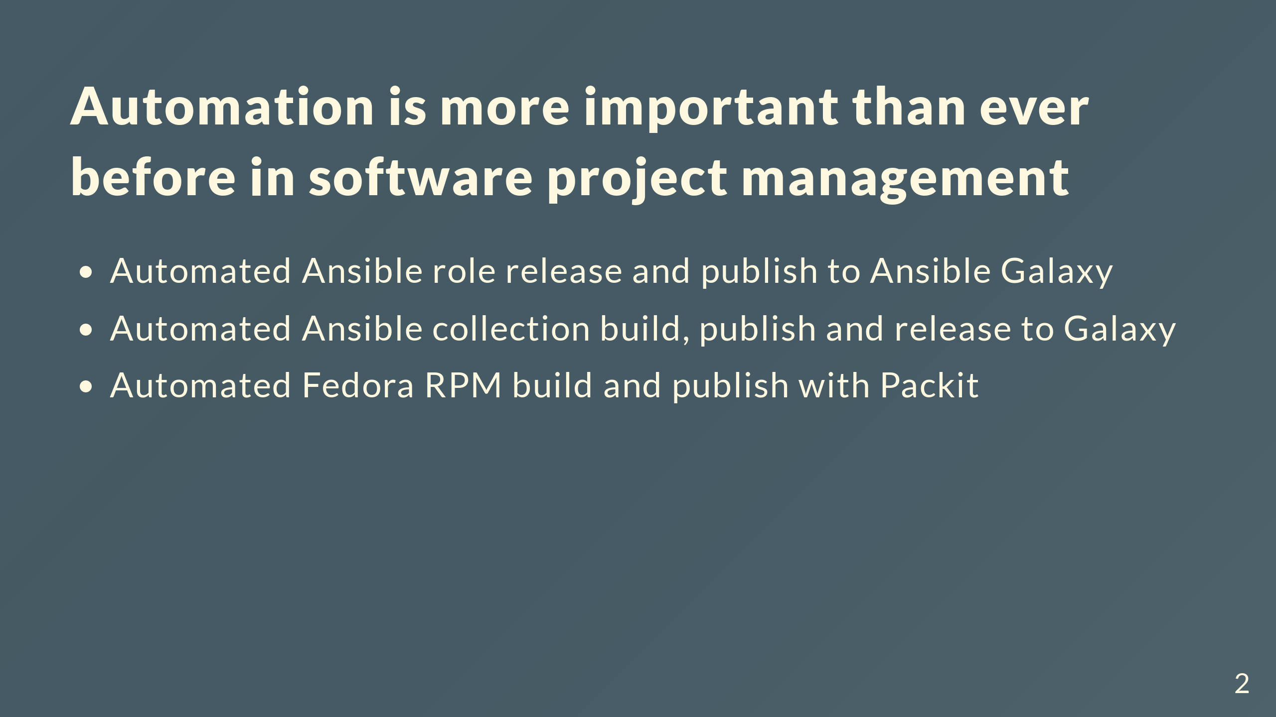
Notes:
Being able to automate the low level, labor intensive parts of project management is critical. There are many tools in the Fedora and Github ecosystems that facilitate project management, such as GitHub Actions, Packit, and more. Learn how the Linux System Roles team leveraged these tools to perform: Comments for the slide for the presenters For slies syntax examples use https://github.com/ralexander-phi/marp-to-pages/blob/main/README.md and https://github.com/spetrosi/jak_psat_moderni_ucebnice/blob/dev/README.md

Slide 3
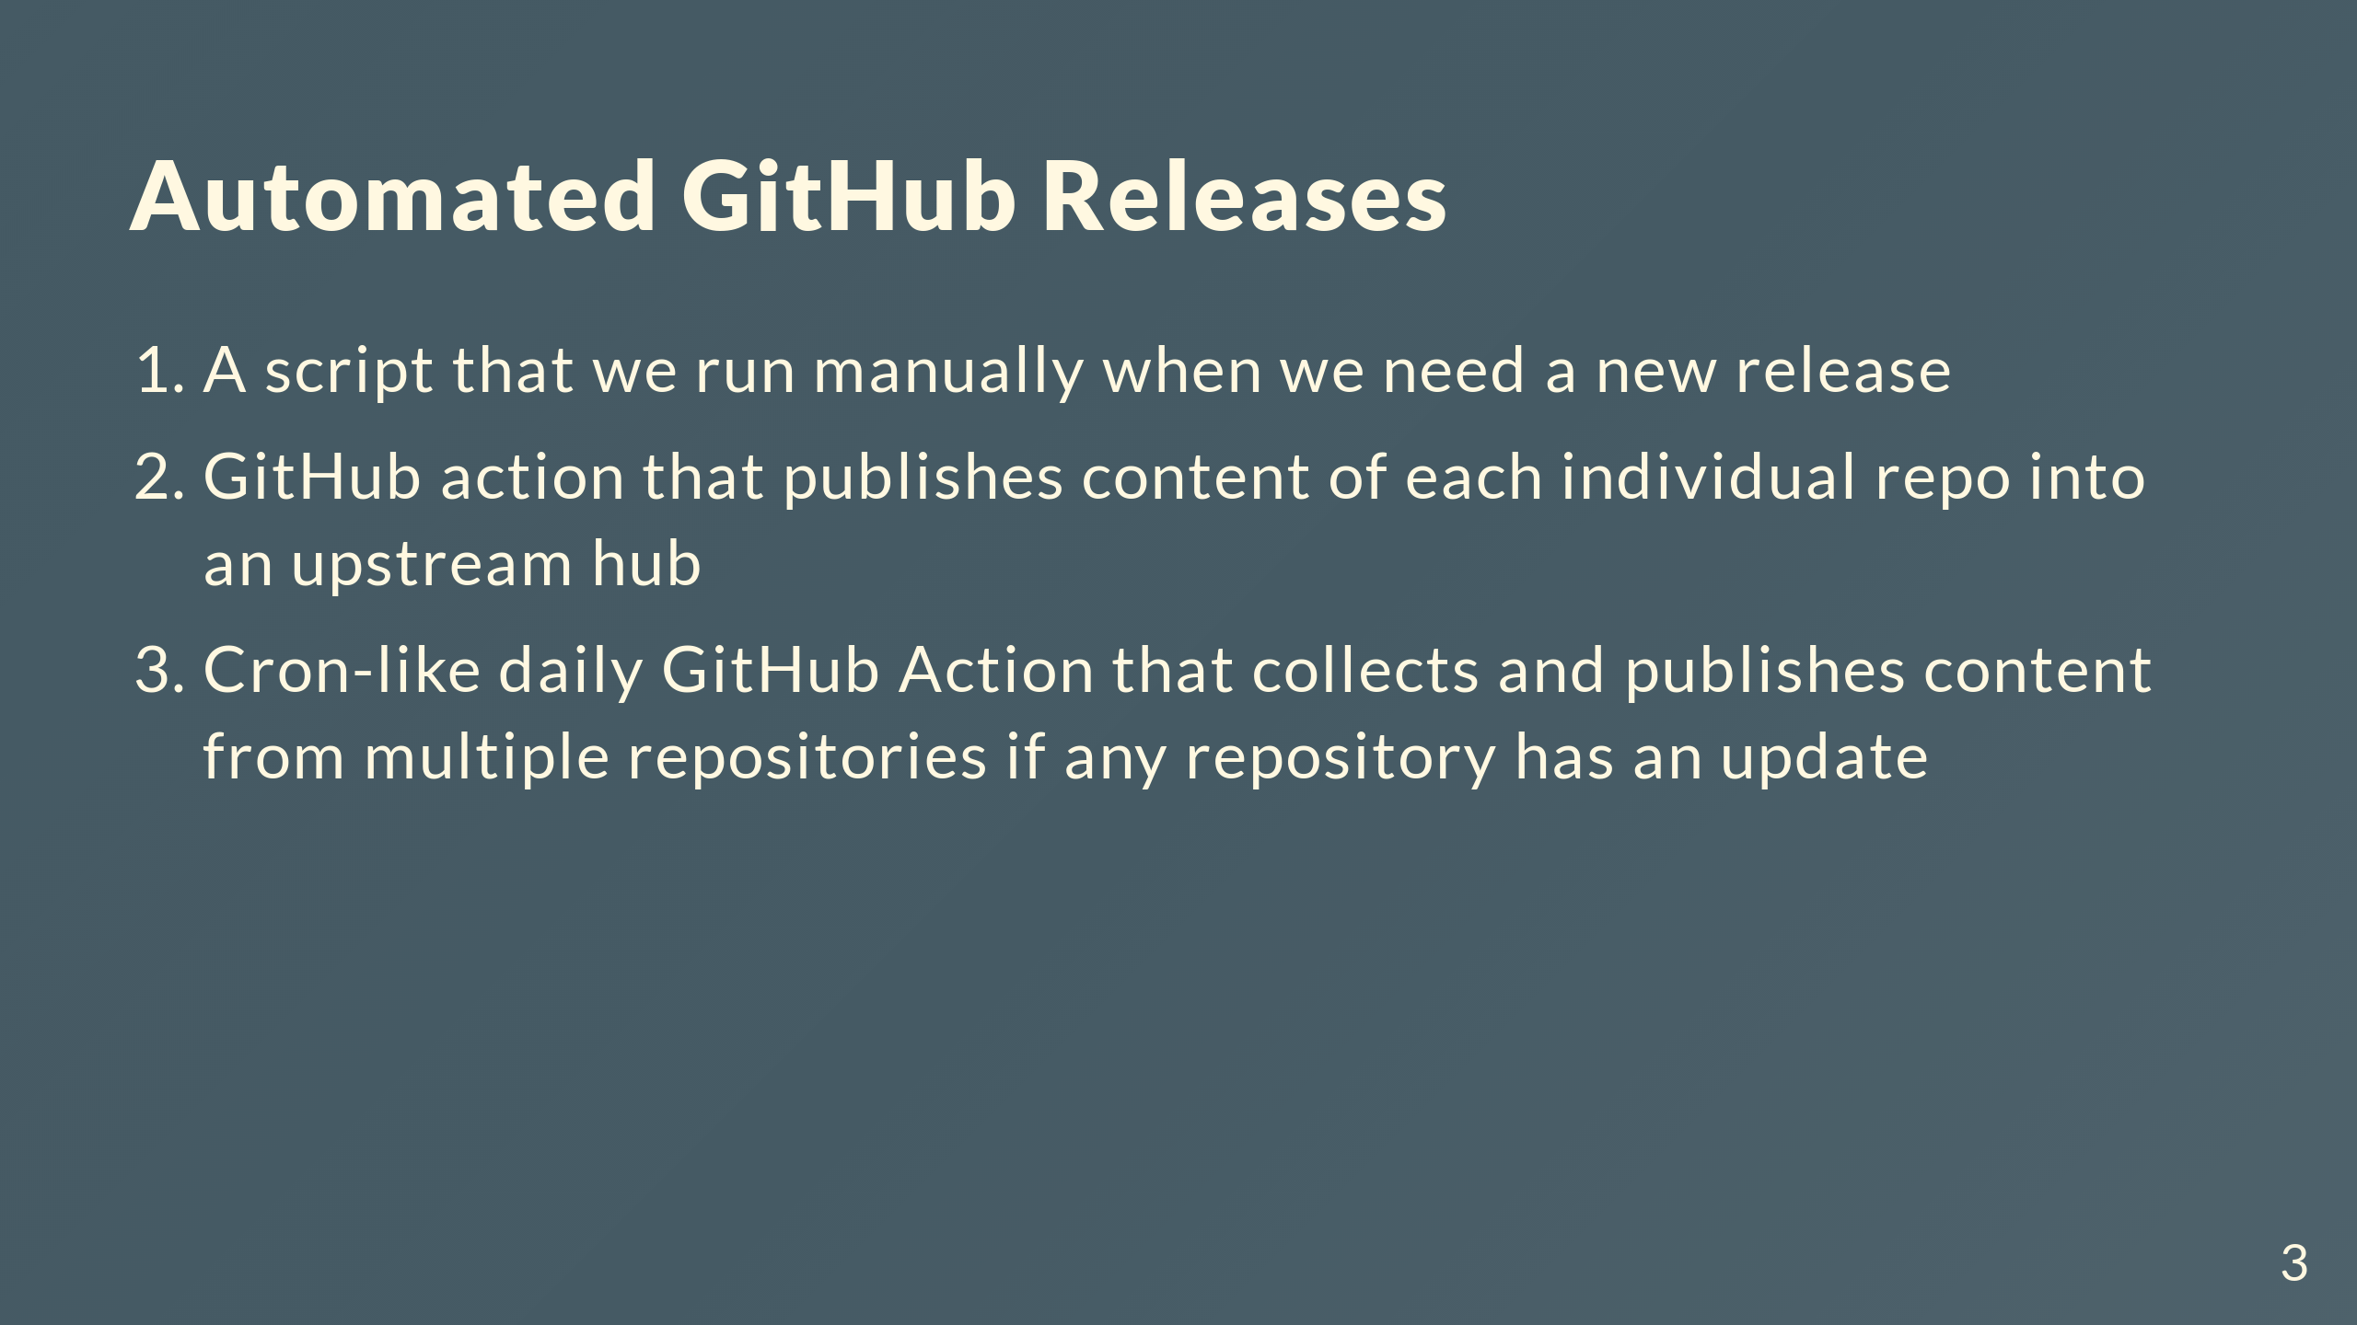

Slide 4
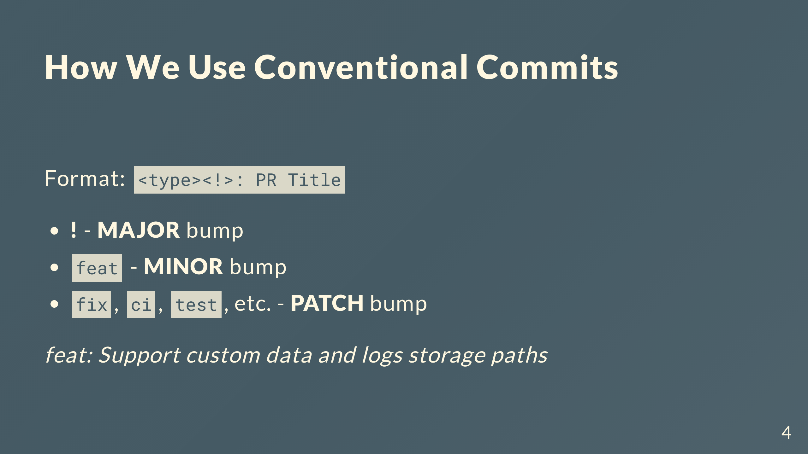

Slide 5
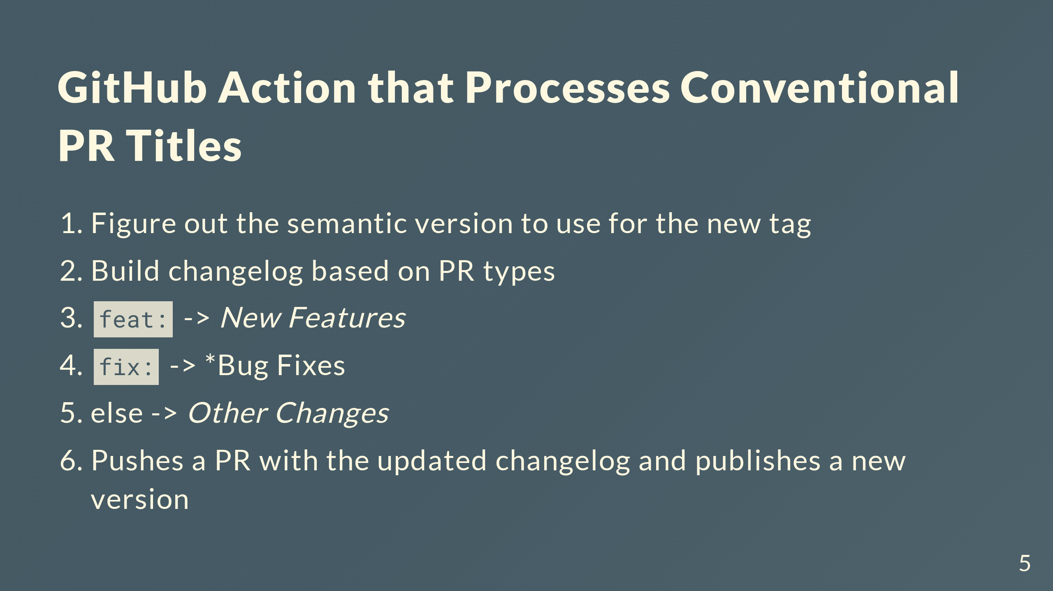
Notes:
We have a GitHub action that we run when we want to create a new release. This action does the following: 3. Pushes a new repository version and tag into GitHub

Slide 6
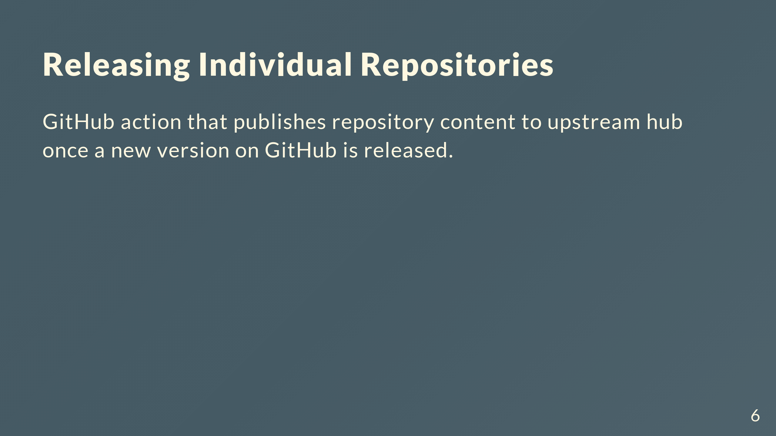
Notes:
In our case, publishes the role to Ansible Galaxy. It can also by PyPi etc.

Slide 7
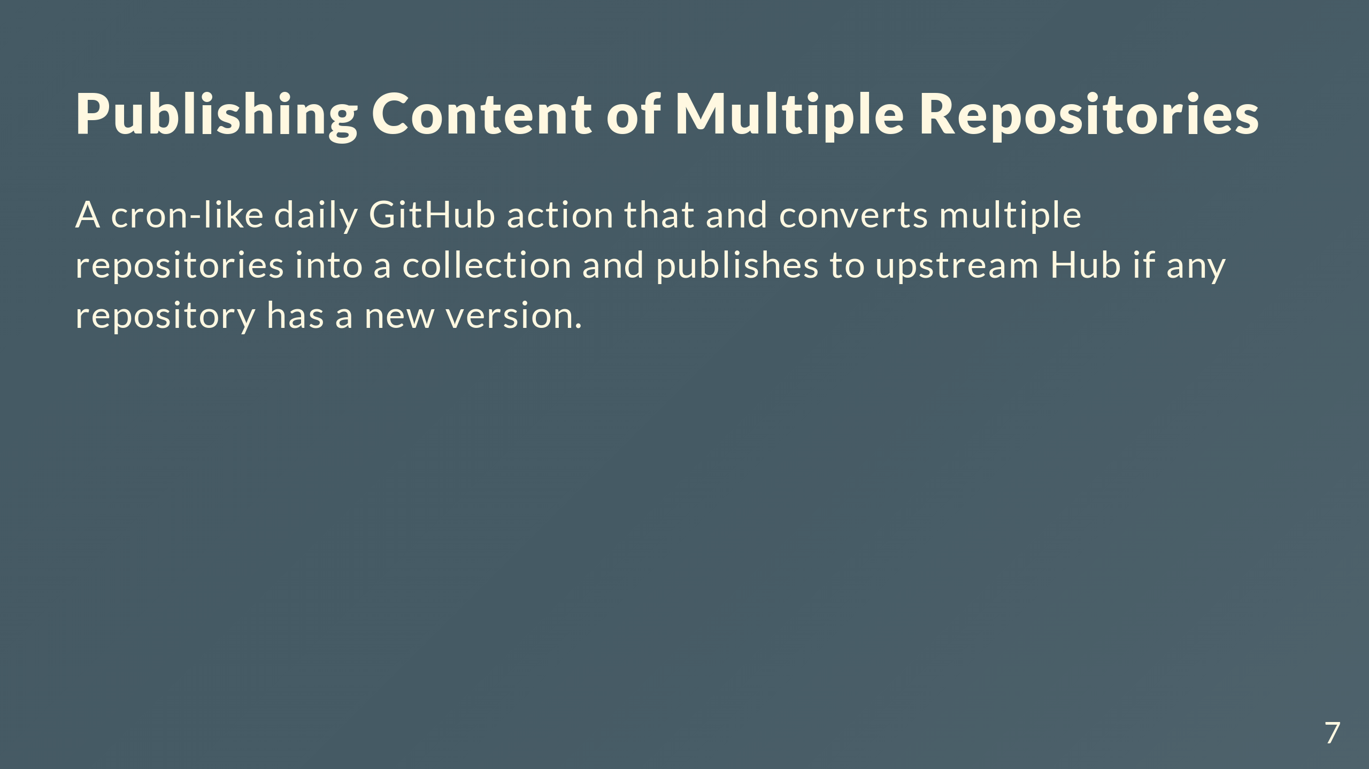
Notes:
In our case, multiple roles are built into a fedora.linux_system_roles collection and published to Galaxy

Slide 8
