Slide 1
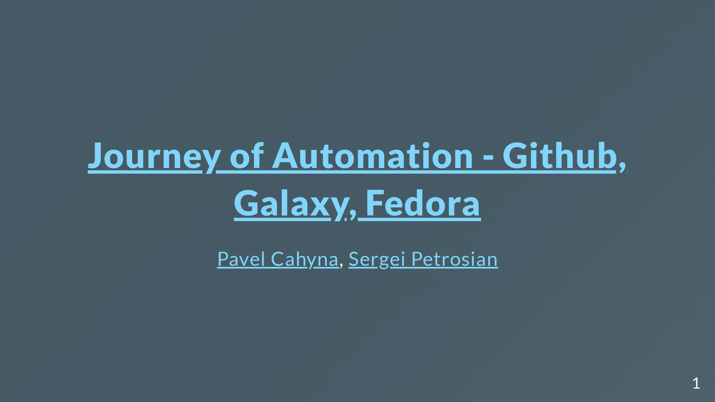

Slide 2
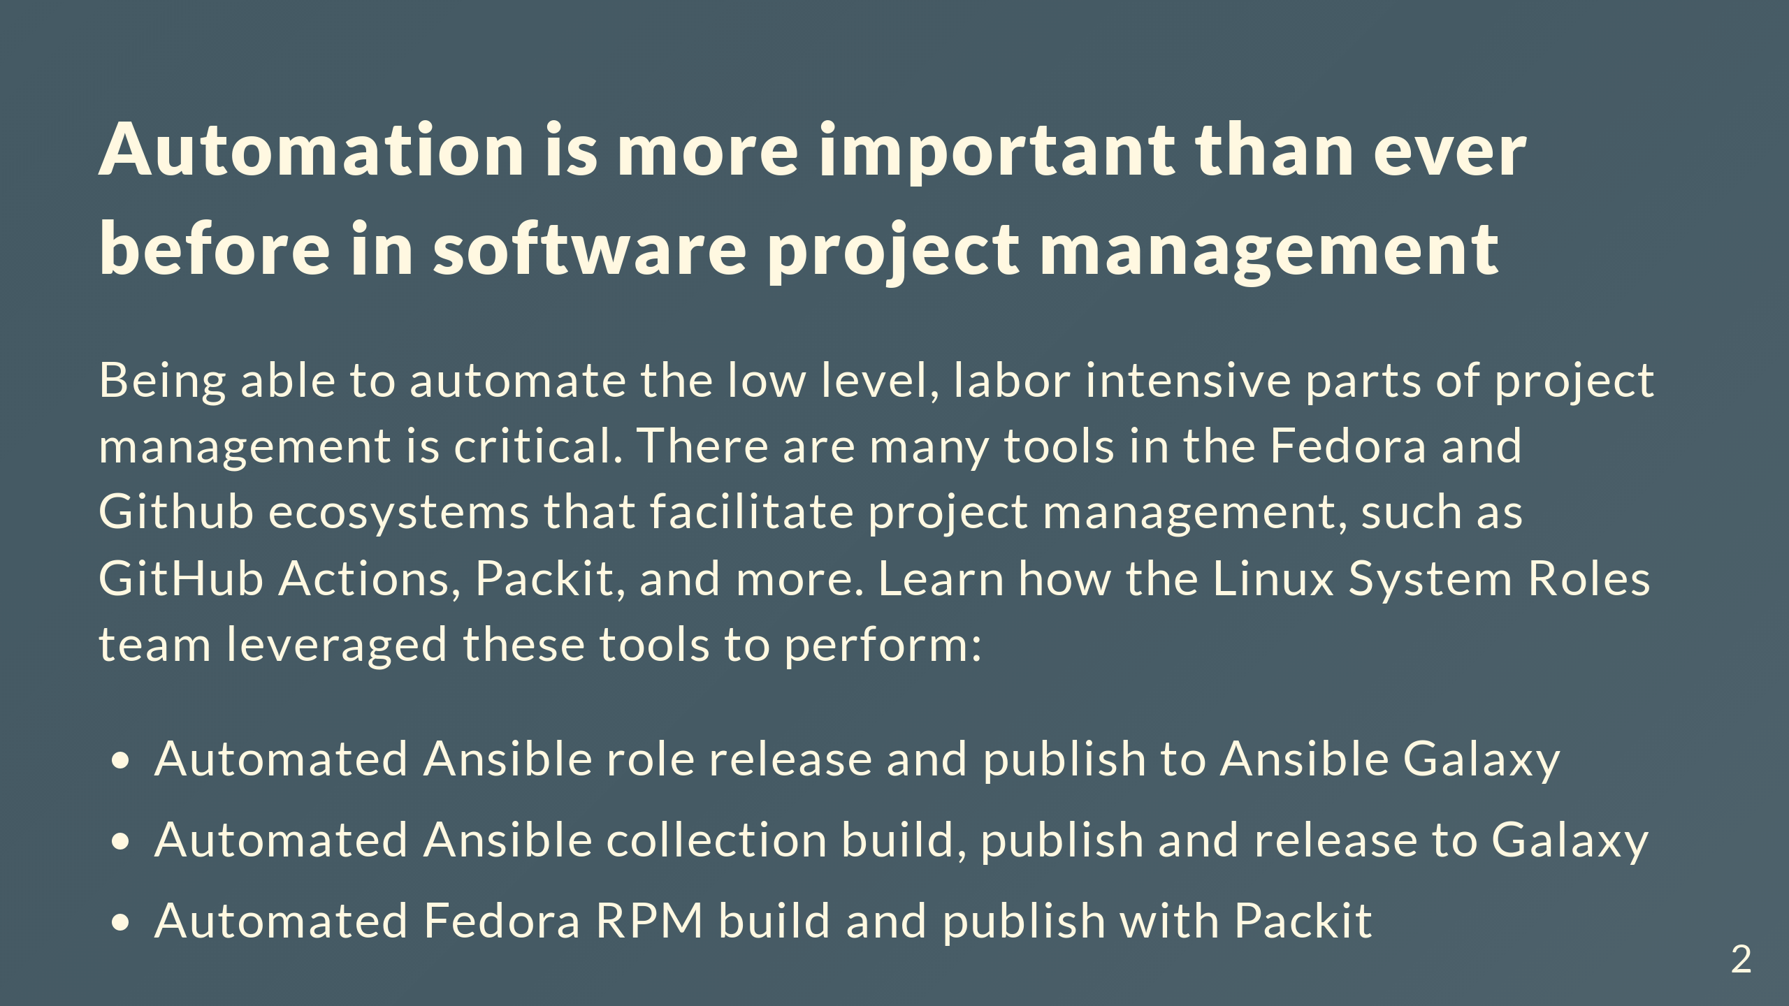
Notes:
Comments for the slide for the presenters For slies syntax examples use https://github.com/ralexander-phi/marp-to-pages/blob/main/README.md and https://github.com/spetrosi/jak_psat_moderni_ucebnice/blob/dev/README.md

Slide 3
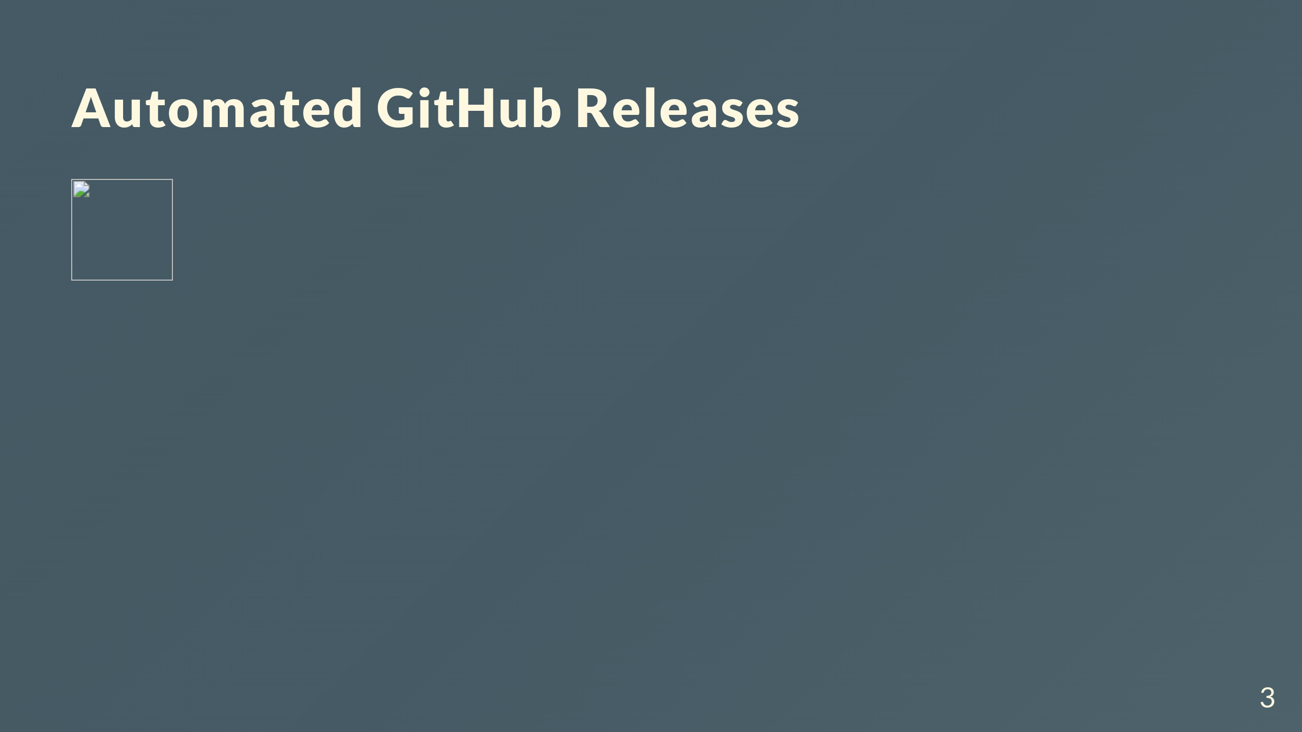

Slide 4
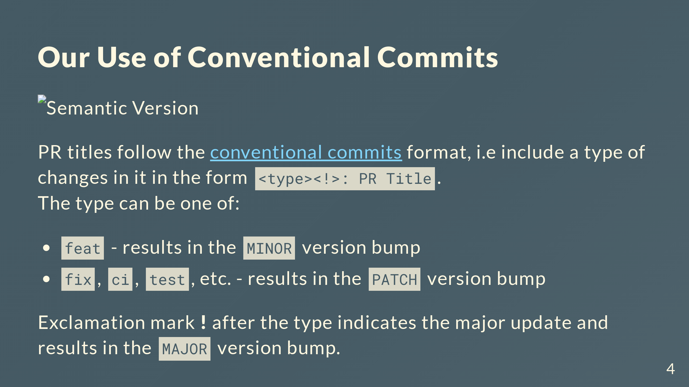
Notes:
Automating Bumping of Semantic Version and Changelog Collection with Conventional Commits

Slide 5
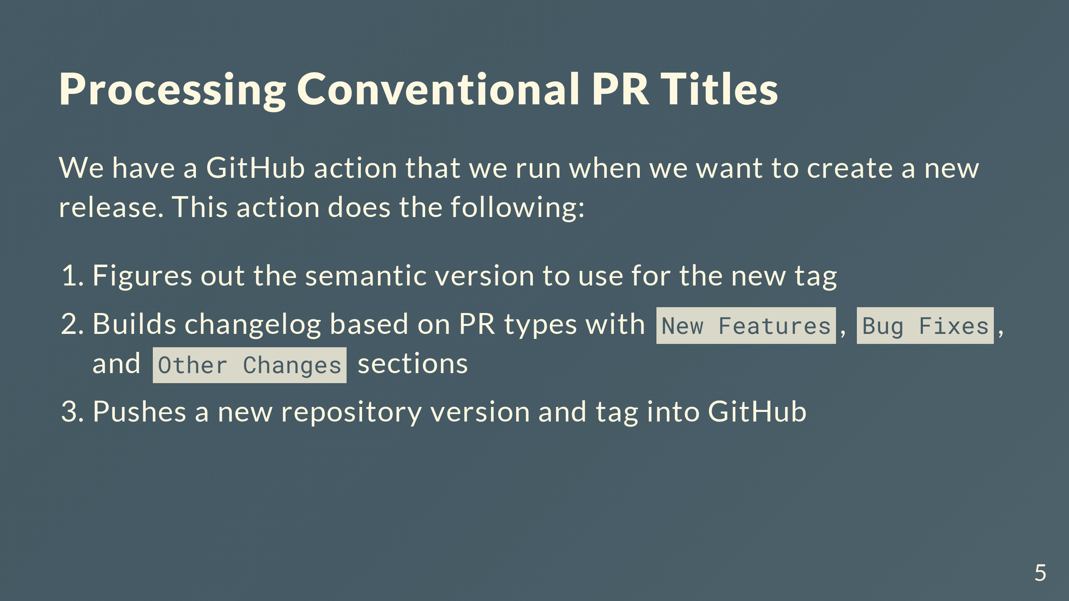

Slide 6
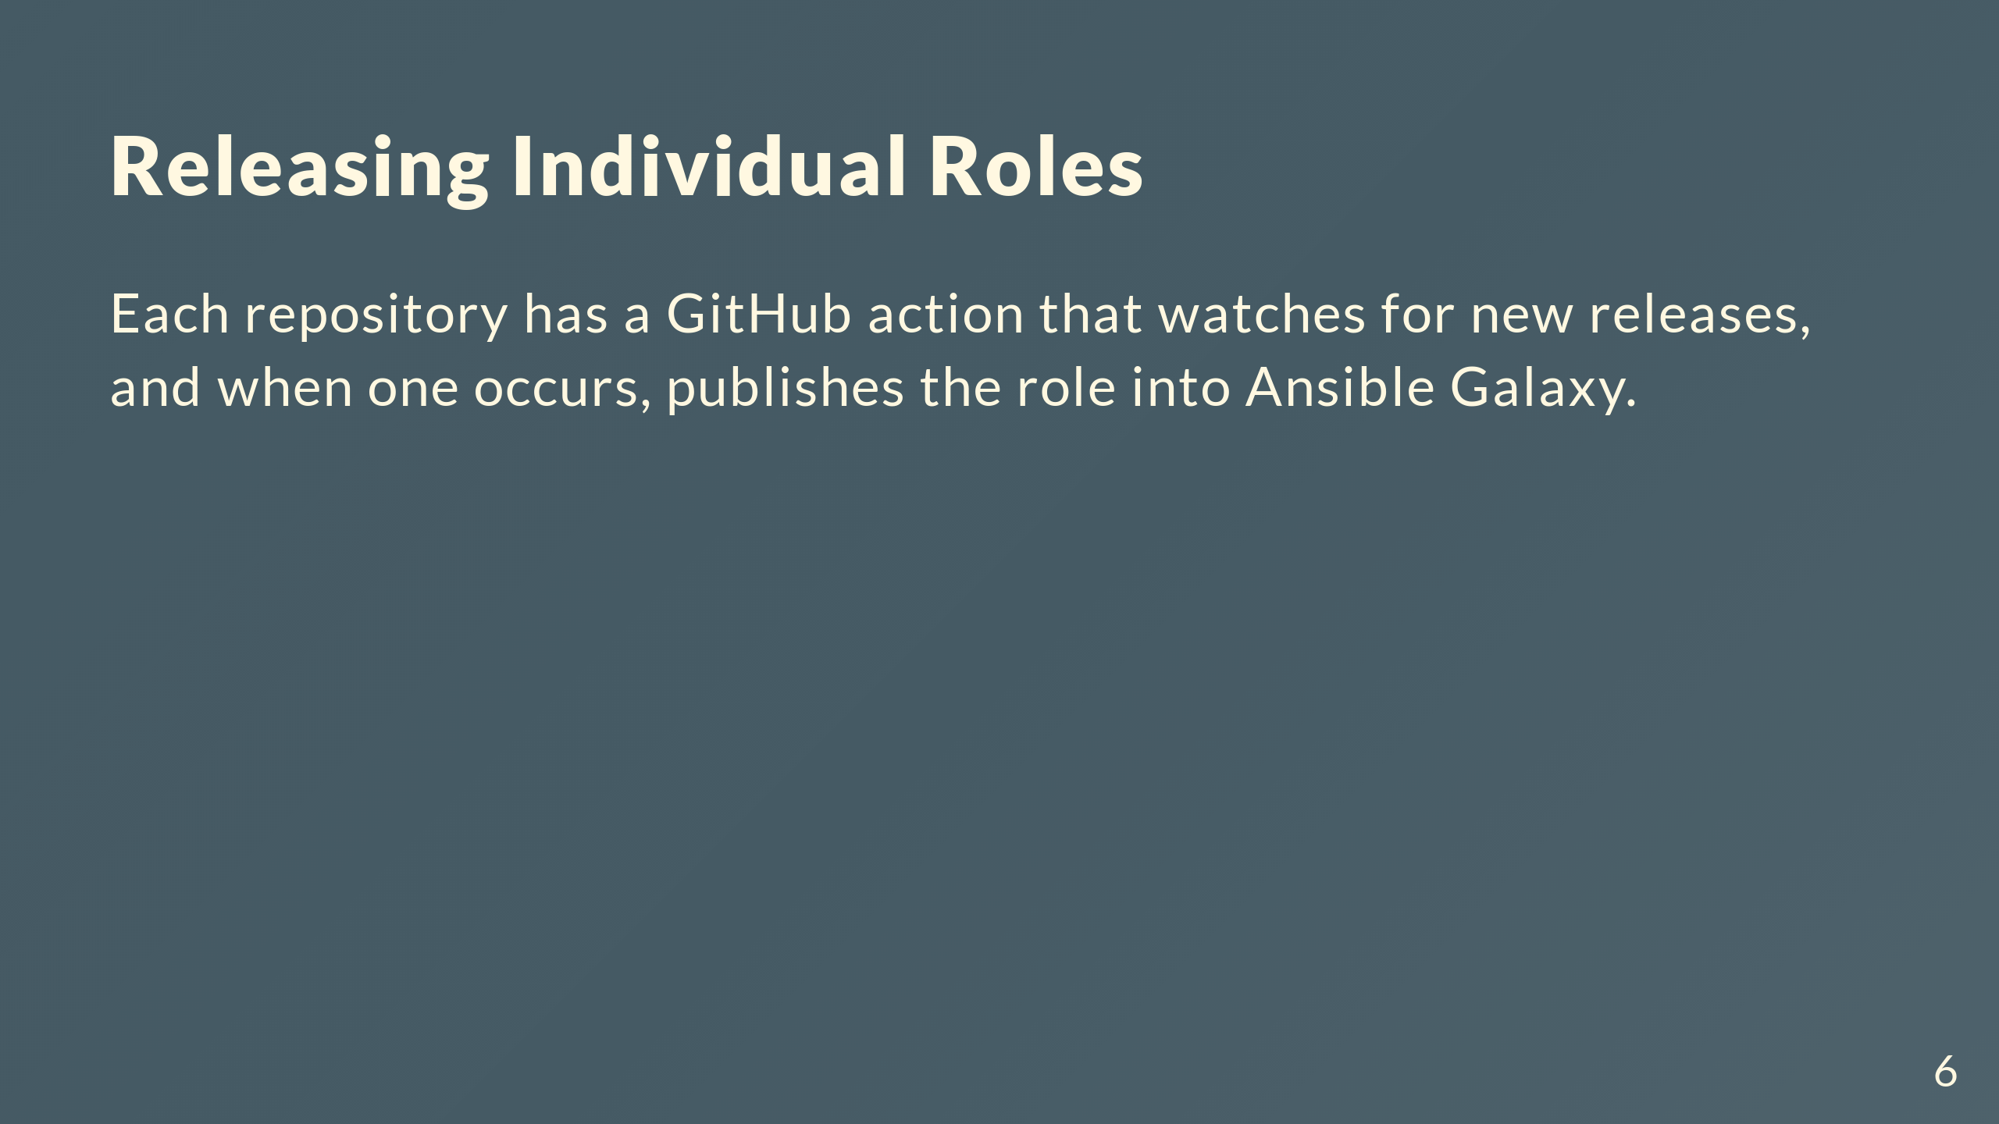

Slide 7
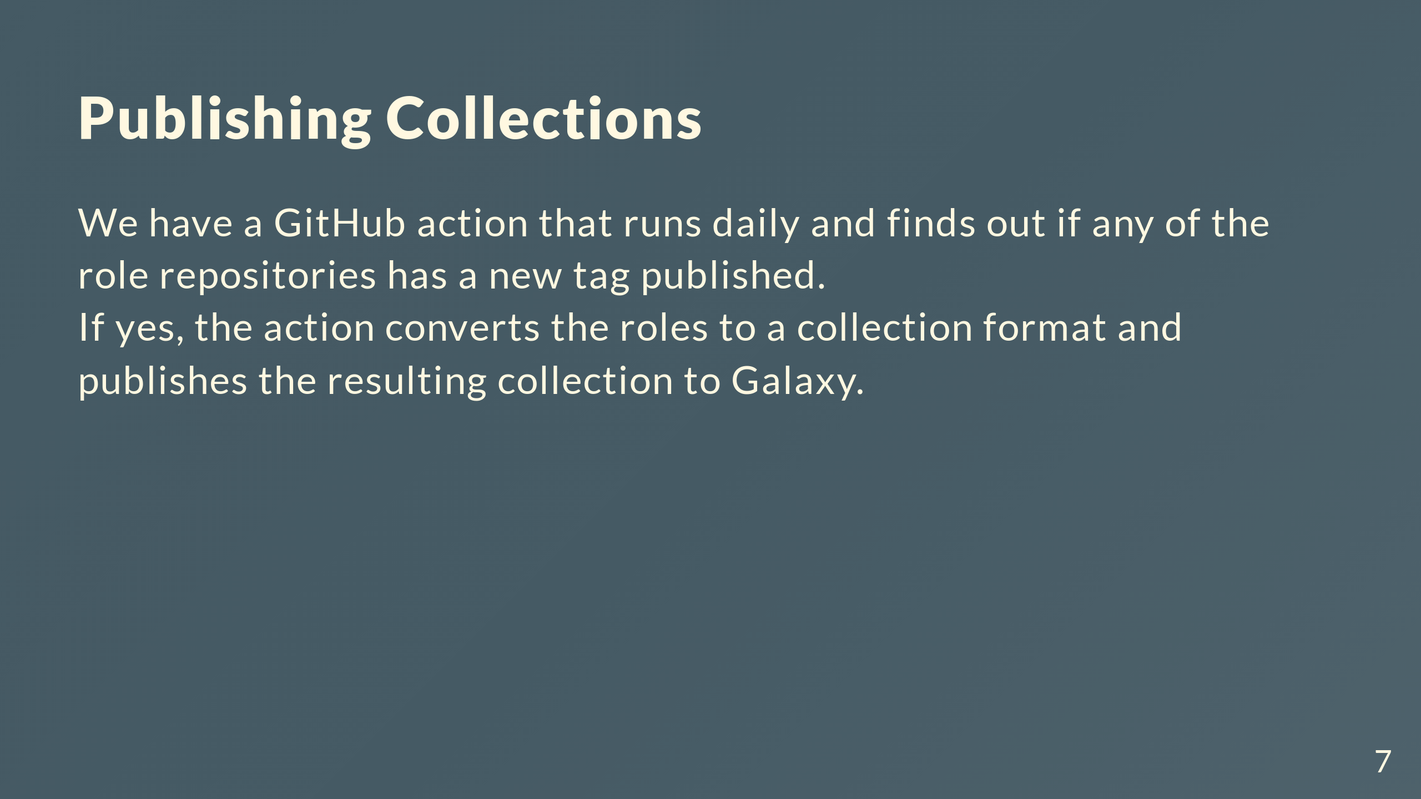

Slide 8
