Slide 1
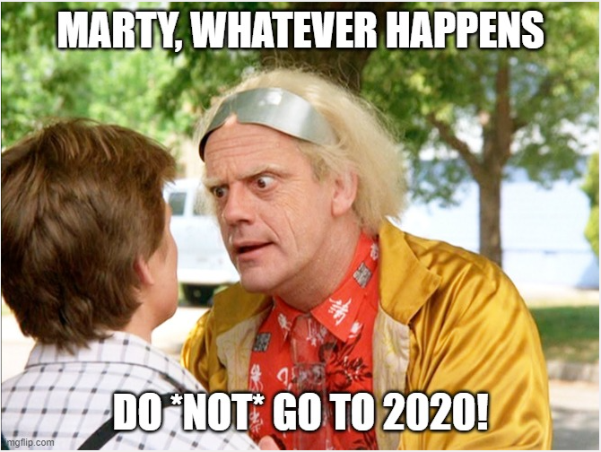
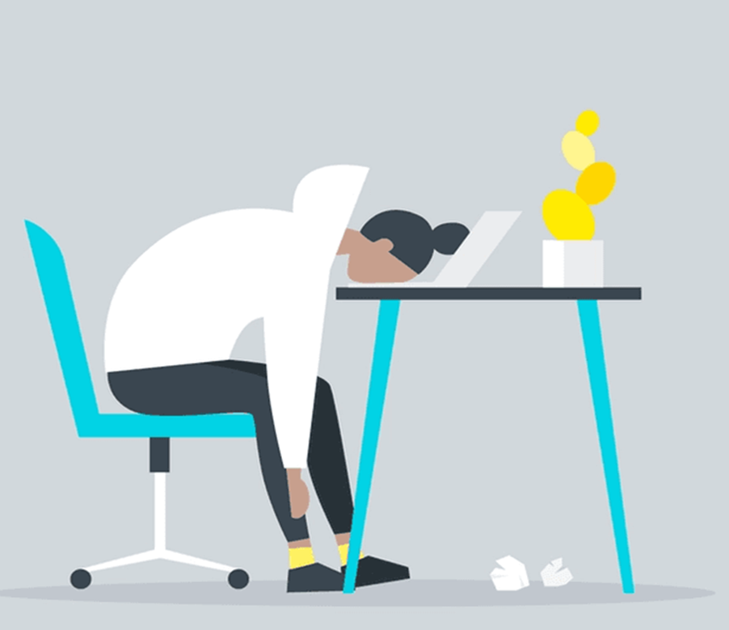

Burnout
It’s more than just a bad day!

Slide 2
Today’s agenda
Burnout
more than just a bad day!
Understanding burnout
Diagnosing and evaluating burnout
Treating / managing burnout

Slide 3
Burnout
more than just a bad day!
Today’s agenda
Understanding burnout
Diagnosing and evaluating burnout
Treating / managing burnout

Slide 4
Burnout
more than just a bad day!
Burnout is a state of
emotional, physical, and mental exhaustion
caused by excessive and prolonged stress
Today’s agenda
Understanding burnout
Diagnosing and evaluating burnout
Treating / managing burnout

Slide 5
Burnout
more than just a bad day!
Burnout is a state of
emotional, physical, and mental exhaustion
caused by excessive and prolonged stress
Pandemic
Inflation
Politics
Job insecurity
Family stress
Deadlines
Adulting
Turnover

