Slide 1

Securing Your API Endpoints A practical guide to API authentication
@spetryjohnson
Notes:
Welcome to "Securing Your API Endpoints!"
This is one of my favorite talks to give and I'm excited to share it with you. Over the next hour I'm going to take you on a journey of discovery, at the conclusion of which you'll leave this room a bit wiser and a bit more knowledgeable than you are right now.

Slide 2

Psst….. I’m hiring!
http://bit.ly/WorkWithSeth
Work from home!*
Solving hard problems!
With smart people!
Who are also great humans!
Who don’t care if you wear pants! (Unless you stand up while on video)
* 1 or 2 face-to-face days per month in Columbus, OH
Notes:
Welcome to “UI Tests Are Fun To Write (If You Write Them Right)”.
This talk is the story of my team's struggle with UI testing over the past 6 years.
Personally, I've been writing tests of some kind or another for over 14 years, and for most of those years I've held the opinion that UI tests…

Slide 3
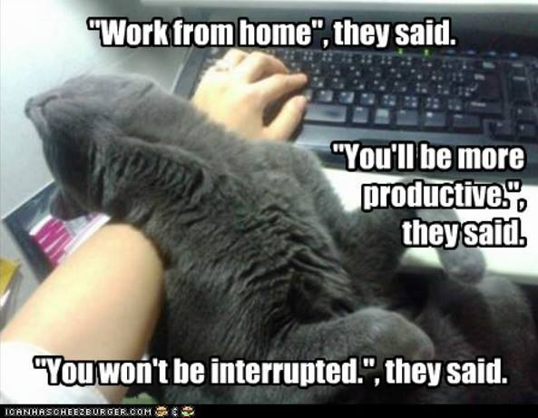
Psst….. I’m hiring!
http://bit.ly/WorkWithSeth
Work from home!*
Solving hard problems!
With smart people!
Who are also great humans!
Who don’t care if you wear pants! (Unless you stand up while on video)
* 1 or 2 face-to-face days per month in Columbus, OH
Notes:
Welcome to “UI Tests Are Fun To Write (If You Write Them Right)”.
This talk is the story of my team's struggle with UI testing over the past 6 years.
Personally, I've been writing tests of some kind or another for over 14 years, and for most of those years I've held the opinion that UI tests…

Slide 4

Psst….. I’m hiring!
http://bit.ly/WorkWithSeth
Work from home!*
Solving hard problems!
With smart people!
Who are also great humans!
Who don’t care if you wear pants! (Unless you stand up while on video)
* 1 or 2 face-to-face days per month in Columbus, OH
Notes:
Welcome to “UI Tests Are Fun To Write (If You Write Them Right)”.
This talk is the story of my team's struggle with UI testing over the past 6 years.
Personally, I've been writing tests of some kind or another for over 14 years, and for most of those years I've held the opinion that UI tests…

Slide 5
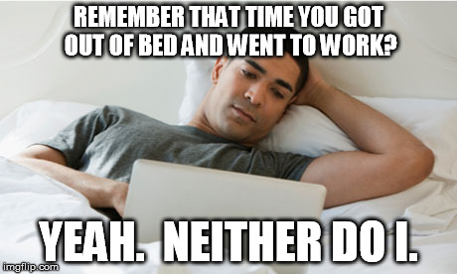
Psst….. I’m hiring!
http://bit.ly/WorkWithSeth
Work from home!*
Solving hard problems!
With smart people!
Who are also great humans!
Who don’t care if you wear pants! (Unless you stand up while on video)
* 1 or 2 face-to-face days per month in Columbus, OH
Notes:
Welcome to “UI Tests Are Fun To Write (If You Write Them Right)”.
This talk is the story of my team's struggle with UI testing over the past 6 years.
Personally, I've been writing tests of some kind or another for over 14 years, and for most of those years I've held the opinion that UI tests…

Slide 6

Psst….. I’m hiring!
http://bit.ly/WorkWithSeth
Work from home!*
Solving hard problems!
With smart people!
Who are also great humans!
Who don’t care if you wear pants! (Unless you stand up while on video)
* 1 or 2 face-to-face days per month in Columbus, OH
Notes:
Welcome to “UI Tests Are Fun To Write (If You Write Them Right)”.
This talk is the story of my team's struggle with UI testing over the past 6 years.
Personally, I've been writing tests of some kind or another for over 14 years, and for most of those years I've held the opinion that UI tests…

Slide 7

Psst….. I’m hiring!
http://bit.ly/WorkWithSeth
Work from home!*
Solving hard problems!
With smart people!
Who are also great humans!
Who don’t care if you wear pants! (Unless you stand up while on video)
* 1 or 2 face-to-face days per month in Columbus, OH
Notes:
Welcome to “UI Tests Are Fun To Write (If You Write Them Right)”.
This talk is the story of my team's struggle with UI testing over the past 6 years.
Personally, I've been writing tests of some kind or another for over 14 years, and for most of those years I've held the opinion that UI tests…

Slide 8
Securing Your API Endpoints A practical guide to API authentication
@spetryjohnson
Notes:
Welcome to "Securing Your API Endpoints!"
This is one of my favorite talks to give and I'm excited to share it with you. Over the next hour I'm going to take you on a journey of discovery, at the conclusion of which you'll leave this room a bit wiser and a bit more knowledgeable than you are right now.

Slide 9
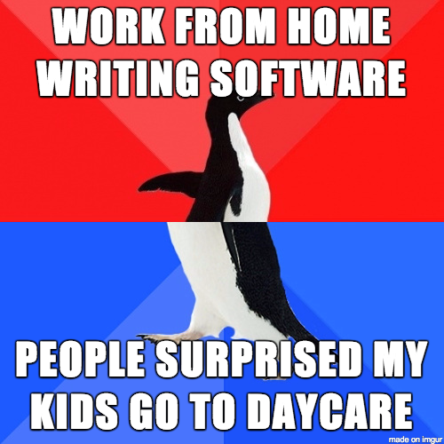
Psst….. I’m hiring!
http://bit.ly/WorkWithSeth
Work from home!*
Solving hard problems!
With smart people!
Who are also great humans!
Who don’t care if you wear pants! (Unless you stand up while on video)
* 1 or 2 face-to-face days per month in Columbus, OH
Notes:
Welcome to “UI Tests Are Fun To Write (If You Write Them Right)”.
This talk is the story of my team's struggle with UI testing over the past 6 years.
Personally, I've been writing tests of some kind or another for over 14 years, and for most of those years I've held the opinion that UI tests…

Slide 10
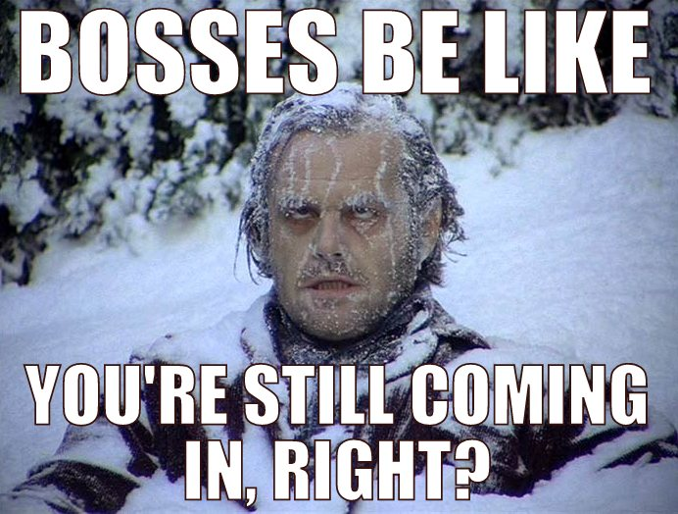
Psst….. I’m hiring!
http://bit.ly/WorkWithSeth
Work from home!*
Solving hard problems!
With smart people!
Who are also great humans!
Who don’t care if you wear pants! (Unless you stand up while on video)
* 1 or 2 face-to-face days per month in Columbus, OH
Notes:
Welcome to “UI Tests Are Fun To Write (If You Write Them Right)”.
This talk is the story of my team's struggle with UI testing over the past 6 years.
Personally, I've been writing tests of some kind or another for over 14 years, and for most of those years I've held the opinion that UI tests…

Slide 11
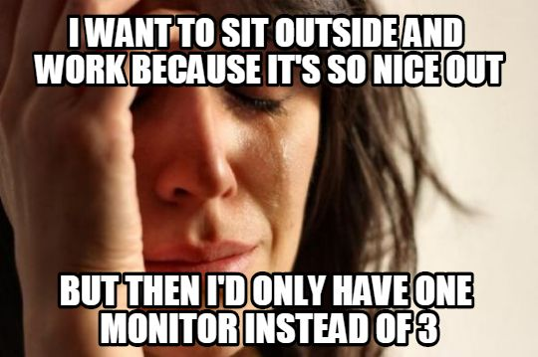
Psst….. I’m hiring!
http://bit.ly/WorkWithSeth
Work from home!*
Solving hard problems!
With smart people!
Who are also great humans!
Who don’t care if you wear pants! (Unless you stand up while on video)
* 1 or 2 face-to-face days per month in Columbus, OH
Notes:
Welcome to “UI Tests Are Fun To Write (If You Write Them Right)”.
This talk is the story of my team's struggle with UI testing over the past 6 years.
Personally, I've been writing tests of some kind or another for over 14 years, and for most of those years I've held the opinion that UI tests…

Slide 12
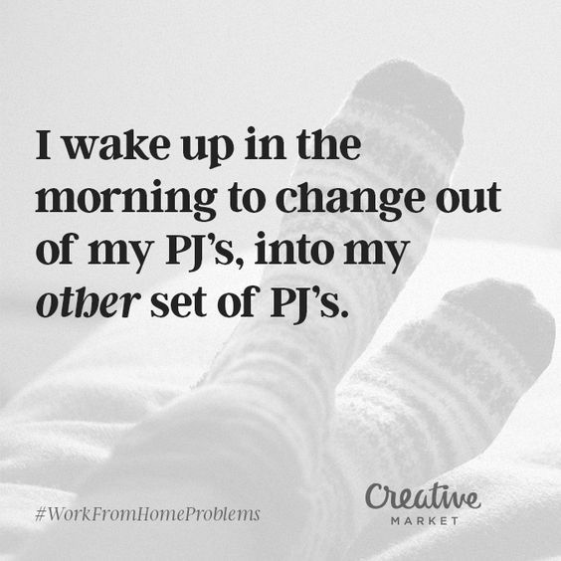
Psst….. I’m hiring!
http://bit.ly/WorkWithSeth
Work from home!*
Solving hard problems!
With smart people!
Who are also great humans!
Who don’t care if you wear pants! (Unless you stand up while on video)
* 1 or 2 face-to-face days per month in Columbus, OH
Notes:
Welcome to “UI Tests Are Fun To Write (If You Write Them Right)”.
This talk is the story of my team's struggle with UI testing over the past 6 years.
Personally, I've been writing tests of some kind or another for over 14 years, and for most of those years I've held the opinion that UI tests…

Slide 13
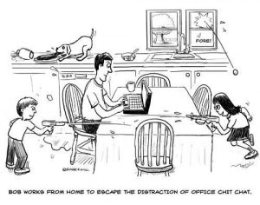
Psst….. I’m hiring!
http://bit.ly/WorkWithSeth
Work from home!*
Solving hard problems!
With smart people!
Who are also great humans!
Who don’t care if you wear pants! (Unless you stand up while on video)
* 1 or 2 face-to-face days per month in Columbus, OH
Notes:
Welcome to “UI Tests Are Fun To Write (If You Write Them Right)”.
This talk is the story of my team's struggle with UI testing over the past 6 years.
Personally, I've been writing tests of some kind or another for over 14 years, and for most of those years I've held the opinion that UI tests…

Slide 14
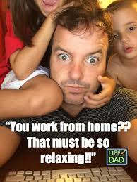
Psst….. I’m hiring!
http://bit.ly/WorkWithSeth
Work from home!*
Solving hard problems!
With smart people!
Who are also great humans!
Who don’t care if you wear pants! (Unless you stand up while on video)
* 1 or 2 face-to-face days per month in Columbus, OH
Notes:
Welcome to “UI Tests Are Fun To Write (If You Write Them Right)”.
This talk is the story of my team's struggle with UI testing over the past 6 years.
Personally, I've been writing tests of some kind or another for over 14 years, and for most of those years I've held the opinion that UI tests…

Slide 15
Securing Your API Endpoints A practical guide to API authentication
@spetryjohnson
Notes:
Welcome to "Securing Your API Endpoints!"
This is one of my favorite talks to give and I'm excited to share it with you. Over the next hour I'm going to take you on a journey of discovery, at the conclusion of which you'll leave this room a bit wiser and a bit more knowledgeable than you are right now.

Slide 16

Psst….. I’m hiring!
http://bit.ly/WorkWithSeth
Work from home!*
Solving hard problems!
With smart people!
Who are also great humans!
Who don’t care if you wear pants! (Unless you stand up while on video)
* 1 or 2 face-to-face days per month in Columbus, OH
Notes:
Welcome to “UI Tests Are Fun To Write (If You Write Them Right)”.
This talk is the story of my team's struggle with UI testing over the past 6 years.
Personally, I've been writing tests of some kind or another for over 14 years, and for most of those years I've held the opinion that UI tests…

Slide 17

Psst….. I’m hiring!
http://bit.ly/WorkWithSeth
Work from home!*
Solving hard problems!
With smart people!
Who are also great humans!
Who don’t care if you wear pants! (Unless you stand up while on video)
* 1 or 2 face-to-face days per month in Columbus, OH
Notes:
Welcome to “UI Tests Are Fun To Write (If You Write Them Right)”.
This talk is the story of my team's struggle with UI testing over the past 6 years.
Personally, I've been writing tests of some kind or another for over 14 years, and for most of those years I've held the opinion that UI tests…

Slide 18
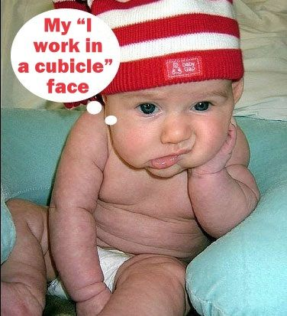
Psst….. I’m hiring!
http://bit.ly/WorkWithSeth
Work from home!*
Solving hard problems!
With smart people!
Who are also great humans!
Who don’t care if you wear pants! (Unless you stand up while on video)
* 1 or 2 face-to-face days per month in Columbus, OH
Notes:
Welcome to “UI Tests Are Fun To Write (If You Write Them Right)”.
This talk is the story of my team's struggle with UI testing over the past 6 years.
Personally, I've been writing tests of some kind or another for over 14 years, and for most of those years I've held the opinion that UI tests…

Slide 19

Psst….. I’m hiring!
http://bit.ly/WorkWithSeth
Work from home!*
Solving hard problems!
With smart people!
Who are also great humans!
Who don’t care if you wear pants! (Unless you stand up while on video)
* 1 or 2 face-to-face days per month in Columbus, OH
Notes:
Welcome to “UI Tests Are Fun To Write (If You Write Them Right)”.
This talk is the story of my team's struggle with UI testing over the past 6 years.
Personally, I've been writing tests of some kind or another for over 14 years, and for most of those years I've held the opinion that UI tests…

Slide 20
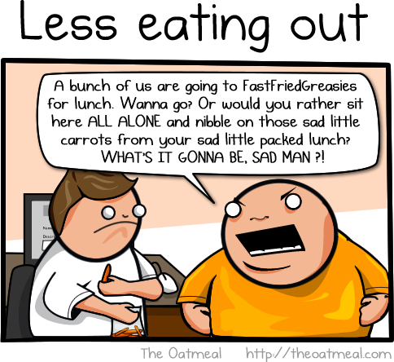
Psst….. I’m hiring!
http://bit.ly/WorkWithSeth
Work from home!*
Solving hard problems!
With smart people!
Who are also great humans!
Who don’t care if you wear pants! (Unless you stand up while on video)
* 1 or 2 face-to-face days per month in Columbus, OH
Notes:
Welcome to “UI Tests Are Fun To Write (If You Write Them Right)”.
This talk is the story of my team's struggle with UI testing over the past 6 years.
Personally, I've been writing tests of some kind or another for over 14 years, and for most of those years I've held the opinion that UI tests…

Slide 21
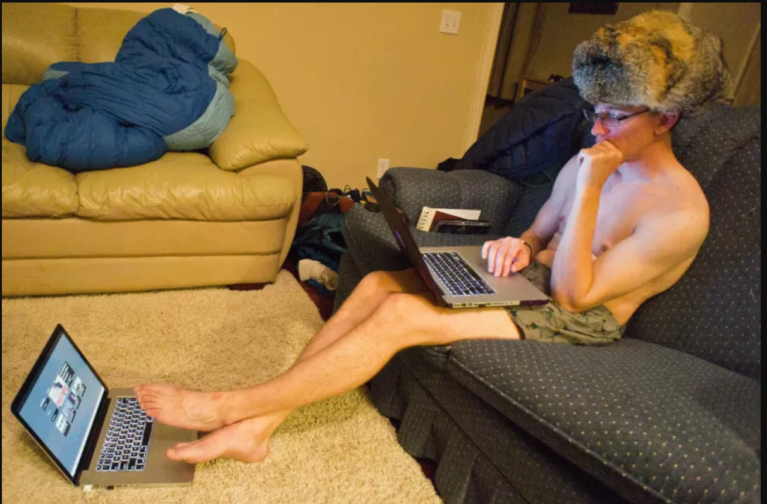
Psst….. I’m hiring!
http://bit.ly/WorkWithSeth
Work from home!*
Solving hard problems!
With smart people!
Who are also great humans!
Who don’t care if you wear pants! (Unless you stand up while on video)
* 1 or 2 face-to-face days per month in Columbus, OH
Notes:
Welcome to “UI Tests Are Fun To Write (If You Write Them Right)”.
This talk is the story of my team's struggle with UI testing over the past 6 years.
Personally, I've been writing tests of some kind or another for over 14 years, and for most of those years I've held the opinion that UI tests…

