Slide 1

Securing Your API Endpoints A practical guide to API authentication
@spetryjohnson
Notes:
Welcome to "Securing Your API Endpoints!"
This is one of my favorite talks to give and I'm excited to share it with you.
Over the next hour I'm going to take you on a journey of knowledge and discovery, at the conclusion of which you'll leave this room a bit wiser and more prepared to handle API authentication than you are today.

Slide 2
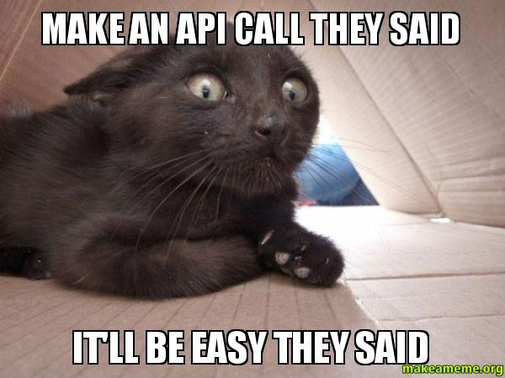
Securing Your API Endpoints

Slide 3
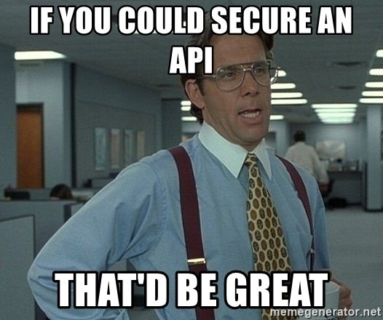
Securing Your API Endpoints

Slide 4
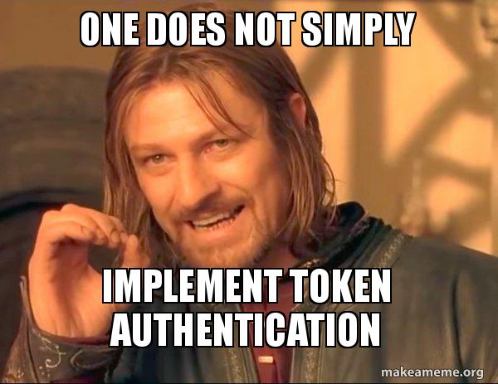

Slide 5
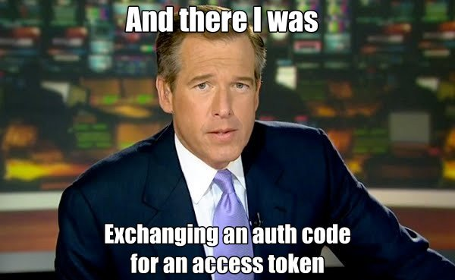

Slide 6
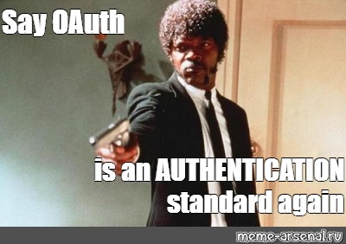

Slide 7
Securing Your API Endpoints A practical guide to API authentication
@spetryjohnson
Notes:
Welcome to "Securing Your API Endpoints!"
This is one of my favorite talks to give and I'm excited to share it with you.
Over the next hour I'm going to take you on a journey of knowledge and discovery, at the conclusion of which you'll leave this room a bit wiser and more prepared to handle API authentication than you are today.

Slide 8
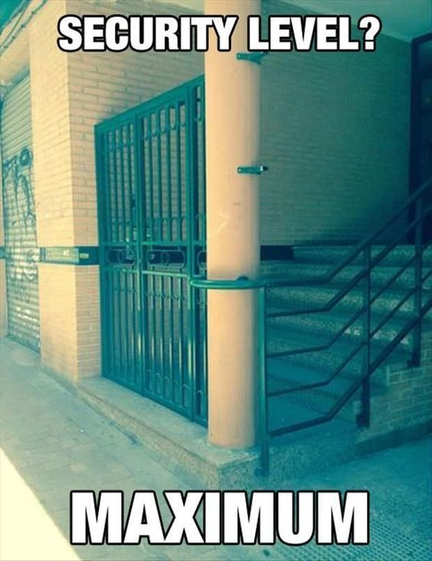
Securing Your API Endpoints

Slide 9
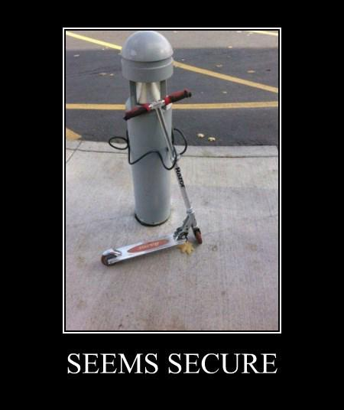
Securing Your API Endpoints

Slide 10
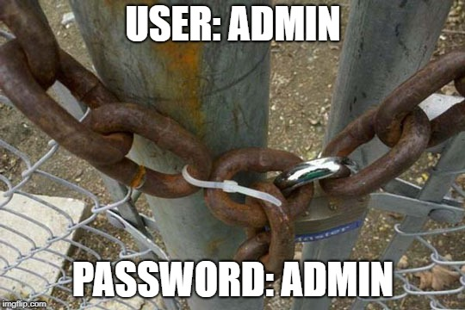
Securing Your API Endpoints

Slide 11
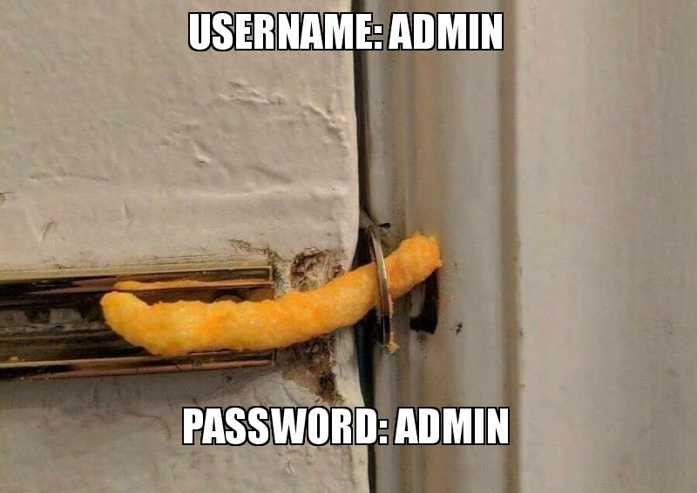

Slide 12
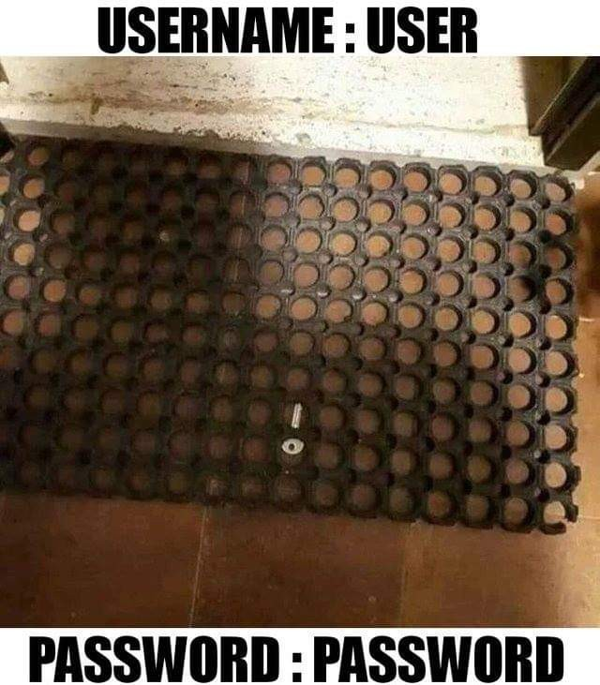

Slide 13
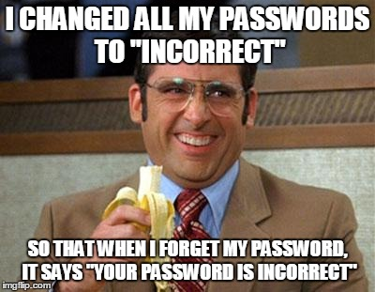

Slide 14
Securing Your API Endpoints A practical guide to API authentication
@spetryjohnson
Notes:
Welcome to "Securing Your API Endpoints!"
This is one of my favorite talks to give and I'm excited to share it with you.
Over the next hour I'm going to take you on a journey of knowledge and discovery, at the conclusion of which you'll leave this room a bit wiser and more prepared to handle API authentication than you are today.

Slide 15
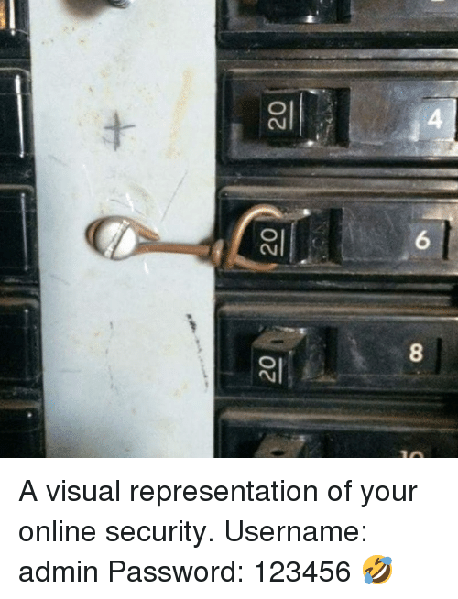

Slide 16
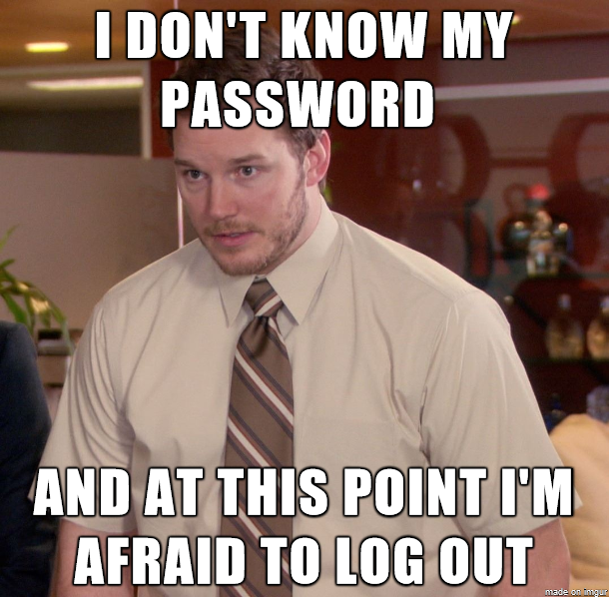

Slide 17
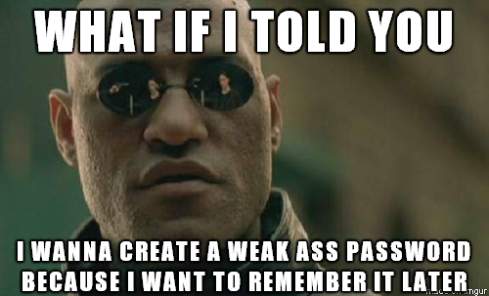

Slide 18
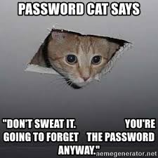

Slide 19
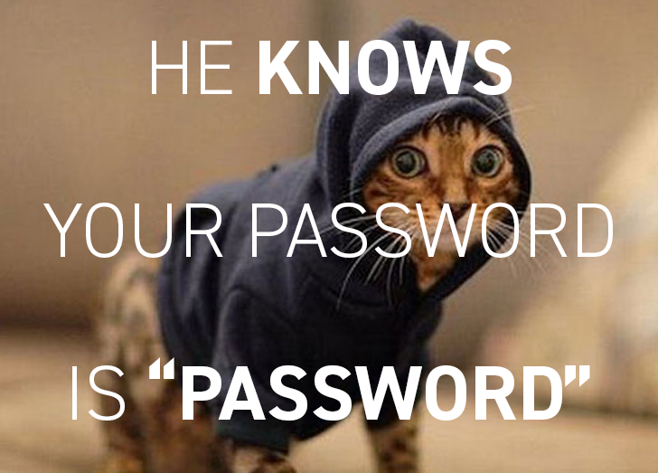

Slide 20
Securing Your API Endpoints A practical guide to API authentication
@spetryjohnson
Notes:
Welcome to "Securing Your API Endpoints!"
This is one of my favorite talks to give and I'm excited to share it with you.
Over the next hour I'm going to take you on a journey of knowledge and discovery, at the conclusion of which you'll leave this room a bit wiser and more prepared to handle API authentication than you are today.

Slide 21
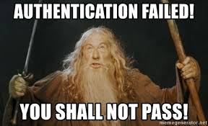

Slide 22
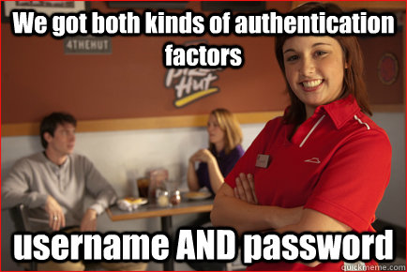

Slide 23
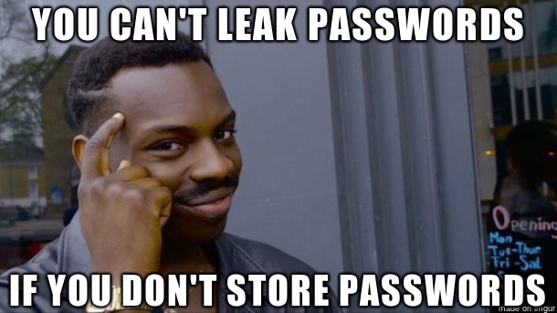

Slide 24
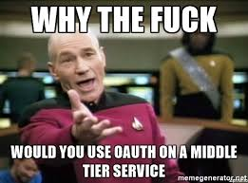
BLEEP

Slide 25
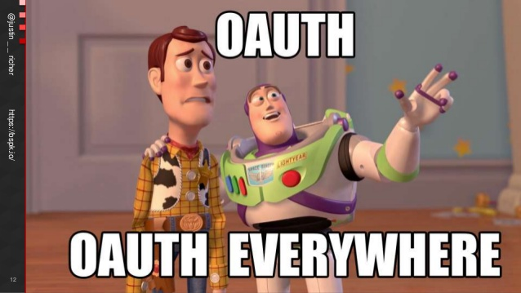

Slide 26
Securing Your API Endpoints A practical guide to API authentication
@spetryjohnson
Notes:
Welcome to "Securing Your API Endpoints!"
This is one of my favorite talks to give and I'm excited to share it with you.
Over the next hour I'm going to take you on a journey of knowledge and discovery, at the conclusion of which you'll leave this room a bit wiser and more prepared to handle API authentication than you are today.

Slide 27
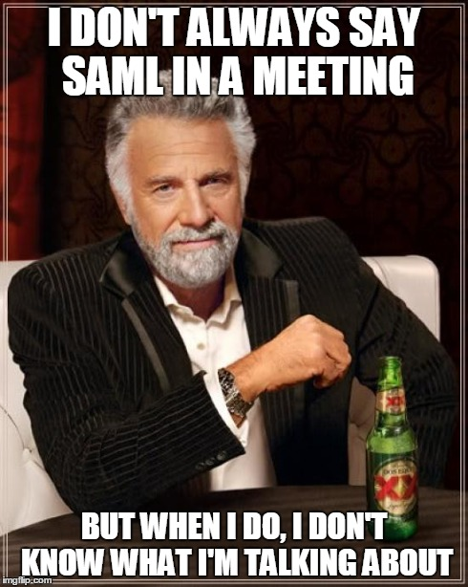

Slide 28
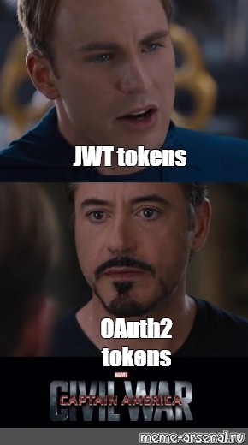

Slide 29
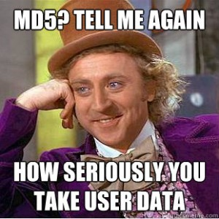

Slide 30
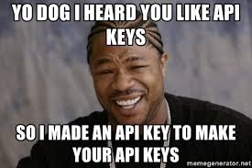

Slide 31
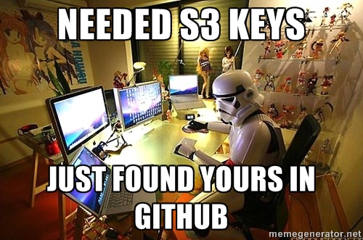

Slide 32
Securing Your API Endpoints A practical guide to API authentication
@spetryjohnson
Notes:
Welcome to "Securing Your API Endpoints!"
This is one of my favorite talks to give and I'm excited to share it with you.
Over the next hour I'm going to take you on a journey of knowledge and discovery, at the conclusion of which you'll leave this room a bit wiser and more prepared to handle API authentication than you are today.

Slide 33
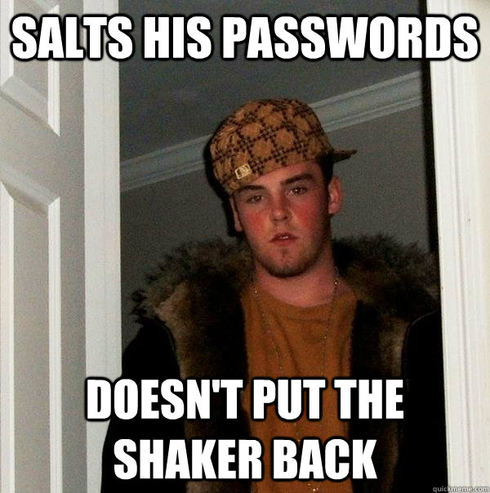

Slide 34
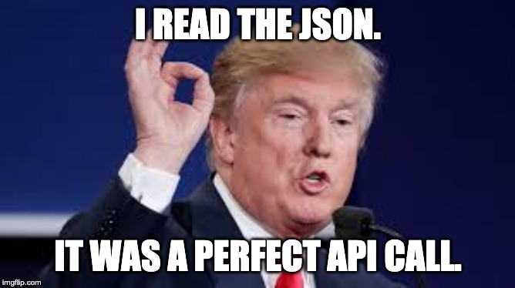

Slide 35
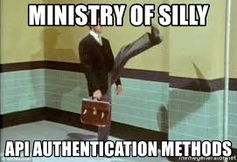

Slide 36
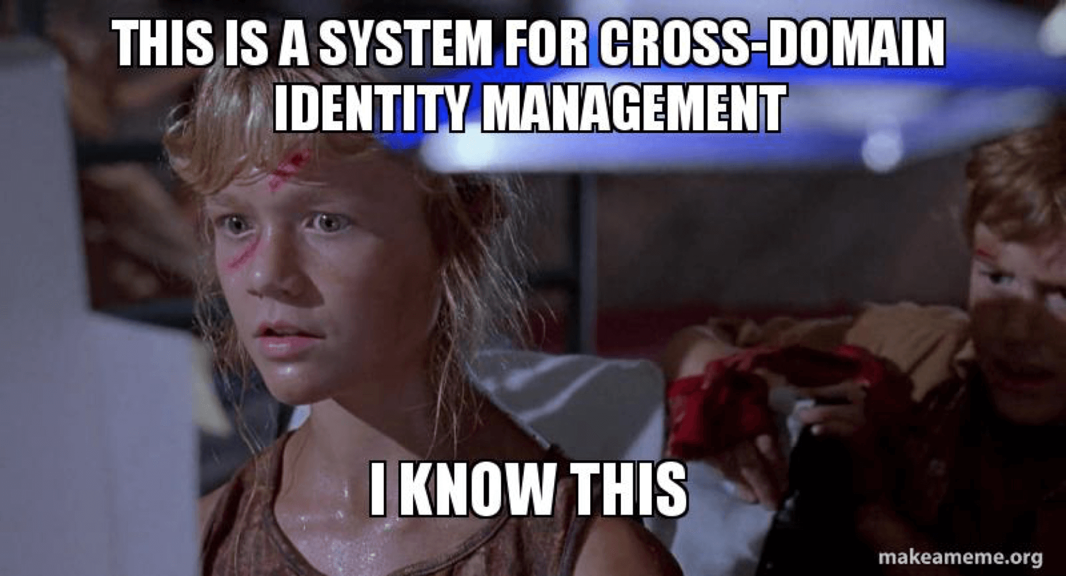

Slide 37
