Slide 1
UI Tests Are Fun to Write!
Seth Petry-Johnson
@spetryjohnson
github.com/spetryjohnson
Notes:
Welcome to “UI Tests Are Fun To Write (If You Write Them Right)”.
This talk is the story of my team's struggle with UI testing over the past 6 years.
Personally, I've been writing tests of some kind or another for over 14 years, and for most of those years I've held the opinion that UI tests…

Slide 2

Psst….. I’m hiring!
http://bit.ly/WFHTester
Work from home!*
Solving hard problems!
With smart people!
Who are also great humans!
Who don’t care if you wear pants! (Unless you stand up while on video)
* 2 or more face-to-face days per month in Columbus, OH
Notes:
Welcome to “UI Tests Are Fun To Write (If You Write Them Right)”.
This talk is the story of my team's struggle with UI testing over the past 6 years.
Personally, I've been writing tests of some kind or another for over 14 years, and for most of those years I've held the opinion that UI tests…

Slide 3
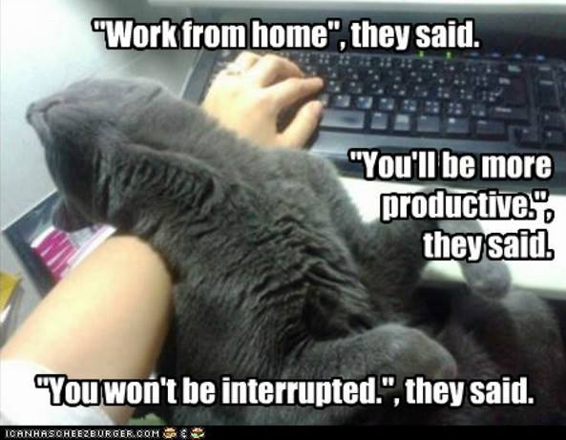
Psst….. I’m hiring!
http://bit.ly/WFHTester
Work from home!*
Solving hard problems!
With smart people!
Who are also great humans!
Who don’t care if you wear pants! (Unless you stand up while on video)
* 2 or more face-to-face days per month in Columbus, OH
Notes:
Welcome to “UI Tests Are Fun To Write (If You Write Them Right)”.
This talk is the story of my team's struggle with UI testing over the past 6 years.
Personally, I've been writing tests of some kind or another for over 14 years, and for most of those years I've held the opinion that UI tests…

Slide 4

Psst….. I’m hiring!
http://bit.ly/WFHTester
Work from home!*
Solving hard problems!
With smart people!
Who are also great humans!
Who don’t care if you wear pants! (Unless you stand up while on video)
* 2 or more face-to-face days per month in Columbus, OH
Notes:
Welcome to “UI Tests Are Fun To Write (If You Write Them Right)”.
This talk is the story of my team's struggle with UI testing over the past 6 years.
Personally, I've been writing tests of some kind or another for over 14 years, and for most of those years I've held the opinion that UI tests…

Slide 5
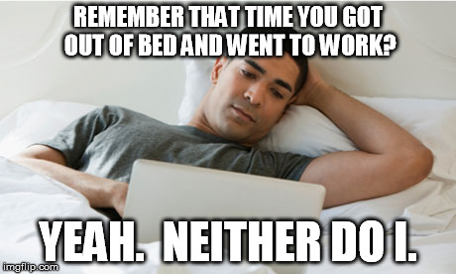
Psst….. I’m hiring!
http://bit.ly/WFHTester
Work from home!*
Solving hard problems!
With smart people!
Who are also great humans!
Who don’t care if you wear pants! (Unless you stand up while on video)
* 2 or more face-to-face days per month in Columbus, OH
Notes:
Welcome to “UI Tests Are Fun To Write (If You Write Them Right)”.
This talk is the story of my team's struggle with UI testing over the past 6 years.
Personally, I've been writing tests of some kind or another for over 14 years, and for most of those years I've held the opinion that UI tests…

Slide 6

Psst….. I’m hiring!
http://bit.ly/WFHTester
Work from home!*
Solving hard problems!
With smart people!
Who are also great humans!
Who don’t care if you wear pants! (Unless you stand up while on video)
* 2 or more face-to-face days per month in Columbus, OH
Notes:
Welcome to “UI Tests Are Fun To Write (If You Write Them Right)”.
This talk is the story of my team's struggle with UI testing over the past 6 years.
Personally, I've been writing tests of some kind or another for over 14 years, and for most of those years I've held the opinion that UI tests…

Slide 7

Psst….. I’m hiring!
http://bit.ly/WFHTester
Work from home!*
Solving hard problems!
With smart people!
Who are also great humans!
Who don’t care if you wear pants! (Unless you stand up while on video)
* 2 or more face-to-face days per month in Columbus, OH
Notes:
Welcome to “UI Tests Are Fun To Write (If You Write Them Right)”.
This talk is the story of my team's struggle with UI testing over the past 6 years.
Personally, I've been writing tests of some kind or another for over 14 years, and for most of those years I've held the opinion that UI tests…

Slide 8
UI Tests Are Fun to Write!
Seth Petry-Johnson
@spetryjohnson
github.com/spetryjohnson
Notes:
Welcome to “UI Tests Are Fun To Write (If You Write Them Right)”.
This talk is the story of my team's struggle with UI testing over the past 6 years.
Personally, I've been writing tests of some kind or another for over 14 years, and for most of those years I've held the opinion that UI tests…

Slide 9
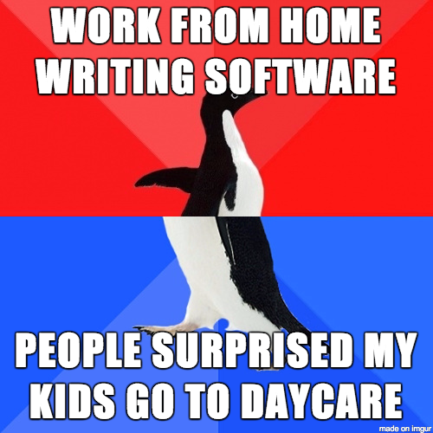
Psst….. I’m hiring!
http://bit.ly/WFHTester
Work from home!*
Solving hard problems!
With smart people!
Who are also great humans!
Who don’t care if you wear pants! (Unless you stand up while on video)
* 2 or more face-to-face days per month in Columbus, OH
Notes:
Welcome to “UI Tests Are Fun To Write (If You Write Them Right)”.
This talk is the story of my team's struggle with UI testing over the past 6 years.
Personally, I've been writing tests of some kind or another for over 14 years, and for most of those years I've held the opinion that UI tests…

Slide 10
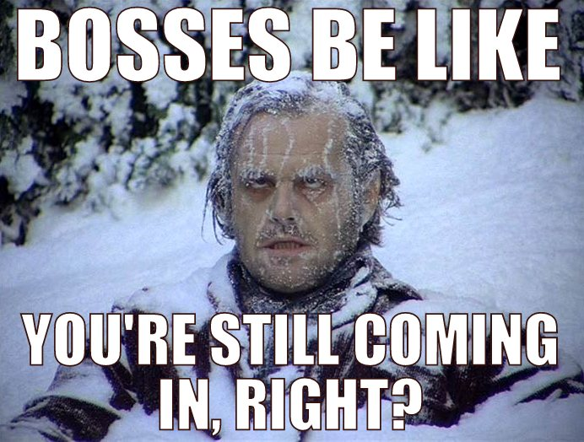
Psst….. I’m hiring!
http://bit.ly/WFHTester
Work from home!*
Solving hard problems!
With smart people!
Who are also great humans!
Who don’t care if you wear pants! (Unless you stand up while on video)
* 2 or more face-to-face days per month in Columbus, OH
Notes:
Welcome to “UI Tests Are Fun To Write (If You Write Them Right)”.
This talk is the story of my team's struggle with UI testing over the past 6 years.
Personally, I've been writing tests of some kind or another for over 14 years, and for most of those years I've held the opinion that UI tests…

Slide 11
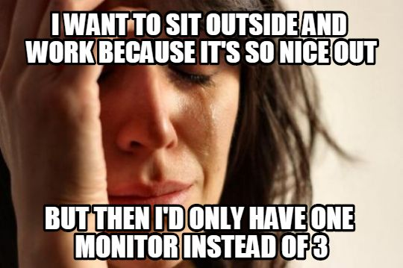
Psst….. I’m hiring!
http://bit.ly/WFHTester
Work from home!*
Solving hard problems!
With smart people!
Who are also great humans!
Who don’t care if you wear pants! (Unless you stand up while on video)
* 2 or more face-to-face days per month in Columbus, OH
Notes:
Welcome to “UI Tests Are Fun To Write (If You Write Them Right)”.
This talk is the story of my team's struggle with UI testing over the past 6 years.
Personally, I've been writing tests of some kind or another for over 14 years, and for most of those years I've held the opinion that UI tests…

Slide 12
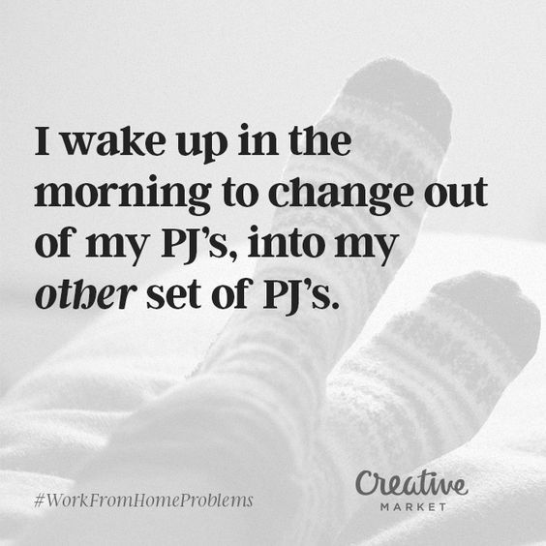
Psst….. I’m hiring!
http://bit.ly/WFHTester
Work from home!*
Solving hard problems!
With smart people!
Who are also great humans!
Who don’t care if you wear pants! (Unless you stand up while on video)
* 2 or more face-to-face days per month in Columbus, OH
Notes:
Welcome to “UI Tests Are Fun To Write (If You Write Them Right)”.
This talk is the story of my team's struggle with UI testing over the past 6 years.
Personally, I've been writing tests of some kind or another for over 14 years, and for most of those years I've held the opinion that UI tests…

Slide 13
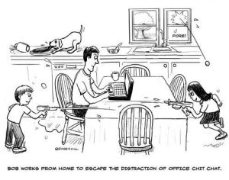
Psst….. I’m hiring!
http://bit.ly/WFHTester
Work from home!*
Solving hard problems!
With smart people!
Who are also great humans!
Who don’t care if you wear pants! (Unless you stand up while on video)
* 2 or more face-to-face days per month in Columbus, OH
Notes:
Welcome to “UI Tests Are Fun To Write (If You Write Them Right)”.
This talk is the story of my team's struggle with UI testing over the past 6 years.
Personally, I've been writing tests of some kind or another for over 14 years, and for most of those years I've held the opinion that UI tests…

Slide 14

Psst….. I’m hiring!
http://bit.ly/WFHTester
Work from home!*
Solving hard problems!
With smart people!
Who are also great humans!
Who don’t care if you wear pants! (Unless you stand up while on video)
* 2 or more face-to-face days per month in Columbus, OH
Notes:
Welcome to “UI Tests Are Fun To Write (If You Write Them Right)”.
This talk is the story of my team's struggle with UI testing over the past 6 years.
Personally, I've been writing tests of some kind or another for over 14 years, and for most of those years I've held the opinion that UI tests…

Slide 15
UI Tests Are Fun to Write!
Seth Petry-Johnson
@spetryjohnson
github.com/spetryjohnson
Notes:
Welcome to “UI Tests Are Fun To Write (If You Write Them Right)”.
This talk is the story of my team's struggle with UI testing over the past 6 years.
Personally, I've been writing tests of some kind or another for over 14 years, and for most of those years I've held the opinion that UI tests…

Slide 16

Psst….. I’m hiring!
http://bit.ly/WFHTester
Work from home!*
Solving hard problems!
With smart people!
Who are also great humans!
Who don’t care if you wear pants! (Unless you stand up while on video)
* 2 or more face-to-face days per month in Columbus, OH
Notes:
Welcome to “UI Tests Are Fun To Write (If You Write Them Right)”.
This talk is the story of my team's struggle with UI testing over the past 6 years.
Personally, I've been writing tests of some kind or another for over 14 years, and for most of those years I've held the opinion that UI tests…

Slide 17

Psst….. I’m hiring!
http://bit.ly/WFHTester
Work from home!*
Solving hard problems!
With smart people!
Who are also great humans!
Who don’t care if you wear pants! (Unless you stand up while on video)
* 2 or more face-to-face days per month in Columbus, OH
Notes:
Welcome to “UI Tests Are Fun To Write (If You Write Them Right)”.
This talk is the story of my team's struggle with UI testing over the past 6 years.
Personally, I've been writing tests of some kind or another for over 14 years, and for most of those years I've held the opinion that UI tests…

Slide 18
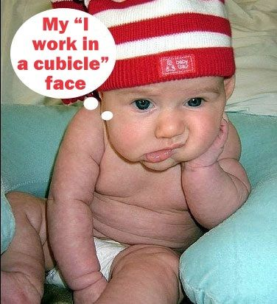
Psst….. I’m hiring!
http://bit.ly/WFHTester
Work from home!*
Solving hard problems!
With smart people!
Who are also great humans!
Who don’t care if you wear pants! (Unless you stand up while on video)
* 2 or more face-to-face days per month in Columbus, OH
Notes:
Welcome to “UI Tests Are Fun To Write (If You Write Them Right)”.
This talk is the story of my team's struggle with UI testing over the past 6 years.
Personally, I've been writing tests of some kind or another for over 14 years, and for most of those years I've held the opinion that UI tests…

Slide 19
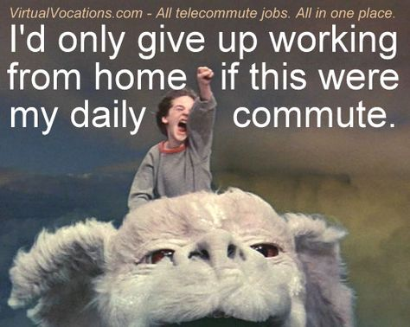
Psst….. I’m hiring!
http://bit.ly/WFHTester
Work from home!*
Solving hard problems!
With smart people!
Who are also great humans!
Who don’t care if you wear pants! (Unless you stand up while on video)
* 2 or more face-to-face days per month in Columbus, OH
Notes:
Welcome to “UI Tests Are Fun To Write (If You Write Them Right)”.
This talk is the story of my team's struggle with UI testing over the past 6 years.
Personally, I've been writing tests of some kind or another for over 14 years, and for most of those years I've held the opinion that UI tests…

Slide 20
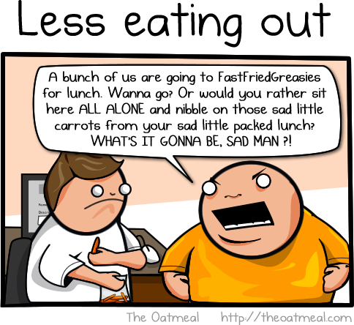
Psst….. I’m hiring!
http://bit.ly/WFHTester
Work from home!*
Solving hard problems!
With smart people!
Who are also great humans!
Who don’t care if you wear pants! (Unless you stand up while on video)
* 2 or more face-to-face days per month in Columbus, OH
Notes:
Welcome to “UI Tests Are Fun To Write (If You Write Them Right)”.
This talk is the story of my team's struggle with UI testing over the past 6 years.
Personally, I've been writing tests of some kind or another for over 14 years, and for most of those years I've held the opinion that UI tests…

Slide 21
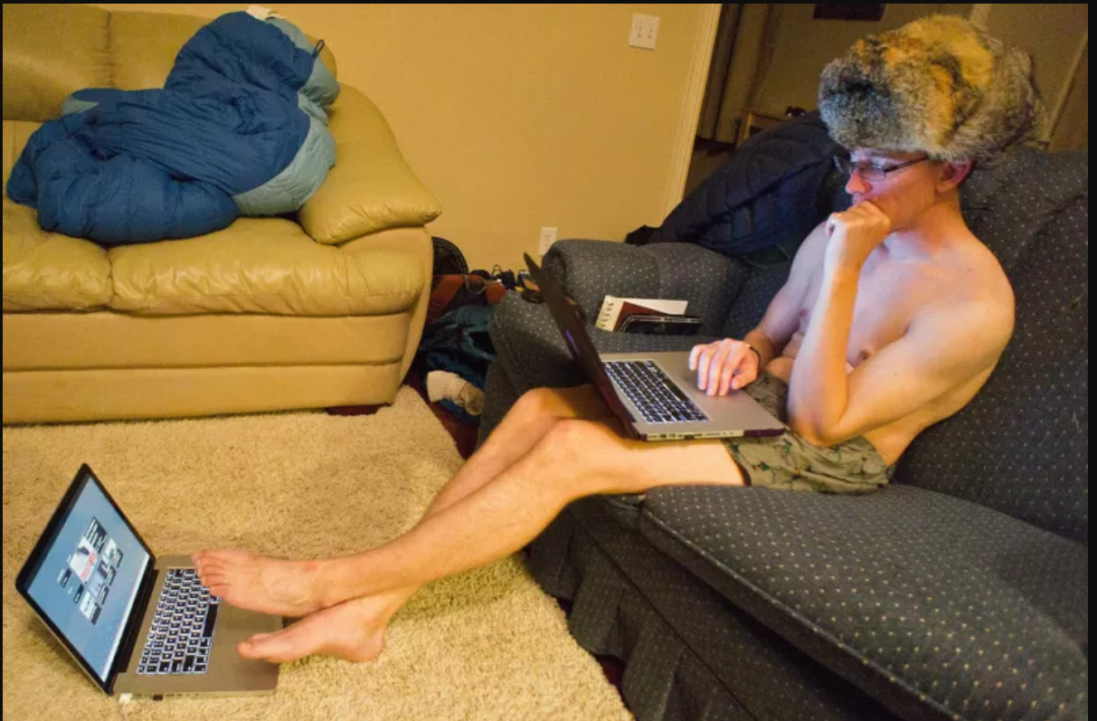
Psst….. I’m hiring!
http://bit.ly/WFHTester
Work from home!*
Solving hard problems!
With smart people!
Who are also great humans!
Who don’t care if you wear pants! (Unless you stand up while on video)
* 2 or more face-to-face days per month in Columbus, OH
Notes:
Welcome to “UI Tests Are Fun To Write (If You Write Them Right)”.
This talk is the story of my team's struggle with UI testing over the past 6 years.
Personally, I've been writing tests of some kind or another for over 14 years, and for most of those years I've held the opinion that UI tests…

