Slide 1

Capstone Hotel Booking Prediction
Presented by: Sharonda Petttiett - Warner April 24, 2020
Notes:
Capstone Hotel Booking Prediction
___
Presented by: Sharonda Petttiett – Warner, Student at Flatiron School (Data Science Program)
Date: April 24, 2020

Slide 2
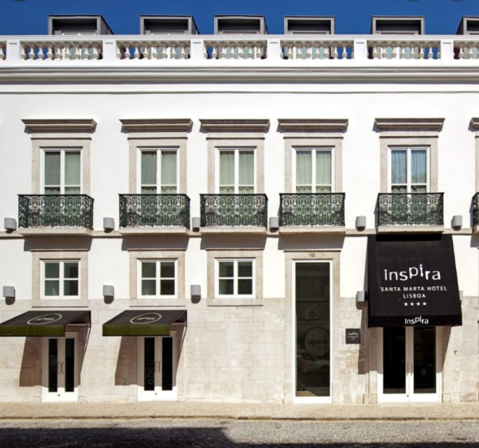

Problem Statement
Reservations for resorts and hotels in Lisbon, Portugal are experiencing 37% cancellations.
Booking cancellations in the hospitality industry can result in:
Overbooking situations
Hotel’s online social reputation
Revenue loss
Pricing, inventory and labor allocation decisions
Notes:
2
As a person who loves to travel it is very ‘annoying’ when you arrive at the hotel and find out that your reservation has been “CANCELLED”!
Well, this is an issue that resorts and hotels in Lisbon, Portugal are experiencing at a cancellation rate of 37%.
Booking cancellations in the hospitality industry can result in:
(Customer Impact)
Overbooking situations
Hotel’s online social reputation
(Hotel Impact)
Revenue loss
Pricing, inventory and labor allocation decisions

Slide 3

Business Value
To predict hotel booking cancellations to decrease uncertainty and increase revenue.
To explain how future cancelled reservations can be predicted in advance by machine learning methods.
Notes:
3
Our business value … is to tackle the uncertainty arising from booking cancellations, we combined the data from city and resort hotel properties and by using machine learning algorithms to develop booking cancellation prediction models for the hotels. In a real production environment, improvement of the forecast accuracy due to the use of these models could enable hoteliers to decrease the number of cancellations, thus, increasing confidence in demand-management decisions.
This data set contains booking information for a city hotel and a resort hotel and includes information such as when the booking was made, length of stay, the number of adults, children, and/or babies, and the number of available parking spaces, among other things.

Slide 4
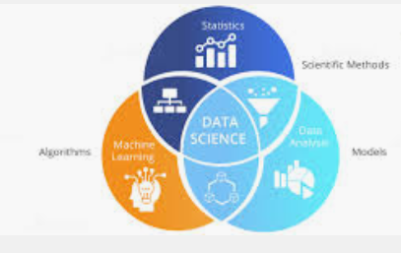
Methodology
Classification problem, based on a Kaggle kernel
Data Science concepts used:
Machine Learning (ML)
Hypothesis Testing
Data Visualization
Time Series
Notes:
4
By addressing this issue as a classification problem which is based on a Kaggle kernel in the scope of data science the following concepts were used to gain more insights on the “cancellation” drivers:
Machine Learning (ML)
Hypothesis Testing
Time Series
Data Visualization
A Portuguese hotel chain - One is a resort hotel (H1), and the other is a city hotel (H2); both have more than 200 rooms and are classified as four star hotels. Data was available from July 2015 to August 2017. Because H2 engaged in a soft-opening process until the end of August 2015, only data from September 2015 onwards was considered for the modeling of H2.
Dataset: 'hotel', 'is_canceled', 'lead_time', 'arrival_date_year', 'arrival_date_month', 'arrival_date_week_number', 'arrival_date_day_of_month', 'stays_in_weekend_nights', 'stays_in_week_nights', 'adults', 'children', 'babies', 'meal', 'country', 'market_segment', 'distribution_channel', 'is_repeated_guest', 'previous_cancellations', 'previous_bookings_not_canceled', 'reserved_room_type', 'assigned_room_type', 'booking_changes', 'deposit_type', 'agent', 'company', 'days_in_waiting_list', 'customer_type', 'adr', 'required_car_parking_spaces', 'total_of_special_requests', 'reservation_status', 'reservation_status_date’

Slide 5
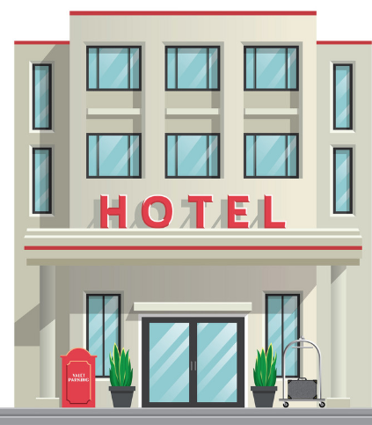
Industry Cancellation Rates
Industry
Portugal
24%
37%
Cancellation rate is 13% higher than the Industry in Portugal
Notes:
5
With a global average of 24% cancellation rate, this trend produces a very negative impact on hotel revenue and distribution management strategies.
Nearly 37 percent of on-the-books revenue is canceled before arrival. “On the books” is a measure used when looking ahead to see how occupancy or revenue is booked in at a hotel. The amount that is ”on-the-books” will change as more reservations and cancellations occur until the date or period is arrived at, so it is a measure of a moment in time.
---
Note: Resource – Nov 2016| http://blog.experience-hotel.com/an-analysis-of-where-cancellations-come-from/

Slide 6



Loss Revenue
Average lost from cancellations per year
Notes:
Revenue lost from cancellations per year averages 5 million euros. 13% = $650K saving/year in Euros.

Slide 7
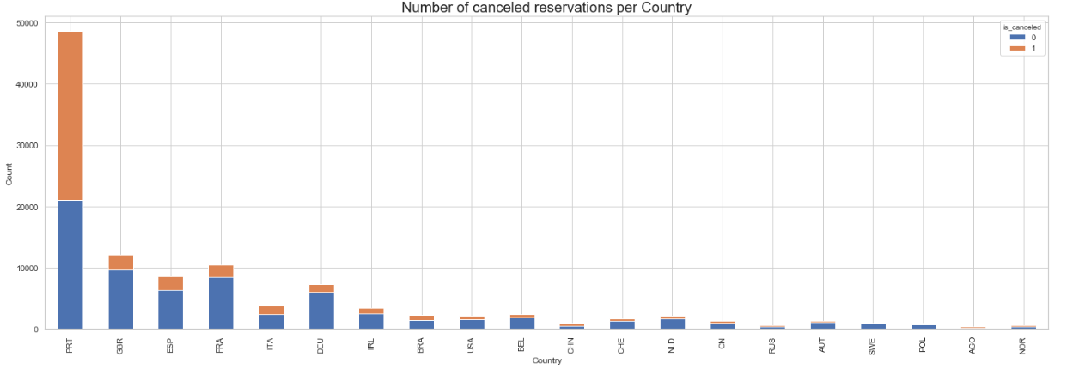
Country
Most of the cancellations are occurring in Portugal with 27,519
10x more than the following:
GBR 2,453
ESP 2,177
FRA 1,934
Notes:
PRT 27519.0
GBR 2453.0
ESP 2177.0
FRA 1934.0

Slide 8
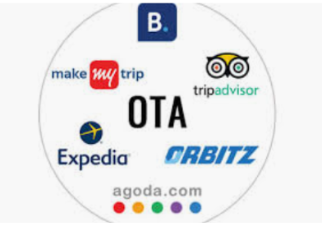
Online Tourist Agents (OTA)
Make up 47% of cancellations
Industry cancellation rate is 40%
“Free Cancellations” policies
Notes:
Most of the cancellations are from “Online TA” with 47%, which is 7% higher than the industry rate at 40%.
Note:
Secondly, is the “Group” market segment with 27%.
“Direct” and “Corporate” has the least cancellations with 4% and 2%, respectively.
Guests have become accustomed to “free cancellation” policies that have been made popular (and encouraged) by mainly Booking.com and channels and apps such as Tingo or Service, designed to cancel and rebook hotel rooms at each rate drop.
This customer behavior hinders accurate forecasting, eventually resulting in non-optimized occupancy. Other factors come into play with cancellation rate increased but we believe none are as pervasive as the increased behaviour and marketing of “Free Cancellations”.

Slide 9
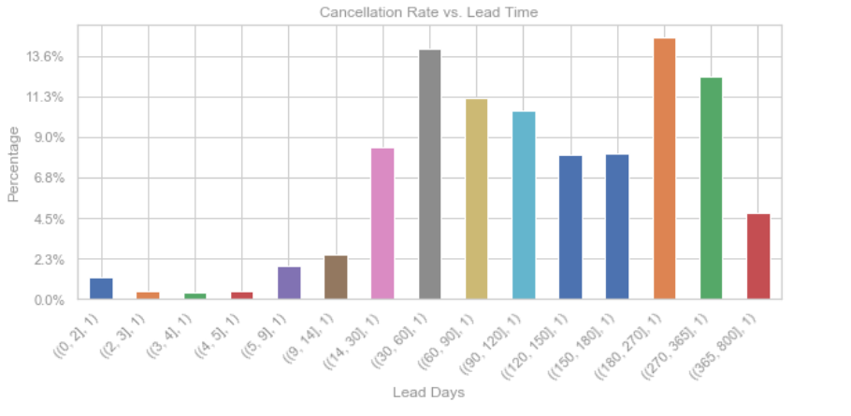
Long Lead Times
Longer than 30 days are 85% more likely to be canceled
Notes:
Longer than 30 days are 85% more likely to be canceled. Cancellation Percentage: 0-6 days = 2.5 % more than 30 days 85%.

Slide 10
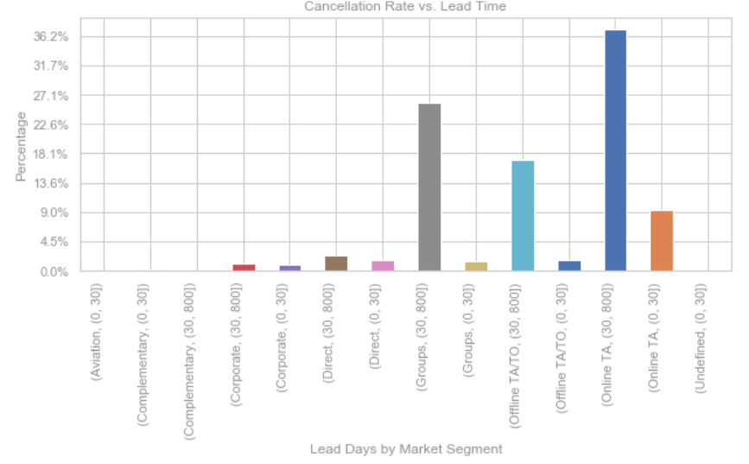
Market Segment Lead Times
Cancellations more than 30 days:
Online TA = 37%
Groups = 26%

Slide 11

Findings - Most Predictive Features
Number #1 predictor was ‘Lead Time’
Others:
‘country’,
‘market segment’,
‘price’,
‘customer type’,
‘specific dates of reservation’
Notes:
Observations: Identify Most Predictive Features
From our analysis, we concluded that the most useful features for prediction were the following features (Top 15):
lead_time 0.116716
deposit_type_Non Refund 0.108665
country_PRT 0.080293
adr 0.078294
total_of_special_requests 0.069174
arrival_date_day_of_month 0.056989
agent 0.051549
arrival_date_week_number 0.048732
stays_in_week_nights 0.037315
previous_cancellations 0.030105
stays_in_weekend_nights 0.025514
arrival_date_year 0.024081
required_car_parking_spaces 0.020868
market_segment_Online TA 0.020407
customer_type_Transient 0.019232

Slide 12
Findings – Best Model for Predictions
Random Forest Classification have the “highest” scoring metrics
Scoring Metric | Value
Test Accuracy Score | 88%
Test Error Rate | 12%
Precision | 87%
ROC/AUC | 87%
Sensitivity (Recall) | 81%
Specificity | 92%
Notes:
RandomForest classifier has an 88% accuracy rate for predicting booking cancellations.
ROC_AUC Score: 87% is the ROC is a probability curve and AUC represents degree or measure of separability. ... By analogy, Higher the AUC, better the model is at distinguishing between the is_canceled class by 87%. The ROC curve is plotted with TPR against the FPR where TPR is on y-axis and FPR is on the x-axis.
Accuracy Score: 0.8776766335158249 is the accuracy of the prediction model.
Precision Score: 0.8693262411347518 is the measure of the accuracy of the model in predicting that a customer will cancel the booking.
Sensitivity / (Recall) Score: 0.8098777667657747 of the cancellations are correctly identified as been canceled.
(True Positive Rate) – Improving hotel’s managements' ability to predict with 81% accuracy - overbooking situations and potential for negative feedback on social channels impacting the hotel’s reputation.
Specificity Score: 0.9214327594477907 of the successful bookings are correctly identified as not been canceled.
(True Negative Rate) – Improving hotel’s managements' ability to predict with 92% accuracy - hotel revenue loss and staffing requirements/allocation.

Slide 13

Recommendations
Hotels should analyze the growth rate of their respective marketing channels, esp.
OTA vs Direct
Allow hotel managers to act on bookings with high cancellation probability
Improve overbooking and cancellation policies
Notes:
1- Hotels should analyze the growth rate of their respective channels and look at which one(s) are generating incremental revenue. Make sure those are optimized with high quality and up-to-date visuals, room inventory availability and rates. Ensure that B2C prices are not being undercut by OTAs, wholesalers, resellers and bed banks, as this disparity will likely hurt overall growth.
Note:
“Direct” and “Corporate” has the least cancellations with 4% and 2%, respectively.
2- We advise hotels to ensure they use channel management tools with a robust two-way connection, so that canceled inventory can be fed back and re-distributed across all channels in real-time. Favoring not-refundable rates over flexible ones or implementing more rigid cancellation policies can also help to limit the issue.
3- Allow hotel managers to act on bookings with high cancellation probability and contain the associated revenue losses, produce better net demand forecasts, improve overbooking/cancellation policies (Implement more rigid cancellation policies ), and have more assertive pricing and inventory allocation strategies.

Slide 14
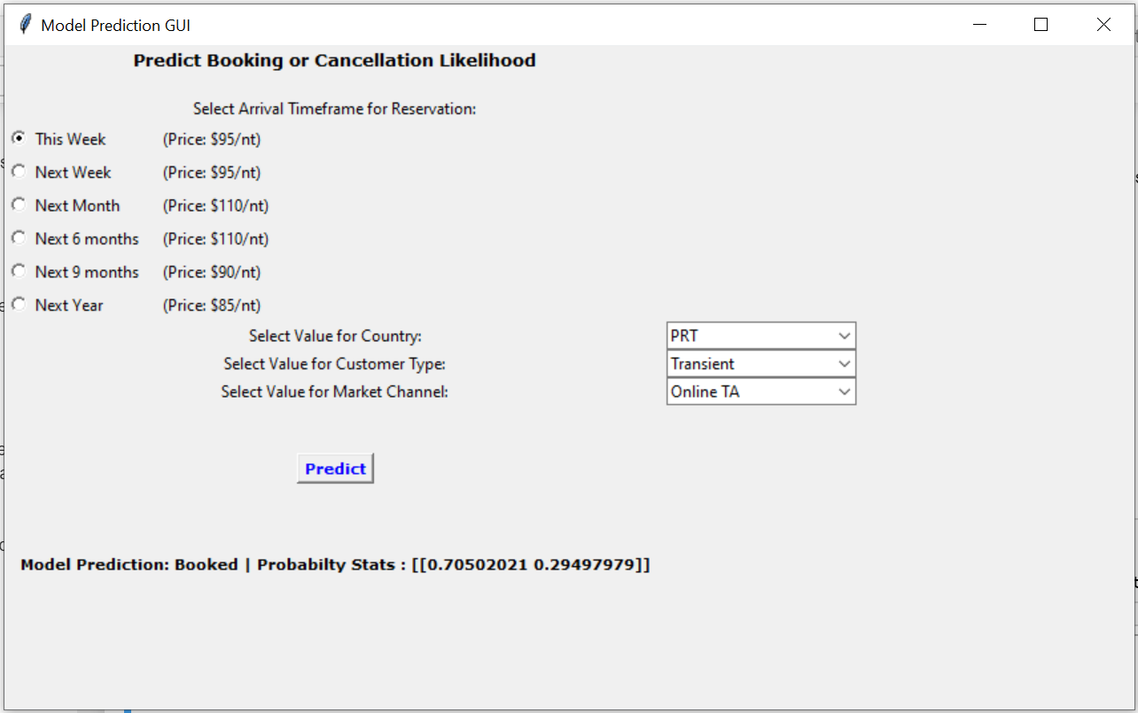
Let’s Do Some Predictions ….
Learn-co.slack.com
@ Sharonda W
Notes:
Demonstration | Single Out-of-Sample prediction using the machine learning model built using RandomForest Classifier.
__
To run demonstration: Run jupyter notebook entitled, “Capstone_Model_Prediction_Using_Tkinter.ipynb”.

Slide 15

Future Work
Perform analysis between the city hotel and resort separately.
Build a neural network to increase accuracy from 88% to 90%.
Create a GUI to convert low cancellation probabilities into revenue.
Perform analysis to determine which OTA will serves hotel better.
Analyze data from weather, holidays and online prices/inventory.
Notes:
Perform analysis between the city hotel and resort to gain insights into cancellation behaviors.
Build a neural network to determine if an increase in accuracy can be achieved from 88% to 90%.
Create a GUI to help hotel convert low cancellation probabilities into revenue, by offering suggestions for amenities, price discounts, etc.
Perform analysis to determine which OTA will serve the hotel business better.
Analyze data from weather, holidays, events, social reputation, and online prices/inventory.

Slide 16

Thank you!
Learn-co.slack.com
@ Sharonda W
LinkedIn: https://www.linkedin.com/in/sharonda-pettiett-8975693b/
Github: https://github.com/spettiett/dsc-capstone-project-v2-online-ds-pt-061019
Notes:
Thank you!
__
LinkedIn: https://www.linkedin.com/in/sharonda-pettiett-8975693b/
Github: https://github.com/spettiett/dsc-capstone-project-v2-online-ds-pt-061019

