Slide 1
Motional Control of Loudspeakers
Sujit Malde, ela17sm
Electrical and Electronic Engineering 3rd Year Project, 2nd Marker Viva

Slide 2
Project Definition
Loudspeakers are run open-loop… for no real reason
Subwoofers are the most non-linear of loudspeakers
Why not just ‘build them better’?
Project aim and description from PID/INT

Slide 3
Technical Understanding of Project
Background theory and research shows that electronic compensation, especially closed-loop compensation, is the best way forward
Open-loop compensator has been designed (show sums)
Closed-loop compensator not designed yet
Importance of careful design highlighted
Results of simulations and hopefully actual subwoofer performance if this can be achieved.
Background theory

Slide 4
Technical Understanding of Project
Background theory reveals two essential things:
Subwoofers have the most distortions and non-linearities of all the loudspeakers
Subwoofers would benefit from an electronic ‘extension’ of their bass response because the lowest frequencies are the hardest to reproduce.
Background research shows that implementing a control system onto a loudspeaker is quite feasible

Slide 5
Milestone Evaluation
Supervisor estimates a 4 week lag behind schedule
Most work can feasibly be completed on time.

Slide 6
Developing Technologies
A novel method of designing and implementing all required open- and closed-loop circuitry could be by using a field-programmable analogue array, such as those designed by Anadigm. Limits physical size and complexity of solutions, allows for patches from manufacturers to users, could even make a GUI to allow users to tune their own devices (although probably not possible because you need to program them through MATLAB)

Slide 7
Motional Control of Loudspeakers
Sujit Malde, ela17sm, Electrical and Electronic Engineering 3rd Year Project
2nd Marker Viva

Slide 8
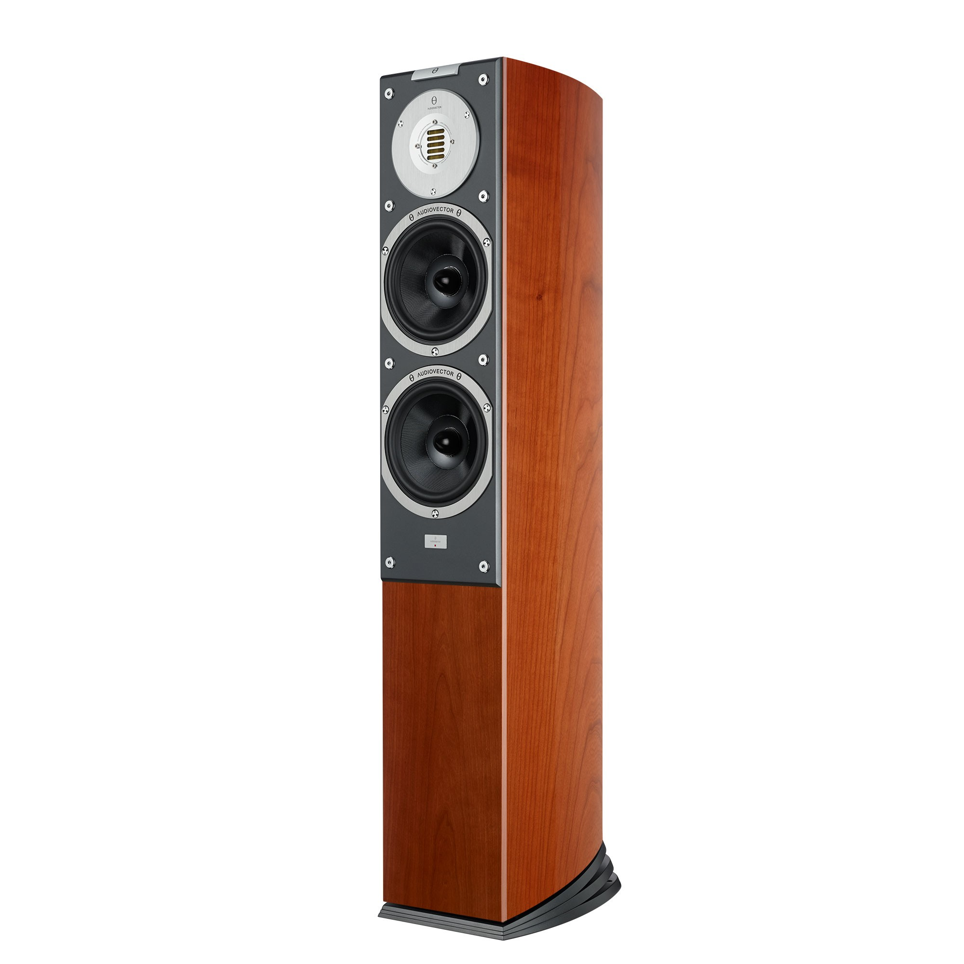
The Problem with Loudspeakers
Not normally controlled
Distortions and non-linearities are rife
Expensive
Manufacturers must spend lots to make loudspeakers ‘perfect’
Most consumers can’t buy good audio
£12000 excluding rest of the system!
https://audiovector.com/sr-3-avantgarde-arrete.html

Slide 9
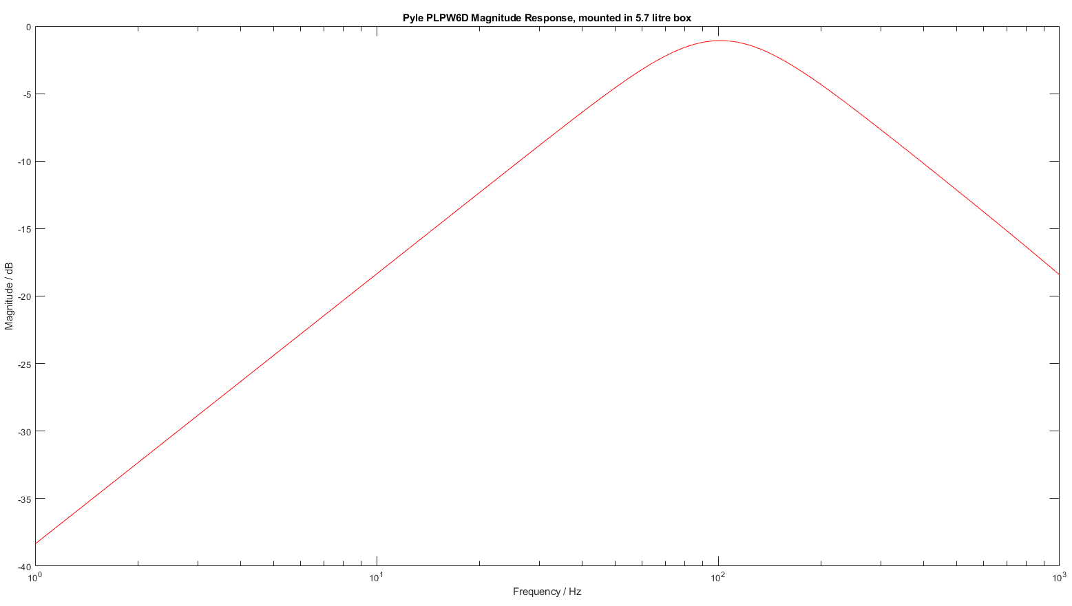
The Problem with Loudspeakers
Background theory shows that:
Subwoofers have the most non-linearities of all the loudspeakers
Subwoofers can have their bass response extended ’for free’
Manufacturers already spending lots on R&D to make uncompensated systems sound good
Shown: typical poor subwoofer response, -15dB down at 20Hz

Slide 10
The solution
Open- and closed-loop compensators
Electronic solution is cheap, easy to manufacture and install
Fewer distortions, fewer non-linearities = cleaner sound reproductions
‘Free’ extension of bass response = better sound from the same physical system

Slide 11
The process
Ideally:
Choose a subwoofer
Make an enclosure for the subwoofer
Open-loop compensator:
Design
Build
Closed-loop compensator:
Design
Build
Testing and tuning throughout

Slide 12
Choosing a subwoofer
Choose a cheap model to prove that good quality sound can be achieved cheaply, in comparison to expensive high-quality systems.
Pyle PLPW6D was cheap and easy to acquire, features two voice coils – potential for sensing/driving setup
We are trying to prove that the open- and closed-loop electronic compensators can make systems sound better than they are, passing on a monetary benefit. Therefore, a cheap system should be made and improved, and then tested against a more expensive model to prove that consumers gain the monetary advantage discussed previously.

Slide 13









Enclosure design
Background theory shows that loudspeakers can be modelled as equivalent electrical circuits:
$$R_{E}$$
$$L_{E}$$
$$I$$
$$V_{in}$$
$$M_{MS}\left(Bl^{2}\right)$$
$$\frac{C_{MS}}{{\left(Bl\right)}^{2}}$$
$$\frac{{\left(Bl\right)}^{2}}{R_{MS}}$$
$$\frac{C_{B}}{{\left(Bl\right)}^{2}}$$
$$\frac{{\left(Bl\right)}^{2}}{R_{B}}$$
Fig. 3 Final loudspeaker electrical and equivalent mechanical circuit
Red indicates voice coil circuit parameters
Blue indicates equivalent circuit parameters for the driver mechanical circuit
Green indicates equivalent circuit parameters for the box mechanical circuit
Electrical and mechanical circuits can be thought of as primary and secondary of a transformer with turns ratio equivalent to Bl factor of driver magnet
Useful for SPICE/MATLAB but not easy information for end-users to digest – Thiele/Small parameters used instead

Slide 14
Enclosure Design
Take T/S parameters from manufacturer
Convert to electromechanical equivalent circuit
Add in box circuit elements

Slide 15
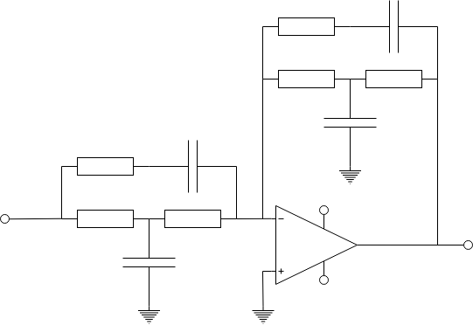















Open-loop circuit design – Linkwitz Transform
For a loudspeaker in an enclosure:
Brings up magnitude response
Reduces group delay
Easy to design, made trivial using resources on the late designer’s website
$$C_{2}$$
Gain / dB
$$R_{2}$$
$$f_{0}=\frac{1}{2πR_{1}\sqrt{C_{1}C_{2}}}$$
$$Q_{0}=\frac{R_{1}}{{2R}_{1}+R_{2}}\sqrt{\frac{C_{1}}{C_{2}}}$$
$$f_{1}=\frac{1}{πR_{1}C_{1}}$$
$$f_{2}=\frac{1}{2π{(R}_{2}+R_{3})C_{2}}$$
$$R_{3}$$
$$R_{3}$$
$$C_{3}$$
$$C_{2}$$
$$R_{2}$$
$$V_{in}$$
$${+V}_{s}$$
$$R_{1}$$
$$R_{1}$$
$$V_{out}$$
f₀
Frequency / Hz
$$C_{1}$$
$${−V}_{s}$$
f₂
f₁
Q₀

Slide 16
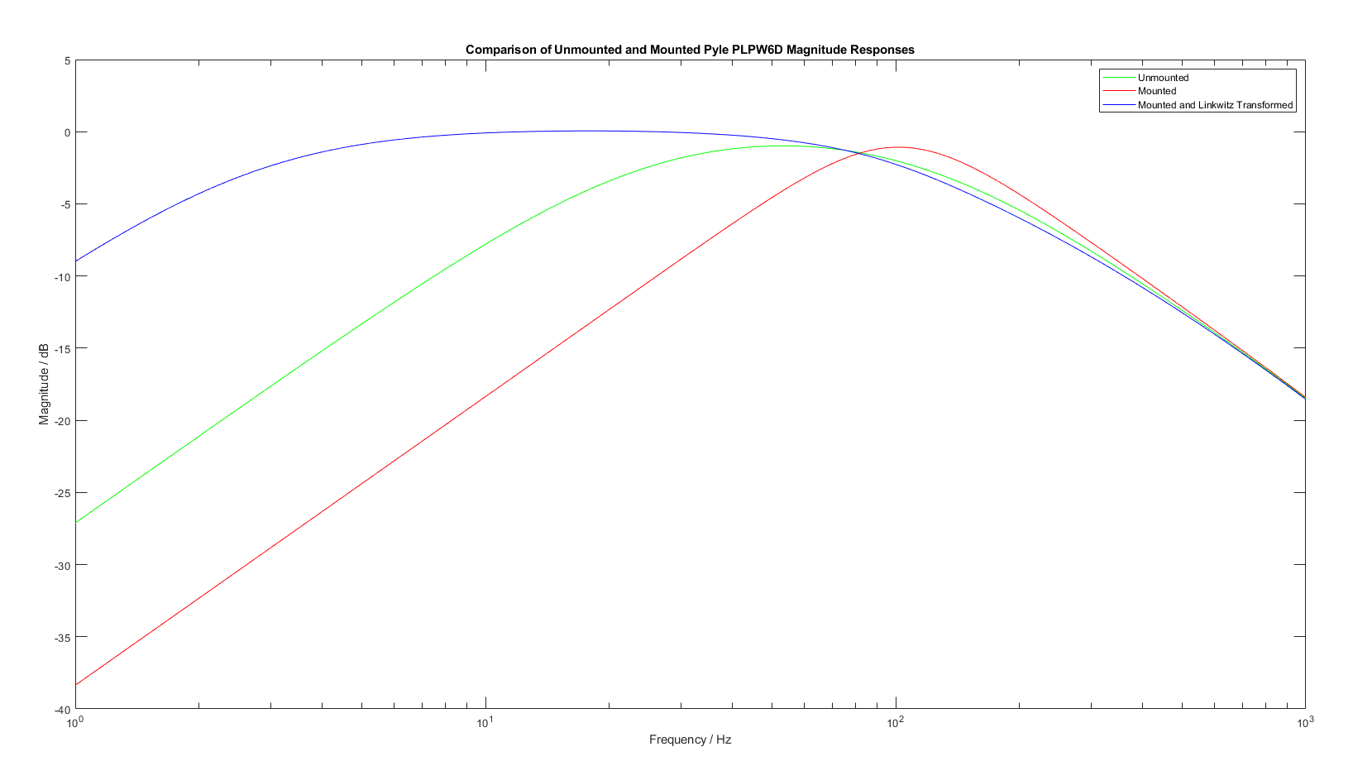
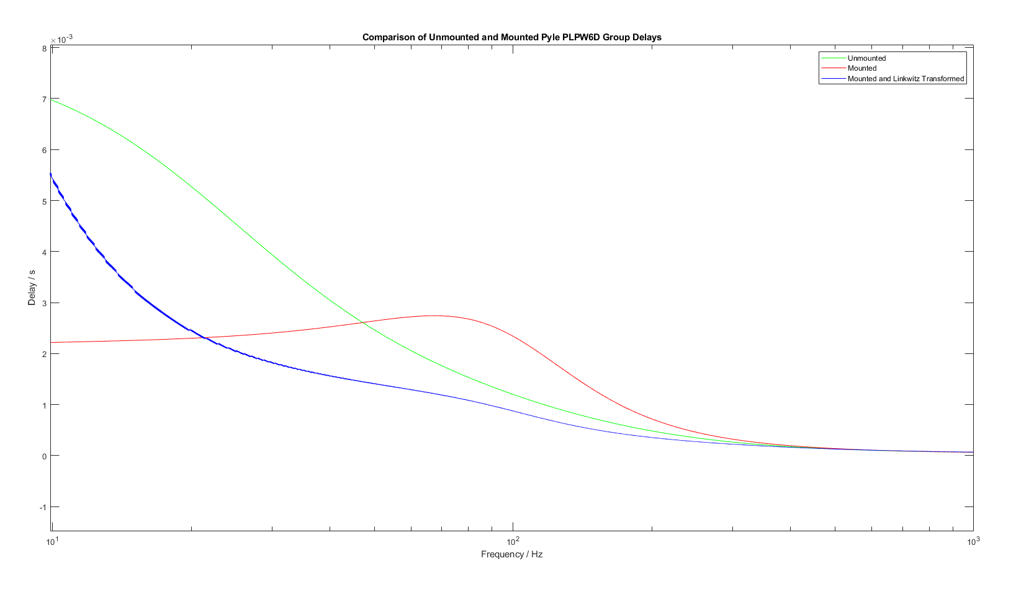
Results
As expected, magnitude response improved massively at low frequencies
In practice this is unobtainable because too much air needs to be moved, cone displacement will exceed maximum allowed value
Group delay of the system improved for most of the range of operation
Improvement by as much as 2ms around 45Hz
System will respond faster to an input, reach a nominal value faster

Slide 17
Plans
Make and test open-loop compensator
Design, simulate, build closed-loop compensators

