Slide 1
Motional Control of Loudspeakers
Sujit Malde, ela17sm, Electrical and Electronic Engineering 3rd Year Project
Second Marker Viva

Slide 2
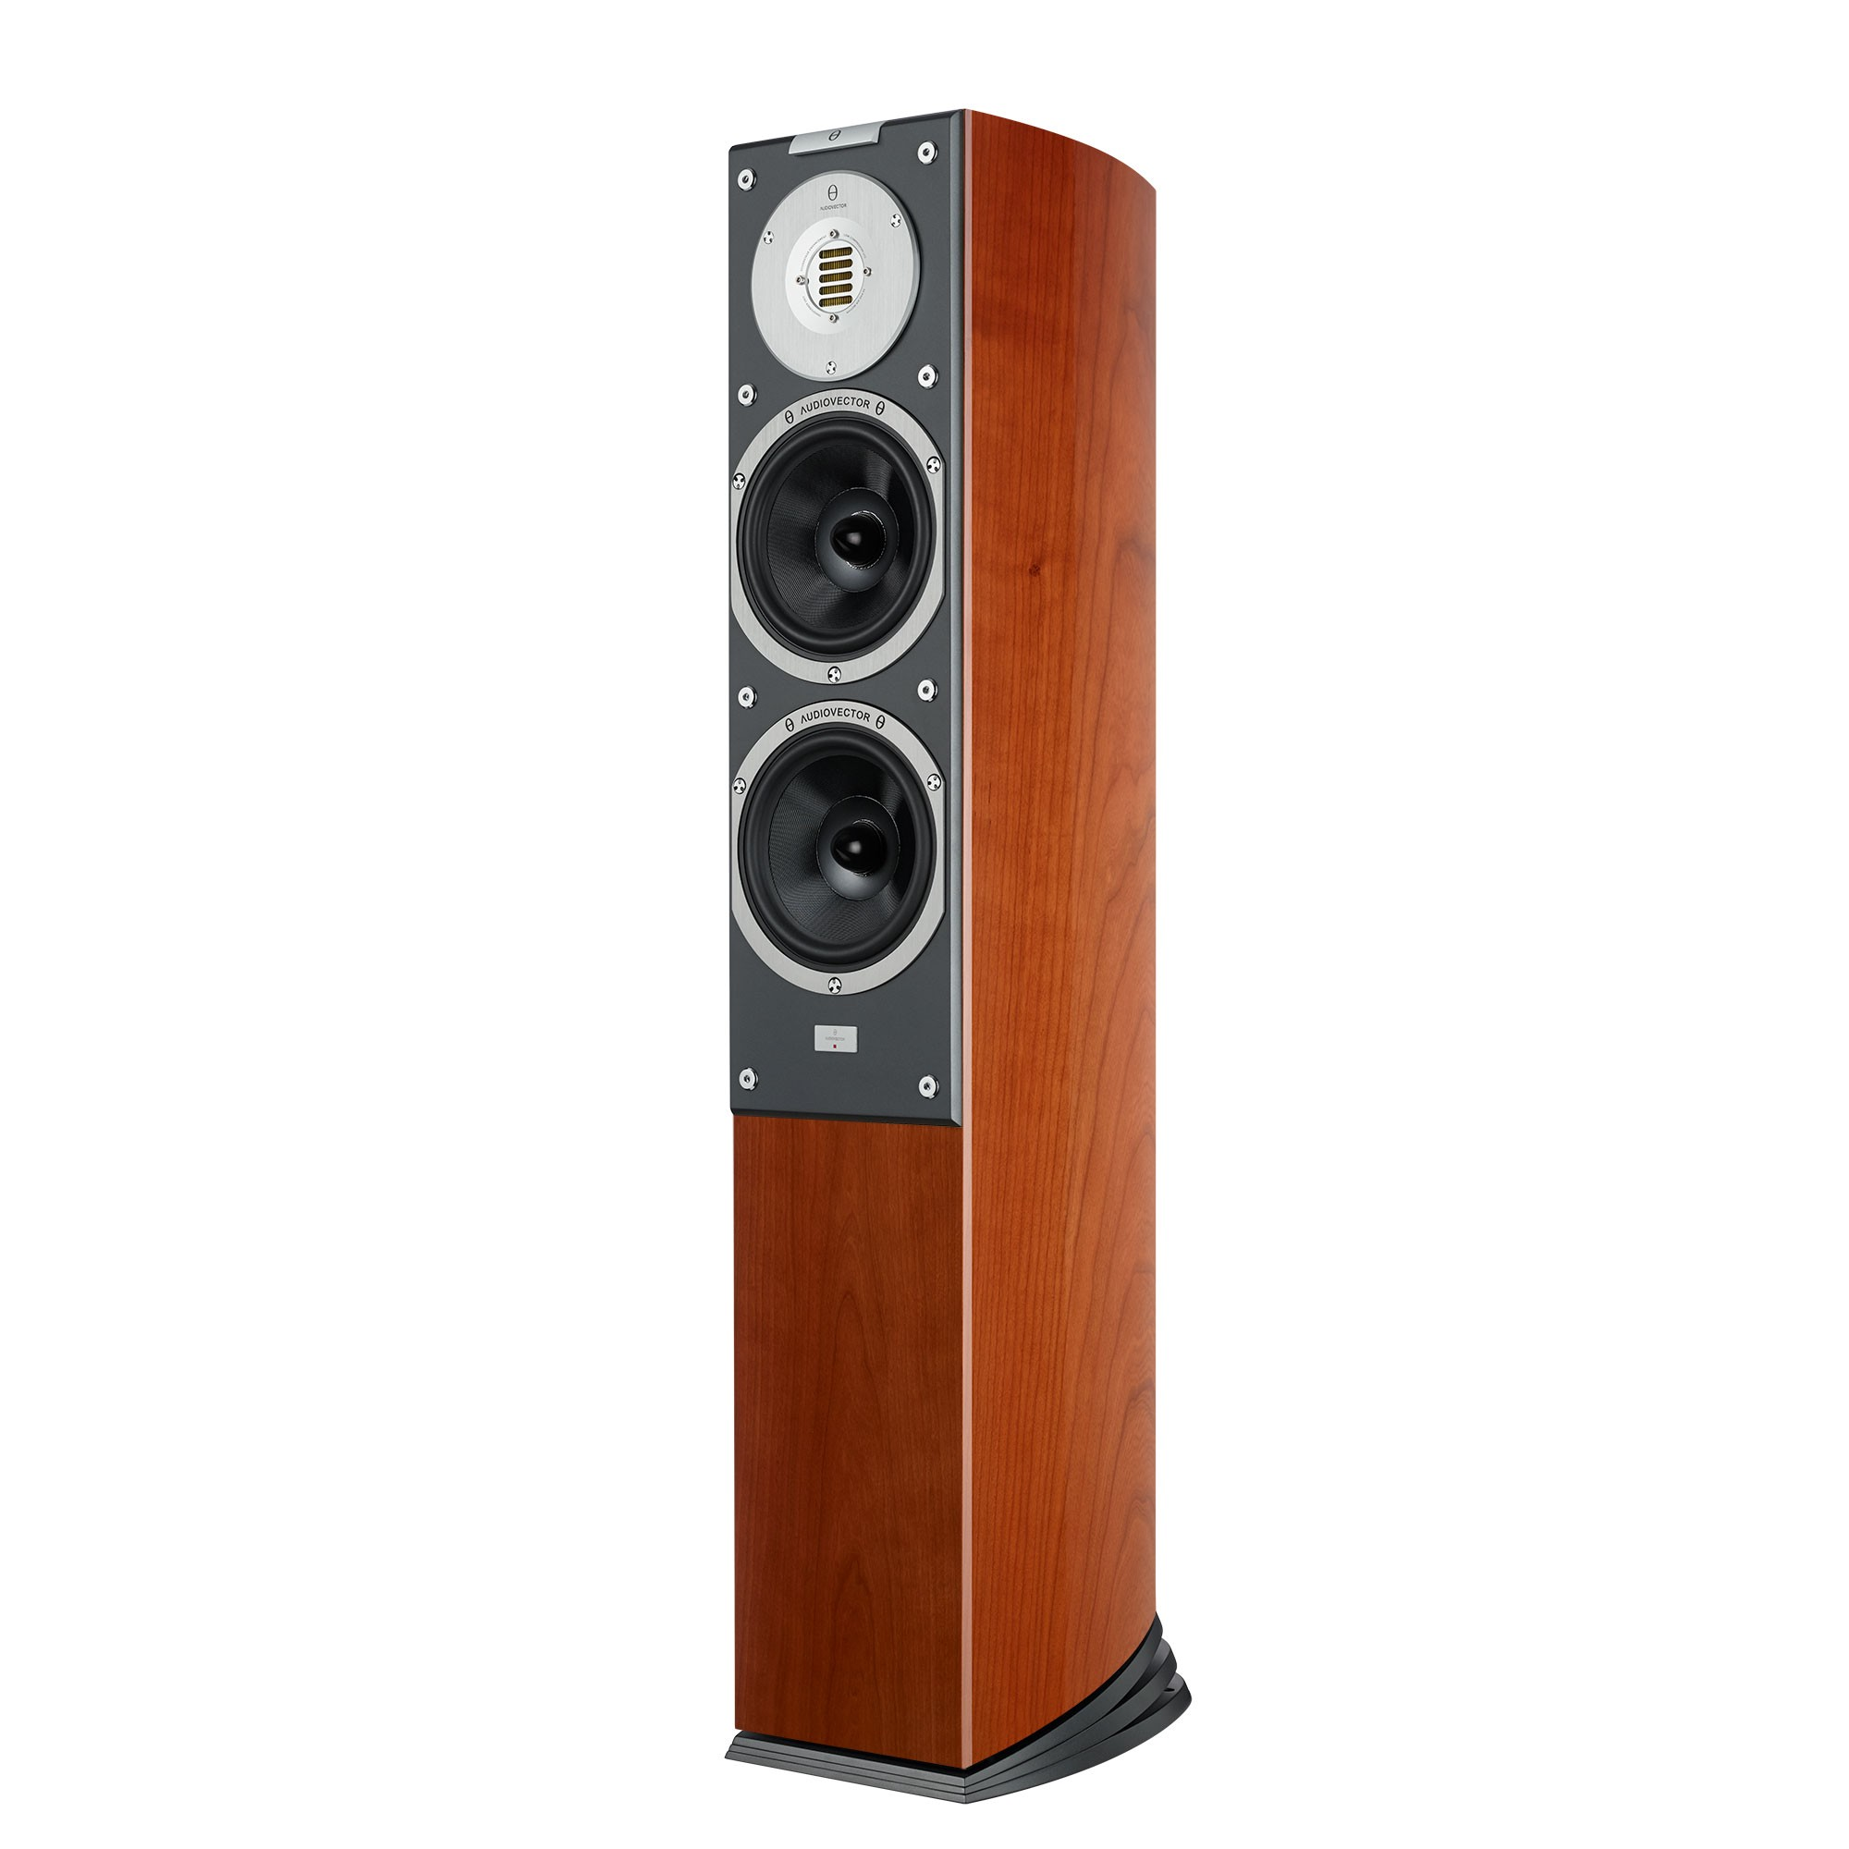
The Problem with Loudspeakers
Not normally controlled
Distortions and non-linearities are rife
Expensive
Manufacturers must spend lots to make loudspeakers ‘perfect’
Most consumers can’t buy good audio
£12000 excluding rest of the system!
https://audiovector.com/sr-3-avantgarde-arrete.html

Slide 3
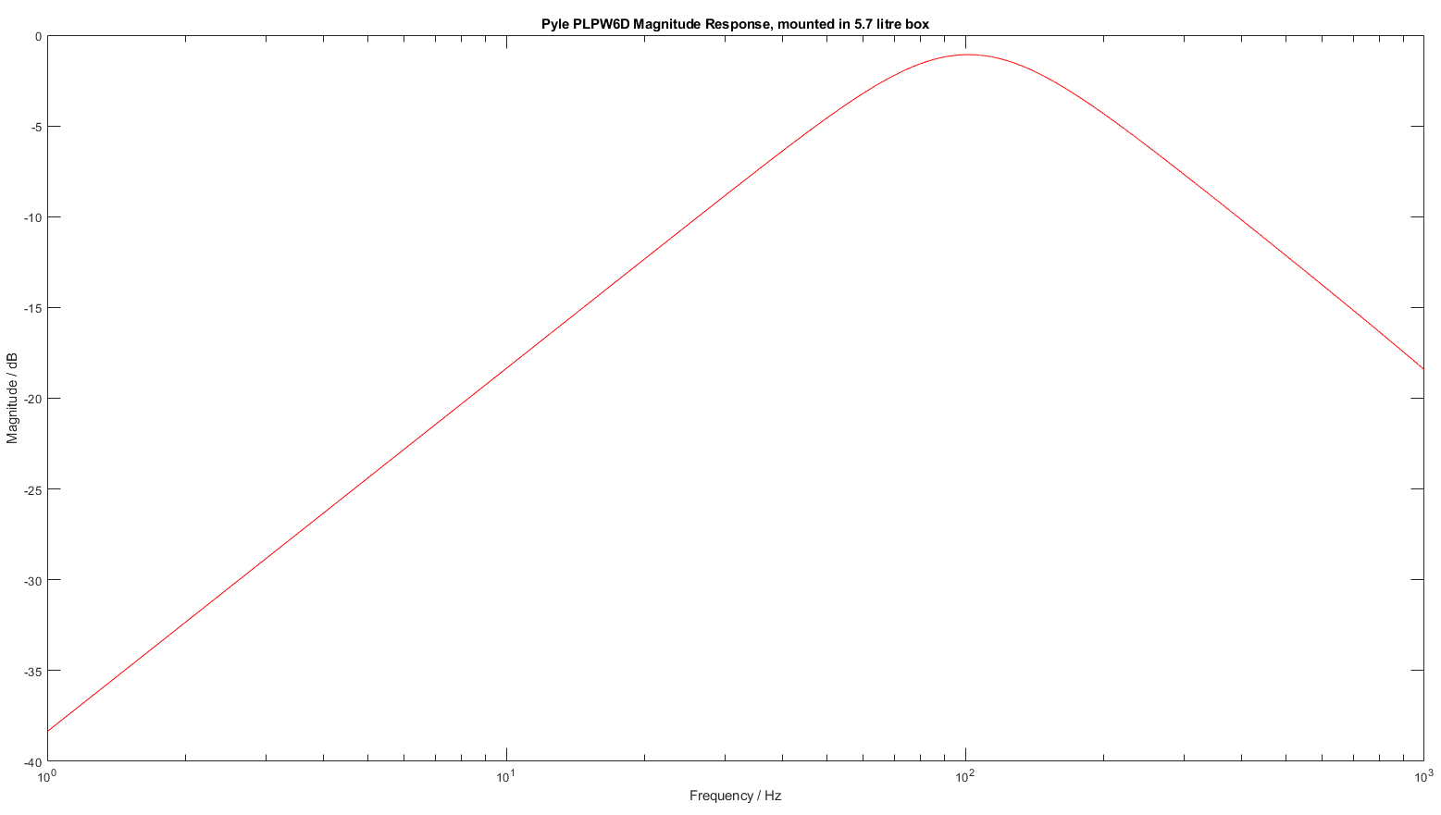
The Problem with Loudspeakers
Background theory shows that:
Subwoofers have the most non-linearities of all the loudspeakers
Subwoofers can have their bass response extended ’for free’
Manufacturers already spending lots on R&D to make uncompensated systems sound good
10⁰
10¹
10²
10³
Frequency / Hz
Shown: typical poor subwoofer response, -15dB down at 20Hz

Slide 4
The solution
Open- and closed-loop compensators
Electronic solution is cheap, easy to manufacture and install
Fewer distortions, fewer non-linearities = cleaner sound reproductions
‘Free’ extension of bass response = better sound from the same physical system

Slide 5
The process
Ideally:
Choose a subwoofer
Make an enclosure for the subwoofer
Open-loop compensator:
Design
Build
Closed-loop compensator:
Design
Build
Testing and tuning throughout

Slide 6
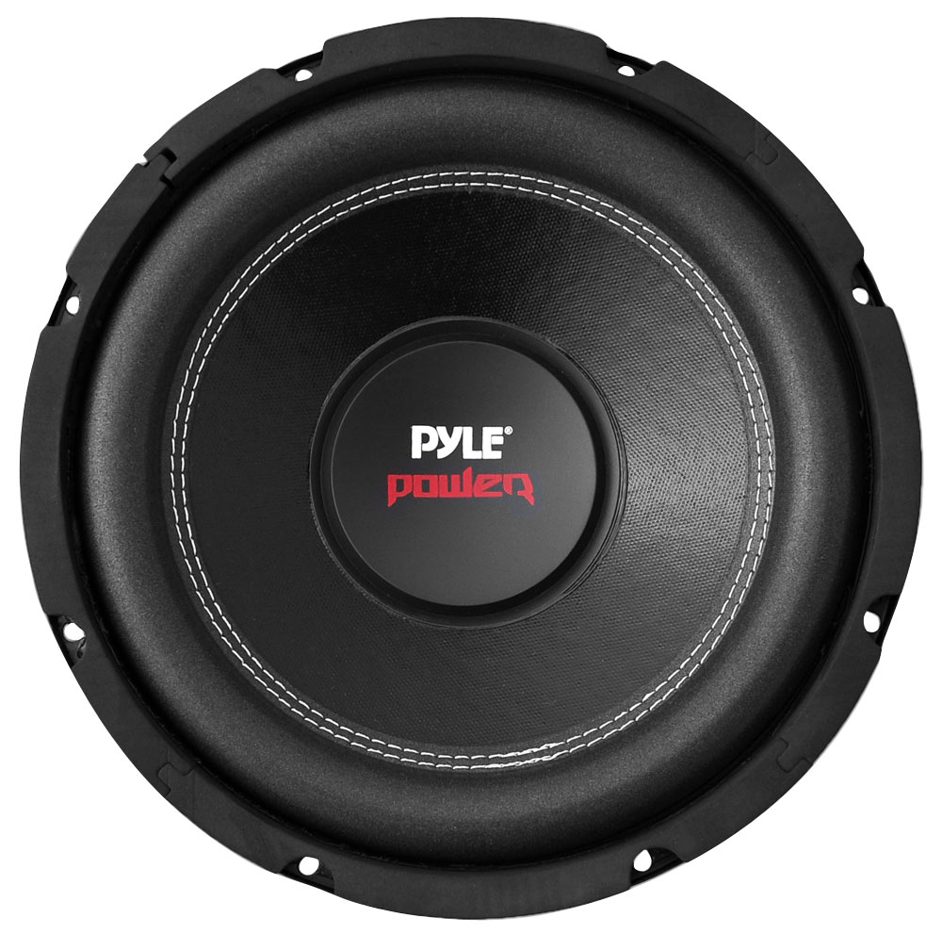
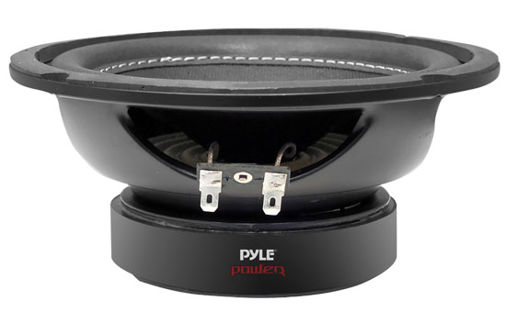
Choosing a subwoofer
https://www.thompsonsltd.co.uk/touring-and-leisure/plpw6d-pyle-plpw6d-6.5-600-watt-dual-voice-coil-4-ohm-subwoofer.html

Slide 7









Enclosure design
Background theory shows that loudspeakers can be modelled as equivalent electrical circuits:
$$R_{E}$$
$$L_{E}$$
$$I$$
$$V_{in}$$
$$M_{MS}\left(Bl^{2}\right)$$
$$\frac{C_{MS}}{{\left(Bl\right)}^{2}}$$
$$\frac{{\left(Bl\right)}^{2}}{R_{MS}}$$
$$\frac{C_{B}}{{\left(Bl\right)}^{2}}$$
$$\frac{{\left(Bl\right)}^{2}}{R_{B}}$$
Red indicates voice coil circuit parameters
Blue indicates equivalent circuit parameters for the driver mechanical circuit
Green indicates equivalent circuit parameters for the box mechanical circuit
Electrical and mechanical circuits can be thought of as primary and secondary of a transformer with turns ratio equivalent to Bl factor of driver magnet
Useful for SPICE/MATLAB but not easy information for end-users to digest – Thiele/Small parameters used instead

Slide 8
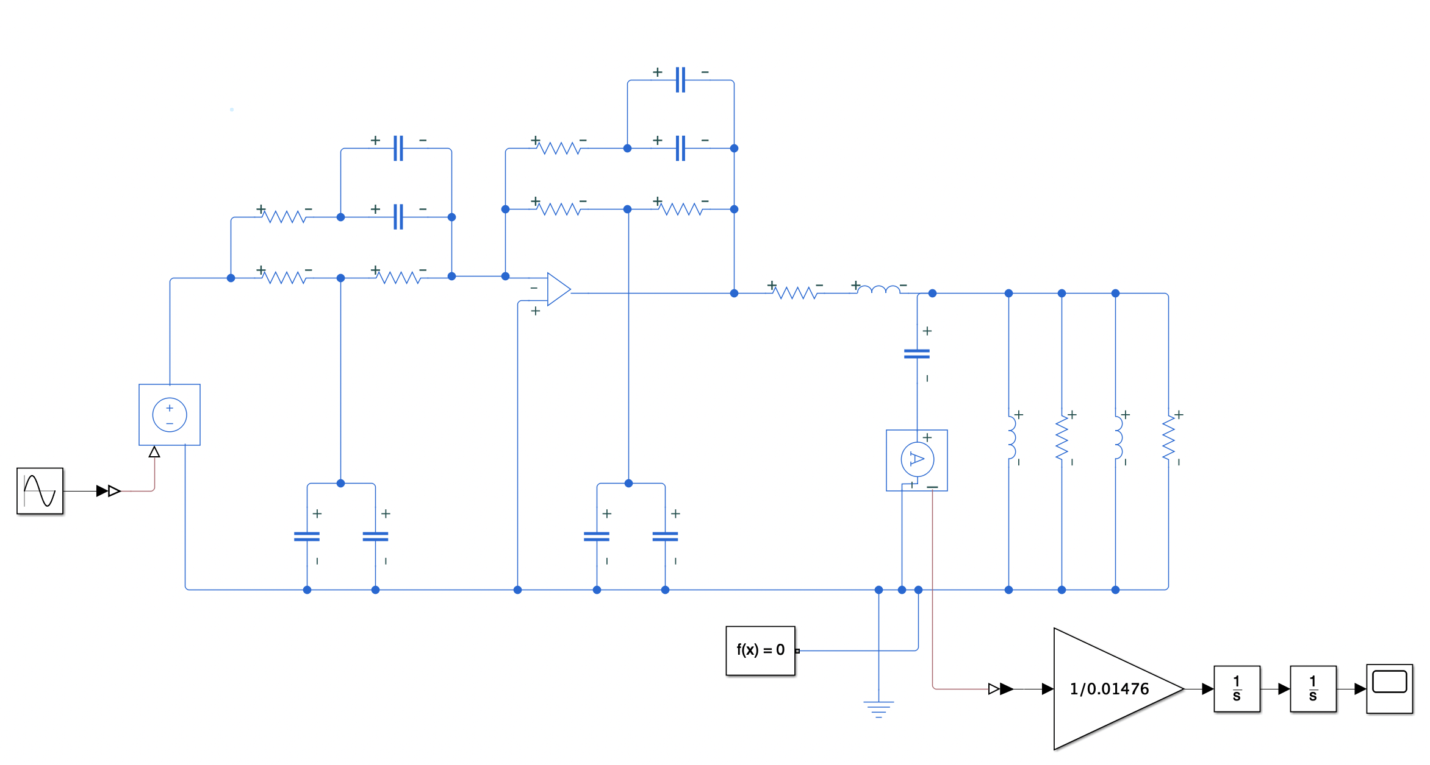
Enclosure Design
Take T/S parameters from manufacturer
Convert to electromechanical equivalent circuit
Add in box circuit elements
Refine

Slide 9
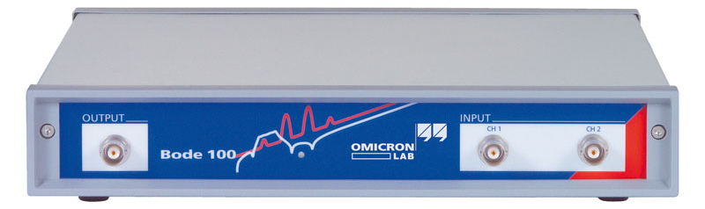
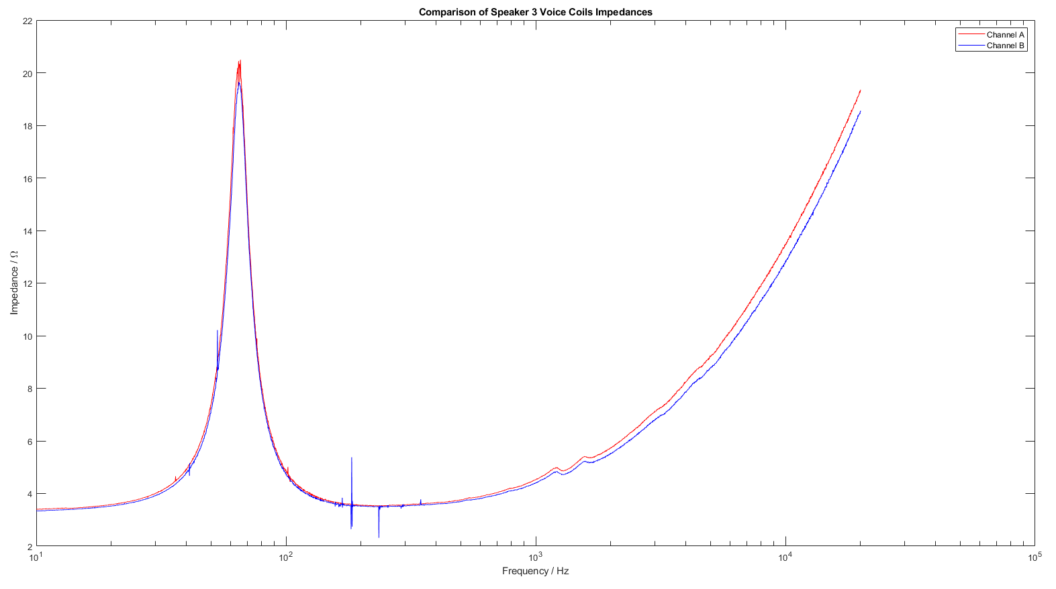
Impedance Measurements
All different permutation of connections were made and measured:
Series
Parallel (in 1 out 2)
Anti-parallel (in 2 out 1)
Replace manufacturer given T/S parameters with these – also yields more accurate Bl

Slide 10
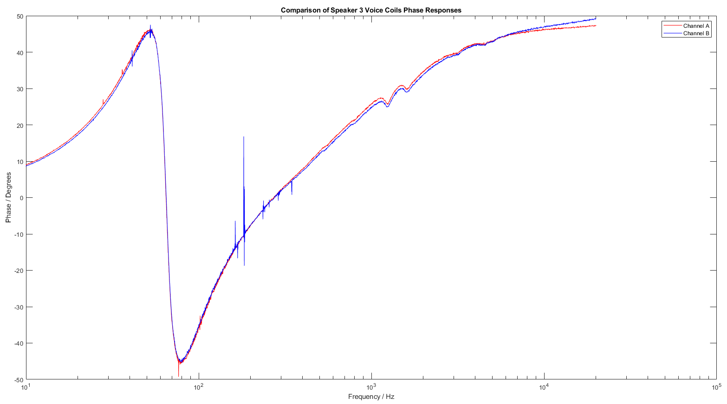

Slide 11
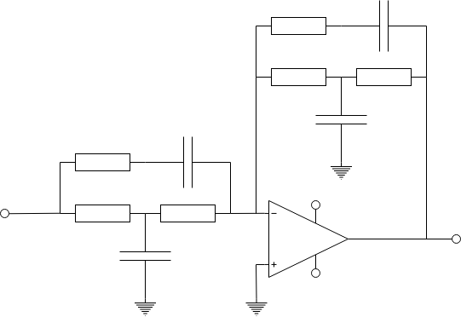















Open-loop circuit design – Linkwitz Transform
For a loudspeaker in an enclosure:
Brings up magnitude response
Reduces group delay
Easy to design, made trivial using resources on the late designer’s website
$$C_{2}$$
Gain / dB
$$R_{2}$$
$$f_{0}=\frac{1}{2πR_{1}\sqrt{C_{1}C_{2}}}$$
$$Q_{0}=\frac{R_{1}}{{2R}_{1}+R_{2}}\sqrt{\frac{C_{1}}{C_{2}}}$$
$$f_{1}=\frac{1}{πR_{1}C_{1}}$$
$$f_{2}=\frac{1}{2π{(R}_{2}+R_{3})C_{2}}$$
$$R_{3}$$
$$R_{3}$$
$$C_{3}$$
$$C_{2}$$
$$R_{2}$$
$$V_{in}$$
$${+V}_{s}$$
$$R_{1}$$
$$R_{1}$$
$$V_{out}$$
f₀
Frequency / Hz
$$C_{1}$$
$${−V}_{s}$$
f₂
f₁
Q₀

Slide 12
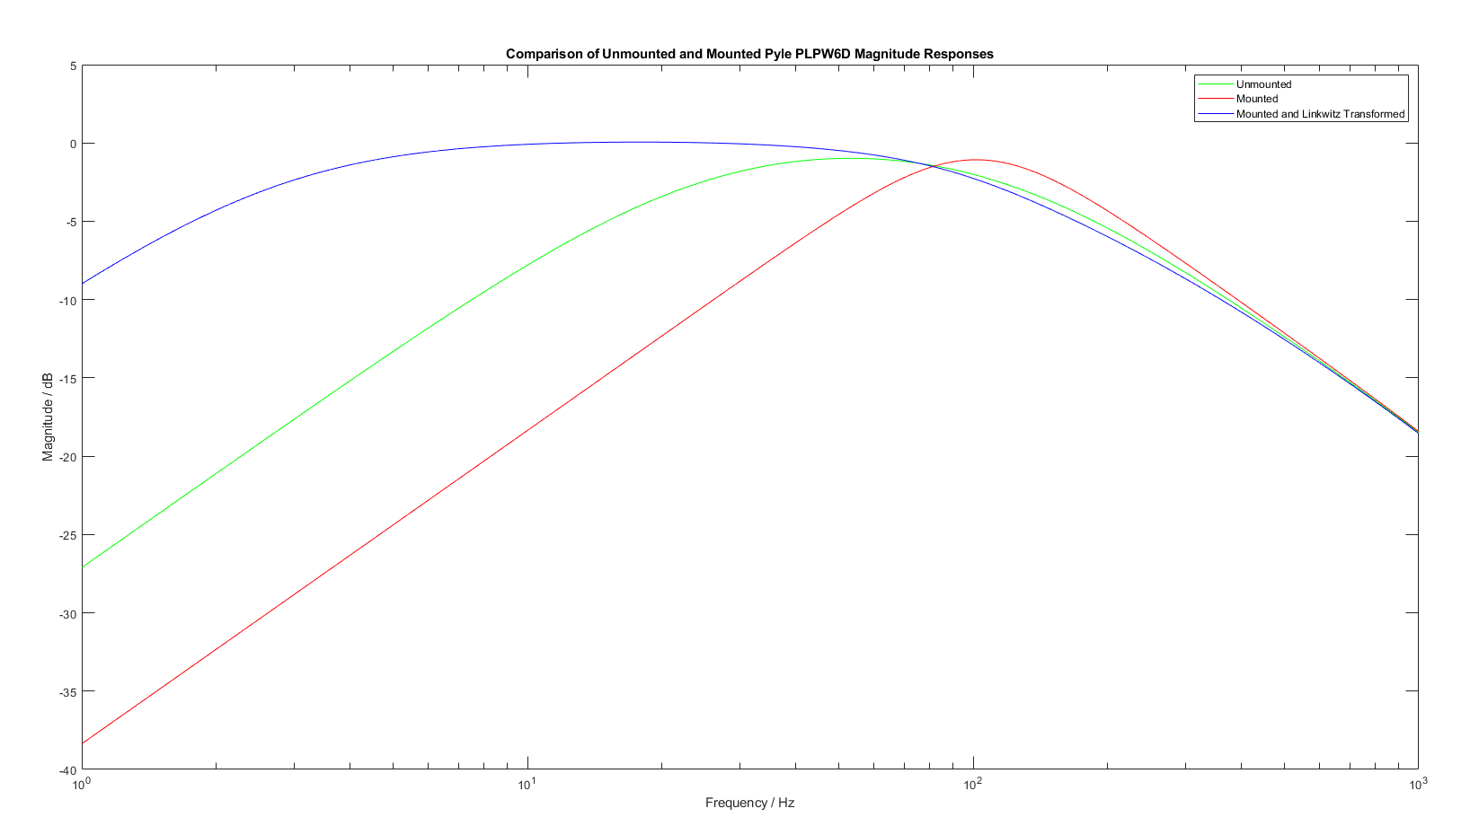
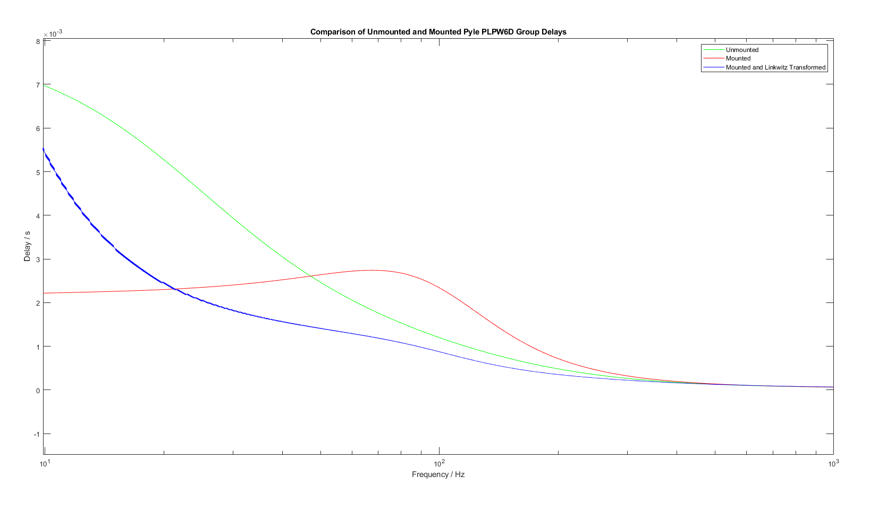
Results
As expected, magnitude response improved massively at low frequencies
In practice this is unobtainable because too much air needs to be moved, cone displacement will exceed maximum allowed value
Group delay of the system improved for most of the range of operation
Improvement by as much as 2ms around 45Hz
System will respond faster to an input, reach a nominal value faster

Slide 13
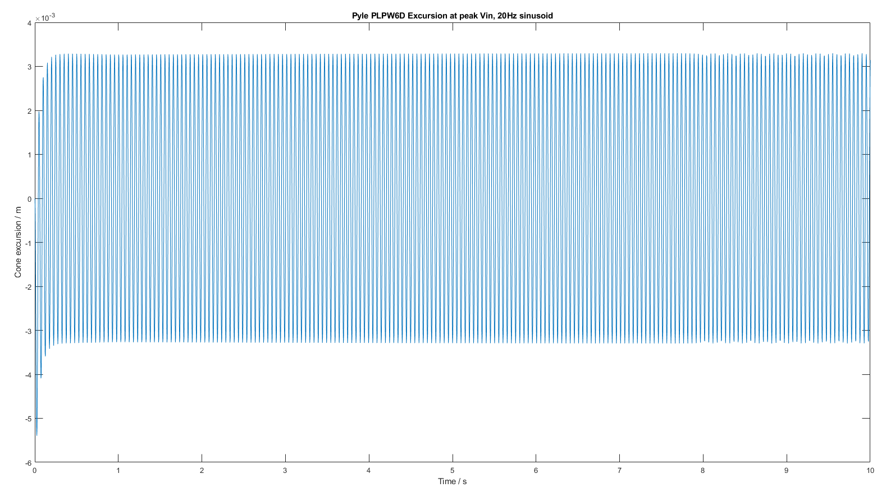
Results
Simulink model confirms that existing setup of Linkwitz Transform, driver, box does not exceed physical limitations
Important result – LT may not have worked for this driver

Slide 14
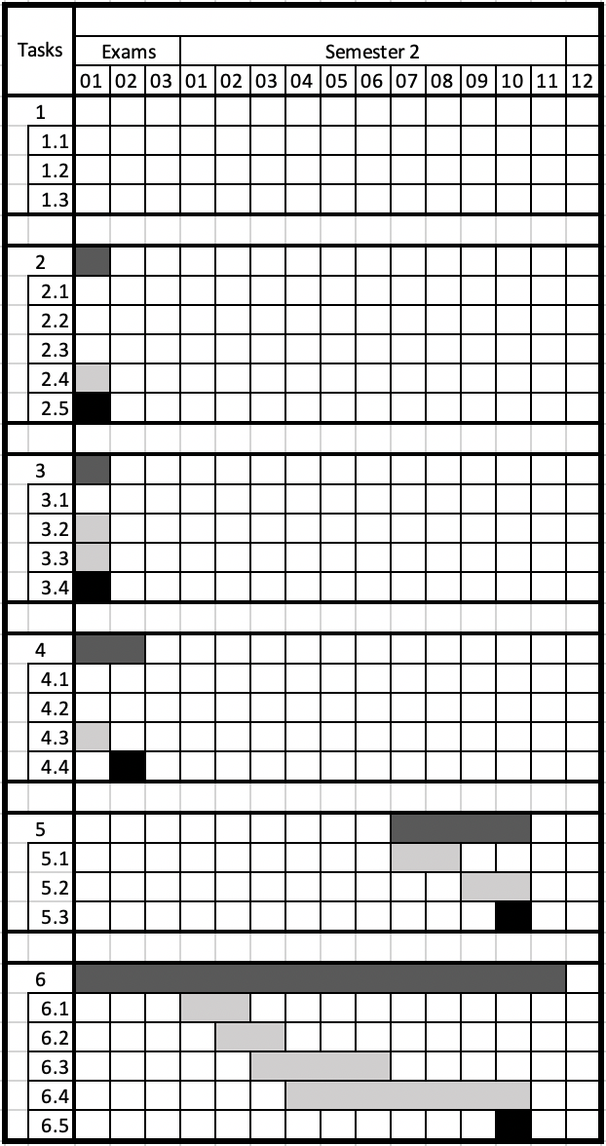
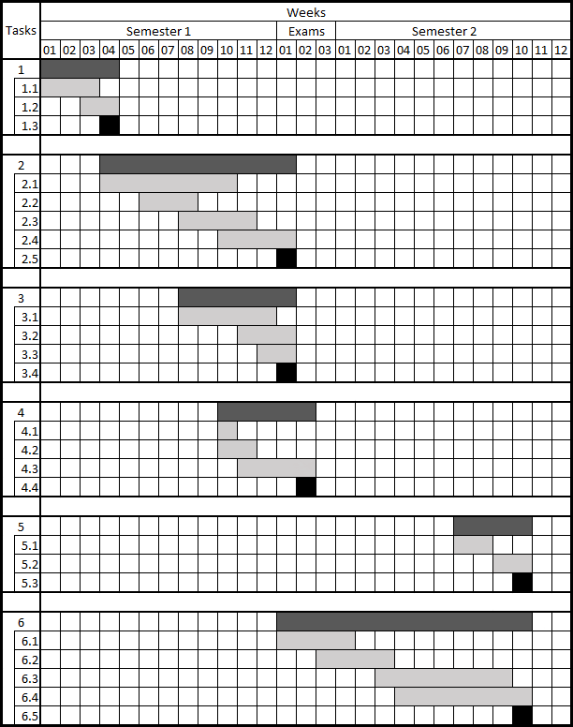
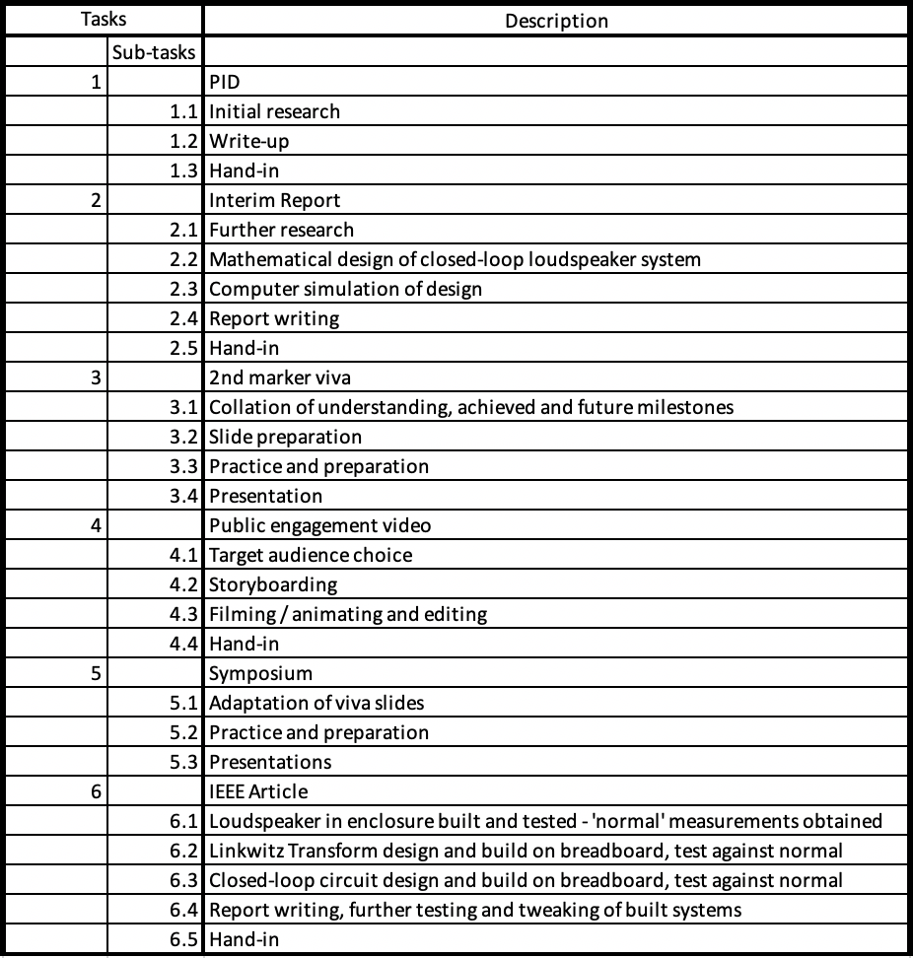
Plans
Finish building subwoofer system
Make and test open-loop compensator
Design, simulate, build closed-loop compensators

Slide 15
Developing Technologies
FPAA (e.g. as made by Anadigm) - easy interfacing with MATLAB/Simulink, mini DSP
Different loudspeaker types other than simple coil-and-cone:
Electrostatic topology
Planar magnetic topology
Each has their own advantages and disadvantages
Most useful innovations are patented!

Slide 16
Thank you for listening, any questions?

