Slide 1

Merge Short

Slide 2
Presented By Instructor
Name: Md. Ibrahim Sarker Prof. Abdul Based
Department of CSE at
Roll: 19 Dhaka International

Slide 3
Introduction
Merge short is a divide and conquer sorting algoritm that breaks down an unshorted list into smaller sublists .
This process is recursive
It’s efficient , general, comperative method for shorting list

Slide 4
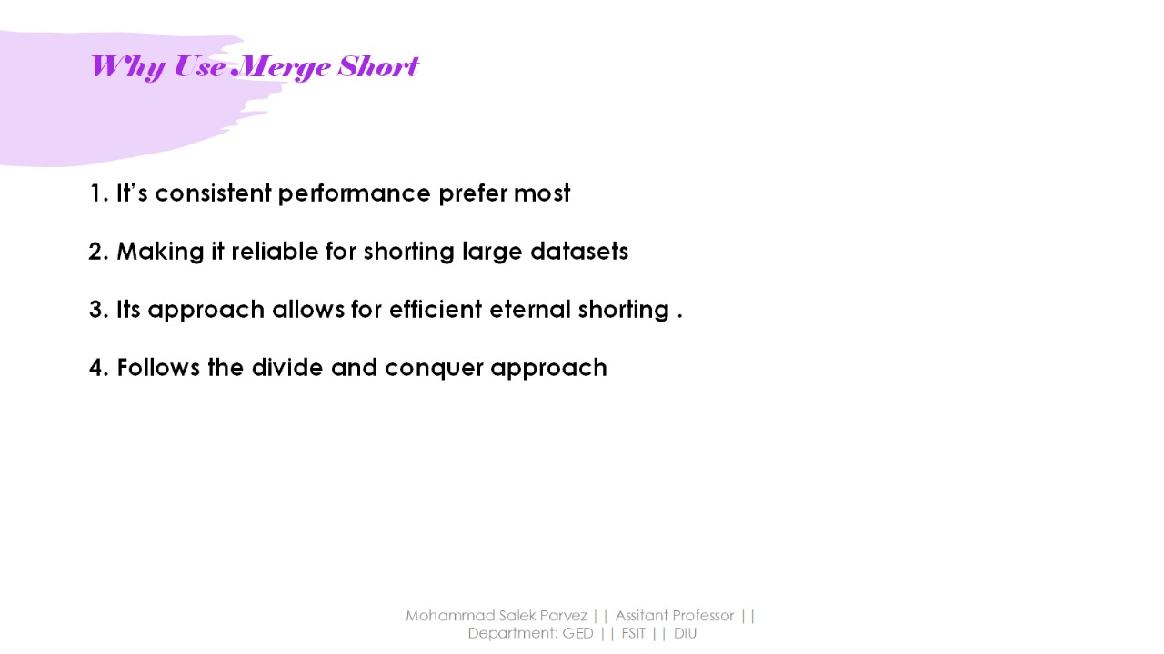

Slide 5
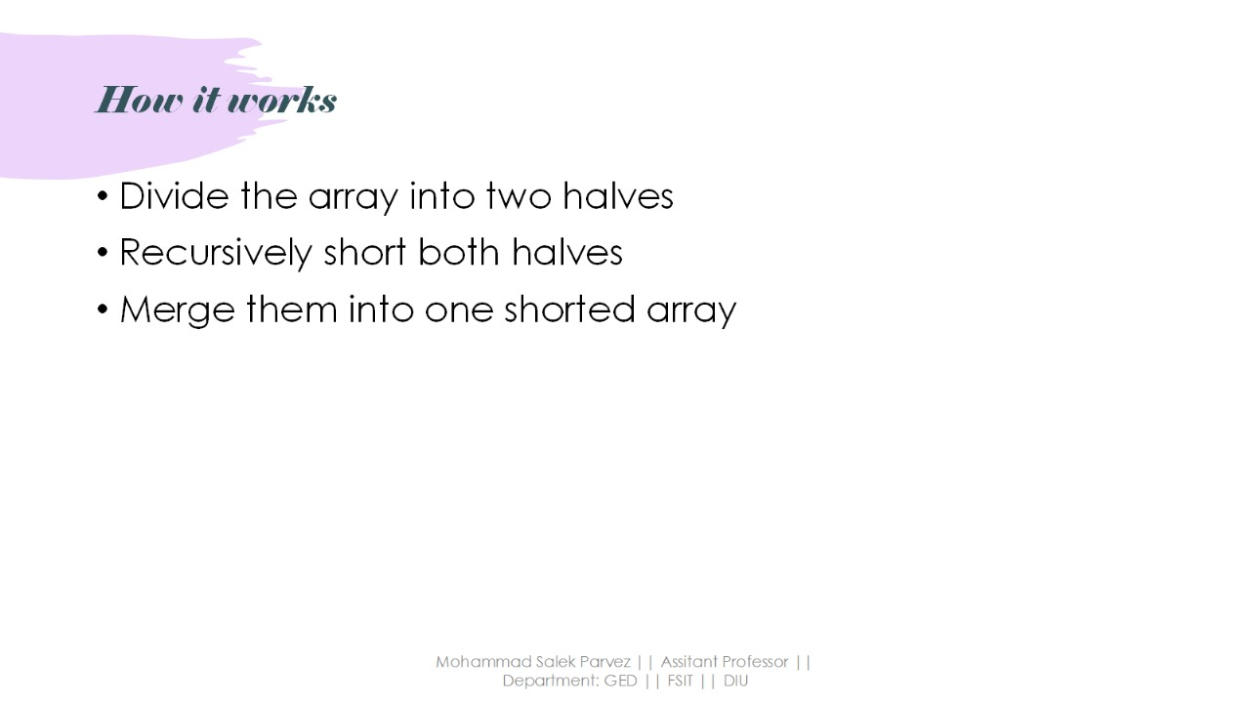

Slide 6
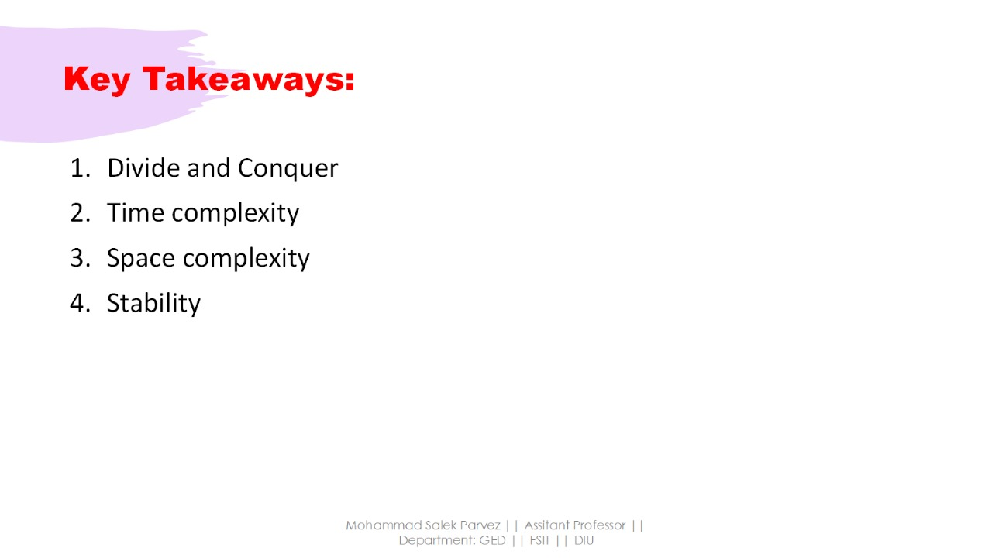

Slide 7
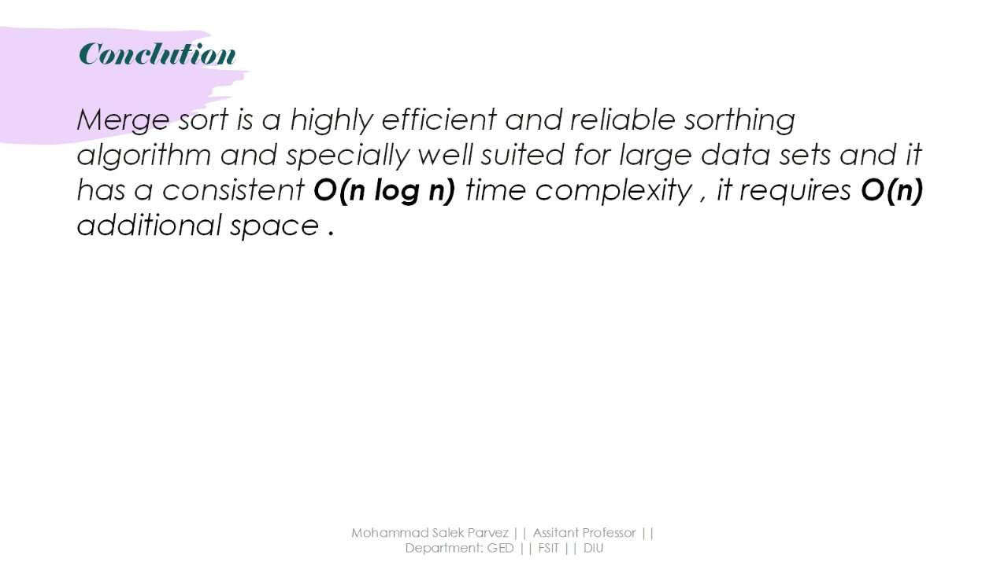

Slide 8


