Slide 1
Dr Spyros Giannelos
Power Portfolio Model
Half-hourly electricity positions and wholesale electricity market cash flows for an energy company’s portfolio
Pre-trade position in each of the 48 half-hours ■ Surplus (long) ■ Shortage (short)
Notes:
The bars show the pre-trade position in each half-hour of the delivery day: green where the portfolio has a surplus, red where it is short. Pre-trade means the position from the company's own electricity generation and its customers’ electricity consumption alone, for that half-hour, before the model's wholesale purchase or sale.

Slide 2



PURPOSE
What the model answers
Electricity Generation Assets
For every half-hour of the delivery day:
Wind and solar PV output in each half-hour.
Is the portfolio long or short?
How much electricity must the company buy or sell?
What does that trade cost or earn?
Customer electricity consumption
Electricity consumed by the company’s customers in the same half-hour.
Wholesale electricity market
Scope: one ordinary delivery day of 48 half-hour settlement periods. Energy in MWh; prices in £/MWh.
Shortfalls are bought and surpluses sold at that half-hour’s wholesale electricity price.
Power Portfolio Model | Dr Spyros Giannelos
Notes:
The model considers the following as its inputs for each half-hour: electricity generation (from the company’s solar PV farm and wind farm), electricity consumption (from the company’s customers) and the wholesale electricity price. From these it works out whether the company’s portfolio is long or short, how much electricity it must trade, and the resulting cash flow.

Slide 3





HOW IT WORKS
How the model functions
STEP 1
STEP 2
STEP 3
STEP 4
STEP 5
Read
Validate
Calculate
Aggregate
Report
Read 1 day of half-hourly inputs from a CSV file.
Check the input data before calculating.
Find each half-hour’s portfolio position, trade and cash flow.
Process the 48 results into daily totals and average prices.
Print the daily report, export a results CSV and produce charts.
Power Portfolio Model | Dr Spyros Giannelos
Notes:
Validation happens before any calculation, so bad data stops the run rather than producing misleading numbers. The outputs are a printed report in the console, a results CSV and four charts.

Slide 4
INPUT DATA
Input data (1)
Field | Unit | Meaning
Delivery date | Date | The model focuses on 1 day, called ‘delivery day’. It has 48 settlement periods (each covers 30 minutes)
Wind generation | MWh | Electricity produced by the company’s wind farm in every settlement period
Solar PV generation | MWh | Electricity produced by the company’s solar PV farm in every settlement period
Customer consumption | MWh | Electricity consumed by the company’s customers in every settlement period
Wholesale price | £/MWh | Wholesale market electricity price, for every settlement period
Power Portfolio Model | Dr Spyros Giannelos
Notes:
The model reads one CSV file with input data.

Slide 5
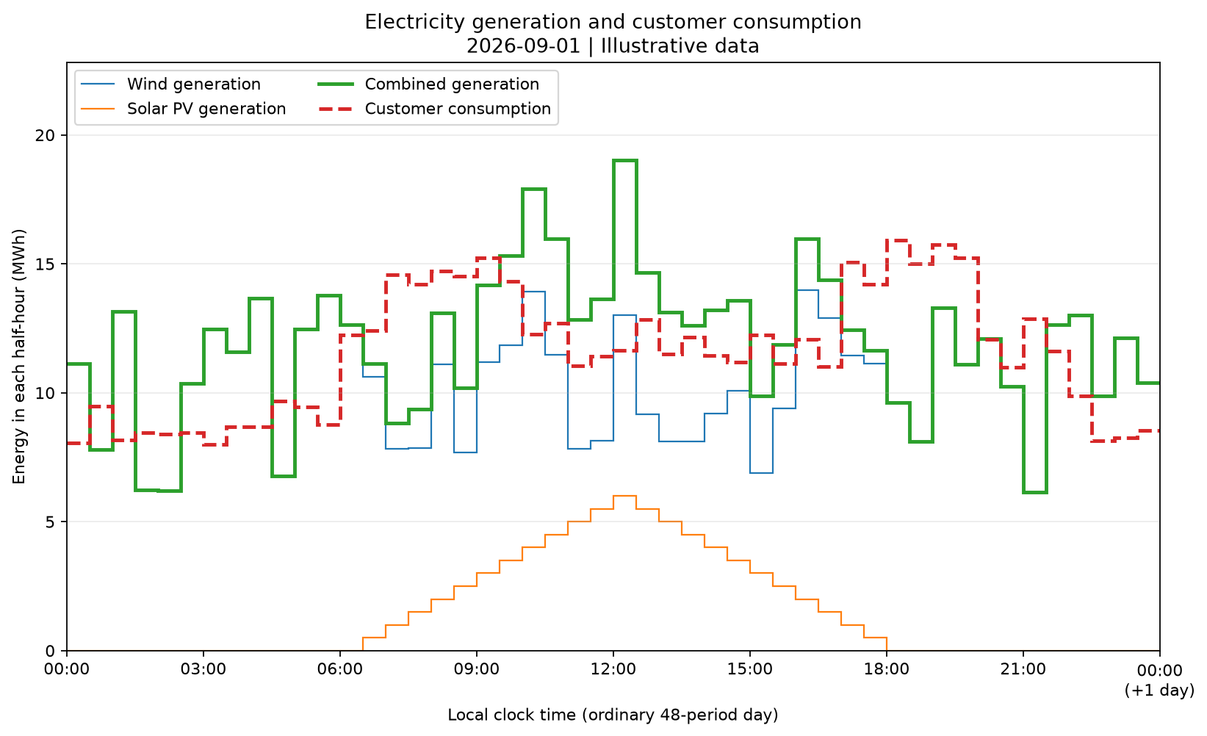


INPUT DATA
Input data (2): Generation & consumption
Over the whole day
We assume the delivery day is on 1st of September 2026. Data are illustrative.
Midday solar boost
Solar adds up to 6 MWh per half-hour, lifting generation above demand.
Demand peaks
Consumption is highest from 07:00 to 10:00 and from 17:00 to 20:00.
Power Portfolio Model | Dr Spyros Giannelos
Notes:
This chart shows electricity (MWh) per half-hour. Electricity generation (MWh) exceeds electricity consumption (MWh) across the day as a whole, but the two peaks in demand are where shortages occur.

Slide 6
INPUT DATA
Input data(3): 48 half-hour settlement periods
Period 1
00:00–00:30
Period 25
12:00–12:30
Period 48
23:30–00:00 (+1 day)
00:00
03:00
06:00
09:00
12:00
15:00
18:00
21:00
00:00
(+1 day)
Start in, end out
Numbered in order
Ordinary days only
Each period includes its start time but not its end time, so periods never overlap.
Records run from 1 to 48.
Days when the clocks change (46 or 50 periods) are outside the current scope.
Power Portfolio Model | Dr Spyros Giannelos
Notes:
The day is divided into 48 half-hour settlement periods. Period 1 starts at midnight and period 48 ends at midnight the following day, which the report labels "+1 day". The model rejects missing, repeated or out-of-order periods.

Slide 7
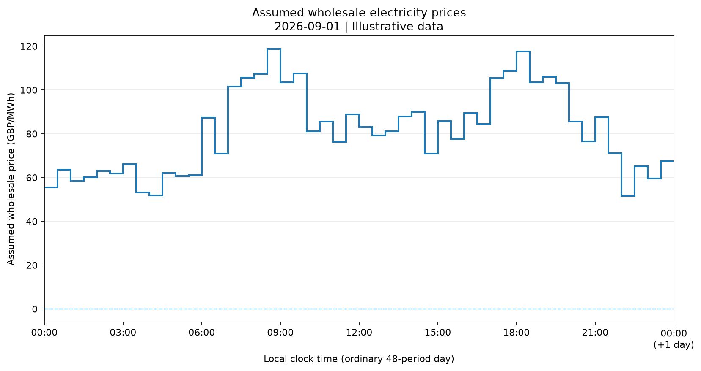
INPUT DATA
Input data(4): Wholesale electricity price
All prices in this day are positive, although the model also handles negative prices.
Prices are highest from 07:00 to 10:00 and 17:00 to 20:00, the same hours as peak consumption.
Power Portfolio Model | Dr Spyros Giannelos
Notes:
All prices in this day are positive, although the model also handles negative prices. The key feature is the price shape: the most expensive hours coincide with peak demand.

Slide 8
CORE LOGIC
The same calculation runs for every half-hour
LONG (net > 0)
Sell the surplus
Total electricity generation
Wind + Solar PV
Net position
Generation − Consumption
Net cash flow
Sale revenue − Purchase cost
SHORT (net < 0)
Buy the shortage
BALANCED (net = 0)
No trade needed
Purchase cost = electricity bought × wholesale price. The company buys electricity shortages from the wholesale market.
Sale revenue = electricity sold × wholesale price. The company sells electricity surpluses to the wholesale market.
The portfolio is long/short at settlement periods when there is an electricity surplus/shortage.
Power Portfolio Model | Dr Spyros Giannelos
Notes:
Every half-hour is calculated independently with the same rules. The position is measured before any trade. A long position is sold (the company sells the surplus electricity to the wholesale electricity market and makes revenue). A short position is bought (the company buys from the wholesale electricity market and has cost. The net market cash flow is equal to sale revenue minus purchase cost.

Slide 9


WORKED EXAMPLE
Example
Settlement Period | Time | Electricity Generated from Wind + solar (MWh) | Electricity Consumption (MWh) | Portfolio Position (MWh) | Company’s Trade with Wholesale Market | Wholesale Electricity Price (£/MWh) | Company’s Cash flow with Wholesale Market
25 | 12:00–12:30 | 8 + 2 = 10 | 12 | SHORT (−2) | Buy 2 MWh | £80 | −£160
26 | 12:30–13:00 | 12 + 2 = 14 | 12 | LONG (+2) | Sell 2 MWh | £100 | +£200
27 | 13:00–13:30 | 10 + 2 = 12 | 12 | BALANCED | No trade | £60 | £0
Total |  | 36 | 36 | Net 0 | Buy 2, sell 2 |  | +£40
Timing matters
Negative prices are handled
Balanced over the three periods, yet +£40. Each half-hour is traded on its own, so a surplus in one cannot cover a shortage in another.
At −£20/MWh, buying 2 MWh earns £40 and selling 2 MWh costs £40. The model keeps these signs.
Power Portfolio Model | Dr Spyros Giannelos
Notes:
Over the three half-hours the energy balances, but the cash flow is +£40 because the surplus was sold at a higher price than the shortage was bought.

Slide 10
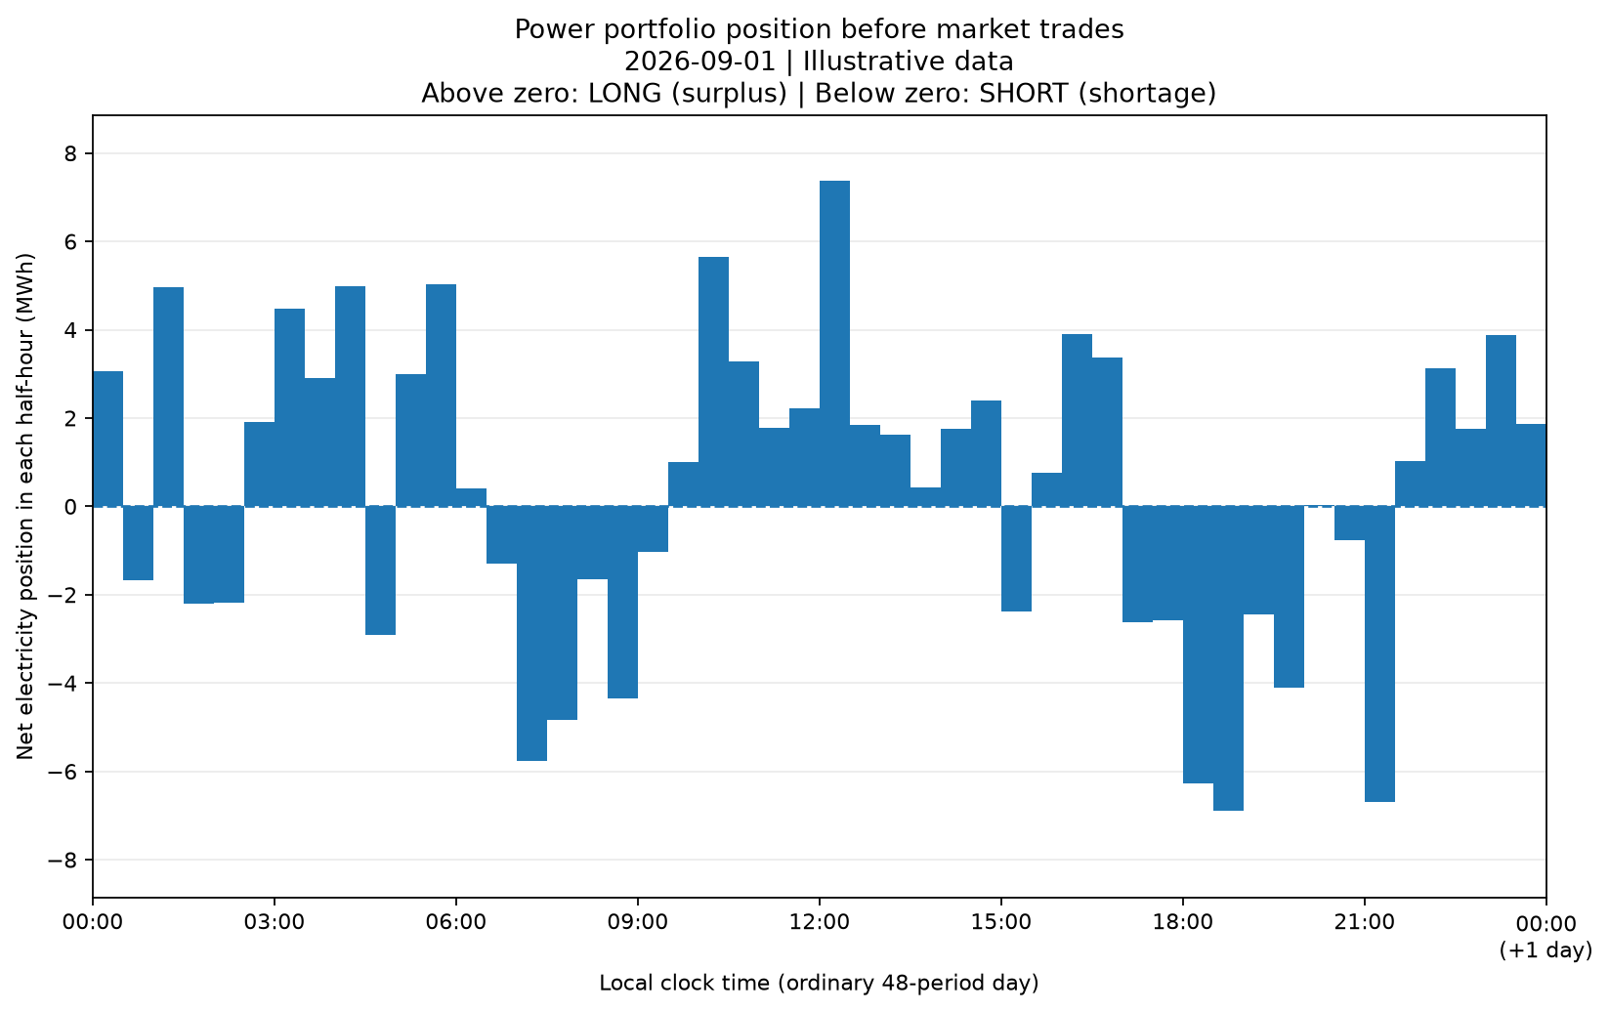
RESULTS
Position before trading: long most of the day
29
half-hours LONG
(surplus to sell)
19
half-hours SHORT
(shortage to buy)
No half-hour is exactly balanced.
Largest surplus
+7.38 MWh at 12:00–12:30
Largest shortage
−6.89 MWh at 18:30–19:00
Power Portfolio Model | Dr Spyros Giannelos
Notes:
Bars above zero are surpluses and bars below zero are shortages, measured before any market trade. Shortages cluster in the morning and evening demand peaks.

Slide 11
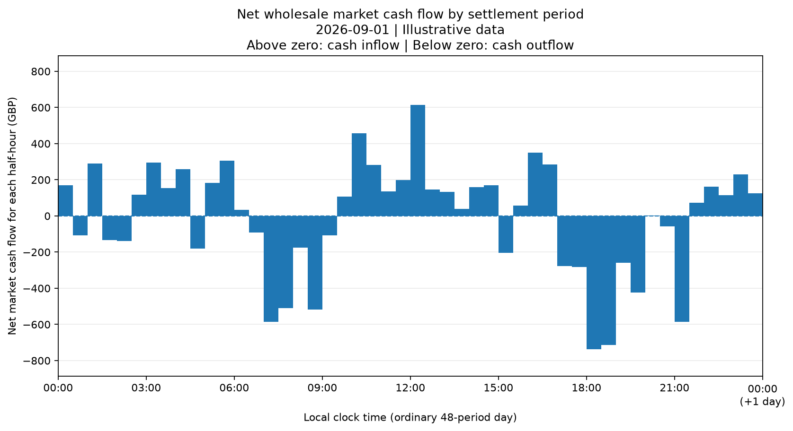
RESULTS
Cash flow by half-hour follows the position
+£613.35
Best half-hour, 12:00–12:30: sold 7.38 MWh at £83.11/MWh
−£738.03
Worst half-hour, 18:00–18:30: bought 6.28 MWh at £117.52/MWh
At positive prices, a surplus brings cash in and a shortage sends cash out.
Power Portfolio Model | Dr Spyros Giannelos
Notes:
Net market cash flow is sale revenue minus purchase cost for each half-hour. The largest outflows are in the evening peak, where the portfolio is short and prices are highest.

Slide 12
DAILY SUMMARY
Long on energy, short on cash
ENERGY
+17.14 MWh net surplus
571.81 MWh generated vs 554.67 MWh consumed
TRADING
62.67 MWh bought · 79.81 MWh sold
Purchase cost £6,085.54 · Sale revenue £5,648.26
NET MARKET CASH FLOW
−£437.28
Paid = purchase cost ÷ energy bought. Received = sale revenue ÷ energy sold. Day average = simple mean of the 48 prices.
A net cash outflow for the day
Power Portfolio Model | Dr Spyros Giannelos
Notes:
Across the day the portfolio generated more than it consumed, yet the net market cash flow is negative. The reason is price: on average it paid £97.10/MWh for the energy it bought but received only £70.77/MWh for the energy it sold. Note that this is the wholesale market cash flow only, not the full profit or loss.

Slide 13
WHAT DRIVES THE RESULT
Peak-hour shortages outweigh surplus sales
Peaks: 12 half-hours
11 are short. 42.56 MWh is bought when prices are highest.
Rest of the day: 36 half-hours
Mostly long. 78.81 MWh of surplus is sold at lower prices.
Net effect
Buying at £97.10 and selling at £70.77 turns a small energy surplus into a £437.28 outflow.
Half-hours grouped by the sample data's time bands; values summed from the model's period results.
Power Portfolio Model | Dr Spyros Giannelos
Notes:
Grouping the half-hours by time band shows where value is won and lost. Nearly all peak half-hours are short at high prices, which outweighs the surplus sold overnight and during the rest of the day.

Slide 14
SCENARIO ANALYSIS
Sensitivity to the wholesale price level
£17.14
gained for every £1/MWh rise in all prices. This equals the net energy sold: 79.81 − 62.67 MWh.
± £342.80
change in the daily result for a ±£20/MWh shift.
Even with prices £20/MWh higher, the result stays negative. The price shape, not the level, drives the loss.
Every half-hourly price shifted by the same amount; energy quantities unchanged.
Power Portfolio Model | Dr Spyros Giannelos
Notes:
The scenario keeps every energy quantity the same and shifts all prices up or down by £20/MWh relative to the original prices. Because the portfolio is a small net seller over the day, higher prices help slightly, but not enough to offset the timing effect.

Slide 15
SUMMARY
Key takeaways
1
The model uses half-hourly generation, consumption and prices to calculate portfolio positions, trades and cash flows.
2
On the day the portfolio is long in 29 of 48 half-hours and 17.14 MWh long overall, yet its net market cash flow is −£437.28.
3
Timing drives value: shortages fall in high-price peaks (£97.10/MWh paid) while surpluses sell at lower prices (£70.77/MWh received).
Notes:
On the day, being long in energy did not mean positive cash, because of when the surpluses and shortages occurred.

