Slide 1
PYTHON / QUANTITATIVE ENERGY ANALYTICS
Power Portfolio
Analytics
Positions, wholesale cash flows
and scenario comparison
Dr. Spyros Giannelos
Independent analytical software project
Illustrative portfolio | One ordinary 24-hour day | 48 half-hour periods
SPYROS GIANNELOS | POWER PORTFOLIO ANALYTICS
01 / 09
Notes:
This project connects electricity quantities to commercial purchases, sales and signed wholesale cash flows. It represents one wind farm, one solar PV farm and a customer-supply obligation. The application reads saved inputs, reports a single case and compares two alternative cases through the same calculation. The emphasis is a transparent, reproducible analytical workflow rather than a live trading service.
Reference basis: main.py; compare_scenarios.py; README.md.
All quantitative results use illustrative data. No executed trades or complete company-profit claim is made.

Slide 2
COMMERCIAL MODEL
One portfolio, evaluated period by period
Generation and customer consumption determine the pre-trade exposure.
ELECTRICITY GENERATION
SUPPLY OBLIGATION
SIGNED POSITION
Wind + solar
−
Customers
=
Long / short
Total energy in each half-hour, MWh
Consumption in the same period, MWh
Before wholesale purchases or sales
Shortage → purchase | Surplus → sale
Period cash flow = sale quantity × price − purchase quantity × price
One supplied price per period. Negative prices are valid. No storage or inter-period energy transfer.
SPYROS GIANNELOS | POWER PORTFOLIO ANALYTICS
02 / 09
Notes:
Generation and consumption are period totals in MWh, not instantaneous MW. Net position is wind plus solar minus consumption. A short position creates a non-negative purchase quantity; a long position creates a non-negative sale quantity. The same assumed price applies to both within the period. The model covers the entire shortage or sells the entire surplus without transaction fees. Negative prices can reverse the direction of money relative to the electricity transaction. Period results must be calculated before daily aggregation.
Reference basis: portfolio_calculations.py; portfolio_day.py.
All quantitative results use illustrative data. No executed trades or complete company-profit claim is made.

Slide 3
IMPLEMENTATION
One calculation engine, two analytical interfaces
File-based inputs and modular responsibilities keep the comparison consistent.
READ
ORGANISE
CALCULATE
REPORT
→
→
→
CSV inputs
Date + 48 records
PortfolioDay
Period checks
Positions and trades
Daily aggregation
Console + CSV
Four PNG charts
SCENARIO COMPARISON
Baseline and alternative CSVs → same engine → metric-by-metric differences
Difference = scenario − baseline. Same delivery date and complete 48-period coverage required.
SPYROS GIANNELOS | POWER PORTFOLIO ANALYTICS
03 / 09
Notes:
The CSV loader converts values to the expected Python types and validates the input structure. PortfolioDay organises records and checks their identifiers. Financial arithmetic is implemented once in portfolio_calculations.py. main.py supplies the single-case reporting interface. compare_scenarios.py loads both inputs and calls PortfolioDay.calculate_totals() separately, rather than invoking the reporting script or duplicating formulas. It writes a comparison with one row per metric and explicit source filenames and units.
Reference basis: portfolio_io.py; portfolio_day.py; portfolio_calculations.py; main.py; compare_scenarios.py.
All quantitative results use illustrative data. No executed trades or complete company-profit claim is made.

Slide 4
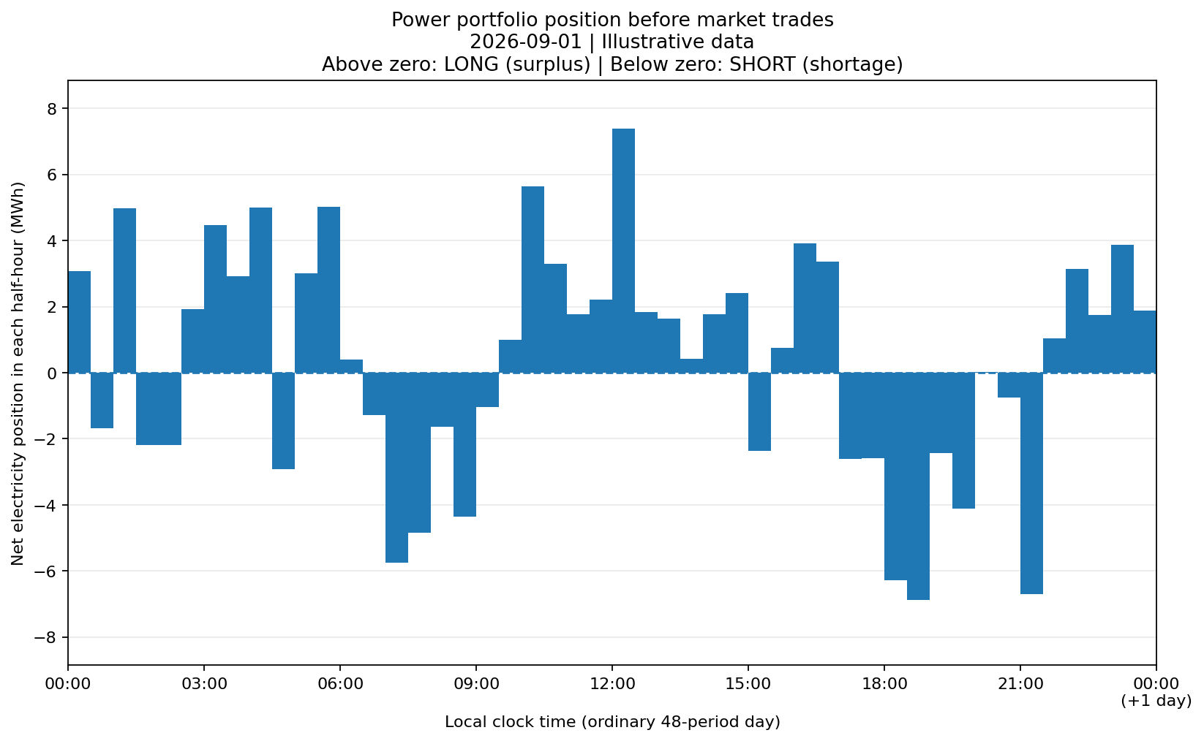
REFERENCE DATASET
Timing matters, even with a daily energy surplus
Synthetic inputs for 1 September 2026. Bars show positions before market trades.
PERIOD COUNTS
29 / 19
Long / short; 0 balanced periods
Largest surplus
+7.38 MWh
Period 25, 12:00–12:30
SPYROS GIANNELOS | POWER PORTFOLIO ANALYTICS
04 / 09
Notes:
Daily generation is 571.81 MWh and consumption is 554.67 MWh, a positive difference of 17.14 MWh. This does not eliminate purchases, because 19 of the 48 periods are short. Total purchases are 62.67 MWh and total sales are 79.81 MWh. The largest surplus is 7.38 MWh in period 25. The largest shortage is 6.89 MWh in period 38. The bars are neither stored energy nor a cumulative balance; each represents one interval.
Reference basis: outputs/portfolio_inputs_2026-09-01_results.csv; outputs/portfolio_inputs_2026-09-01_positions.png.
All quantitative results use illustrative data. No executed trades or complete company-profit claim is made.

Slide 5
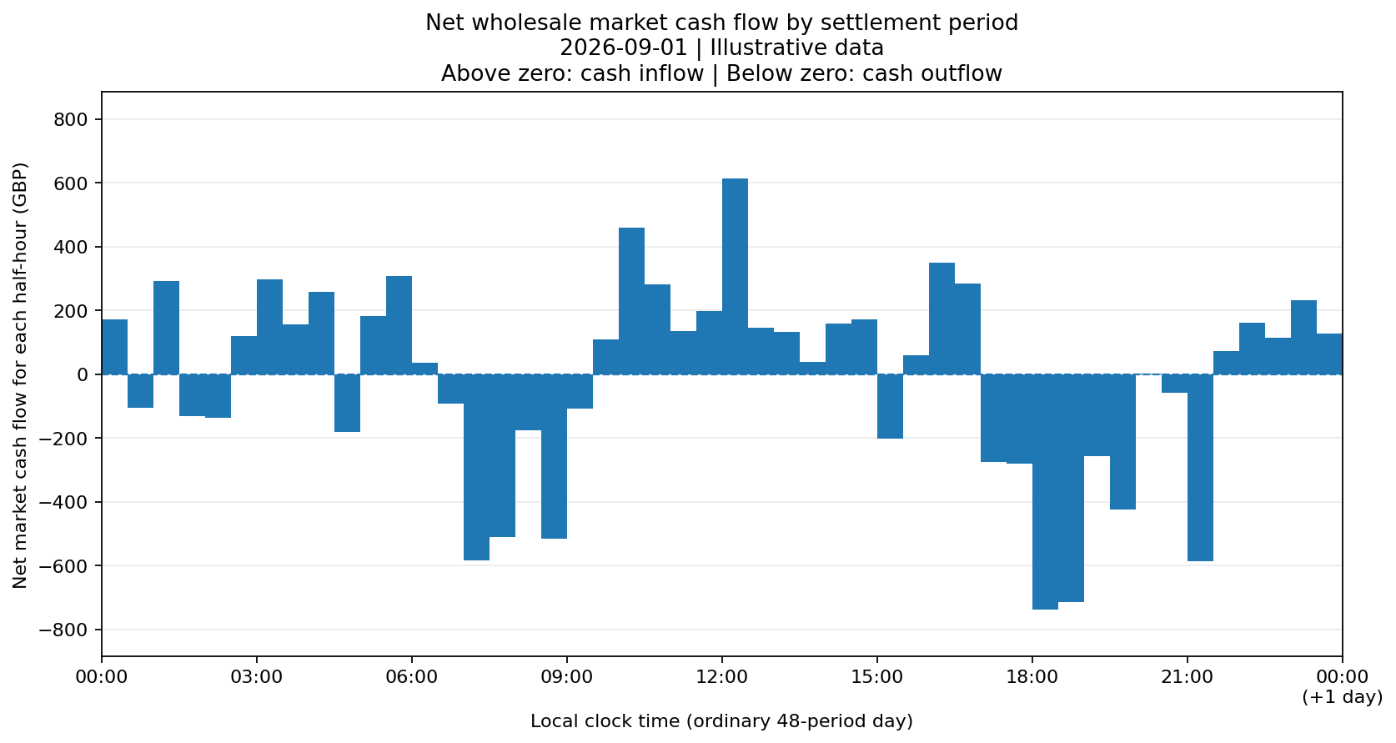
REFERENCE CASH FLOWS
More MWh sold does not guarantee a cash inflow
Both the traded quantity and the applicable price determine the monetary result.
PURCHASES
62.67 MWh
£97.10/MWh volume-weighted
SALES
79.81 MWh
£70.77/MWh volume-weighted
NET MARKET CASH FLOW
−£437.28
SPYROS GIANNELOS | POWER PORTFOLIO ANALYTICS
05 / 09
Notes:
The reference sale revenue is £5,648.26 and purchase cost is £6,085.54. Their difference is a net wholesale market cash outflow of £437.28. Volume-weighted prices are calculated from the corresponding cost or revenue divided by traded energy. The rounded average prices should not be used to reconstruct exact totals. Period 37 has a larger cash outflow than period 38 despite a smaller shortage, because its price is higher. This is not complete company profit, a cumulative bank balance or an actual payment schedule.
Reference basis: outputs/portfolio_inputs_2026-09-01_results.csv; portfolio_calculations.py; main.py.
All quantitative results use illustrative data. No executed trades or complete company-profit claim is made.

Slide 6
SCENARIO COMPARISON
A controlled input change gives an explainable result
Increase period 1 consumption by 1 MWh. Keep all other inputs unchanged.
Daily metric
Baseline
Scenario
Difference
Consumption (MWh)
554.67
555.67
+1.00
Purchases (MWh)
62.67
62.67
0.00
Sales (MWh)
79.81
78.81
−1.00
Market cash flow (GBP)
−437.28
−492.78
−55.50
Period 1 remains long: 1 MWh less sold × £55.50/MWh = £55.50 lower cash flow.
SPYROS GIANNELOS | POWER PORTFOLIO ANALYTICS
06 / 09
Notes:
The scenario input changes only period 1 demand from 8.05 to 9.05 MWh. Wind remains 11.12 MWh, solar is zero and the price remains £55.50/MWh. The surplus decreases from 3.07 to 2.07 MWh, so the change reduces sales rather than increasing purchases. Every comparison difference is scenario minus baseline. This is an alternative case for the same date, not another day to add. The result excludes any additional retail revenue earned on the higher customer consumption.
Reference basis: data/portfolio_inputs_2026-09-01.csv; data/portfolio_inputs_more_demand.csv; outputs/scenario_comparison/more_demand_comparison.csv; compare_scenarios.py.
All quantitative results use illustrative data. No executed trades or complete company-profit claim is made.

Slide 7
REPRODUCIBILITY
Select files from the command line
The same calculations support an individual report and a two-case comparison.
SINGLE CASE
python main.py --input data/example.csv --output-dir outputs/run_a
TWO CASES
python compare_scenarios.py --baseline data/base.csv
--scenario data/alternative.csv --output outputs/comparison.csv
Illustrative command paths. Exact reference-file commands and environment setup are in README.md.
CSV inputs remain unchanged. Repeated runs replace selected outputs, so use distinct destinations.
SPYROS GIANNELOS | POWER PORTFOLIO ANALYTICS
07 / 09
Notes:
These slides show the interface compactly. The filenames are illustrative, and the README contains commands using the supplied files and the project virtual-environment interpreter. main.py accepts --input and --output-dir while keeping the Python function interface and established defaults. compare_scenarios.py requires --baseline and --scenario; --output selects a CSV filename rather than a directory. Help describes each interface. A new machine needs the stated dependencies, not the author’s virtual-environment folder or an AI account.
Reference basis: main.py::run_cli; compare_scenarios.py::run_cli; requirements.txt; README.md.
All quantitative results use illustrative data. No executed trades or complete company-profit claim is made.

Slide 8
QUALITY AND MAINTAINABILITY
Checks support, but do not replace, interpretation
The reference snapshot contains 30 automated tests. Coverage is targeted, not exhaustive.
FINANCIAL EXPECTATIONS
Fixed cases establish quantities and cash-flow signs independently of the model.
INTERFACE AND FILES
Checks cover argument forwarding, period coverage, exports and input-file protection.
SCENARIO CONSISTENCY
Identical inputs, reversed comparisons and controlled changes have known outcomes.
Modular Python • pytest • Ruff development checks • shared agent instructions • Git version history
SPYROS GIANNELOS | POWER PORTFOLIO ANALYTICS
08 / 09
Notes:
The reference run completed 30 pytest checks. This is a local verification result for the supplied snapshot, not a claim about a live remote branch or every platform. Tests include expected period results, three-period totals, negative prices, ordering, time labels, report exports, command-line behaviour and scenario comparisons. Ruff is available as a development tool, but no Ruff pass is asserted here. AI project instructions remain in the repository, yet the model runs without a coding-agent account. Neither passing tests nor linting proves every commercial assumption is suitable.
Reference basis: test_main.py; test_portfolio_day.py; test_settlement_periods.py; local verification log; AGENTS.md; CLAUDE.md.
All quantitative results use illustrative data. No executed trades or complete company-profit claim is made.

Slide 9
SCOPE AND NEXT READING
A defined analytical model, not a trading platform
The limitations are part of the result and should remain visible with the code.
IMPLEMENTED
NOT REPRESENTED
One wind farm and one solar PV farm
Customer supply obligation
48-period position and cash-flow analysis
CSV inputs and numerical / visual outputs
Controlled two-scenario comparison
Live execution or imbalance settlement
Forecasting, storage or optimisation
PPAs, forwards or hedge positions
Retail revenue and full operating costs
Clock-change days or network constraints
Explore the code, reference inputs, charts and comparison results:
github.com/spgian/power_portfolio
SPYROS GIANNELOS | POWER PORTFOLIO ANALYTICS
09 / 09
Notes:
This is an analytical project by Dr. Spyros Giannelos. The reference data is synthetic and the date is an illustrative label. The model does not optimise operations or emulate a particular live electricity market. It excludes customer revenue, capital and operating costs, financing and taxes, and therefore must not be presented as complete company profit. The repository provides the implementation, reference inputs and outputs, and instructions for reproducing the analysis. Future scope extensions require new assumptions and validation rather than reinterpretation of the current results.
Reference basis: README.md, scope and limitations; portfolio_calculations.py; settlement_periods.py.
All quantitative results use illustrative data. No executed trades or complete company-profit claim is made.

